Slide 1
Jenkins
java -jar jenkins.war

Slide 2
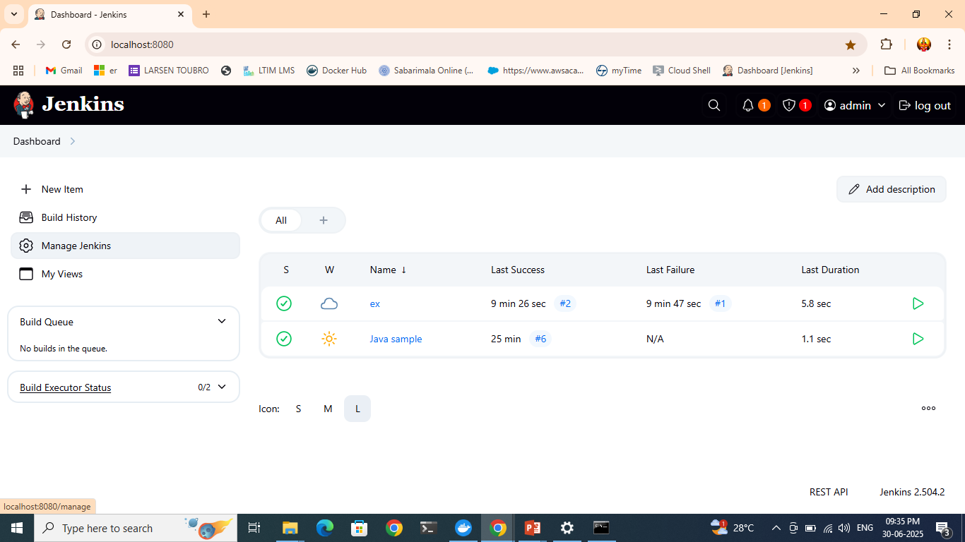
To add JDK

Slide 3
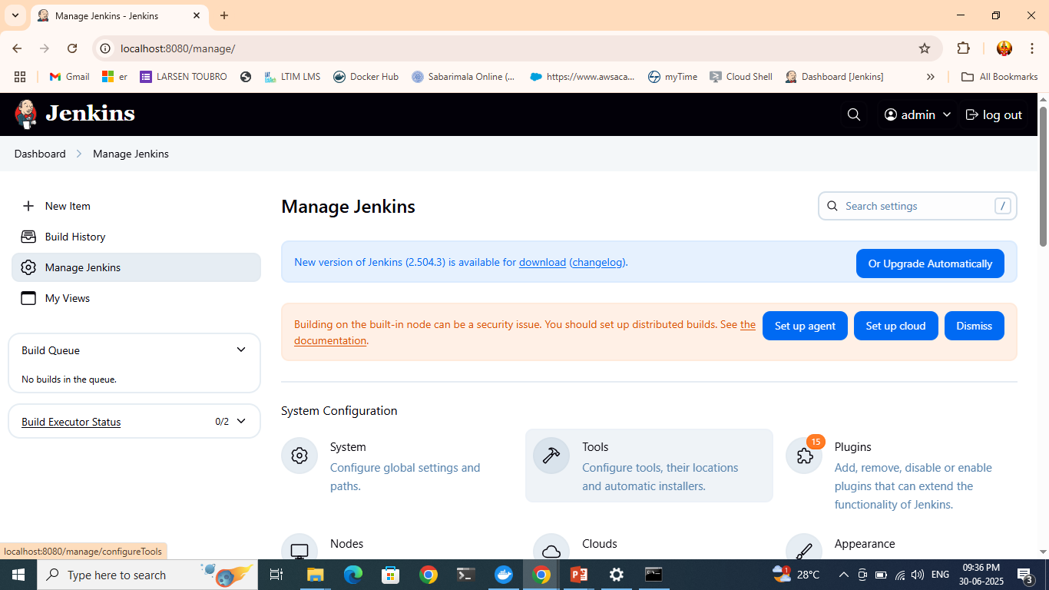
In manage Jenkins…click “tools”

Slide 4
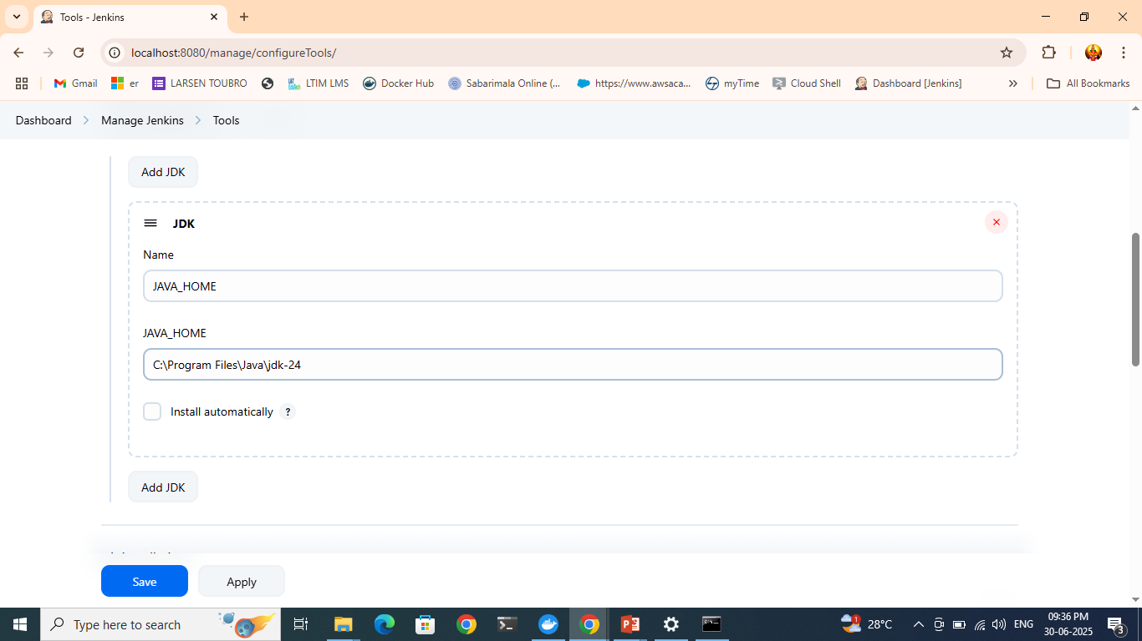
Click add JDK and add the details

Slide 5
If the file path is not mentioned on “Build” then Jenkins will search the file the default location ”workspace”
Run without the file and show the error message to the participants

Slide 6
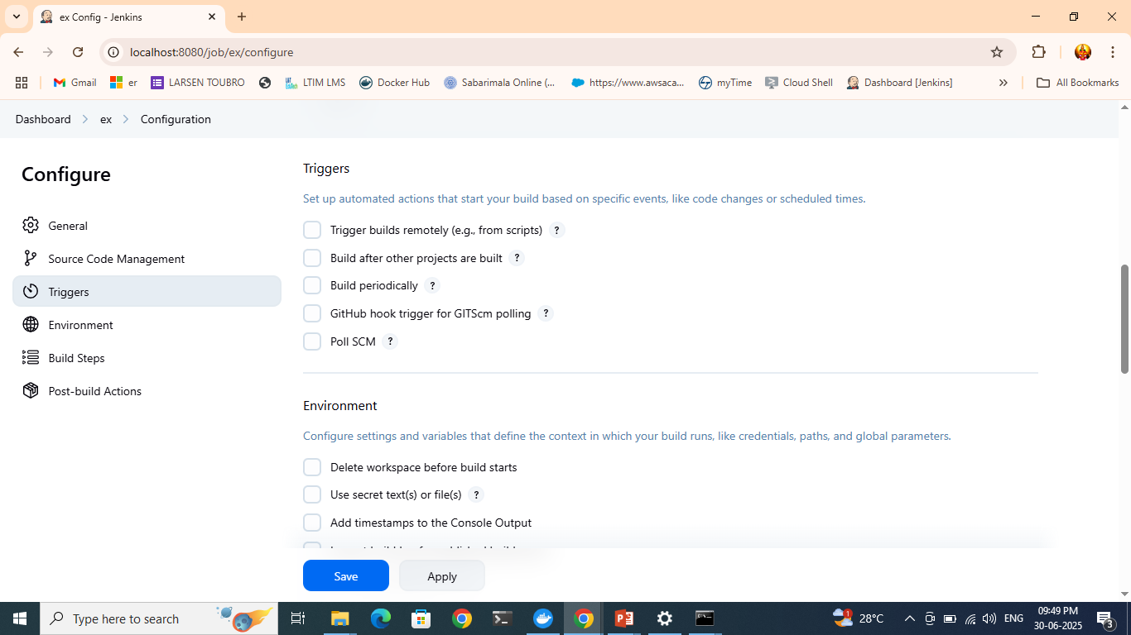
To schedule a build

Slide 7
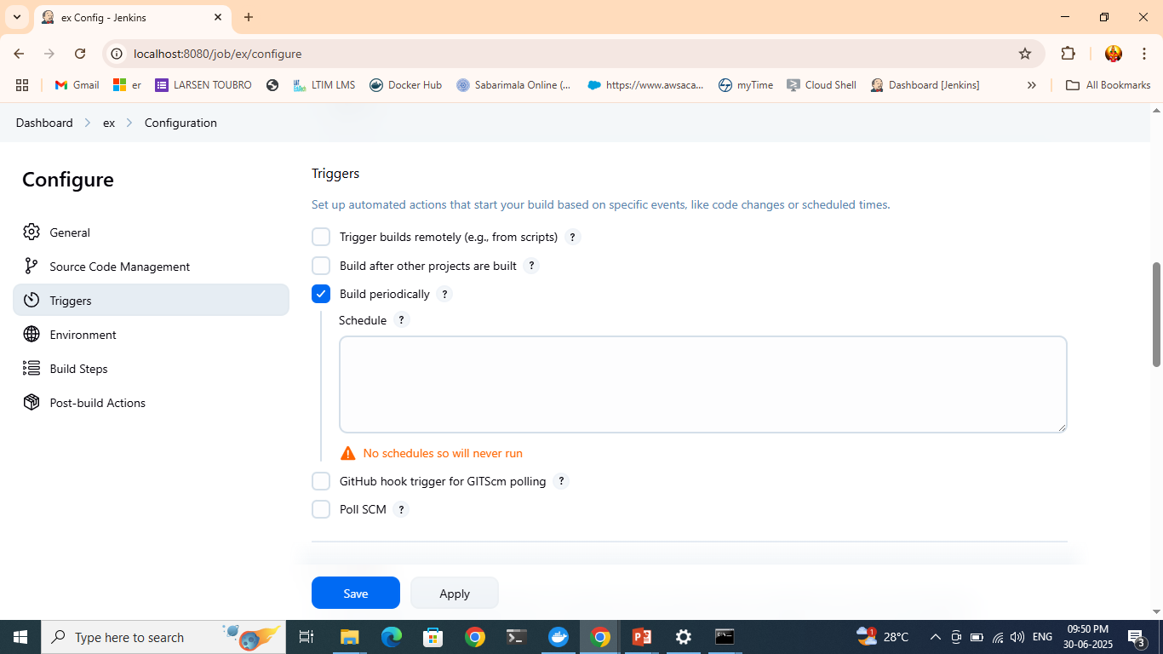

Slide 8
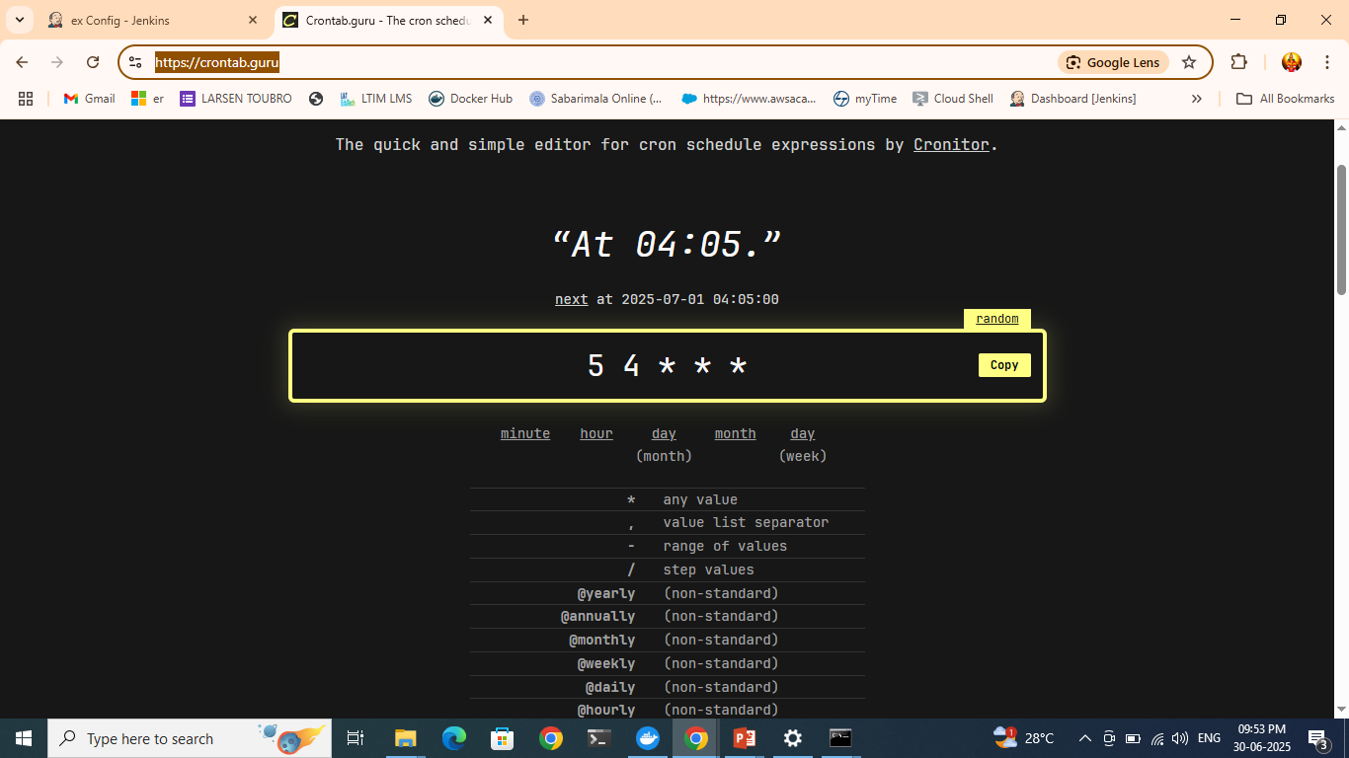
https://crontab.guru/ also search in wikipedia

Slide 9
MINUTE (0-59),HOUR (0-23), DAY (1-31),MONTH (1-12),DAY OF THE WEEK(0-6)
BUILD DAILY AT 10:00pm MONDAY-FRIDAY Can given like:
00 22 * * 1-5

Slide 10
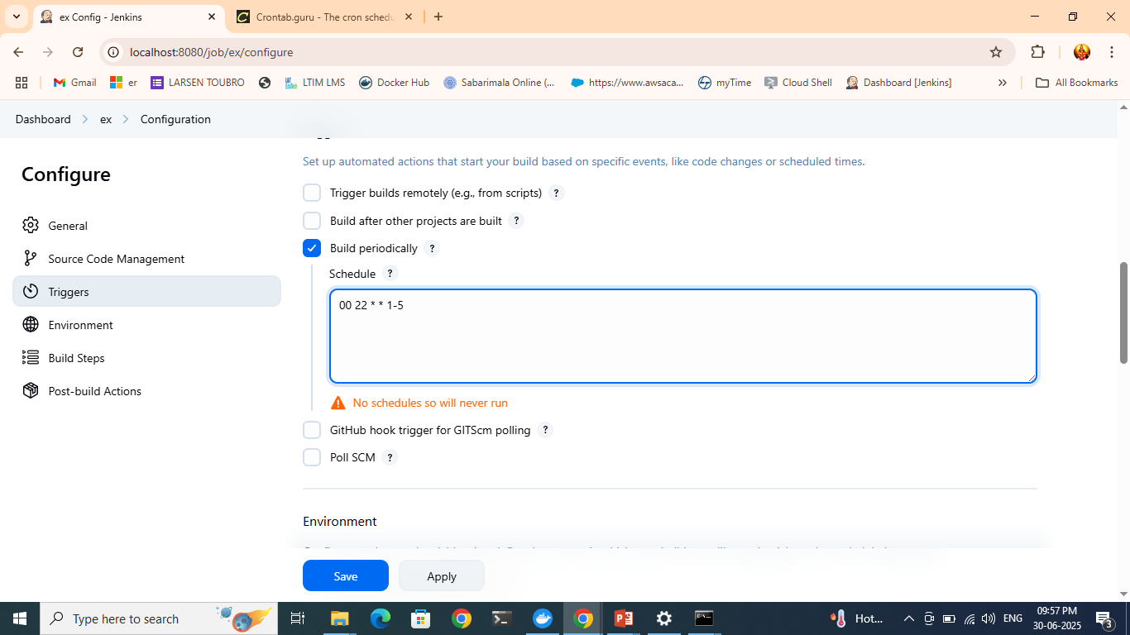

Slide 11
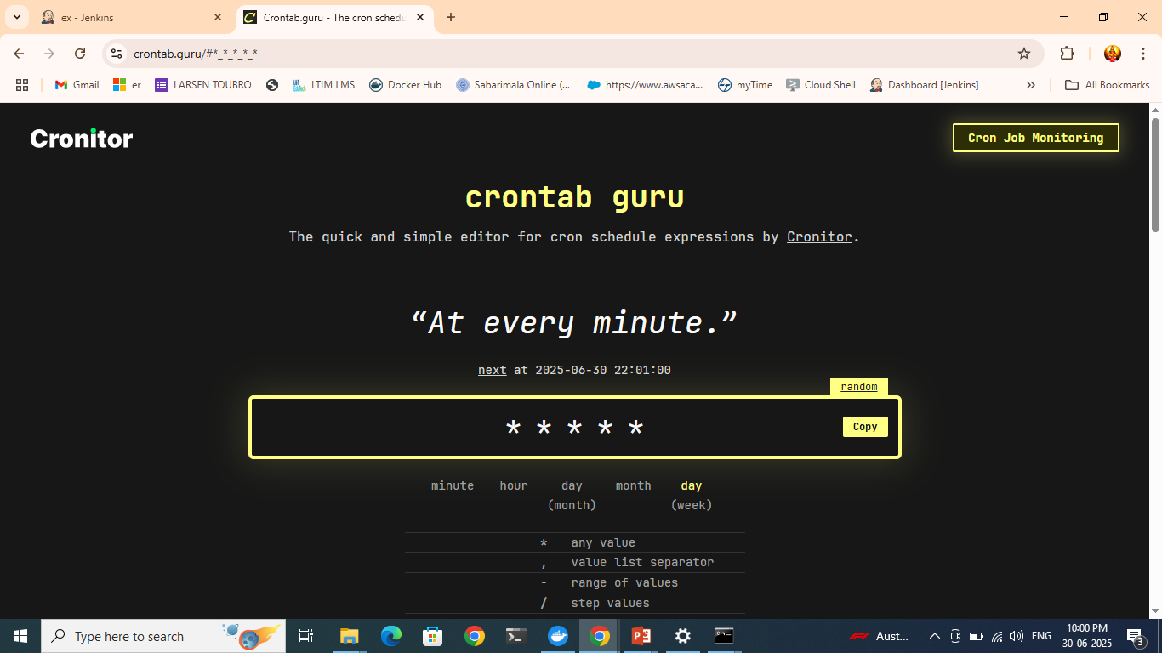
You can specify using crontab portal itself

Slide 12
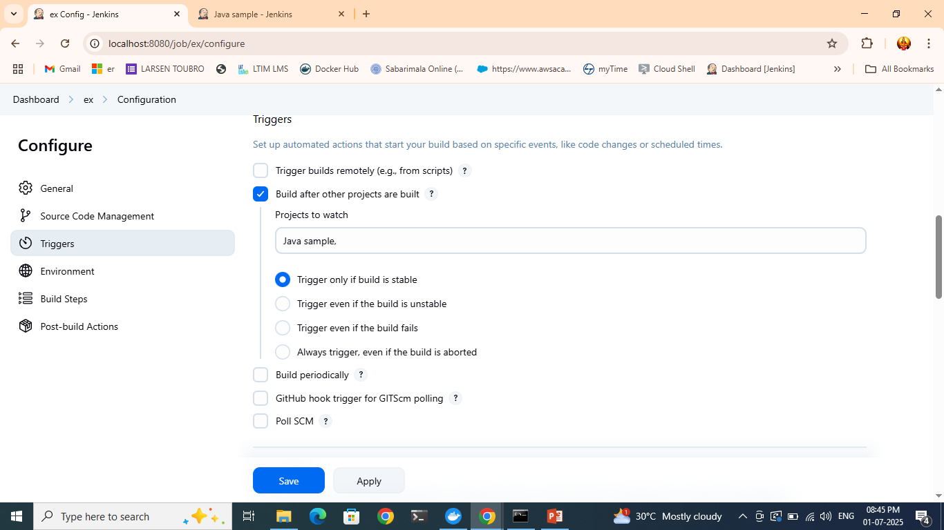
Build after other projects are built

Slide 13
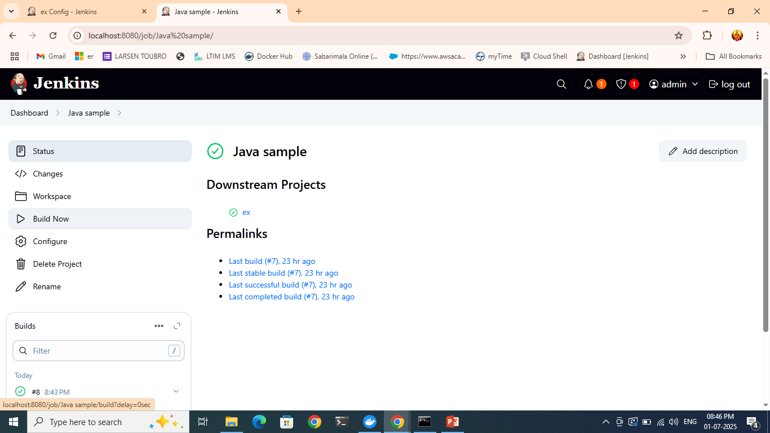
Now go to “java sample” project and build there

Slide 14
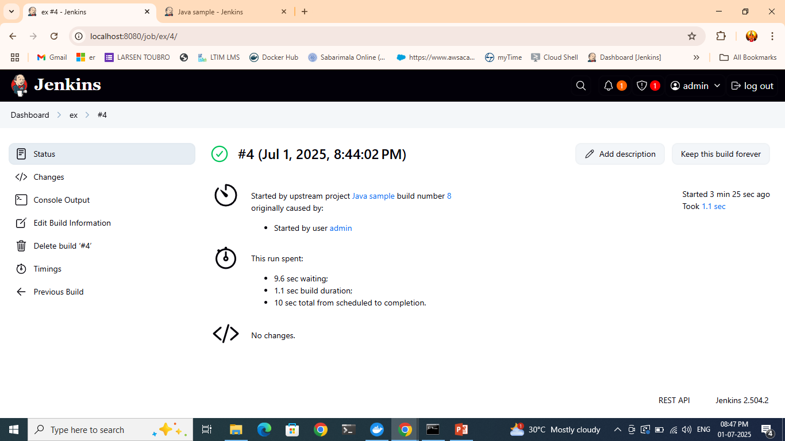
After it builds , check the ex project and see that also got built

Slide 15
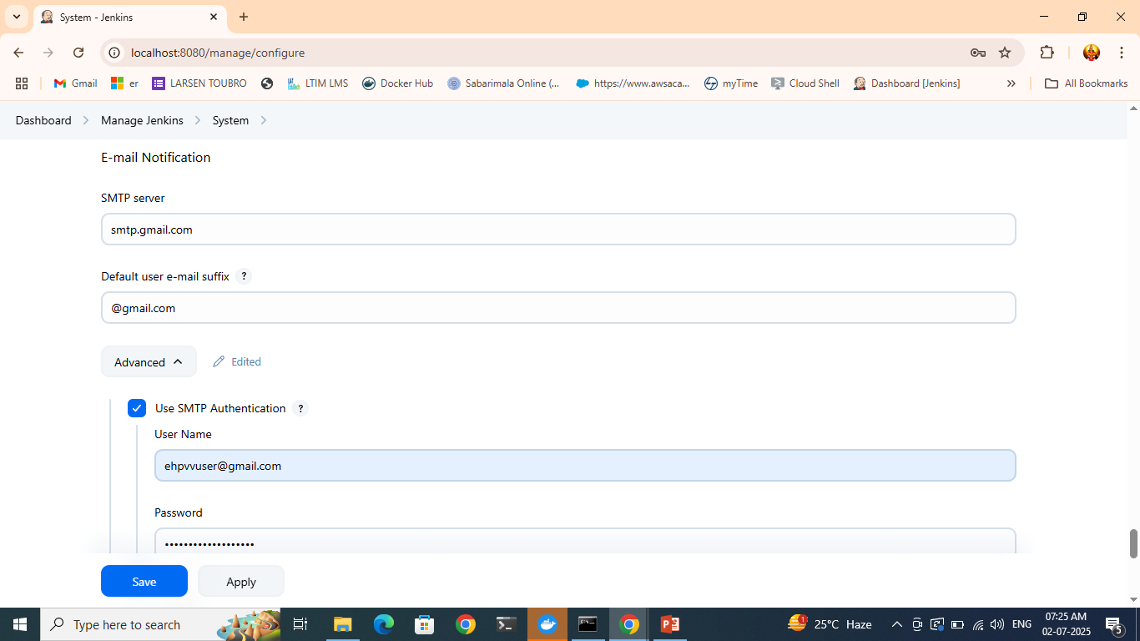
Mail notifications

Slide 16
For password, go to gmail account→ security → enanble 2 fact auth→ then search for “App passwords”

Slide 17
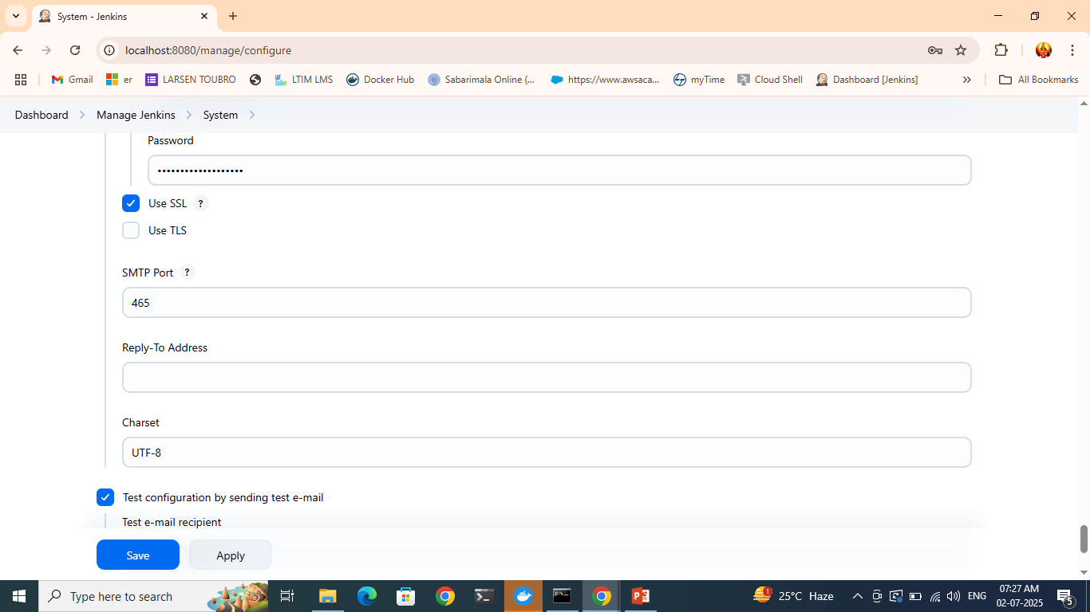
Enter the details and click “test”

Slide 18
Give a wrong file name and try to build now error comes and it triggers a mail

Slide 19
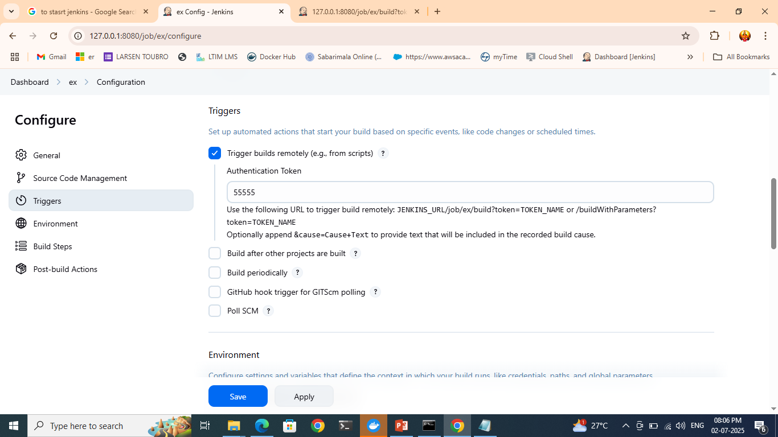
Remote build

Slide 20
Type the URL,
http://127.0.0.1:8080/job/ex/build?token=55555
Check the build and see it got built

Slide 21
Task to build chain of jobs

Slide 22
github merging with jenkins
For github merging
https://zrok.io/

Slide 23
Install Git pluging on jenkins

Slide 24
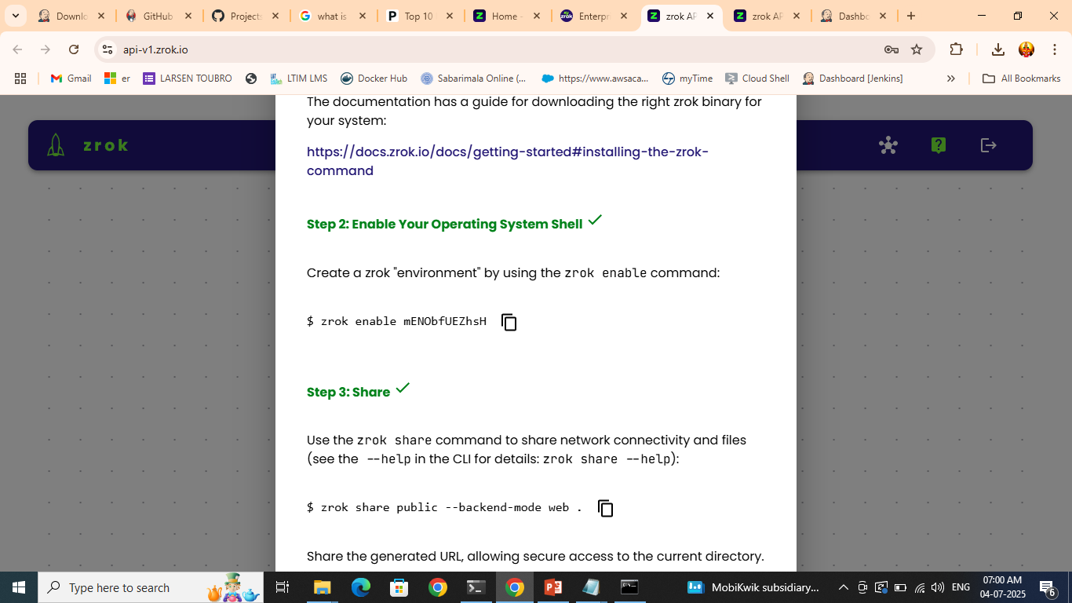
In step3 use: zrok share public 8080
Notes:
https://a4wlak5et6y3.share.zrok.io

Slide 25
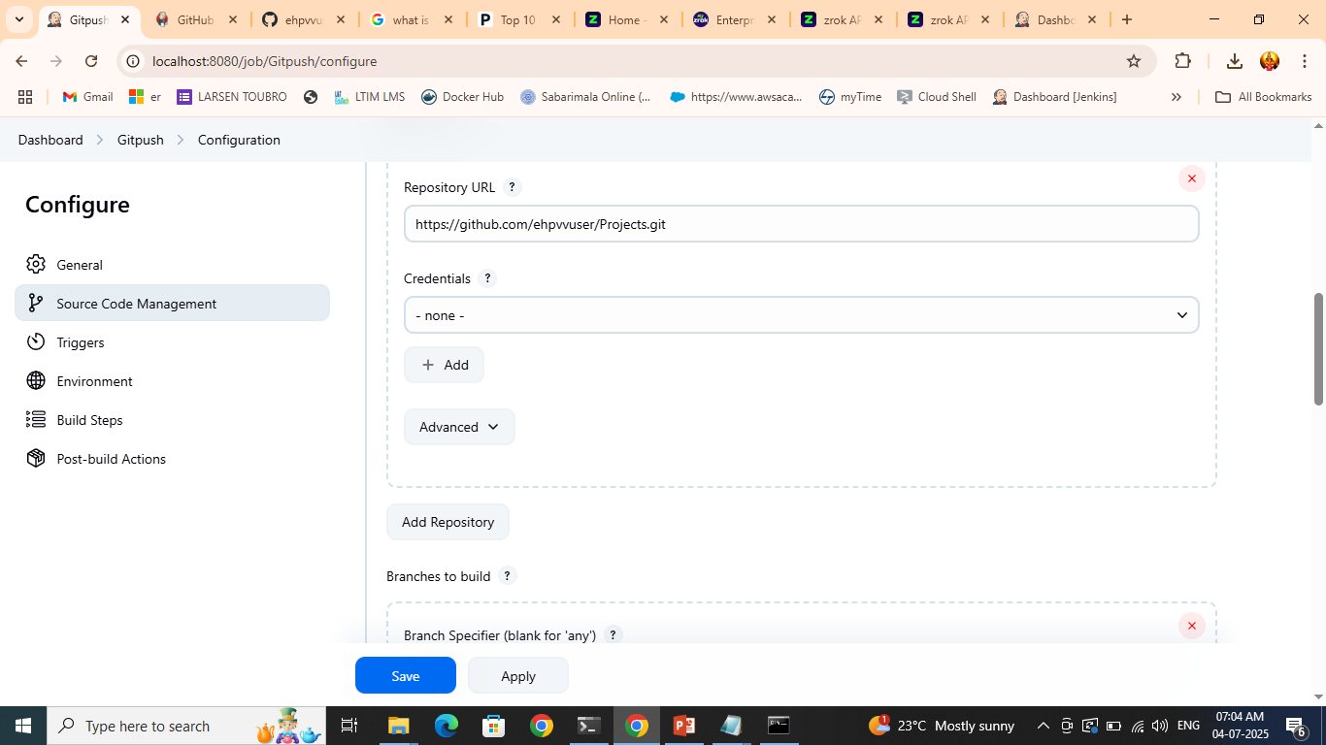
Copy github url

Slide 26
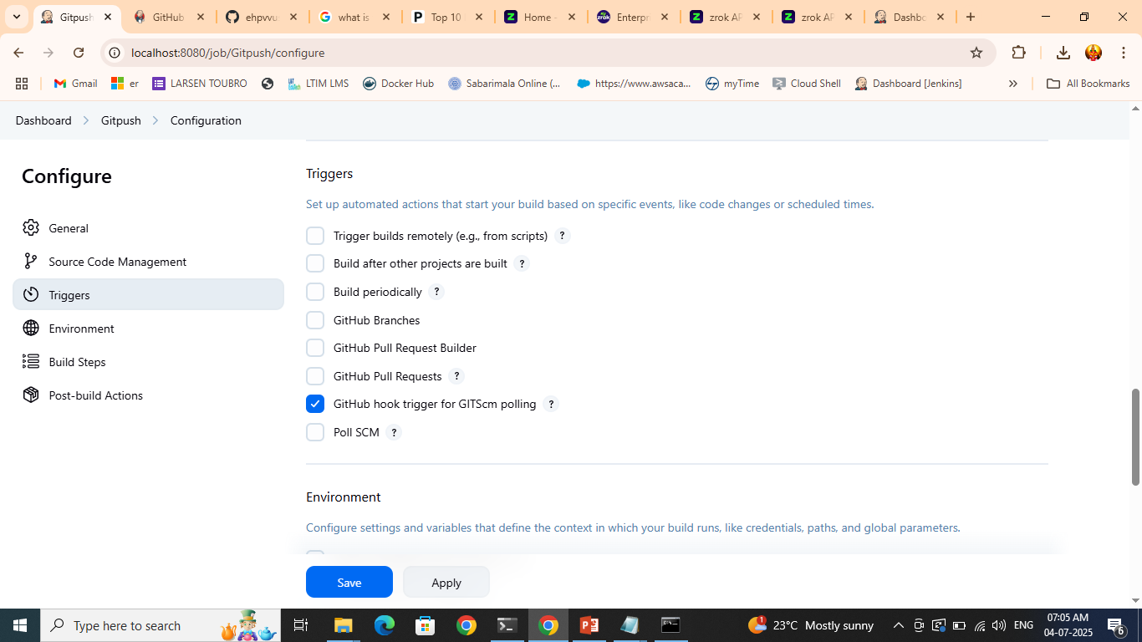
Apply and save

Slide 27
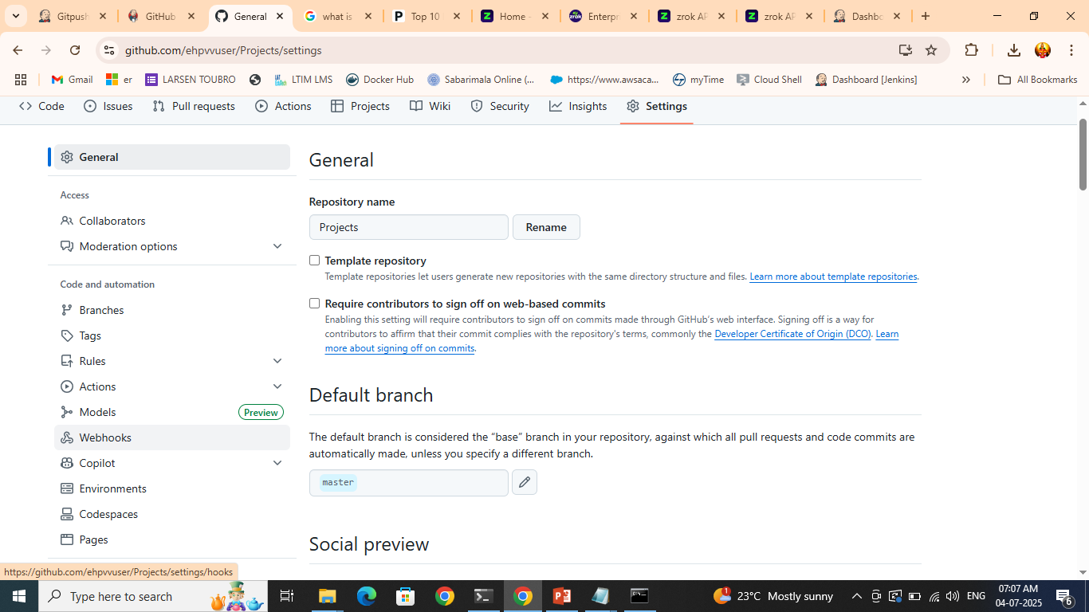
Click webhooks at github

Slide 28
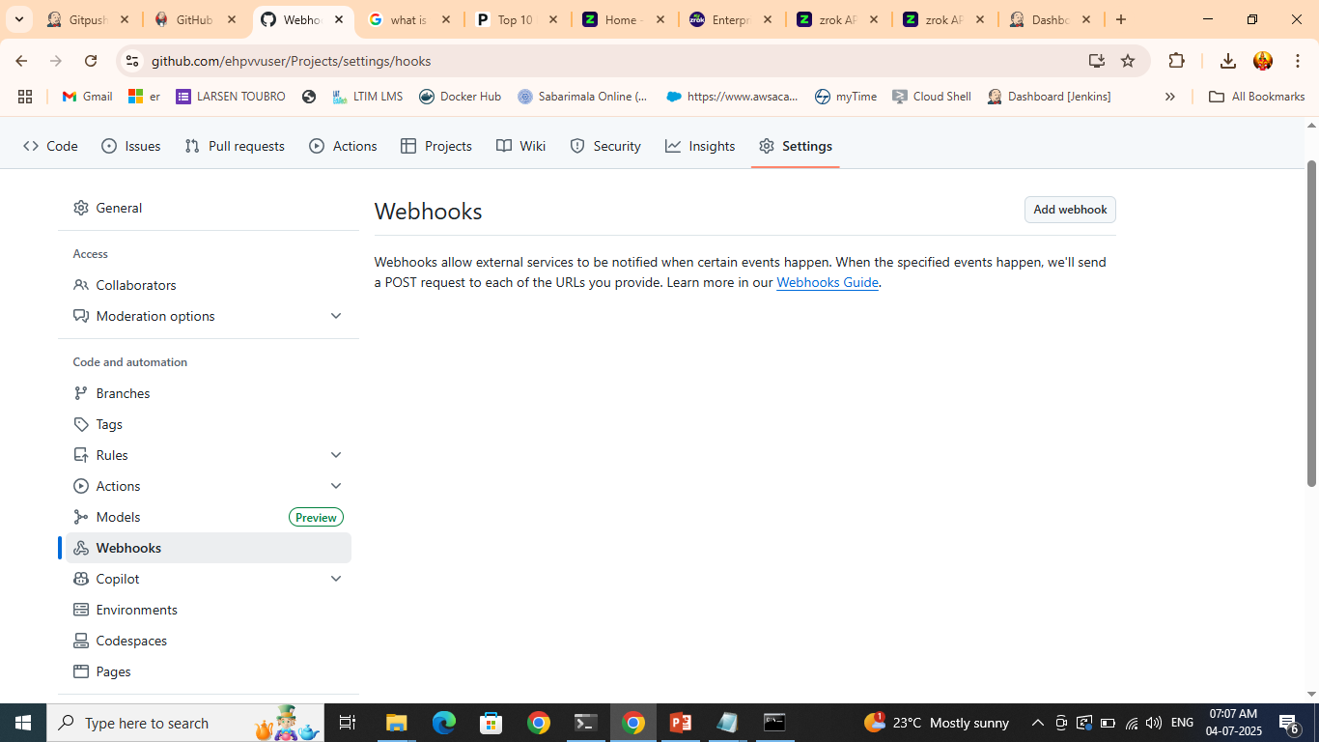
Add webhook

Slide 29
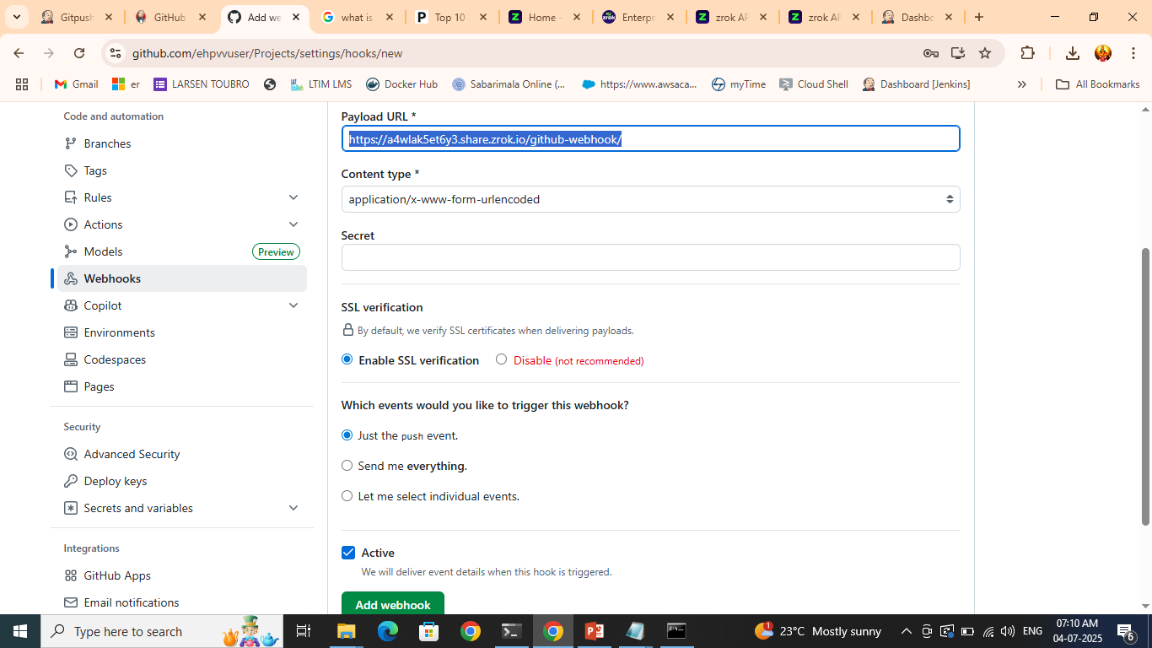
https://a4wlak5et6y3.share.zrok.io/github-webhook/

Slide 30
Goto github
Make changes at code and commit it
Once committed come back to Jenkins
See the build happening
Now after the build , check the console Output for more details

Slide 31
Ex: pipeline

Slide 32
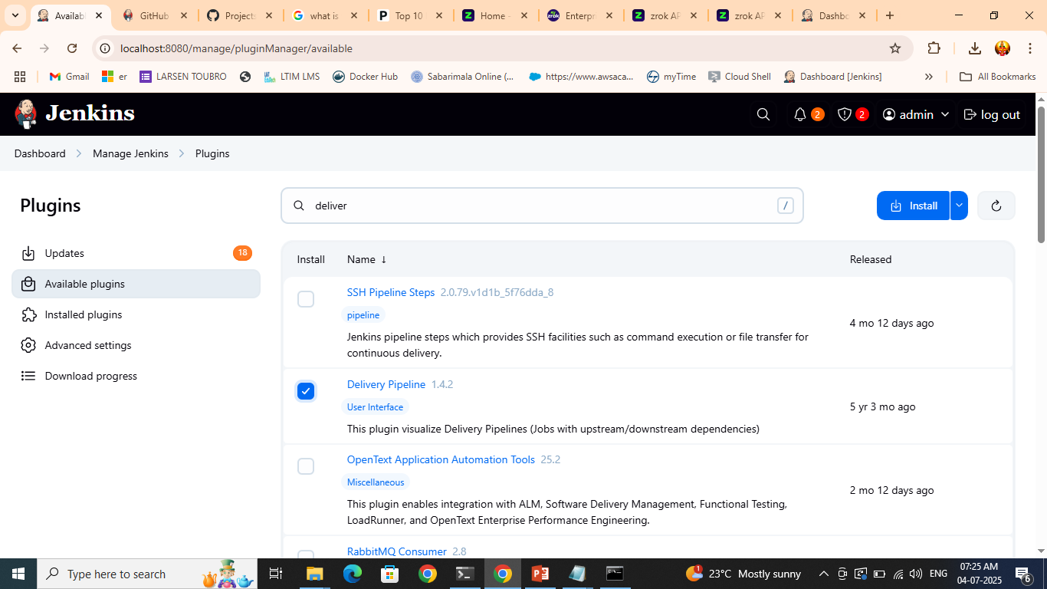
Install delivery pipeline

Slide 33
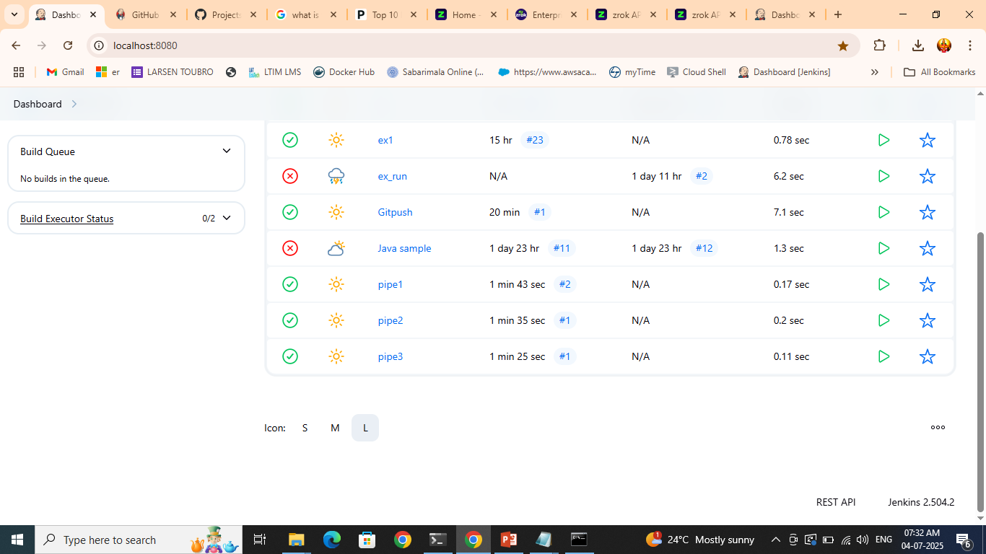
Create 3 projects, one depending on another Chain of projects

Slide 34
Execute pipeline1 project so that it will trigger pipe2 and pipe2 will trigger pipe3

Slide 35
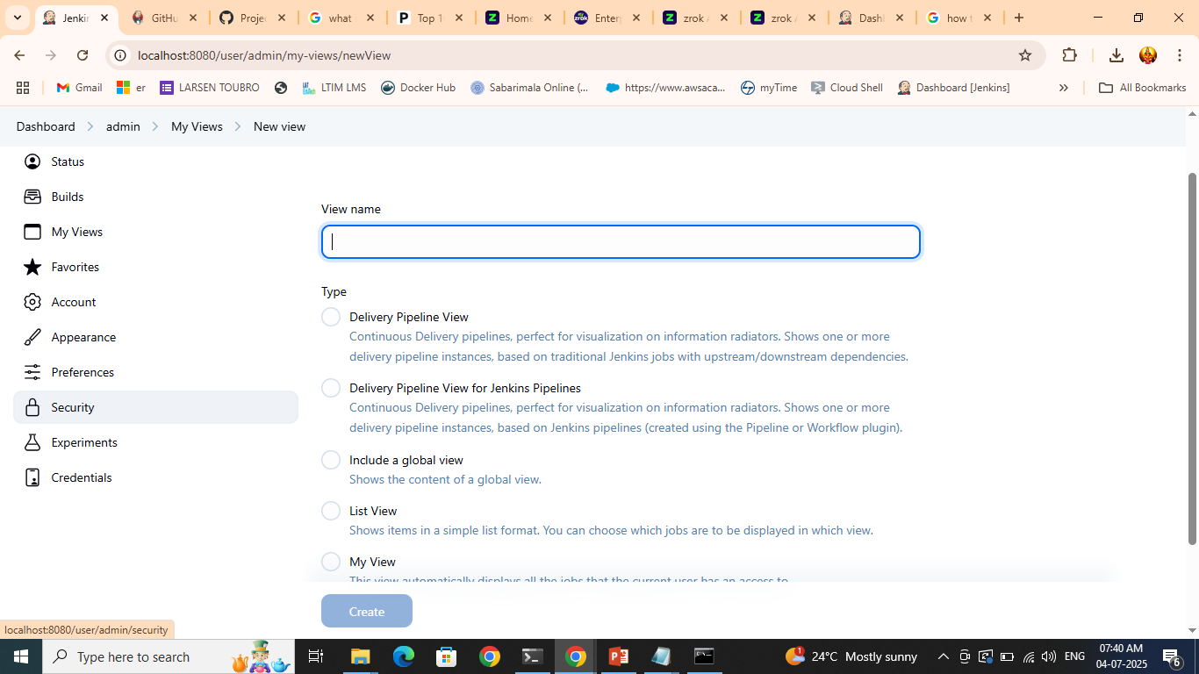
Dashboard—myviews—new view

Slide 36
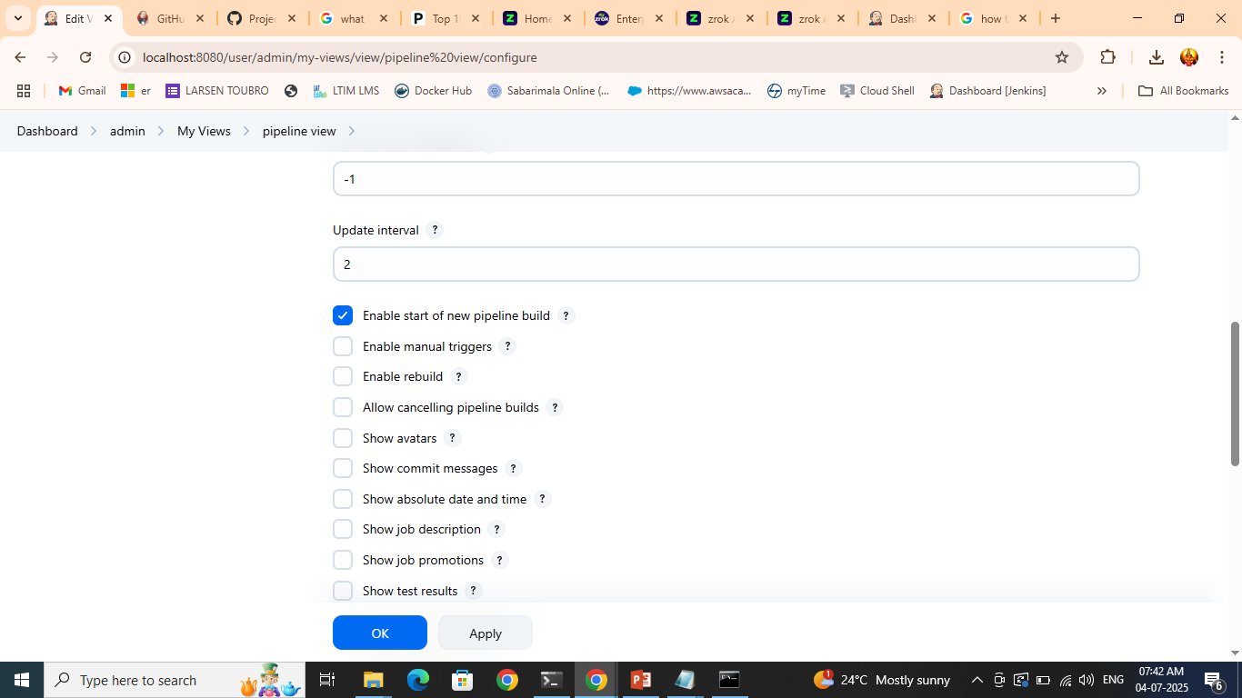

Slide 37
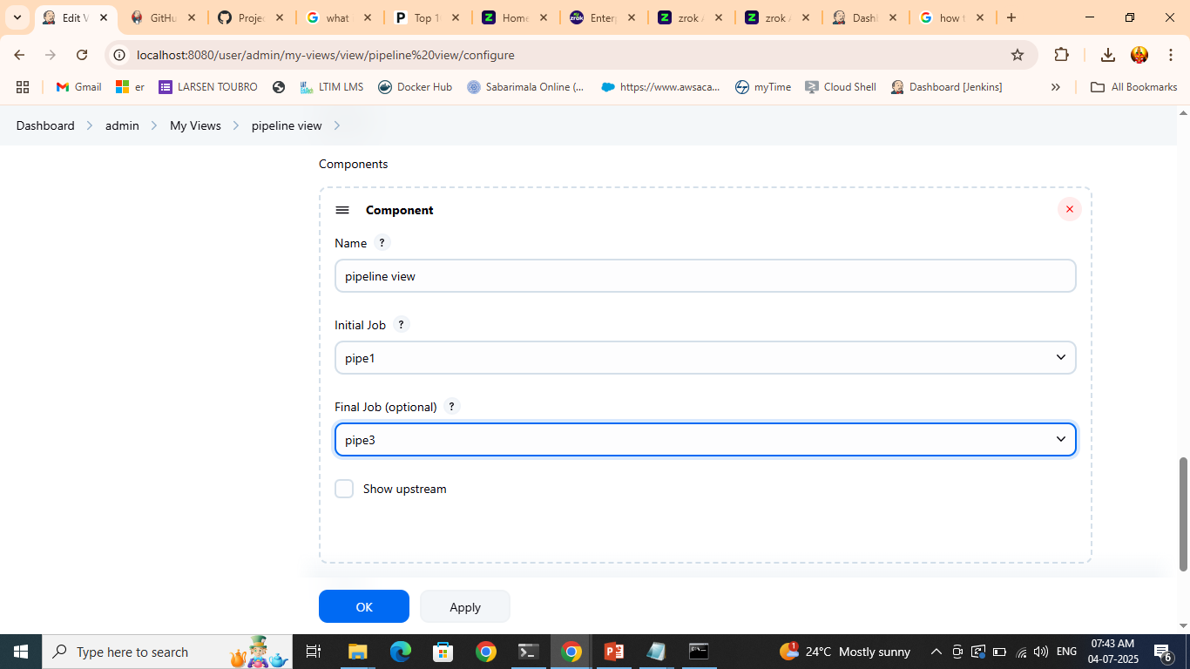
apply

Slide 38
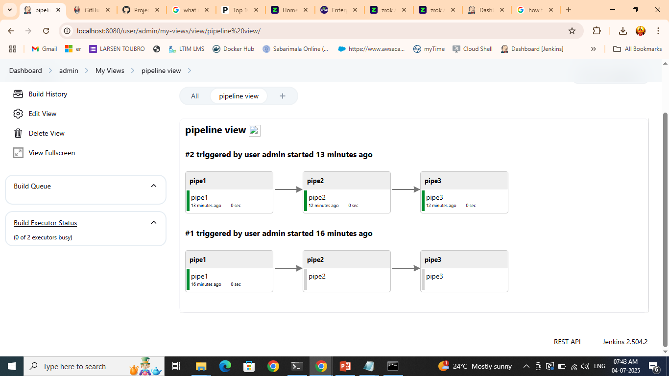

Slide 39
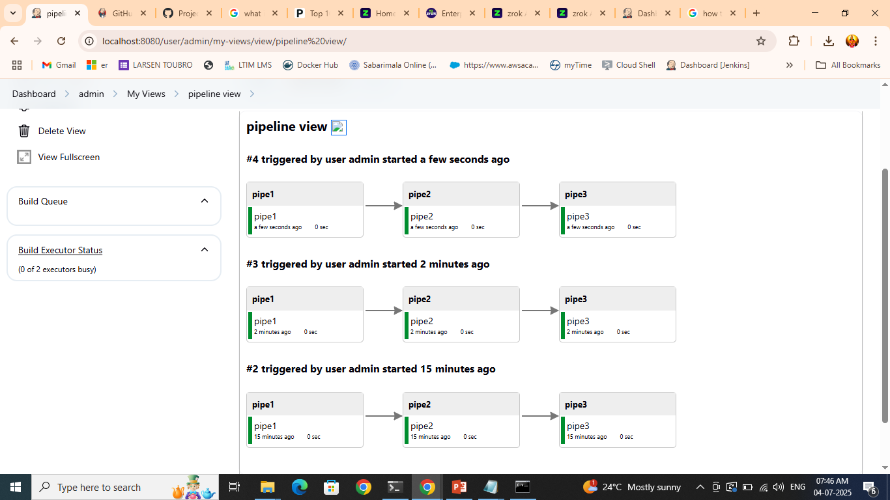
Click the build now and see the exe going through

