Slide 1

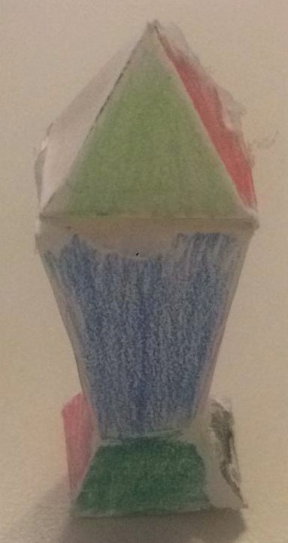

Construction steps
1- cut
2- fold lines
3- glue green area
Size : Micro
Copyright Dr. Sherif Omran, 14.4.2021, Creative Common License
Sherif.Omran@gmx.de +498972101087914
Copyright Dr. Sherif Omran, 14.4.2021, Creative Common License
Sherif.Omran@gmx.de +498972101087914

Slide 2
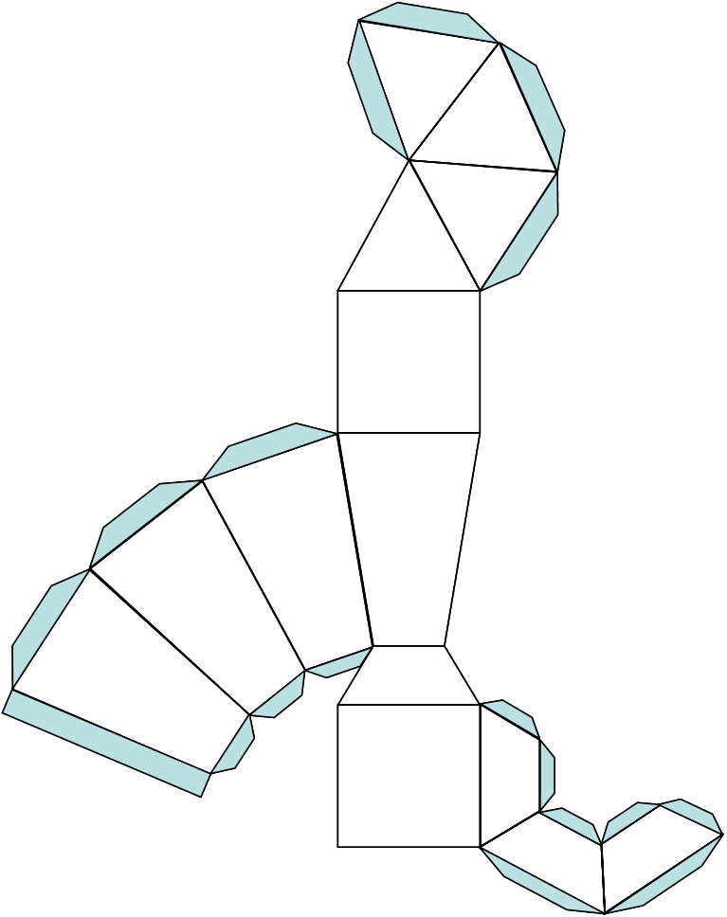
Size : Mini
Copyright Dr. Sherif Omran, 14.4.2021, Creative Common License
Sherif.Omran@gmx.de +498972101087914

