Slide 1
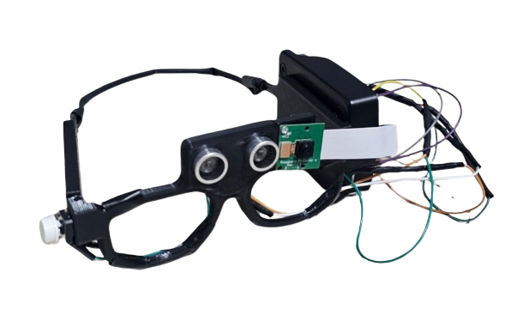
AI VISION
VIAD
AI-Vision
VIAD: Vision Impaired Assistive Device
Rayan Altawijari
431107823
Faris Alsuhibani
431107834
Presented by:
Mohammed Alsharekh
431108100
Mohaya Almutairi
431107802
Abdullah Alfayez
431108148
Supervised by: Dr. Ali Mustafa Qamar Khan
Qassim University · Department of Computer Science · 1447/1448 (2025/2026)

Slide 2

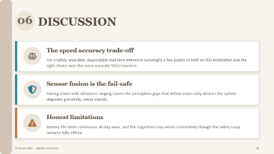
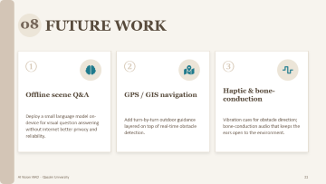


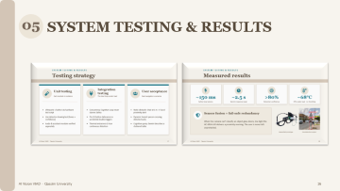
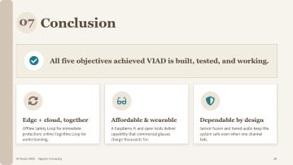
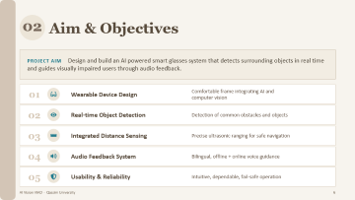
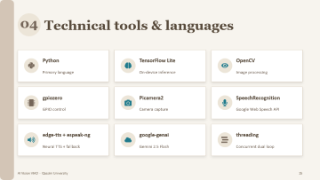

Plan
AI Vision VIAD · Qassim University
2

Slide 3
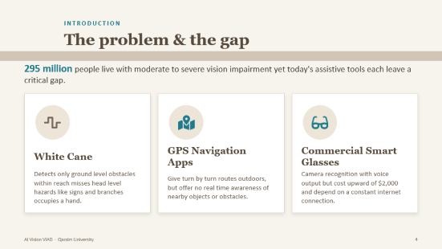
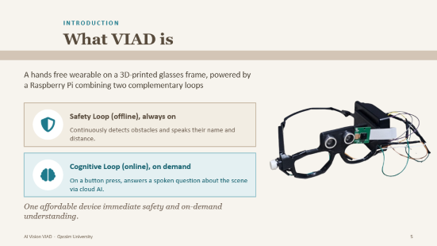
01
INTRODUCTION
AI Vision VIAD · Qassim University
3

Slide 4



INTRODUCTION
The problem & the gap
295 million people live with moderate to severe vision impairment yet today's assistive tools each leave a critical gap.
White Cane
GPS Navigation Apps
Commercial Smart Glasses
Detects only ground level obstacles within reach misses head level hazards like signs and branches occupies a hand.
Give turn by turn routes outdoors, but offer no real time awareness of nearby objects or obstacles.
Camera recognition with voice output but cost upward of $2,000 and depend on a constant internet connection.
AI Vision VIAD · Qassim University
4

Slide 5


INTRODUCTION
What VIAD is
A hands free wearable on a 3D-printed glasses frame, powered by a Raspberry Pi combining two complementary loops
Safety Loop (offline), always on
Continuously detects obstacles and speaks their name and distance.
Cognitive Loop (online), on demand
On a button press, answers a spoken question about the scene via cloud AI.
One affordable device immediate safety and on-demand understanding.
AI Vision VIAD · Qassim University
5

Slide 6




02
Aim & Objectives
PROJECT AIM Design and build an AI powered smart glasses system that detects surrounding objects in real time and guides visually impaired users through audio feedback.
01
Wearable Device Design
Comfortable frame integrating AI and computer vision
DONE
02
Real-time Object Detection
Detection of common obstacles and objects
DONE
03
Integrated Distance Sensing
Precise ultrasonic ranging for safe navigation
DONE
04
Audio Feedback System
Bilingual, offline + online voice guidance
DONE
05
Usability & Reliability
Intuitive, dependable, fail-safe operation
DONE
AI Vision VIAD · Qassim University
6

Slide 7
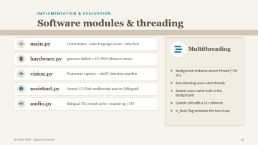
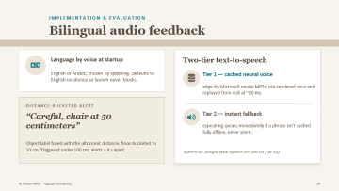
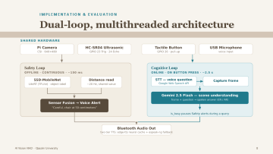
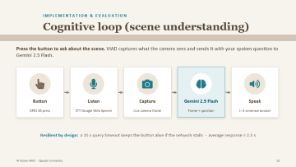
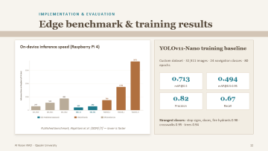
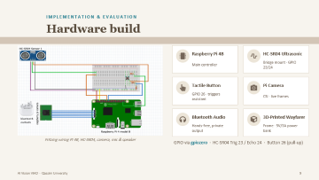

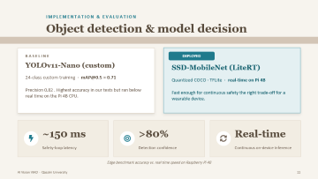
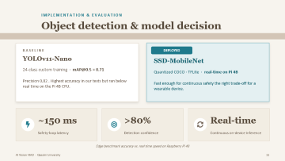
03
IMPLEMENTATION & EVALUATION
AI Vision VIAD · Qassim University
7

Slide 8
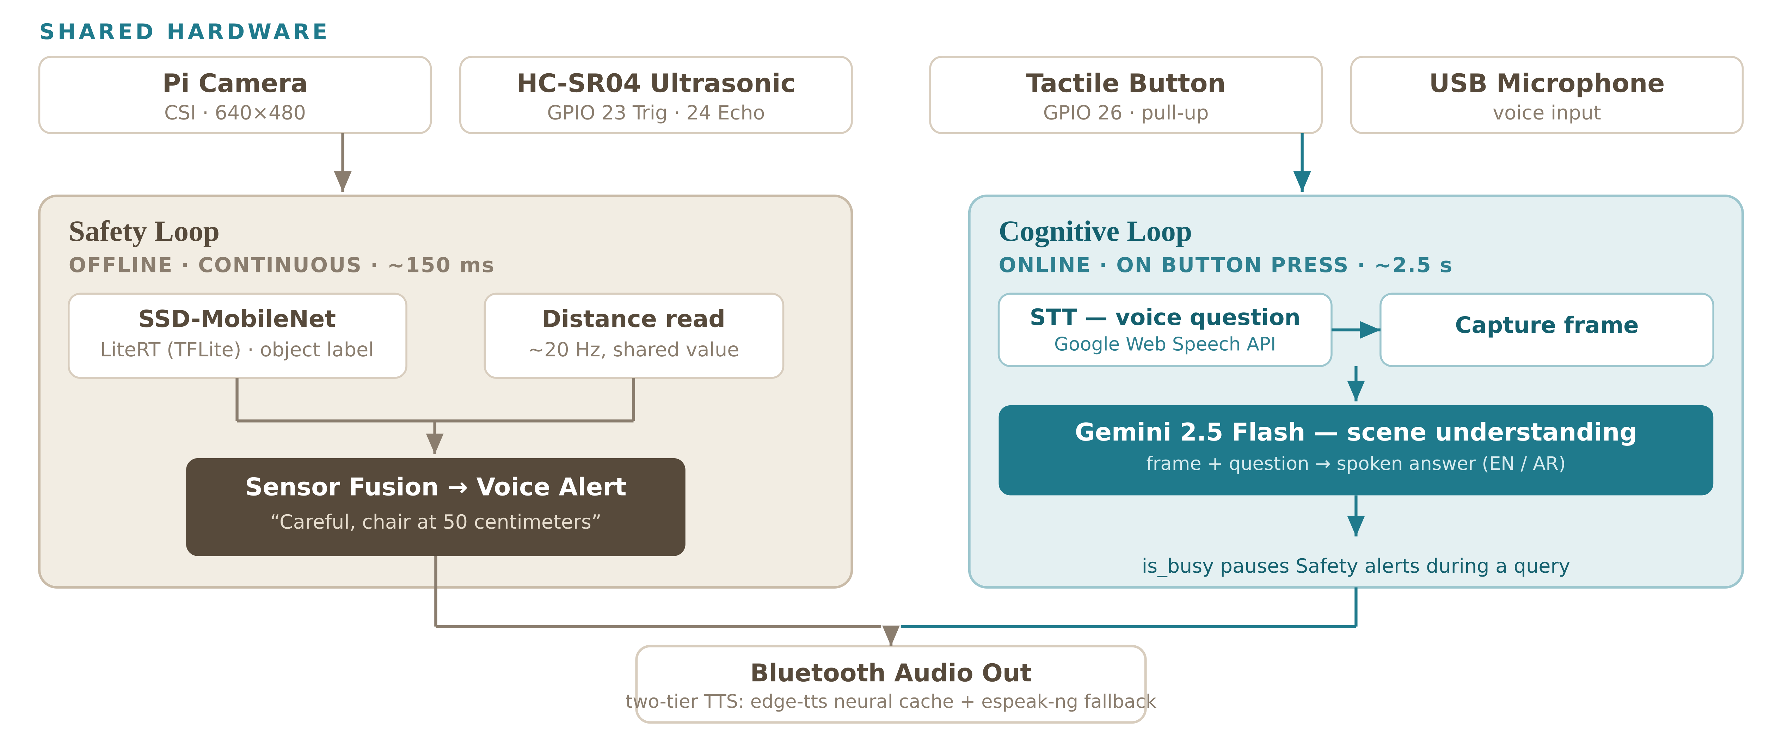
IMPLEMENTATION & EVALUATION
Dual-loop, multithreaded architecture
AI Vision VIAD · Qassim University
8

Slide 9
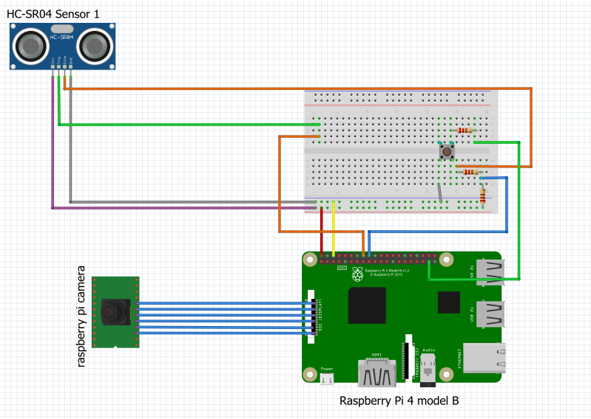
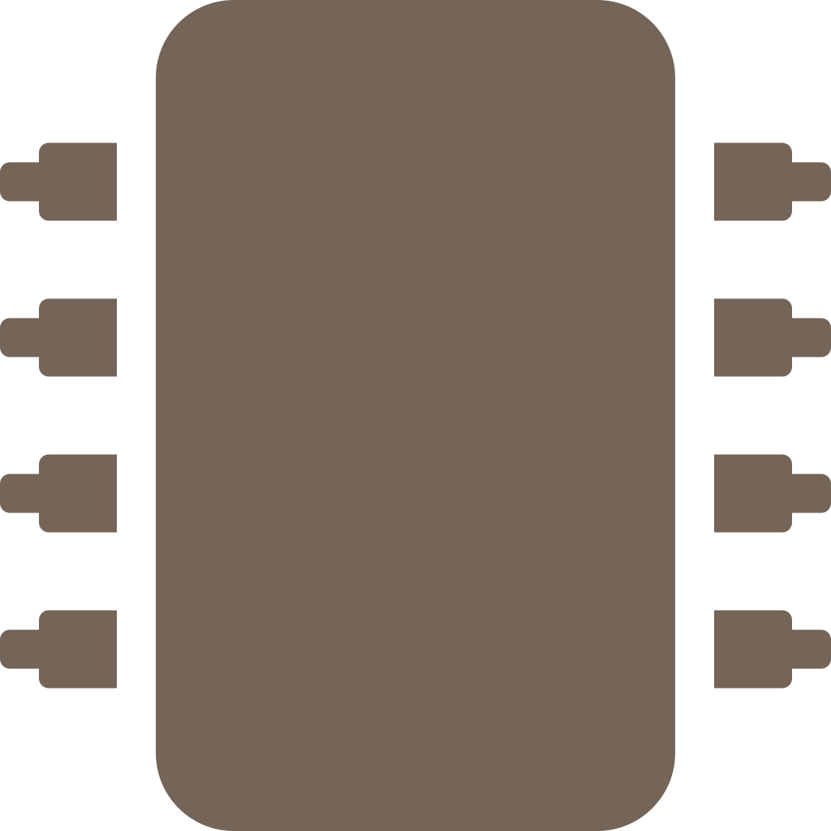





IMPLEMENTATION & EVALUATION
Hardware build
Raspberry Pi 4B
HC-SR04 Ultrasonic
Main controller
Bridge mount · GPIO 23/24
Tactile Button
Pi Camera
GPIO 26 · triggers assistant
CSI · live frames
bluetooth earbuds
Bluetooth Audio
3D-Printed Wayfarer
Hands-free, private output
Frame · 5V/3A power bank
Fritzing wiring Pi 4B, HC-SR04, camera, mic & speaker
GPIO via gpiozero · HC-SR04 Trig 23 / Echo 24 · Button 26 (pull-up)
AI Vision VIAD · Qassim University
9

Slide 10


IMPLEMENTATION & EVALUATION
Software modules & threading
main.py
Orchestrator · voice language picker · data flow
Multithreading
hardware.py
gpiozero button + HC-SR04 distance sensor
Background distance sensor thread (~20 Hz)
Non-blocking voice alert threads
Neural voice cache built in the background
Gemini call with a 15 s timeout
is_busy flag serializes the two loops
vision.py
Picamera2 capture + LiteRT detection pipeline
assistant.py
Gemini 2.5 Flash multimodal queries (bilingual)
audio.py
Bilingual TTS neural cache + espeak-ng / STT
AI Vision VIAD · Qassim University
10

Slide 11



IMPLEMENTATION & EVALUATION
Object detection & model decision
BASELINE
DEPLOYED
YOLOv11-Nano
SSD-MobileNet
24-class custom training · mAP@0.5 ≈ 0.71
Quantized COCO · TFLite · real-time on Pi 4B
Precision 0.82 . Highest accuracy in our tests but ran below real time on the Pi 4B CPU.
Fast enough for continuous safety the right trade-off for a wearable device.
~150 ms
>80%
Real-time
Safety-loop latency
Detection confidence
Continuous on-device inference
Edge benchmark accuracy vs. real time speed on Raspberry Pi 4B
AI Vision VIAD · Qassim University
11

Slide 12
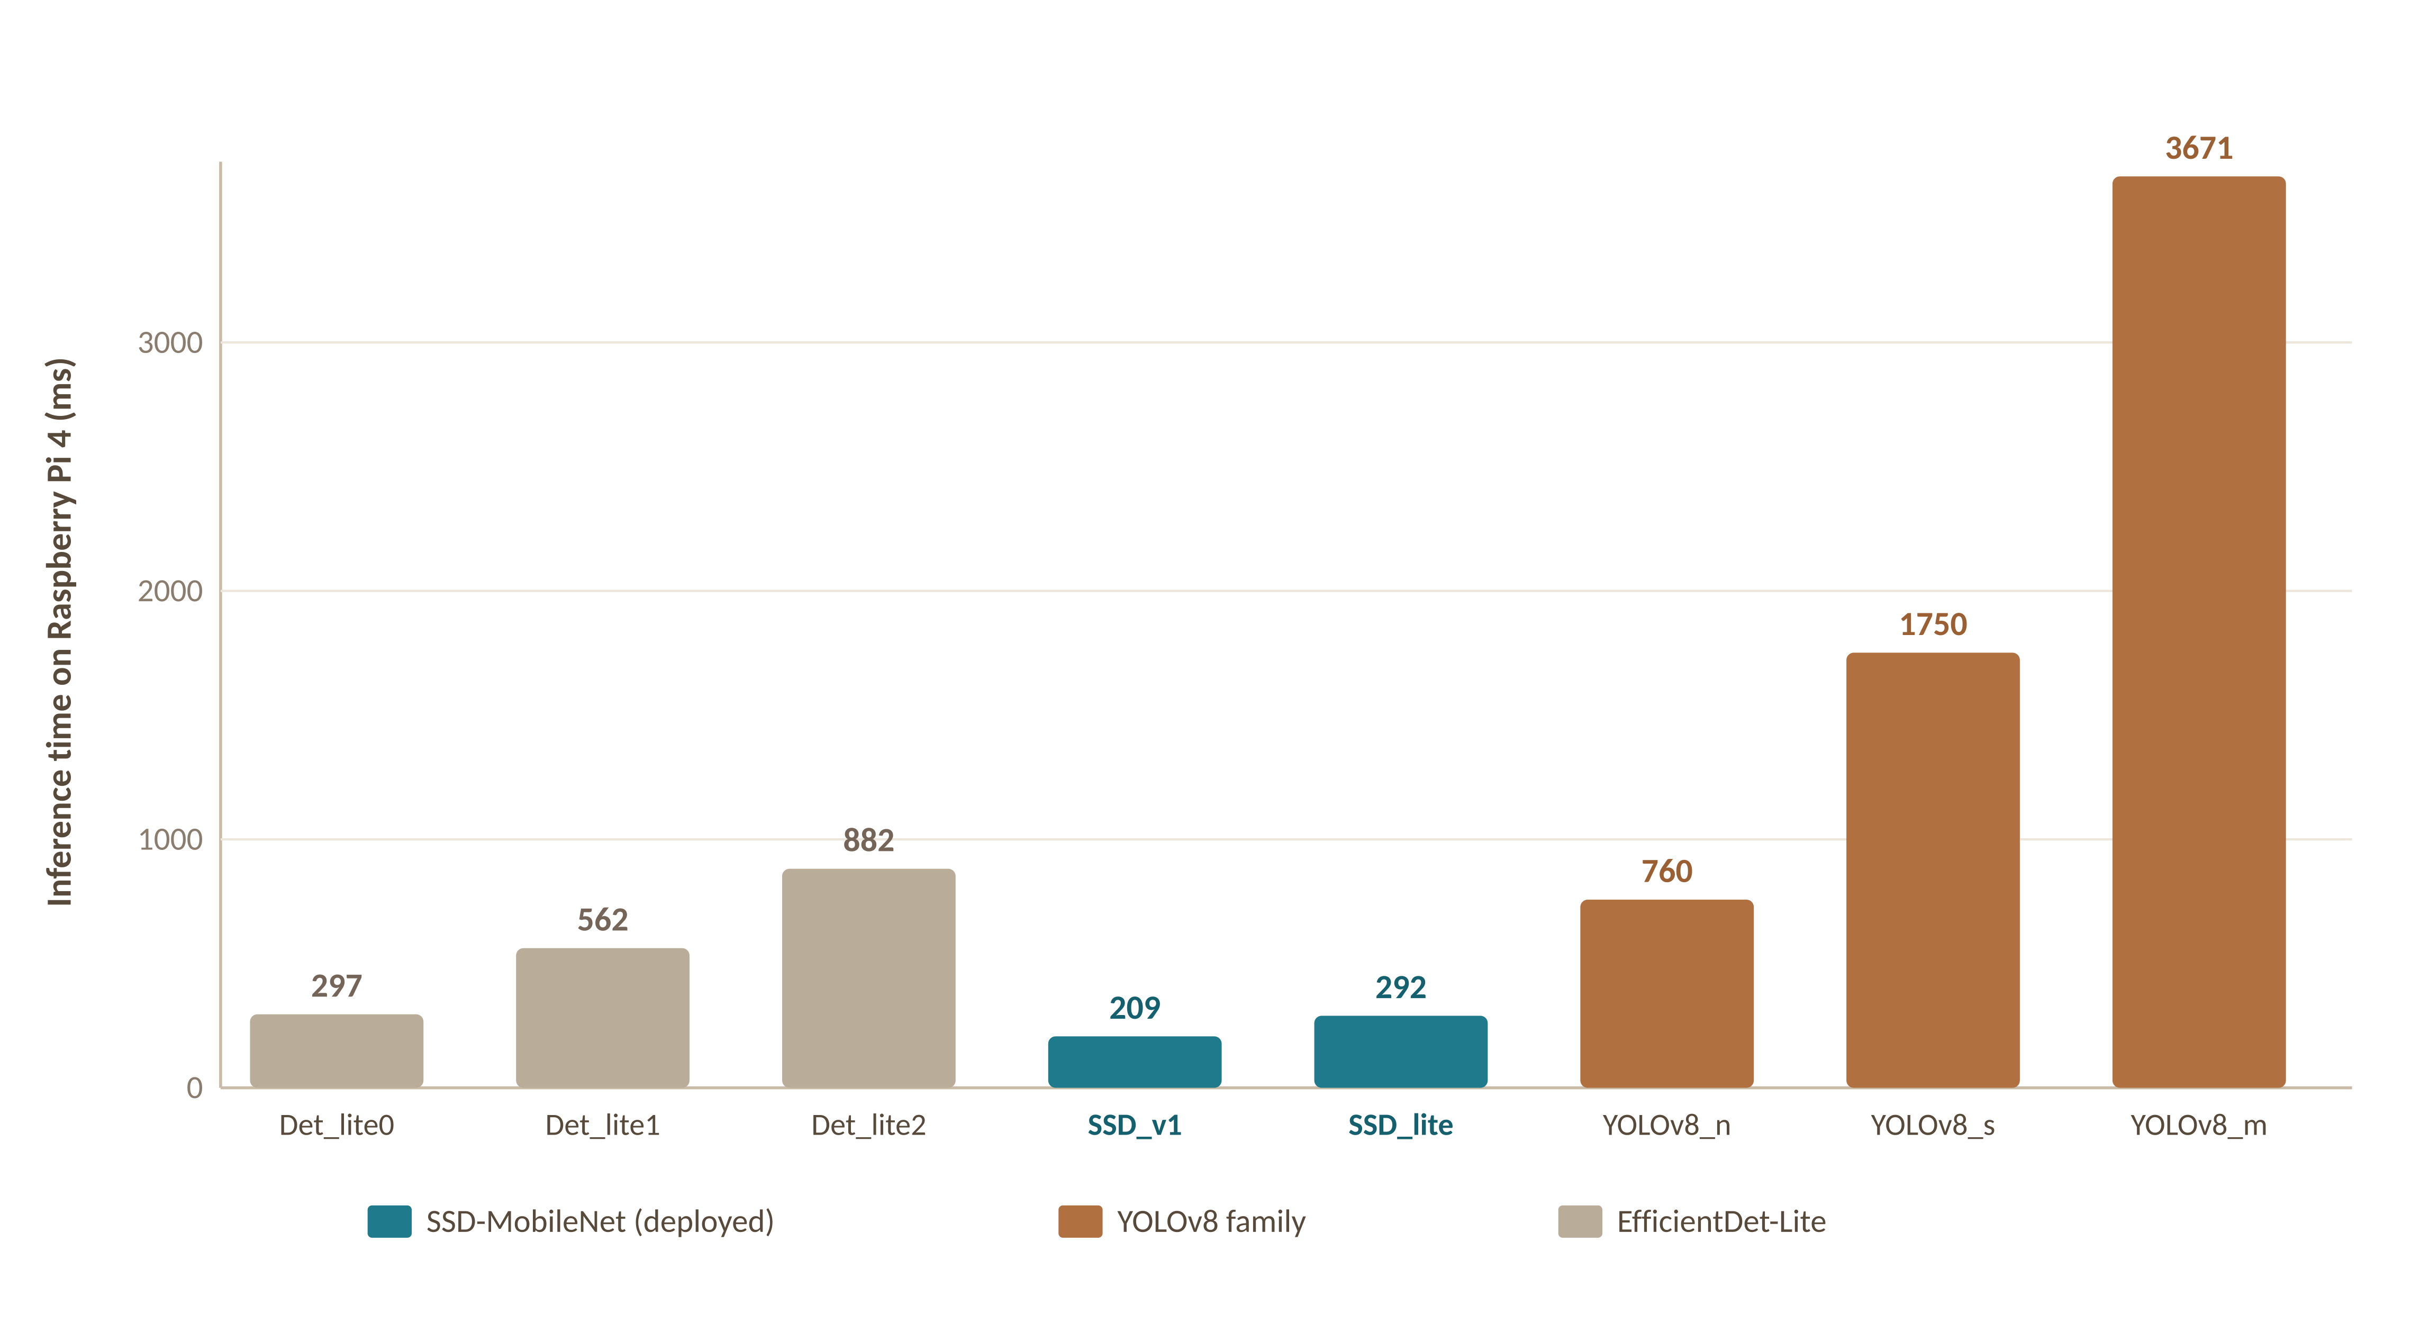
IMPLEMENTATION & EVALUATION
Edge benchmark & training results
On-device inference speed (Raspberry Pi 4)
YOLOv11-Nano training baseline
Custom dataset · 32,511 images · 24 navigation classes · 80 epochs
0.713
0.494
mAP@0.5
mAP@0.5:0.95
0.82
0.67
Precision
Recall
Strongest classes: stop signs, doors, fire hydrants 0.98 · crosswalks 0.95 · trees 0.94
Published benchmark, Alqahtani et al. (2024) [7] — lower is faster
AI Vision VIAD · Qassim University
12

Slide 13


IMPLEMENTATION & EVALUATION
Cognitive loop (scene understanding)
Press the button to ask about the scene. VIAD captures what the camera sees and sends it with your spoken question to Gemini 2.5 Flash.
Button
Listen
Capture
Gemini 2.5 Flash
Speak
GPIO 26 press
STT Google Web Speech
Live camera frame
Frame + question
1–2 sentence answer
Resilient by design: a 15 s query timeout keeps the button alive if the network stalls · average response ≈ 2.5 s
AI Vision VIAD · Qassim University
13

Slide 14


IMPLEMENTATION & EVALUATION
Bilingual audio feedback
Language by voice at startup
Two-tier text-to-speech
English or Arabic, chosen by speaking. Defaults to English on silence so launch never blocks.
Tier 1 — cached neural voice
edge-tts Microsoft neural MP3s, pre-rendered once and replayed from disk at ~80 ms.
DISTANCE-BUCKETED ALERT
“Careful, chair at 50 centimeters”
Tier 2 — instant fallback
espeak-ng speaks immediately if a phrase isn't cached fully offline, never silent.
Object label fused with the ultrasonic distance, floor-bucketed to 10 cm. Triggered under 100 cm; alerts ≥ 4 s apart.
Speech-in: Google Web Speech API (en-US / ar-SA)
AI Vision VIAD · Qassim University
14

Slide 15



04
Technical tools & languages
Python
TensorFlow Lite
OpenCV
Primary language
On-device inference
Image processing
gpiozero
Picamera2
SpeechRecognition
GPIO control
Camera capture
Google Web Speech API
edge-tts + espeak-ng
google-genai
threading
Neural TTS + fallback
Gemini 2.5 Flash
Concurrent dual loop
AI Vision VIAD · Qassim University
15

Slide 16
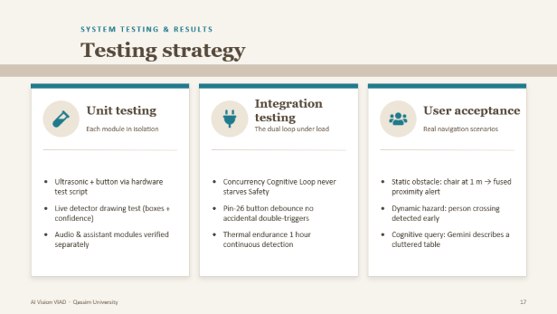
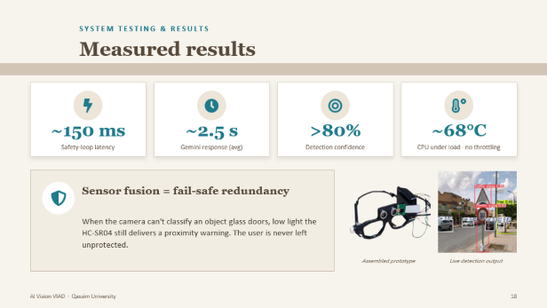
05
SYSTEM TESTING & RESULTS
AI Vision VIAD · Qassim University
16

Slide 17



SYSTEM TESTING & RESULTS
Testing strategy
Unit testing
Integration testing
User acceptance
Each module in isolation
The dual loop under load
Real navigation scenarios
Ultrasonic + button via hardware test script
Live detector drawing test (boxes + confidence)
Audio & assistant modules verified separately
Concurrency Cognitive Loop never starves Safety
Pin-26 button debounce no accidental double-triggers
Thermal endurance 1 hour continuous detection
Static obstacle: chair at 1 m → fused proximity alert
Dynamic hazard: person crossing detected early
Cognitive query: Gemini describes a cluttered table
AI Vision VIAD · Qassim University
17

Slide 18


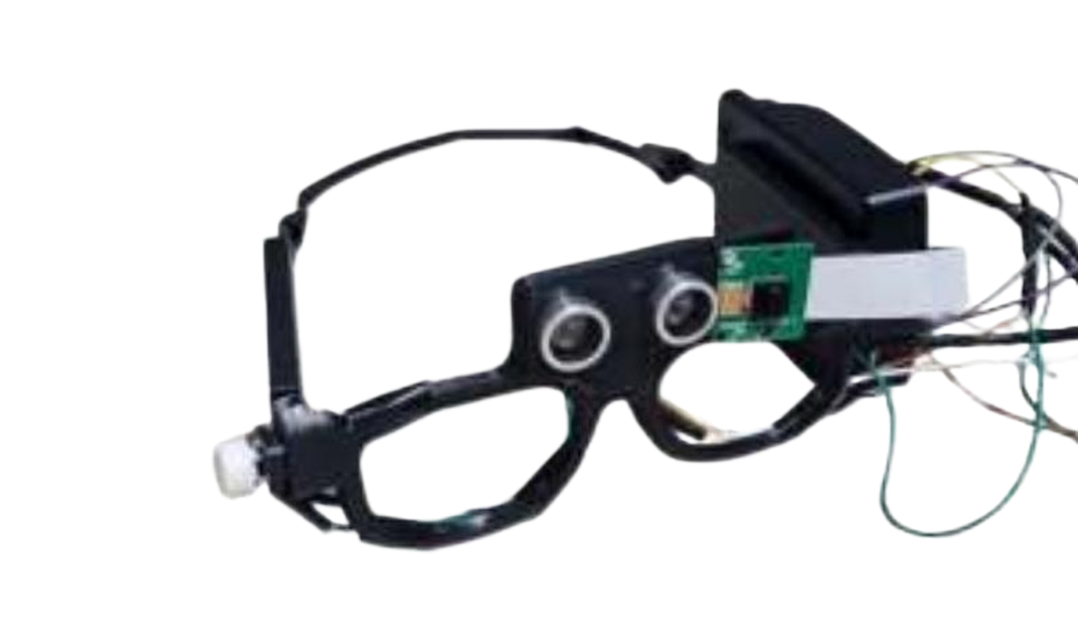
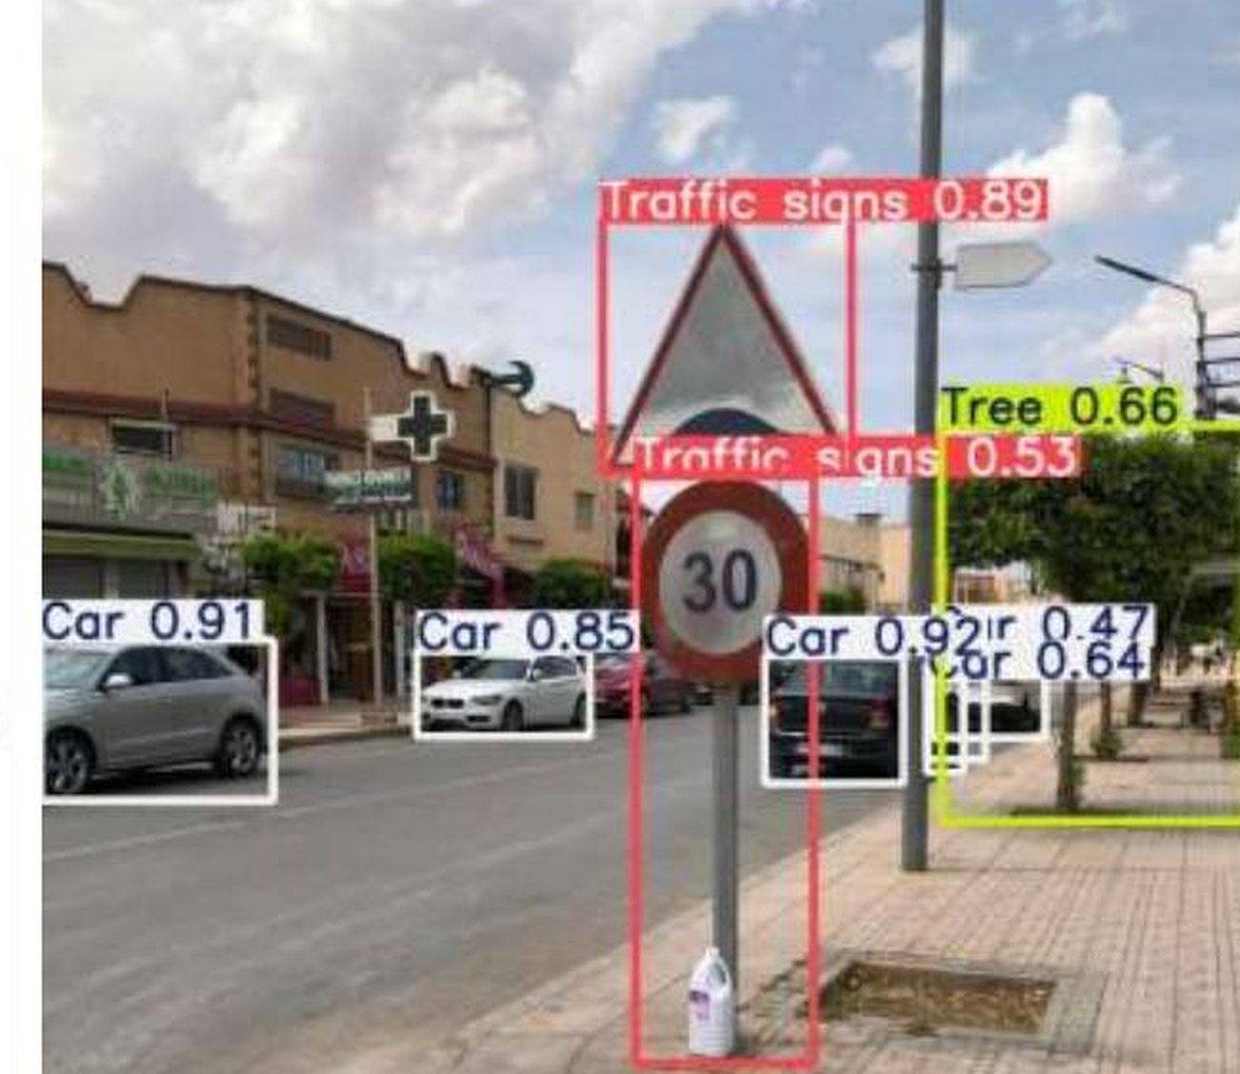
SYSTEM TESTING & RESULTS
Measured results
~150 ms
~2.5 s
>80%
~68°C
Safety-loop latency
Gemini response (avg)
Detection confidence
CPU under load · no throttling
Sensor fusion = fail-safe redundancy
When the camera can't classify an object glass doors, low light the HC-SR04 still delivers a proximity warning. The user is never left unprotected.
Assembled prototype
Live detection output
AI Vision VIAD · Qassim University
18

Slide 19


06
DISCUSSION
The speed accuracy trade-off
For a safety wearable, dependable real-time inference outweighs a few points of mAP so SSD-MobileNet was the right choice over the more accurate YOLO baseline.
Sensor fusion is the fail-safe
Pairing vision with ultrasonic ranging covers the perception gaps that defeat vision-only devices the system degrades gracefully, never silently.
Honest limitations
Battery life limits continuous all-day wear, and the Cognitive Loop needs connectivity though the Safety Loop remains fully offline.
AI Vision VIAD · Qassim University
19

Slide 20

07
Conclusion
All five objectives achieved VIAD is built, tested, and working.
Edge + cloud, together
Affordable & wearable
Dependable by design
Offline Safety Loop for immediate protection; online Cognitive Loop for understanding.
A Raspberry Pi and open tools deliver capability that commercial glasses charge thousands for.
Sensor fusion and tiered audio keep the system safe even when one channel fails.
AI Vision VIAD · Qassim University
20

Slide 21

08
FUTURE WORK
①
②
③
Offline scene Q&A
GPS / GIS navigation
Haptic & bone-conduction
Deploy a small language model on-device for visual question answering without internet better privacy and reliability.
Add turn-by-turn outdoor guidance layered on top of real-time obstacle detection.
Vibration cues for obstacle direction; bone-conduction audio that keeps the ears open to the environment.
AI Vision VIAD · Qassim University
21

Slide 22

Questions & Answers
Thank you
AI Vision VIAD · Qassim University · Department of Computer Science · 1447/1448

