Slide 1
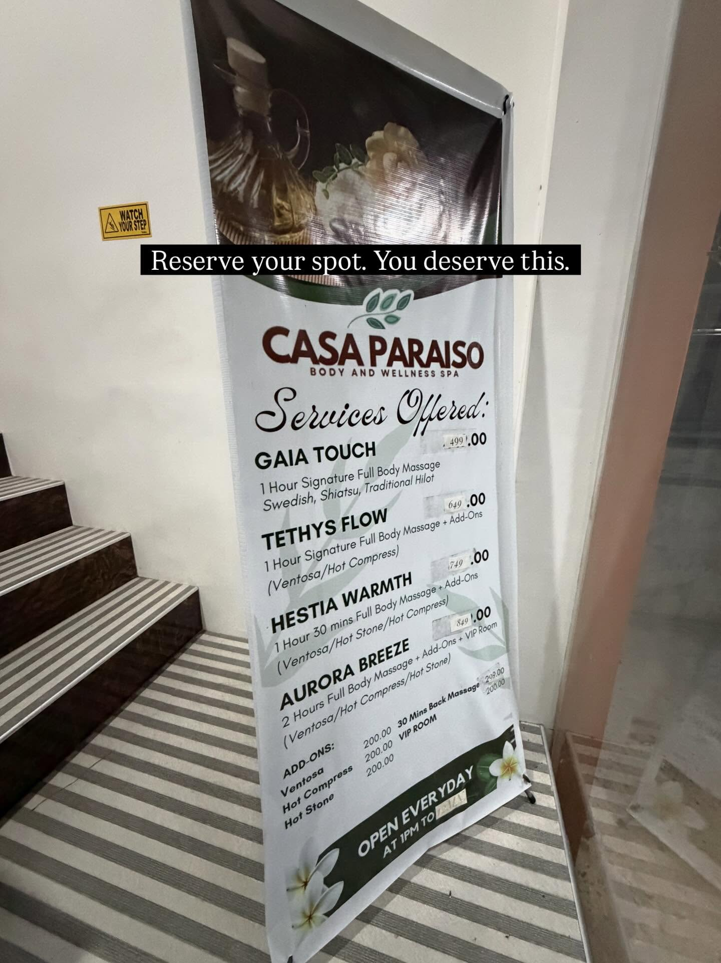

Spa service browsing
and appointment booking
A warm tropical wellness experience translated into a dependable local-first Flutter application.
ANDROID + RESPONSIVE WEB
Academic Project · 2026

Slide 2
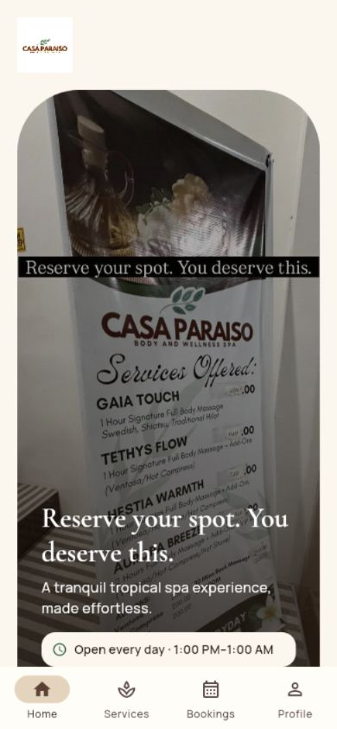
PRODUCT EXPERIENCE
02
Customers get a clear path from discovery to confirmation
The application removes friction from service comparison and keeps each step reassuring, readable, and locally recoverable.
4
Browse without an account
Four packages explain price, duration, treatments, and extras.
navigation
areas
Book in Manila time
Validated 30-minute slots respect duration, lead time, and local conflicts.
Manage plans locally
Upcoming, completed, and cancelled records remain on the current device.
Casa Paraiso · Academic Prototype

Slide 3
BRAND SYSTEM
03
The interface carries the spa’s materials, warmth, and calm
Nature distilled
Arched imagery, soft depth, natural spacing, and restrained motion make the booking experience feel premium without hiding operational detail.
Cacao
Palm
Brass
Sand
Cream
Cormorant Garamond
Manrope
Emotional headings and signature moments
Navigation, forms, schedules, prices
Casa Paraiso · Academic Prototype

Slide 4
CUSTOMER JOURNEY
04
One continuous journey keeps booking decisions understandable
1
2
3
4
5
Choose
Personalize
Schedule
Review
Manage
Compare package, price, and duration
Select style, treatment, and extras
Pick a valid Manila-time slot
Check details, duration, total, and consent
Reschedule or cancel before start
Every transition preserves context; no login, payment form, or hidden server state interrupts the flow.
Casa Paraiso · Academic Prototype

Slide 5
SERVICE MODEL
05
A small catalog still supports meaningful personalization
Package
Price
Duration
Included treatment choice
Gaia Touch
₱499
60 min
Massage style
Tethys Flow
₱649
60 min
Ventosa / Hot Compress
Hestia Warmth
₱749
90 min
Ventosa / Hot Stone / Hot Compress
Aurora Breeze
₱849
120 min
Ventosa / Hot Compress / Hot Stone
Optional extras
30-minute Back Massage · ₱298 · adds 30 minutes
VIP Room · ₱200 · no added time
Casa Paraiso · Academic Prototype

Slide 6
ARCHITECTURE
06
Replaceable boundaries keep a future backend migration practical
Bundled catalog
Feature screens
Riverpod state
Business services
Versioned JSON
and asset snapshots
Onboarding · Home · Services
Booking · History · Profile
AppController coordinates
local state and side effects
Pricing · Availability
Validation · Manila timezone
Local adapters
SharedPreferences
Android reminders
Production path
Swap repository and notification implementations for authenticated remote services—without rebuilding the customer experience.
Casa Paraiso · Academic Prototype

Slide 7
BOOKING INTEGRITY
07
Local-first rules are explicit about what the prototype can guarantee
Scheduling
Data and consent
Honest limitations
Asia/Manila business time
Separate versioned payloads
No shared spa capacity
Daily 1:00 PM–1:00 AM
Service snapshots preserve history
No cross-device synchronization
30-minute starts
Malformed data resets selectively
No online payment or account
1-hour lead · 30-day horizon
Confirmed reset clears all local data
Web reminders only while open
Confirmation is local; customers should contact the spa for real operational availability.

Slide 8
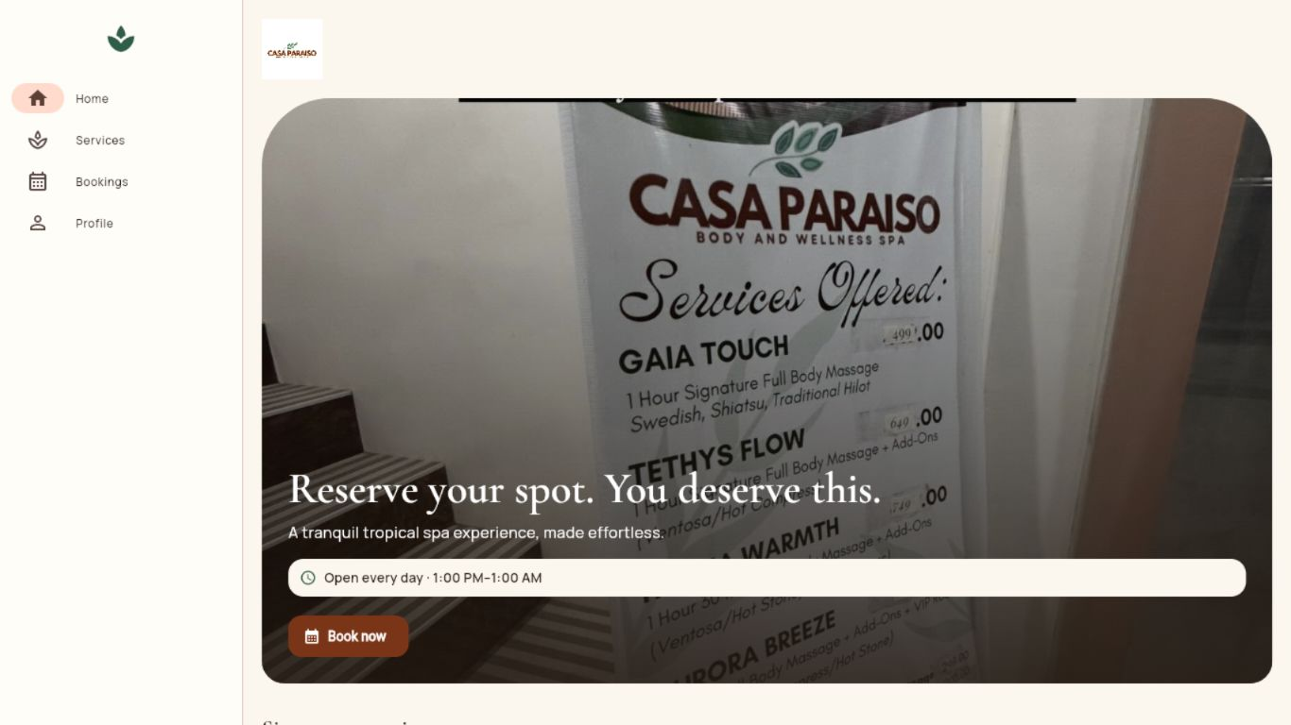
VERIFICATION EVIDENCE
08
Automated checks and responsive inspection support the handoff
9
automated tests passed
0
analyzer issues
2
validated navigation modes
Release web build compiled with the GitHub Pages base path. Android release APK built successfully with the explicit Flutter entry point.
Casa Paraiso · Academic Prototype

Slide 9
SCOPE AND FUTURE
09
The prototype proves the experience—not shared spa operations
What works today
What production requires
✓
Bilingual service discovery
01
Shared source of availability
✓
Validated local appointment flow
02
Authenticated customer and staff roles
✓
Persistent profile and history
03
Server-authoritative confirmation
✓
Responsive Android/web experience
04
Payment and notification infrastructure
✓
Android reminders and contact actions
05
Operational security, audit, and privacy controls
Casa Paraiso · Academic Prototype

Slide 10
Casa Paraiso
A calm customer experience, backed by clear local rules.
Browse
Personalize
Schedule
Review
Manage
Casa Paraiso Body & Wellness Spa
Barangay Cuta East, Santa Teresita, Batangas
In front of Alfamart and PLDT
Source: supplied brand/menu assets and the implemented project’s verified documentation and test evidence.

