Slide 1
Vector graphic (from ReporteRs)
Treatment difference
100
75
50
y
25
0
0
1
2
3
4
5
x

Slide 2
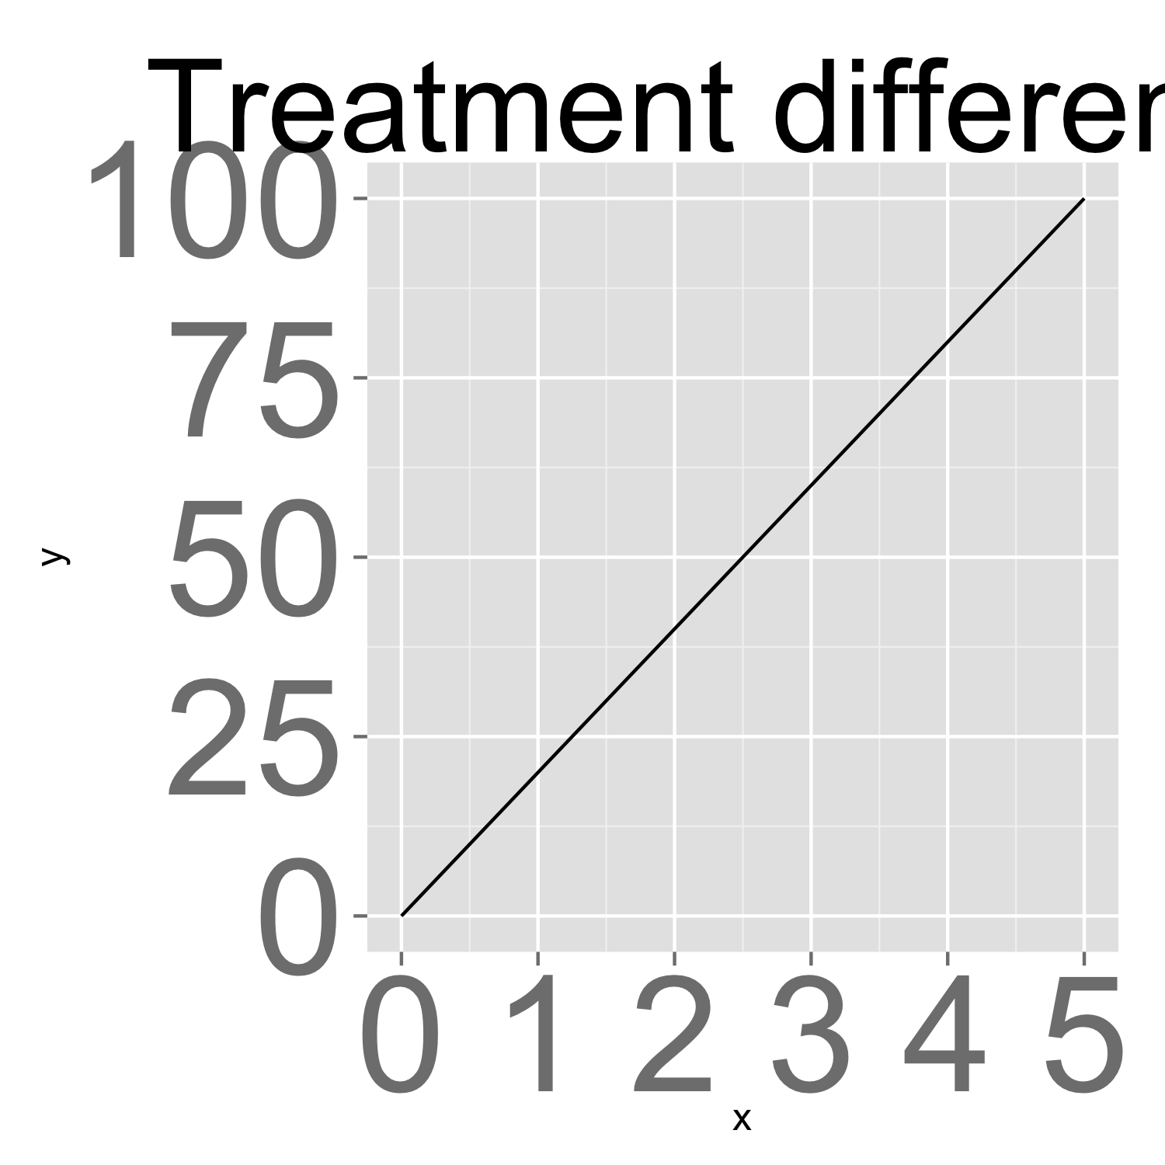
Raster graphic (from grDevices)

