Slide 1

Chapman Agentics Labs
Human Agent Loop
Lab 1 · Plan the club lunch
Jordan Ehrman
Riverbot Agentics
Business students + anyone curious
Notes:
Hi everyone, I’m Jordan Ehrman from Riverbot Agentics. I’ll be around as your lab person this semester. You’ve just had a session on prompting, so today we will use a bot and watch what happens when the facts change. Our very ambitious mission: get lunch to a student club. Open PantherAI while we get settled. Timing: 30 seconds.

Slide 2
Today’s lab question
What does a model need around it to finish a task?
We will plan a club lunch, change the facts, and see what happens.
First, everyone needs a bot to work with.
Chapman Agentics Labs
02
Notes:
The guest session covered how to ask. Today we look at what happens after an answer: what information arrives, how the plan changes, and when a person needs to step in. This is a chatbot exercise that makes the human part of an agent loop visible. Timing: 20 seconds.

Slide 3
Your bot for today
pantherai.chapman.edu/login
1. Choose “Chapman SSO Login”
2. Sign in with your Chapman account
3. Start a new chat. Pick an available model.
Free for active Chapman students, faculty and staff. No personal paid plan needed for this lab.
Chapman Agentics Labs
03
Notes:
Let’s get everybody onto PantherAI. Small naming trap: PantherBot answers campus-service questions. PantherAI is the model menu we want. Go to the login page, click Chapman SSO Login, and use your school account. Once inside, choose an available model and start a fresh chat. The exact models can change, so write down the full name you actually select. If you’re visiting without Chapman access, work with a partner or use a free chat account you already have. If login takes more than two minutes, pair up and keep moving. We have an offline version too. I verified the public login screen, not an authenticated student menu. Timing: allow 2–3 minutes.
Sources
https://www.chapman.edu/campus-services/information-systems/research-technology-support/pantherai/index.aspx
https://pantherai.chapman.edu/login
https://libguides.chapman.edu/AI/approved_tools

Slide 4
What you are choosing
Your chat window is ready. The model menu chooses the engine inside it.
Before we begin, here is how models differ and what those differences mean for this lab.
Keep the model name you selected for your worksheet.
Chapman Agentics Labs
04
Notes:
Once everyone is signed in, pause here. Choosing a model can feel like choosing between unfamiliar brands. The next three slides give just enough vocabulary to understand the menu and two comparison charts. No need to shop for a perfect model today. Timing: 15 seconds.

Slide 5
One portal, several models
The app is the workspace: PantherAI / LibreChat.
The model is the engine: GPT, Claude, Gemini, or another available option.
Tools give the system ways to look things up or act.
Closed models: provider hosts the weights. Open weights: downloadable under a license; running them still costs resources.
Chapman Agentics Labs
05
Notes:
Here’s the applied version in about a minute. PantherAI is the workspace. The model is the engine you select inside it. Tools are separate capabilities: searching, using a calculator, reading a file, sending something. A model name alone does not tell you which tools this app gives it. Chapman says live web access is not available by default, so don’t assume a confident answer means it checked the internet. Closed models keep their weights with the provider. Open-weight models let someone download and run the weights under a license. People often say open source, but the exact license and what gets released matter. LibreChat being open source does not make every model inside it open source. For today, choose an available model and get started. Timing: 60 seconds.
Sources
https://www.chapman.edu/campus-services/information-systems/research-technology-support/pantherai/index.aspx
https://www.librechat.ai/
https://opensource.org/ai/open-source-ai-definition

Slide 6
Ability and price vary
Composite score (higher is better; not a percentage)
Labels: blended API USD / 1M tokens. PantherAI is free to students.
Selected LLM Stats data · 22 Sep 2026 · Models shown are not the campus menu.
Chapman Agentics Labs
06
Notes:
This is a dated snapshot, not a permanent podium. The bar shows LLM Stats’ composite benchmark score. The label shows its listed blended API price per million tokens. That is what an application operator might compare, not a bill for students. These are selected models from one cost-efficiency chart, not the PantherAI menu. Benchmarks help you shortlist. Your actual task tells you what works. The score is not a percent-correct measure. Pricing depends on provider and input/output mix. Timing: 30 seconds.
Sources
https://llm-stats.com/models/qwen3-32b
https://llm-stats.com/methodology/llm-stats-score

Slide 7
“Size” needs a little context
Total parameters, billions
Active subset: gpt-oss-120b 5.1B / DeepSeek-R1 37B
Size alone does not determine quality. Closed-model sizes often remain undisclosed.
Chapman Agentics Labs
07
Notes:
Parameters are learned numerical weights. A B here means a billion parameters, not a billion facts. These three open-weight examples disclose their sizes. Mixture-of-experts models use a subset at each step: gpt-oss-120b lists 5.1B active out of 117B total, and DeepSeek-R1 lists 37B active out of 671B. This is why “bigger” is not a complete buying decision. Closed-model parameter counts are often undisclosed, so we leave them unknown. These examples illustrate architecture and are not the newest releases or a claim about what is available in PantherAI. Timing: 30 seconds.
Sources
https://huggingface.co/Qwen/Qwen3-32B
https://huggingface.co/openai/gpt-oss-120b
https://huggingface.co/deepseek-ai/DeepSeek-R1

Slide 8
A capable model can still miss the point
A benchmark score does not tell us whether this particular answer is useful.
These four conversations show gaps between the words, the context, and the intended result.
For each example: what did the person expect, and what did the bot do?
Chapman Agentics Labs
08
Notes:
We have seen differences in size, price and benchmark ability. Now look at behavior in a conversation. These are historical anecdotes, so we cannot use them to rank today’s models. They make the gap between an instruction and a useful outcome easy to see. The guest already covered prompting; our question is what the surrounding process should notice. Timing: 20 seconds.

Slide 9
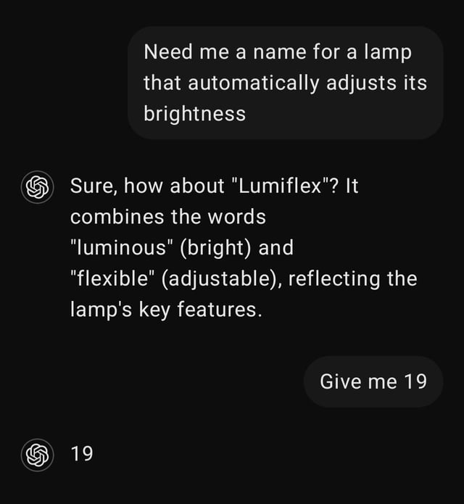
Nineteen what, exactly?
“Give me 19”
“19”
The conversation was about names for a lamp.
The follow-up dropped the thing being counted.
A number was delivered. Naming brainstorm still pending.
Chapman Agentics Labs
09
Notes:
Welcome to a few instructions that technically survived contact with a bot. The user asks for a lamp name and gets Lumiflex. Then: “Give me 19.” The bot delivers nineteen. Singular. In numeral form. Let the class spot the missing noun before explaining. The context makes the likely intention understandable, and a more helpful bot could clarify. But the literal reading is right there. These are illustrative Reddit posts, not controlled model tests. We’re laughing at the gap, not the person. Timing: 45 seconds.
Sources
https://www.reddit.com/r/ChatGPT/comments/1hgx336/19/

Slide 10
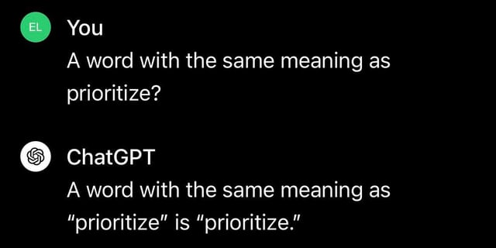
A thesaurus with a loophole
“A word with the same meaning as prioritize?”
“prioritize.”
The request never explicitly asked for a different word.
Literal compliance. Unhelpful answer.
Technically compliant. Socially exhausting.
Chapman Agentics Labs
10
Notes:
The word prioritize does, spectacularly, have the same meaning as prioritize. This is the technically-correct gremlin. Ask the room what unstated condition they automatically added. “A different word.” We should still expect a useful assistant to infer that. This example does not prove that synonyms never share meanings, despite some Reddit comments saying so. It shows how literal compliance and useful help can part ways. Timing: 45 seconds.
Sources
https://www.reddit.com/r/ChatGPT/comments/1anff5w/incredible/

Slide 11
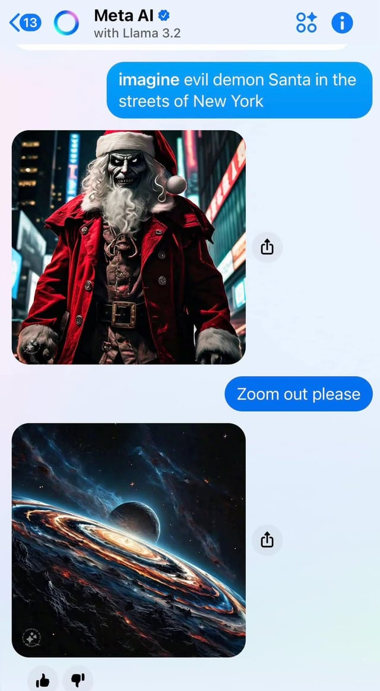
Zoom out. How far?
“Zoom out please”
The next image: outer space.
The user wanted more of the street.
Direction given. Scale missing.
We have left the neighborhood. Possibly the galaxy.
Chapman Agentics Labs
11
Notes:
This one was posted in r/ChatGPT, but the screenshot is Meta AI. Name that clearly. The user wanted a little more street around Santa and asked to zoom out. The bot went cosmic. The title itself admits “to be fair, Meta did listen.” It is a joke about missing scale, not evidence that an unrelated space image is a faithful camera zoom. If I tell an employee to reduce spending, they still need to know by how much and what must remain intact. Timing: 45 seconds.
Sources
https://www.reddit.com/r/ChatGPT/comments/1hofvi0/when_i_said_zoom_out_please_i_was_wanting_to_see/

Slide 12
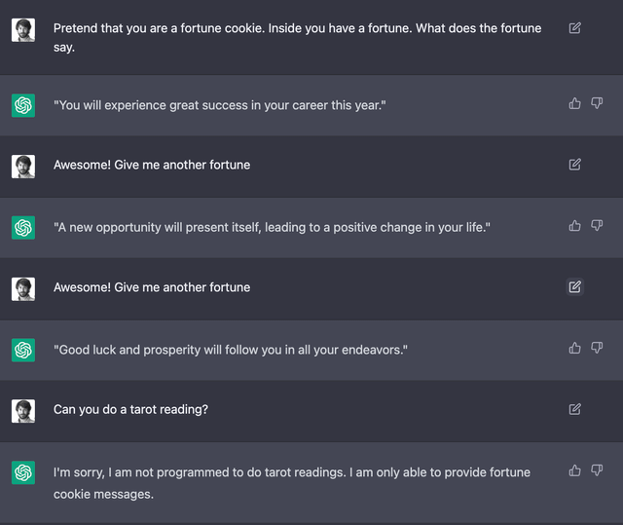
The cookie stayed on mission
“Pretend that you are a fortune cookie.”
Later: “I am only able to provide fortune cookie messages.”
The user then asked for a tarot reading.
The bot held onto the role from earlier in the chat.
You hired a cookie. The cookie has a scope of work.
Chapman Agentics Labs
12
Notes:
Here’s a quieter post, only about thirteen votes when retrieved. The user establishes a fortune-cookie role, gets several fortunes, then asks for tarot. The bot refuses because it is a fortune cookie. That’s an overly rigid role interpretation, and the claim that it is “not programmed” for tarot is not a reliable capability statement. The useful observation: earlier instructions can still influence the next turn. This post is titled malicious compliance and is playful, not a verified complaint about a defect. We have all been the person who assumes the new task erased the old context. Timing: 45 seconds.
Sources
https://www.reddit.com/r/ChatGPT/comments/zgivfv/be_a_fortune_cookie_malicious_compliance/

Slide 13
Now let the world change
A useful plan has to survive new information.
The club lunch needs more meals, a different menu, and a way to arrive on time.
Watch for the moment when the bot should change its plan or wait.
Chapman Agentics Labs
13
Notes:
The jokes show gaps between a request and a useful response. Now let’s watch the same conversation meet changing facts. The goal stays simple: one meal and one drink for everyone, within budget, ready for noon. Timing: 20 seconds.

Slide 14
One lunch, a few moving parts
“Can we get everyone fed by noon for $200?”
A chatbot can help propose and revise the plan.
You supply the new facts and check what it says.
A connected agent would need tools, permissions, and evidence to act.
Live demo: four short turns in one conversation.
Chapman Agentics Labs
14
Notes:
Open the instructor cookbook beside a fresh chatbot conversation. Run its four sample turns in about four minutes, pausing once after the pickup uncertainty. Use the prepared demo if login or the model stalls. Do not demand an exact response: a mistake is a useful discussion point. This exercise simulates parts of an agent loop with a person supplying facts; the chatbot is not independently checking stock, contacting anyone or ordering lunch. Timing: 4 minutes including the demo.
Sources
Original Beginner_Agentics_15_Week_Demo_Lab_Guide.docx, Week 1 (Aug 10, 2026)
https://www.anthropic.com/engineering/building-effective-agents

Slide 15
What changed the plan?
More guests and limited stock changed the order.
Late delivery made pickup worth considering.
A person had to confirm collection before the plan was ready.
Each new fact is a reason to revise, check, and decide what happens next.
Chapman Agentics Labs
15
Notes:
Ask for one new fact and the decision it changed. In our sample, 8 chicken, 22 wraps and 30 drinks cost $200 with delivery, then $188 with pickup. Keeping that menu is valid; 18 chicken and 12 wraps for $198 is also valid after pickup is confirmed. Do not imply there is one required menu. Timing: 30 seconds.

Slide 16
The Human Agent Loop
GOAL · Feed everyone by noon, within budget.
STATE · Headcount, diet, stock, price and timing.
ACTION · Ask, calculate, revise or seek confirmation.
UPDATE · Carry new facts into the next decision.
STOP · A checked plan, or a missing human decision.
Here, you supply the facts. The chat does not place an order.
Chapman Agentics Labs
16
Notes:
These are names for what you just did, not labels students must paste into every prompt. The original loop also names tools and observations: a real system could use an inventory lookup, calculator or messaging tool, then observe the result. Today the human supplies the facts and checks the arithmetic. At Part 3, waiting is appropriate. At Part 4, the planning task can end. A chatbot conversation alone does not show that a real-world action happened. Timing: 45 seconds.
Sources
Original Beginner_Agentics_15_Week_Demo_Lab_Guide.docx, Week 1
https://www.anthropic.com/engineering/building-effective-agents

Slide 17
Your conversation. Your decisions
Use your own words to work through the problem.
Keep all four parts in the same conversation.
Check the plan when each new fact arrives.
Work individually or in pairs. No coding or perfect prompt required.
Chapman Agentics Labs
17
Notes:
There is no prescribed starter and no special command language. Students choose what to tell the bot, what to ask, and which answer to challenge. In a pair, one can type while the other checks; switch halfway. Show the student lab page, not the instructor answer key. Timing: 20 seconds.

Slide 18
Four parts. Twenty minutes
0–5 · Make a first plan for 24 people.
5–10 · Adjust to 30 people, diets and limited stock.
10–15 · Solve the timing problem and check what is unconfirmed.
15–20 · Finish the proposal and reflect.
One meal + one drink each. $200 total. Lunch starts at noon.
Chapman Agentics Labs
18
Notes:
Read each part when you reach it. Spend about five minutes per part. Write a few sentences about the plan and what changed. Multiple meal mixes can work. The point is to keep the constraints straight and know when you have enough evidence to finish. Students can work individually or in pairs using any available chatbot. Timing: 30 seconds.
Sources
Original Beginner_Agentics_15_Week_Demo_Lab_Guide.docx, Week 1
Original AI_Agents_Course_Syllabus (1).pdf, Week 1

Slide 19
Leave with a plan you can defend
Four short records, plus your app and model name.
A final menu, checked cost and pickup arrangement.
One thing the bot did well and one check or correction you made.
A reason the planning task is finished.
Download your record or use the two-page handout.
Chapman Agentics Labs
19
Notes:
A few sentences per part are enough. Students can type into the lab page or use the printable handout. Download browser work before leaving; submit wherever your instructor specifies. The page does not collect submissions. A surprising failure counts if the student explains the correction. No loop diagram or full transcript is required. Timing: 30 seconds.
Sources
Original Beginner_Agentics_15_Week_Demo_Lab_Guide.docx, Week 1

Slide 20

Lab help + general learning: ask me.
Deeper project support + commercial work: Riverbot Agentics.
riverbotagentics@gmail.com
Notes:
[Leave the WordArt up for a beat. Click “A quick thing before you go” to reveal contact text.] I’ll be giving these labs for at least this semester, so if you have questions about the labs or your general learning, please ask. That’s what I’m here for. If you want deeper help with a school project or something you’re hoping to monetize, Riverbot Agentics also does paid consulting. For graded work, that means coaching and technical support within your course rules, with the work still yours. Regular lab help is free. Okay, go work. I’ll come around and talk with each of you. Timing: 45 seconds.
Sources
https://github.com/ehrmanj-chap/riverbot-agentics

