Slide 1
Chapter 4: Intermediate SQL

Slide 2
Chapter 4: Intermediate SQL
Join Expressions
Views
Transactions
Integrity Constraints
SQL Data Types and Schemas
Authorization
Notes:
1

Slide 3
Joined Relations
Join operations take two relations and return as a result another relation.
A join operation is a Cartesian product which requires that tuples in the two relations match (under some condition).
It also specifies the attributes that are present in the result of the join.
The join operations are used in the from clause.

Slide 4


Join operations – Example
Relation course
Relation prereq
select * from course natural join prereq;
  ⇒ prereq information missing for CS-315 and course information missing for CS-437.

Slide 5
Outer Join
Outer join operation → Avoids loss of information.
  Computes the join and then adds tuples form one relation that does not match tuples in the other relation to the result of the join.
  Uses null values.

Slide 6

Natural Left Outer Join
  course natural left outer join prereq

Slide 7

Natural Right Outer Join
course natural right outer join prereq

Slide 8

Natural Full Outer Join
course natural full outer join prereq

Slide 9

Joined Relations
Join operations
  Take two relations and return as a result another relation.
  These additional operations are typically used as subquery expressions in the from clause
Join type
  Defines how tuples in each relation that do not match any tuple in the other relation (based on the join condition) are treated.
Join condition
  Defines which tuples in the two relations match, and what attributes are present in the result of the join.

Slide 10


Joined Relations – Examples
course inner join prereq on course.course_id = prereq.course_id
  “inner” ← Default
course left outer join prereq on course.course_id = prereq.course_id

Slide 11

Views
In some cases, it is not desirable for all users to see all the actual relations stored in the database.
  Consider a person who needs to know an instructors name and department, but not the salary.
  This person should see a relation described, in SQL, by
  select ID, name, dept_name
  from instructor
A view provides a mechanism to hide certain data from the view of certain users.
Any relation that is not of the conceptual model but is made visible to a user as a “virtual relation” is called a view.

Slide 12
View Definition
A view is defined using the create view statement which has the form
  create view v as < query expression >
  <query expression> is any legal SQL expression.
  The view name is represented by v.
Once a view is defined, the view name can be used to refer to the virtual relation that the view generates.
View definition is not the same as creating a new relation
  A view definition causes the saving of an expression.
  The expression is substituted into queries using the view.

Slide 13
Example Views
instructor
A view of instructors without their salary
create view faculty as
select ID, name, dept_name
from instructor
Find all instructors in the Biology department
select name
from faculty
where dept_name = ‘Biology’
Create a view of department salary totals
create view departments_total_salary(dept_name, total_salary) as
select dept_name, sum (salary)
from instructor
group by dept_name;
faculty

Slide 14
Views Defined Using Other Views
create view physics_fall_2009 as
select course.course_id, sec_id, building, room_number
from course, section
where course.course_id = section.course_id
and course.dept_name = ’Physics’
and section.semester = ’Fall’
and section.year = ’2009’;
create view physics_fall_2009_watson as
select course_id, room_number
from physics_fall_2009
where building= ’Watson’;
Expansion!!
create view physics_fall_2009_watson as
(select course_id, room_number
from (select course.course_id, building, room_number
from course, section
where course.course_id = section.course_id
and course.dept_name = ’Physics’
and section.semester = ’Fall’
and section.year = ’2009’)
where building= ’Watson’;

Slide 15
Update of a View
Add a new tuple to faculty view which we defined earlier
insert into faculty values (’30765’, ’Green’, ’Music’);
This insertion must be represented by the insertion of the tuple
(’30765’, ’Green’, ’Music’, null)
into the instructor relation.
create view faculty as
select ID, name, dept_name
from instructor
faculty
instructor

Slide 16

Some Updates cannot be Translated Uniquely
create view instructor_info as
select ID, name, building
from instructor, department
where instructor.dept_name= department.dept_name;
insert into instructor_info values (’69987’, ’White’, ’Taylor’);
  After insert
    select * from instructor_info
      Instructor ‘White’ disappeared!!
create view history_instructors as
select *
from instructor
where dept_name= ’History’;
  insert (’25566’, ’Brown’, ’Biology’, 100000)
  into history_instructors
      Instructor ‘Brown’ disappeared!!

Slide 17
Difficulties in View Updates
Most SQL implementations allow updates only on simple views
The from clause has only one database relation.
The select clause contains only attribute names of the relation
  Do not have any expressions, aggregates, or distinct specification.
Any attribute not listed in the select clause can be set to null
  May cause violation of Entity Integrity Constraints
The query does not have a group by or having clause
  Identifying specific rows becomes impossible
Updates are possible if and only if identifying the target rows becomes possible

Slide 18
Transactions
Unit of work
Atomic transaction
  Either fully executed or rolled back as if it never occurred
Isolation from concurrent transactions
Transactions begin implicitly
  Ended by commit work or rollback work
  But default on most databases, each SQL statement commits automatically
    Can turn off auto commit for a session
    In SQL:1999, can use: begin atomic …. end

Slide 19
begin tran – rollback/commit tran
MS SQLServer
  begin tran
  sql statements
  rollback tran
  commit tran

Slide 20
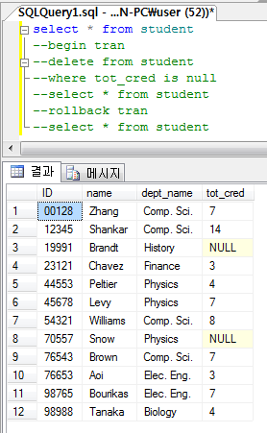
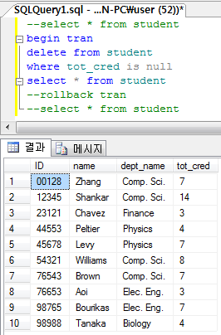
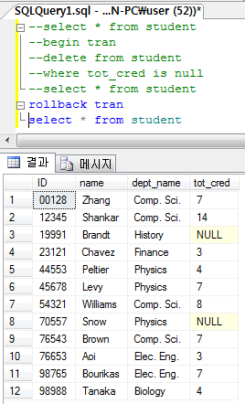
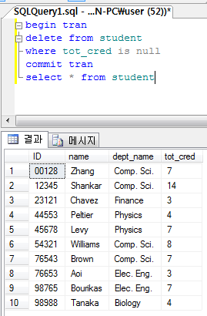
begin tran – rollback/commit tran

Slide 21
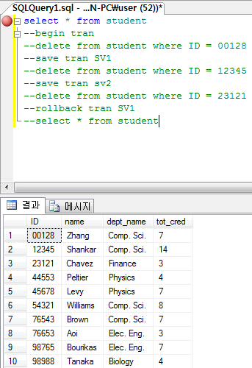
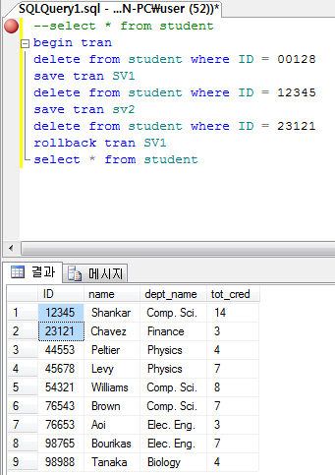
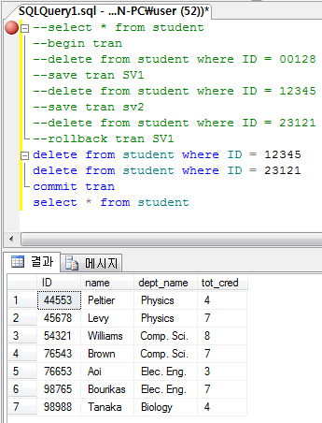
SAVEPOINT & ROLLBACK

Slide 22
Integrity Constraints
Guard against accidental damage to the database
  By ensuring that authorized changes to the database do not result in a loss of data consistency.
  Examples
    A checking account must have a balance greater than $10,000.00.
    A salary of a bank employee must be at least $4.00 an hour.
    A customer must have a (non-null) phone number.

Slide 23
Constraints on Relation
not null
primary key
unique
check (P), where P is a predicate

Slide 24
Not Null Constraint
not null
  Declare name and budget to be not null
name varchar(20) not null
budget numeric(12,2) not null

Slide 25
Unique Constraint
unique ( A₁, A₂, …, A_{m})
  States that the attributes A₁, A₂, … A_{m} form a candidate key.
  Candidate keys are permitted to be null (in contrast to primary keys).

Slide 26
Check Constraint
check (P)
  where P is a predicate
Example: ensure that semester is one of fall, winter, spring or summer:
create table section (
course_id varchar (8),
sec_id varchar (8),
semester varchar (6),
year numeric (4,0),
building varchar (15) not null,
room_number varchar (7),
time slot id varchar (4),
primary key (course_id, sec_id, semester, year),
unique(building, room_number),
check (semester in (’Fall’, ’Winter’, ’Spring’, ’Summer’))
);

Slide 27
Referential Integrity
Ensures that a value that appears in one relation for a given set of attributes also appears for a certain set of attributes in another relation.
  Example: If “Biology” is a department name appearing in one of the tuples in the instructor relation, then there exists a tuple in the department relation for “Biology”.
Never refer any facts that do not exist!!

Slide 28
Cascading Actions in Referential Integrity
create table course (
course_id char(5) primary key,
title varchar(20),
dept_name varchar(20) references department
)
create table course (
…
dept_name varchar(20),
foreign key (dept_name) references department
on delete cascade
on update cascade,
. . .
)
alternative actions to cascade: set null, set default, restrict

Slide 29
Data type: Day and Time
date: Dates, containing a (4 digit) year, month and date
  Example: date ‘2005-7-27’
time: Time of day, in hours, minutes and seconds.
  Example: time ‘09:00:30’ time ‘09:00:30.75’
timestamp: date plus time of day
  Example: timestamp ‘2005-7-27 09:00:30.75’

Slide 30
Data type: User-Defined
create type construct in SQL creates user-defined type
  Add semantics
  create type Dollars as numeric (12,2)
  create table department
  (dept_name varchar (20),
  building varchar (15),
  budget Dollars);

Slide 31
Domains
create domain construct in SQL-92 creates user-defined domain types
create domain person_name char(20) not null
  Add semantics
Types and domains are similar
  Difference: Domains can have constraints, such as not null, specified on them.
  create domain degree_level varchar(10)
  constraint degree_level_test
  check (value in (’Bachelors’, ’Masters’, ’Doctorate’));

Slide 32
Large-Object Types
Large objects (photos, videos, CAD files, etc.) are stored as a large object
blob
  Binary large object is a large collection of uninterpreted binary data
  Whose interpretation is left to an application outside of the database system
clob
  Character large object
  A large collection of character data
When a query returns a large object, rather than the large object itself, a pointer is returned.

Slide 33
Index Creation
create table student (
ID varchar (5),
name varchar (20) not null,
dept_name varchar (20),
tot_cred numeric (3,0) default 0,
primary key (ID)
)
create index studentID on student(ID)

Slide 34
Authorization Specification in SQL
The grant statement is used to confer authorization
grant <privilege list>
on <relation name or view name> to <user list>
<user list> is:
  a user-id
  public, which allows all valid users the privilege granted
  A role (more on this later)
The grantor of the privilege must already hold the privilege on the specified item (or be the database administrator).
Granting a privilege on a view does not imply granting any privileges on the underlying relations.

Slide 35
Privileges in SQL
select: Allows read access to relation, or the ability to query using the view
  Example: grant users U₁, U₂, and U₃ select authorization on the branch relation:
grant select on instructor to U₁, U₂, U₃
insert: The ability to insert tuples.
update: The ability to update using the SQL update statement.
delete: The ability to delete tuples.
all privileges: Used as a short form for all the allowable privileges.

Slide 36
Revoking Authorization in SQL
The revoke statement is used to revoke authorization.
  revoke <privilege list>
  on <relation name or view name> from <user list>
  Example:
  revoke select on branch from U₁, U₂, U₃
<privilege-list> may be all to revoke all privileges the revokee may hold.
If <revokee-list> includes public, all users lose the privilege except those granted it explicitly.
If the same privilege was granted twice to the same user by different grantees, the user may retain the privilege after the revocation.

Slide 37
Roles
create role instructor;
Privileges can be granted to roles:
  grant select on takes to instructor;
Roles can be granted to users, as well as to other roles
  create role student
  grant instructor to Amit;
  create role dean;
  grant instructor to dean;
  grant dean to Satoshi;

Slide 38
Transfer of Privileges
grant select on department to Amit with grant option;
revoke select on department from Amit, Satoshi cascade;
revoke select on department from Amit, Satoshi restrict;

Slide 39
End of Chapter 4

