Slide 1
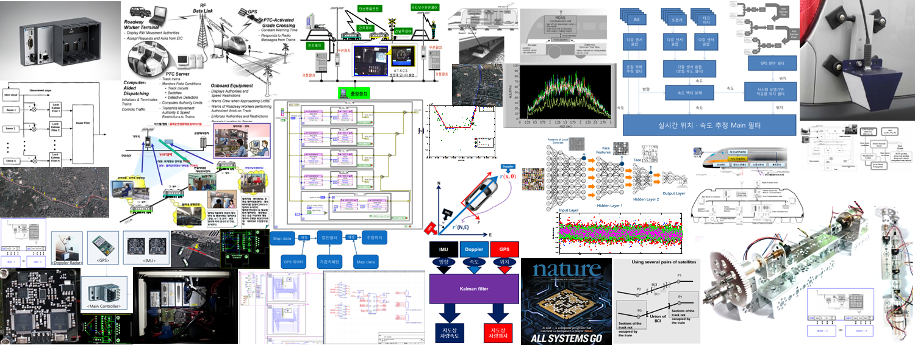


Batch Method for Approx. and Deep Q Network

Slide 2
Brief Review about On-Policy prediction with Approximation

Slide 3
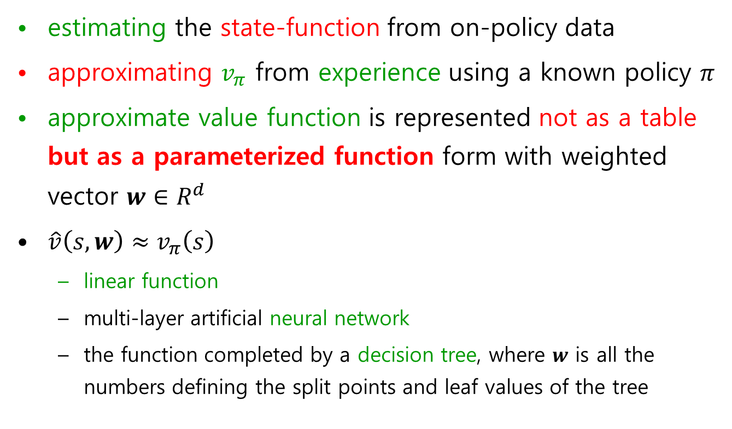
근사함수에 의한 On-policy 예측

Slide 4
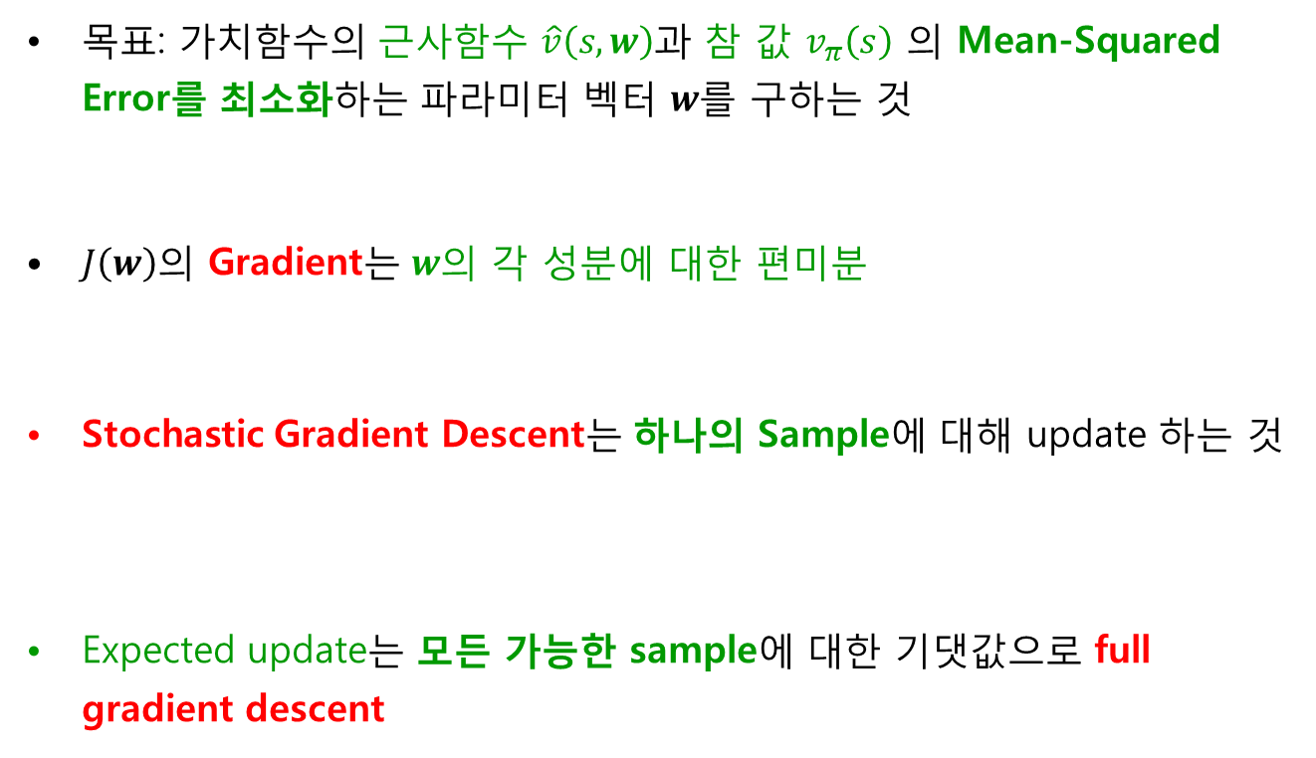
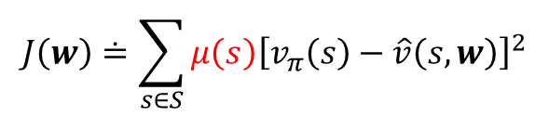


Value function approximation. - Stochastic Gradient Descent

Slide 5
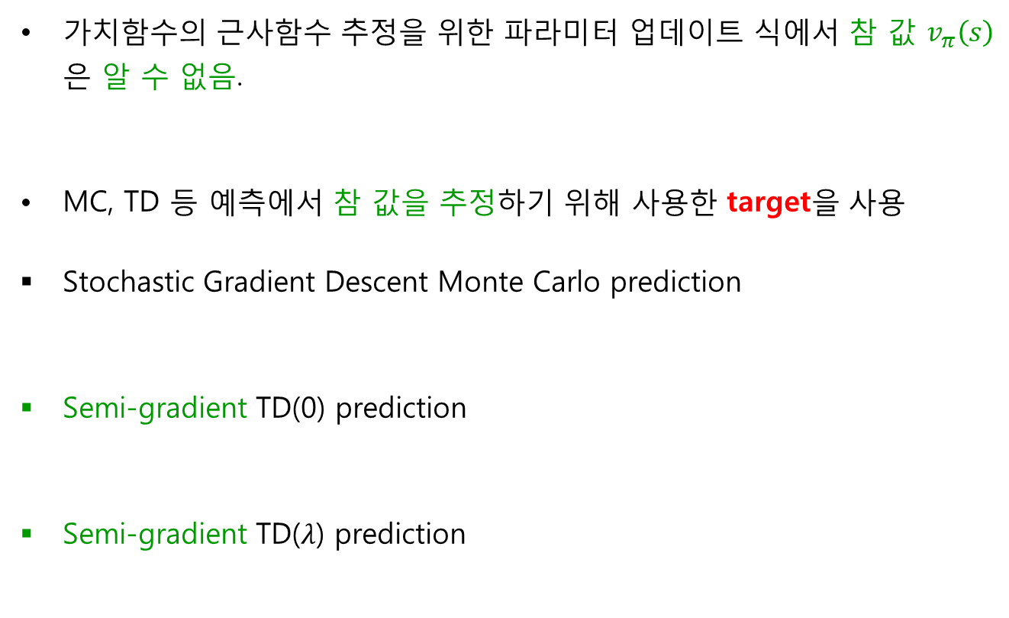



Stochastic Gradient Descent Predictions

Slide 6
Batch method for Approximation: Linear Approximation

Slide 7
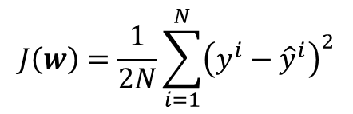

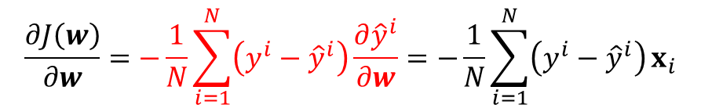
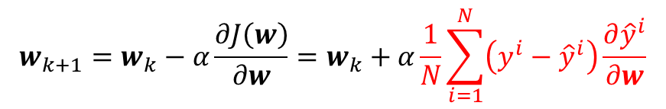
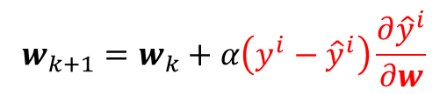
Full Gradient Descent (Batch) and Stochastic Gradient Descent
Linear Regression: simple example
Linear approximation Cost function
Gradient of Cost function
Full(Batch) Gradient Descent
Stochastic Gradient Descent (only one example)
Least Squares
for i in range (N)

Slide 8
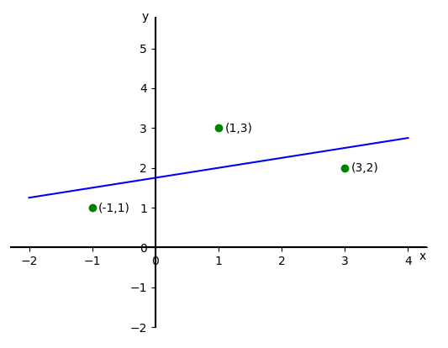
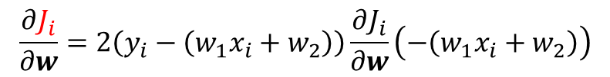

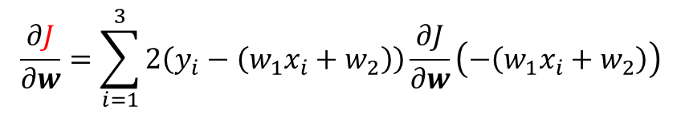
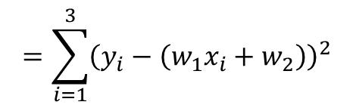


Simple Example
Linear approximation of 3 data pairs:
Full Gradient and Stochastic Gradient of cost function
$$\hat{y}=w_{1}x+w_{2}$$
$$\hat{y}=\left[x 1\right]\left[\begin{aligned}w_{1} \\ w_{2}\end{aligned}\right]$$
$$J\left(w\right)=\sum_{i=1}^{3}{{\left(y_{i}−{\hat{y}}_{i}\right)}^{2}}$$
$$=\sum_{i=1}^{3}{{\left(y_{i}−\left(w_{1}x_{i}+w_{2}\right)\right)}^{2}}$$
$$\frac{∂J}{∂w}=\sum_{i=1}^{3}{2\left(y_{i}−\left(w_{1}x_{i}+w_{2}\right)\right)\frac{∂J}{∂w}\left(−\left(w_{1}x_{i}+w_{2}\right)\right)}$$
Full Gradient
Stochastic Gradient
$$\frac{∂J_{i}}{∂w}=2\left(y_{i}−\left(w_{1}x_{i}+w_{2}\right)\right)\frac{∂J_{i}}{∂w}\left(−\left(w_{1}x_{i}+w_{2}\right)\right)$$

Slide 9
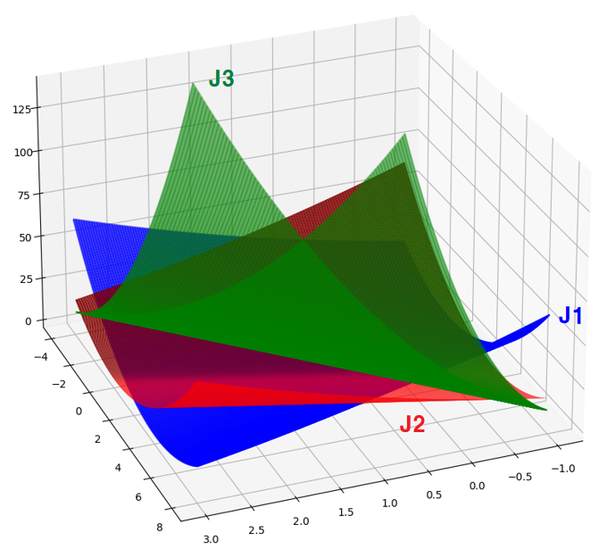
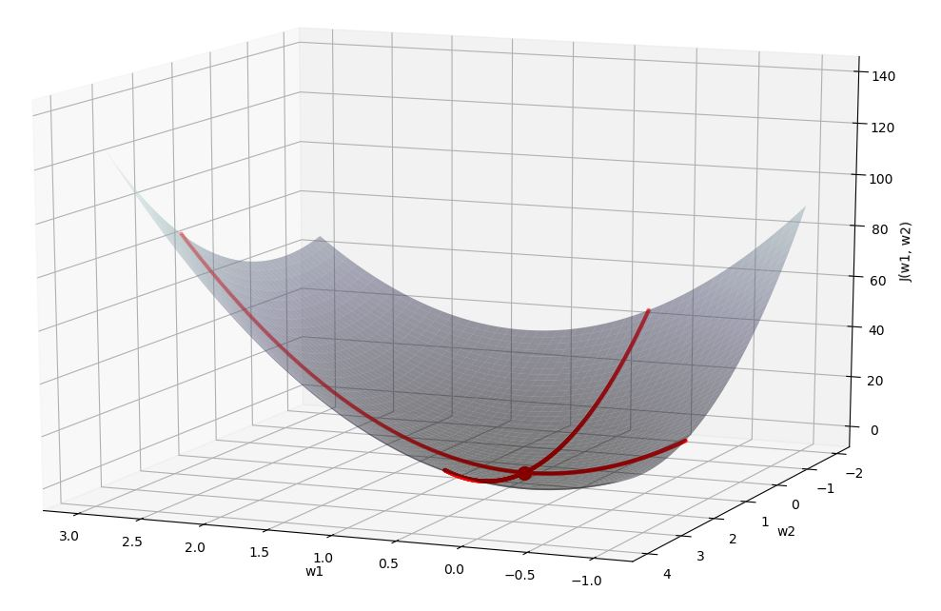
Cost function of Full and Stochastic Grad.
Stochastic Grad. use cost functions individually
Full Grad. use cost function combined

Slide 10
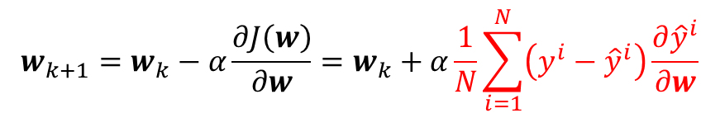
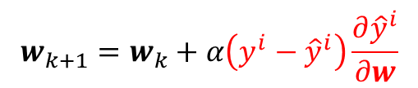
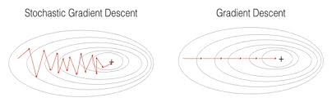
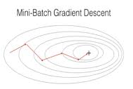
Full Gradient Descent (Batch) and Stochastic Gradient Descent
Full(Batch) Gradient Descent
Stochastic Gradient Descent (only one example)
for i in range (N)

Slide 11
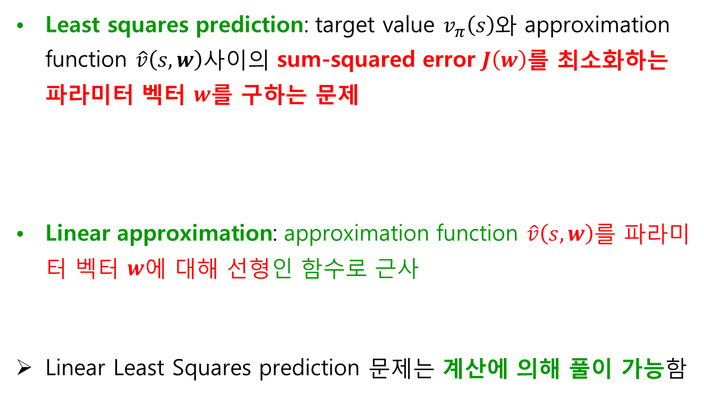
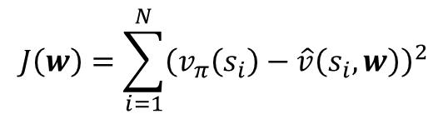

Linear Least Squares Prediction

Slide 12
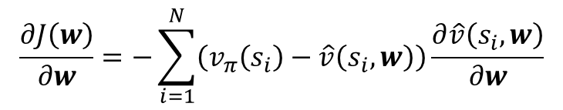
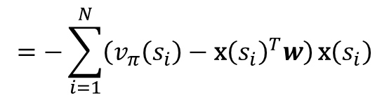
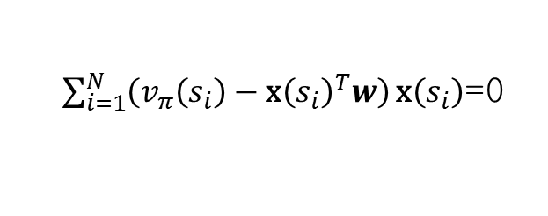
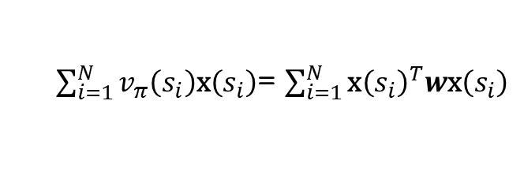
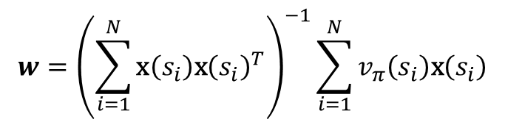
Linear Least Squares Prediction
Gradient for Least squares prediction:
목적함수를 최소화하는 파라미터는 목적함수의 Gradient가 0인 지점임

Slide 13
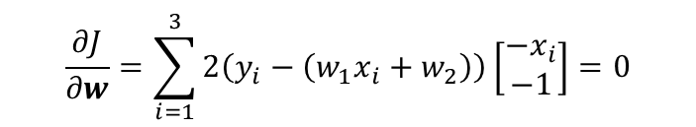

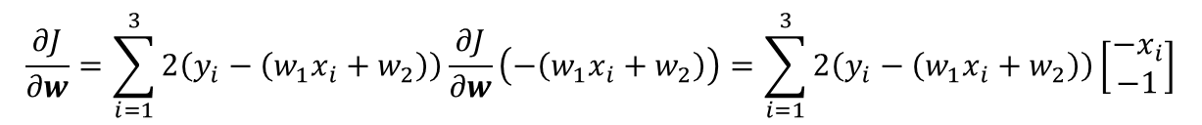
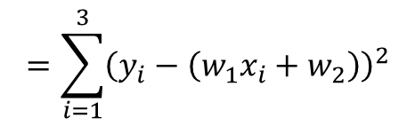


Simple Example of Linear Least Squares
Linear approximation of 3 data pairs:
Gradient of cost function
Cost function의 minimum point는 Gradient가 0이 되는 지점
$$\hat{y}=w_{1}x+w_{2}$$
$$\hat{y}=\left[x 1\right]\left[\begin{aligned}w_{1} \\ w_{2}\end{aligned}\right]$$
$$J\left(w\right)=\sum_{i=1}^{3}{{\left(y_{i}−{\hat{y}}_{i}\right)}^{2}}$$
$$=\sum_{i=1}^{3}{{\left(y_{i}−\left(w_{1}x_{i}+w_{2}\right)\right)}^{2}}$$
$$\frac{∂J}{∂w}=\sum_{i=1}^{3}{2\left(y_{i}−\left(w_{1}x_{i}+w_{2}\right)\right)\frac{∂J}{∂w}\left(−\left(w_{1}x_{i}+w_{2}\right)\right)}=\sum_{i=1}^{3}{2\left(y_{i}−\left(w_{1}x_{i}+w_{2}\right)\right)\left[\begin{aligned}−x_{i} \\ −1\end{aligned}\right]}$$
$$\frac{∂J}{∂w}=\sum_{i=1}^{3}{2\left(y_{i}−\left(w_{1}x_{i}+w_{2}\right)\right)\left[\begin{aligned}−x_{i} \\ −1\end{aligned}\right]}=0$$

Slide 14
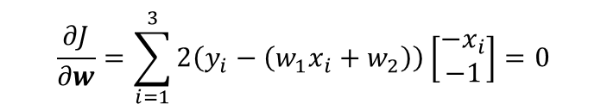
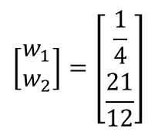

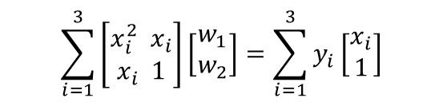
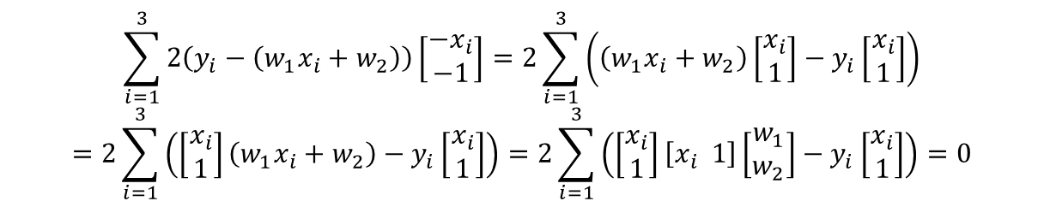
Simple Example of Linear Least Squares
Best approximation parameter는 Cost function을 최소화하는 지점
$$\frac{∂J}{∂w}=\sum_{i=1}^{3}{2\left(y_{i}−\left(w_{1}x_{i}+w_{2}\right)\right)\left[\begin{aligned}−x_{i} \\ −1\end{aligned}\right]}=0$$
$$\sum_{i=1}^{3}{2\left(y_{i}−\left(w_{1}x_{i}+w_{2}\right)\right)\left[\begin{aligned}−x_{i} \\ −1\end{aligned}\right]}=2\sum_{i=1}^{3}{\left(\left(w_{1}x_{i}+w_{2}\right)\left[\begin{aligned}x_{i} \\ 1\end{aligned}\right]−y_{i}\left[\begin{aligned}x_{i} \\ 1\end{aligned}\right]\right)}$$
$$=2\sum_{i=1}^{3}{\left(\left[\begin{aligned}x_{i} \\ 1\end{aligned}\right]\left(w_{1}x_{i}+w_{2}\right)−y_{i}\left[\begin{aligned}x_{i} \\ 1\end{aligned}\right]\right)}=2\sum_{i=1}^{3}{\left(\left[\begin{aligned}x_{i} \\ 1\end{aligned}\right]\left[x_{i} 1\right]\left[\begin{aligned}w_{1} \\ w_{2}\end{aligned}\right]−y_{i}\left[\begin{aligned}x_{i} \\ 1\end{aligned}\right]\right)}=0$$
$$\sum_{i=1}^{3}{\left[\begin{aligned}x_{i}^{2}{ x}_{i} \\ x_{i} 1\end{aligned}\right]\left[\begin{aligned}w_{1} \\ w_{2}\end{aligned}\right]}=\sum_{i=1}^{3}{y_{i}\left[\begin{aligned}x_{i} \\ 1\end{aligned}\right]}$$
$$\left[\begin{aligned}w_{1} \\ w_{2}\end{aligned}\right]=\left[\begin{aligned}\frac{1}{4} \\ \frac{21}{12}\end{aligned}\right]$$
$$\left[\begin{aligned}1+1+9 −1+1+3 \\ −1+1+3 1+1+1 \end{aligned}\right]\left[\begin{aligned}w_{1} \\ w_{2}\end{aligned}\right]=\left[\begin{aligned}−1+3+6 \\ 1+3+2\end{aligned}\right]$$

Slide 15
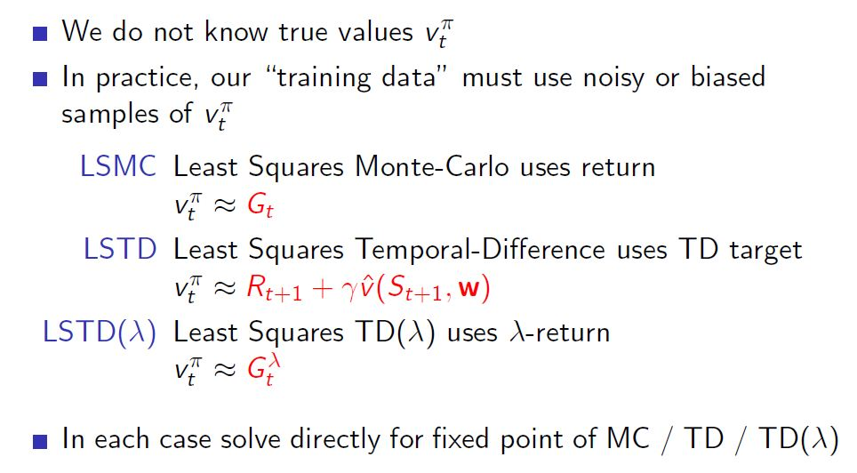
Linear Least Squares Prediction Algorithms

Slide 16
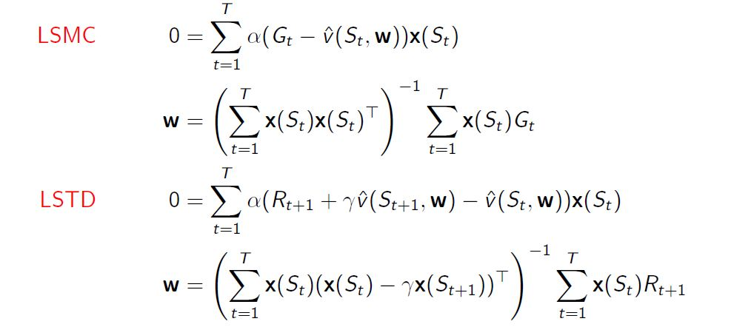
Linear Least Squares Prediction Algorithms

Slide 17
Batch method for Approximation: Non-linear(DNN) Approximation

Slide 18
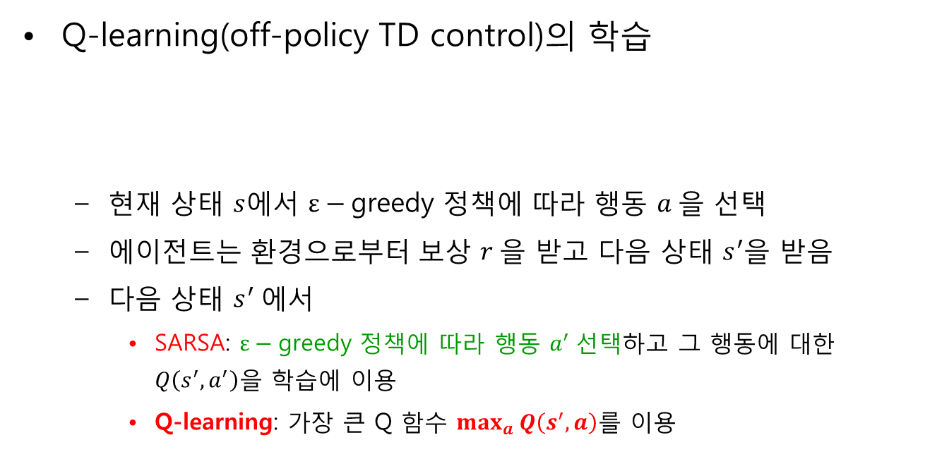
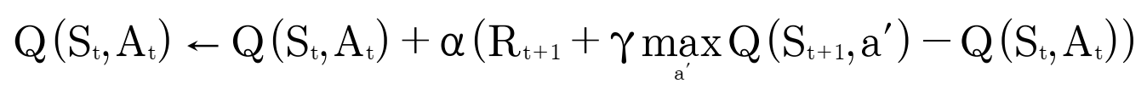
Review: Q-learning

Slide 19
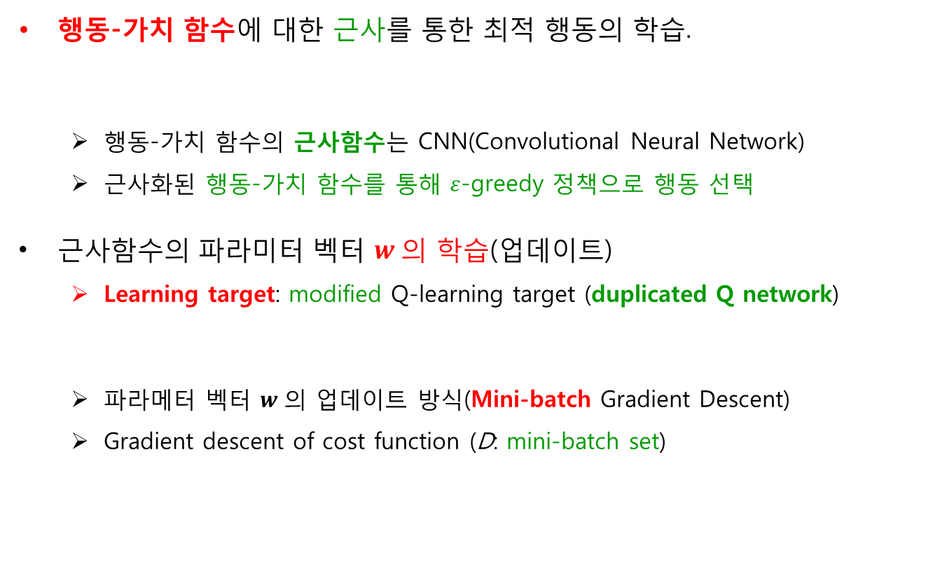


DQN(Deep Q Network)

Slide 20
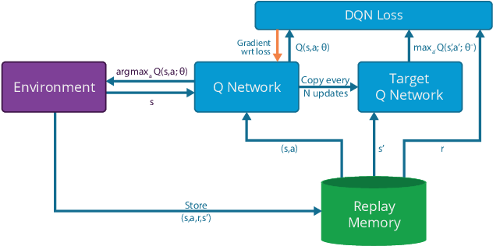
DQN(Deep Q Network) 구조

Slide 21
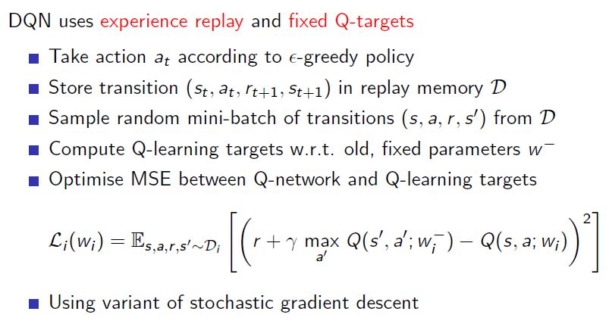
DQN with Experience Replay

Slide 22
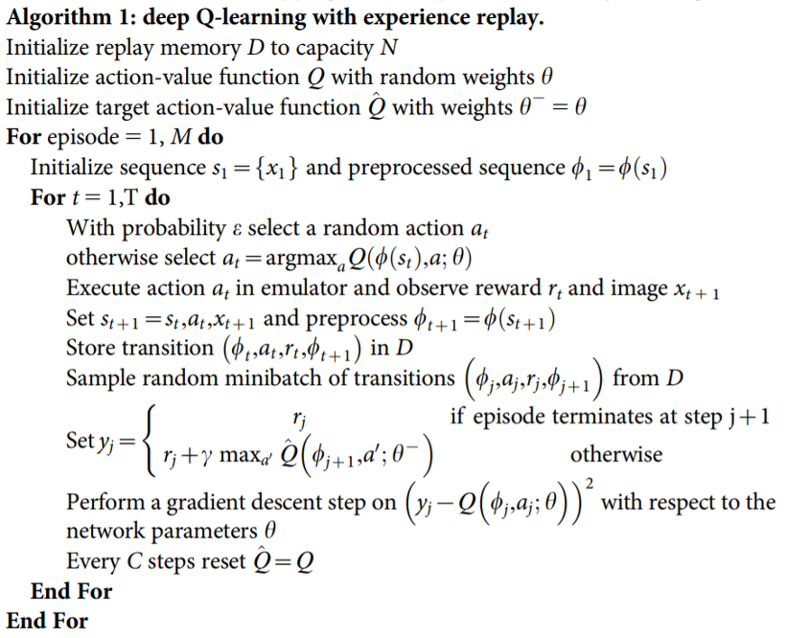
DQN Algorithm

