Slide 1
2D & 3D Transformations

Slide 2
2D Transformations
World Coordinates
Translate
Rotate
Scale

Slide 3
Transformations
Rigid Body Transformations - transformations that do not change the object.
Translate
  If you translate a rectangle, it is still a rectangle
Scale
  If you scale a rectangle, it is still a rectangle
Rotate
  If you rotate a rectangle, it is still a rectangle

Slide 4
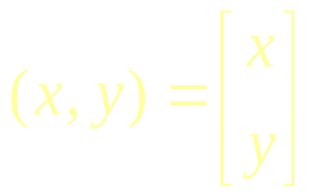
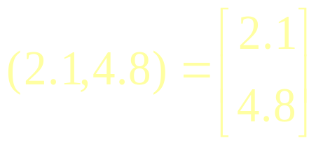
Vertices
We have always represented vertices as (x,y)
An alternate method is:
Example:

Slide 5
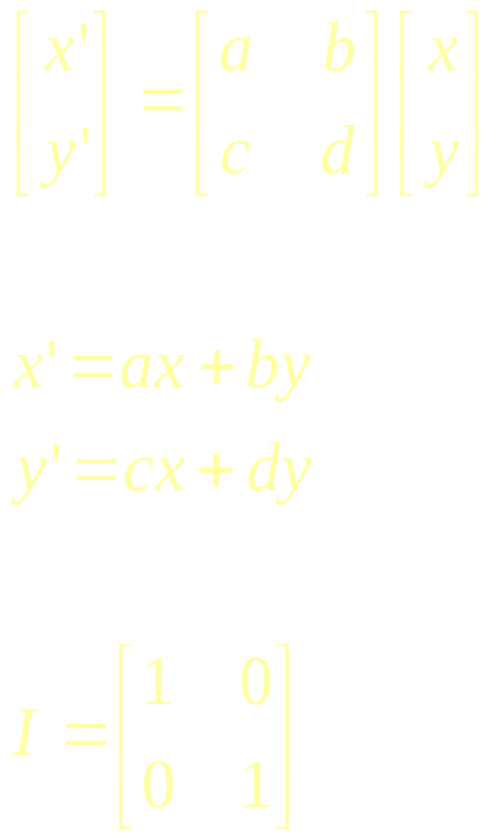
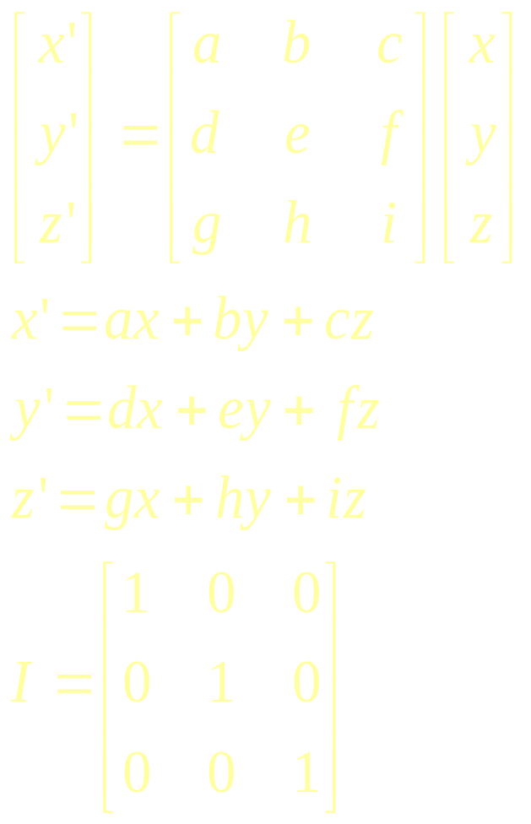
Matrix * Vector

Slide 6
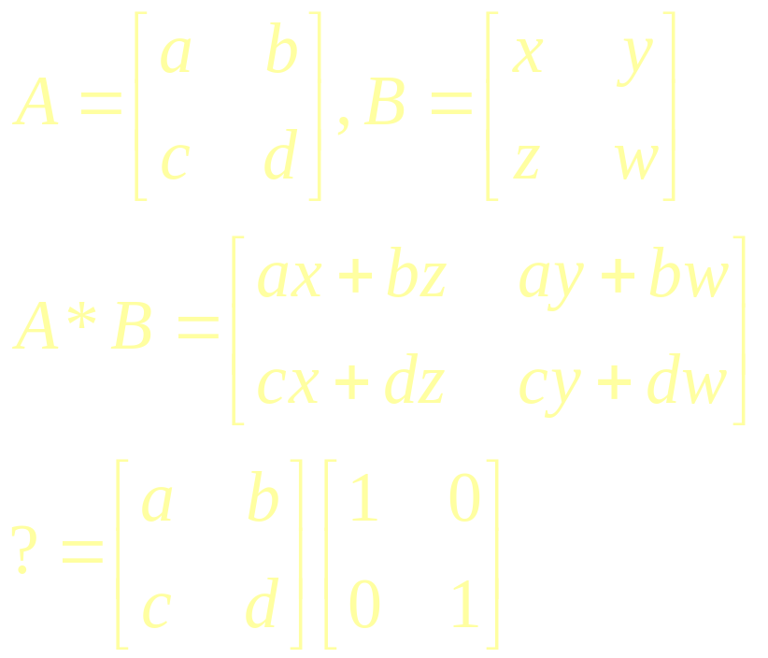
Matrix * Matrix
Does A*B = B*A?
What does the identity do?

Slide 7
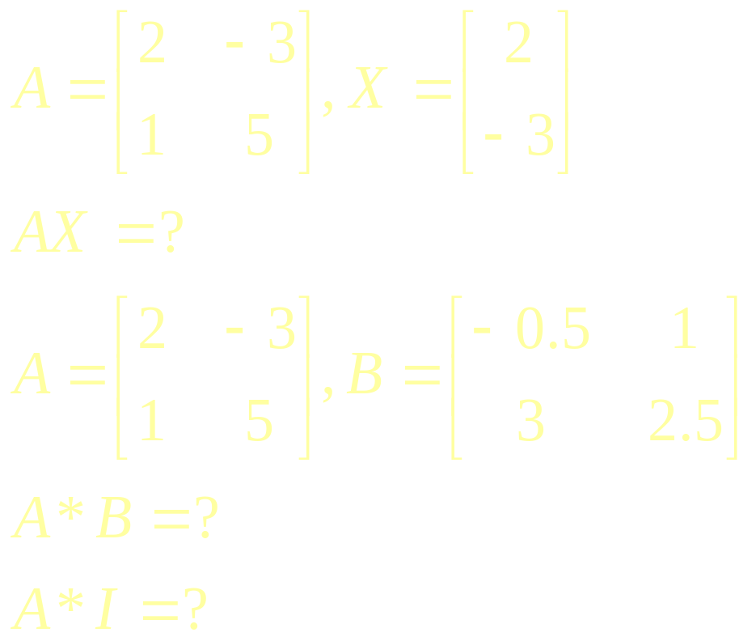
Practice

Slide 8
Translation
Translation - repositioning an object along a straight-line path (the translation distances) from one coordinate location to another.
(x’,y’)
(t_{x},t_{y})
(x,y)

Slide 9
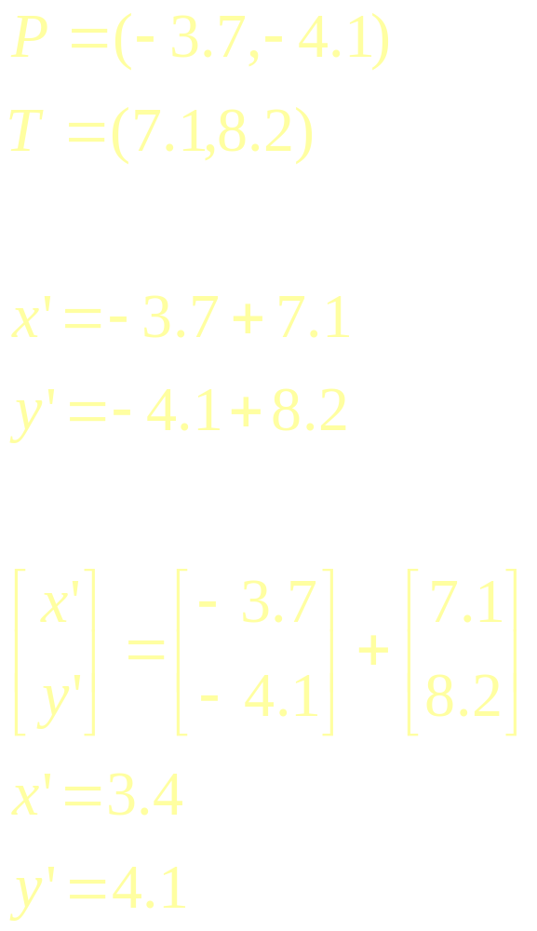
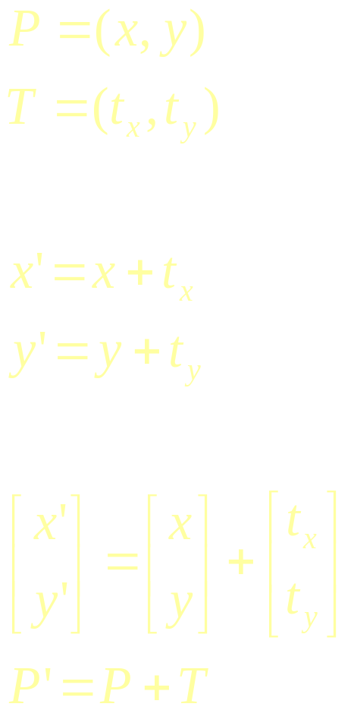
Translation
Given:
We want:
Matrix form:

Slide 10
Translation Examples
P=(2,4), T=(-1,14), P’=(?,?)
P=(8.6,-1), T=(0.4,-0.2), P’=(?,?)
P=(0,0), T=(1,0), P’=(?,?)

Slide 11
Applying to Triangles
(t_{x},t_{y})

Slide 12
Scale
Scale - Alters the size of an object.
Scales about a fixed point
(x’,y’)
(x,y)

Slide 13
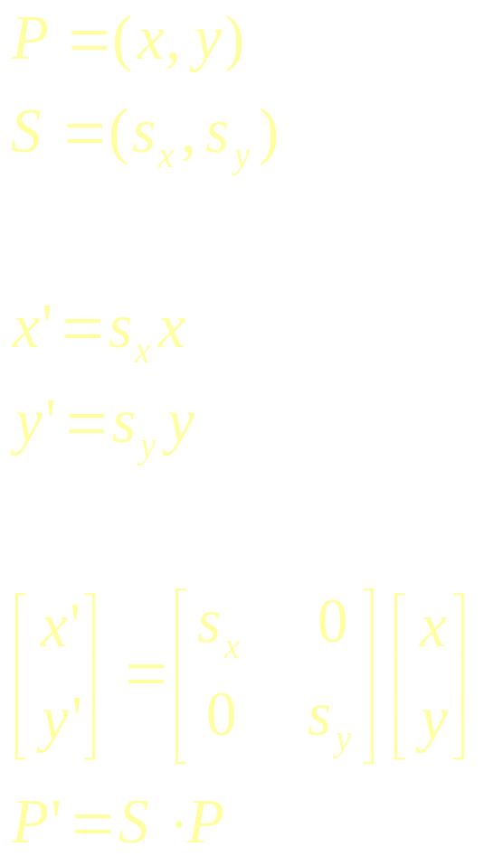
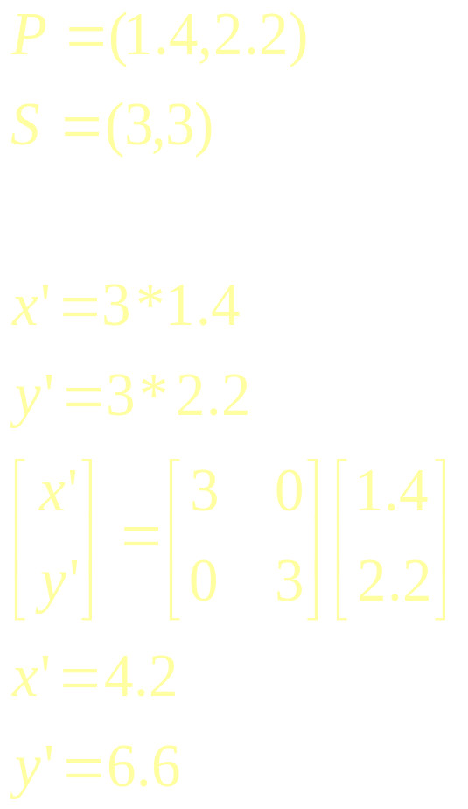
Scale
Given:
We want:
Matrix form:

Slide 14
Non-Uniform/Differential Scalin’
(x’,y’)
(x,y)
S=(1,2)

Slide 15
Rotation
Rotation - repositions an object along a circular path.
Rotation requires an Θ and a pivot point

Slide 16
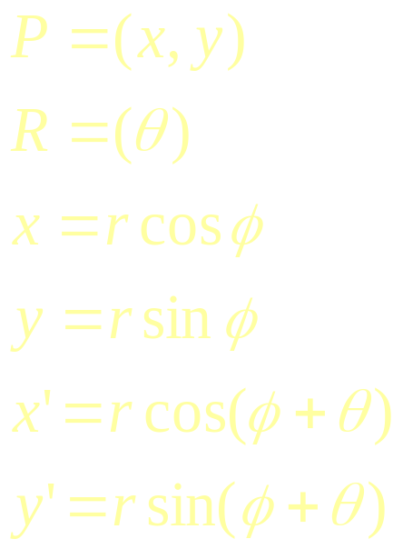
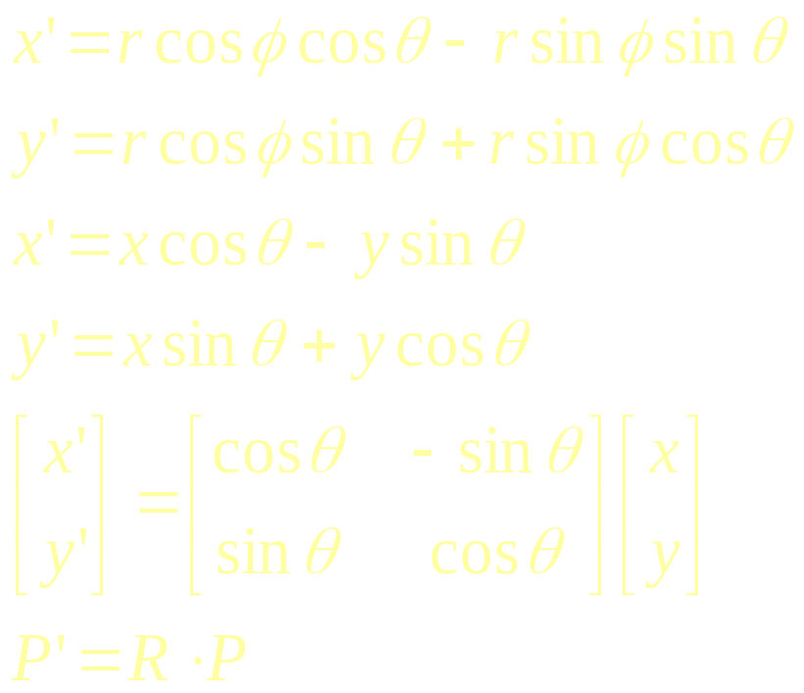
Rotation

Slide 17
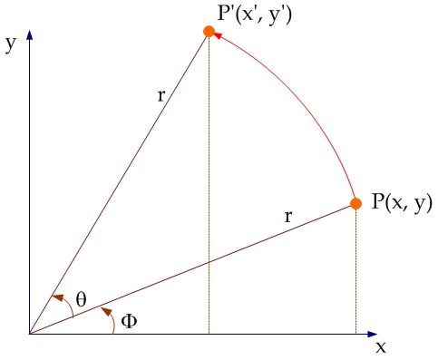
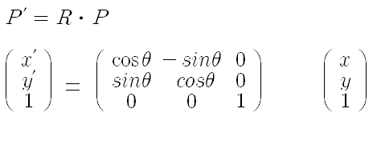
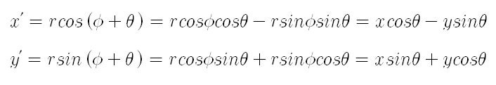
Rotation

Slide 18
Example
P=(4,4)
Θ=45 degrees

Slide 19
Specifying 2D Transformations
Translation
  T(t_{x}, t_{y})
  Translation distances
Scale
  S(s_{x},s_{y})
  Scale factors
Rotation
  R(θ)
  Rotation angle

Slide 20
Combining Transformations
Using translate, rotation, and scale, how do we get:

Slide 21
Combining Transformations
Note there are two ways to combine rotation and translation. Why?

Slide 22
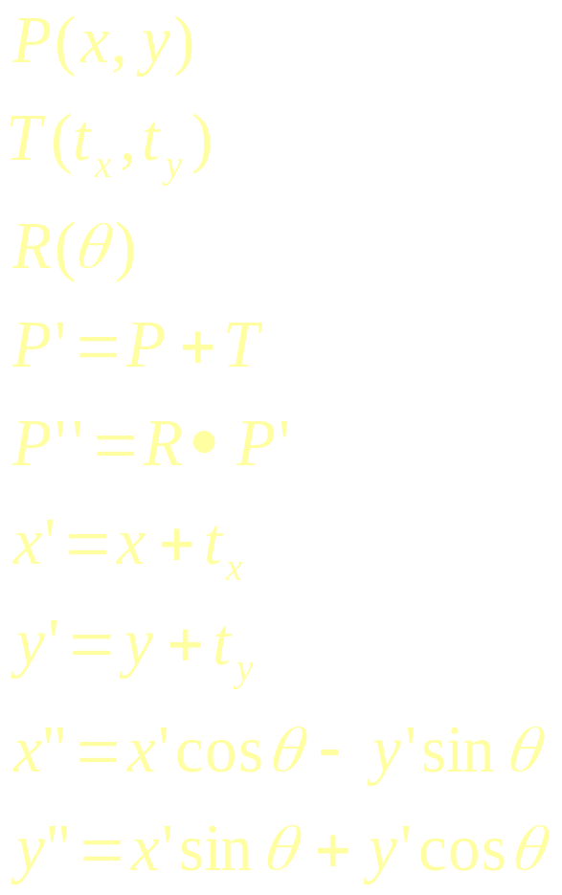
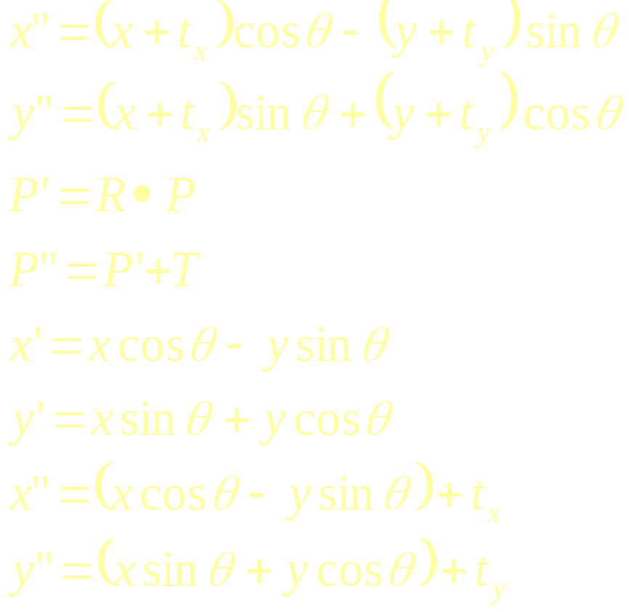
Let’s look at the equations

Slide 23
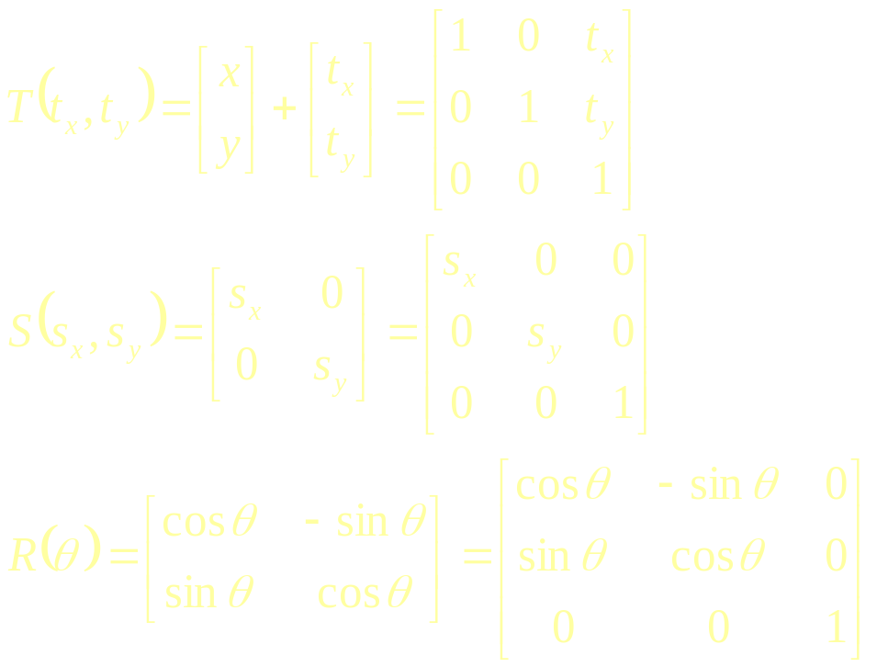
2x2 -> 3x3 Matrices
We can combine transformations by expanding from 2x2 to 3x3 matrices.

Slide 24
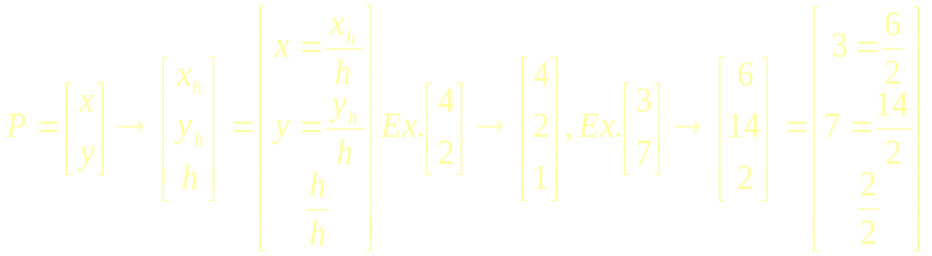
Homogeneous Coordinates
We need to do something to the vertices
By increasing the dimensionality of the problem we can transform the addition component of Translation into multiplication.

Slide 25
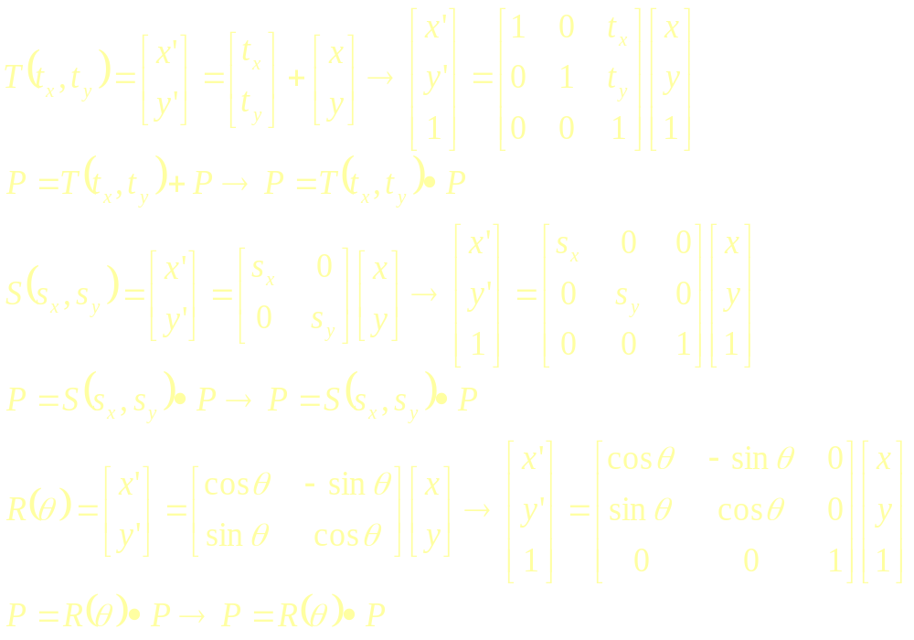
Final Transformations -
Compare Equations

Slide 26
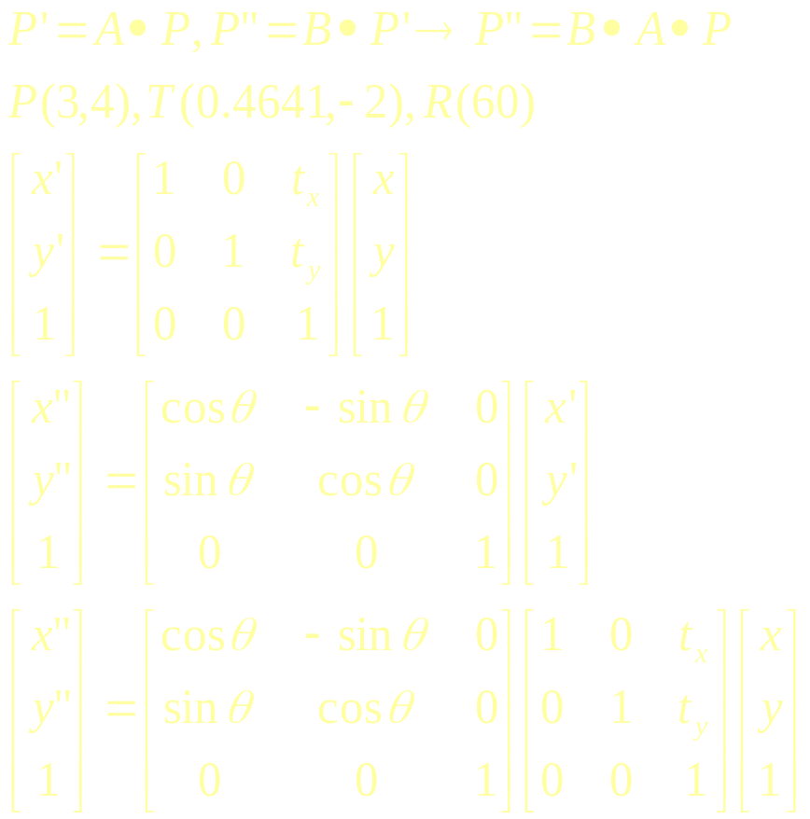
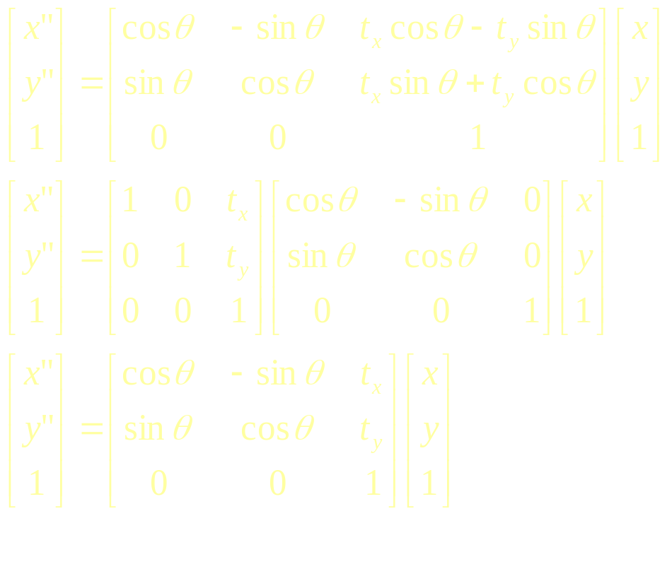
Combining Transformations

Slide 27
How would we get:

Slide 28
How would we get:

Slide 29
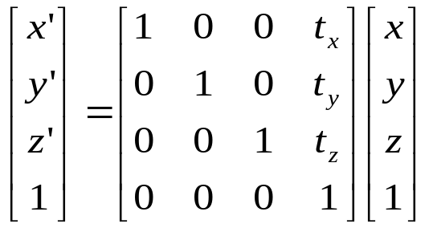
Transformations in 3D!
Translation of a Point
y
x
z

Slide 30
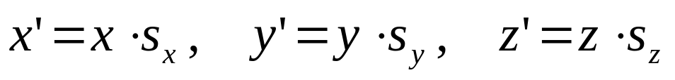
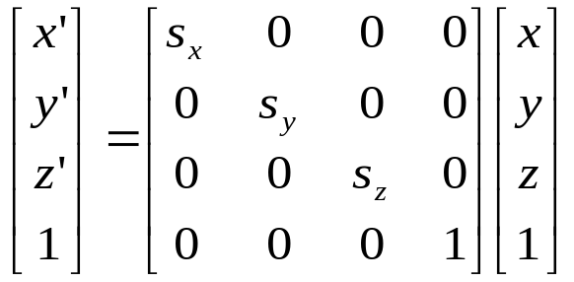
Scaling
Uniform scaling
y
x
z

Slide 31
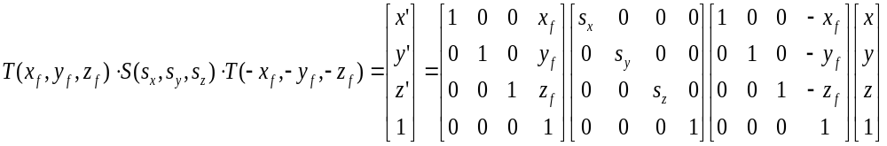
Relative Scaling
Scaling with a selected fixed position
y
y
y
y
z
x
z
x
z
x
z
x
Original position
Translate
Scaling
Inverse Translate

Slide 32
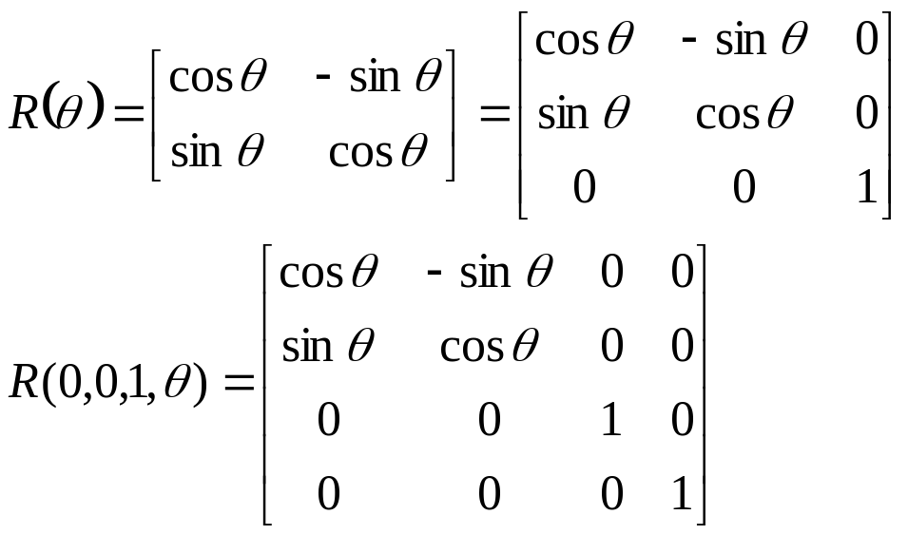
Rotation about Z axis
What do you think the rotation matrix is for rotations about the z axis?
R=(0,0,1,θ)
θ

Slide 33
Cyclic Permutation X-Y-Z-X
Y
Z
X
X
Y
Z
Z
X
Y

Slide 34
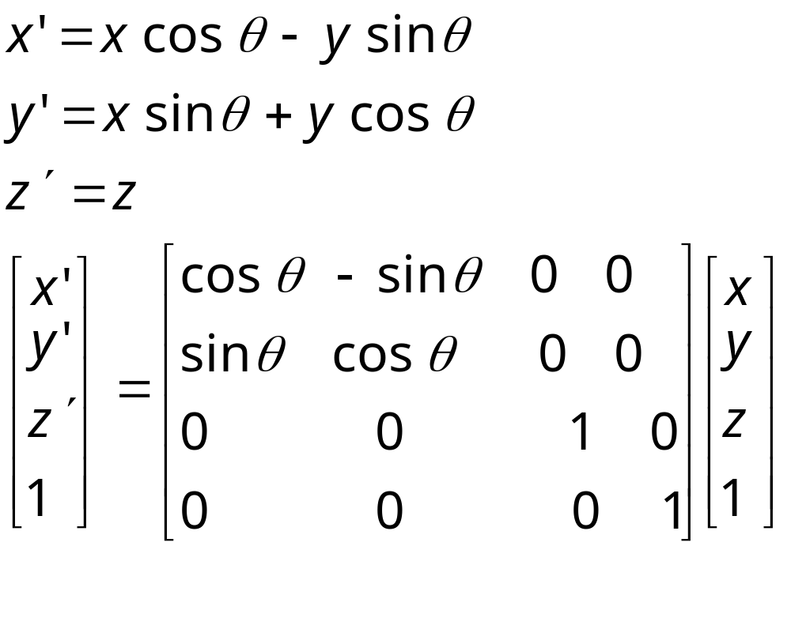
Cyclic Permutation X-Y-Z-X
Rotations about the Z axis

Slide 35
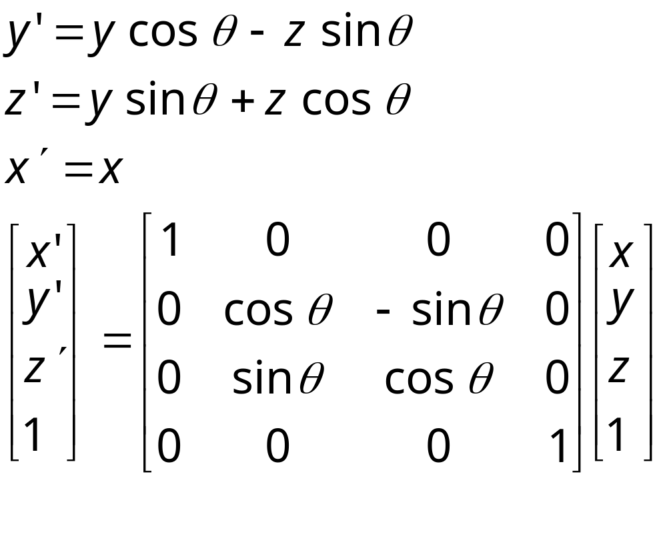
Cyclic Permutation X-Y-Z-X
Rotations about the X axis

Slide 36
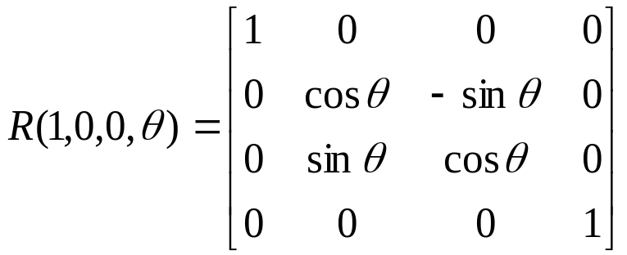
Rotations about the X axis
Let’s look at the other axis rotations
R=(1,0,0,θ)
θ

Slide 37
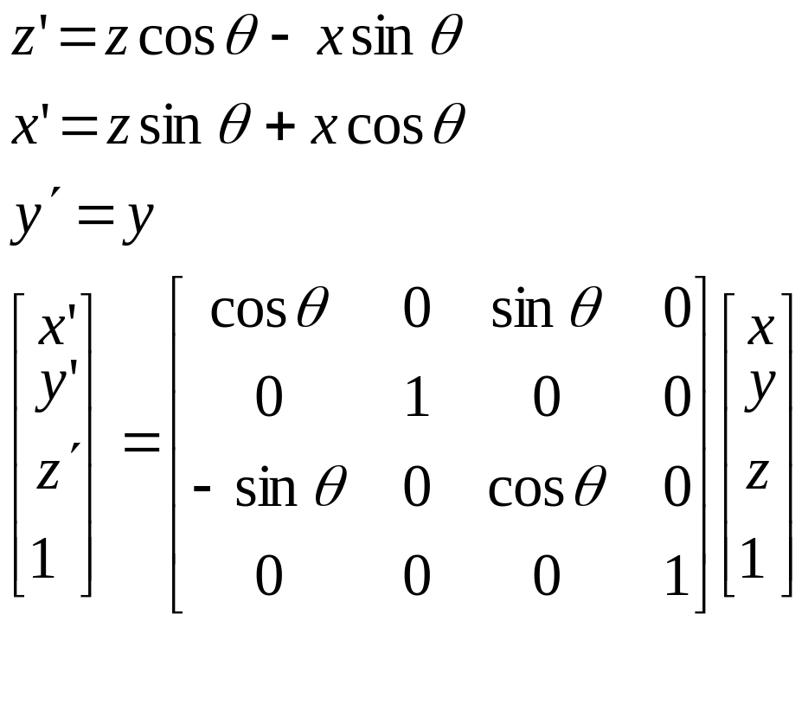
Cyclic Permutation X-Y-Z-X
Rotations about the Y axis

Slide 38
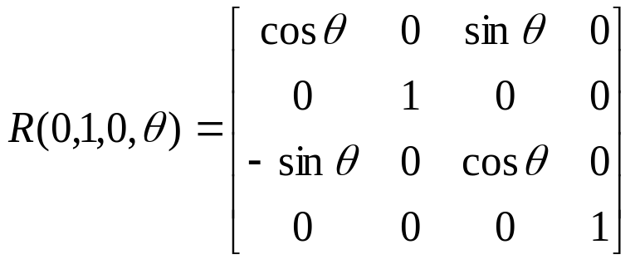
Rotations about the Y axis
R=(0,1,0,θ)
θ

Slide 39
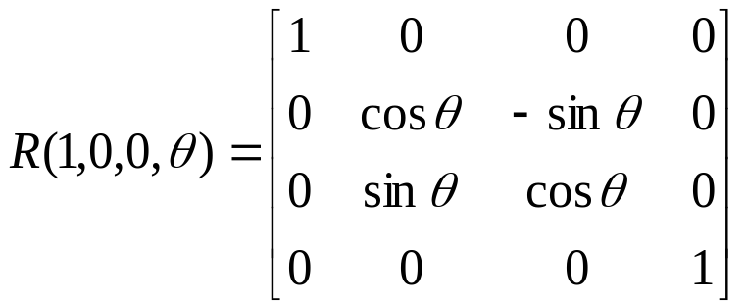

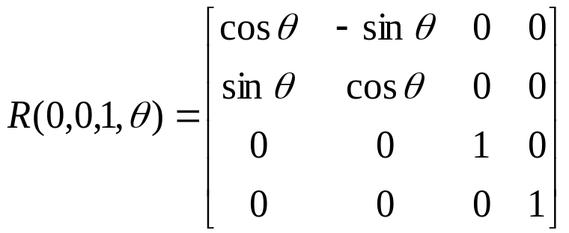
Rotations for an arbitrary axis

Slide 40
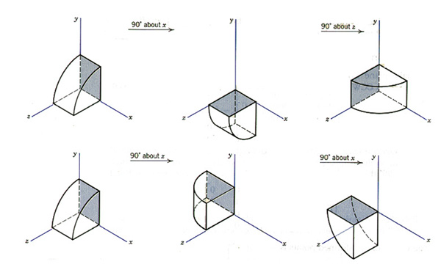
Order of Rotations

