Slide 1



3D Transformations

Slide 2
Right Handed Coordinate System
+Y
+Y
+Z
+X
+X
+Z

Slide 3
Viewing a 3D world
+Y
We have a model in this world and would like to view it from a new position.
We’ll call this new position the camera or eyepoint. Our job is to figure out what the model looks like on the display plane.
+X
+Z

Slide 4
Parallel Projection
+Y
+Z
+X

Slide 5
Perspective Projection
+Y
+Z
+X

Slide 6
Projection Methods
Parallel projection
  입체는 물체의 표면 위에 있는 점들을 평행선을 따라서 관측면 위에 투영하여 표현
  물체 표면의 평행선들은 2차원 평면에서도 평행한 것으로 나타냄
Perspective projection
  멀리 있는 물체가 작게 보이도록 크기를 변화 시키는 투영
  눈이나 사진기가 상을 형성하는 방식

Slide 7


What are some new things to think about?
Hidden Surface Removal
Visibility
Depth Cueing

Slide 8
Depth Cueing
앞면의 line을 뒷면의 line보다 두껍게 그림으로써 강조. 관측자로부터 떨어져 있는 선들의 밝기는 점차로 감소.
Maximum과 minimum intensity(or color) value 선택, Intensity의 다양화로 인한 거리 표현

Slide 9
Model Definition

Slide 10
Transformations

Slide 11
Projection

Slide 12
Different Phases : Projection

Slide 13
Different Phases : Rasterization

Slide 14
Different Phases : Scan Conversion

Slide 15
Graphics Pipeline
Object
Object Coordinates
Modeling
Transformation
World
World Coordinates
Viewing
Transformation
View
View Coordinates
Projection
Screen Coordinates
Rasterization
Scan Converting Triangles

Slide 16
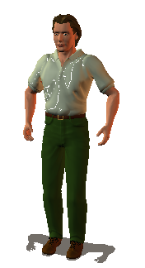
Transformation
Object->World
Translation
Scaling
Rotation

Slide 17
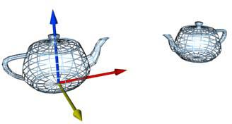

Example : Teapots
A world with two teapots
  1. Create a teapot, and copy it.
  2. Rotate the copy around y-axis by 180o.
  3. Translate it along x-axis

Slide 18
Let’s Examine the Camera
If I gave you a world, and said I want to “render” it from another viewpoint, what information do I have to give you?
  Position
  Which way we are looking
  Which way is “up”
  Aspect Ratio
  Field of View
  Near and Far

Slide 19
Camera
View Right
View Up
View Normal
View Direction

Slide 20
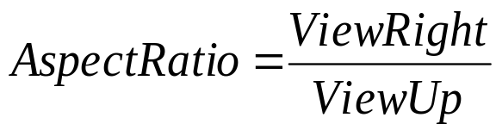

Camera
View Up
View Right

Slide 21
Graphics Pipeline So Far
Object
Object Coordinates
Modeling
Transformation
World
World Coordinates
Viewing
Transformation
View
View Coordinates
Projection
Screen Coordinates
Rasterization
Scan Converting Triangles

Slide 22
Transformation
World->Camera
View Right
View Up
View Normal
View Direction

Slide 23
Graphics Pipeline So Far
Object
Object Coordinates
Modeling
Transformation
World
World Coordinates
Viewing
Transformation
View
View Coordinates
Projection
Screen Coordinates
Rasterization
Scan Converting Triangles

Slide 24
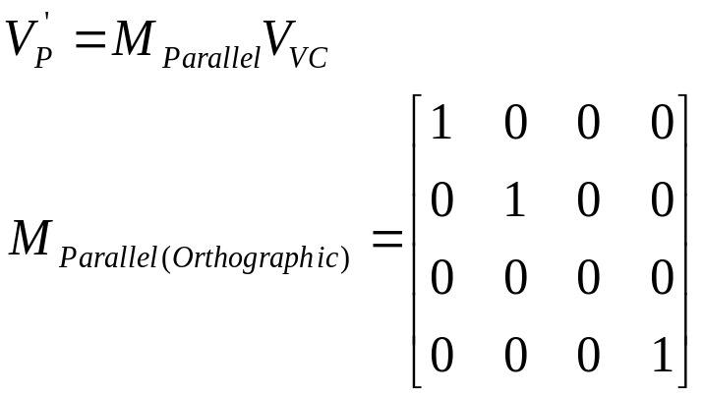
Parallel Projections: Orthographic or Isometric Projection

Slide 25
Parallel Projection

Slide 26
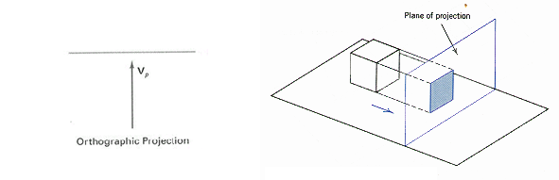
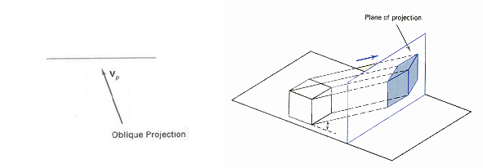
Parallel Projections
Orthographic parallel projection
  the projection is perpendicular to the view plane
Oblique parallel projection
  The projectors are inclined with respect to the view plane

Slide 27
Perspective Projections
foreshortening - the farther an object is from the camera , the smaller it appears in the final image

Slide 28
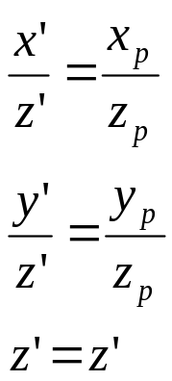
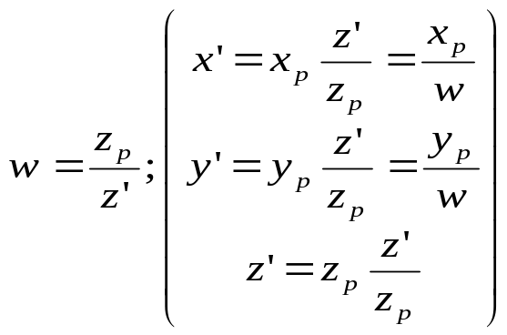
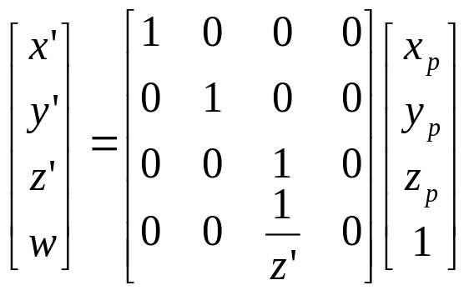
Perspective Projection Side View
P=(x_{p},y_{p},z_{p}) t=0
P’=(x’,y’,z’) t=?
C=(x_{c},y_{c},z_{c}) t=1
x_{p}
x’
z’
z_{p}

