Slide 1
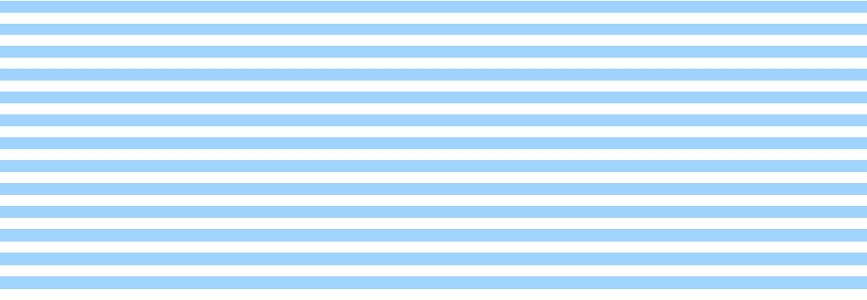

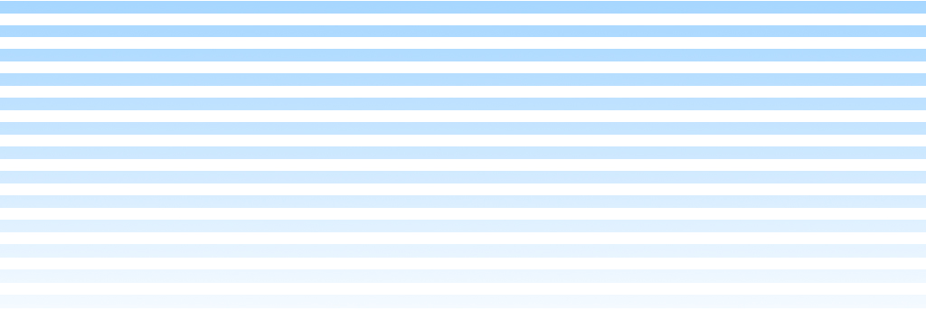
3D Transformations 과제

Slide 2
Graphics Pipeline
Object
Object Coordinates
Transformation
Object -> World
World
World Coordinates
Transformation
World -> Viewport
Viewport
Viewport Coordinates
Clipping
Screen Coordinates
Rasterization
Scan Converting Triangles

Slide 3
Examples
y
(8,16,30)
x
(16,10,30)
(16,0,30)
(0,10,54)
(16,0,54)
z

Slide 4
Projection 결과는?
y
VRP(WC) (0,0,0)
VPN(WC) (0,0,1)
VUP(WC) (0,1,0)
COP(VC) (8,8,100)
Window(VC) (-1,17,-1, 17)
Projection type Parallel
VUP
VRP
(8,16,30)
x
VPN
(16,10,30)
(16,0,30)
(0,10,54)
(16,0,54)
z
COP (8,8,100)

Slide 5
Projection 결과는?
y
VRP(WC) (0,0,54)
VPN(WC) (1,0,0)
VUP(WC) (0,1,0)
COP(VC) (12,8,16)
Window(VC) (-1,25,-5, 21)
Projection type Parallel
(8,16,30)
x
(16,10,30)
(16,0,30)
(0,10,54)
(16,0,54)
z

Slide 6
Projection 결과는?
y
VRP(WC) (0,0,54)
VPN(WC) (0,0,1)
VUP(WC) (0,1,0)
COP(VC) (8,6,30)
Window(VC) (-1,17,-1, 17)
Projection type Perspective
(8,16,30)
x
(16,10,30)
(16,0,30)
(0,10,54)
(16,0,54)
z

