Slide 1
mRNA-based Prostate Cancer Classification
Ehsan Ul Haque

Slide 2
Dataset Description
Series GSE112264
Organism: Homo Sapiens
Platform: GPL21263 3D-Gene Human miRNA V21_1.0.0
Overall Design
The dataset contains serum miRNA profiles of 1591 male samples, consists of –
809 prostate cancer patients
241 negative prostate biopsy patients
41 non-cancer controls
500 other cancer specimens
Urabe F, Matsuzaki J, Yamamoto Y, Kimura T et al. Large-scale Circulating microRNA Profiling for the Liquid Biopsy of Prostate Cancer. Clin Cancer Res 2019 May 15;25(10):3016-3025. PMID: 30808771

Slide 3
Motivation
Prostate cancer is one of the common type of cancer. While some types of prostate cancer grow slowly and may not need only minimal or no treatment, some other types can be very aggressive and can grow quickly.
Prostate cancers that is detected early, has the best chance for successful treatment. However, the high false rate of prostate-specific antigens (PSA) may often lead to negative prostate biopsies, which does not definitively exclude the presence of cancer and often requires further investigation.
A serum miRNA combination could be a powerful predictor for the of patients with prostate cancer.
Urabe F, Matsuzaki J, Yamamoto Y, Kimura T et al. Large-scale Circulating microRNA Profiling for the Liquid Biopsy of Prostate Cancer. Clin Cancer Res 2019 May 15;25(10):3016-3025. PMID: 30808771

Slide 4
Goals and Methodologies
Here are my individual goals:
Comparing Prostate Cancer miRNA and healthy control miRNA, which might help determining the divergences among the groups.
Comparing Negative Biopsy miRNA to healthy control miRNA, to understand the deviation from normal miRNA in the Negative Biopsy miRNA.
Work on training classifiers on detecting prostate cancer and negative prostate biopsies.
Methodologies:
Performing dimension reduction techniques, e.g., PCA and tSNE to understand divergences among groups in lower dimensions.
Performing clustering methods, e.g., kmeans to see whether clusters can be generated based on the data

Slide 5
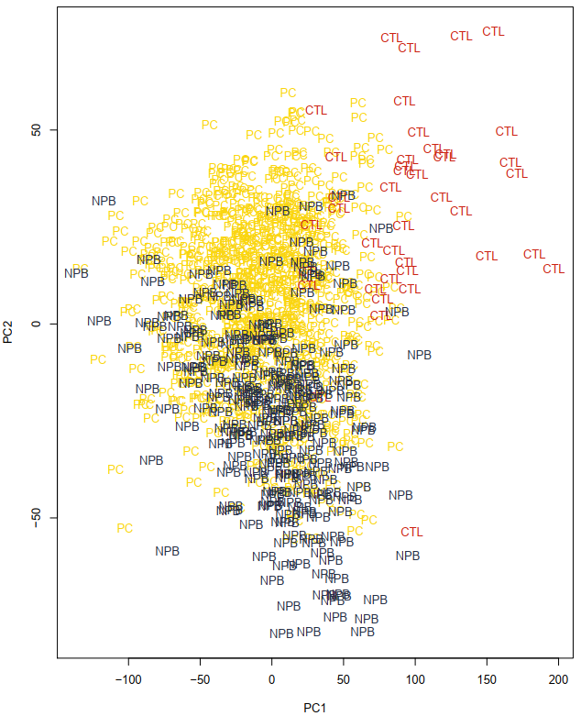
Preliminary Results
PCA: prostate cancer vs. negative biopsies vs. healthy control
PC: Prostate Cancer
NPB: Negative Prostate Biopsies
CTL: Healthy Control
Observation: PC and NPB overlapped, however, CTL shows segregation from both.

Slide 6
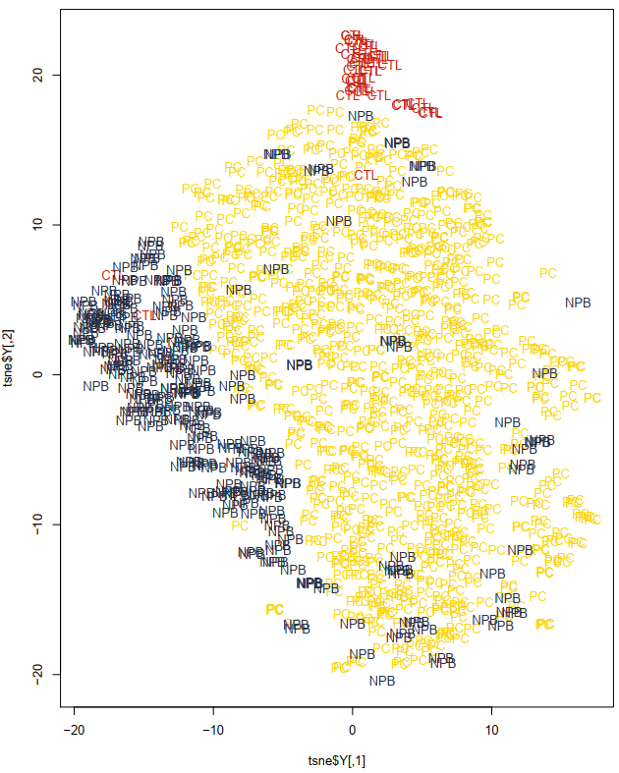
Preliminary Results
tSNE (perp: 40, max_iter: 1000): prostate cancer vs. negative biopsies vs. healthy control
PC: Prostate Cancer
NPB: Negative Prostate Biopsies
CTL: Healthy Control
Observation: All three groups shows visible separation among each others

Slide 7
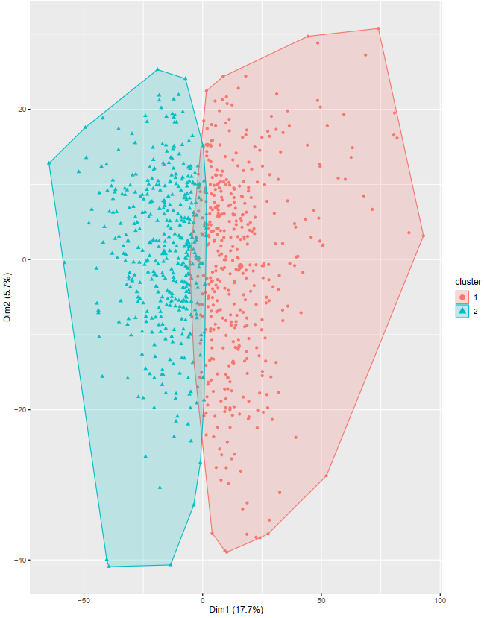
Preliminary Results
Kmeans: data with prostate cancer and healthy control patients only
Observation: Clusters overlap with each other, max silhouette value found for 2 clusters with a value < 0.1

Slide 8
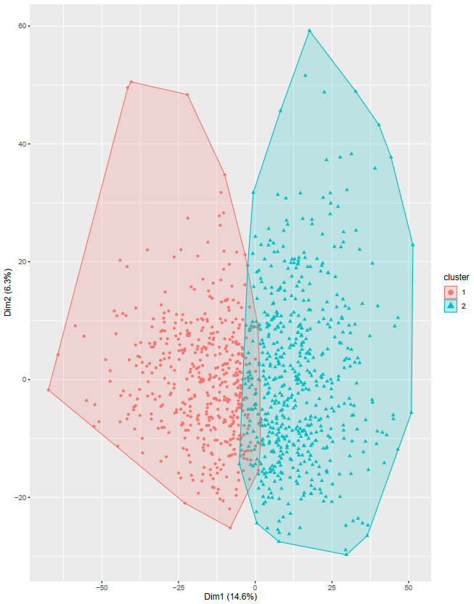
Preliminary Results
Kmeans: data with prostate cancer and negative biopsies patients only
Observation: Clusters overlap with each other, max silhouette value found for 2 clusters with a value < 0.1

Slide 9
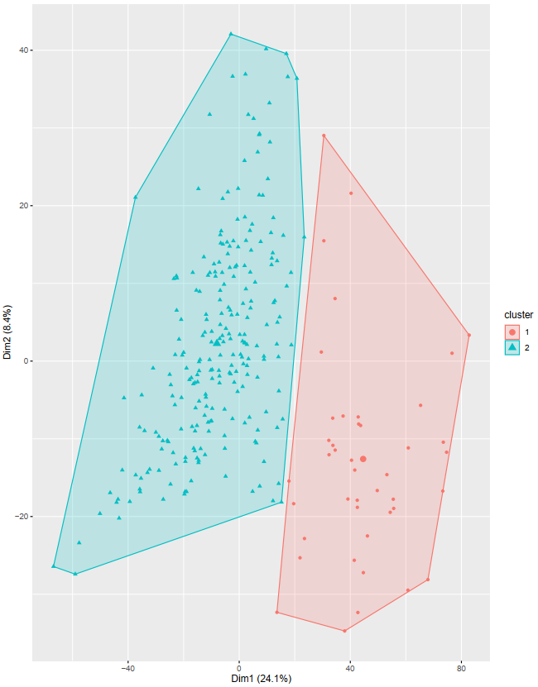
Preliminary Results
Kmeans: data with healthy control and negative biopsies patients only
Observation: Clusters showed clear segregation, max silhouette value found for 2 clusters with a value > 0.25

Slide 10
Expectations
tSNE shows support for divergences in features among prostate cancer, NPB, and control patients.
Kmeans clustering results show that miRNA serums are clustered distinctively for NPB and control data.
From the results, we expect good performance from a classifier trained on the data containing prostate cancer, control and NPB.

Slide 11
Classification
3 binary classifiers for the below sets -
Prostate Cancer Vs Control
Prostate Cancer Vs Negative Biopsies
Negative Biopsies Vs control
Algorithm:
KNN
Random Forest
Evaluation Metric: Accuracy
Repeated cross validation - 10 fold 10 repeats each
Train/test split - 75%/25%

Slide 12
Classification Results
Prostate Cancer (N = 809) Vs Control (N = 41)
Imbalance resolution: Up samling of the data
KNN: Best model for k = 4
Train Accuracy: 99.8% (cross validation)
Prediction Accuracy: 99.53%
Random Forest: Best model for mtry = 7
Train Accuracy: 99.8% (cross validation)
Prediction Accuracy: 98.58%

Slide 13
Classification Results
Prostate Cancer (N = 809) Vs Negative Biopsy (N = 241)
Imbalance resolution: Both Up and Down sampling of the data
KNN (Up sampled): Best model for k = 1
Train Accuracy: 69.5% (cross validation)
Prediction Accuracy: 73.2%
Random Forest (Up sampled): Best model for mtry = 10
Train Accuracy: 95.3% (cross validation)
Prediction Accuracy: 94.27%
Random Forest (Down sampled): Best model for mtry = 10
Train Accuracy: 98.3% (cross validation)
Prediction Accuracy: 98%

Slide 14
Classification Results
Negative Biopsy (N = 241) Vs Control (N = 41)
Imbalance resolution: Up sampling of the data
KNN (Up sampled): Best model for k = 2
Train Accuracy: 98.9% (cross validation)
Prediction Accuracy: 98.6%
Random Forest (Up sampled): Best model for mtry = 2
Train Accuracy: 99% (cross validation)
Prediction Accuracy: 98.5%

Slide 15
Findings – Data Mining Results
Takeaways:
mRNA based classification works fairly well for spearting prostate cancer patients from negative biopsies which can improve early detection of prostate cancer, which is crucial for successful treatment.
Accuracy of detecting negative biopsy patients from healthy individuals was also found very good, which may enable early detection and chance for close observation for further development of prostate cancer.

