Slide 1
Master Thesis Proposal Presentation Sentiment Analysis of Social Media Content in the Context of Learning Environments
Seyed Ehsan Badakhshan
Student of M.Sc. Media Informatics RWTH Aachen University
Ehsan.badakhshan@rwth-aachen.de
Supervisor
Anas Abdelrazeq
06.10.2015

Slide 2
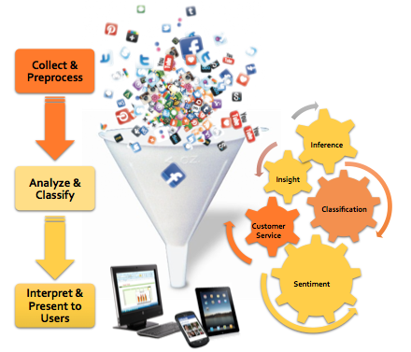
Overview
Introduction
Sentiment Analysis
Related works
Social Media Sentiment Analysis
Conclusion
Proposed Timetable
Literature
metavana.com/exchange/sites/default/files/technology_0.png

Slide 3
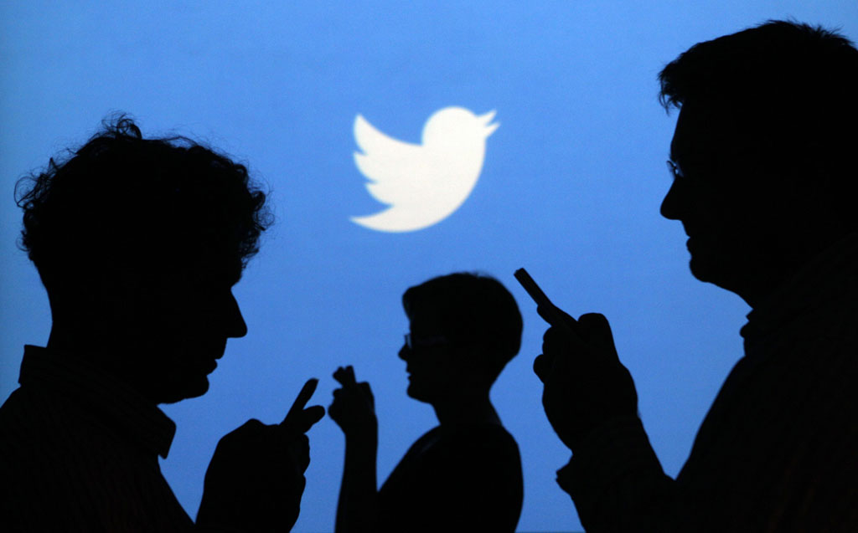
Introduction
Nowadays, social media platforms such as Twitter and Facebook are popular microblogging services.
They allow countless number of users to create and exchange unlimited number of content (called tweets in Twitter and status update in Facebook).
New sources of people’s opinions on different topics
Extracting and analyzing these opinions with
the help of Sentiment Analysis
https://www.enca.com/technology/twitter-listening-data-mining-gnip-and-fabled-firehose

Slide 4

Sentiment Analysis
Definition:
“Sentiment analysis, also called opinion mining, is the field of study that analyzes people’s opinions, sentiments, evaluations, appraisals, attitudes, and emotions towards entities such as products, services, organizations, individuals, issues, events, topics, and their attributes” [13].
Computational study of opinions, sentiments and emotions expressed in texts.
https://datafloq.com/read/sentiment-analytics-no-brainer-organisations/145

Slide 5

Sentence example:
I love this book
It is a terrible movie
I am commuting to work
Most of works in sentiment analysis research area focus on classifying texts according to their sentiment polarity.

Slide 6
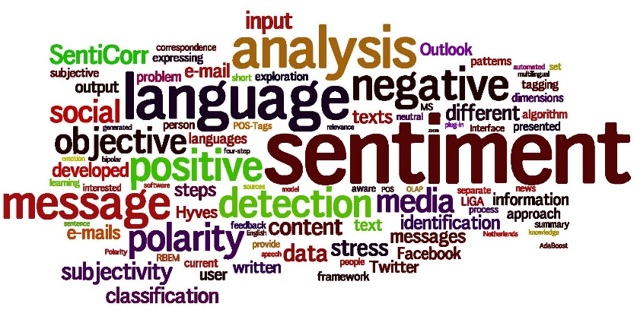
Related works
One of the first works that used the term ‘‘sentiment analysis’’
analyzing messages written in stock boards in order to extract the market sentiment (Das & Chen,2001).
Other application areas:
Recommendation systems (Tatemura, 2000).
Flame detection (Spertus, 1997).
Sensitive content detection for advertising (Jin, Li, Mah, & Tong, 2007).
Human–computer interaction (Liu, Lieberman, & Selker, 2003).
Business Intelligence (Mishne & Glance, 2006)
Prediction of hostile or negative sources (Abbasi, 2007).
Classification of citizens’ opinions on a law before its approval: ‘‘eRuleMaking’’ (Cardie, Farina, Bruce, & Wagner, 2006).
Broadcasting based on the receiver sentiment (Rogers, 2003).
Dynamic adaptation of daily tools, such as e-mail
(Carro, Ballesteros, Ortigosa, Guardiola, & Soriano, 2012).
Marketing or politics (Feldman, 2013).

Slide 7
Related works
Sentiment analysis on social networks
Movie reviews (Pang et al., 2002).
Twitter Sentiment Analysis
Twitter as a Corpus for Sentiment Analysis and Opinion Mining (Pak, et al., 2012).
Sentiment Analysis and Opinion Mining of Microblogs (Shah, et al., 2013)
Sentiment Analysis of twitter data (Agarwal, et al., 2011)
Twitter Sentiment Analysis: The good the bad and the OMG!(Kouloumpis, et al., 2011).
Twitter sentiment classification using distant supervision (Go, et al. 2009).
Facebook Sentiment Analysis
Sentiment analysis in Facebook and its application to e-learning (Ortigosa, et al., 2014)

Slide 8

Related works
Preprocessing
Tweets are informal sentences that have to pass through a filtering stage before it can be processed for up coming steps.
Switch all text to lowercase ( HELLO → hello)
Remove hyperlinks
Remove special characters (#,RT, @, … )
Dictation correction ( luv → love, hapyyyy → happy)
Remove extra spaces and punctuation marks
Remove stop words (a - about - too - so - ... )
…

Slide 9
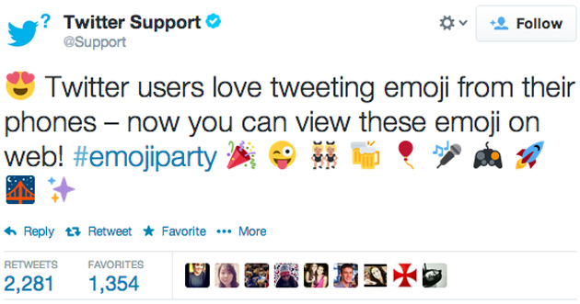
Related works
Feature selection
Features are the sentence properties that are getting analyzed in an attempt to correlate it to the tweet sentiment.
Emoticons
Hashtags
N-grams
Retweets
Part of speech (POS) tags
…
http://o.aolcdn.com/hss/storage/adam/6ec5370df98908cbcc6a7be0c6dd72ed/twitter-emoji-web.jpg

Slide 10
Related works
Sentiment analysis classification techniques
main
approaches
Machine-learning methods lexicon-based approach
Supervised classifiers:
Support Vector Machine (SVM)
Maximum Entropy
Naïve Bayes
Analyzing the text grammar

Slide 11
Social Media Sentiment Analysis
The focus of this master thesis is in the context of education, just the tweets related to university learning environment is important.
According to the pilot research Sentiment Analysis of Social Media for Evaluating Universities, the process of sentiment analysis consists of three general phases:
Data collection,
Data Processing,
Test and evaluation.
Data collection :
From October 1st, 2014 till March 31st, 2015
16488 tweets related to selected universities in Germany (TU9) posted on Twitter.
Languages: English – German
Just 10189 original tweets
- insufficient

Slide 12
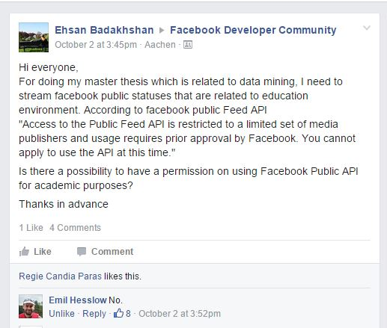
Proposed solution for solving this problem
Collecting tweets from more universities (top 200 universities).
36,000 tweets a day (with retweets)
Around 15,000 tweets a day ( without retweets)
Language: English
Considering another resources such as Facebook.
Access to the Public Feed API is restricted to
a limited set of media publishers and usage
requires prior approval by Facebook.

Slide 13
2. Data processing :
Preprocessing
Feature selection
They adopted a combination of uni- and bigrams and they considered emoticons a part of n-gram features.
Idea: Considering individual or mixture of different sentence features such as emoticons, parts of speech (POS) tags.
Classification step
They used naïve Bayes technique. Their classifier accuracy performance is 73.6%, while Go et al. [17] achieved around 80% accuracy rate.
An idea to increase sentiment analysis accuracy rate: Testing other supervised machine learning classification techniques such as Support Vector Machine (SVM) and Maximum Entropy for classifying tweets.

Slide 14
3. Test and evaluation
Comparison between the TU9 based on the tweets related to each university
Tweets sentiment on daily basis for each university .
Comparison based on daily events is giving us a general result of sentiment analysis for each university.
Idea: Classifying tweets based on topics such as
Advertisement/Announcement,
City News,
Course/Class/Teaching/Professor,
Exam/Homework,
University Event/Sport Day,
Party/Fun/Drinking,
Conference.
Benefits:
educational environments can make use of this information to come up with specific indicator.
Topic based sentiment analysis information can act as feedback for the university.

Slide 15
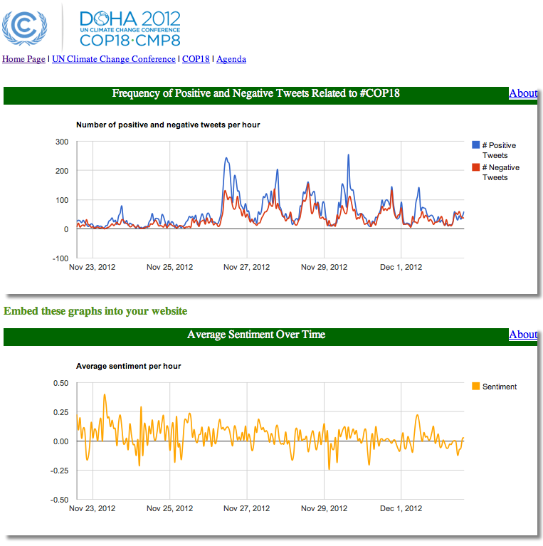
Idea: Based on the results which are coming from testing and implementation of above mentioned ideas, an easy-to-use web-based platform for online sentiment analysis on education related data and report the result in different formats will be implemented.
https://irevolution.files.wordpress.com/2012/12/qcri_cop18_sentiment_analysis.png

Slide 16
Conclusion
The purpose of presented master thesis proposal is comparing sentiment analysis methods and using them in the context of education and learning environment of universities by tracking data over social networks such as Twitter and Facebook.
It will explore and compare the natural language processing and data mining techniques and applies them to existing sentiment analysis methods to extract useful information from social networks

Slide 17
Proposed Timetable
The estimated needed time to accomplish this project would be 6 months.
1. Literature Review: 3 weeks
We have a review to the current works and knowledge in the area of sentiment analysis on twitter. Sentiment analysis on Facebook would also be considered. We will compare our planed work with existing solutions.
2. Preparation/Initialization Phase: 2 weeks
In this step, we prepare some prerequisite of our work, including required tools and environment, etc. In addition, review some Python programming materials.
3. Data collection: 1 week
Sentiments collection from Twitter and Facebook APIs

Slide 18
Proposed Timetable
4. Text filtering: 2 week
The process of cleaning tweets texts removing all irrelevant text for the sentiment classifier learning step.
5. Features selection: 4 weeks
One of the main parts of the project. Features are the sentence properties that we analyze in an attempt to correlate it to the tweet sentiment.
6. Classification: 4 weeks
Another important part of the sentiment analysis is sentiment classification. We are considering supervised classifiers which requires training and testing sets.

Slide 19
Proposed Timetable
7 Evaluation and discussion: 4 weeks
The results section evaluates three main aspects. Measuring the classifier efficiency. Establishing a comparison between universities. Investigation the tweets on new aspects for each university to obtain feedback on different topics.
8 Documentation 4 weeks
We finally document our findings in the thesis. Nevertheless, there would be a continuous process of writing notes during the whole project.

Slide 20
References
[1] Spertus, E. (1997). Smokey: Automatic recognition of hostile messages. In Proceedings of Innovative Applications of Artificial Intelligence (IAAI).
[2] Tatemura, J. (2000). Virtual reviewers for collaborative exploration of movie reviews.
Proceedings of Intelligent User Interfaces (IUI), 272–275.
[3] Jin, X., Li, Y., Mah, T., & Tong, J. (2007). Sensitive webpage classification for content advertising. In Proceedings of the 1st international workshop on data mining and audience intelligence for advertising (ACM) (pp. 28–33), San Jose, CA, USA.
[4] Liu, H., Lieberman, H., & Selker, T. (2003). A model of textual affect sensing using realworld knowledge (pp. 125–132). Proceedings of Intelligent User Interfaces (IUI).
[5] Mishne, G., & Glance, N. (2006). Predicting movie sales from blogger sentiment. In AAAI symposium on computational approaches to analysing weblogs (AAAI-CAAW) (pp. 155–158).
[6] Abbasi, A. (2007). Affect intensity analysis of dark web forums. In Proceedings of intelligence and security informatics (ISI) (pp. 282–288).
[7] Cardie, C., Farina, C., Bruce, T., & Wagner, E. (2006). Using natural language processing to improve eRulemaking. In Proceedings of the 7th annual international conference on digital government research (pp. 177–178), San Diego.
[8] Rogers, E. (2003). Diffusion of innovations. New York: Free Press.
[9] Carro, R., Ballesteros, F. J., Ortigosa, A., Guardiola, G., & Soriano, E. (2012) HYPERLINK. <http://www.bibsonomy.org/bibtex/6c910cf2aa9b3c48690deb3cabbdde09> AngryEmail? Emotion-based E-mail tool adaptation. Lecture notes in computer science, 7657 (pp. 399–406). Springer.
[10] Feldman, R. (2013). Techniques and applications for sentiment analysis.
[11] Das, S., & Chen, M. (2001). Yahoo! for Amazon: Extracting market sentiment from stock message boards. In Proceedings of the Asia Pacific Finance Association annual conference (APFA). Communications of the ACM, 56(4), 82–89.

Slide 21
References
[12] Alexander Pak, Patrick Paroubek. , (2010). Twitter as a Corpus for Sentiment Analysis and Opinion Mining. In In Proceedings of the Seventh Conference on International Language Resources and Evaluation. 3.1, 3.2, 6, 4.2, 4.3, 5.1
[13] Pang, B., Lee, L., & Vaithyanathan, S. (2002). Thumbs up? Sentiment classification using machine learning techniques. In Proceedings of Empirical Methods in Natural Language Processing (EMNLP) (pp. 79–86).
[14] Shah, K., Munshi, N., Reddy, P. (2013). Sentiment analysis and opinion mining of microblogs. University of Illinoise at Chicago, Course CS. 2.3, 4.2
[15] Agarwal, A., Xie, B., Vovsha, I., Rambow, O., Passonneau, R. (2011). Sentiment Analysis of twitter data. In Proceedings of the workshop on Languages in Social Media, (pp.30-38).
[16] Kouloumpis, E., Wilson, T., Moore, J. (2011). Twitter Sentiment Analysis: The good the bad and the OMG! In International Conference on Weblogs and Social Media (ICWSM), 2.3, 3.3, 4.2.
[17] Go, A., Huang, L., Bhayani, R. (2009). Twitter sentiment analysis.
[18] Go, A., Huang, L., Bhayani, R. (2005). Twitter sentiment classification using distant supervision.
[19] Ortigosa, A., M. Martín, J., M. Carro, R. (2014). Sentiment analysis in Facebook and its application to e-learning. In Journal of Computers in Human Behavior, (pp. 527-541).
[20] Abdelrazeq, A., Janssen, D., Tummel, C., Richert, A., Jeschke, S. (2015). Sentiment Analysis of Social Media for Evaluating Universities

Slide 22
Thank you so much for your attention!
Introduction
Sentiment Analysis
Related works
Social Media Sentiment Analysis
Conclusion
Proposed Timetable
Literature

