Slide 1



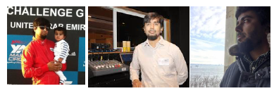


Muhammad Ehsan
MSc, M.Eng, P.Eng, BE
HTTP://MEHSANULLAH.BLOGSPOT.COM

Slide 2


Competitor Capacity Comparison
Assumptions, Calculations, Observations and Challenges
Based on the data provided I am assuming the following:
Assumption: The Data represents monthly flights as only one Date entry is provided.
Assumption: The Date field represents Date/Month/Year rather Month/Date/Year (Region date format setting)
Observation : There are no white liars in the data (Flight 77W with minimal seat count vs flights (By computation and comparison)
Notes:
ASKs or Available Seat Kilometers is a measure of passenger carrying capacity. It is equal to the number of seats available multiplied by the number of miles or kilometers flown
DOH LCK
Flights ASKs Seats
5 342017.7881 30 = 11,400
doha to LCK airport distance by flight
11401 (KM)
ASKs = No. of seats * distance
ASKs 342017.7881
No of seats=30
By Calculation No of seats = 342017.7881 ÷ 5732 = 60
DOH LGG
Flights ASKs Seats
14 405149.1347 84 = distance 4,823
By Google: 4818 KM Approximate

Slide 3
Future of Analytics and Reporting
AI, Machine Learning
Generation 1:
Data exported -> Analyzed (Aggregation etc) -> Reported (Static, Dynamic Dashboard) -> Proof of Concept
Generation 2:
POC -> Data extracted -> ingested into Datalake -> Validated (Quality) -> Reported (Static, Dynamic Dashboard) -> Data Pipelines (ETL/ELT)
Generation 3:
Data Pipelines (ETL/ELT) -> AI MODEL (TRAINED, TESTED, OUTPUT) -> Reported (Static, Dynamic Dashboard) -> CICD Pipelines -> AI MODEL (TRAINED, TESTED, OUTPUT) -> Refresh

Slide 4





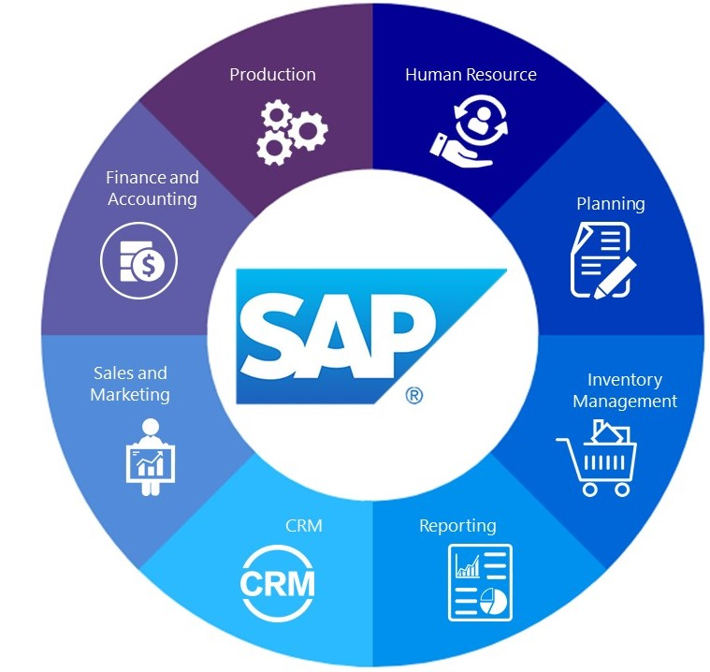



Manager Data Engineering
Pratt and Whitney Canada
Enterprise Data lake, Data warehouse Planning (AWS Data bricks, Redshift)
Execution (Azure, On premise Cloudera Data lake, Data bricks on , AWS cloud)
Data Catalog (Identifying Data Sources, Business and Technical)
Data Governance, Data governance council
Audit & Lineage
Security Assessment & Penetration Testing
Concept of Operation Development
Data Pipelines - Extraction Transform Load (ETL/ELT) , Continuous Integration and Continuous Delivery (CICD)
Data Quality
Advance Analytics (Microsoft Power BI – on premise and cloud)
Notes:
Type Division
Industry Aerospace
Founded November 1928; 93 years ago
Headquarters Longueuil, Quebec, Canada
Key people Maria Della Posta
(President)
Owner Raytheon Technologies
Number of employees 10,000[1]
Parent Pratt & Whitney
Website www.pwc.ca
Executive Champion
Convener (AIM team – Us)
Council members (After Market, Finance, HR, Supply Chain Management, Engineering)
Data stewards
https://moov.ai/en/projects/pratt-and-whitney/

Slide 5

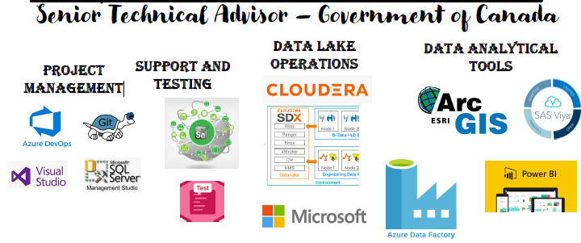
Manager Solution Architect
Employment & Social Development Canada
Enterprise Data lake Planning
Execution (Azure, On premise Oracle Cloud)
Data Catalog
Data Governance & Lineage
Security Assessment & Penetration Testing
Concept of Operation Development
Extraction Transform Load (ETL/ELT)
Advance Analytics

Slide 6









My Career + Families
Canada/America
Manager Solution Architect Senior Technical Advisor Federal Government of Canada Senior Solution and Data Architect Public Health Ontario Manager Enterprise Support KBR Inc Engineering company Manager Web and Database Services UAE University (Ministry of Education)
Australia + Canada
Middle East (Saudi Arabia UAE)
Middle East UAE
Middle East UAE, Saudi Arabia OMAN, Egypt

Slide 7

























Technologies
Project Management
Identity & Access Management (IAM)
Data Access Management (DAM)
Enterprise Management & Support
Data Lake Storage & Advance Analytics
Infrastructure on Cloud and On-Premise (Hybrid)
Research and Operation Open source + Enterprise

Slide 8

Questions
Feel free to ask any questions that would help you understand how can I serve your organization
Passionate about overcoming digital transformation challenges in designing, development, management by bringing transformation, Innovation and evolution of emerging solutions across various industries by bringing alternative viewpoints and driving digital transformation through data and analytics. Motivated, organized, proactive performance driven professional with technological and diverse experience in Software and IT Infrastructure related products and services. Knowledgeable in applications of DevOps, scrum and agile methodologies. Providing organizations with different possibilities to create business value and, data and analytics which are key to a successful digital business.

Slide 9
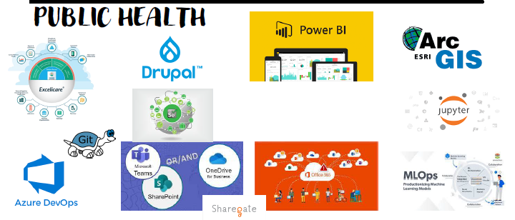
Senior Solution and Data Architect
Public Health Ontario
IT Strategy Effectively align IT to enterprise business objectives
Build the foundation to prepare IT strategy development
Adopt agile methodologies for IT and enterprise strategy development
IT Audit (Penetration testing, IT Security Campaigns)
ITIL
Enterprise ERP (Microsoft Dynamic 365)
Migration (Office365, Power Apps, Microsoft Power BI, Servers, Analytics) to Cloud (Azure),
Machine Learning and Artificial Intellegence

Slide 10




THANK YOU
MUHAMMAD EHSAN
+1 (647) 525-8520
ehsan4u@gmail.com
HTTP://MEHSANULLAH.BLOGSPOT.COM/

