Slide 1


آموزش یادگیری ماشین با پایتون
مدرس: مهدی حبیبیان
بهار 1404

Slide 2

Getting to know
How am I ?
What is important?
what will we do?
Requirement
Asking
Any Question ?
who are you?
Education/ Age / Sex/ Position/ python coding experience
Why you need ML ?
Contact:
Email: m.habibian1171@gmail.com
Telegram: @mehdi_1171
Social Media Group: …

Slide 3

Contents
Introduction
History of Machine Learning
What is the Machine Learning ?
Types of Learning
Introduction to Tools
Work with Python
Clustering
Metric
Spectral Clustering
Partitional Clustering
Grid base
Density based
Hierarchical

Slide 4
Contents
Regression & Classification
Naïve Bayes
KNN
SVM
RF
Decision Tree
Regression
Neural Network
MLP
CNN
RNN

Slide 5

Source
Hands-On Machine Learning with Scikit-Learn and TensorFlow: Concepts, Tools, and Techniques to Build Intelligent Systems
A Course in Machine Learning Hal Daumé III
Ian Goodfellow, Yoshua Bengio, Aaron Courville - Deep Learning [pre-pub version]-MIT Press (2016)
Deep Learning Yoshua Bengio

Slide 6

Lesson1: Introduction
“A breakthrough in machine learning would be worth ten Microsoft”
(Bill Gates, Chairman, Microsoft)

Slide 7
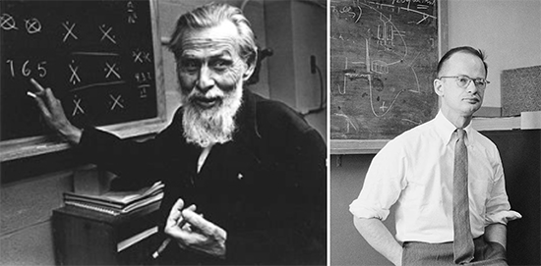
History
1943
A logical calculus of the ideas immanent in nervous activity
Warren McCulloch
Walter Pitts
1

Slide 8
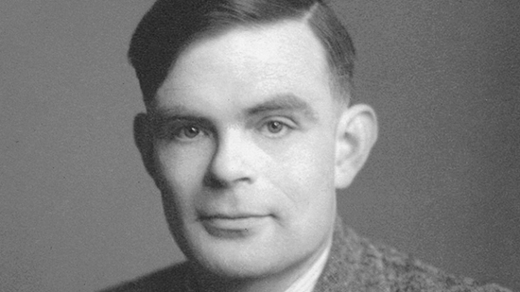
History
1950
Turing test
Allen Turing
2

Slide 9
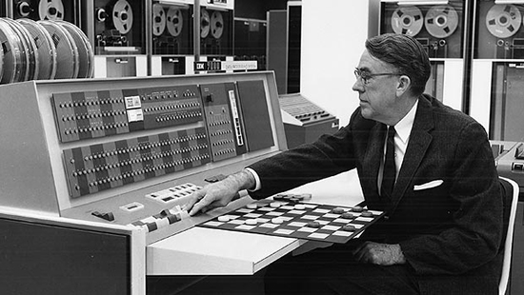
History
1952
IBM
Arthur Samuel
3

Slide 10
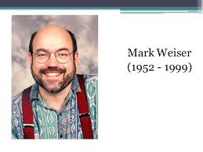
History
Ubiquitous Computing
“The most profound technologies are those that disappear. They weave themselves into the fabric of everyday life until they are indistinguishable from it.”
4

Slide 11
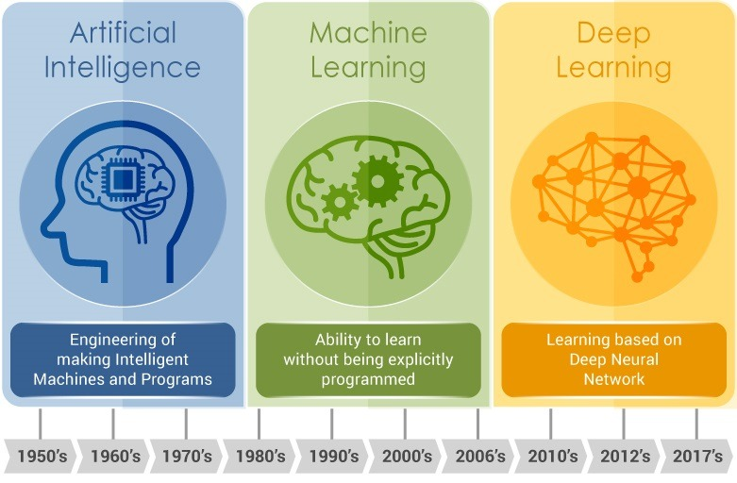
AI, ML, DL !!!
5

Slide 12
Programming
Traditional Programming
Machine Learning
Data
Computer
Output
Program
Data
Computer
Program
Output
6

Slide 13

Magic?
No, more like gardening
Seeds = Algorithms
Nutrients = Data
Gardener = You
Plants = Programs
7

Slide 14
Types of Learning
Supervised (inductive) learning
Training data includes desired outputs
Weather Prediction, Object Classification
Unsupervised learning
Training data does not include desired outputs
Clustering data to find similar patern
Semi-supervised learning
Training data includes a few desired outputs
Unlabelled data for training and labelled data for testing
Eexperiments to locate oil at a particular location
Reinforcement learning
Rewards from sequence of actions
Punishment vs Reward
Auto Drive, Game, ...
8

Slide 15
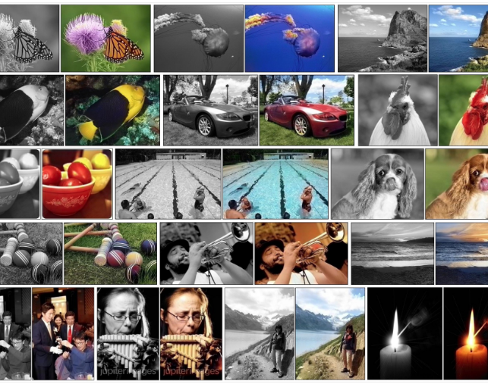
Regression
9

Slide 16
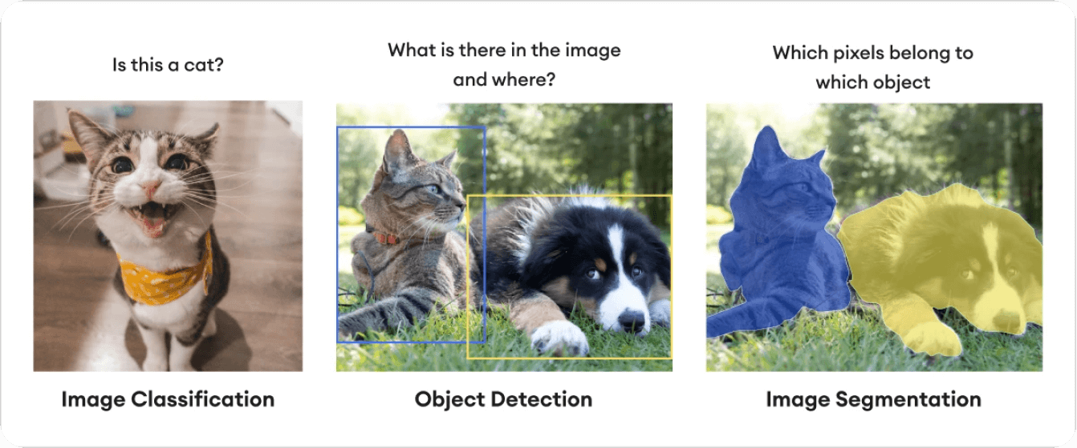
Classification
10

Slide 17
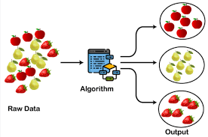
Clustering
11

Slide 18
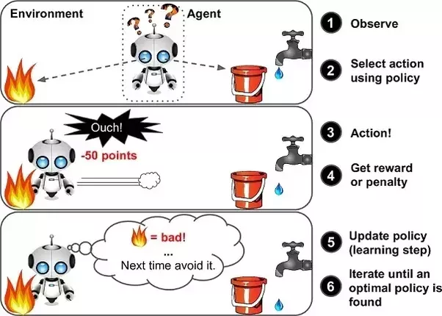
Reinforcement Learning
12

Slide 19

Reasons for failure
Asking the wrong question
Trying to solve the wrong problem
Not having enough data
Not having the right data
Having too much data
Hiring the wrong people
Using the wrong tools
Not having the right model
Not having the right yardstick
13

Slide 20
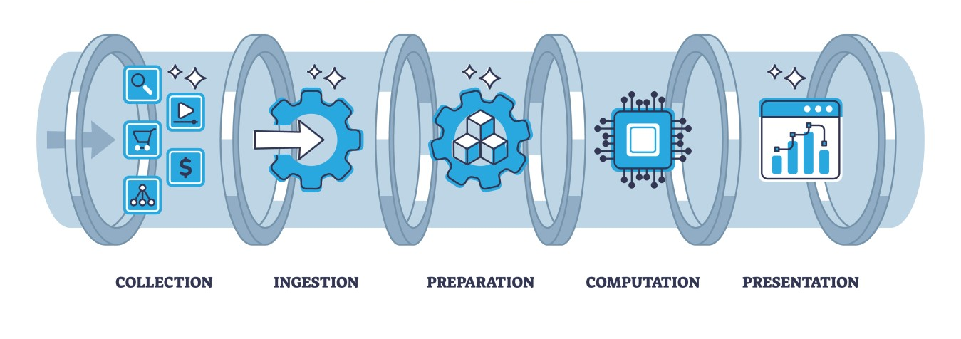
Data Pipeline
14

Slide 21
Data Pipeline
E
Ingestion
CSV/JSON/XML/H5 files, RDBMS, NoSQL, HTTP,...
T
Data cleaning
outliers/invalid values? → filter
missing values? → impute
Data transformation
scaling/normalization
Transformation
L
Presentation
Visualization
Prepare for another Pipeline
15

Slide 22




Tools
16

Slide 23




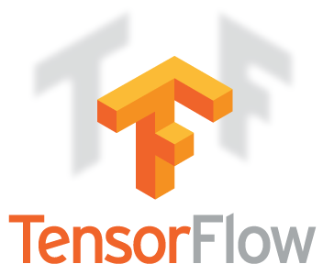
Python
17

Slide 24
Task
Download data from Kaggle
Practice on Data Manipulation
Cleaning, Visualization , …
18

Slide 25
Lesson2: Clustering

Slide 26





Metric
Name | Distance Function
Euclidean
Manhattan
Minkowski
Chebyshev
Haversine
sklearn.neighbors.DistanceMetric
Exp: >>dist = DistanceMetric.get_metric('euclidean')
In Python
20

Slide 27

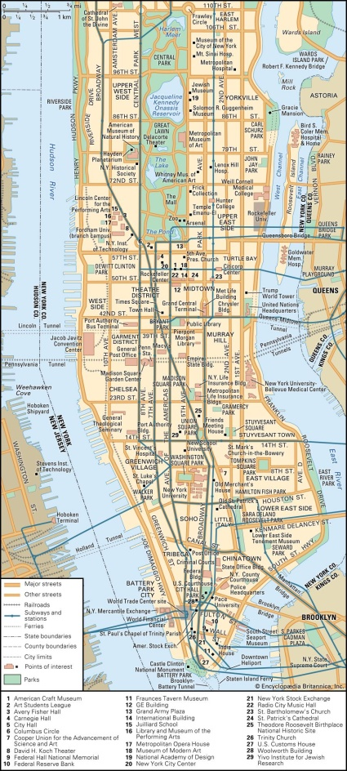
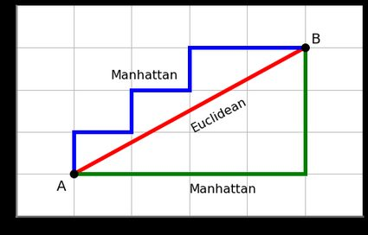
Manhattan distance
21

Slide 28
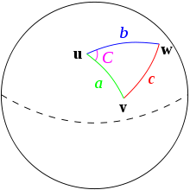
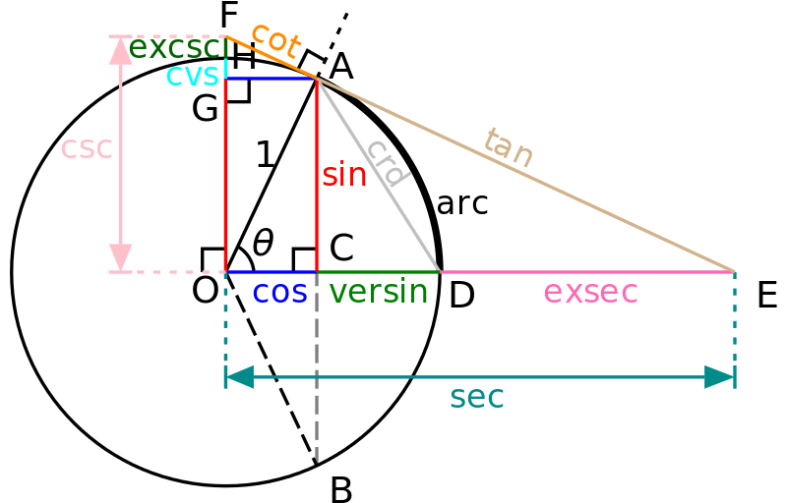
Haversine Distance
22

Slide 29
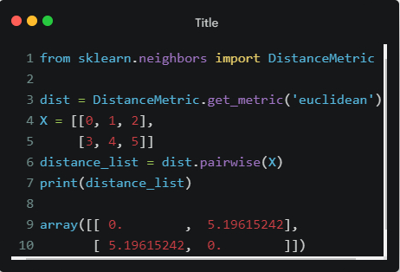
Distance in Python
23

Slide 30
Introduction
it’s the task of partitioning the dataset into groups, called clusters
Clustering is one of the most widely used techniques for exploratory data analysis
Clustering is one of the main tasks in unsupervised machine learning
Its goal is to divide the data points into several groups such that points in the same group are similar
24

Slide 31
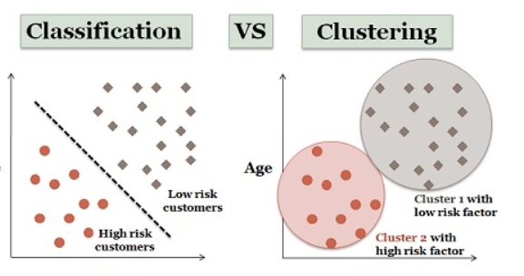
What is difference ?
Classification is the process of classifying the data with the help of class labels. On the other hand, Clustering is similar to classification but there are no predefined class labels.
Classification is geared with supervised learning. As against, clustering is also known as unsupervised learning.
Training sample is provided in classification method while in case of clustering training data is not provided
25

