Slide 1


وبینارآموزشی یادگیری ماشین با پایتون
صندوق نوآوری و شکوفایی با همکاری پارک علم و فناوری استان خوزستان
جلسه 2
پاییز 1401

Slide 2


Lesson2: Clustering

Slide 3
Type of Clustering
Clustering
Centroid
Optics
Agglomerative
Divisive
DBSCAN
Density
Connectivity
K-Mean
Mean-Shift
Spectral
Grid base
STING
CLIQUE
Distribution
GMM
1

Slide 4
Introduction
it’s the task of partitioning the dataset into groups, called clusters
Clustering is one of the most widely used techniques for exploratory data analysis
Clustering is one of the main tasks in unsupervised machine learning
Its goal is to divide the data points into several groups such that points in the same group are similar
2

Slide 5

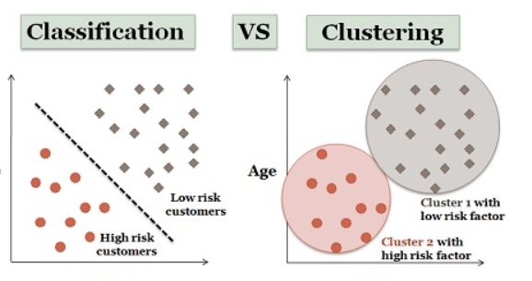
What is difference ?
Classification is the process of classifying the data with the help of class labels. On the other hand, Clustering is similar to classification but there are no predefined class labels.
Classification is geared with supervised learning. As against, clustering is also known as unsupervised learning.
Training sample is provided in classification method while in case of clustering training data is not provided
3

Slide 6
Centroid Based Clustering
K-Means
MiniBatchKMeans
K-Medoids
4

Slide 7
k-means clustering
Specify number of clusters K.
Initialize centroids by first shuffling the dataset and then randomly selecting K data points for the centroids without replacement.
Keep iterating until there is no change to the centroids. i.e assignment of data points to clusters isn’t changing.
Compute the sum of the squared distance between data points and all centroids.
Assign each data point to the closest cluster (centroid).
Compute the centroids for the clusters by taking the average of the all data points that belong to each cluster.
K-Means
Code
5

Slide 8
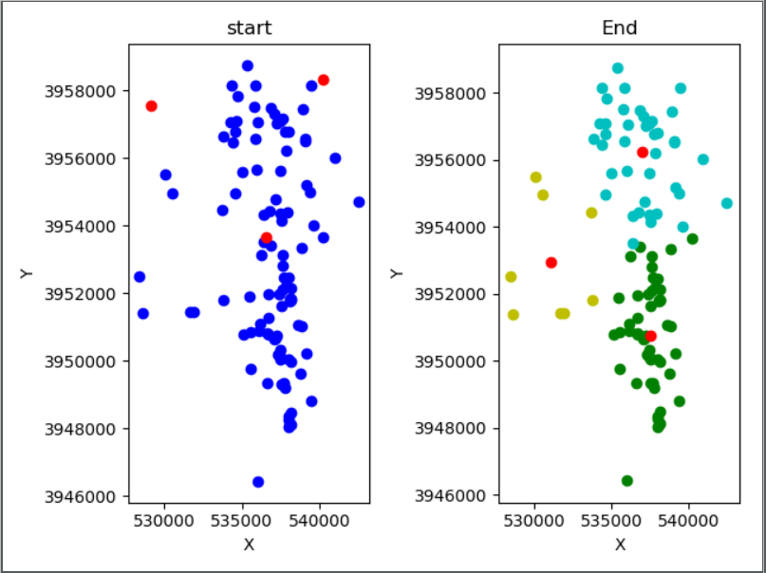
The clustering of POI data from Foursquare
6

Slide 9
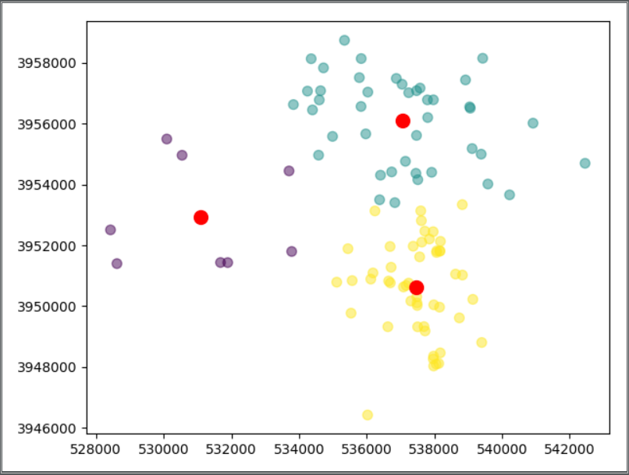
The clustering of POI data from Foursquare
7

Slide 10




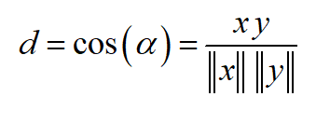

Metric
Name | Distance Function
Euclidean
Manhattan
Minkowski
Chebyshev
Cosine
Haversine
8

Slide 11
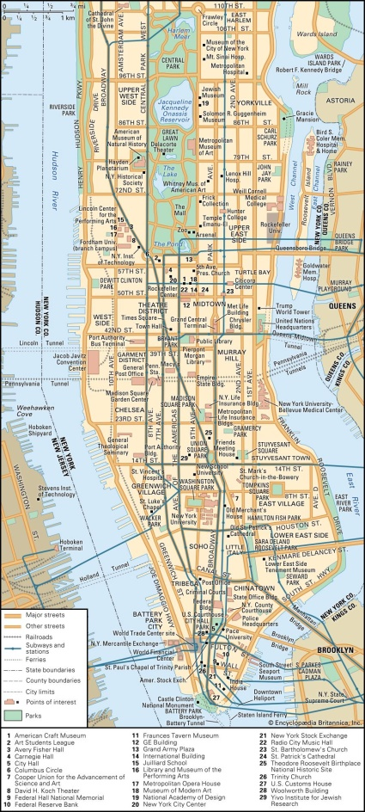
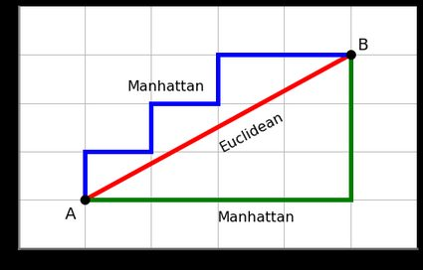
Manhattan distance
9

Slide 12
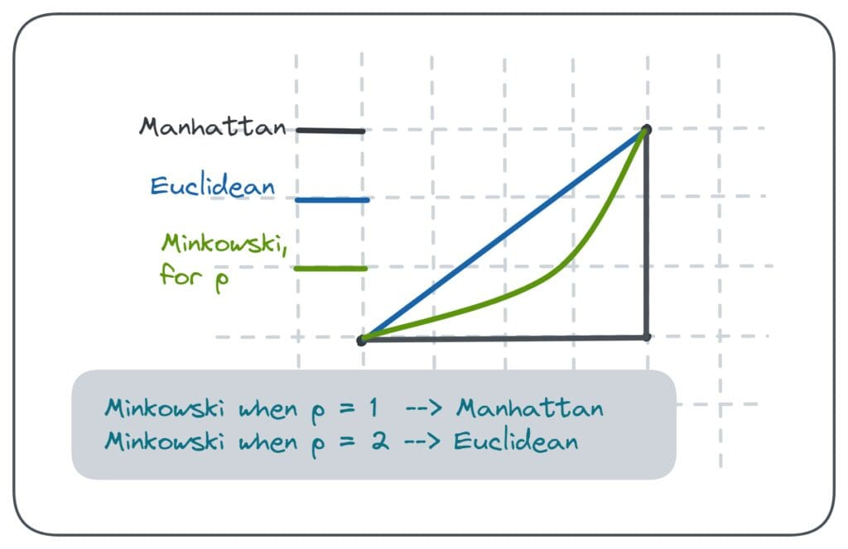
Minkowski distance
10

Slide 13
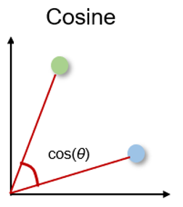
Cosine distance
11

Slide 14
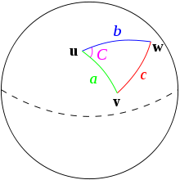
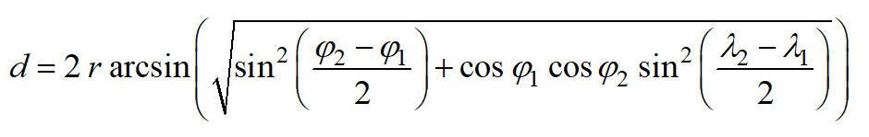
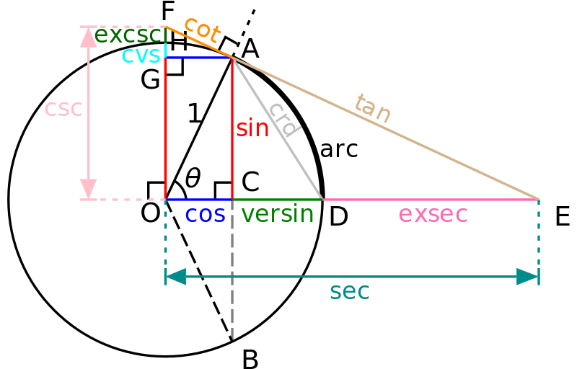
Haversine Distance
12

Slide 15
Metric
In Python
from sklearn.metrics import pairwise_distances
Exp: >>dist = pairwise_distances(a, b, metric='euclidean')
13

Slide 16
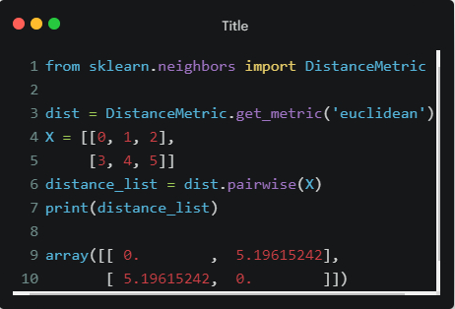
Distance in Python
14

Slide 17
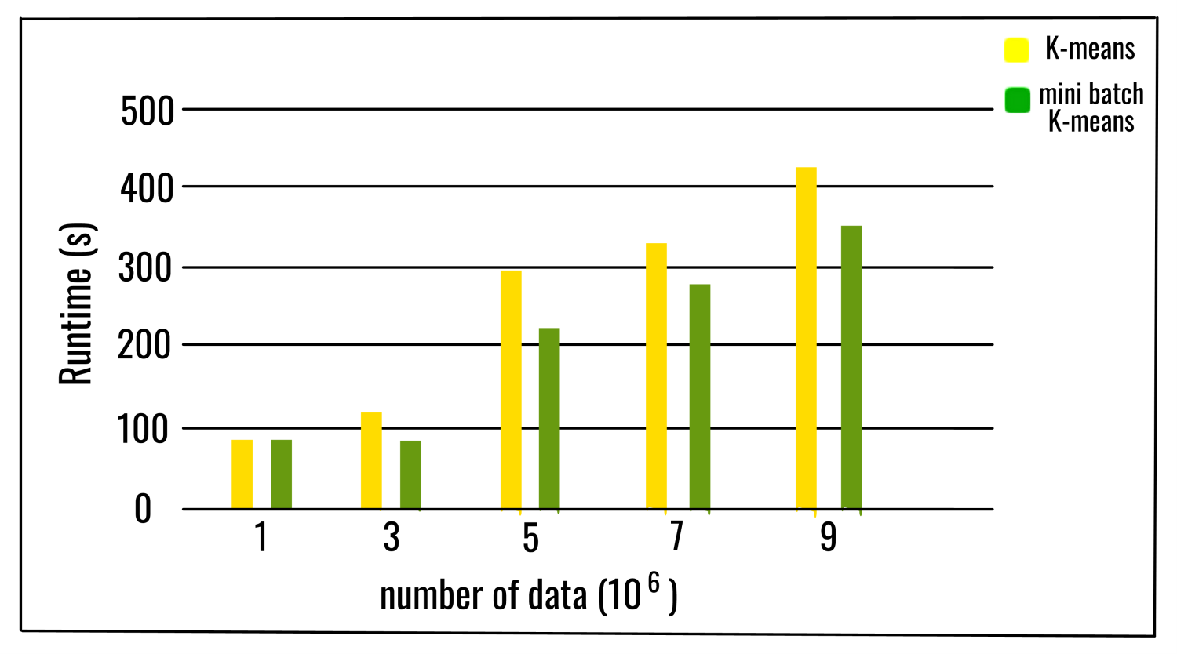
MiniBatchKMeans
Decrease Running Time
RAM Usage
Use a Batch size
15

Slide 18
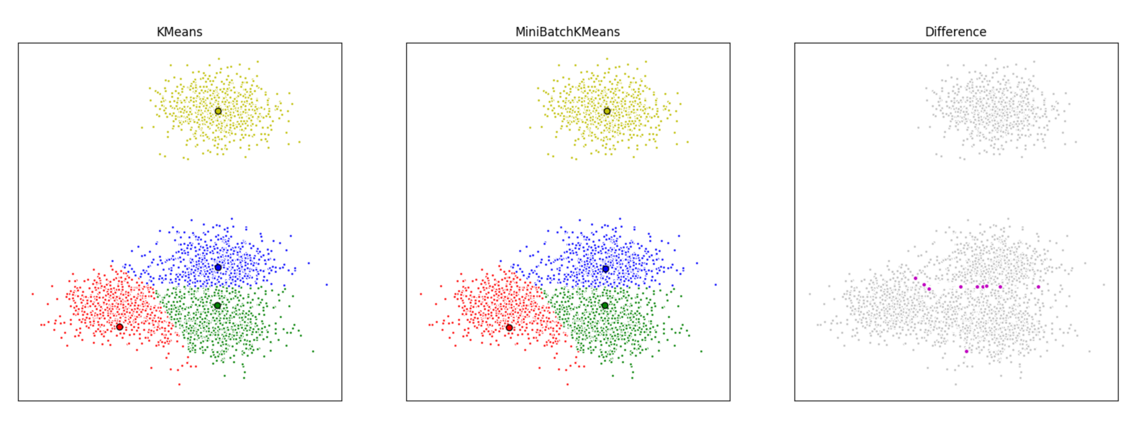
MiniBatchKMeans
Decrease Quality and precision ☹
16

Slide 19

What is problem ?
This algorithm is simple ☺
If variables are huge, then K-Means most of the times computationally faster than any clustering
K !!!!
all directions are equally important for each cluster.
This is usually not a big problem, unless we come across with some oddly shape data
17

Slide 20
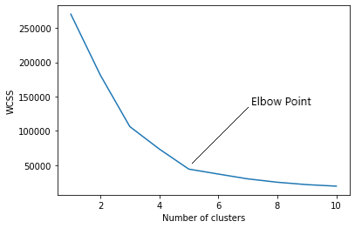
How to find best K ?
Elbow method
Within-Cluster Sum of Square (WCSS)
number of clusters increases -→ WCSS decrease
Overfitting
18

Slide 21
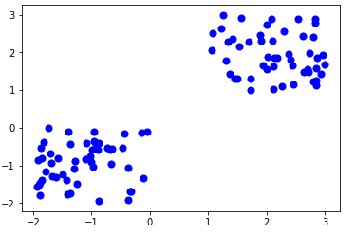
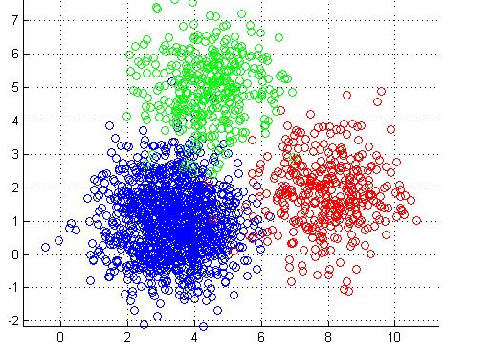
Silhouette
Cohesion
Separation
Image A
Image B
19

Slide 22
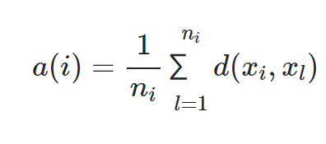
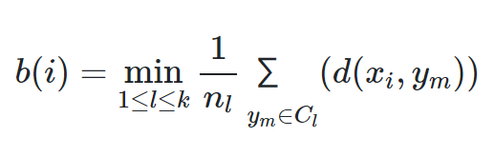
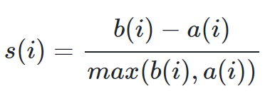
Silhouette
Cohesion
Separation
20

Slide 23
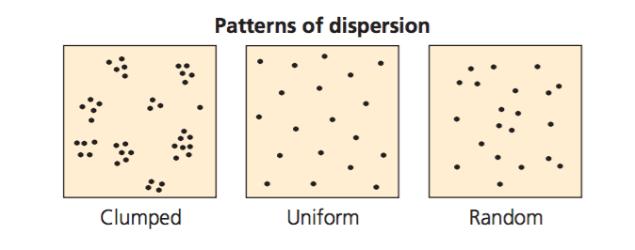
Data Distribution
Cluster
Uniform
Random
21

