Slide 1


وبینارآموزشی یادگیری ماشین با پایتون
جلسه 3
پاییز 1401

Slide 2

k-medoids
Initialize: select k random points out of the n data points as the medoids.
Associate each data point to the closest medoid by using any common distance metric methods.
While the cost decreases: For each medoid m, for each data o point which is not a medoid:
Swap m and o, associate each data point to the closest medoid, recomputed the cost.
If the total cost is more than that in the previous step, undo the swap.
1

Slide 3
K-Medoids VS KMeans
K-means attempts to minimize the total Squared Error,
while
k-medoids minimizes the sum of dissimilarities between points.
k-medoids algorithm is less sensitive to outliers than other partitioning algorithms.
k-median?
2

Slide 4
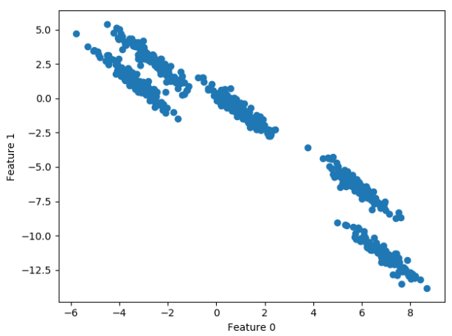
What is problem ?
3

Slide 5
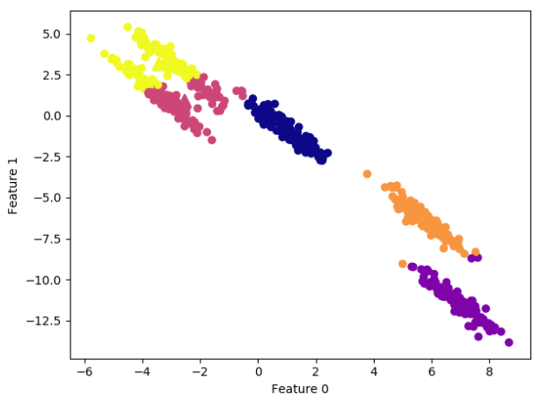
Centroid Based Clustering Have Problem ☹
4

Slide 6
Density based clustering

Slide 7
DBSCAN Clustering
Density Based Spatial Clustering of Applications with Noise
does not require the user to set the number of clusters a priori
can capture clusters of complex shapes
very useful as outliers detector
is somewhat slower than another clustering methods, but still scales to relatively large datasets.
6

Slide 8
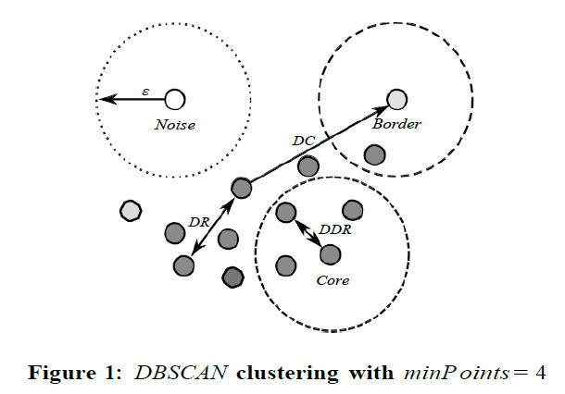
DBSCAN Algorithm
Epsilon (ε): set of all points within a distance ‘ε’.
Minpt : number of point in ‘ε’ radius
Core point: A point that has at least ‘minPoint’ (including itself) points within it’s Nε
Border Point: Point that are DDR but not a core point.
Noise : Points that do not belong to any point’s Nε .
Visualize
7

Slide 9
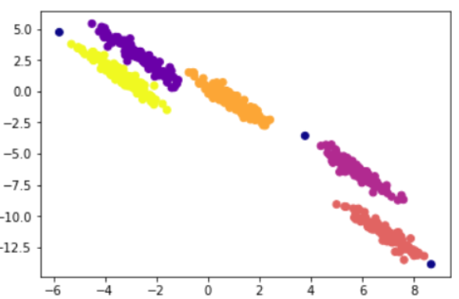
DBSCAN Algorithm
8

Slide 10
DBSCAN Algorithm
class sklearn.cluster.DBSCAN (
eps=0.5, *,
min_samples=5,
metric='euclidean',
metric_params=None,
algorithm='auto',
leaf_size=30 (),
p=None, (power of the Minkowski)
n_jobs=None (number of parallel jobs))
9

Slide 11
Application
Anomaly Detection:
Identifying unusual patterns that deviate from normal behavior. For example,
Detecting fraudulent credit card transactions
Spatial Data Analysis:
Analyzing geographical or spatial data.
Grouping customer locations to identify market segments
Analyzing crime hotspots in a city
Identifying patterns in satellite image analysis for land use classification
Biological Data Analysis:
Clustering gene expression data
Identifying structures in protein databases.
Recommendation Systems:
Grouping users with similar preferences based on sparse interaction data
10

Slide 12
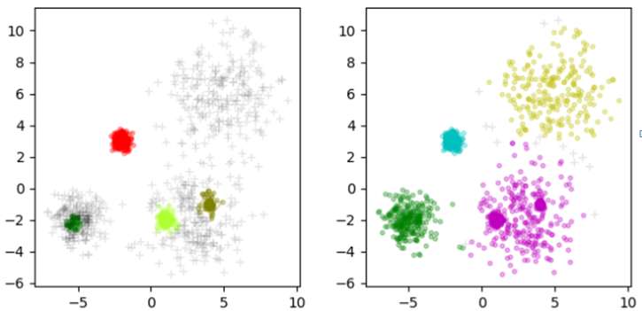
OPTICS Clustering
Ordering Points To Identify the Clustering Structure
What is the problem of DB scan algorithm?
ε : 0.5
ε : 2
Detectable Cluster with variety Distribution
Separation Close Clustering
11

Slide 13
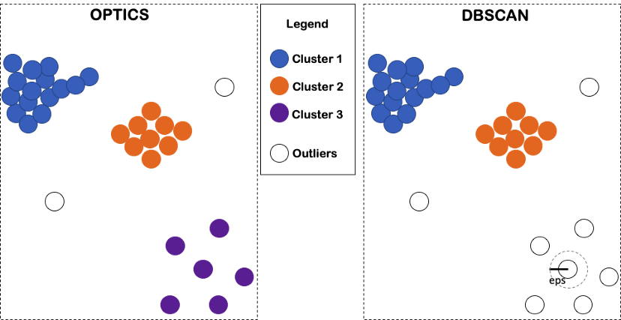
OPTICS Clustering
Detectable Cluster with variety Distribution
Separation Close Clustering
12

Slide 14
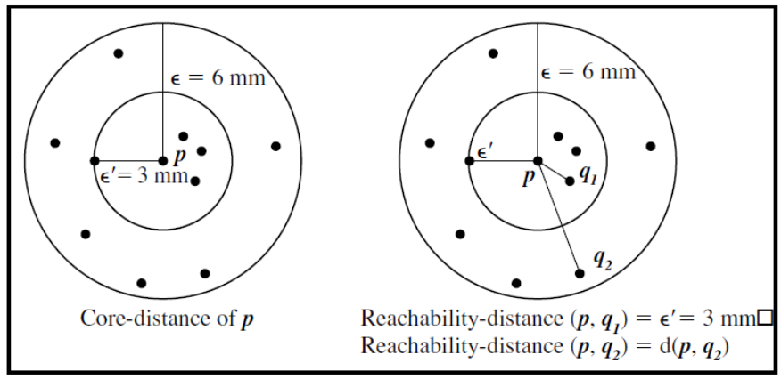
OPTICS Algorithm
ε: 6
Minpt: 5
13

Slide 15
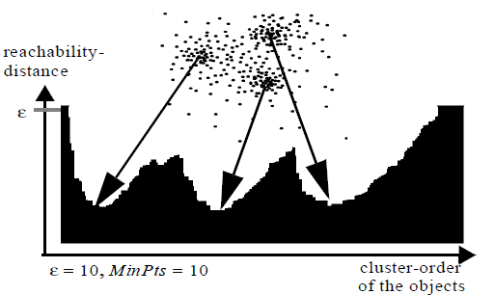
OPTICS Algorithm
14

Slide 16
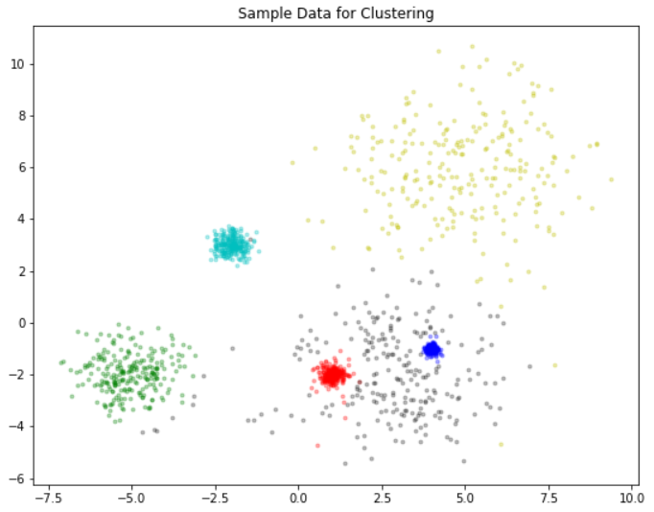
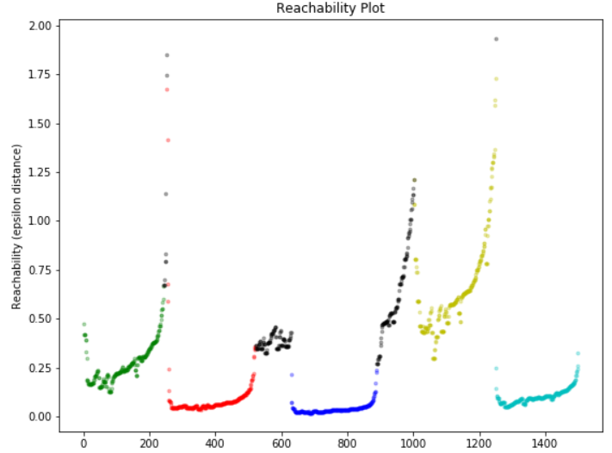
OPTICS Algorithm
15

Slide 17
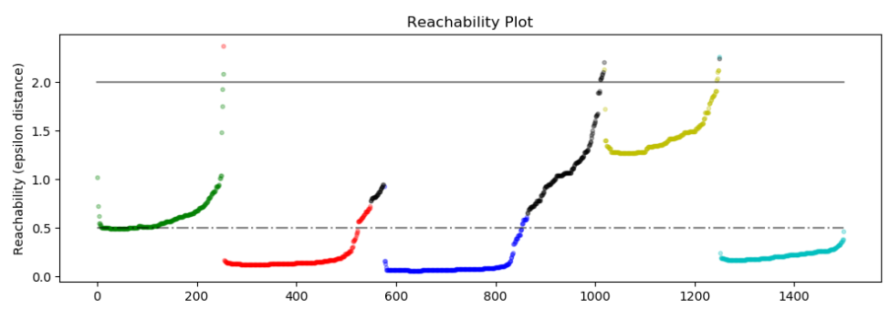
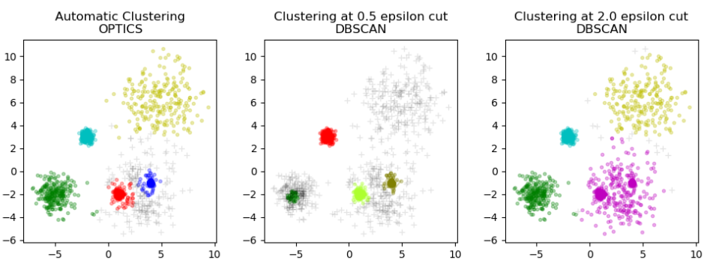
OPTICS Algorithm
The problem of detecting clusters in different density data
16

Slide 18
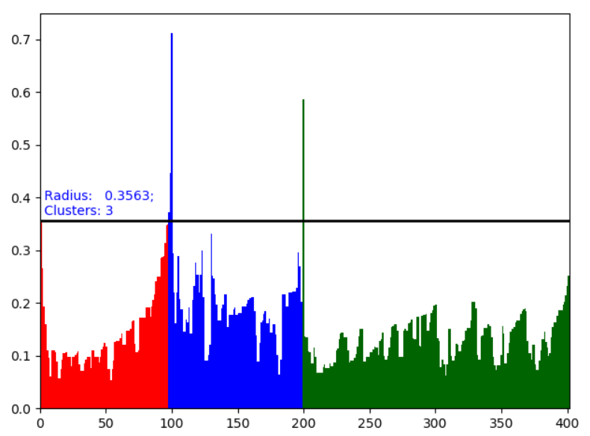
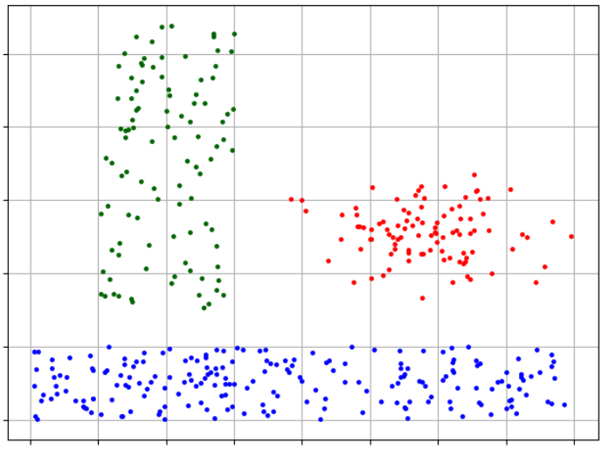
OPTICS Algorithm
Code:
Sklearn
Pyclustering
17

Slide 19

Density based clustering
Does not require a predefined number of cluster
Clusters can be of any shape
Able to identify noise data
Density-based clustering is fails if there are no density drops between clusters
It is also sensitive define parameters (Eps , Minpt)
Proper parameter setting may require domain knowledge
DBSCAN : which assumes constant density of clusters
OPTICS : which allows for varying density
18

Slide 20
Distribution base Clustering

Slide 21
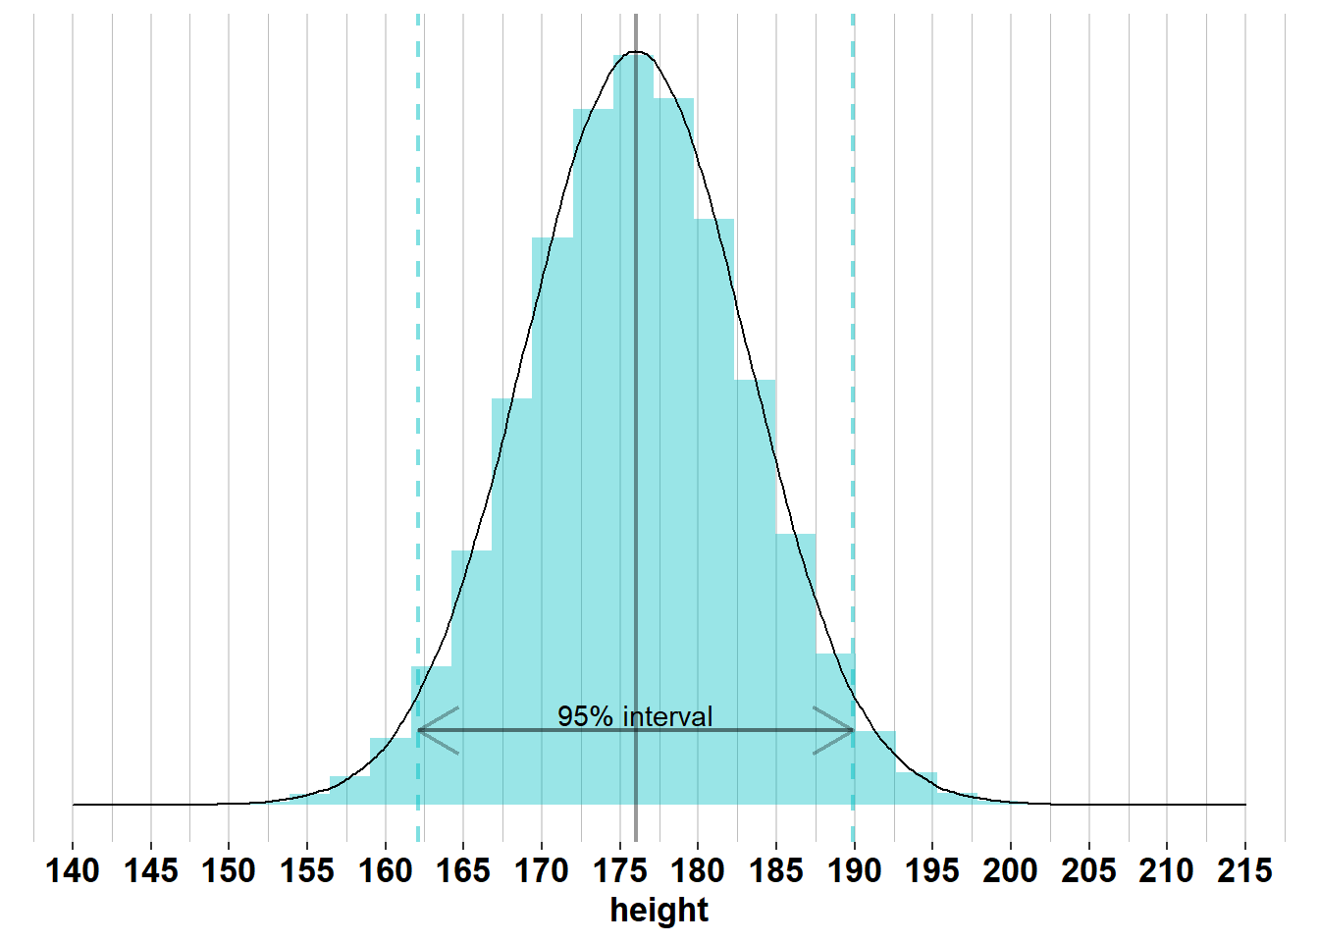
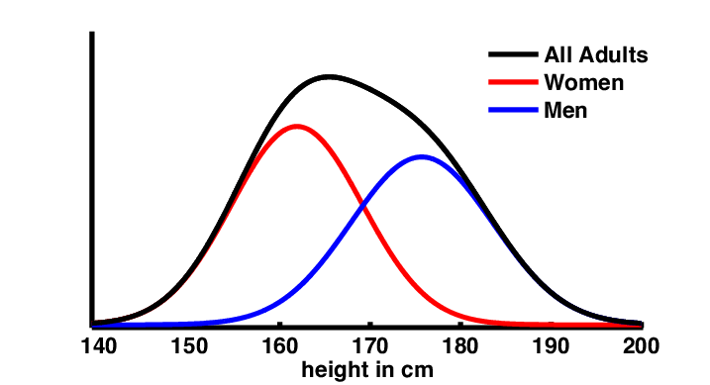
GMM
20

Slide 22
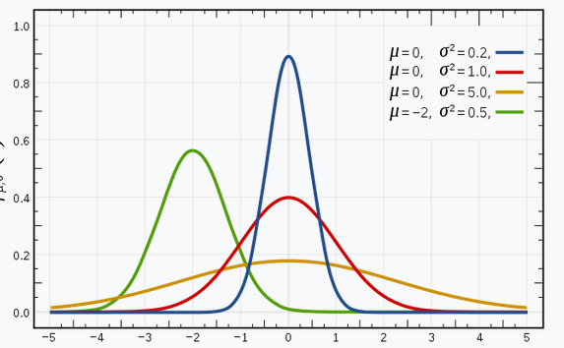
GMM
A Gaussian mixture model is a soft clustering technique used in unsupervised learning to determine the probability that a given data point belongs to a cluster.
It’s composed of several Gaussians, each identified by
k ∈ {1,…, K}, where K is the number of clusters in a data set
21

Slide 23
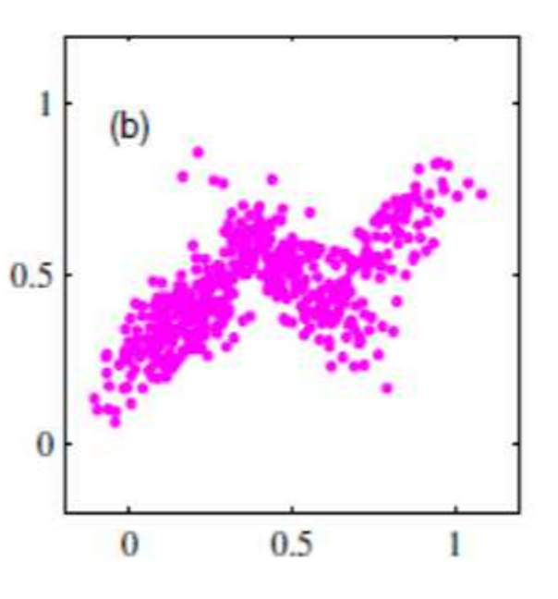
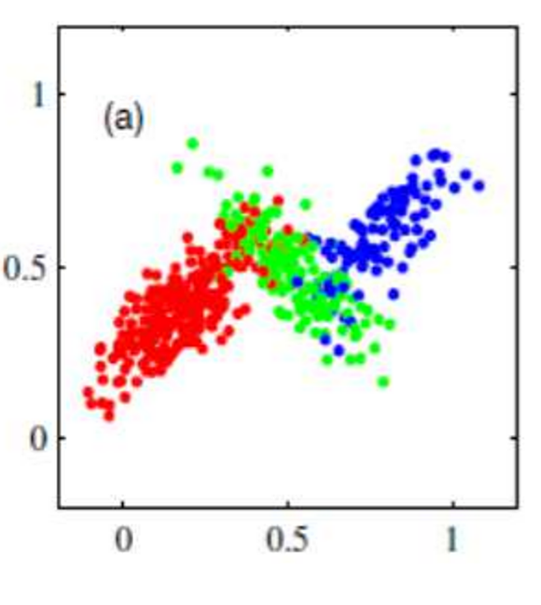
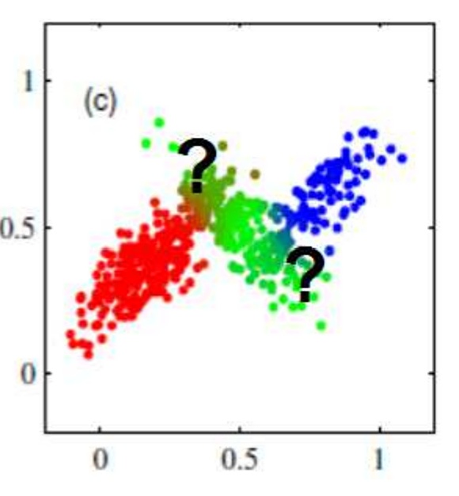
GMM
22

Slide 24
GMM
Initialization
The algorithm starts by initializing the parameters of the Gaussian distributions (means, covariances, and mixing proportions). This can be done randomly or using other techniques like K-means.
Expectation Step
For each data point, the algorithm calculates the probability of it belonging to each cluster. These probabilities are called "responsibilities".
Maximization Step
The algorithm updates the parameters of each Gaussian distribution based on the responsibilities calculated in the previous step. This involves recalculating the means, covariances, and mixing proportions.
Iteration
Steps 2 and 3 are repeated until the algorithm converges, meaning the changes in the model parameters become very small.
Clustering
After convergence, each data point is assigned to the cluster for which it has the highest responsibility (probability).
23

Slide 25
GMM Applications
GMMs are used in a wide range of applications, including:
Density Estimation: Modeling the probability distribution of the data.
Anomaly Detection: Identifying data points that deviate significantly from the learned distribution.
Image Recognition: Analyzing and classifying images based on pixel distributions.
Natural Language Processing: Modeling word distributions and topic modeling.
Financial Modeling: Analyzing market data and predicting trends.
24

Slide 26
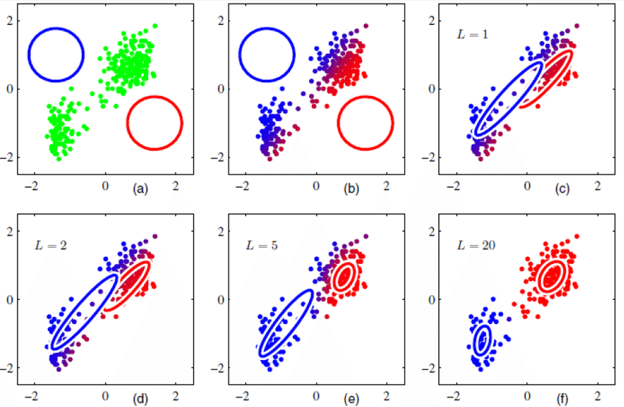
GMM
25

Slide 27
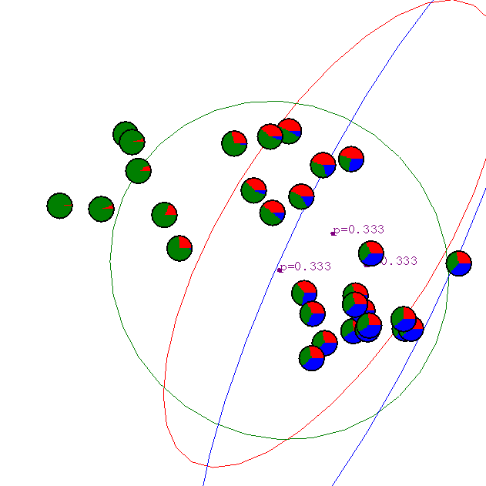
GMM
Iteration : 1
26

Slide 28
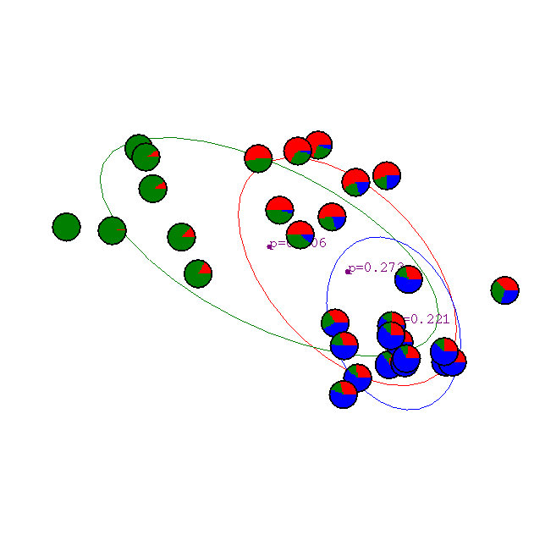
GMM
Iteration : 2
27

Slide 29

GMM
Iteration : 3
28

Slide 30

GMM
Iteration : 4
29

Slide 31

GMM
Iteration : 5
30

Slide 32

GMM
Iteration : 6
31

Slide 33

GMM
Iteration : 7
32

Slide 34

GMM
Iteration : 20
33

