Slide 1


وبینارآموزشی یادگیری ماشین با پایتون
بهار 1404

Slide 2

Hierarchical Clustering

Slide 3
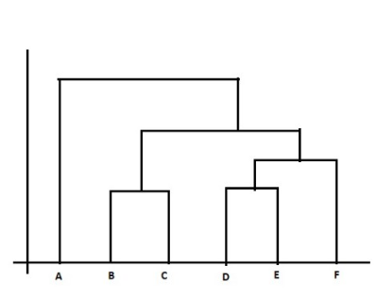
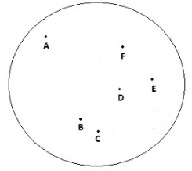
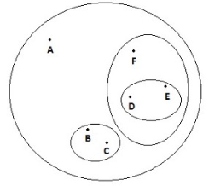

Hierarchical Clustering
Find a hierarchy of clusters, where this hierarchy resembles a tree structure, called a dendrogram.
2

Slide 4
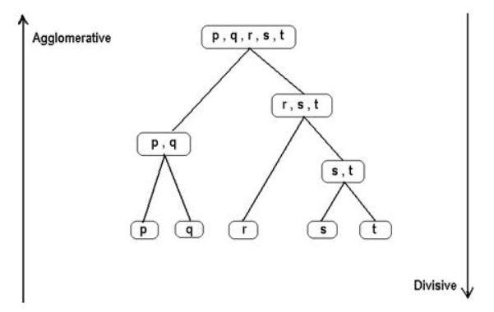
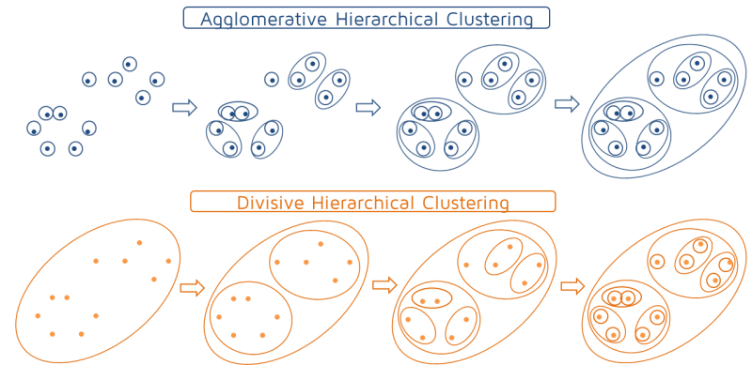
Type of Hierarchical Clustering
Agglomerative
Divisive
3

Slide 5
Hierarchical Clustering
Step 1: Compute the proximity matrix using a particular distance metric
Step 2: Each data point is assigned to a cluster
Step 3: Merge the clusters based on a metric for the similarity between clusters
Step 4: Update the distance matrix
Step 5: Repeat Step 3 and Step 4 until only a single cluster remains
4

Slide 6
Hierarchical Clustering
Metric
Linkage criteria
single-linkage
Complete-linkage
Average-linkage
Centroid-linkage
Ward
5

Slide 7
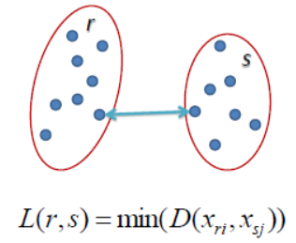
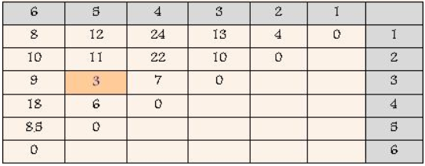
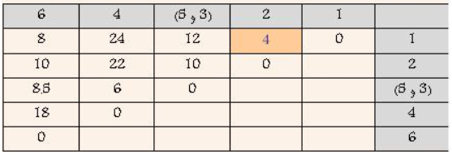
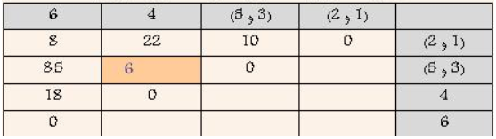
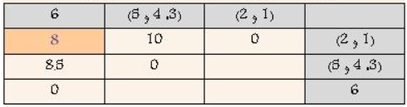
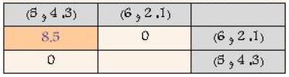
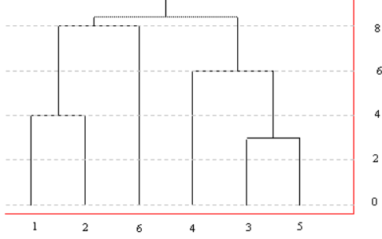
single-linkage
6

Slide 8

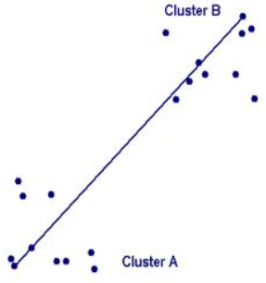
complete-linkage
7

Slide 9

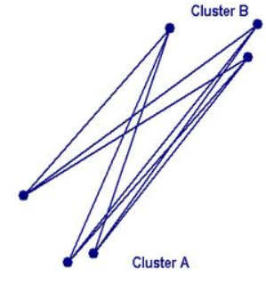
Average-linkage
8

Slide 10

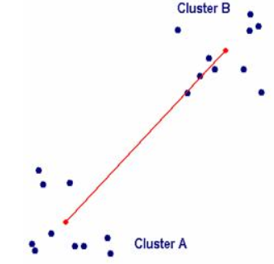
centroid-linkage
9

Slide 11
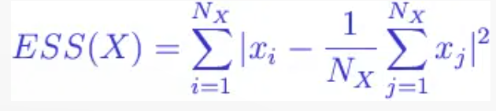
ward
Instead of Distance Calculation → minimizing the variance between clusters.
With the Ward method, the distance between two clusters is related to how much the sum of squares (SS) value will increase when combined.
+
10

Slide 12
Agglomerative Clustering
Preparing the data
Select the type of metric
Computing (dis)similarity information between every pair of objects in the data set.
Using linkage function to group objects into hierarchical cluster
Determining where to cut the hierarchical tree into clusters.
11

Slide 13
Divisive Clustering
Top-down approach
all data points start in the same cluster. You can then use a parametric clustering algorithm like K-Means to divide the cluster into two clusters. For each cluster, you further divide it down to two clusters until you hit the desired number of clusters.
12

Slide 14
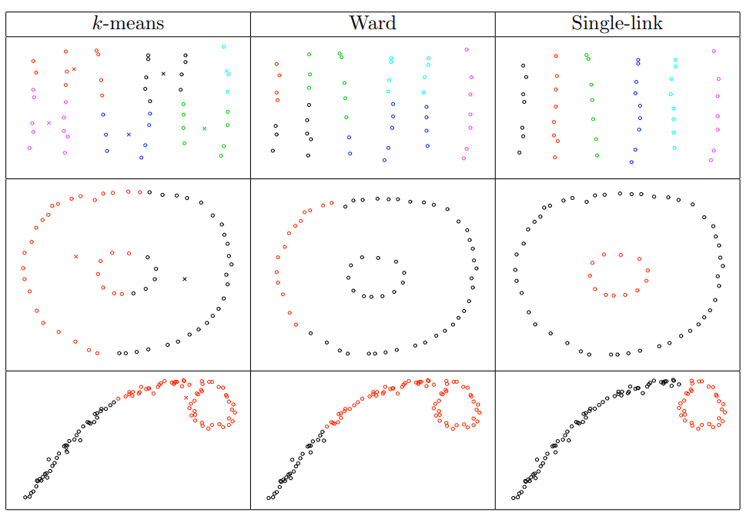
Divisive Clustering
13

Slide 15
Spectral Clustering

Slide 16
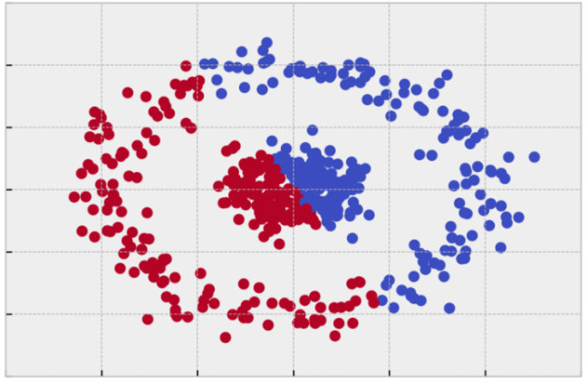
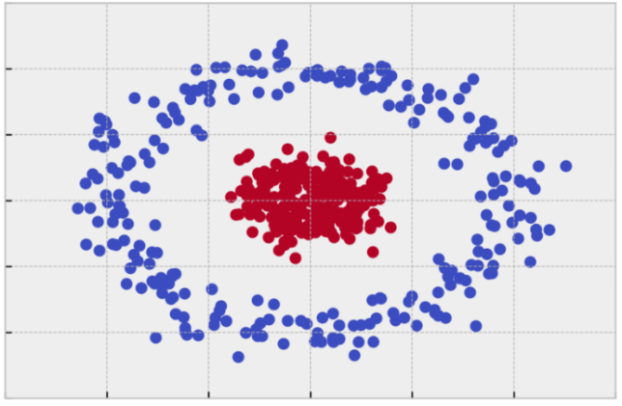
Spectral Clustering
Create a similarity graph between our N objects to cluster.
Compute the first k eigenvectors of its Laplacian matrix to define a feature vector for each object.
Run k-means on these features to separate objects into k classes
K-Mean
Spectral
15

Slide 17
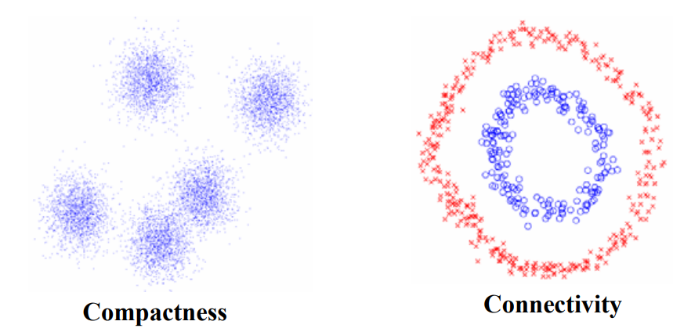
Spectral Clustering
Two different criteria
Compactness, e.g., k-means, mixture models Connectivity, e.g., spectral clustering
16

Slide 18
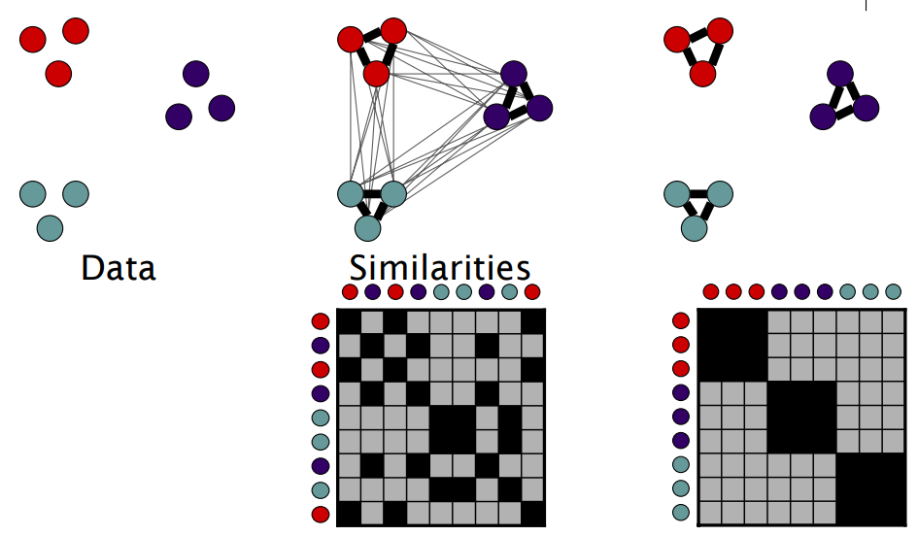
Spectral Clustering
17

Slide 19
How to do Spectral Clustering?
1. Form a distance matrix
2. Transform the distance matrix into an affinity matrix A
3. Compute the degree matrix D and the Laplacian matrix L = D – A.
4. Find the eigenvalues and eigenvectors of L.
5. With the eigenvectors of k largest eigenvalues computed from the previous step form a matrix.
6. Normalize the vectors.
7. Cluster the data points in k-dimensional space.
18

Slide 20
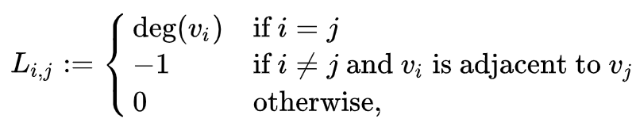
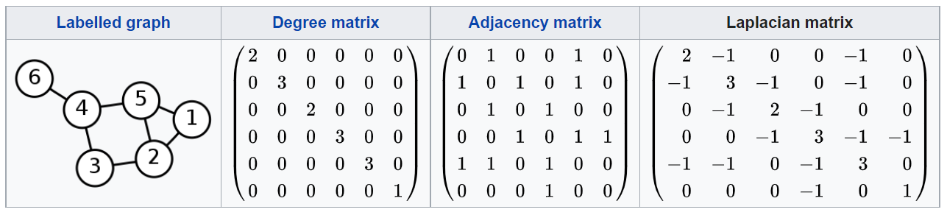
Laplacian Matrix
L = D – A
19

Slide 21
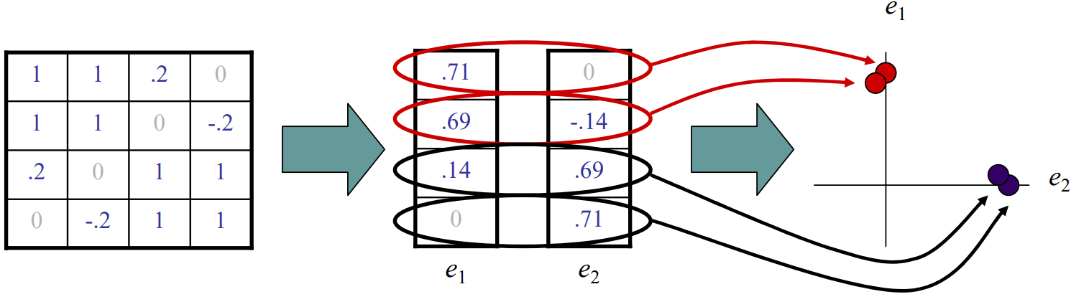
Spectral Space
Simple and powerful methods to segment images.
High memory requirements (use sparse matrices).
20

Slide 22
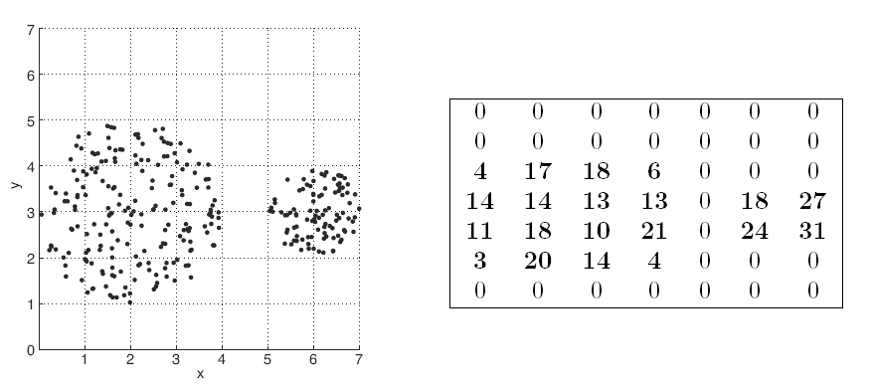
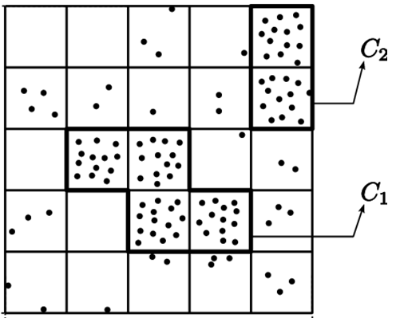
Grid Based Clustering
Define a set of grid-cell
Assign objects to the appropriate grid cell and compute the density of each cell
Eliminate cells, whose density is below a certain threshold t
Form clusters from contiguous (adjacent) groups of dense cells (usually minimizing a given objective function)
21

Slide 23
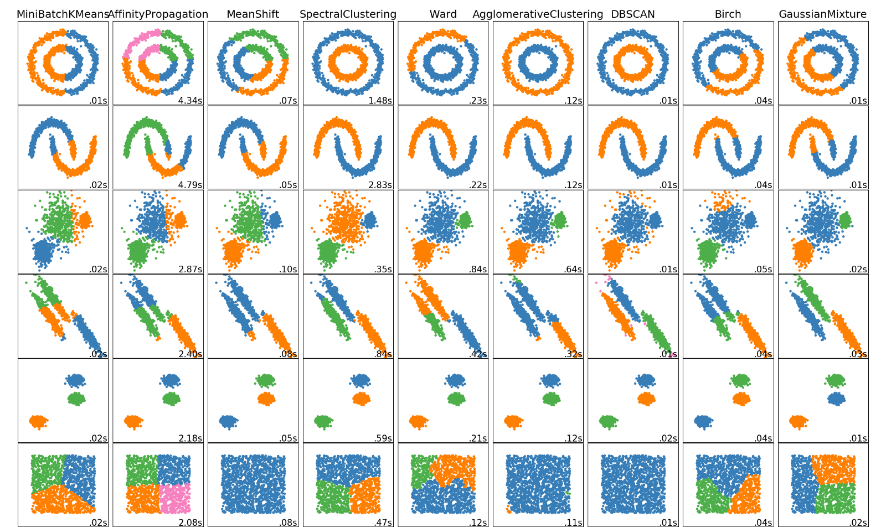
Compare
37

Slide 24
Thank You for Your Attention
78
37

