Slide 1


وبینارآموزشی یادگیری ماشین با پایتون
بهار 1404

Slide 2
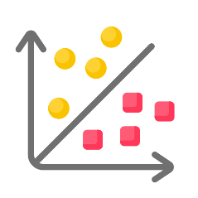
Supervised Learning
Classification

Slide 3

Classification
Classification is the technique of categorizing a given collection of data into groups.
Data -----?-----> Group
Classifier
( Perceptive inputs )
Discrete-valued
2

Slide 4
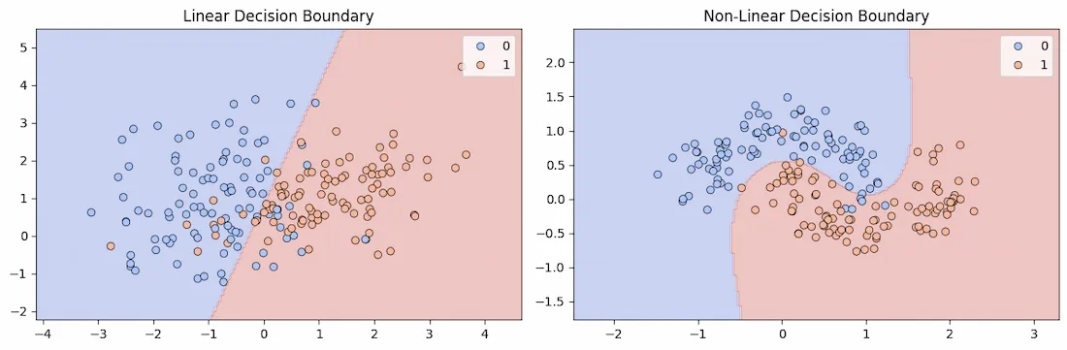
Decision Boundary in Classification
It is an surface or line that separates data points into different classes in a feature space.
It can be linear (a straight line) or non-linear (a curve), depending on the complexity of the data and the algorithm used.
During training classifier learns to partition the feature space by finding a boundary that minimizes classification errors.
For binary classification, this boundary separates data points into two groups (e.g., spam vs. non-spam emails).
In multi-class classification, multiple boundaries are created to separate more than two classes.
3

Slide 5
Terminologies
1. Classifier – A classifier is an algorithm that maps input data to a specified class.
2. Classification Model – The model can predict or come to conclusions using input data provided for training.
3. Feature – A feature is a single quantifiable attribute of the object being examined.
4. Binary Classification – This is a sort of categorization that has two results, such as positive or negative.
5. Multi-Class Classification – A categorization with two or more categories, in which each item is allocated to one and only one label or target. Such as Fruits classification and …
6. Multi-label Classification – This is a classification method in which each item is allocated to one of many labels. Such as Movie, it may belong to horror, romance, adventure, action
4

Slide 6
Type of Classification
Logistic Regression
K Nearest Neighbors
Naive Bayes
Decision Tree
Random forest
Support Vector Machine
5

Slide 7
Classification
Training Phase
Model
Testing Phase
Learning the classifier
from the available data
‘Training set’
(Labeled)
Testing how well the classifier
performs
‘Testing set’
6

Slide 8
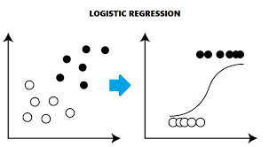
Logistic Regression
Logistic Regression is a supervised ML algorithm used for classification problems. Unlike linear regression which predicts continuous values it predicts the probability that an input belongs to a specific class. It is used for binary classification where the output can be one of two possible categories such as Yes/No, True/False or 0/1. It uses sigmoid function to convert inputs into a probability value between 0 and 1
Application – Email Spam Detection
Output {0,1} -------> Binary Classification
7

Slide 9
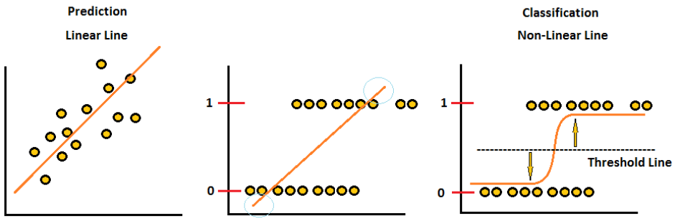
Why Linear Regression is not suitable for classification?
1. The first one is that Linear Regression deals with continuous values whereas classification problems mandate discrete values.
2. As this regression line is highly susceptible to outliers, it will not do a good job in classifying two classes.
8

Slide 10

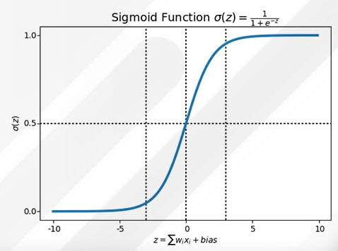
Logistic Classifier
This function takes any real number and maps it into the range 0 to 1 forming an "S" shaped curve called the sigmoid curve or logistic curve. Because probabilities must lie between 0 and 1, the sigmoid function is perfect for this purpose.
Linear Regression
Z = β₀ + β₁X
Logistic Regression
GIF
9

Slide 11
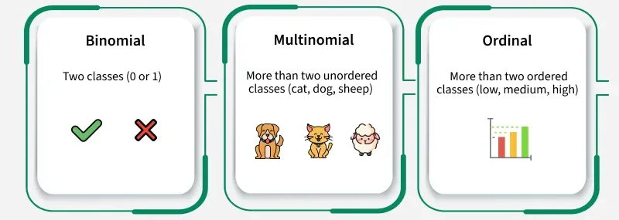
Type of Logistic Regression
10

Slide 12
Stop !!
Confusion Matrix
Evaluate Parameter
Sensitivity
Specificity
ROC
AUC

Slide 13
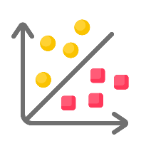
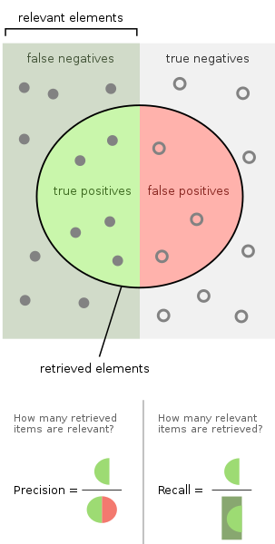
Confusion Matrix
12

Slide 14
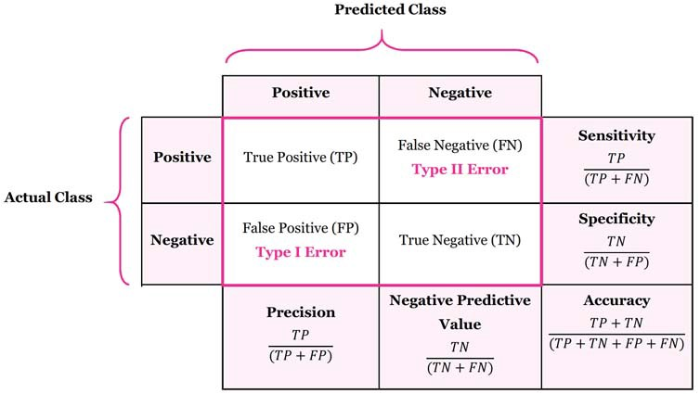
Evaluation Methods
13

Slide 15
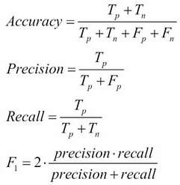
Evaluation Methods
Covid 19 | Predict | Predict
Actual |  | Positive | Negative
Actual | Positive | 80 | 10
 | Negative | 4 | 6
14

Slide 16
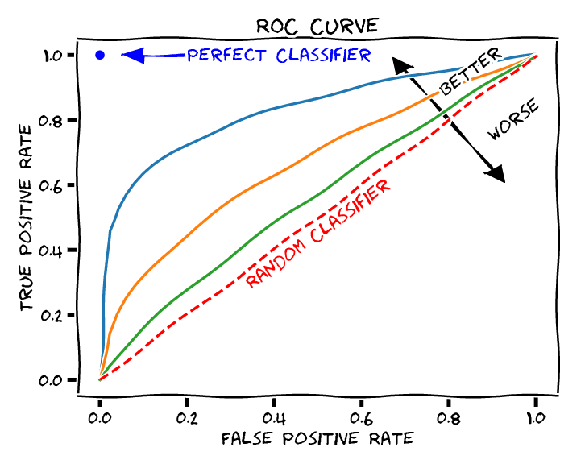
Receiver operating characteristic (ROC) Curve
Sensitivity
1 - Specificity
15

Slide 17
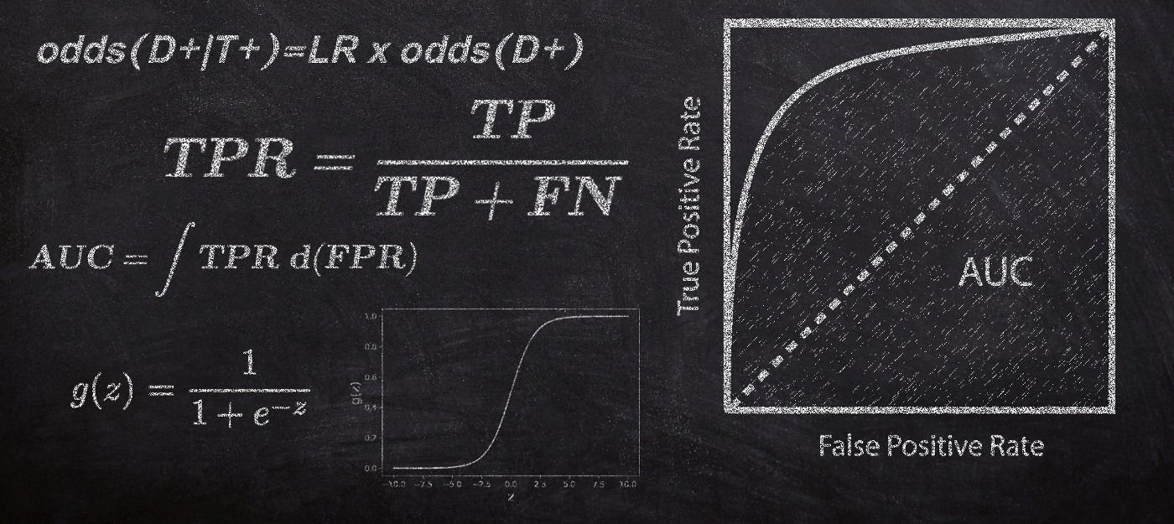
Area Under Curve (AUC)
16

Slide 18
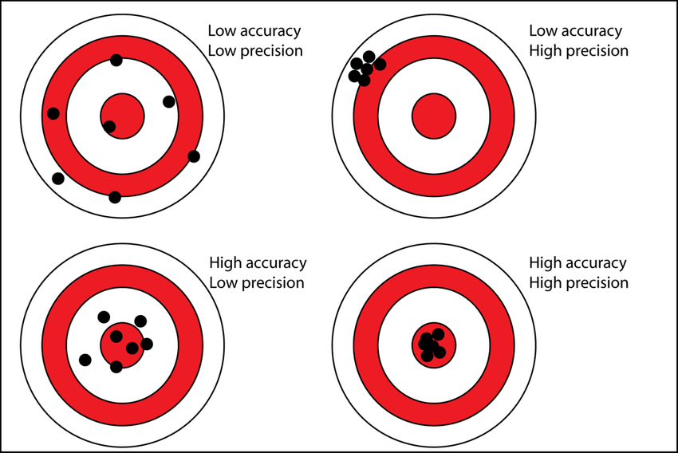
Accuracy VS Precision
17

Slide 19

Advantages VS Disadvantages of Logistic Regression
Is easier to implement, interpret, and very efficient to train.
It is very fast at classifying unknown records
It performs well when the dataset is linearly separable.
It can interpret model coefficients as indicators of feature importance.
It constructs linear boundaries. Logistic Regression needs that independent variables are linearly related to the log odds.
The major limitation is the assumption of linearity between the dependent variable and the independent variables.
More powerful and compact algorithms such as Neural Networks can easily outperform this algorithm.
18

Slide 20
K-Nearest Neighbor Classification
Knn is one of the simplest ML algorithms based on Supervised Learning.
K-NN algorithm assumes the similarity between the new case/data and available cases and put the new case into the category that is most similar to the available categories.
K-NN algorithm can be used for Regression as well as for Classification but mostly it is used for the Classification problems.
K-NN is a non-parametric algorithm, which means it does not make any assumption on underlying data.
It is also called a lazy learner algorithm because it does not learn from the training set immediately instead it stores the dataset and at the time of classification, it performs an action on the dataset.
19

Slide 21
KNN Classification
Step 1: Select the value of K neighbors(say k=5)
Step 2: Find the K (5) nearest data point for our new data point based on euclidean distance(which we discuss later)
Step 3: Among these K data points count the data points in each category
Step 4: Assign the new data point to the category that has the most neighbors of the new datapoint
20

Slide 22
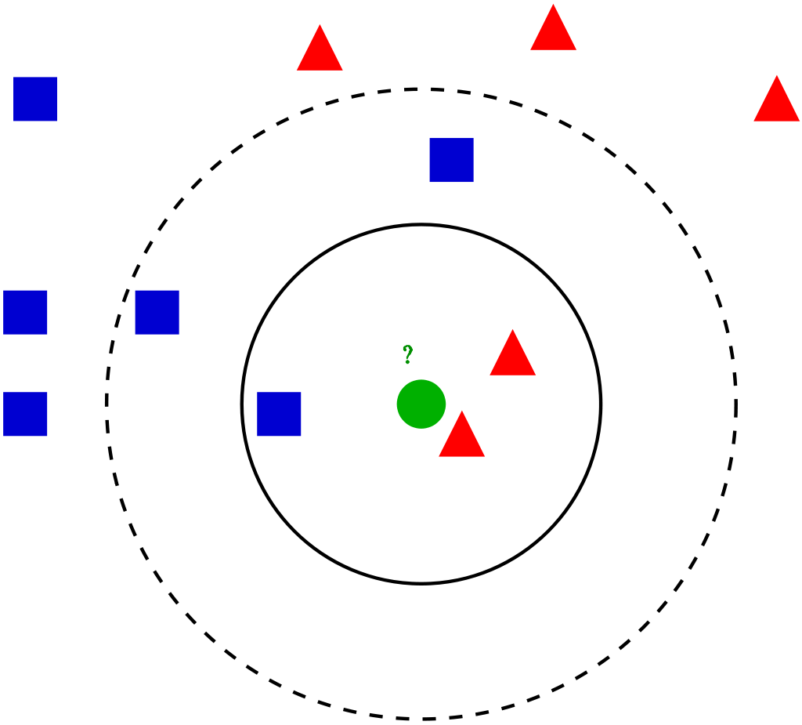
KNN Classification
21

Slide 23
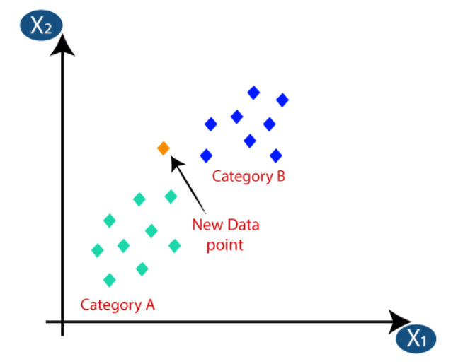
KNN Classification
22

Slide 24
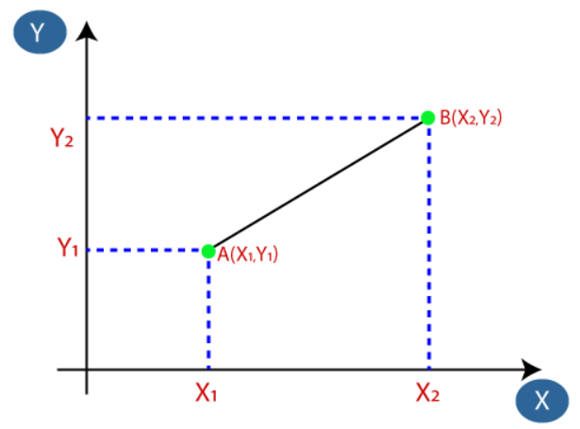
KNN Classification
23

Slide 25
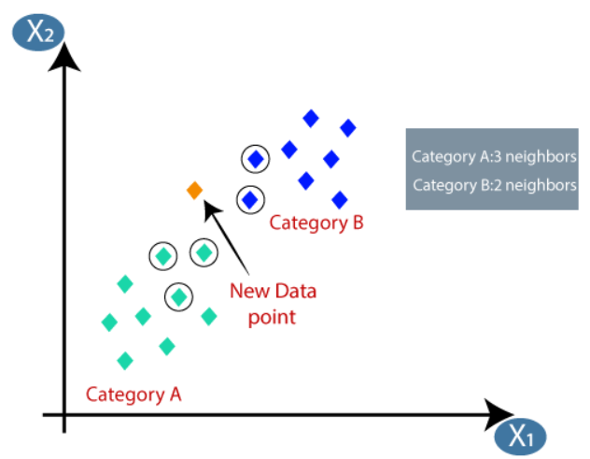
KNN Classification
K = 5
24

Slide 26



Iris Dataset
Iris setosa
Iris versicolor
Iris virginica
25

Slide 27
KNN Classification
It is simple to implement.
It is robust to the noisy training data
It can be more effective if the training data is large.
Always needs to determine the value of K which may be complex some time.
The computation cost is high because of calculating the distance between the data points for all the training samples.
26

