Slide 1


وبینارآموزشی یادگیری ماشین با پایتون
بهار 1404

Slide 2
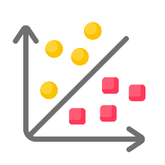
Classification
Section 2

Slide 3
Classification
SVM

Slide 4
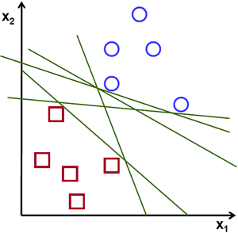
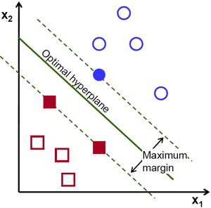
Which decision Boundary is the best?
To separate the two classes of data points, there are many possible hyperplanes that could be chosen. Our objective is to find a plane that has the maximum margin, i.e the maximum distance between data points of both classes. Maximizing the margin distance provides some reinforcement so that future data points can be classified with more confidence.
3

Slide 5
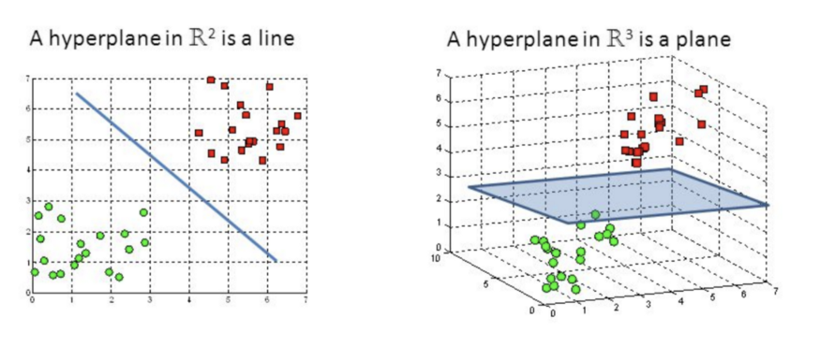
Support Vector Machine
The objective of the support vector machine algorithm is to find a hyperplane in an N-dimensional space(N — the number of features) that distinctly classifies the data points.
The main goal of SVM is to maximize the margin between the two classes. The larger the margin the better the model performs on new and unseen data.
4

Slide 6
Key Concepts of SVM
Hyperplane: A decision boundary separating different classes in feature space and is represented by the equation wx + b = 0 in linear classification.
Support Vectors: The closest data points to the hyperplane, crucial for determining the hyperplane and margin in SVM.
Margin: The distance between the hyperplane and the support vectors. SVM aims to maximize this margin for better classification performance.
5

Slide 7
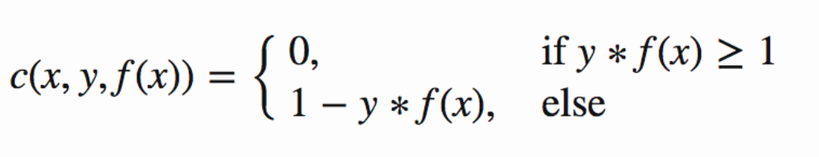
Loss Function
In the SVM algorithm, we are looking to maximize the margin between the data points and the hyperplane.
The loss function that helps maximize the margin is hinge loss.
6

Slide 8
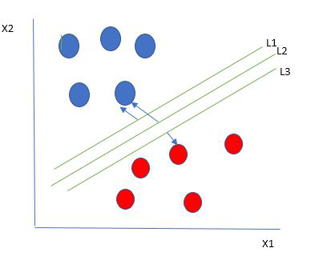
Hard and Soft SVM
The best hyperplane also known as the "hard margin" is the one that maximizes the distance between the hyperplane and the nearest data points from both classes. This ensures a clear separation between the classes.
7

Slide 9
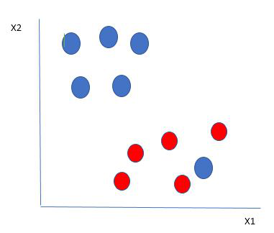
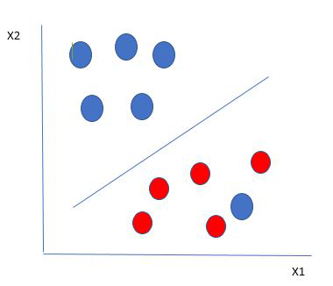
What We Do?
The SVM algorithm has the characteristics to ignore the outlier and finds the best hyperplane that maximizes the margin. SVM is robust to outliers.
A SOFT margin allows for some misclassifications or violations of the margin to improve generalization. The SVM optimizes the loss function to balance margin maximization and penalty minimization
8

Slide 10
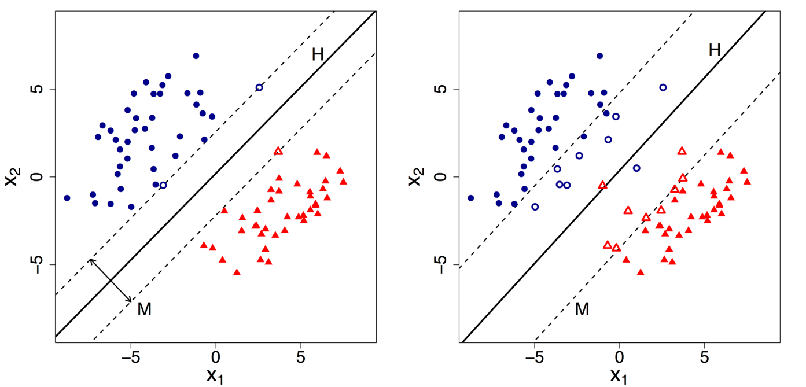
Hard and Soft SVM
By default, SVM implements Hard margin SVM.
It works well only if our data is linearly separable.
Hard margin SVM does not allow any misclassification to happen.
When our data is non-separable/ nonlinear :
Hard margin SVM will not return any hyperplane ☹
it will not be able to separate the data.
Hence this is where Soft Margin SVM comes to the rescue.
9

Slide 11
Regularization parameter
Soft margin SVM allows some misclassification to happen by relaxing the hard constraints of Support Vector Machine.
Soft margin SVM is implemented with the help of the Regularization parameter (C)
Regularization parameter (C):
The C parameter in SVMs is a hyperparameter that determines the trade-off between achieving a low training error and a low testing error. It controls the level of misclassification that can be tolerated in the training dataset.
– C margin ----> Hard SVM
– C margin ----> Soft SVM
10

Slide 12
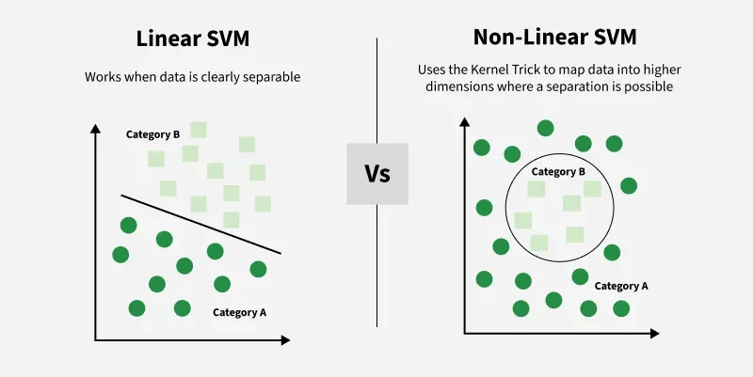
Linear VS Non-Linear SVM
11

Slide 13
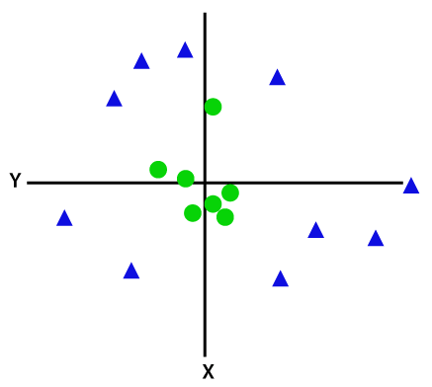
Non-Linear SVM
12

Slide 14
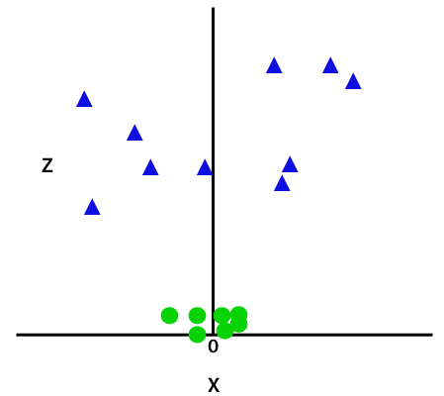
Non-Linear SVM
Use best Mapper(kernel)
z=x² +y²
13

Slide 15
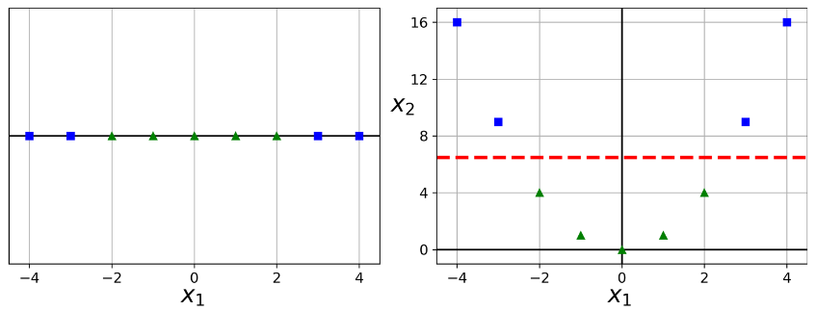
Non-Linear SVM
X ---------> X^2
14

Slide 16
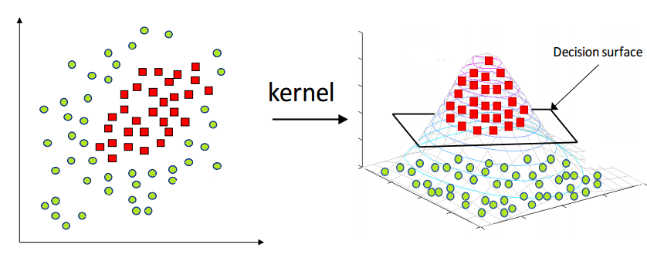
Kernel in SVM
Support Vector Machine deals with nonlinear data by transforming it into a higher dimension where it is linearly separable.
We have various options available with kernel like:
linear,
rbf,
poly
15

Slide 17



Kernel
Polynomial Kernel
Gaussian Kernel
RBF Kernel
RBF Laplacian
Tan Hyperbolic
Sigmoid
Bessel
Kernel GIF
16

Slide 18

Radial Basis Function
The Radial Basis Function (RBF) kernel is a popular choice for Support Vector Machines (SVMs) because it can effectively handle non-linear data by mapping it into a higher-dimensional space. It is particularly useful when the data is not easily separable by a straight line or hyperplane
RBF kernels are the most generalized form of kernelization and is one of the most widely used kernels due to its similarity to the Gaussian distribution. The RBF kernel function for two points X₁ and X₂ computes the similarity or how close they are to each other. This kernel can be mathematically represented as follows:
17

Slide 19

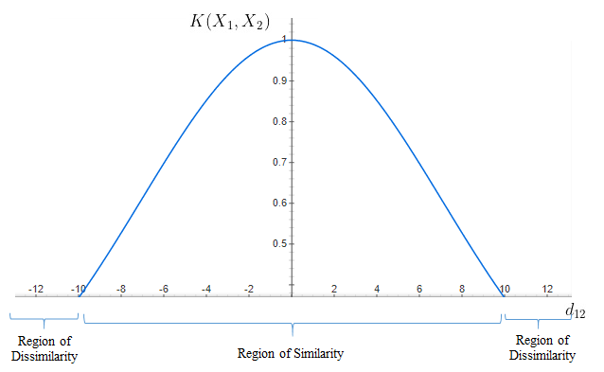
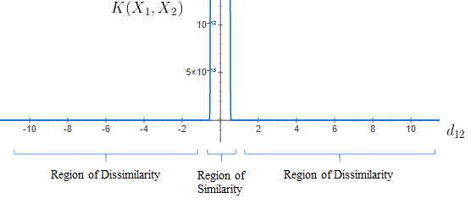
Radial Basis Function
‘σ’ is the variance and our hyperparameter
2. ||X₁ – X₂|| is the Euclidean (L₂-norm) Distance between two points X₁ and X₂
γ = 0.1
γ = 10
18

Slide 20
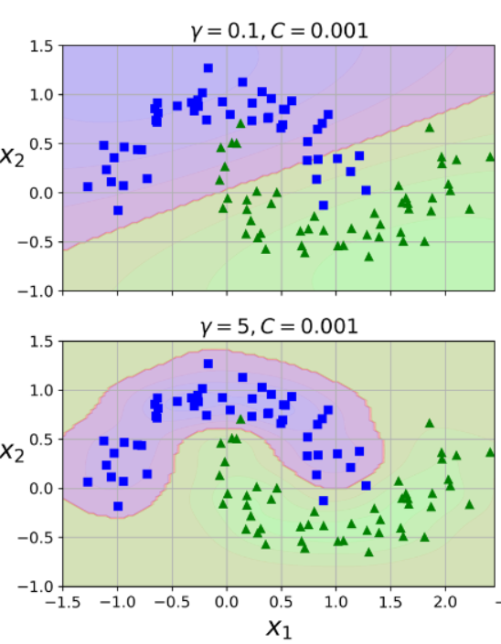
Gamma Parameter
It tells us how much will be the influence of the individual data points on the decision boundary.
– Small Gamma: More data points will influence the decision boundary. Therefore, the decision boundary is more generic.
– Large Gamma: Fewer data points will influence the decision boundary. Therefore, decision boundary becomes non-linear leading to overfitting
19

Slide 21
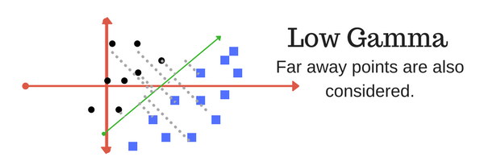
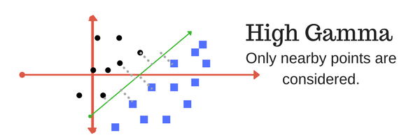
Gamma Parameter
Gamma GIF
Gamma Data Curvature Variance
Gamma Data Curvature Variance
20

Slide 22
SVM Conclusion
Linear, Non linear, Regression, even outlier Detection
One of the Best ML
Better for small or medium Dataset
Memory Usage is high
21

Slide 23
Classification
Decision Tree

Slide 24
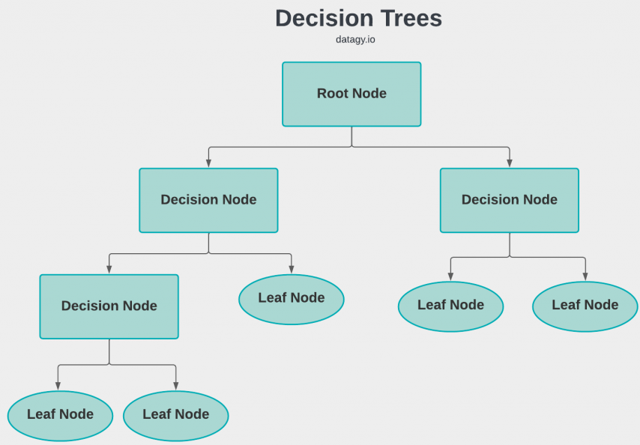
Terminologies of Decision Tree Classification
Root Node
Decision Node
Leaf Node
Splitting
Pruning
Branch
Parent and Child Node
23

Slide 25
Decision Trees Algorithms
ID3
C4.5
CART
CHAID
MARS
24

Slide 26
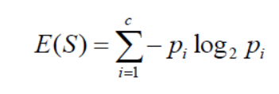

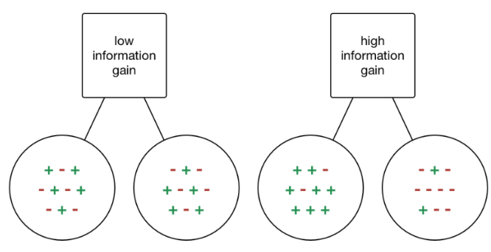
Attribute Selection Measures
Entropy measures the impurity or randomness in a dataset
Information gain tells you how much a specific feature helps in separating the data into more organized groups
Entropy
Information gain
High Entropy
Low Entropy
25

Slide 27
ID3 Decision Trees
It begins with the original set S as the root node.
On each iteration of the algorithm, it iterates through the very unused attribute of the set S and calculates Entropy(H) and Information gain(IG) of this attribute.
It then selects the attribute which has the smallest Entropy or Largest Information gain.
The set S is then split by the selected attribute to produce a subset of the data.
The algorithm continues to recur on each subset, considering only attributes never selected before.
26

Slide 28
Application of Decision Tree
Loan Application Approval
Prediction of Customer Churn
Fraud Detection
Medical Diagnosis
27

Slide 29
Classification of Croplands Using Decision Tree
Spring
Peak Value > 210
Samples =
Class = Spring
Fall
230 < P2 < 290
& 130 < P4 < 170
& 190 < P5 < 260
Samples =
Class = Arboretum
84 < P5 < 93 &
0.02<P6 <0.05
Samples =
Class = Corn
17< P1 < 33
& 0.10 < P6 < 0.14
& 0.51< P8 < 0.56
Samples =
Class = Rapeseed
Samples =
Class = Arboretum
Samples =
Class = Corn
95 < P5 < 102
&
0.06 < P6 < 0.09
Samples =
Class = Rice
Samples =
Class = Rapeseed
150 <P2<180
& 0.41< P9 < 0.43
Samples =
Class = Wheat
Samples =
Class = Rice
Samples =
Class = Others
25 <P12<35
& 0.38< P9 < 0.40
Samples =
Class = Barley
Samples =
Class = Wheat
25 <P12<35
& 0.38< P9 < 0.40
Samples =
Class = Barley
Samples =
Class = Others
28

Slide 30
Classification of croplands using Decision Tree
Parameter of Classification :
Parameter:
P1 = Start Growing Period
P2 = End Growing Period
P3 = Start Growing Period1
P4 = End Growing Period1
P5 = Length
P6 = Base Level
P7 = Middle Growing Period
P8 = Maximum EVI
P9 = AMP Growing Period
P10 = Rate Growing
P11 = Rate Decreasing
P12 = large Growing Integral
P13 = Small Growing Integral
29

Slide 31
C4.5 Decision Tree
Data Type: Can handle both categorical and continuous data.
Splitting Criterion: Uses gain ratio, a modification of information gain, to overcome the bias towards attributes with many values.
Overfitting: Uses pruning techniques to reduce overfitting and improve generalization.
Missing Values: Can handle missing values by considering only the records where the attribute is defined.
Computational Cost: Generally faster and more efficient than ID3
30

Slide 32
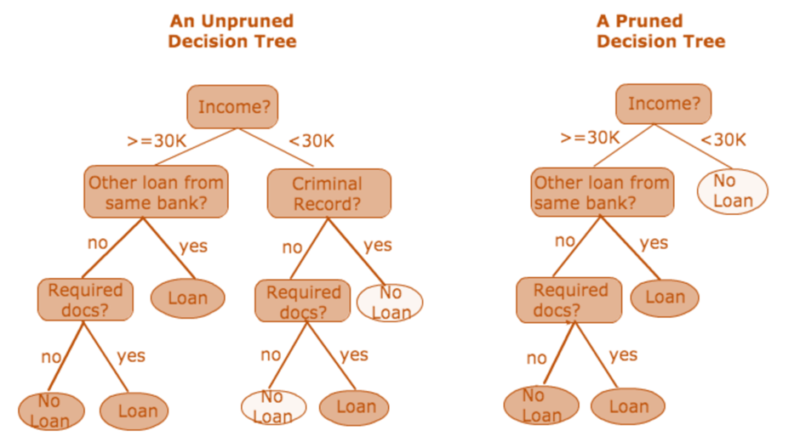
Pruning
Decision tree pruning is a technique used to prevent decision trees from overfitting the training data. Pruning aims to simplify the decision tree by removing parts of it that do not provide significant predictive power, thus improving its ability to generalize to new data.
Pre-Pruning (Early Stopping)
Maximum Depth
Post-Pruning (Reducing Nodes)
Minimum Leaf Size
31

Slide 33
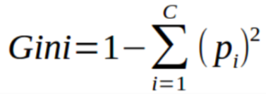
CART
CART( Classification And Regression Trees) is a variation of the decision tree algorithm. It can handle both classification and regression tasks.
Splitting criteria
Classification: CART uses Gini impurity as the splitting criterion. The lower the Gini impurity, the more pure the subset is.
Regression: CART uses residual reduction as the splitting criterion. The lower the residual reduction, the better the fit of the model to the data.
Pruning
To prevent overfitting of the data/ Reduce cost and complexity
Gini Index:
calculates the probability of a certain randomly selected feature that was classified incorrectly.
The Gini Index varies between 0 and 1.
Gini Index = 0 ------> purity of the classification
Gini Index = 1 ------> random distribution
32

Slide 34
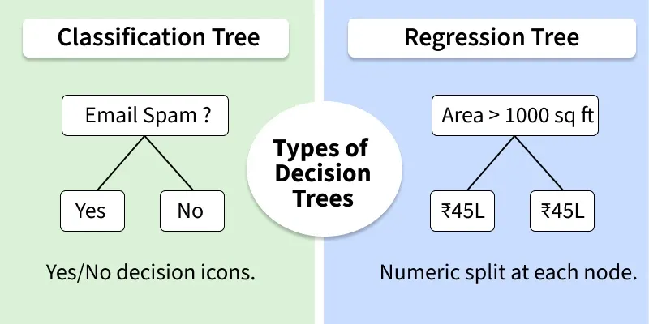
Decision Tree
33

Slide 35

Advantages VS Disadvantages of Decision Tree
The decision tree is a white-box model. We can easily understand any particular condition of the model which results in either true or false.
It can handle both continuous and categorical data.
Decision trees may become very large and complex with a large number of attributes.
A decision tree at times can be sensitive to the training data, a very small variation in data can lead to a completely different tree structure.
34

Slide 36
Classification
Random Forest

Slide 37
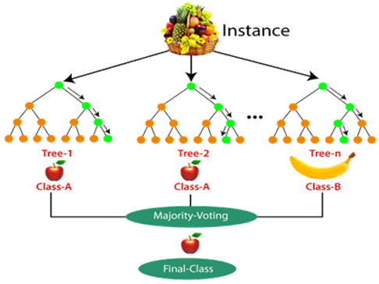
Random forest
Random forest, like its name implies, consists of a large number of individual decision trees that operate as an ensemble. Each individual tree in the random forest spits out a class prediction and the class with the most votes becomes our model’s prediction.
Ensemble Learning
Ensemble methods
The Wisdom of Crowds
36

Slide 38
How to work the RF Algorithm
Create Many Decision Trees
Pick Random Features
Each Tree Makes a Prediction
Combine the Predictions:
For classification we choose a category as the final answer is the one that most trees agree on i.e majority voting.
For regression we predict a number as the final answer is the average of all the trees predictions.
Why It Works Well: Using random data and features for each tree helps avoid overfitting and makes the overall prediction more accurate and trustworthy.
37

Slide 39
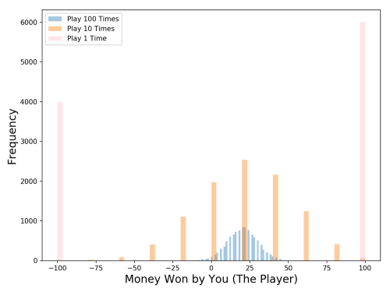
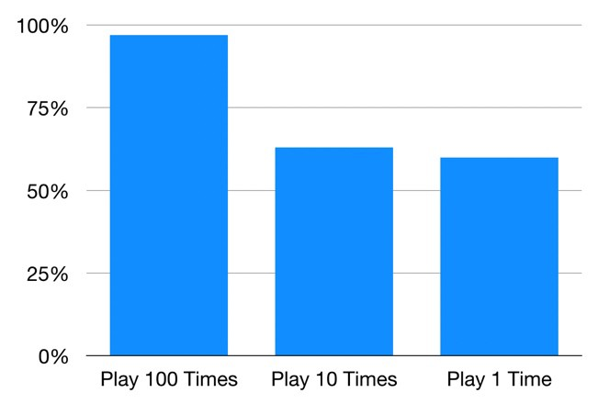
The Wisdom of Crowds
Many uncorrelated models is Useful
38

Slide 40
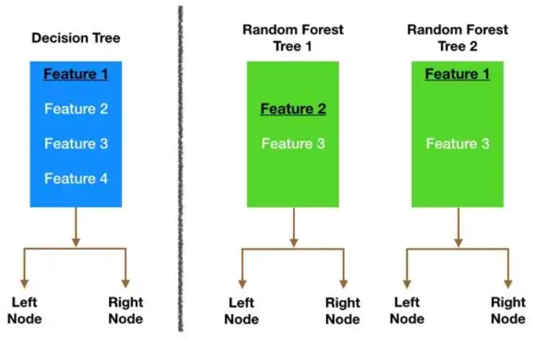
Is Random forest Use Diversity?
[1, 2, 3, 4, 5, 6]
Bagging
[2, 2, 3, 4, 6, 6]
Feature Randomness
39

Slide 41
Random forest Important Parameter
n_estimators: Number of trees in the forest.
max_depth: Maximum depth of each tree.
max_features: Number of features considered for splitting at each node.
criterion: Function used to measure split quality ('gini' or 'entropy').
min_samples_split: Minimum samples required to split a node.
min_samples_leaf: Minimum samples required to be at a leaf node.
bootstrap: Whether to use bootstrap sampling when building trees (True or False).
40

Slide 42
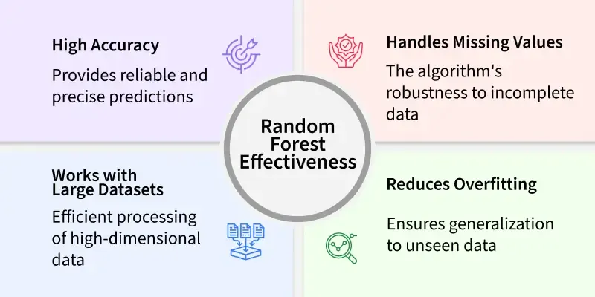
Random forest Effectiveness
41

