Slide 1


وبینارآموزشی یادگیری ماشین با پایتون
بهار 1404

Slide 2

Supervised Learning
Classification / Regression

Slide 3
Regression
Regression algorithms predict a continuous value based on input data. This is used when you want to predict numbers such as income, height, weight, or even the probability of something happening (like the chance of rain).
Regressor
( Perceptive inputs )
continuous-valued
2

Slide 4
Classification
Classification is the technique of categorizing a given collection of data into groups.
Data -----?-----> Group
Classifier
( Perceptive inputs )
Discrete-valued
3

Slide 5
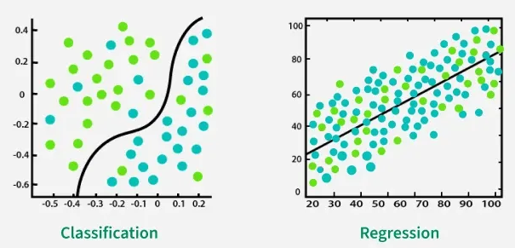
Regression VS Classification
Classification
Regression
classification aims to find decision boundaries that separate classes
whereas regression focuses on finding the best-fitting line to predict numerical outcomes
4

Slide 6
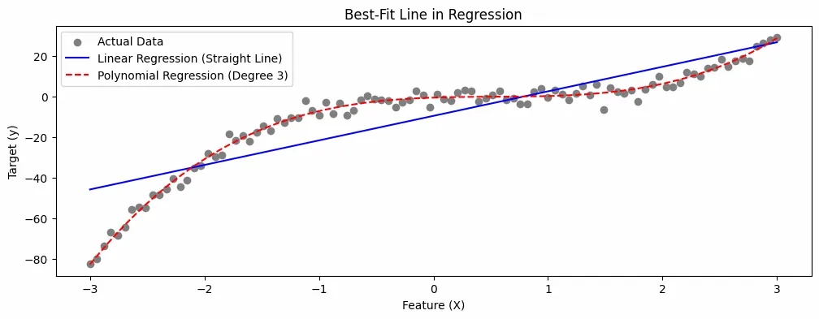
Best-Fit Line in Regression
In regression, a best-fit line (or regression line) represents the relationship between independent variables (inputs) and a dependent variable (output). It is used to predict continuous numerical values capturing trends and relationships within the data, allowing for accurate predictions of continuous variables. The best-fit line can be linear or non-linear:
A straight line is used for linear regression.
Curves are used for more complex regressions, like polynomial regression
5

Slide 7
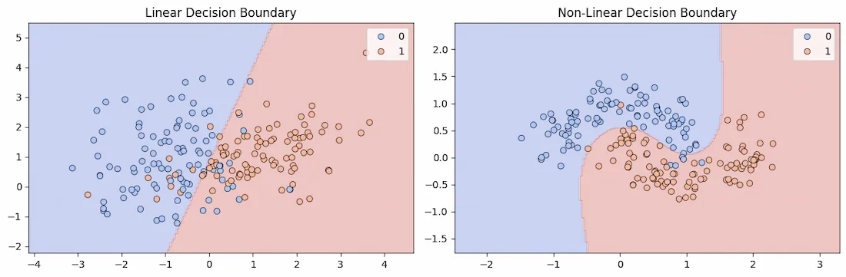
Decision Boundary in Classification
It is an surface or line that separates data points into different classes in a feature space.
It can be linear (a straight line) or non-linear (a curve), depending on the complexity of the data and the algorithm used.
During training classifier learns to partition the feature space by finding a boundary that minimizes classification errors.
For binary classification, this boundary separates data points into two groups (e.g., spam vs. non-spam emails).
In multi-class classification, multiple boundaries are created to separate more than two classes.
6

Slide 8
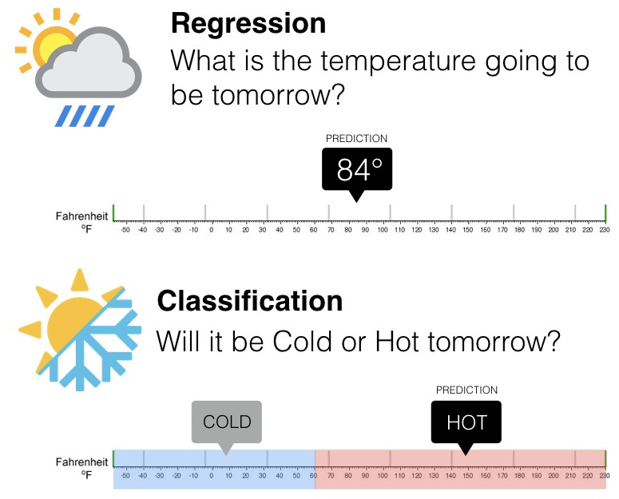
Classification VS Regression
7

Slide 9

Supervised Learning
Training Phase
Model
Testing Phase
Learning the classifier
from the available data
‘Training set’
(Labeled)
Testing how well the classifier
performs
‘Testing set’
8

Slide 10
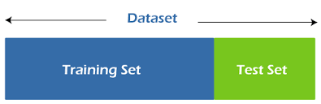
Data in Supervised Learning
9

Slide 11
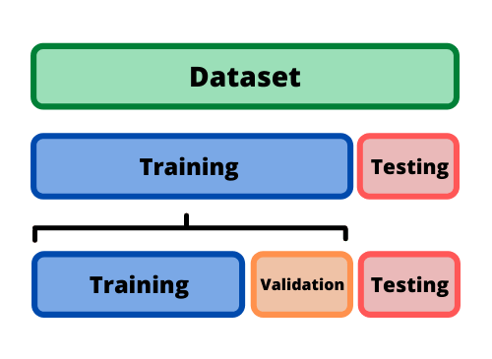
Data in Supervised Learning
9

Slide 12
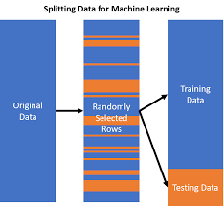
Data in Supervised Learning
9

Slide 13
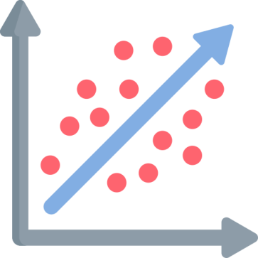
Supervised Learning
Regression

Slide 14
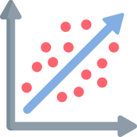
Regression
In Machine Learning, we use various kinds of algorithms to allow machines to learn the relationships within the data provided and make predictions based on patterns or rules identified from the dataset.
So, Regression is a machine learning technique where the model Predicts the output as a continuous numerical value.
Finds out the relationship between a single dependent variable(target variable) dependent on several independent ones.
11

Slide 15
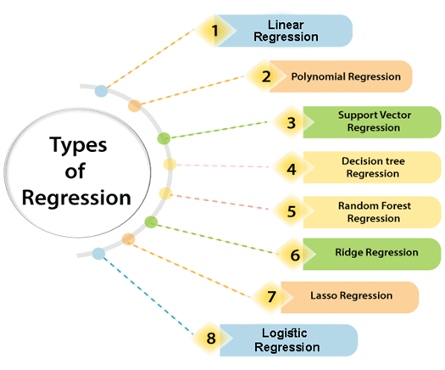
Type of Regression
12

Slide 16
Type of Regression
1
Linear Regression
2
Multiple Linear Regression
3
Polynomial Regression
4
Ridge Regression
5
Lasso Regression
13

Slide 17
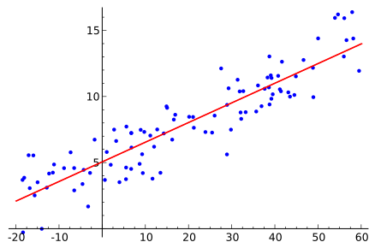
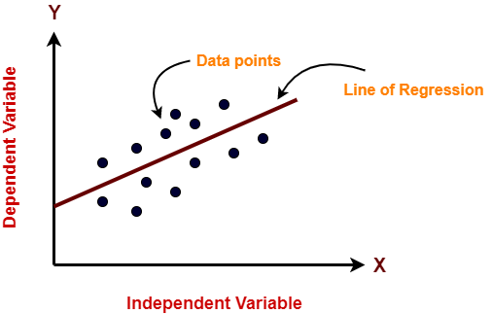
Simple Linear Regression
Linear Regression is an ML algorithm used for supervised learning.
Linear regression performs the task to predict a dependent variable(target) based on the given independent variable(source).
So, this regression technique finds out a linear relationship between a dependent variable and the other given independent variables.
14

Slide 18
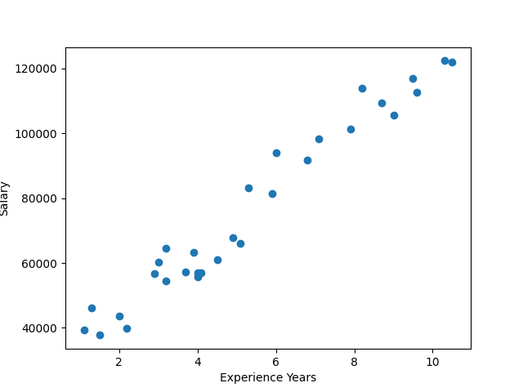
Simple Linear Regression
Y = m*x + b
15

Slide 19
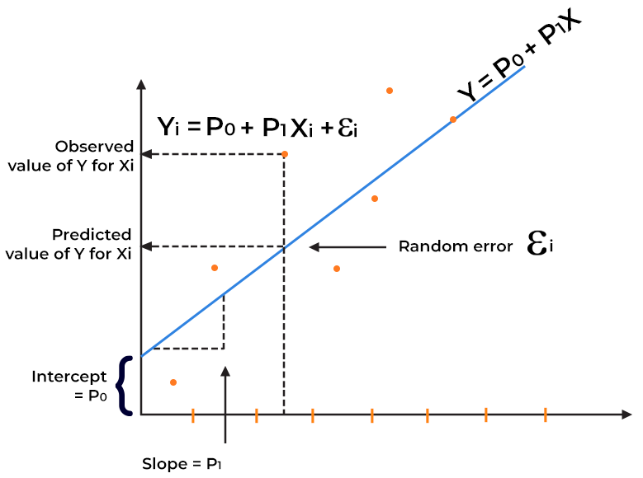
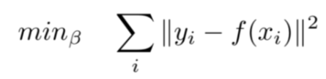
Loss Function
Our aim is to find such
values of coefficients
minimize the cost function
16

Slide 20
Evaluation Metrics
1
Mean Square Error (MSE)
2
Mean Absolute Error (MAE)
3
Root Mean Squared Error (RMSE)
4
R-squared
17

Slide 21


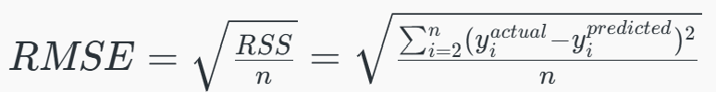

Evaluation Metrics
Evaluation | Description | Formula
MSE | Is equal to the average squared difference between an observation’s actual and predicted values.
MAE | MAE measures the average absolute difference between the predicted values and actual values
RMSE | It represents the square root of the average squared differences between predicted and actual values.
R^2 | statistic that indicates how much variation the developed model can explain or capture. It is always in the range of 0 to 1.
18

Slide 22
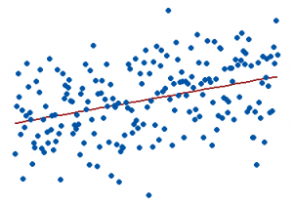
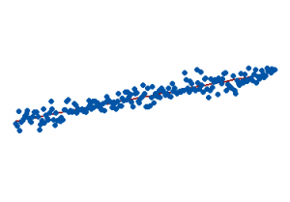
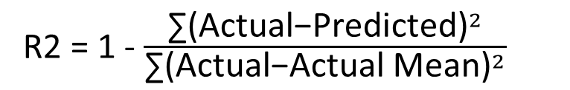
R-Squared
R-Squared (R² or the coefficient of determination) is a statistical measure in a regression model that determines the proportion of variance in the dependent variable that can be explained by the independent variable.
In other words, r-squared shows how well the data fit the regression model.
R2 = 1 - $\frac{{\text{∑(}\text{Actual}\text{−}\text{Predicted}\text{)}}^{2}}{{\text{∑(}\text{Actual}\text{−}\text{Actual} \text{Mean}\text{)}}^{2}}$
A
B
19

Slide 23
Gradient Descent
"Augustin-Louis Cauchy" in mid of 18th century.
Gradient Descent is known as one of the most commonly used optimization algorithms to train machine learning models by means of minimizing errors between actual and expected results.
Further, gradient descent is also used to train Neural Networks.
20

Slide 24
Gradient Descent
In mathematical:
Optimization algorithm ------> task of minimizing/maximizing an objective function f(x) parameterized by x.
In machine learning:
optimization -----------> task of minimizing the cost function parameterized by the model's parameters.
The main objective of gradient descent is :
to minimize the convex function using iteration of parameter updates.
21

Slide 25
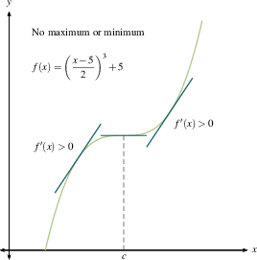
Gradient Descent
If we move towards a negative gradient or away from the gradient of the function at the current point, it will give the local minimum of that function.
Whenever we move towards a positive gradient or towards the gradient of the function at the current point, we will get the local maximum of that function.
22

Slide 26
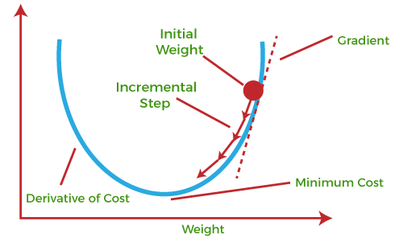
Gradient Descent
The main objective of using a gradient descent algorithm is to minimize the cost function using iteration
Two Steps:
Calculates the first-order derivative of the function to compute the gradient or slope of that function.
Move away from the direction of the gradient, which means slope increased from the current point by alpha times, where Alpha is defined as Learning Rate.
23

Slide 27
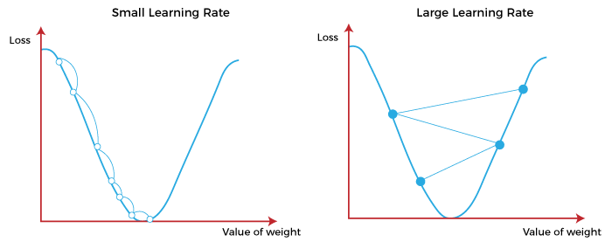
Alpha Rate
24

Slide 28
Cost Function - Gradient Descent
The cost function is defined as the measurement of difference or error between actual values and expected values at the current position.
Gradient Descent helps to increase and improve machine learning efficiency by providing feedback to this model so that it can minimize error and find the local or global minimum.
Loss Function : Error within the single training set.
Cost Function : Calculates the average error in all loss function.
25

Slide 29

Multiple linear regression
Multiple linear regression is used to estimate the relationship between two or more independent variables and one dependent variable.
Y : is the dependent variable.
x1, x2,x3,… : are independent variables.
b0 : intercept of the line.
b1, b2, … : are coefficients.
26

Slide 30

Linear Regression
Linear Regression is simple to implement.
Less complexity compared to other algorithms.
Linear Regression may lead to over-fitting but it can be avoided using some dimensionality reduction techniques and etc.
Outliers affect this algorithm badly.
It over-simplifies real-world problems by assuming a linear relationship among the variables, hence not recommended for practical use-cases.
27

Slide 31
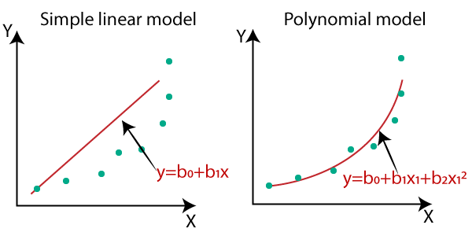
Polynomial Regression
Polynomial Regression is a regression algorithm that models the relationship between a dependent(y) and independent variable(x) as nth degree polynomial.
Y = b₀+b₁x₁+ b₂x₁²+ b₂x₁³+...... b_{n}x₁^{n}
Polynomial Regression is a form of Linear regression known as a special case of Multiple linear regression which estimates the relationship as an nth degree polynomial. Polynomial Regression is sensitive to outliers so the presence of one or two outliers can also badly affect the performance.
28

Slide 32
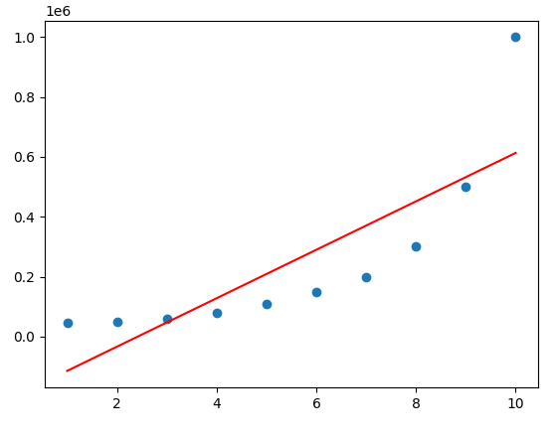
Bias VS Variance
Bias
Bias is the difference between the average prediction of our model and the correct value that we are trying to predict.
The model with high bias pays very little attention to the training data and oversimplifies the model. It always leads to high error in training and test data.
Under fitting ☹
29

Slide 33
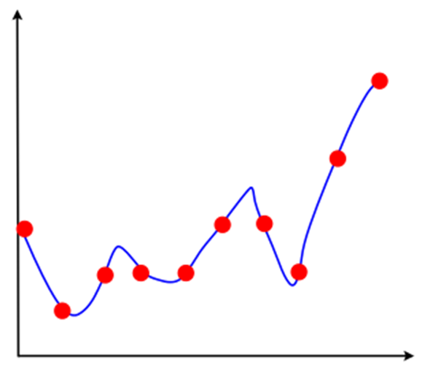
Bias VS Variance
Variance
The model with high variance pays a lot of attention to training data and does not generalize on the data which it hasn’t seen before. As a result, such models perform very well on training data but has high error rates on test data.
Over fitting ☹
1
30

Slide 34
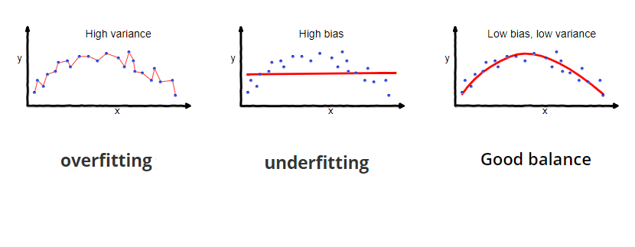
Bias VS Variance
High Error In test
High Error
Irreducible Error
31

Slide 35
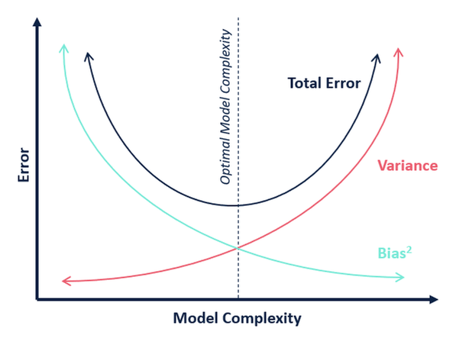
Bias VS Variance Trade off
Use more data for training
Use Regularization
32

Slide 36
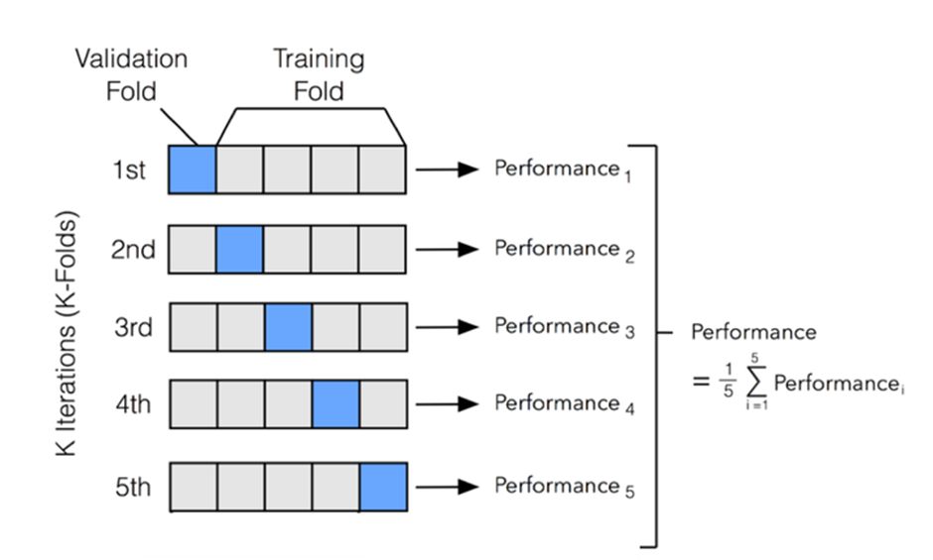
K-Fold Cross Validation
Validation
Over fitting !
33

Slide 37
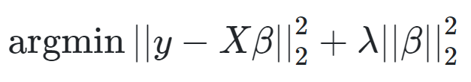
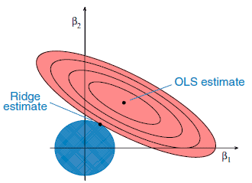
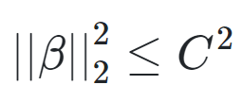
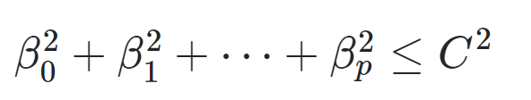
Ridge Regression
Ridge regression usually used when there is a high correlation between the independent variables.
This is because, in the case of multi collinear data, the least square estimates give unbiased values. But, in case the collinearity is very high, there can be some bias value.
Imagine your model is overreacting to tiny details in the data (like memorizing noise). Ridge regression "calms it down" by shrinking the model's weights (coefficients) toward zero.
L2 regularization
34

Slide 38
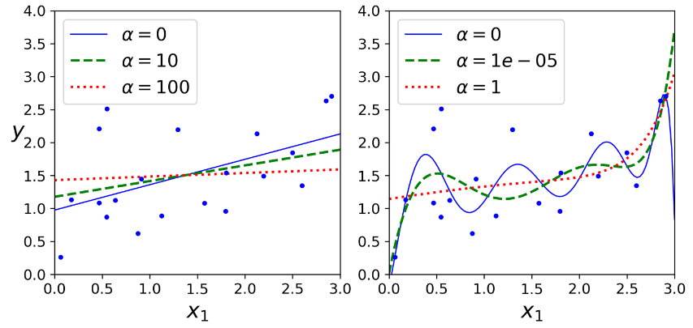
Ridge Regression
35

Slide 39
Hyperparameter Tuning
Hyperparameter tuning is one of the most important parts of a machine learning pipeline.
A wrong choice of the hyperparameters values may lead to wrong results and a model with poor performance.
Grid search
Random search
36

Slide 40
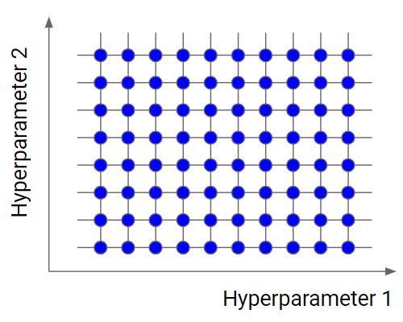
Hyperparameter Tuning
Grid search
Grid search is the simplest algorithm for hyperparameter tuning. Basically, we divide the domain of the hyperparameters into a discrete grid. Then, we try every combination of values of this grid, calculating some performance metrics using cross-validation. The point of the grid that maximizes the average value in cross-validation, is the optimal combination of values for the hyperparameters.
37

Slide 41
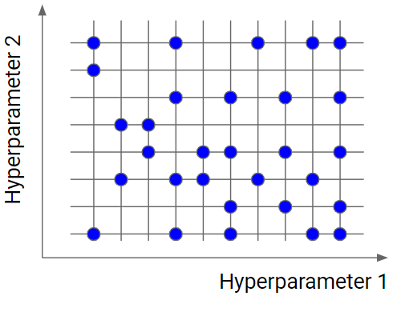
Hyperparameter Tuning
Random search
Random search is similar to grid search, but instead of using all the points in the grid, it tests only a randomly selected subset of these points.
38

Slide 42
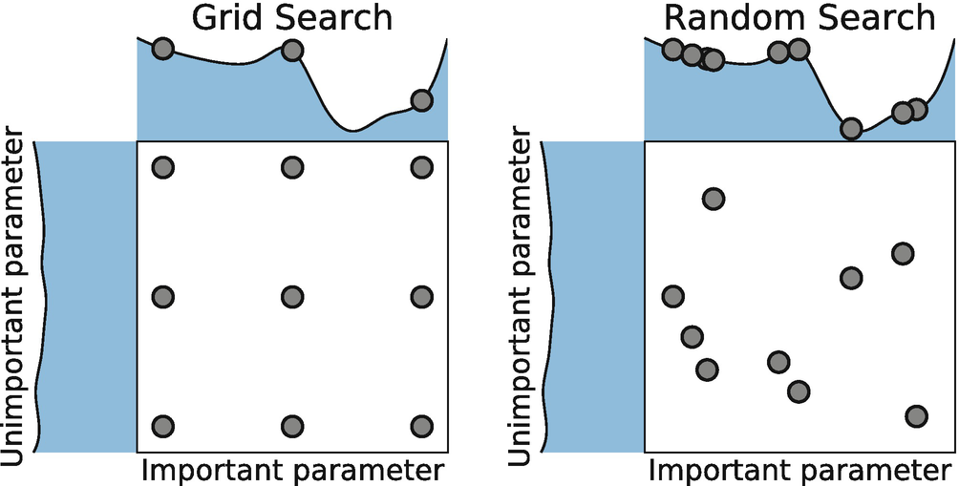
Hyperparameter Tuning
39

Slide 43
LASSO Regression
LASSO stands for Least Absolute Selection Shrinkage Operator.
Shrinkage is basically defined as a constraint on attributes or parameters.
Performs regularization along with feature selection.
Variables with a regression coefficient of zero are excluded from the model.
So, lasso regression analysis is basically a shrinkage and variable selection method and it helps to determine which of the predictors are most important.
In case the independent variables are highly collinear, then Lasso regression picks only one variable and makes other variables to shrink to zero.
40

Slide 44
LASSO Regression
Feature selection in machine learning involves selecting a subset of relevant features (or variables) from the original set of features available in the dataset. The goal of feature selection is to improve model performance by reducing the dimensionality of the feature space, removing irrelevant or redundant features, and focusing only on those features that contribute most to the predictive power of the model.
Regularization refers to the technique of adding a penalty term to the objective function during training to prevent overfitting and improve generalization performance.
The primary goal of regularization is to discourage the model from fitting the training data too closely, which can lead to poor performance on unseen data.
41

Slide 45
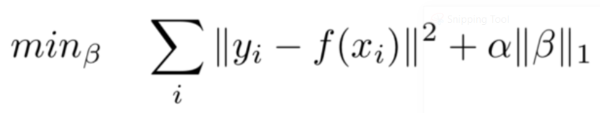
LASSO Regression
penalty term contains only the absolute weights instead of a square of weights.
It enforces sparsity on the learned weights.
L1 regularization
42

Slide 46
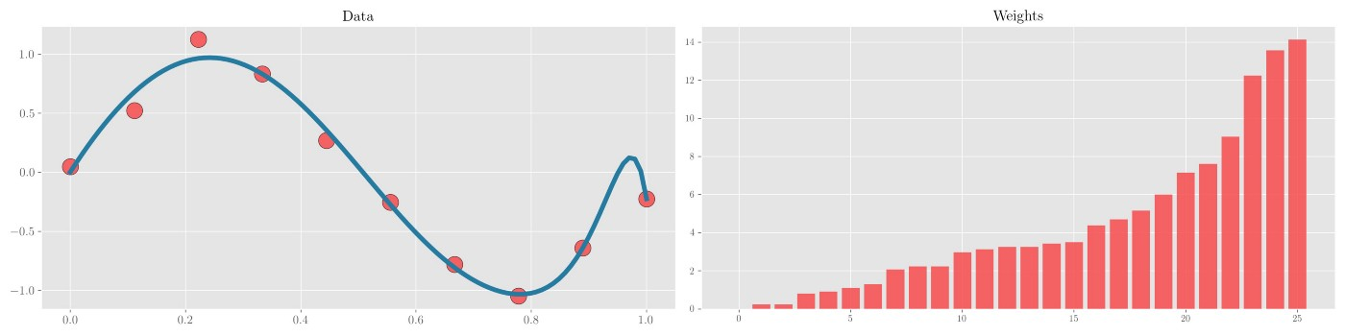
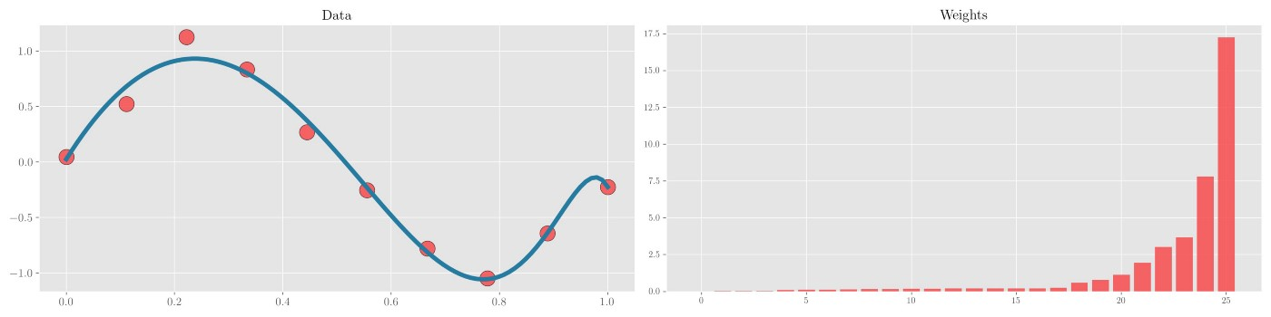
Ridge VS LASSO
43

