Slide 1
Enhancement of TCP Congestion Control Protocol
CSE497

Slide 2
Presented by:
Umma Sahorina Sultana (2018-1-60-145)
Arina Islam Ahona (2018-1-60-179)
Rehana Akter (2018-1-60-202)
Ehsanul Haque (2018-1-68-079)
Supervisor:
Dr. Anisur Rahman
Associate Professor,
Dept. of Computer Science and Engineering,
East West University

Slide 3
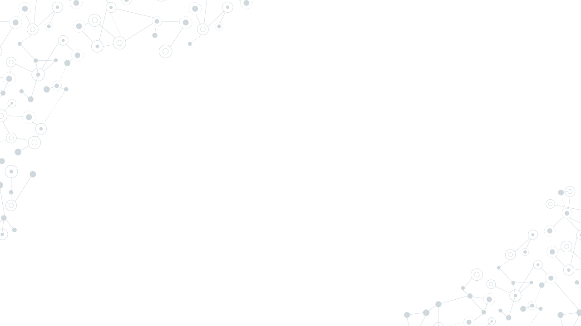
Introduction
Network congestion refers to a reduction in quality of service (QOS) that causes packet loss, queue delay, or the blocking of new connections.
Effects of Congestion:
1. As delay increases, performance decreases.
2. If delay increases, retransmission occurs, making situation worse.

Slide 4
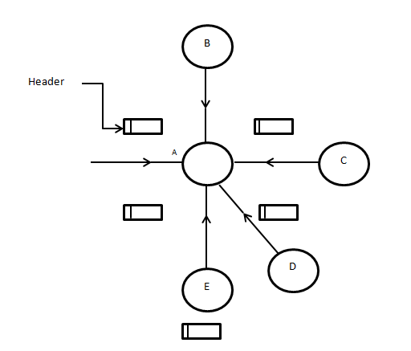
How is Congestion Created?
Figure: Creation of Congestion

Slide 5
Importance of Congestion Control
When the sender is sending packets which is higher than the capacity of the receiver, packet drop occurs.
Importance of Congestion Control:
1.To Control Data Loss.
2.To save the Bandwidth from being waste
3.Unreliable connection.

Slide 6
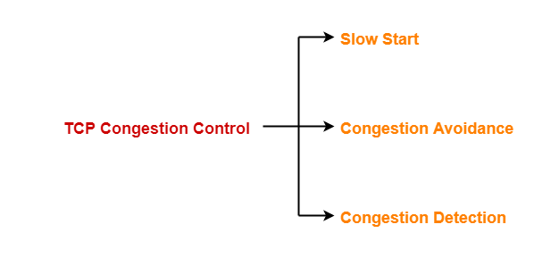
TCP Congestion Control Algorithm
TCP (Transmission Control Protocol) uses various kinds of congestion control algorithms. To find the solution to this problem we have decided to use Slow and Start algorithm.
Congestion control of TCP has 3 phases-

Slide 7
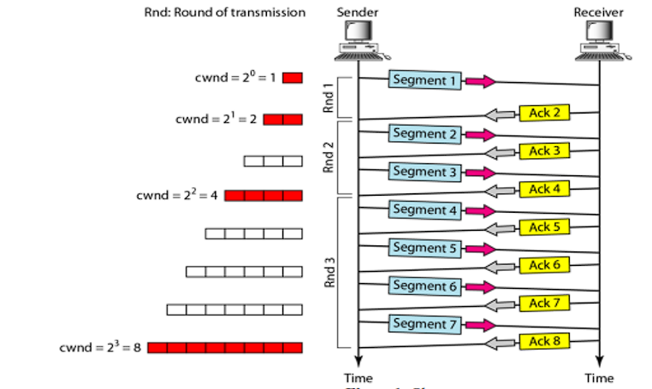
Formula of Slow-Start Phase Congestion window size = Congestion window size + Maximum Segment Size (MSS)
Figure: Slow Start Phase

Slide 8
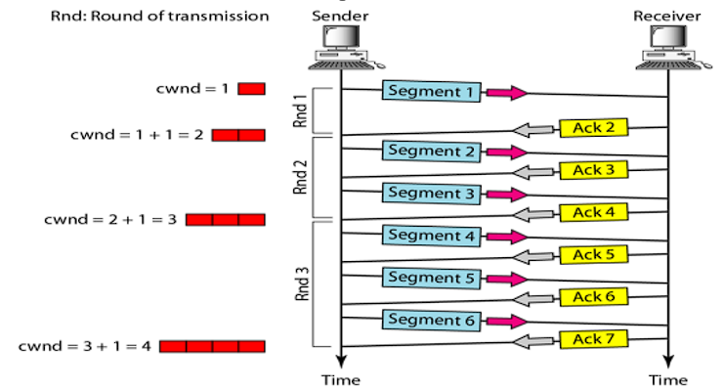
Congestion Avoidance Phase After reaching the threshold value congestion avoidance phase starts. The congestion window size is increased linearly by the sender after receiving each acknowledgement.
Figure: Congestion avoidance

Slide 9
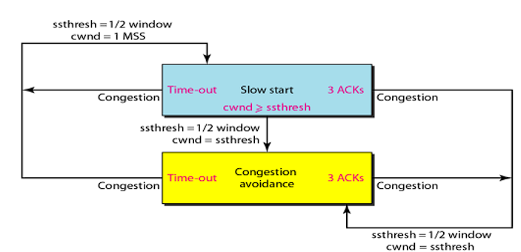
Congestion Detection Phase When sender does not get acknowledgement for the received transmitted segment, sender understands congestion has occurred. Retransmission occurs in : 1. When a timer times out. 2. When 3 acknowledgments are achieved. In both cases threshold will be dropped to one half.
Figure: TCP congestion policy

Slide 10
Limitations of Previous Algorithm
Algorithm:
initialize: cwnd = 1
for (each segment ACKed)
cwnd++;
until (congestion event or cwnd > ssthresh)
/* slowstart is over */
/* cwnd > ssthresh */
every new ACK: cwnd += 1/cwnd
Until (timeout) /* loss event */
If receiving 3ACK for one segment or timeout occurs
Retransmit the packet
/*Perform congestion avoidance phase
ssthresh = cwnd /2
cwnd = 1
perform slowstart
The main problem of slow and start algorithm is that in the slow start phase we have to send small segment of data even if the condition of the network is good.
This is also a time-consuming process.

Slide 11
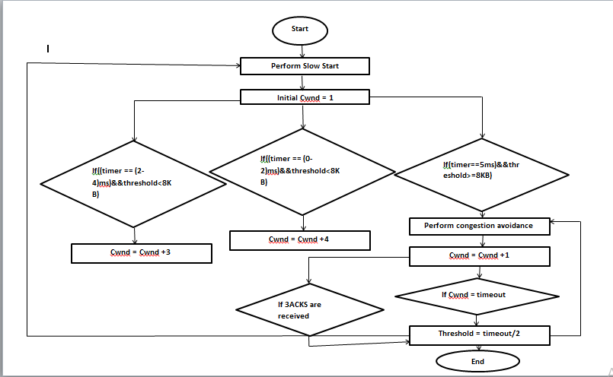
Proposed Version of Slow-Start Algorithm
Improved Part of the Algorithm:
We have taken the timer is of 5ms and threshold is 8KB.
If((timer == (0-2)ms) && threshold<8KB)
Cwnd+=4;
If((timer == (2-4)ms) && threshold<8KB)
Cwnd+=3;
If (timer == 5ms && threshold>= 8KB)
Cwnd += 1;
If (timeout == 12KB)
threshold = timeout/2;
Cwnd =cwnd+1;
Figure: Flowchart of proposed method

Slide 12
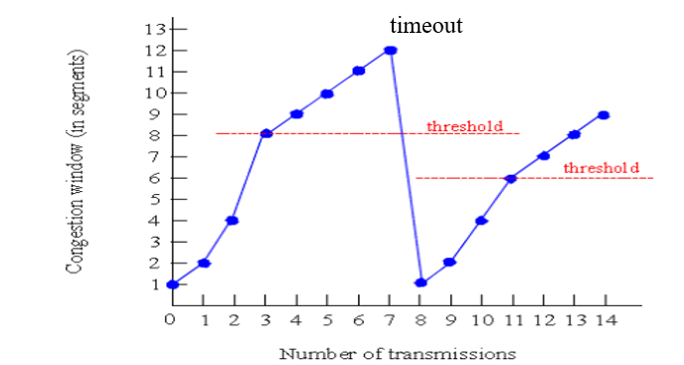
Graphical Representation
Figure: Proposed version of slow-start algorithm

Slide 13
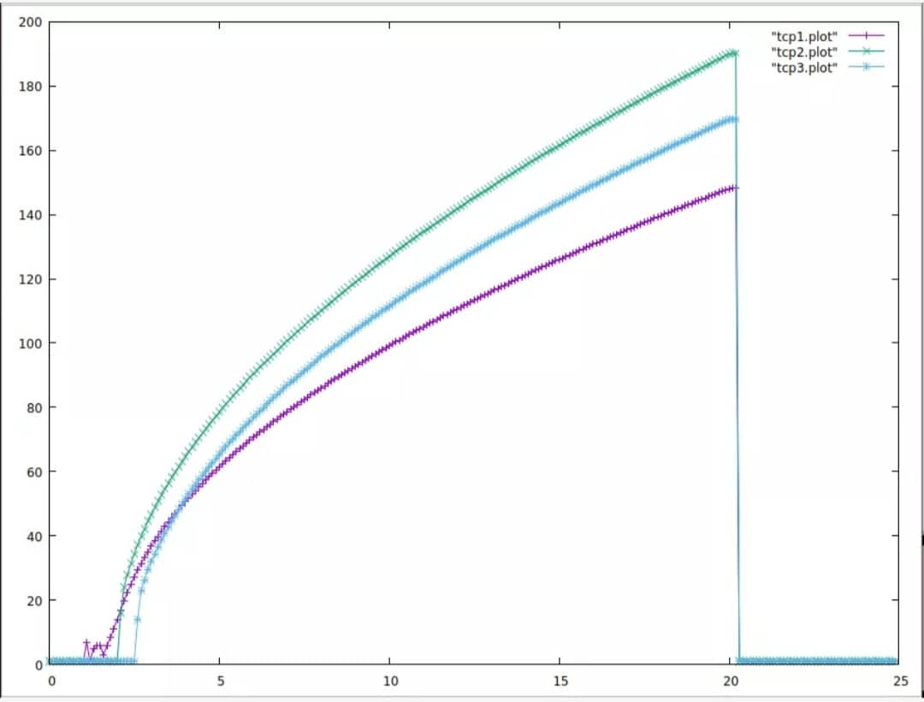
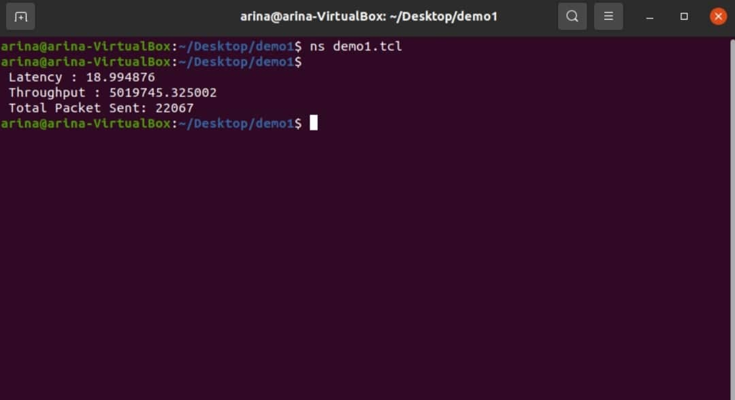
Graph and Calculated Output of the Stimulation

Slide 14

Future Work and Conclusions
Inserting timer to expand the congestion window according to acknowledgement.
Inserting threshold to prevent the window from increasing exponentially.
Calculating and comparing accuracy of the proposed method.
Our proposed method should perform better than the previous slow-start algorithm since it has a flexible congestion window and a timer to calculate the arrival of the acknowledgment packet. We had a better understanding on Transmission Control Protocols, and we have learnt how to stimulate them. Our proposed method is efficient but there is also room for improvement.

Slide 15
Thank You!

