Slide 1
CSE 472 Project Presentation
Project Title : Musical Instruments Classification
Group Members :
Muhammad Ehsanul Kader(1805067)
Shehabul Islam Sawraz(1805088)

Slide 2
Motivation
The goal of the project was to predict the musical instruments that are present in a given musical piece
Prediction of musical instruments can be considered a proxy for the prediction of musical style or genre, as the presence (or absence) of most instruments characterizes musical style

Slide 3
Experiment-I Model Overview
Input
(10,128)
Conv1d
(10,64)
[Kernel Size=3,
Padding=1]
ReLU
Max Pool
[Kernel Size=2,
Stride=2]
Conv1d
(64,128)
[Kernel Size=3,
Padding=1]
ReLU
Max Pool
[Kernel Size=2,
Stride=2]
Conv1d
(128,256)
[Kernel Size=3,
Padding=1]
ReLU
Max Pool
[Kernel Size=2,
Stride=2]
Flatten
Fully Connected
(409, 512)
ReLU
Fully Connected
(512, 20)
Output
(1, 20)

Slide 4
Experiment-I Overview
Loss Function: Binary Cross Entropy with Logits Loss
Optimizer: Adam Optimizer
- Learning Rate: 0.0005
Number of epochs: 20
Number of Samples:
- Training: 11932
- Validation: 2983
- Test: 5085

Slide 5
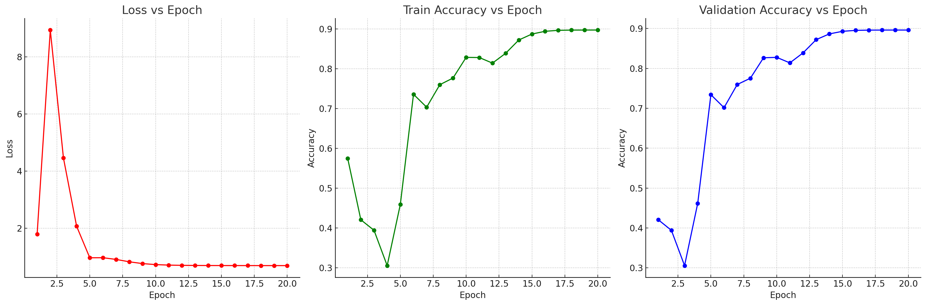
Experiment-I Result
Test Accuracy: 0.89647

Slide 6
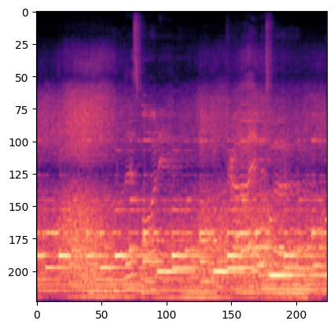

Experiment-II Overview
Model
Output

Slide 7
Experiment-II Model Overview
Input
(3, 224, 224)
ResNet18
ReLU
Fully Connected
(1000, 20)
Output
(1, 20)

Slide 8
Experiment-II Overview
Loss Function: Binary Cross Entropy
Optimizer: Adam Optimizer
- Learning Rate: 0.001
Number of epochs: 10
Number of Samples:
- Training: 4000
- Validation: 1000
- Test: 500

Slide 9
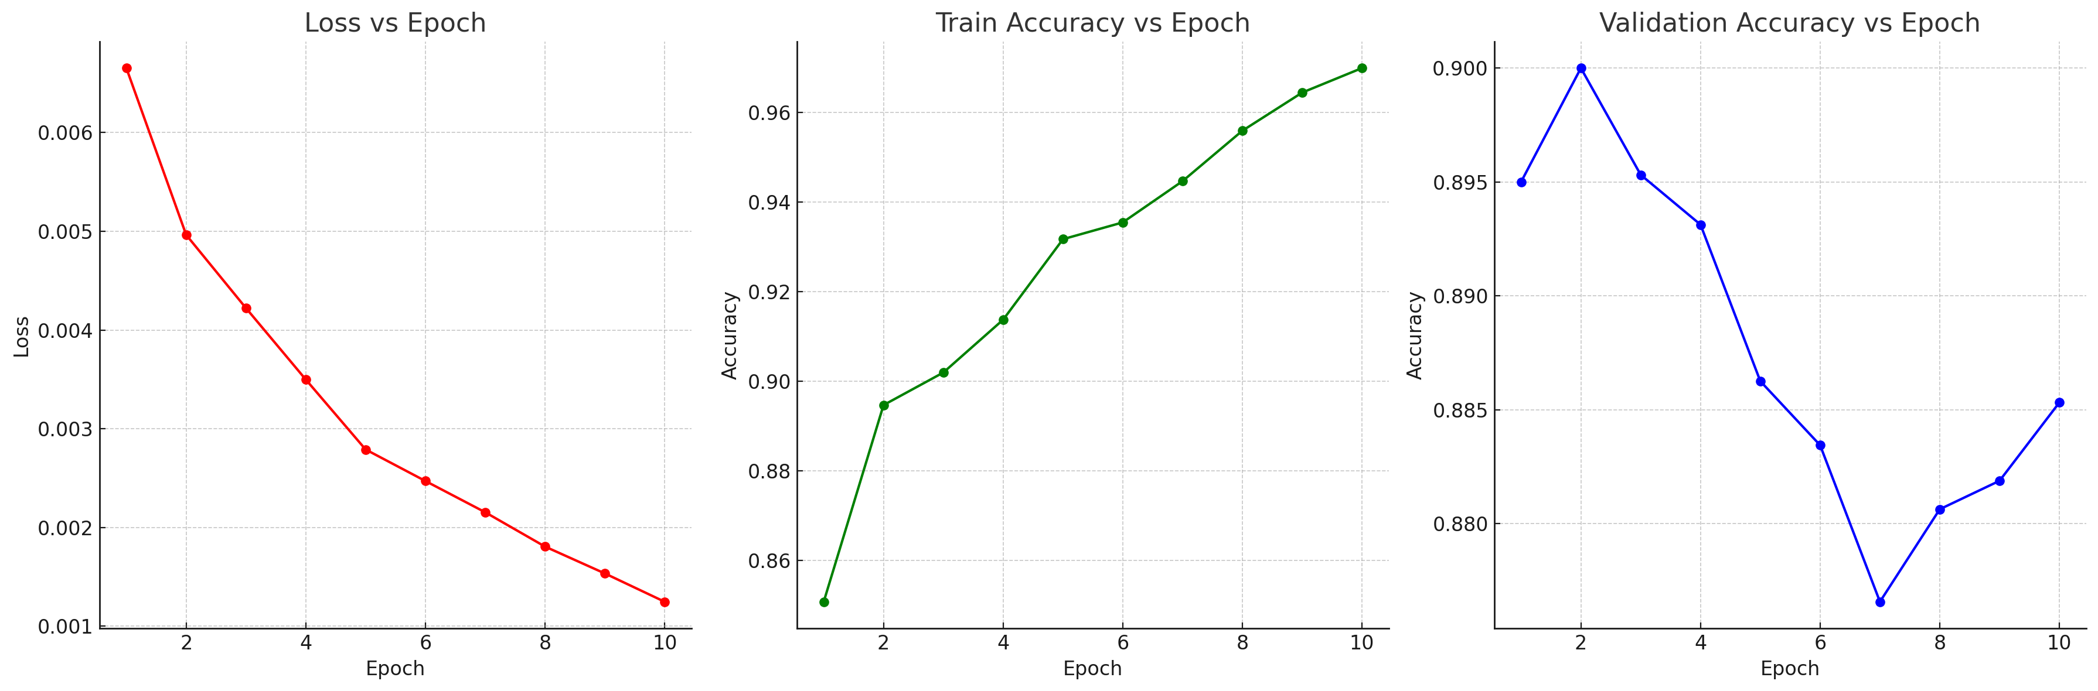
Experiment-II Result
Test Accuracy: 0.8737

Slide 10
Future Direction
Using techniques like SMOTE, different types of Augmentation (Pitch Shifting, Noise Addition, Amplitude Scaling etc.) to create a more balanced dataset
Experimenting with other vision models(e.g. vgg19), transformer based models (e.g. Audio Spectrogram Transformer)

Slide 11
Thank You

