Slide 1

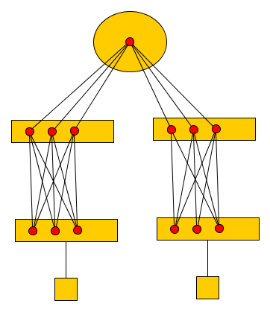
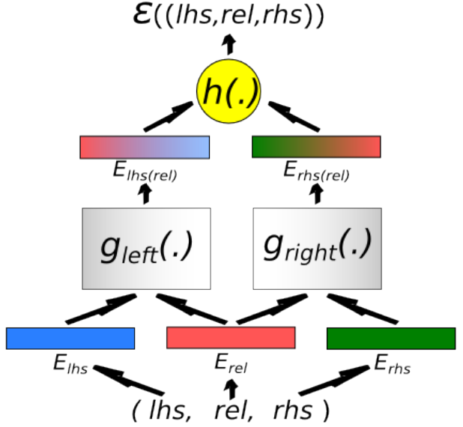
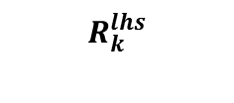
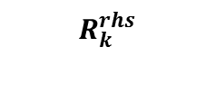
Models
Right Embedding
Left Embedding
Entity Index
Entity Index

Slide 2
Training
Randomly initialize embeddings and relation matrices
Generate random negative triplets:
Rank training triplets and negative triplets
Using Stochastic Gradient Descent to tune embeddings and relations with large margin.
At the end we will have d-dimension vector representations of entities and relations (Bordes 2012)
Training
Training
Training
Randomly initialize embeddings and relation matrices
Generate random negative triplets:
Rank training triplets and negative triplets
Using Stochastic Gradient Descent to tune embeddings and relations with large margin.
Randomly initialize embeddings and relation matrices
Generate random negative triplets:
Rank training triplets and negative triplets
Using Stochastic Gradient Descent to tune embeddings and relations with large margin.
Randomly initialize embeddings and relation matrices
Generate random negative triplets:
Rank training triplets and negative triplets
Using Stochastic Gradient Descent to tune embeddings and relations with large margin.

Slide 3
Link KB to Text
Bordes models learn embeddings from KB. No link to text.
The goal is to link Bordes method to text. Learn embeddings both from Freebase structure and contextual features.
We use Reidel dataset for this purpose and train the bordes model using new types of features.
By mew features we mean introducing new relation types which encode contextual data.

Slide 4
Data Encoding
POSITIVE
“Karl Popper” /people/person/place_of_birth “Vienna”
“/people/person/place_of_birth” HAS_TRIGGER “bear”
“Karl Popper” Born “Vienna”
“bear” HAS_LEX “born”
“Karl Popper” TYPE_OF “PERSON”
“Vienna” TYPE_OF “LOCATION”
“Karl Popper” HAS_DEPENDENCY_ROLE “nsubjpass”
“Vienna” HAS_DEPENDENCY_ROLE “pobj”
“bear” HAS_POS “VBD”
Example of Ridel dataset
POSITIVE
Karl Popper Vienna
path#nsubjpass|<-nsubjpass<-bear->prep->in->pobj->|pobj
trigger#bear
pos#VBD VBN IN
rc#.
lex#born
REL$/people/person/place_of_birth ner#PERSON->LOCATION
Make triples

Slide 5
Bordes Experiment
Only Freebase relations.
Only Freebase relations with their entities mentioned in the text are used (Reidel dataset).
Data:
  Train = 16818 (%50 positive)
  Test = 4000 (50% positive)
  Validation = 2000 (50% , subset of test)
Encoding:
  Freebase
Freebase: '/people/person/place_of_birth','/people/person/nationality','/book/author/works_written', 'NA',...

Slide 6
Experiment 1
Data:
  Same as previous experiment
Encoding:
  Trigger, Freebase
Trigger: 'play','professor', 'die',...
Freebase: '/people/person/place_of_birth','/people/person/nationality','/book/author/works_written', 'NA',...

Slide 7
Experiment 2
Data:
  Same as previous experiment
Encoding:
  HAS_TRIGGER , HAS_TYPE, HAS_DEP_ROLE, Freebase NO TRIGGER
'/business/person/company', '/location/location/containedby'
'NA'
'HAS_TRIGGER','HAS_TYPE','HAS_DEP_ROLE'

Slide 8
Experiment 3
Data:
  Same as previous experiments
Relations:
  HAS_TRIGGER , HAS_TYPE, HAS_DEP_ROLE, TRIGGER, Freebase
TRIGGER: 'play', 'professor','die'
Freebase: ('/business/person/company','/location/location/containedby'
'NA'
'HAS_TRIGGER','HAS_TYPE','HAS_DEP_ROLE'

Slide 9
Evaluation
Given two entities in test set, predict the freebase relation (sorting all the relations), report top 100 relations
Mean and median of true rank among top 100
 |  | Micro | Macro
Experiment 3 | Mean | 6.729 | 57.137
 | Median | 2.0 | 55.714
 | r@100 | 98.85% | 76.88%
Experiment 2 | Mean | 59.631 | 61.592
 | Median | 25.5 | 56.491
 | r@100 | 73.85% | 73.88%
Experiment 1 | Mean | 639.677 | 534.729
 | Median | 544 | 503.205
 | r@100 | 20.925% | 19.858%
Bordes Exp. | Mean | 71.113 | 78.398
 | Median | 31.0 | 72.736
 | r@100 | 67.05% | 62.79%

Slide 10
Examples
RELATION NA , N=2000:
  Exp. 01: mean: 789.2755 median: 797.0 r@100: 14.1%
  Exp. 02: mean: 83.278 median: 64.0 r@100: 61.55%
  Exp 03: mean: 2.5575 median: 1.0 r@100: 99.95%
  Bordes: mean: 88.65 median: 60 r@100: 5.45%
RELATION /business/person/company , N=124:
  Exp. 01: mean: 359.483 median: 105.5 r@100: 50.0%
  Exp. 02: mean: 16.43 median: 3.0 r@100: 95.161
  Exp 03: mean: 2.83 median: 2.0 r@100: 100%
  Bordes: mean: 47.0 median: 7.5 r@100: 79.839%

Slide 11
Universal Schema
Reidel et al., NAACL-HLT 2013
Tensor of co-occurrence of entities and relations
Learn representation of entities by tensor factorization
Relations can be either from Freebase or surface patterns(triggers)

Slide 12
Our model vs. UnivSchema
Our model: Similarity (rel ,e_left, e_right)
UnivSchema: P(e_left, e_right | rel)
UnivSchema evaluation is based on a Human judged relation bank.
They asked humans to judge their predictions. Report AP per relation and MAP for whole system.
There is a chance that we predict a correct relation but since they didn't predict it, it is not available in their bank.

Slide 13
How to make our score comparable to UnivSchema?
First Idea: Raw Similarity Score
  Take a specific relation as query, e.g. rel = /people/deceased_person/place_of_death
  Take sample of 1000 or more entities in test set, make all combination of them (e_i, e_j), we will have 1M tuple
  Compute similarity score of (e_i, rel, e_j) (score is Dot product of vectors and therefore can be negative too)
  Sort all the tuples based on the score above
  Report top 50
  for the mentioned relation almost all of the top 50 are not correct, only the type of arguments are correct, always (person, location)

Slide 14
Second Idea: Raw Similarity Score * P(e_i,e_j):
  Enforce probable entities rank higher
  sort all the tuples with new parameter
  score = similarity_score (e_i,rel,e_j) * estimated_probability( e_i,e_j)
Joint probability of (e_i, e_j) is estimated using Lidston's smoothing technique from train and test dataset.
  Now we have some correct predictions but now the type of arguments are more messy

Slide 15
/people/deceased_person/place_of_death
Hart Michigan 1.45941141107e-08
Paul#Poiret Paris 1.33493734722e-08
James#Joll London 1.26167223734e-08
Democratic Virginia 1.20127785258e-08
Leonardo France 1.15272068902e-08
Hansel East#Germany 1.15018049116e-08 (haha, nice one, what about Gretel?)
Jackie#Robinson Brooklyn 1.12591078579e-08
Herbert#Muschamp New#York#City 1.09272247019e-08
Browns California 1.0466434077e-08
James Mississippi 1.02714950357e-08
Columbia New#York 1.00720024951e-08
Johnson New#York 1.00650292207e-08
German Eisenach 1.00106022983e-08
Suzanne#Pillsbury Andrew#Hauptman 9.68197314022e-09
Victor#Riesel Manhattan 9.53614375921e-09
Frank Virginia 9.25068587287e-09
Federal California 9.18117644642e-09
Brownsville Brooklyn 9.15450623527e-09
Jackson New#York 9.09522118924e-09
Edwards California 9.04419572734e-09

