Slide 1


Learning Distributed Embeddings from Knowledge Base With Focus on Relation Extraction
Master’s Colloquium
Ehsan khoddam mohammadi
Prof. Dietrich klakow
Prof. Iryna Gurevych

Slide 2
Outline
Artifical Neural Networks:
ANN architecture
Learning parameters
Representation Learning
Definition and motivation
Different families of repr. Learning
Learning Representation of a Knowledge Base
Linking Text to a KB
Problem formulation
Experiments
Evaluation & Analysis
Learning Word Features from Multiple Resources
Motivation
Experiments
Evaluation & Analysis

Slide 3
Artificial neural networks
Section 1

Slide 4
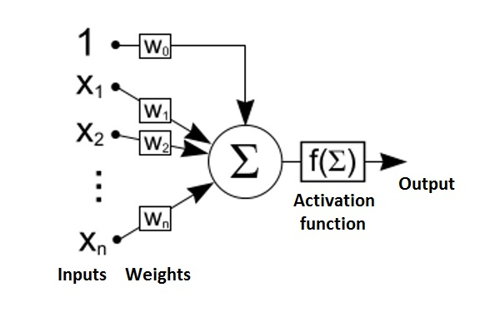
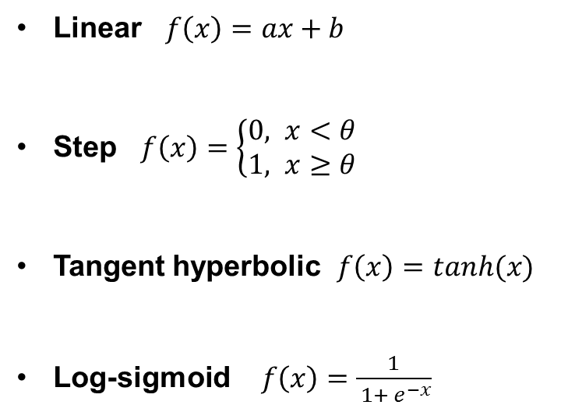
Single neuron Model
Linear $f\left(x\right)=ax+b$
Step $f\left(x\right)=\left\{\begin{aligned}0, x<θ \\ &1, x≥θ\end{aligned}\right.$
Tangent hyperbolic $f\left(x\right)=tanh(x)$
Log-sigmoid $f\left(x\right)=\frac{1}{ 1+ e^{−x}}$

Slide 5
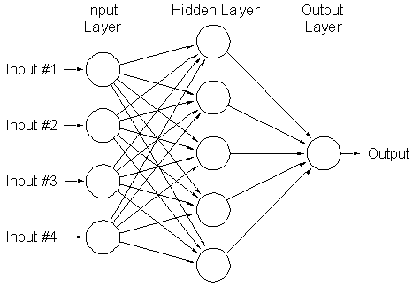
A network

Slide 6
Learning ANN parameters
Optimization Problem
Error: difference between output of network and true value
Minimizing Error
Single Supervised Layer
Batch Learning
Online Learning
Stochastic Gradient Descent
Other Layers
Backpropagation: Backward propagation of errors

Slide 7
Representation Learning
Section 2

Slide 8
Representation Learning
Feature Engineering is labor-intensive:
90% of labor in industrial ML
Performance is dependent on feature engineering.
Learn Features

Slide 9
Word REpresentation
A mathematical object , often a vector
Each dimension corresponds to a feature.
Each feature or subset of features has grammatical or semantical interpretation.
Can be designed by hand or can be learned.
Most of NLP applications can benefit from it:
NER [Turian et al., ACL ’10]
Chunking [Turian et al., ACL ’10]
Parsing [Socher et al., ACL ’13]
SRL [Collobert & Weston, ICML ’08]
Language Models [Huang et al., ACL ’12] [Bengio,JMLR ’03]

Slide 10
Family of Representations
Distributional Representations
Features are windows around a word
Usually co-occurrence matrix
Dimensionality Reduction: SVD, LDA, PCA,…
Word Clustering:
Brown clustering
Distributed Representation
High Dimensional but sparse!
Real-values (can be binary too)
Compact ( exponential number of clusters)

Slide 11
Word Embeddings
Word representations induced by neural networks.
Neural Language Models
Joint task of learning features and
a classification task
Word Representation
Distributed Representation
Neural Language Models
Structured Embedding
Distributional Representation
Word Clustering

Slide 12
A template of learning Word Embeddings
logit score for the candidate word
hidden units that discover good or bad combinations of features
learned word emb. of word t-2
learned word emb. of word t-1
learned word emb. of candidate
table look-up
table look-up
table look-up
index of word at t-2
index of word at t-1
index of candidate
Courtesy: Geofry Hinton

Slide 13
A Neural Language Model

Slide 14
But … Corpus is not the only resource.

Slide 15
Structured Resources
Lexical Resources
WordNet
GermaNet
FrameNet
…
Knowledge Base:
Freebase
Yago
…

Slide 16
Learning representation of knowledge bases
Relational Graph
Feature Space

Slide 17
Relation A
Entity 1
Entity 2
Relation B
Relation A
Entity 3
Entity 4
 | f1 | f2 | f3 | f4 | f5 | f6
Entity 1
Entity 2
Entity 3
Entity 4

Slide 18
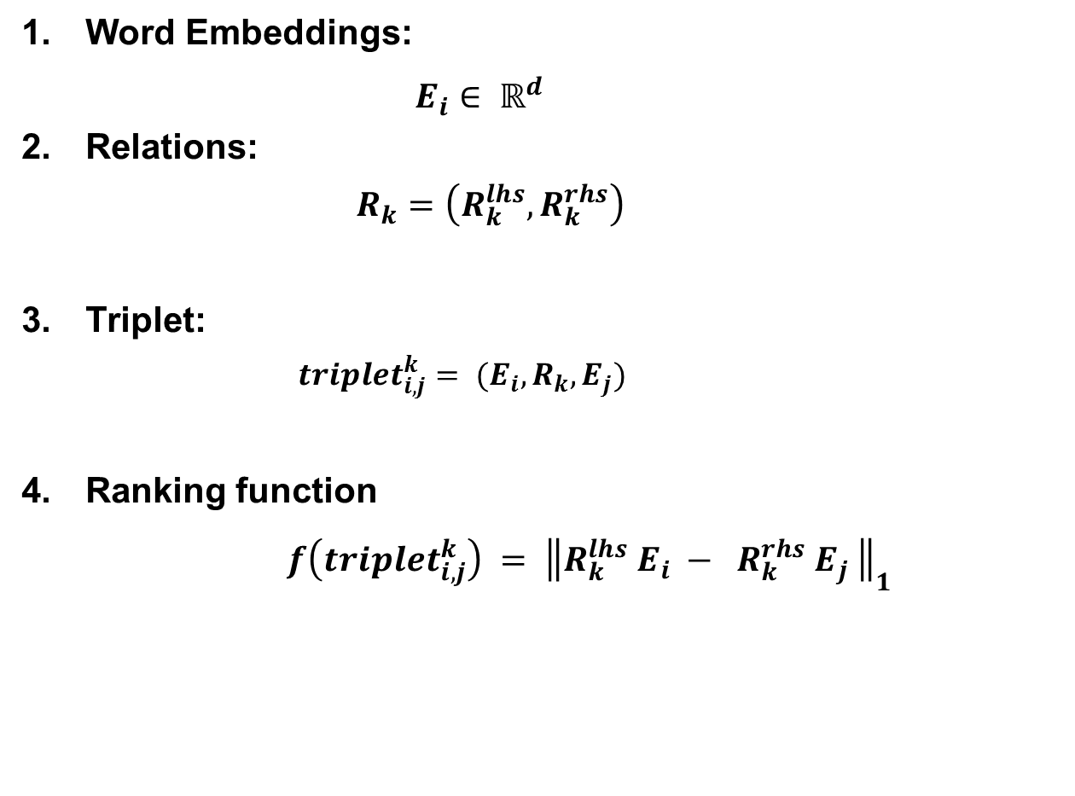
Terminology
Word Embeddings:
$E_{i}∈ ℝ^{d}$
Relations:
$$R_{k}=\left(R_{k}^{lhs}, R_{k}^{rhs}\right)$$
Triplet:
$$triplet_{i,j}^{k}= (E_{i}, R_{k}, E_{j})$$
Ranking function
$f\left(triplet_{i,j}^{k}\right) = {\left\|R_{k}^{lhs} E_{i} − R_{k}^{rhs} E_{j} \right\|}_{1}$

Slide 19
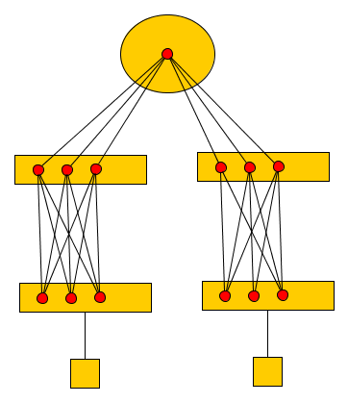

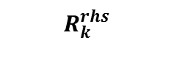
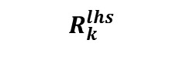
A distributed model for Learning structured embeddings (Bordes et al., 2011)
$$\max_{}{( 1+ f\left(triplet_{i,j}^{k}\right)−f\left(triplet_{neg}\right), 0)}$$
$$R_{k}^{lhs}$$
$$R_{k}^{rhs}$$
Right Embedding
Left Embedding
Entity Index
Entity Index

Slide 20
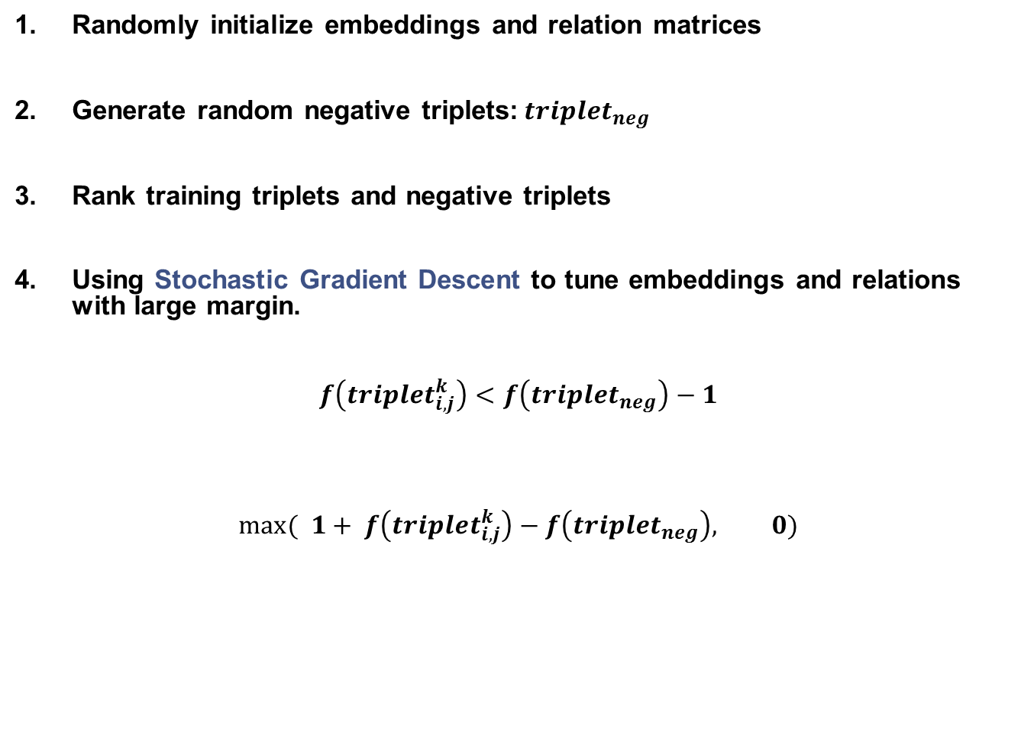
Training
Randomly initialize embeddings and relation matrices
Generate random negative triplets:$triplet_{neg}$
Rank training triplets and negative triplets
Using Stochastic Gradient Descent to tune embeddings and relations with large margin.
$f\left(triplet_{i,j}^{k}\right)<f\left(triplet_{neg}\right)−1$
$$\max_{}{( 1+ f\left(triplet_{i,j}^{k}\right)−f\left(triplet_{neg}\right), 0)}$$

Slide 21
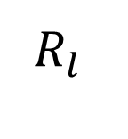
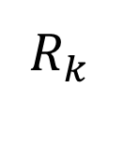
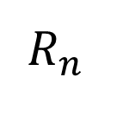
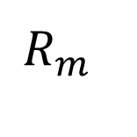
Multi-Task Learning
Learning each relation is a separate task.
$$R_{n}$$
$$R_{k}$$
$$R_{l}$$
$$R_{m}$$
Word Embeddings are shared among each task and transfer information

Slide 22
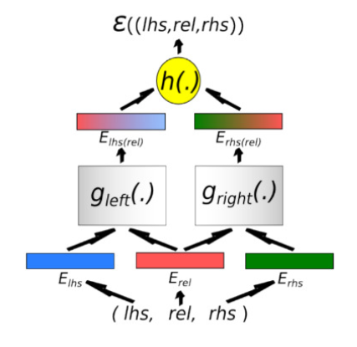
Parameter sharing for relation embeddings (Bordes et al., 2012)

Slide 23
Linking Text to Knowledge Base for relation discovery
Section 3

Slide 24
Relation discovery/extraction
Relation Extraction is the task of detecting and classifying semantic relationship between named entities (NE).
DIRT: frequent (dependency) surface patterns from text
TextRunner: bootstraping a classifier on small annotated data set
Distant supervision: using Freebase to annotate a text and learn a classifier on it

Slide 25
PRObLEM
Shallow, hand-crafted features extracted from text
Some facts are missed in Freebase
Features extracted from Freebase is 0/1
Solution
Learning and using word embeddings
Learning and using entity/relation embeddings
Populating Freebase

Slide 26
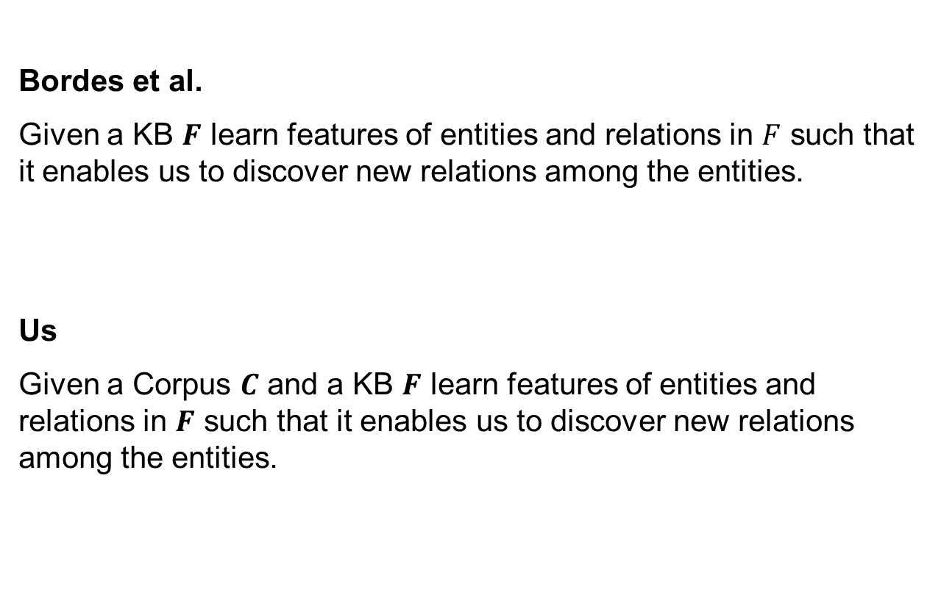
Task Description
Bordes et al.
Given a KB $F$ learn features of entities and relations in $F$ such that it enables us to discover new relations among the entities.
Us
Given a Corpus $C$ and a KB $F$ learn features of entities and relations in $F$ such that it enables us to discover new relations among the entities.

Slide 27
Available information
Freebase
Corpus
NYTimes corpus, parsed, POS and NE tagged, Only sentences with two NEs
Problem
Two different formalization, we need to unify this information

Slide 28
Unified formalization
Represent any desired contextual feature in form of predicate-argument
Introducing auxiliary predicates for different type of features
Contextual features are
Type of NEs: LOC, PER, ORG,…
Dependency role of a word: DOBJ, NSUBJ,…
Head of a dependency path: president, head,…

Slide 29
HAS_TYPE ( Iran, LOC)
HAS_TYPE(Mousavi, PER)
HAS_DEP_ROLE (Iran, POBJ)
HAS_DEP_ROLE (Mousavi, APPOS)
PRESIDENT (Mousavi, Iran)
/Government/Position_held/President (Mousavi, Iran)
HAS_TRIGGER (/Government/Position_held/President, PRESIDENT )

Slide 30
Experiments
KB only freebase relations, Bordes et al. settings
KB+Trigger freebase relations and surface patterns
Text+KB\Trigger all features except surface patterns
Text+KB all features

Slide 31
Evaluation
Training _________ Evaluation
Repr. Learning
Vector Space
Reproducing by Prediction
Text+KB
Idea
Use embeddings to predict unseen relations
Given: Two NEs
Task: Rank Relations

Slide 32
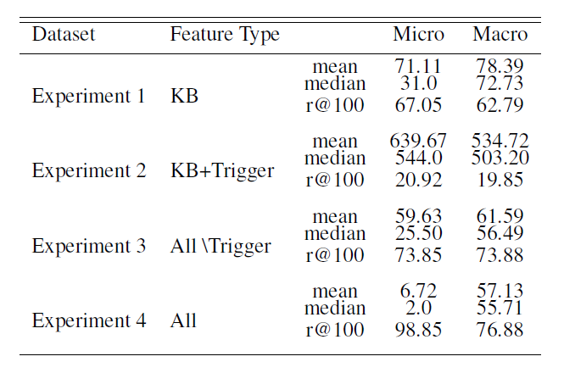
Evaluation

Slide 33
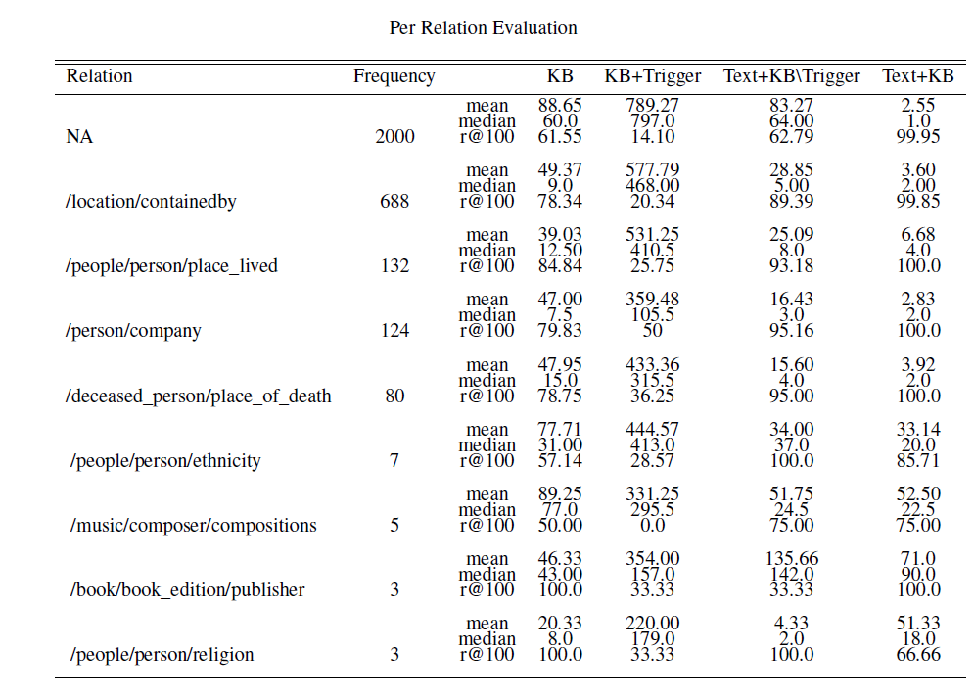
analysis

Slide 34
Conclusion
A formalization and process proposed which incorporates information from text to KB to learn entity/relation embeddings from both resources.
Joint Text+KB embeddings perform much better than KB embeddings in predicting unseen relations among entities.
We can induce new relations: this model is not only able to predict Freebase relations among entities but with using Triggers or surface patterns can predict relations that is not mentioned in it.

Slide 35
Entity linking among multiple Lexical resources
Section 3

Slide 36
Motivation
In previous section we were predicting semantic relations among NEs by learning representation of NEs and relations.
We can do the same for any semantic relation among words in general.
Several advantages:
Induced word features can be used in almost every other NLP task: parsing, tagging, …
We can learn word embeddings from multiple resources with different perspective
We can link resources together or learn multi-lingual word embeddings: machine translation, word sense disambiguation

Slide 37
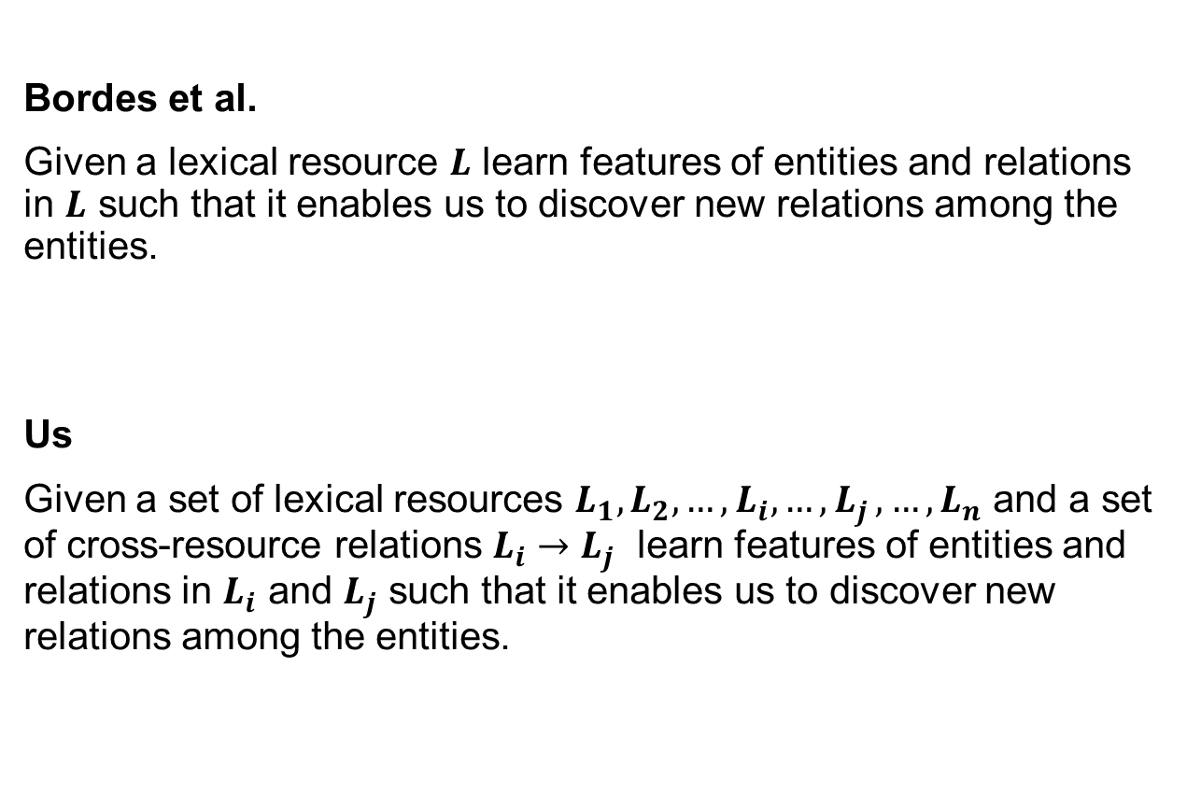
Task Description
Bordes et al.
Given a lexical resource $L$ learn features of entities and relations in $L$ such that it enables us to discover new relations among the entities.
Us
Given a set of lexical resources $L_{1}, L_{2},…,L_{i}, {…,L}_{j},…,L_{n}$ and a set of cross-resource relations $L_{i}{→L}_{j}$ learn features of entities and relations in $L_{i}$ and $L_{j}$ such that it enables us to discover new relations among the entities.

Slide 38
Bi-lingual word embeddings
Relations:
Semantic relations: meronymy, holonymy,…
Entities:
Word senses
Learning WordNet-GermaNet embeddings
WordNet triples
GermaNet triples
ILI cross-lingual triples

Slide 39
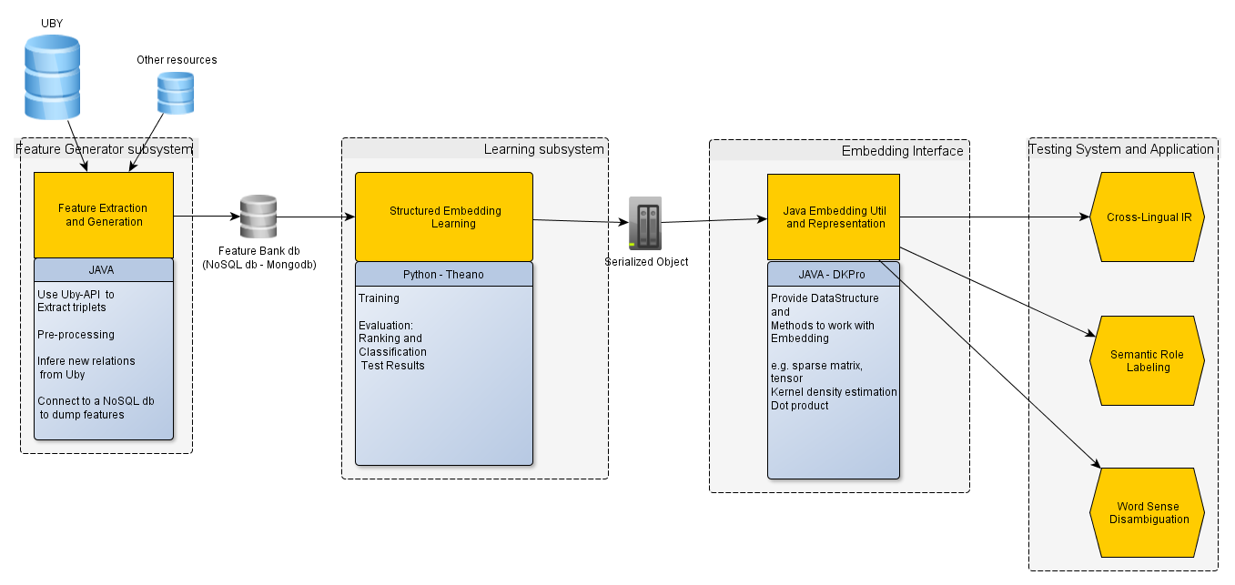
System Architecture

Slide 40
Intrinsic Evaluation
Idea
Training _________ Evaluation
Structured Embedding Learning
Vector Space
Reproducing by Prediction
WN-GN
Use embeddings to predict missing entities
Given: An entity and a relation
Task: Rank the missing entity

Slide 41
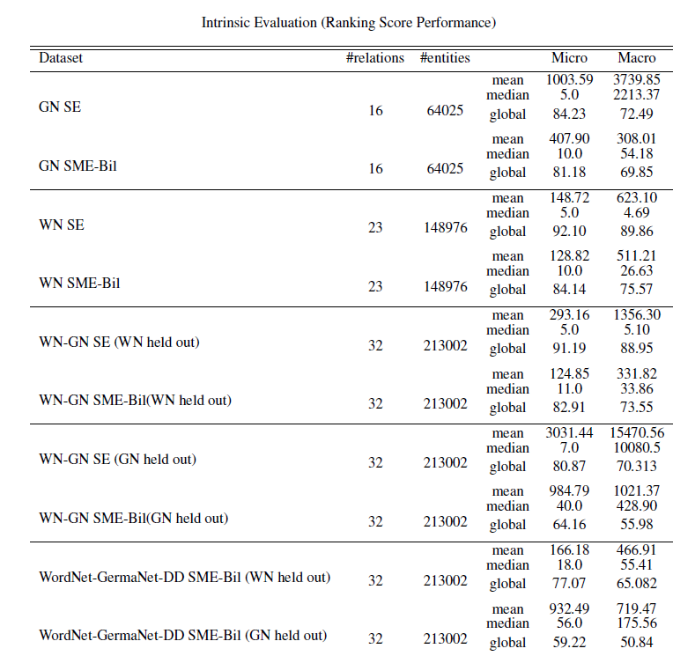
Model comparison

Slide 42
Extrinsic Evaluation
Idea
Use embeddings to predict semantic similarity of word pairs judged by humans
Given: a pair of words
Task: predict their similarity

Slide 43
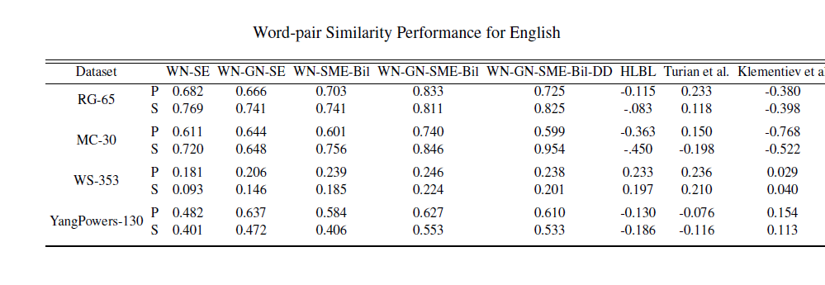
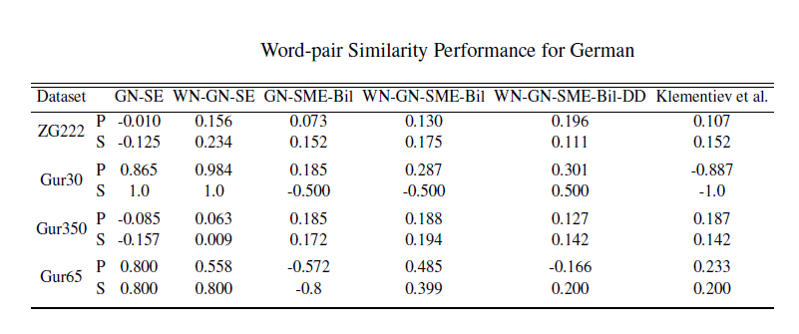
Word-pair Similarity

Slide 44
Conclusion
A framework is proposed here to learn word features from multiple resources.
The motivation behind the framework has been empirically tested by learning bi-lingual word embeddings from WordNet and GermaNet.
Bi-lingual structured embeddings have been evaluated on several word-pair similarity datasets and shown significant improvement over mono-lingual and other type of corpus-based embeddings.

Slide 45
Future Work
Our models don’t have probabilistic output which hurts their ability to be used along other NLP models in cascade or for evaluation.
More types of features can be used for all of our models to examine their effect.

Slide 46
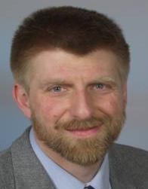

Thank you, LSV!

Slide 47




Thank you, ukp!

Slide 48
Thank you for your attention.
Question?

