Slide 1
Git tutorial
By Ehsan Shirzadi

Slide 2
What is Git?
Kind of VCS (Version Control System)
By Linus Trovalds 2005
As a developer you can:
  Track your changes
  Revert your changes
  Synchronize
  Collaboration
  Manage conflicts

Slide 3
Types of VCS architecture
Centralized
Distributed

Slide 4

Centralized architecture
Online connection needed
Can not work on same file

Slide 5
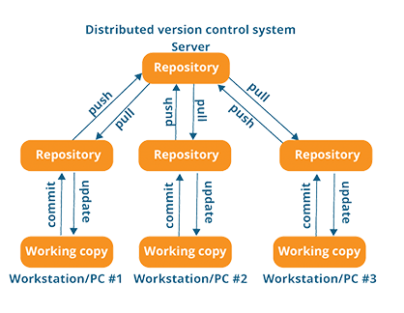
Decentralized architecture
Can develop offline
There are local repositories
Work on a same file

Slide 6
Before Git?
Carry via flash
Zip backups
Versions:
  Final.zip
  Final2.zip
  Finalest-final-version
  Final-final-sh*t.zip

Slide 7
Install Git
https://git-scm.com/download/win
apt install git

Slide 8
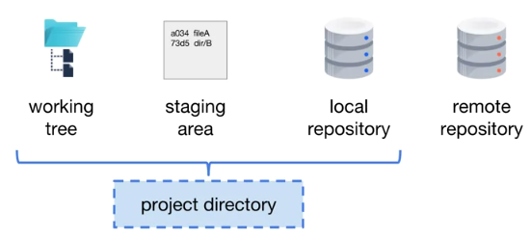
Git locations

Slide 9
What is a Commit?
Single snapshot of project

Slide 10
Working tree
location of files of a single commit

Slide 11
Staging area (Index)
List of files included in next commit
You can prepare it as you want

Slide 12
Local repository
Contains all commits
Commits are version history

Slide 13
Project directory
Working tree
Staging area (.git)
Local repository (.git)

Slide 14
Remote repository
Contains commits of the project
Can be synchronized with local repository

Slide 15
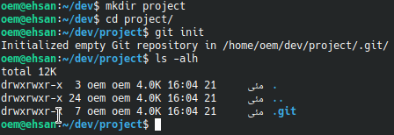
Create a local repository
Initialize an empty git repository using `git init`

Slide 16
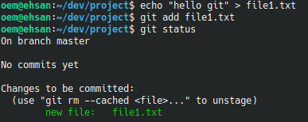
Add a file
Add a file using `git add` command

Slide 17
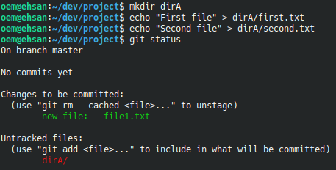
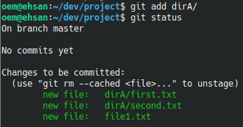
Add files in directory
Add files in a directory using `git add dir_name`

Slide 18
What is Git?

Slide 19
What is Git?

Slide 20
What is Git?

Slide 21
What is Git?

Slide 22
What is Git?

Slide 23
What is Git?

Slide 24
What is Git?

Slide 25
What is Git?

Slide 26
What is Git?

Slide 27
What is Git?

Slide 29
This work is licensed under a Creative Commons Attribution-ShareAlike 3.0 Unported License.
It makes use of the works of
Kelly Loves Whales and Nick Merritt.

