Slide 1
CI/CD
By Ehsan Shirzadi

Slide 2

Who I am?
Software engineers and developer
About 20 years coding experience
11 years of Python and Git
Green plus R&D engineer

Slide 3
Introduction
Software deployment is risky!
  Verify changes working as expected
  Will changes work on all machines as yours?
  Risk of manual deployment
Amazon is delivering every 11 seconds!
What about your company?

Slide 4
CICD overview
Continuous Integration:
Continuous Delivery/Deployment

Slide 5
Continuous Integration
A software development method
Team can integrate their work at least once a day.
Every integration is checked by an automated build to search the error.
Errors automatically shipped to the right person

Slide 6
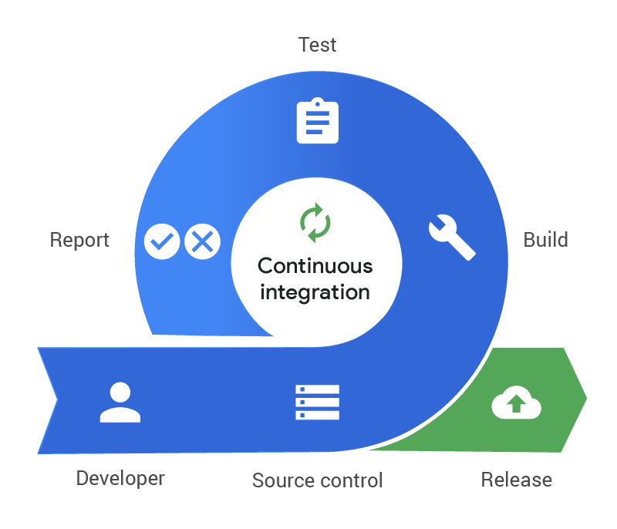
Continuous Integration

Slide 7
Continuous Delivery/Deployment
A software engineering method/process
Team develops software products in a short cycle
Ensures that software can be easily released at any time automatically (No manual works)
Helps testers to validate whether the codebase changes are correct, and it is stable or not.

Slide 8
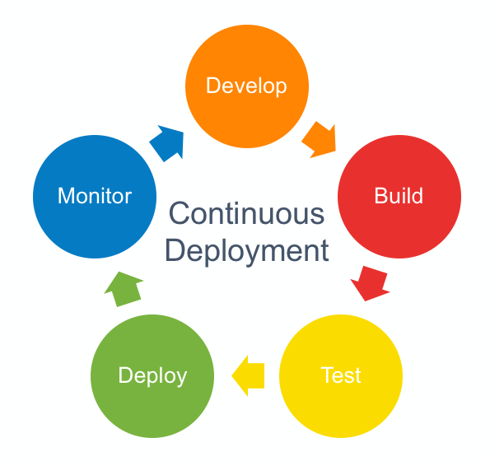
Continuous Delivery/Deployment

Slide 9
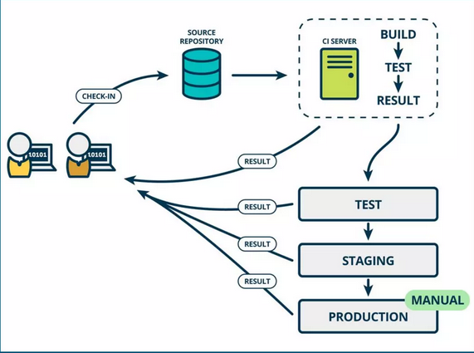
CICD diagram

Slide 10
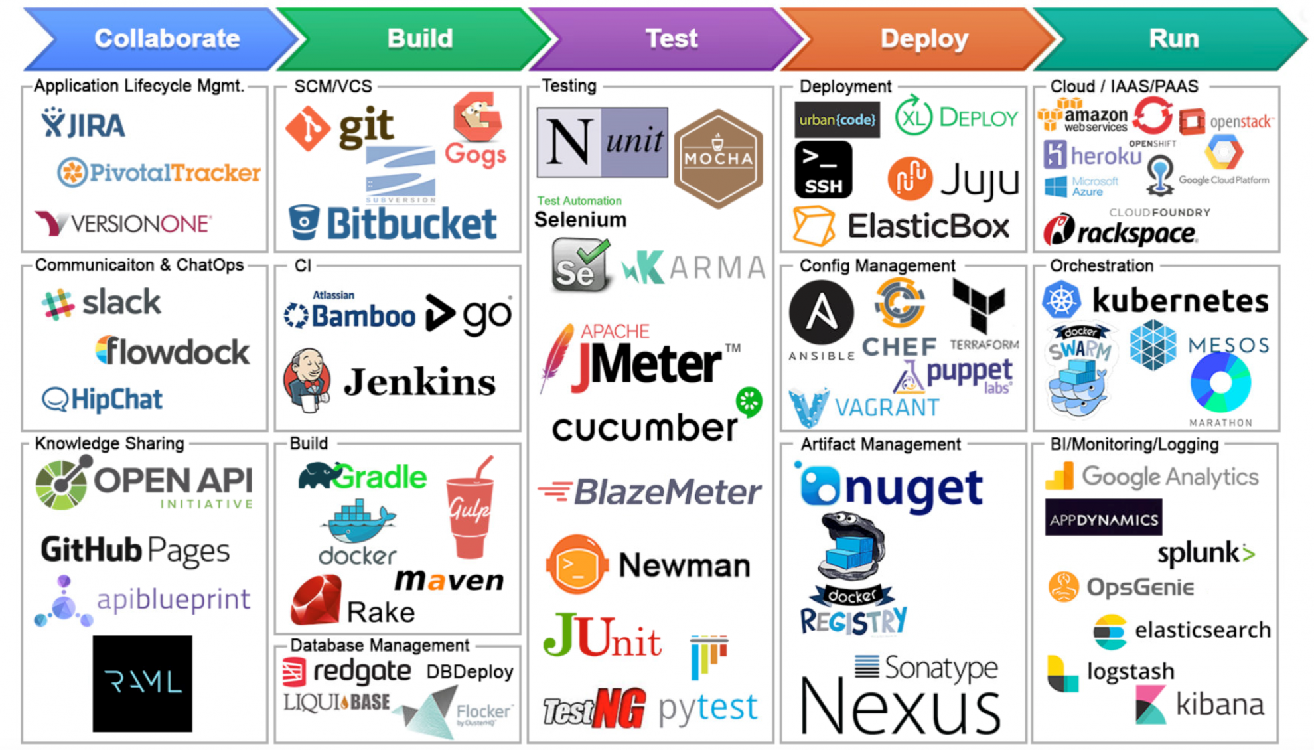
Some CICD tools

Slide 11
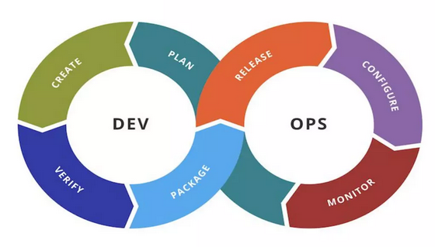
CICD life cycle

Slide 12
Why CI/CD?
Smaller code changes
Continuous testing
Early fault detections
Faster release rate (11 seconds?!)
Customer satisfaction
Easy maintenance and update

