Slide 1

Deep Learning Final Project:
Walking Speed Classification
By Colby Ellis and Ehsan Sharafian
December 2023

Slide 2
Introduction
Goal: Classify speed based on marker positions on the feet
Impact on Our Research Area: Design of a Haptic Feedback system to increase walking speeds of older adults

Slide 3
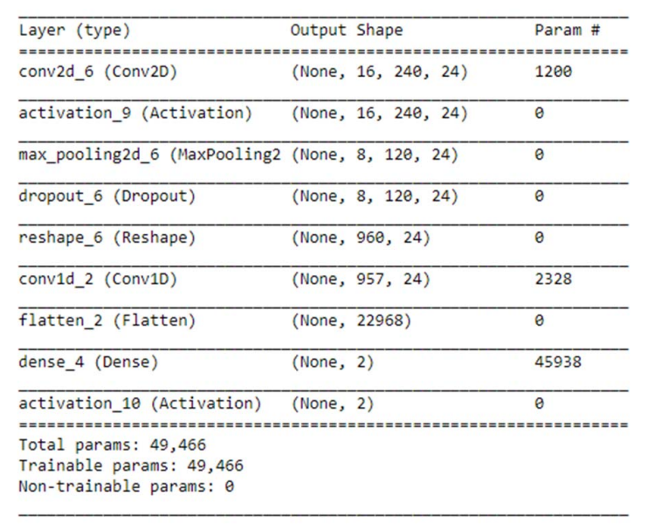
Related Work
Gait classification for Parkinson’s Disease using Stacked 2D and 1D Convolutional Neural Network:
  Used Vertical Ground Reaction Force Data
  Preprocessed Data into Images (2.4s of data per image)
  2D Convolution For Feature Extraction
  1D Convolution For Time Series
  Binary Classification (Parkinson’s Patients vs. Control)
  88.7% Classification Accuracy
Figure 1: 2D and 1D Convolutional Neural Network Model Summary [1]

Slide 4
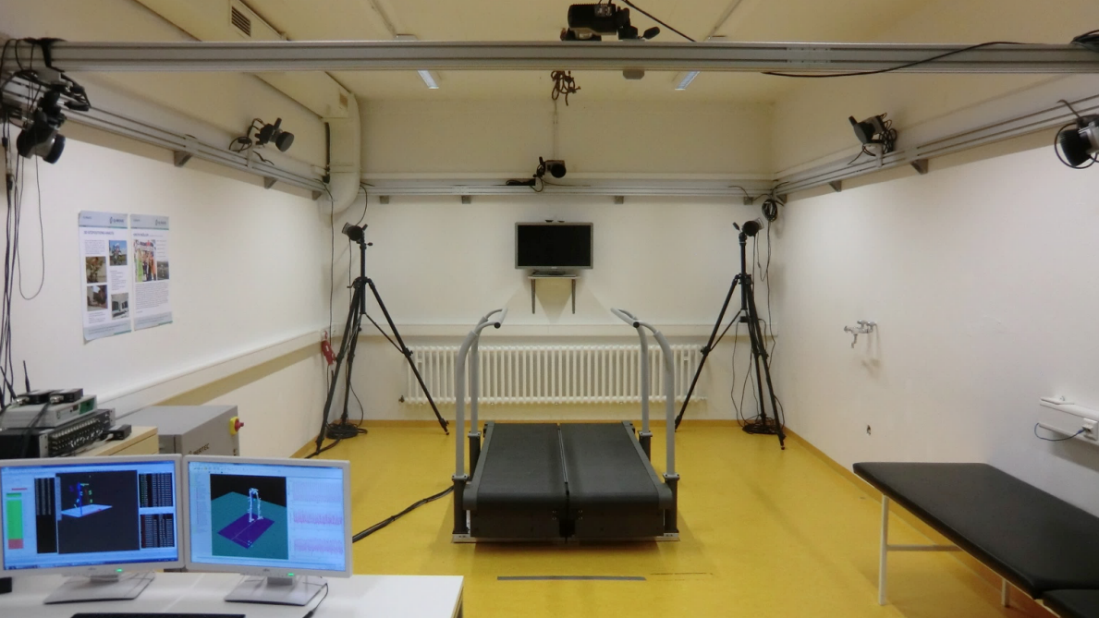
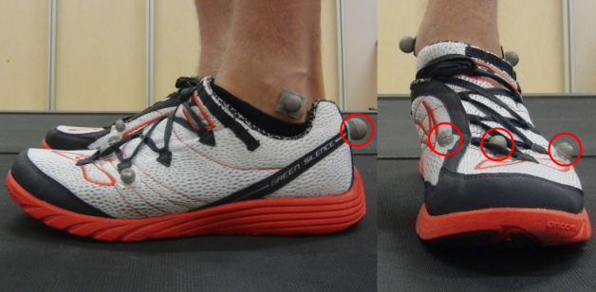
About the Dataset
Dataset downloaded from Kaggle
21 Subjects: 10 male, 11 female
Each subject walked at 12 different speeds for 1 minute each (0.6m/s to 1.7m/s at 0.1m/s intervals)
2 datasets collected: GRF at 1000Hz and Marker Positions at 200Hz
24 total marker data points (4 markers per foot, 3 dimensions)
Figure 2: Lab Setup [2]
Figure 3: Marker Positions [2]

Slide 5

Data Description
Date: 432000 rows
70% Training and 30% Validation
Transform raw data to 2D
Using Conv2D

Slide 6

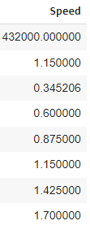
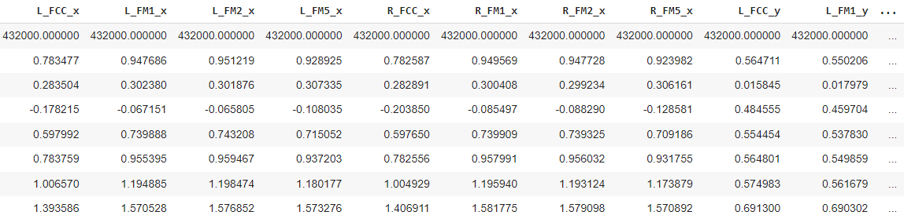

Data Description
Figure 4: Data Description (From Colab)

Slide 7
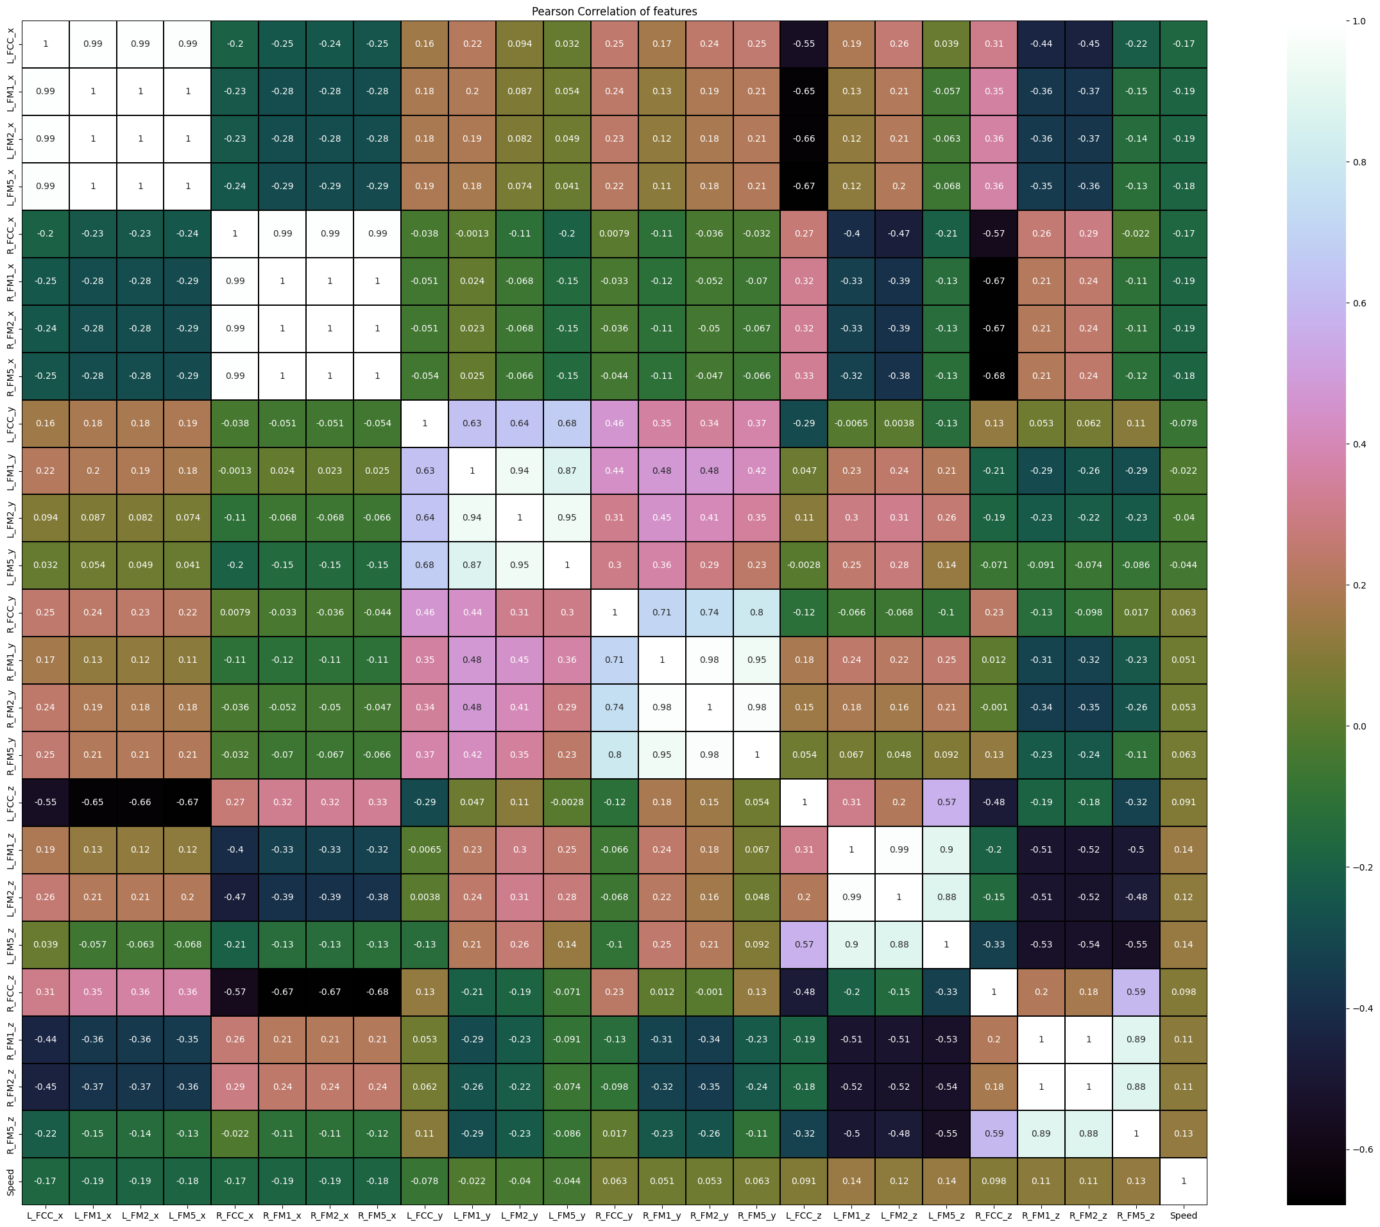
Input Data Distribution
Figure 5: Pearson Correlation of Features

Slide 8

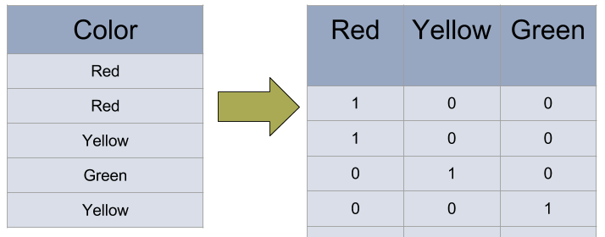
Using One-hot encoding
A technique to represent categorial variables a numerical values
One way to present labels to a ML model
Using probabilities with a square matrix with 0 to 1 for each cell
Figure 5: Example of One-hot encoding

Slide 9
Results of Classifier functions
None of the are acceptable
Table 1: Accuracies of Other Types of Models
Guassian NB (Naïve bayes) | 37%
Decision Tree Classifier | 38%
Modified SVM | 56 %
K-Neighbor | 73%
So, we should build Our Model to have a better accuracy with classification!

Slide 10
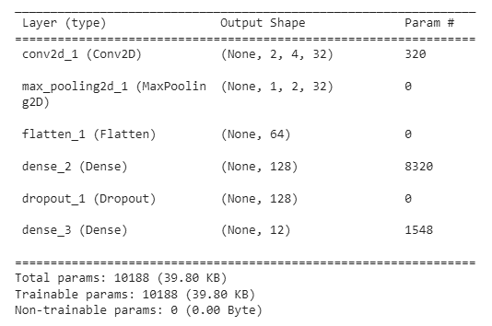
Model Summary
Figure 6: Our Model Summary

Slide 11
Model Features
Loss function type | Categorical_crossentropy
Metrics | accuracy
Optimizer | Adam
Learning Rate | 0.001, adaptive with min 1e-6
Batch_size | 64
epochs | 120

Slide 12
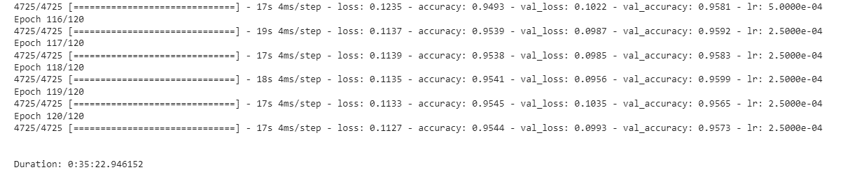
Results
Figure 7: Results of Final 5 Epochs

Slide 13
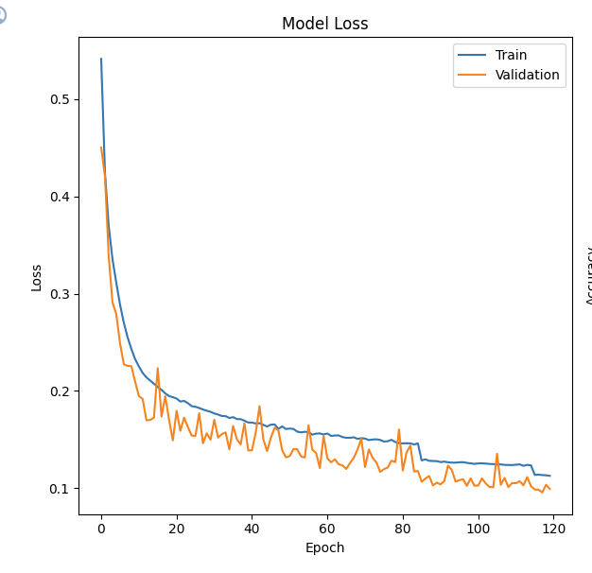
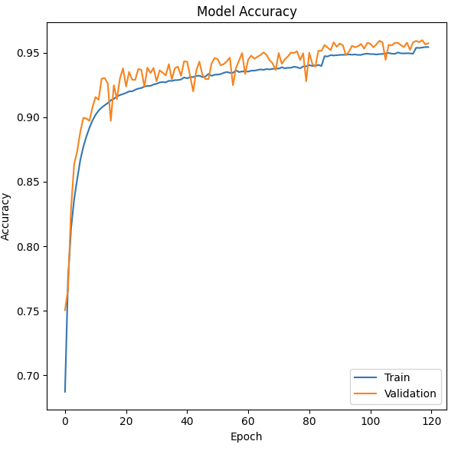
Results
Figure 8: Model Loss
Figure 9: Model Accuracy

Slide 14
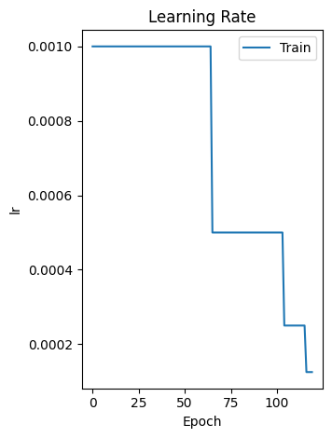
Results
Figure 10: Learning rate change

Slide 15
Conclusion and Future Work
Conclusions:
  Speed walking classification using CNN
  Muli-classification with 12 speed classes
  Model had good accuracy and good converge in loss function
  Limitation on number of subjects it could include
Future Work:
  Fewer classification categories (set Slow, Medium, Fast)
  Add more subject data without decreasing performance
  Create a model using Force Data instead of Position Markers (or combination)

Slide 16
References
[1] N. S. Hoang, Y. Cai, C. -W. Lee, Y. O. Yang, C. -K. Chui and M. C. Heng Chua, "Gait classification for Parkinson's Disease using Stacked 2D and 1D Convolutional Neural Network," 2019 International Conference on Advanced Technologies for Communications (ATC), Hanoi, Vietnam, 2019, pp. 44-49, doi: 10.1109/ATC.2019.8924567.
[2] F. Hebenstreit, A. Leibold, S. Krinner, G. Welsch, M. Lochmann, and B. M. Eskofier, "Human Gait Phase Dataset," Dataset, 2014. Available: https://www.kaggle.com/datasets/dasmehdixtr/human-gait-phase-dataset/data

