Slide 1
Can the walker measure the environment?
Obstacle height, position and toe clearance back-calculated from wearable IMUs
Camera only as teacher · 10 young adults · Tests 101–110
Ehsan Sharafian · 11 November 2026
Notes:
Question from the advisor meeting: if the walker is the sensor, can the gait measured by IMUs tell us about the environment - how high the obstacle was, where it stood relative to the feet, and how much clearance the person kept? The camera is used only to train and score; the inputs are the Dot IMUs.

Slide 2





The question
If the walker is the sensor, what can the IMUs tell us about the obstacle and the crossing?
Obstacle height
how high is it?
Trailing foot placement
where is the trailing foot before it?
clearance
Landing distance
where does the foot land after it?
height
Toe clearance
how much margin did the person keep?
trailing foot
leading foot
Which IMUs and limb?
thigh, shank, foot; leading or trailing
placement
landing
Notes:
The camera measures each of these per crossing; the question is whether the IMUs alone can estimate them for a new person, once a model has been trained with the camera on other people.

Slide 3




How we tested it
Camera as teacher, IMUs as inputs, and every estimate scored on a person the model has never seen.
Camera = teacher
IMUs = inputs
Models
A new person
Eight camera quantities per crossing: obstacle height, foot placement, landing distances, toe clearance and toe peak. Used only to train and to score.
5 sensor sets (thigh, shank, foot, thigh + shank, all three) × 3 limb choices (leading, trailing, both) = 15 input sets.
Ridge and random forest; generic or person scaling; plus physics estimators from the foot path, with no machine learning.
Leave-one-participant-out. Error in mm against the training mean; r within one person and obstacle.
Calibration option: the camera on 1 or 3 crossings of the new person, compared with simply using the mean of those crossings.
Notes:
Inputs: 110 Dot features + 13 clearance-shape features per limb, grouped by the IMU they come from, plus leg length. 2 normalisations x 2 models x 15 input sets = 60 runs per target, all leave-one-participant-out. The best run is reported together with a model fixed in advance (two foot IMUs, person scaling, forest) and the physics estimators, which involve no selection.

Slide 4
Physics: the foot apex marks the obstacle
People lift the foot highest roughly over the obstacle, so the foot path itself locates it.
x apex (IMU)
Three relations, learned on 9 people
apex
Placement ≈ a + b · x apex (trailing)
38 mm, r = 0.78; within one person r = 0.79
Landing ≈ a + b · (x landing − x apex)
trailing 72 mm, r = 0.87 (baseline 158)
height
Height ≈ a + b · foot lift
41 mm with the lifts alone; 30 mm with the full model
trailing foot
leading foot
placement
landing
Notes:
x apex = progression of the foot sensor from its foot-flat to the highest point of the swing (Dot foot trajectory). The offset a absorbs the sensor-to-toe distance and half the obstacle depth (the device does not know the depth; it adds about +-25 mm). No machine learning: an ordinary least-squares line learned on the nine training participants.

Slide 5

Results
01
What the IMUs can and cannot tell about the obstacle
Notes:
Results for a participant left out of training, without any label unless stated.

Slide 6
The answer at a glance
For a new person, from the IMUs alone (camera for training only).
Quantity | Answer | Error for a new person (baseline) | Best source
Obstacle height | Yes | 30 mm, r = 0.87 (69 mm) | foot IMUs; leading limb enough
Trailing foot placement | Yes | 38 mm, r = 0.78; follows one person (r = 0.79) (66 mm) | trailing foot apex (physics)
Trailing landing distance | Yes | 72 mm, r = 0.87 (158 mm) | trailing foot path (physics)
Leading toe peak height | Yes | 47 mm, r = 0.78 (88 mm) | leading foot lift
Leading landing distance | Partly | 58 mm, r = 0.51 (78 mm) | thigh IMUs
Trailing toe clearance | Partly | 73 mm, r = 0.46 (88 mm) | foot IMUs
Leading toe clearance | No | 50 mm (49 mm) | no sensor set helps
Baseline = predicting the mean of the training participants. r within one person = estimate and camera minus their participant × obstacle means.
Notes:
Best of 60 runs per target (small selection optimism); the physics rows involve no selection. Fixed device model (two foot IMUs, person scaling, forest): height 31 mm, placement 44 mm (within r 0.80), leading landing 75 mm, clearance 57 / 101 mm.

Slide 7
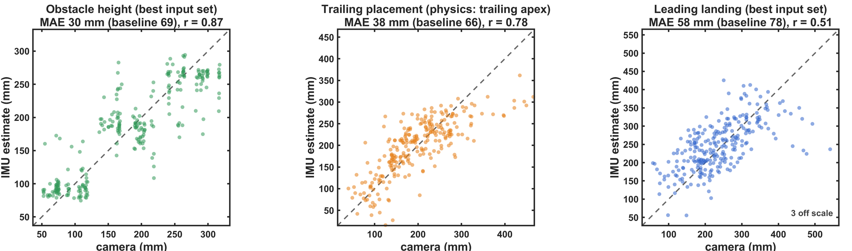
IMU estimate vs camera: height and position
Each dot is one crossing of a participant the model has never seen; dashed = identity.
30 mm
obstacle height, r = 0.87 (baseline 69)
38 mm
trailing placement from the foot apex, r = 0.78 (baseline 66)
58 mm
leading landing, r = 0.51 (baseline 78)
Notes:
Obstacle height: best model (all IMUs of both limbs, person scaling, forest). Trailing placement: physics estimator from the trailing apex position, which beats the machine-learning models (44 mm). Leading landing: three implausible camera values (one at 1.5 m) are off scale.

Slide 8

Obstacle height: about 3 cm
Neighbouring heights are 83–106 mm apart: the error is about a third of a step.
30 mm
31 mm
22 mm
35 mm
mean absolute error (95 % CI 25–36), r = 0.87
leading limb only: known before the trailing foot crosses
with 3 labelled crossings of the person
thigh IMUs alone (no foot sensor)
Person scaling matters
Physics alone
Generic 41 mm → person scaling 30 mm: the foot lift of a new person is read relative to their own crossings.
The two foot lifts with one straight line give 41 mm: the foot rises about 1 mm per mm of obstacle.
Notes:
Target = obstacle top measured from its markers in each crossing (52-318 mm). Best model: all three IMUs of both limbs, person scaling, random forest; the fixed two-foot device gives 31 mm. Bias -1 mm, 95 % limits of agreement +-76 mm. With the nominal height the earlier regression gave 24 mm.

Slide 9
Obstacle position from the feet
The trailing foot places the obstacle well; the leading landing is harder.
Trailing foot placement
Landing distance
38 mm
r = 0.78 (baseline 66 mm)
Trailing: 72 mm
r = 0.87 (baseline 158 mm), from the progression after the apex
Leading: 58 mm
r = 0.51 (baseline 78 mm), best with the thigh IMUs
From the trailing apex position alone (physics).
Follows each crossing of one person: r = 0.79 within person and obstacle.
The leading limb alone gives 44 mm: known before the trailing foot lifts.
Why harder: the leading foot does not peak consistently over the obstacle, and its landing depends on the step chosen after it.
Notes:
Placement = near edge minus the trailing toe at its foot-flat before the obstacle (classic take-off distance). Trailing landing = trailing heel after the obstacle minus the far edge (a full step past). Leading landing = leading heel minus far edge; 3 crossings are implausible (one at 1.5 m). Machine learning on all IMUs: placement 44 mm, trailing landing 78 mm.

Slide 10
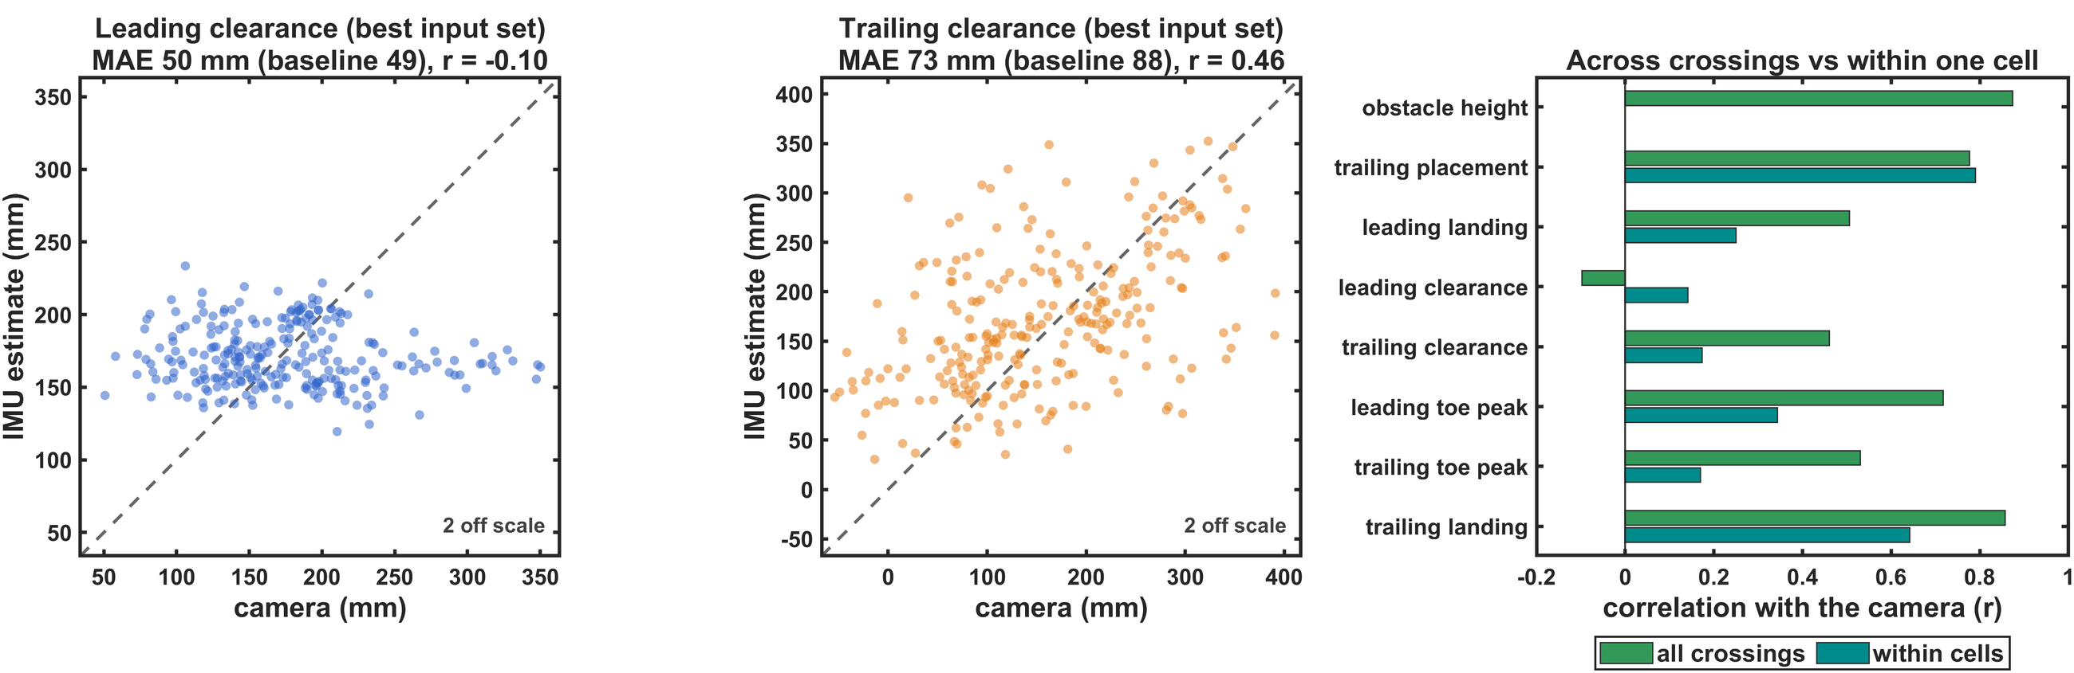
IMU estimate vs camera: toe clearance
The clearance is not estimated for a new person; the position is followed crossing by crossing.
50 mm
leading clearance: baseline 49 mm, r = −0.10
73 mm
trailing clearance: baseline 88 mm, r = 0.46
r ≈ 0.8
within one person for placement and landing; not the clearance
Notes:
Right panel: correlation with the camera across all crossings and within participant x obstacle cells (both minus their cell means). Height has no within-cell value (constant within a cell).

Slide 11

Toe clearance: one measurement, two unknowns
The foot lift holds the obstacle height and the margin together.
foot lift = obstacle height + margin (clearance)
Without the height
The evidence
With a known height
Clearance 50 / 73 mm (leading / trailing) against 49 / 88 mm for the baseline: the margin is lost.
Within a person, the height error rises with the clearance (r = +0.34 / +0.28): a larger margin looks like a higher obstacle.
The foot lift then gives the clearance to 42 / 68 mm (r = 0.41 / 0.55): the margin is in the lift.
Calibration does not fix it: 3 labelled crossings give 38 / 67 mm, the same as the mean of those crossings (38 / 68 mm).
Notes:
The device reads the height from the foot lift assuming a typical margin, so it cannot read the margin from the same number. No sensor set or model recovered it. The camera itself (toe peak + take-off distance) reaches 34 / 55 mm; the remaining gap is the toe: the foot sensor sits on the dorsum and the trailing foot crosses heel-up.

Slide 12
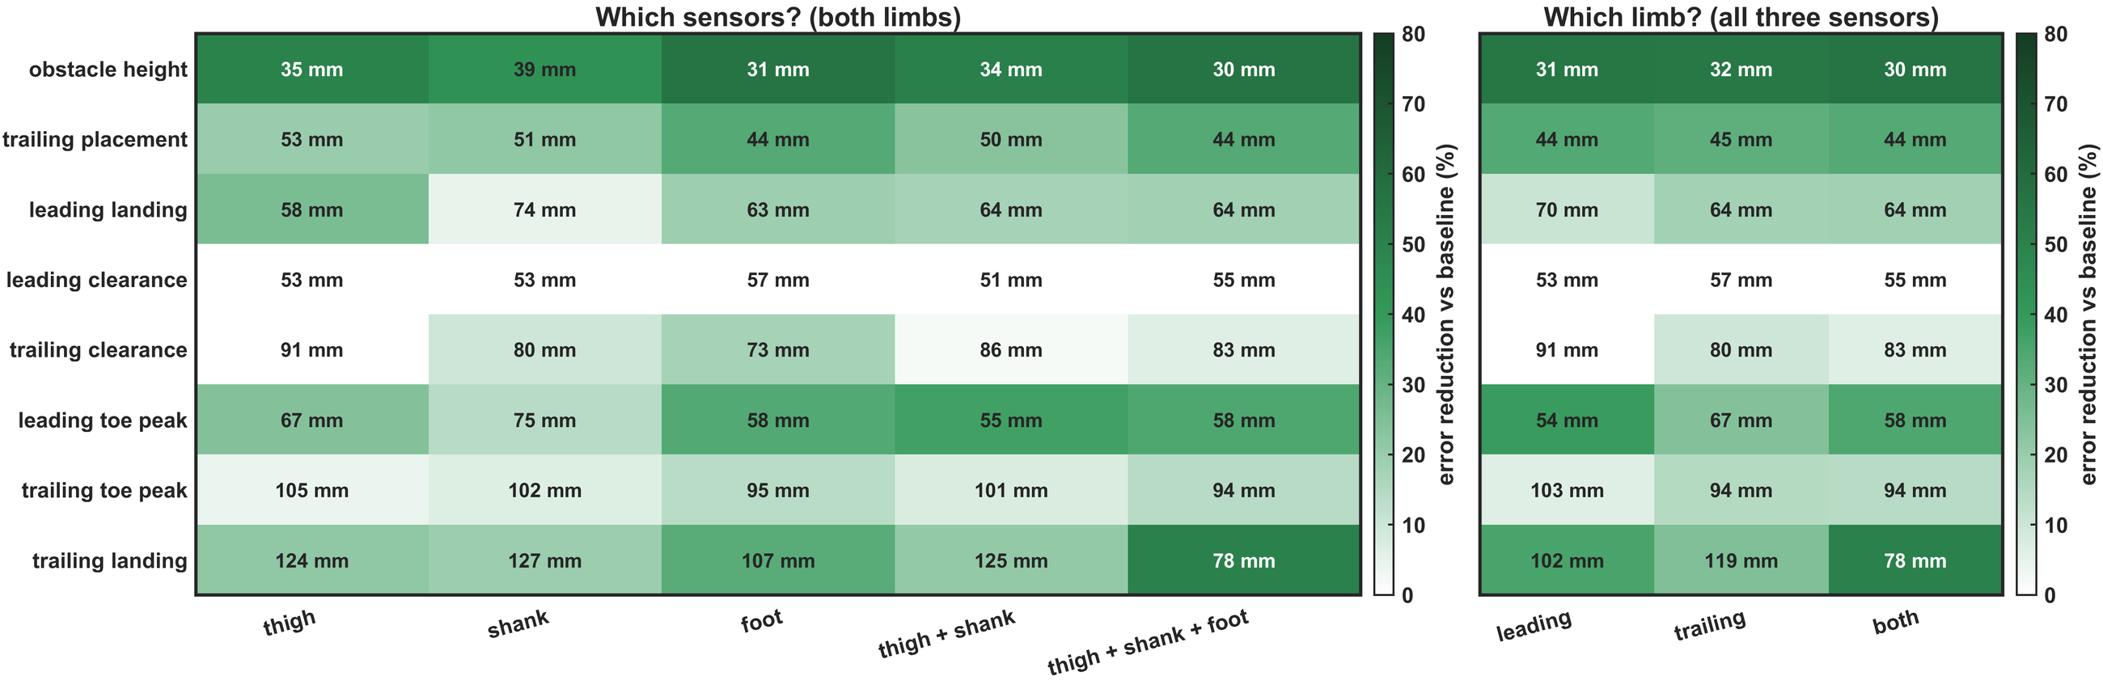
Which IMUs and which limb?
Error (mm) and error reduction against the baseline; best model per cell, no labels.
Foot IMU
best or near-best for height and position
+ thigh + shank
help only the trailing landing (107 → 78 mm)
Thigh alone
height 35 mm; leading landing 58 mm
Leading limb
enough for height and placement
Notes:
Foot IMU: height 31 mm, trailing placement 44 mm, trailing clearance 73 mm. Leading limb only: height 31 mm, placement 44 mm. No sensor set makes the leading clearance estimable. The shank alone is weak for the leading limb (height 63 mm from the leading shank). For classification two foot IMUs were also enough (92.3 %).

Slide 13
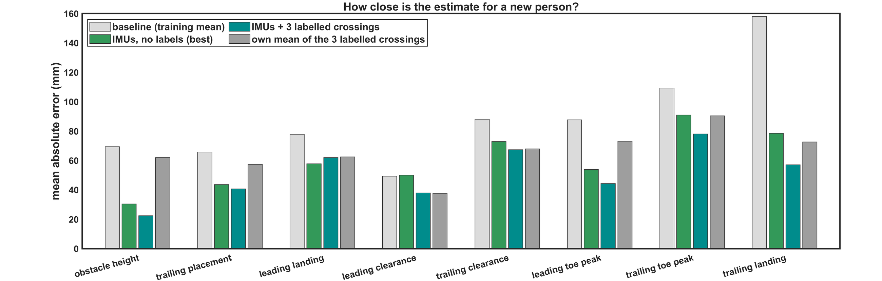
What a short calibration adds
Camera on 3 crossings of the new person (one per height), against using the mean of those crossings.
22 mm
height with 3 labelled crossings (30 mm without)
54–72 mm
trailing landing with 3 labelled (158 baseline)
= own mean
clearance: the IMUs add nothing beyond the person's mean margin
Notes:
The calibration shifts the estimate by its mean error on the labelled crossings. It helps where the estimate has a personal offset (height, landing, toe peak); for the clearance it only reaches the own mean.

Slide 14

Discussion
02
What the walker reveals, what it hides, and what to do next
Notes:
Interpretation, how to get at the clearance, limitations and next steps.

Slide 15

The walker as a sensor
Two of three properties of the obstacle are written in the gait, by simple physics.
Height: yes
Position: yes
Margin: hidden
Written in the foot lift (about 1 mm per mm of obstacle). Two foot IMUs read it to about 3 cm, from the leading limb, before the trailing foot crosses.
Written in where the foot peaks. The trailing apex places the obstacle to about 4 cm, crossing by crossing (r ≈ 0.8 within one person).
The lift is height + margin. Reading the height uses up the information the clearance needs; no IMU set recovers it.
What it enables: for each obstacle crossed, how high it was and where it stood relative to the steps — no camera once trained.
Notes:
The physics: obstacle height drives the foot lift (dose-response 10 mm per cm), and the foot apex lies over the obstacle. Both are learned once on other people; for a new person only the IMUs are needed. Absolute positions on a map would need chaining the steps of a walk (dead reckoning), not tested here.

Slide 16

Getting at the clearance
Three routes follow from the analysis.
1
2
3
Know the height
Measure the toe
Relative to habit
From a route map, a previous crossing or a camera on the person. Then the foot lift carries the margin: 42 / 68 mm (r up to 0.55).
A toe-mounted IMU or the measured sensor-to-toe geometry: the dorsum sensor misses the toe, and the trailing foot crosses heel-up.
Flag a crossing lifted less than usual for the estimated height — what a fall-risk monitor needs, rather than absolute mm.
More thigh and shank IMUs would help the clearance only through a full leg-and-foot chain that rebuilds the toe (not tried here).
Notes:
Route 1 is testable now with the existing data (the true-height rows of the physics table). Route 2 needs a measured sensor position on the shoe or a toe sensor. Route 3 uses person-relative monitoring, in line with the person scaling that made the classification work.

Slide 17
Limitations and next steps
Feasibility results on ten young adults in a laboratory.
Limitations
Next steps
Ten young adults, one obstacle type, two depths.
Position is relative to the feet of the same crossing, not on a map.
Camera values are marker centres; a few landing distances are implausible.
Best-of-grid results keep a small optimism; physics and the fixed device model are the conservative numbers.
New participants and everyday obstacles (kerbs, steps).
Add the toe: toe IMU or measured sensor-to-toe geometry.
Combine with a known obstacle height and test the margin.
Chain the crossings of a walk to place obstacles along a route.
Notes:
All numbers: Analysis/ML/crossing_ml_environment.m, report Results/ML Models/MATLAB/ml_environment_matlab.md, and the new report section "Can the walker measure the environment?".

Slide 18

Answers to the questions
1
Height: yes. About 3 cm for a new person, from the leading foot, before the trailing foot crosses.
Numbers to remember
Height: 30 mm (22 with 3 labels)
2
Position: yes. The trailing foot apex places the obstacle to about 4 cm, crossing by crossing.
Placement: 38 mm, r = 0.78
Trailing landing: 72 mm, r = 0.87
3
Clearance: not without the height. The foot lift holds height and margin together.
Leading landing: 58 mm, r = 0.51
Sensors: two foot IMUs carry it; thigh and shank add little.
Clearance: ≈ baseline (49 / 88 mm)
4
Known height: clearance 42 / 68 mm
Notes:
The answer to the advisor's question: the walker is a good sensor of obstacle height and position, not of the clearance it keeps, unless the height comes from somewhere else.

