Slide 1
Table 1: Obstacle-crossing kinematic parameters across different obstacle widths and heights.
W1: Mean (SD)
W2: Mean (SD)
Main-effect p
Parameter Leg | H1 | H2 | H3 |  | H1 | H2 | H3 |  | Width | Height
Minimum clearance ^{Leading} | 17.50 (4.28) | 17.16 (4.92) | 15.29 (7.02) |  | 16.93 (4.57) | 18.53 (5.47) | 17.31 (4.28) |  | .368 | .236
Trailing | 17.91 (8.86) | 17.45 (10.05) | 13.56 (6.76) |  | 17.31 (6.03) | 15.91 (9.49) | 16.14 (9.44) |  | .946 | .195
Takeoff distance ^{Leading} | 90.48 (18.23) | 89.30 (18.07) | 86.67 (21.52) |  | 89.06 (19.37) | 86.41 (20.19) | 86.76 (18.23) |  | .590 | .442
Trailing | 21.57 (6.07) | 24.51 (9.75) | 19.05 (5.90) |  | 19.59 (7.26) | 18.19 (5.64) | 17.93 (5.90) |  | .028** | .251
Leading | 31.50 (8.99) | 25.55 (6.95) | 26.39 (8.67) |  | 25.58 (14.25) | 21.10 (6.77) | 22.76 (12.80) |  | .014** | .367
Trailing | 97.98 (13.22) | 96.58 (18.05) | 95.57 (23.72) |  | 92.90 (16.67) | 87.10 (23.45) | 92.78 (17.30) |  | .005** | .508
Thigh forward angle ^{Leading} | 59.32 (11.73) | 76.61 (9.35) | 82.38 (8.93) |  | 65.54 (8.76) | 79.01 (8.64) | 85.78 (7.47) |  | < .001** | < .001*
Trailing | 34.92 (5.92) | 37.71 (4.15) | 40.90 (7.25) |  | 37.32 (5.05) | 38.28 (6.10) | 40.54 (8.23) |  | .386 | .062
_{Foot ROM} Leading | 96.32 (11.83) | 91.36 (17.28) | 86.84 (15.67) |  | 98.51 (16.85) | 91.78 (18.28) | 89.16 (16.01) |  | .363 | .147
Trailing | 112.43 (17.06) | 121.55 (14.87) | 123.98 (18.34) |  | 118.68 (16.25) | 121.77 (16.55) | 128.55 (15.72) |  | .012** | .025*
Shank forward angle ^{Leading} | 29.35 (4.16) | 29.67 (3.71) | 30.51 (4.14) |  | 31.34 (3.35) | 31.93 (3.88) | 31.01 (5.83) |  | .044** | .771
Trailing | 24.48 (3.66) | 24.16 (4.89) | 22.78 (6.06) |  | 25.17 (3.20) | 22.05 (6.32) | 24.24 (3.49) |  | .986 | .376
Shank backward angle ^{Leading} | 52.45 (5.93) | 53.39 (6.03) | 53.51 (6.07) |  | 52.32 (5.07) | 54.06 (5.94) | 54.22 (6.23) |  | .337 | .208
Trailing | 82.03 (14.61) | 95.74 (13.44) | 102.63 (10.03) |  | 83.70 (12.06) | 96.33 (10.83) | 108.14 (11.78) |  | .088 | < .001*
Leading | 23.00 (4.11) | 35.09 (4.23) | 49.48 (4.49) |  | 23.54 (4.12) | 35.65 (4.50) | 49.43 (4.57) |  | .136 | < .001*
Trailing | 17.87 (4.06) | 28.09 (4.23) | 40.48 (4.49) |  | 18.42 (4.08) | 28.65 (4.48) | 40.43 (4.57) |  | .120 | < .001*
Leading | 47.09 (5.50) | 60.10 (5.57) | 74.78 (6.03) |  | 47.34 (5.28) | 60.31 (5.39) | 74.75 (5.09) |  | .492 | < .001*
Trailing | 38.83 (4.12) | 50.39 (4.56) | 63.68 (4.83) |  | 39.08 (4.09) | 50.78 (4.40) | 63.69 (4.19) |  | .249 | < .001*
Ankle ROM ^{Leading} | 64.42 (33.22) | 54.66 (31.40) | 58.27 (25.59) |  | 60.74 (33.83) | 52.45 (30.48) | 63.78 (27.84) |  | .977 | .025*
Trailing | 88.95 (54.56) | 92.89 (57.07) | 113.89 (44.76) |  | 92.34 (49.49) | 101.79 (47.94) | 103.35 (51.68) |  | .948 | .143
Landing distance
Hip flexion
Knee flexion
Values represent mean (SD). W1 and W2 denote obstacle widths; H1, H2, and H3 denote obstacle heights. Main-effect p-values are from a 2 × 3 repeated-measures ANOVA. Height
p-values use the Greenhouse–Geisser adjustment.
** Significant main effect of width (p < 0.05); * significant main effect of height (p < 0.05). No correction was applied across the 20 outcomes.
Complete-case sample size is typically n = 9; hip flexion and ankle ROM use n = 8. Width-by-height interactions and post hoc comparisons are not shown.

Slide 2
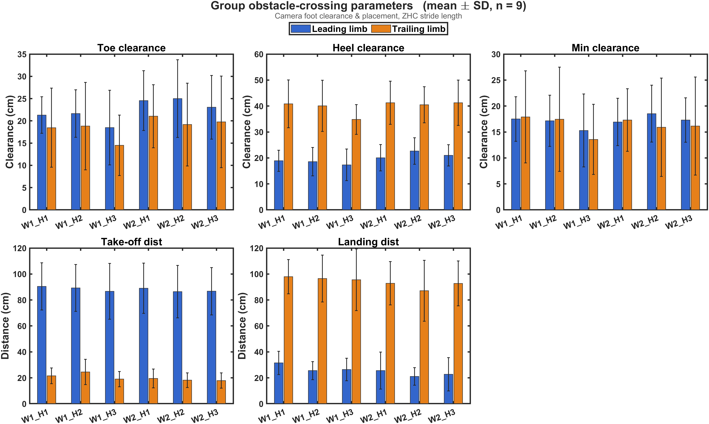

Slide 3
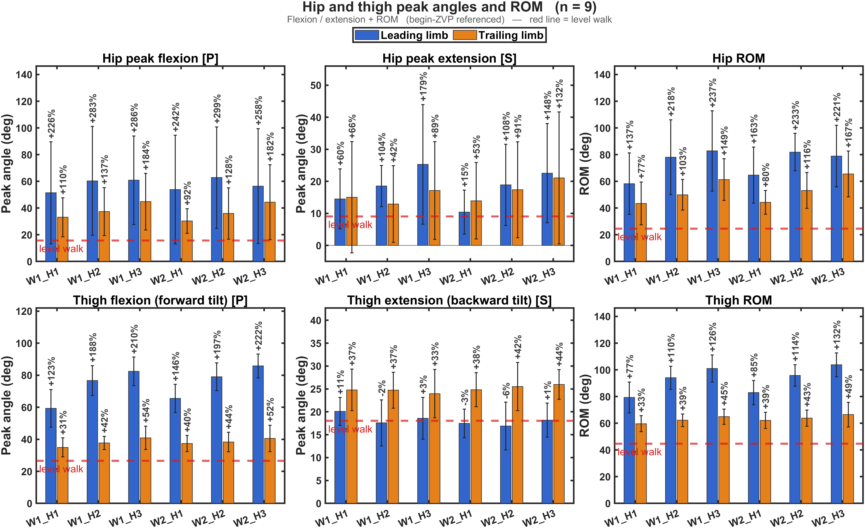

Slide 4
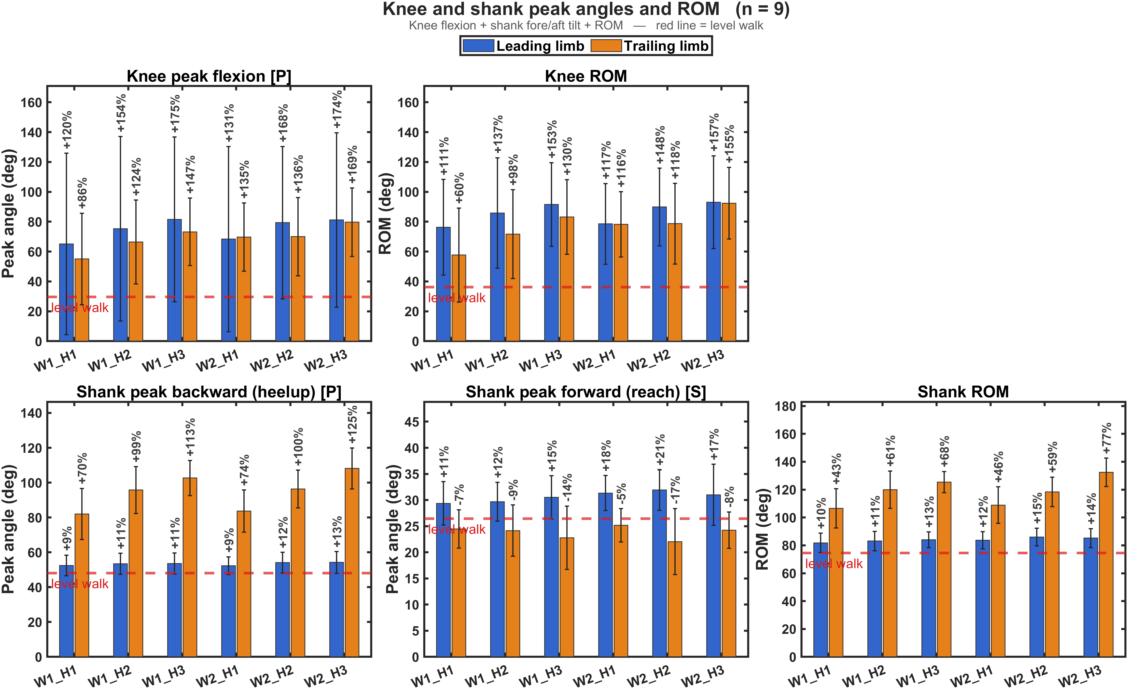

Slide 5
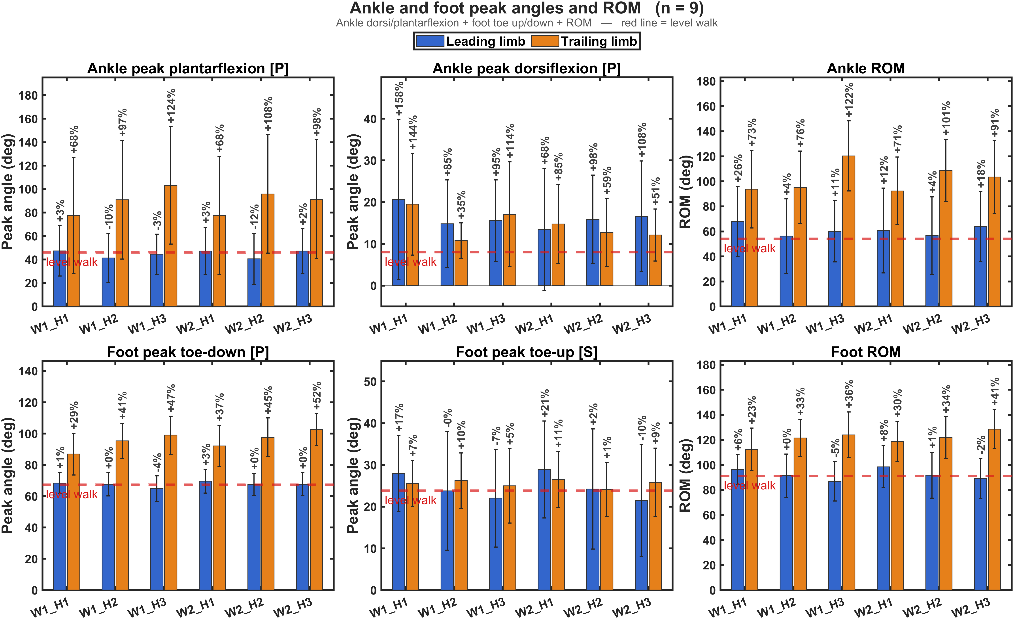

Slide 6
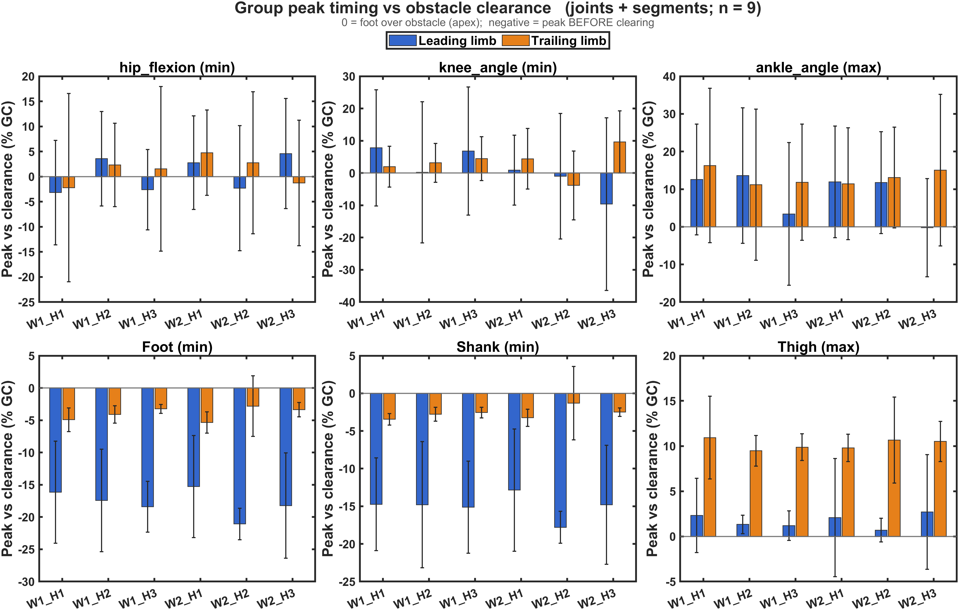

Slide 7
