Slide 1
What do the arms do when we step over an obstacle?
Upper-arm and forearm IMUs, shoulder and elbow, and the trunk: level walk and six obstacles
Heading-free angles · 10 young adults · Tests 101–110
Ehsan Sharafian · 12 November 2026

Slide 2
The question
The arm IMUs and the shoulder and elbow angles were recorded with the legs. What do they tell us?
Data
Level walk
Each obstacle
Is anything lost or drifting in the arm IMUs and in the IK shoulder and elbow angles?
How do the arms swing, and how much do people differ?
Upper arm, forearm, shoulder, elbow: range and peaks in each of the six obstacles. Different from level? From each other?
Variability
Leading leg and arms
Trunk
Between people, and from one repeat to the next within a person.
What does the arm opposite to the leading leg do, and the arm on its side? Is the arm still coupled to the leg?
What does the trunk do, and how do the arms relate to it?
2

Slide 3
What was measured on the upper body
Five Awinda IMUs and the OpenSim shoulder and elbow angles, on the same clock as the Dot leg IMUs.
Two IMUs per arm
Two joints per arm
Events from the legs
Upper arm and forearm (Xsens Awinda, 40 Hz, resampled to 60 Hz). One more on the sternum for the trunk.
Shoulder (flexion, adduction) and elbow from OpenSim inverse kinematics on the same IMUs.
Strides, toe-off and landing from the Dot foot IMUs; leading and trailing limb from the camera (steps 4 to 8).
274
39
2 strides
Read-only
obstacle crossings with complete arm data (of the 349 rows of the crossing dataset)
level walks, 3 to 5 per participant
per crossing: the stride of the leading limb and the stride of the trailing limb, analysed separately
on the pipeline: steps 1 to 9 were not run and not changed
3

Slide 4
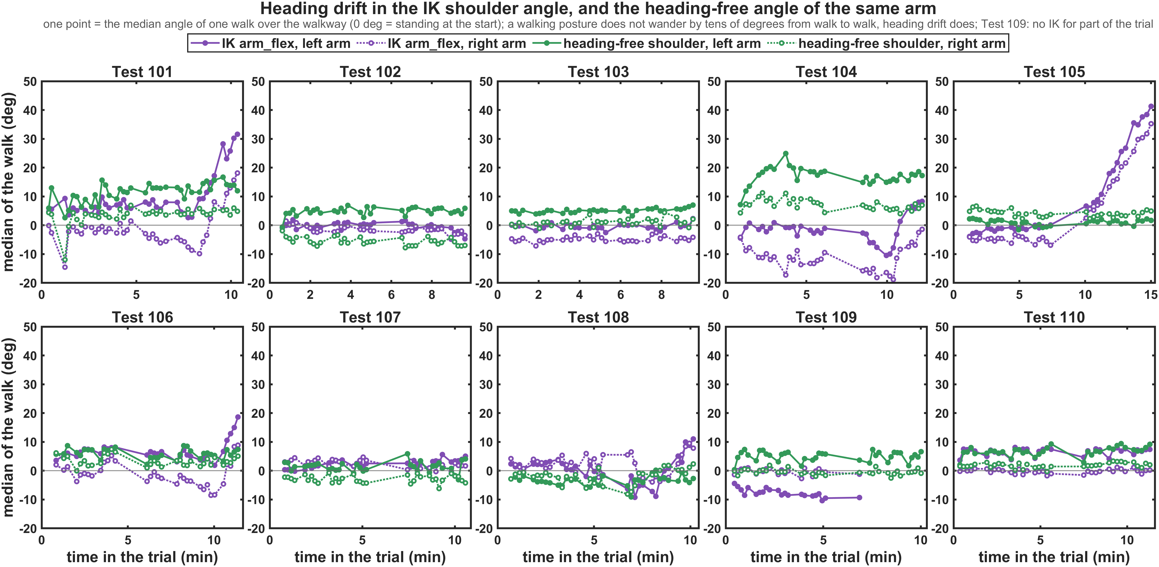
Data check: the IMUs are complete, the IK angles drift
Median shoulder flexion of every walk. A posture does not wander by tens of degrees; heading drift does.
0.00 %
arm IMU samples lost inside the walks
10°, up to 45°
IK shoulder angle wanders between the walks of a trial (heading-free: 7°)
48 %
of the walking samples: IK elbow on its 0° limit
Test 109
no IK for 39 % of the walking samples (14 of its usable rows)
4

Slide 5
Heading-free angles from the tilt of each IMU
The heading (magnetometer) is the unreliable part in this laboratory. The tilt is clean, so only the tilt is used.
1 Vertical in the sensor frame
2 Swing axis from the gait
3 Segment and joint angles
4 Level walk matched by side
The direction of gravity seen by the IMU does not change when the heading drifts. Standing at the start of the trial gives the long axis of the segment.
The direction in which the arm travels while the opposite leg swings (toe-off to heel-strike). No assumption on how the sensor is strapped.
Upper arm and forearm to the vertical. Shoulder = upper arm to the trunk. Elbow = forearm to upper arm. Abduction across the swing plane.
Left and right arm swing differently, so each obstacle stride is compared with level strides of the same leg, hence the same arm.
The four signals of each arm
Check
Upper-arm IMU, forearm IMU: elevation of the segment to the vertical, forward +.
Shoulder joint: upper arm relative to the trunk (flexion +), and its abduction.
Elbow joint: forearm relative to the upper arm (flexion +). OpenSim IK joints: ranges, as reference.
The opposite-leg swings move each sensor along its swing axis in 73–100 % of the cases. Zero = standing posture at the start of the trial.
5

Slide 6
Results
Level walk, the six obstacles, variability, and how the arms relate to the legs and the trunk
6

Slide 7
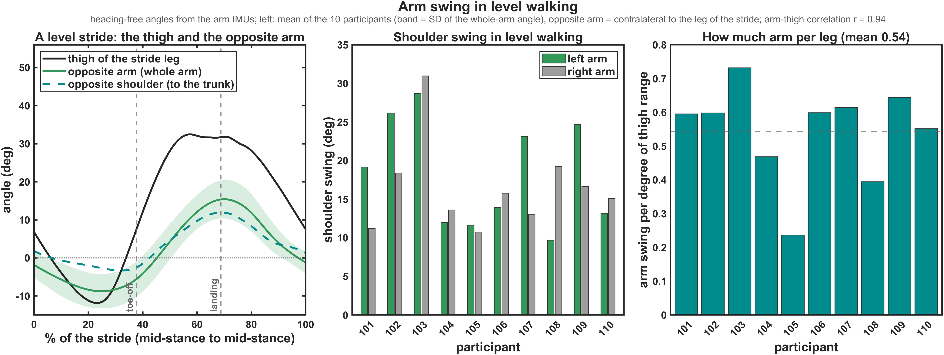
Level walking: the arms swing with the opposite leg
Mean of the ten participants; the opposite arm is the arm contralateral to the leg of the stride.
17° / 38°
r = 0.94
11–30°
up to 70 %
shoulder / forearm swing
arm with the opposite thigh; peak +12 ms from heel-strike
shoulder swing between participants
left-right difference in one person, no common side
7

Slide 8
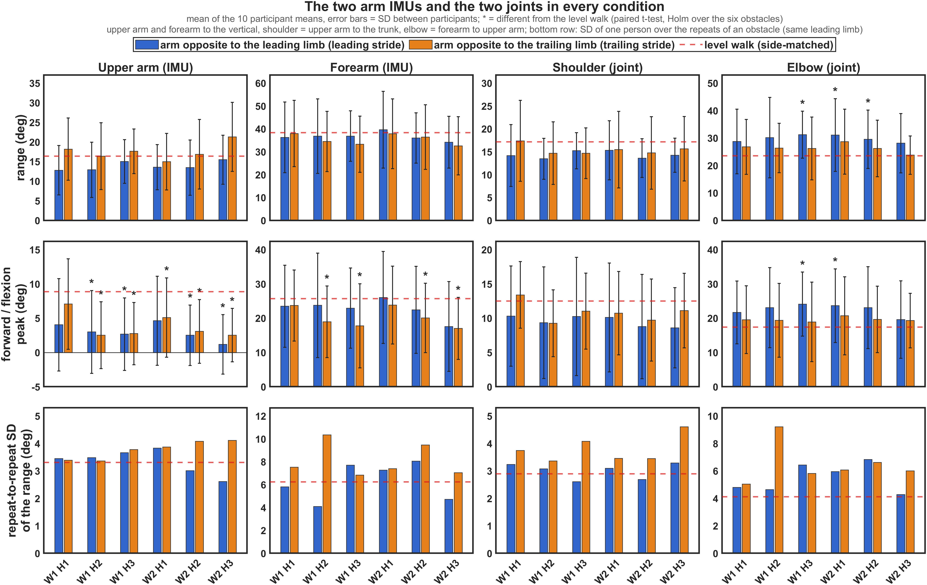
Two IMUs and two joints in every condition
Level walk (red dashed) and the six obstacles; * = different from the level walk (Holm-corrected).
Range
3 of 48 obstacle cells of the four ranges differ from the level walk.
Peaks
The peaks do move: arm further back to the vertical, elbow more flexed, arms further out.
Repeat to repeat
One person varies by 4.1° in level walking and 5.0° over obstacles (SD of the ranges).
8

Slide 9
Range of motion: level walk and the six obstacles
Participant means in degrees (SD between people); * = different from the level walk (Holm-corrected).
Signal | Arm (stride) | Level | W1 H1 | W1 H2 | W1 H3 | W2 H1 | W2 H2 | W2 H3
Upper arm (IMU) | opposite to leading | 16 (6) | 13 (6) | 13 (7) | 15 (6) | 14 (6) | 13 (7) | 15 (6)
 | opposite to trailing | 17 (6) | 18 (8) | 16 (8) | 18 (6) | 15 (7) | 17 (9) | 21 (9)
Forearm (IMU) | opposite to leading | 37 (11) | 36 (15) | 37 (16) | 37 (11) | 40 (17) | 36 (11) | 34 (11)
 | opposite to trailing | 40 (13) | 38 (14) | 35 (13) | 33 (12) | 38 (15) | 36 (14) | 33 (13)
Shoulder (joint) | opposite to leading | 17 (6) | 14 (7) | 13 (4) | 15 (4) | 15 (6) | 14 (4) | 14 (4)
 | opposite to trailing | 18 (6) | 17 (9) | 15 (7) | 15 (6) | 15 (8) | 15 (8) | 16 (7)
Elbow (joint) | opposite to leading | 23 (7) | 29 (12) | 30 (15) | 31 (9)* | 31 (13)* | 30 (11)* | 28 (11)
 | opposite to trailing | 24 (8) | 27 (10) | 26 (9) | 26 (11) | 29 (12) | 26 (10) | 24 (7)
Shoulder, OpenSim IK | opposite to leading | 24 (8) | 24 (13) | 23 (11) | 32 (21) | 24 (12) | 24 (10) | 21 (8)
 | opposite to trailing | 24 (9) | 26 (12) | 26 (11) | 25 (14) | 22 (10) | 26 (11) | 26 (15)
Elbow, OpenSim IK | opposite to leading | 8 (7) | 10 (8) | 11 (10)* | 11 (9) | 12 (9)* | 12 (11) | 8 (6)
 | opposite to trailing | 12 (12) | 12 (14) | 10 (8) | 12 (13) | 11 (11) | 9 (8) | 10 (7)
Reading: the size of the arm movement stays in the same region in all seven conditions, while the thigh range of the leading limb goes from 47° to 102°. Height effect: 0 of the 8 heading-free ranges; width effect: 0 of 8. Grey = OpenSim IK joints, for reference (the IK elbow is cut by its 0° limit).
9

Slide 10
Peaks: level walk and the six obstacles
Participant means in degrees from the standing posture; * = different from the level walk (Holm).
Peak | Arm (stride) | Level | W1 H1 | W1 H2 | W1 H3 | W2 H1 | W2 H2 | W2 H3
Upper arm, forward peak | opposite to leading | 8.3 | 4.1 | 3.0* | 2.7* | 4.6 | 2.5* | 1.2**
 | opposite to trailing | 9.5 | 7.1 | 2.5** | 2.8** | 5.1* | 3.1** | 2.5**
Upper arm, backward peak | opposite to leading | −7.6 | −8.7 | −9.9 | −12.4 | −9.0 | −11.0 | −14.3
 | opposite to trailing | −7.4 | −11.1* | −13.9 | −14.9** | −9.9 | −13.8* | −18.8**
Forearm, forward peak | opposite to leading | 24.7 | 23.5 | 23.8 | 23.0 | 26.0 | 22.5 | 17.6
 | opposite to trailing | 26.7 | 23.7 | 19.0* | 17.8* | 23.8 | 20.1* | 17.0*
Shoulder, flexion peak | opposite to leading | 11.9 | 10.3 | 9.4 | 10.3 | 10.1 | 8.8 | 8.6
 | opposite to trailing | 13.1 | 13.4 | 9.3 | 11.0 | 10.7 | 9.7 | 11.1
Shoulder, abduction peak | opposite to leading | 6.8 | 8.4 | 9.6* | 11.6* | 8.5* | 9.7* | 11.8*
 | opposite to trailing | 6.4 | 9.9 | 11.4 | 12.5* | 10.0 | 12.3* | 17.5*
Elbow, flexion peak | opposite to leading | 17.0 | 21.7 | 23.1 | 24.1* | 23.7* | 23.1 | 19.6
 | opposite to trailing | 17.8 | 19.6 | 19.4 | 18.9 | 20.7 | 19.7 | 19.3
Reading: 27 of the 108 obstacle cells of the peaks differ from the level walk; the flexion peak of the shoulder joint in none. Between two obstacles: 4 of 390 pairwise comparisons survive the Holm correction; after the FDR correction 0 rows keep a height effect and 1 a width effect.
10

Slide 11
Variability: people differ far more than obstacles
Between people, within a person from repeat to repeat, and the share of the variance of all obstacle crossings.
28–42 %
46–64 %
6–28 %
0.58–0.76
coefficient of variation of the four ranges between people, over obstacles (level: 28–38 %)
of the variance of the ranges over all obstacle crossings: who is walking and which of the two arms it is
is the obstacle; the repeats of the same obstacle take 22–41 %
ICC of the ranges: a single crossing is a fair picture of the person
Range | Repeat-to-repeat SD: level | H1 | H2 | H3 | Obstacles vs level | H3 vs H1
Upper arm (IMU), opp. to leading | 3.3° | 3.6° | 3.2° | 3.1° | p = 0.948 | p = 0.542
Upper arm (IMU), opp. to trailing | 3.3° | 3.6° | 3.7° | 3.9° | p = 0.362 | p = 0.669
Forearm (IMU), opp. to leading | 6.2° | 6.5° | 6.1° | 6.2° | p = 0.967 | p = 0.720
Forearm (IMU), opp. to trailing | 6.2° | 7.5° | 9.9° | 6.9° | p = 0.008 | p = 0.739
Shoulder (joint), opp. to leading | 2.9° | 3.2° | 2.9° | 2.9° | p = 0.736 | p = 0.748
Shoulder (joint), opp. to trailing | 2.9° | 3.6° | 3.4° | 4.3° | p = 0.003 | p = 0.410
Elbow (joint), opp. to leading | 4.1° | 5.4° | 5.7° | 5.4° | p = 0.011 | p = 0.984
Elbow (joint), opp. to trailing | 4.1° | 5.6° | 7.9° | 5.9° | p = 0.015 | p = 0.649
11

Slide 12
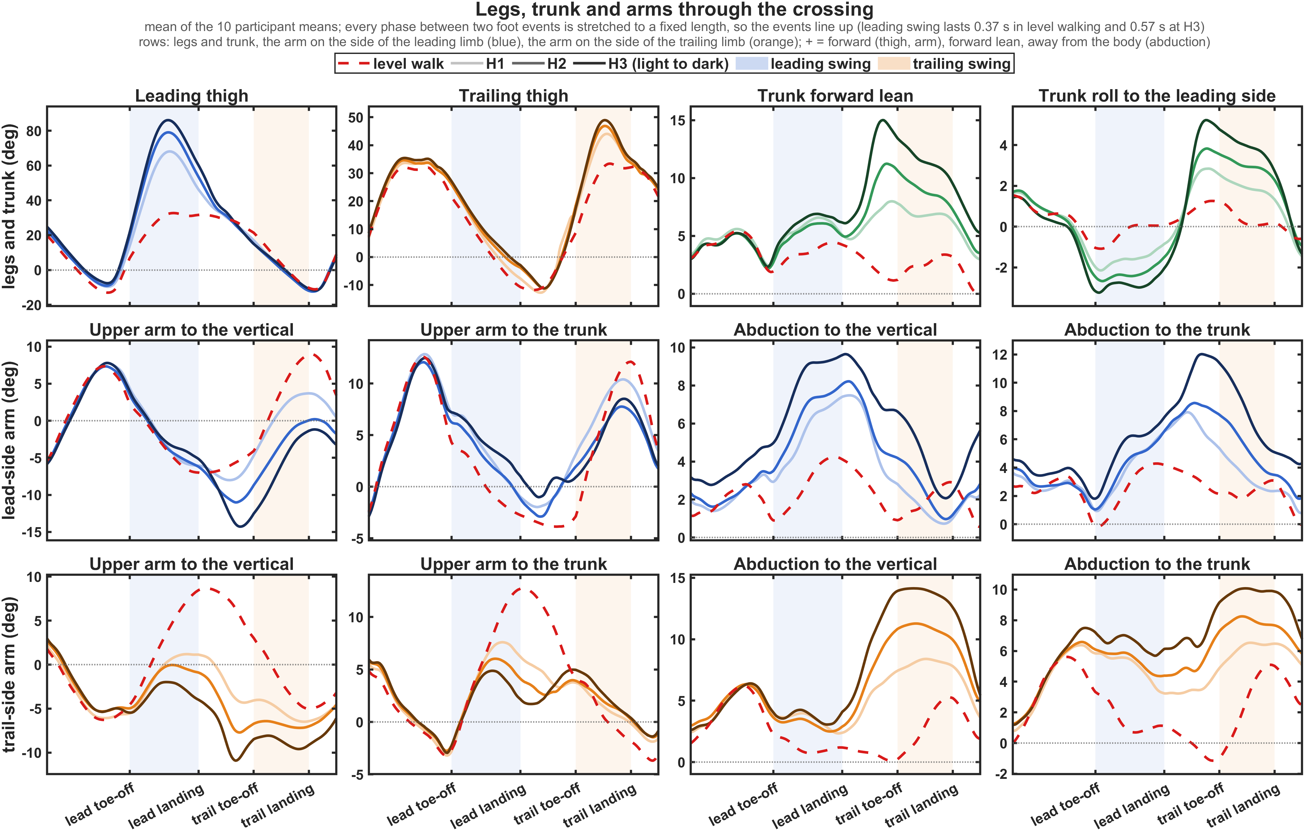
Legs, trunk and arms through the crossing
Phase axis: the foot events of all crossings line up. Red dashed = level walk; light to dark = H1 to H3.
Trunk
Leans forward and rolls to the stance leg, more with the height.
To the vertical
Both upper arms end up behind the body while the trailing limb crosses.
To the trunk
The shoulder does nearly what it does in level walking; the arms move out.
12

Slide 13
The answer at a glance
Participant means: level walk → H1 / H2 / H3 (10 / 20 / 30 % of leg length).
Question | Answer | Numbers
Do the arms swing more? | No | shoulder swing 16.6 → 14.8 / 13.6 / 14.8°; leading thigh range 47 → 81 / 94 / 102°
Arm per leg | Halves | arm swing per degree of thigh range 0.52 → 0.28 / 0.24 / 0.22
Opposite arm, forward peak | Lower, earlier | to the vertical 8.3 → 4.3 / 2.8 / 1.9°; peak minus foot landing 11 → −112 / −184 / −304 ms
Arms away from the body | Yes, both | mean abduction to the trunk 2.6 → 4.6 / 5.7 / 7.9° (lead side), 1.6 → 4.9 / 6.1 / 7.6° (trail side)
Elbow | More flexed | flexion peak of the trail-side arm 17.0 → 22.7 / 23.1 / 21.9°
Trunk | Leans and rolls | forward lean, peak 5.0 → 10.4 / 12.8 / 16.5°; roll range 4.0 → 6.4 / 8.4 / 9.9°
Arms and trunk | Move together | upper arm to the vertical −1.3 → −2.7 / −5.0 / −6.2°, to the trunk 1.7 → 3.6 / 2.3 / 3.1°
Height or width | Height | 27 of 56 measures change with the height (FDR), 0 with the width
13

Slide 14
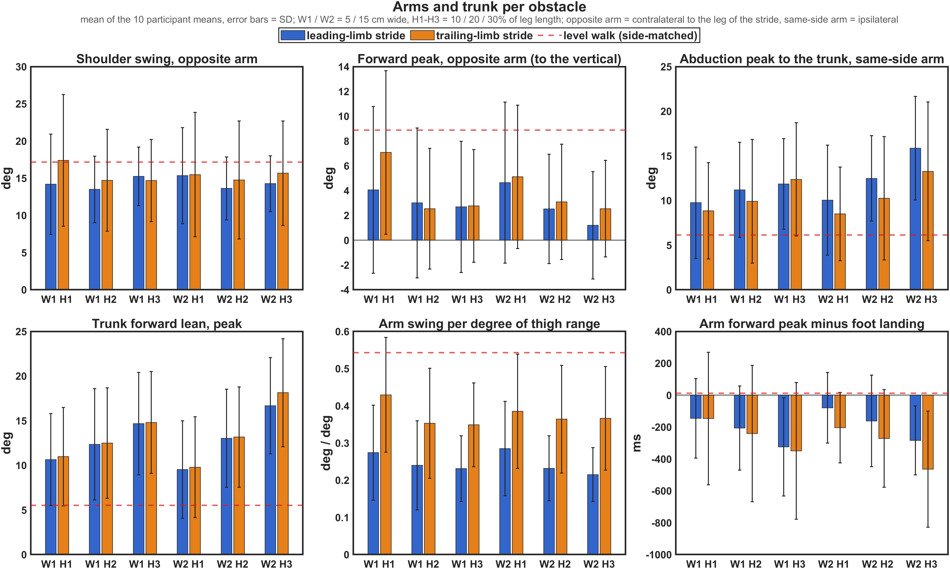
The arms do not scale with the legs
The thigh range almost doubles and the stride takes longer; the shoulder swing stays where it was.
47° → 92°
16.6° → 14.4°
0.52 → 0.25
thigh range of the leading limb, level → obstacles (trailing: 47° → 64°)
shoulder swing of the opposite arm (p = 0.183); no slope with the height
arm swing per degree of thigh range (trailing stride: 0.56 → 0.37)
Not an effect of speed
A faster crossing has more shoulder swing (+0.8° per 0.1 m/s), but with the speed in the model the height effects keep their size. The strides before and after the obstacle swing as in level walking.
Blue = leading-limb stride, orange = trailing-limb stride, red dashed = level walk; error bars = SD between people.
14

Slide 15
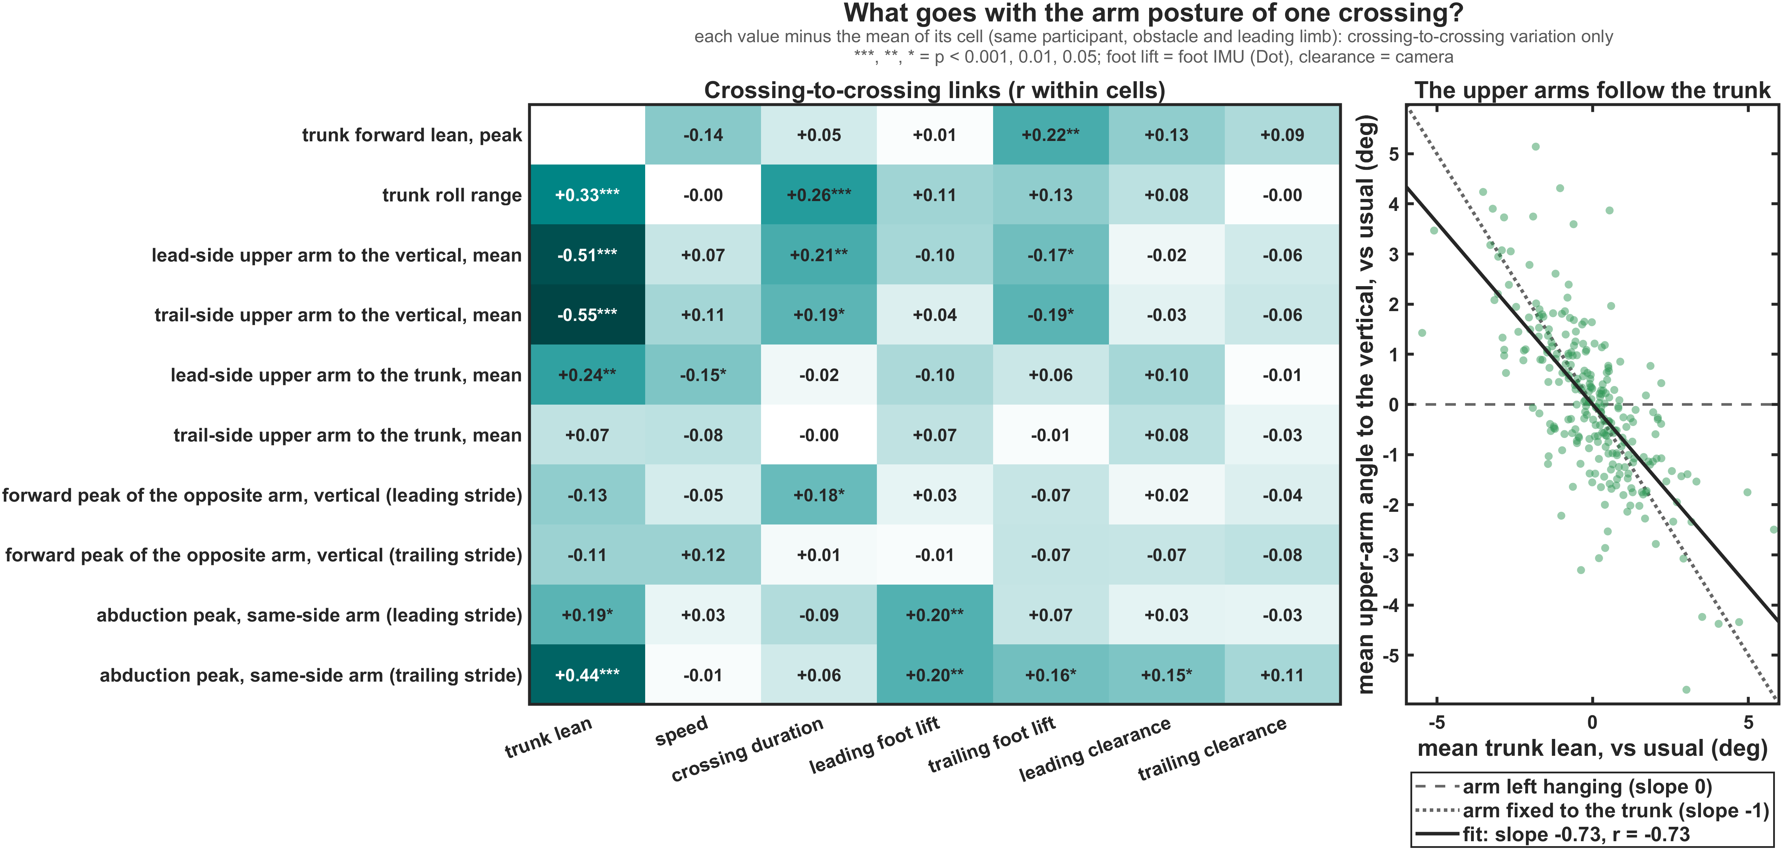
The trunk leans forward and the upper arms go with it
Right: one dot per crossing, relative to the usual of that person, obstacle and leading limb.
5° → 16°
peak forward lean, level → H3 (+0.33° per cm)
73 %
of the trunk lean is followed by the upper arms (r = −0.73)
+212 ms
lean peak from the trailing toe lift-off at H3: the trunk leans most as the trailing limb is lifted
Lead-side upper arm over the crossing: to the vertical −1.3° → −6.2° (H3); to the trunk +1.7° → +3.1° (p = 0.077).
15

Slide 16
The arm keeps its own schedule
The leg swing gets longer; the forward swing of the opposite arm does not (leading-limb stride).
0.37 → 0.57 s
0.53 → 0.48 s
+11 → −304 ms
0.94 → 0.74
leg swing time (level → H3)
forward swing of the opposite arm: unchanged (p = 0.580)
arm forward peak minus foot landing: at heel-strike in level walking, well before it at H3
arm–thigh correlation (trailing stride 0.95 → 0.83)
Leading-limb stride | Level | H1 | H2 | H3
Leg swing time (s) | 0.37 | 0.53 | 0.56 | 0.57
Forward swing of the opposite arm (s) | 0.53 | 0.56 | 0.50 | 0.48
Angle travelled in that swing (°) | 25 | 22 | 19 | 18
Arm forward peak minus foot landing (ms) | +11 | −112 | −184 | −304
Arm forward peak minus foot apex (ms) | +129 | +123 | +75 | −50
Reading: the arm does not stretch its swing to the longer leg swing; it peaks about when the foot passes over the obstacle and is already returning when the foot lands.
16

Slide 17
Both arms move out, and the elbow bends
Both arms abduct to the trunk; with the trunk roll, the arm beside the crossing leg is furthest out.
2.6° → 7.9°
1.6° → 7.6°
mean abduction to the trunk, lead-side arm (level → H3)
mean abduction to the trunk, trail-side arm
7° → 17°
17° → 23°
abduction peak to the vertical of the arm beside the trailing limb (+0.36° per cm; 10 of 10 people)
elbow flexion peak of the arm that swings forward with the leading leg, whatever the height
Top: arm on the side of the leading limb. Bottom: arm on the side of the trailing limb. Red dashed = level walk; light to dark = H1 to H3; shaded = leading and trailing swing.
17

Slide 18
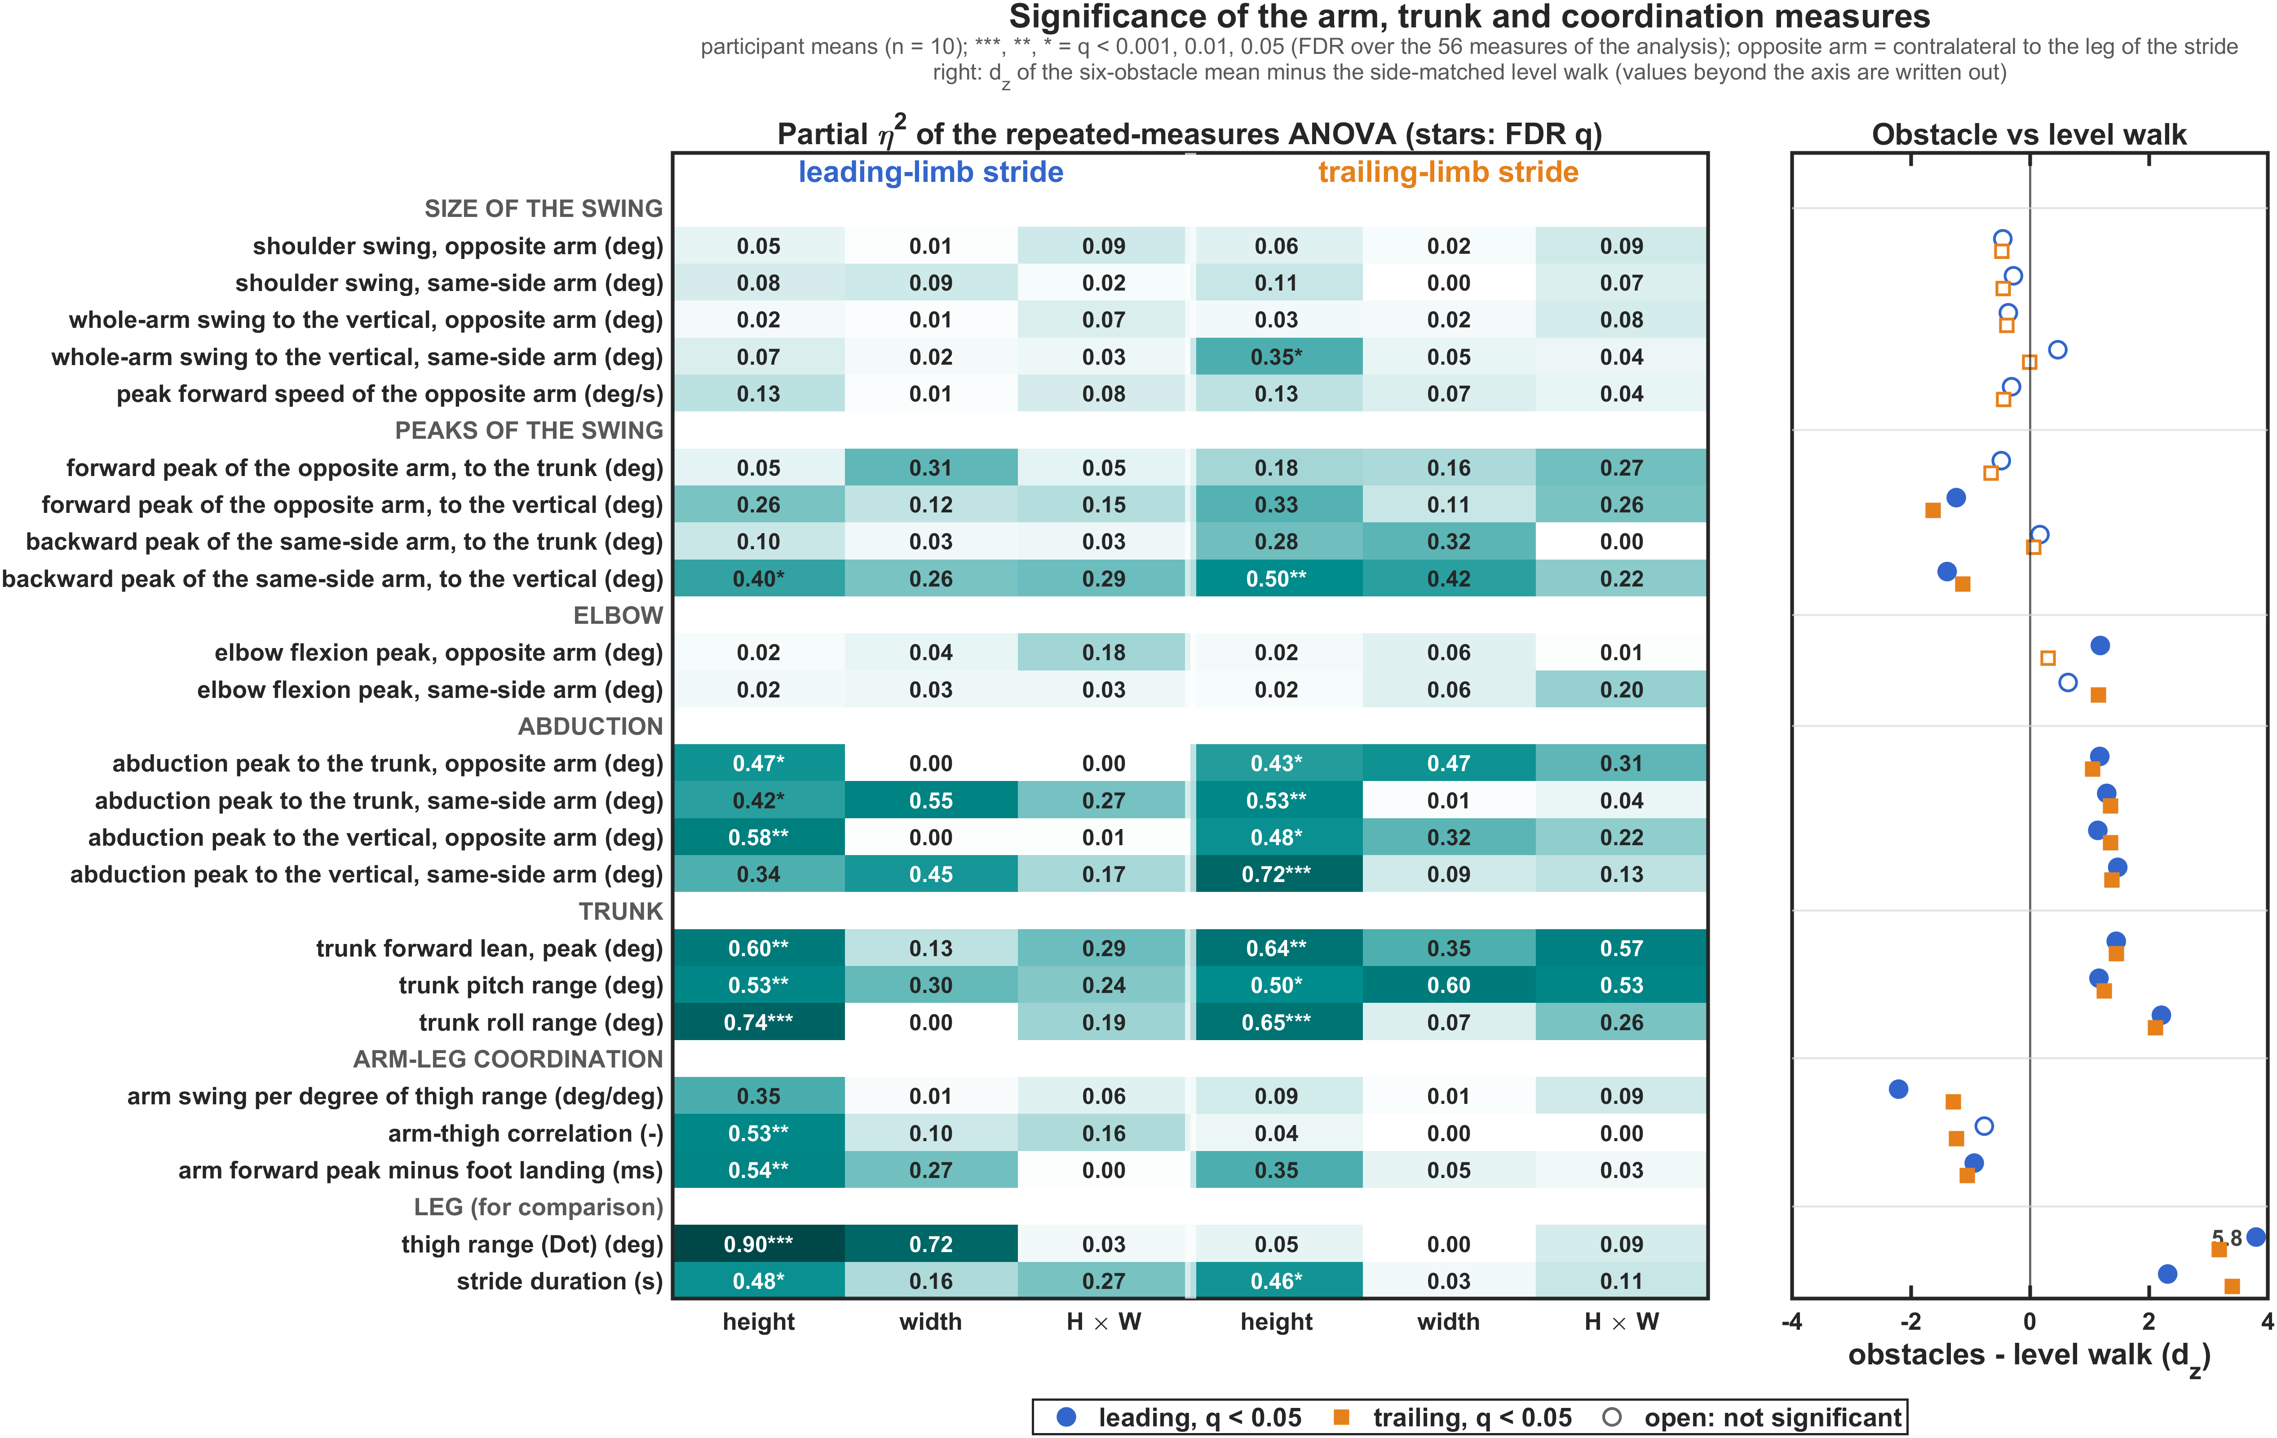
Height, not width
Partial η² of the repeated-measures ANOVA (stars: FDR) and the effect size against the level walk.
Height
27 of 56 measures change with the obstacle height after the FDR correction.
Width
0 of 56: 5 or 15 cm deep makes no difference to the arms or the trunk.
What scales
Trunk lean and roll, abduction, arm position to the vertical, timing against the leg. Not the size of the swing, not the elbow.
18

Slide 19
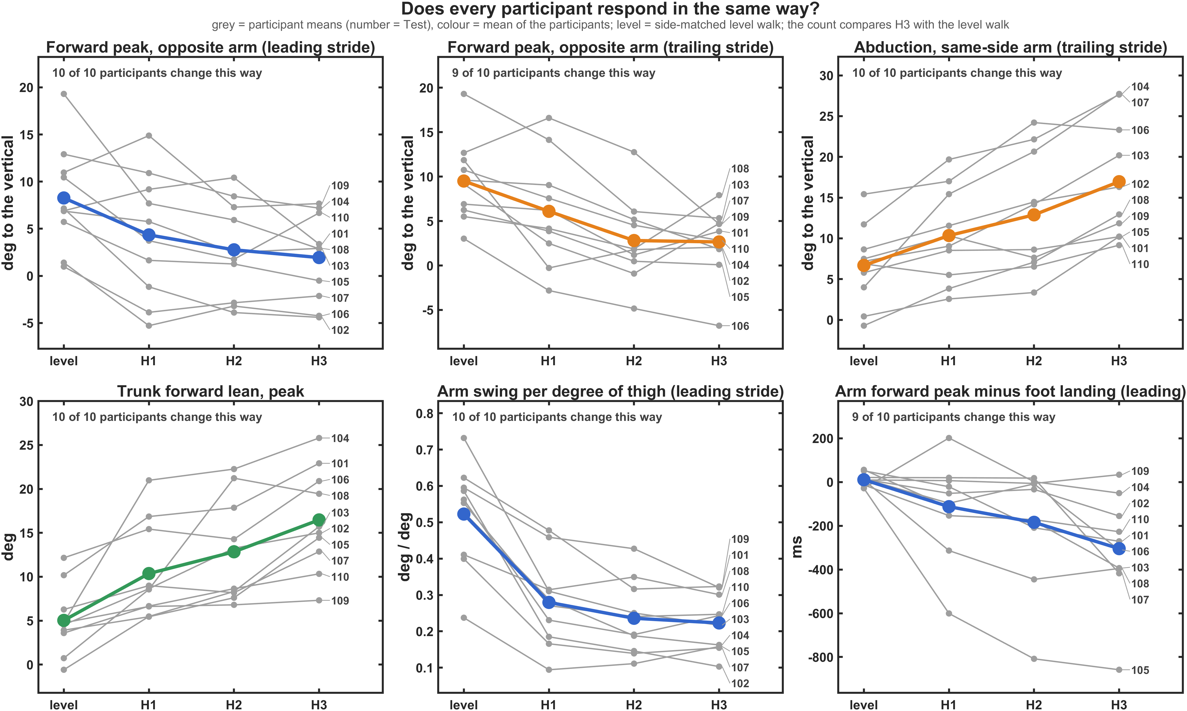
Does everyone do it?
Every participant from the level walk to the highest obstacle. The direction is shared, the size is personal.
10 of 10
lean the trunk more; 10 of 10 abduct the arm beside the trailing limb.
10 of 10
lose arm swing per degree of thigh; 9 of 10 reach the arm peak earlier.
Personal size
Forward peak of the opposite arm changes by −3° to −16° between people.
19

Slide 20
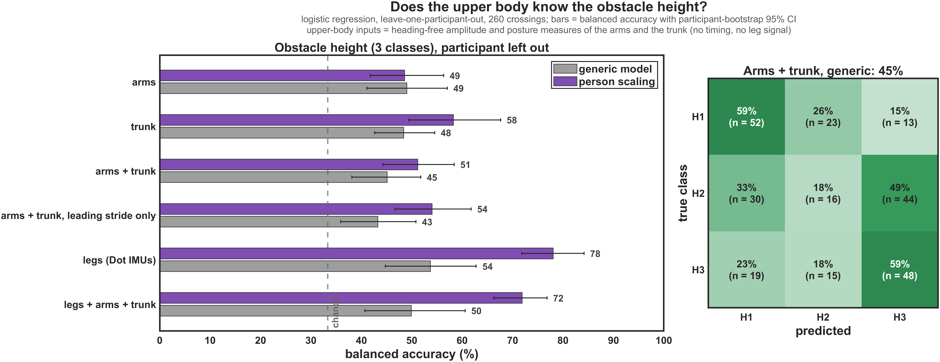
IK angles, and the upper body as a sensor
Left: do the OpenSim shoulder and elbow angles agree? Right: does the upper body tell the obstacle height?
IK shoulder
Stride by stride the arm_flex range follows the heading-free swing with r = 0.43; adding arm_add back gives r = 0.54. Same group result: no growth with the obstacle.
IK elbow
Its range is 17° smaller than the planar elbow, cut by the 0° limit. Peaks and posture cannot be read from the IK angles: their zero wanders with the heading.
Obstacle height for a new person (chance 33 %): arms 49 %, trunk 48 %, legs 54 % with the generic model; trunk 58 %, legs 78 % with person scaling. The upper body responds to the obstacle but adds nothing to the leg IMUs for the device.
20

Slide 21
Discussion
What the upper body does, what it does not do, and what to do next
21

Slide 22
What it means
The crossing is a task of the legs and the trunk; the shoulders keep walking.
Not a bigger pendulum
Trunk and arms as one unit
If the arms balanced the rotation of the legs, the arm opposite to the leading leg would swing more and longer. It does not: same size, same duration, earlier than the leg.
The trunk leans by a third of a degree per cm of obstacle and the upper arms follow three quarters of it. Too quick for a hanging pendulum, or held by the shoulder: EMG would tell.
A mild guard
For the device
Arms a few degrees further out and one elbow more flexed, scaling with the height like the trunk roll: more time on one leg.
Arm and trunk IMUs add nothing to the recognition of the height. Their value is the description of the upper body.
22

Slide 23
Limitations and next steps
Planar, heading-free angles of ten young adults in the laboratory.
Limitations
Next steps
• Tilt only: no rotation of the arm or of the trunk about the vertical.
• Zero = standing posture at the start; differences between conditions are not affected.
• 3 to 5 level walks per participant; step 4 events (late trailing toe-off).
• No forces or muscle recordings: the mechanisms are interpretations.
1. Correct the heading of the arm and trunk IMUs to get the transverse plane and the whole-body angular momentum.
2. Older adults: a larger guard and trunk response is expected; the measures are ready.
3. Cross with the arms folded: does the arm behaviour matter for clearance and speed?
4. Run the SPSS sheet of the arm measures (one row per participant) if wanted.
23

Slide 24
Answers to the questions
1
Data: the arm IMUs are complete; the IK shoulder and elbow angles drift, so the angles come from the tilt.
Numbers to remember
Level walk: shoulder 17°, forearm 38°, tied to the opposite leg; people differ a lot.
Thigh range: 47° → 102°
2
Shoulder swing: 17° → 15°
3
Six obstacles: the ranges hardly change; the peaks, the abduction and the trunk do, with the height, not the width.
Arm per thigh: 0.52 → 0.22
Trunk lean: 5° → 16° (+0.33° per cm)
4
Variability: who is walking and which arm make up 46–64 % of the variance of the ranges, the obstacle 6–28 %.
Arms follow the trunk: 73 %
Arm peak vs landing: +11 → −304 ms
5
Leading leg and arms: the opposite arm no longer follows the leg; it keeps its own timing.
Abduction (trail side): 7° → 17°
24

