Slide 1
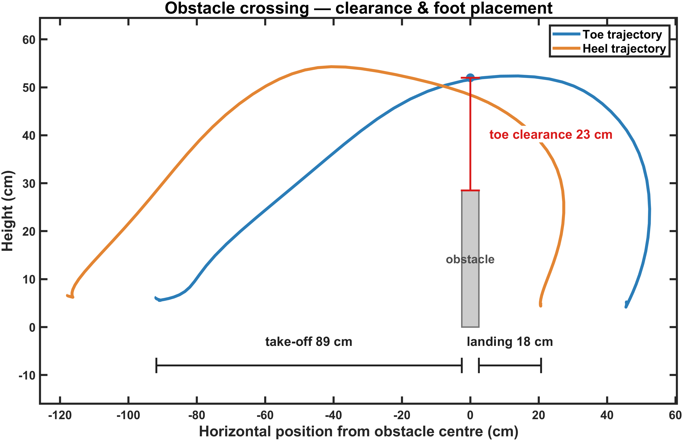

Slide 2
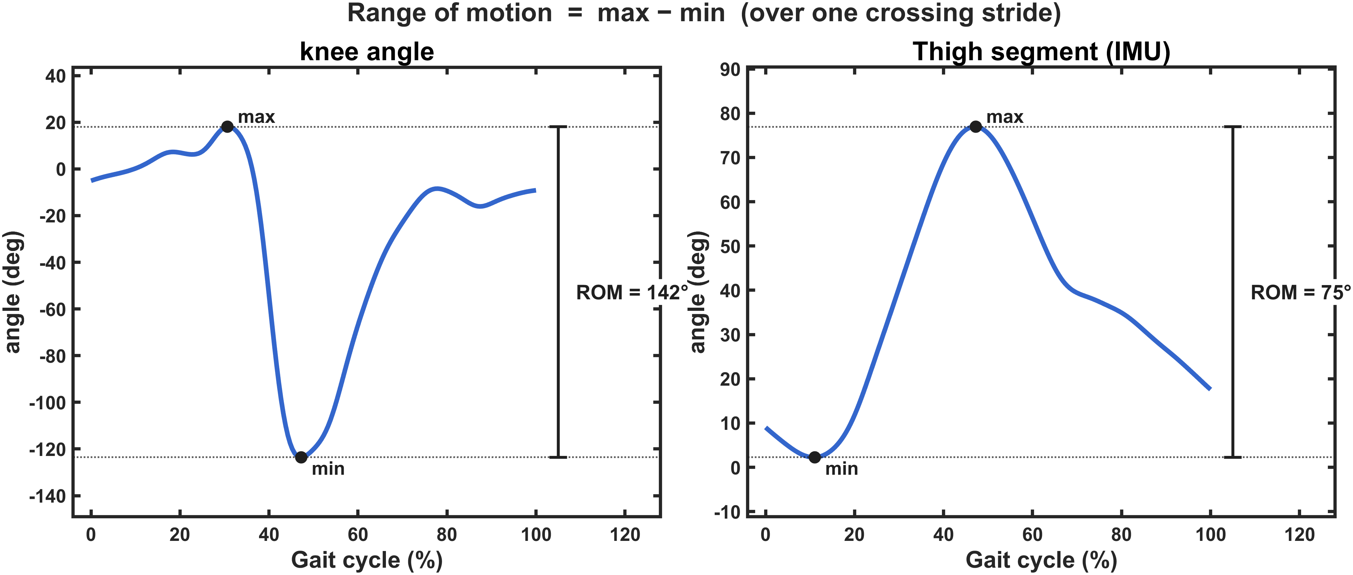

Slide 3
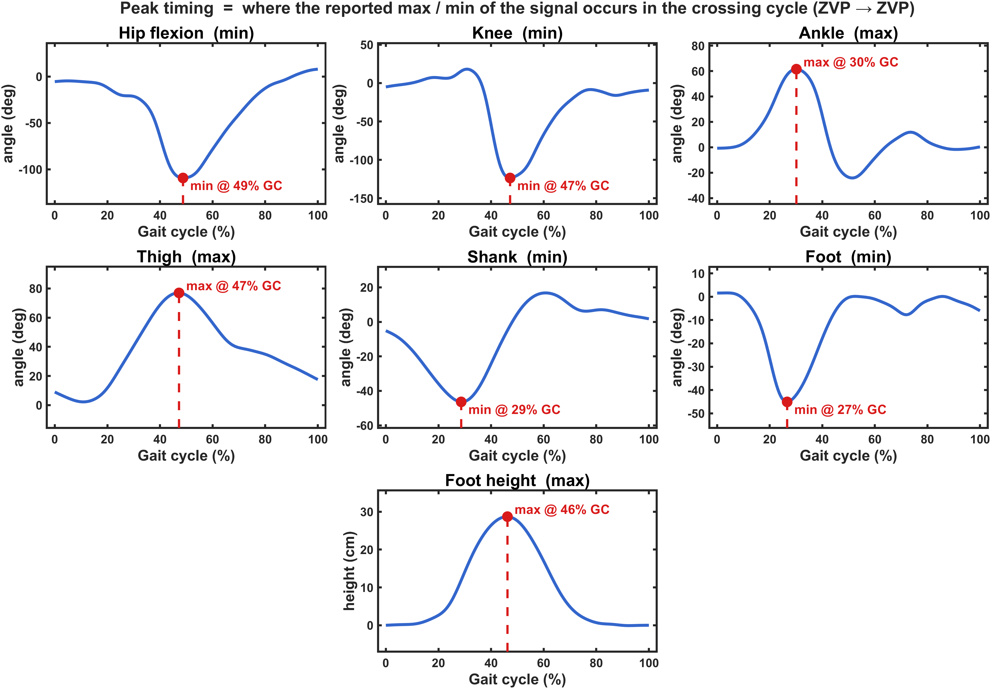

Slide 4
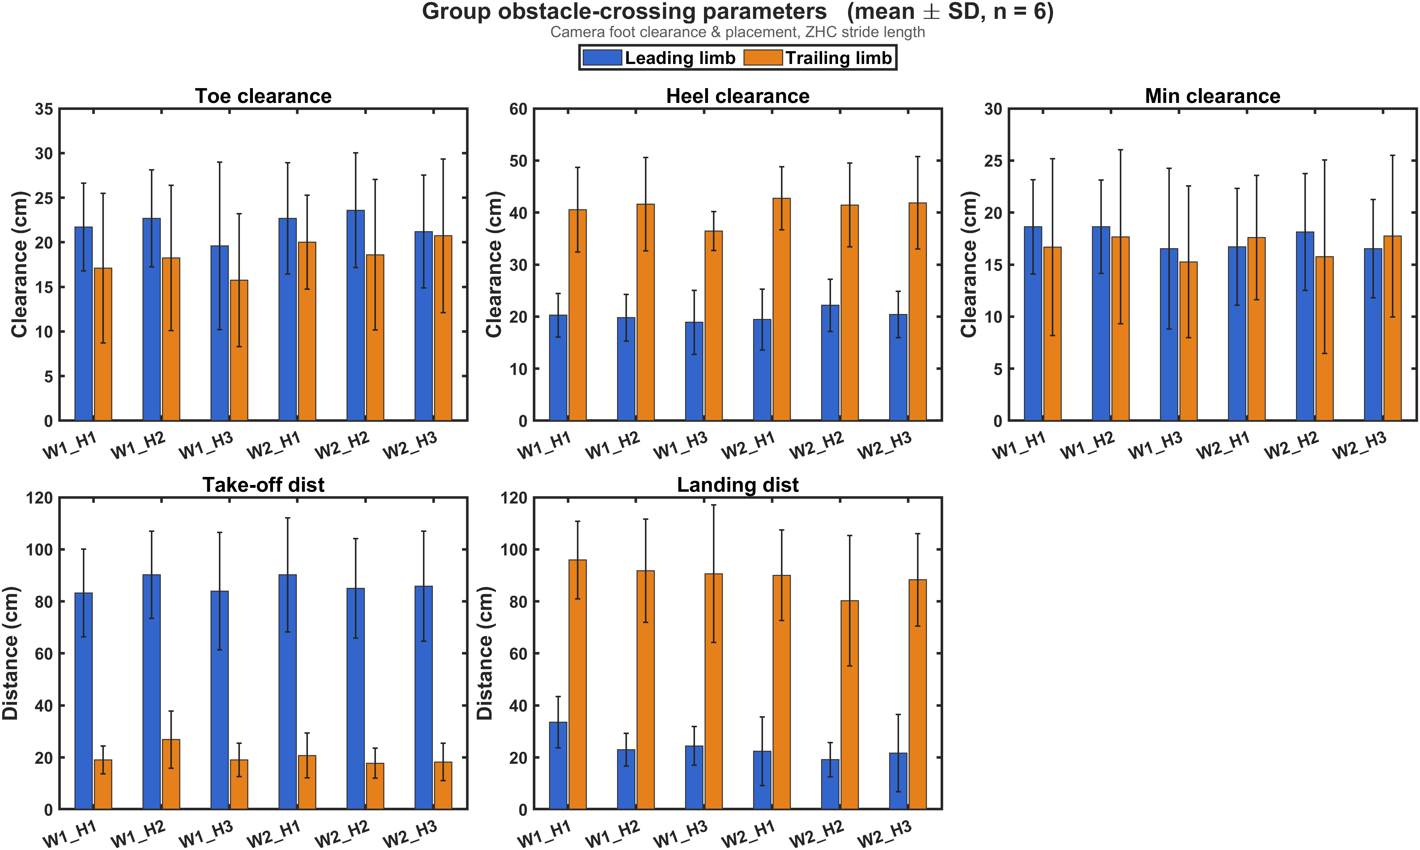

Slide 5
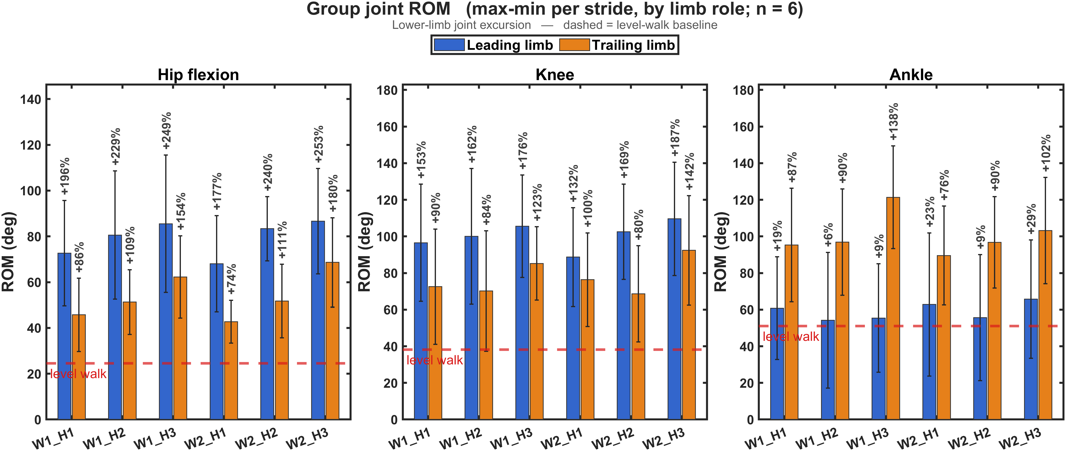

Slide 6
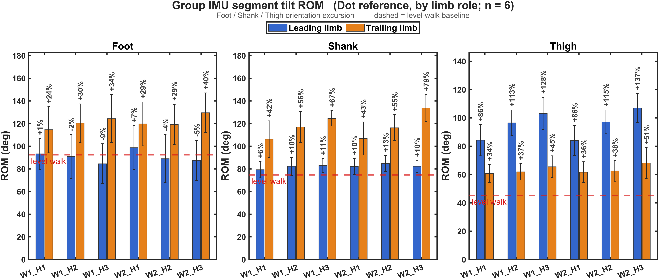

Slide 7
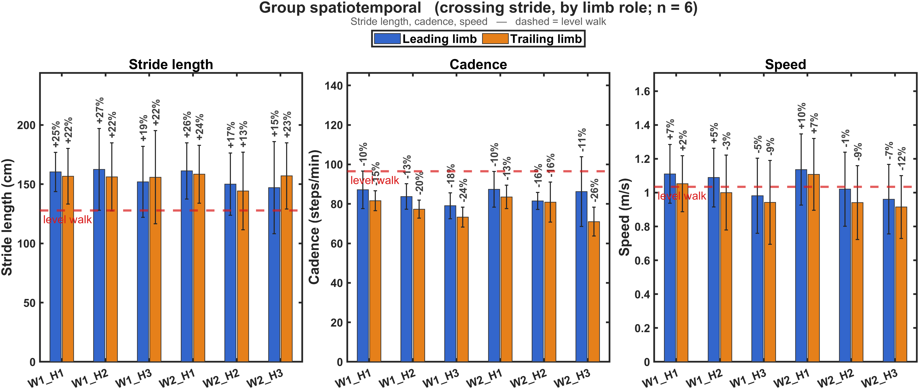

Slide 8
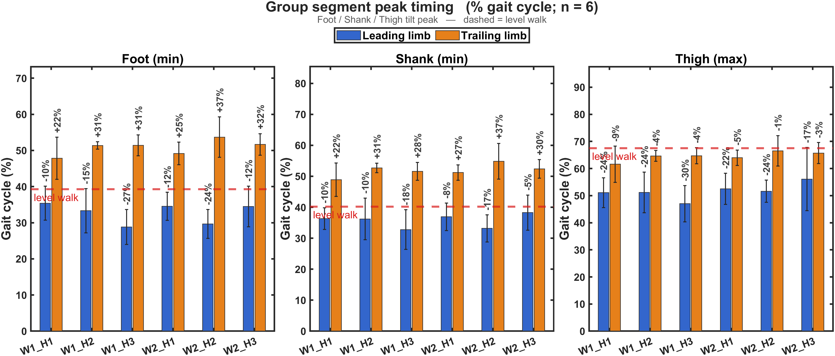

Slide 9
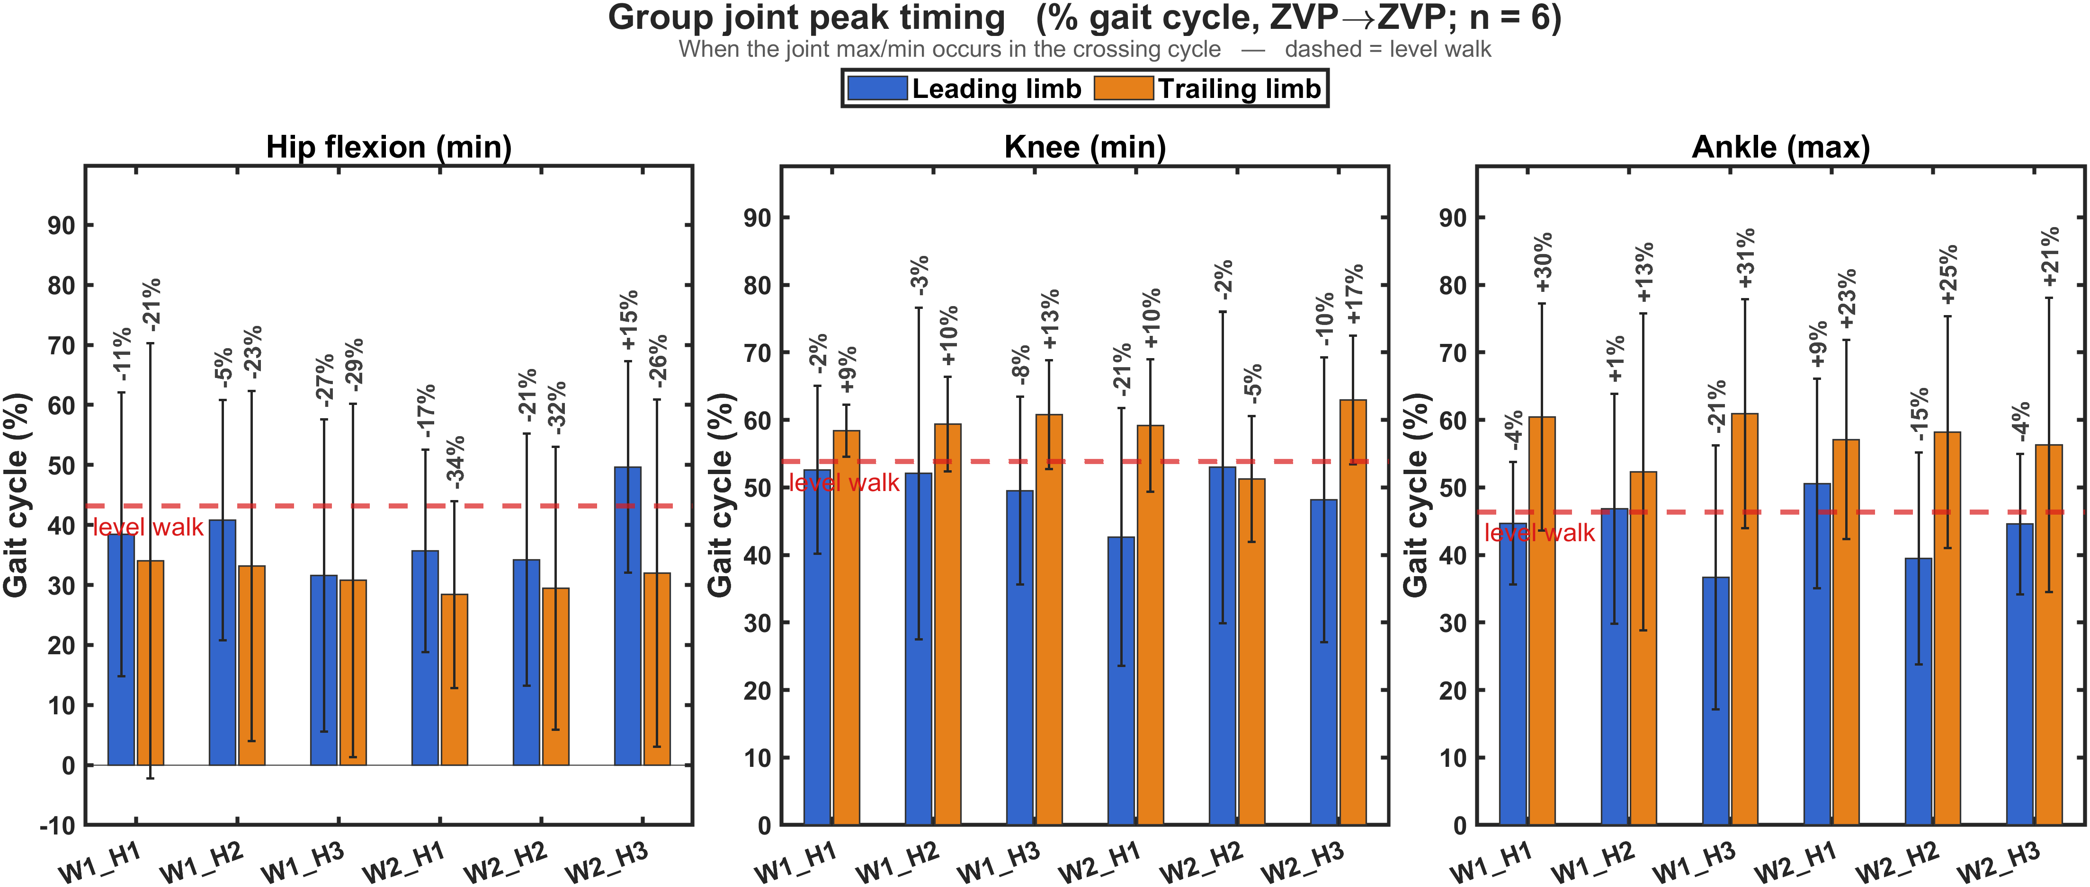

Slide 10
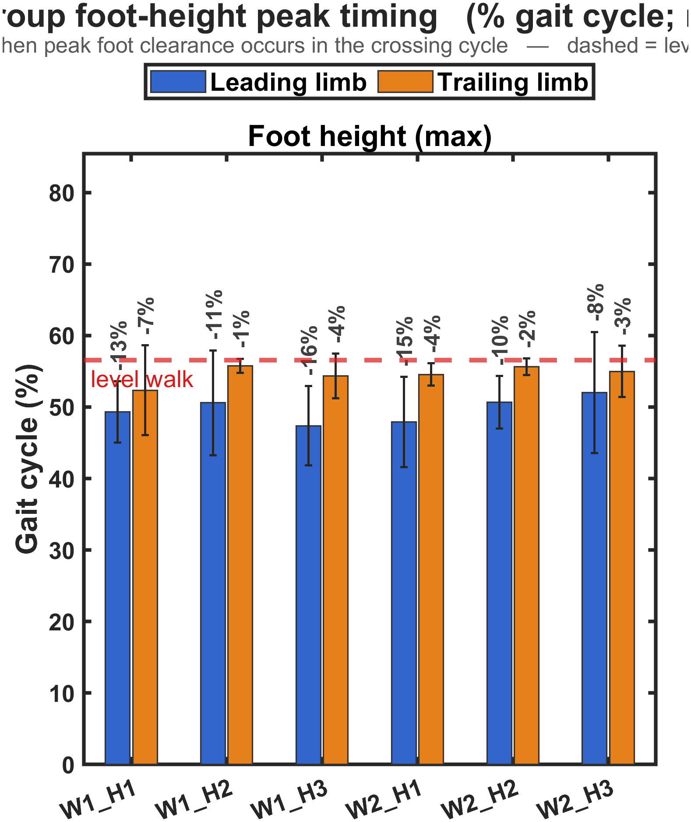

Slide 11
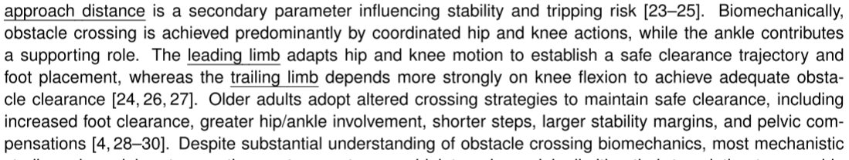
Take Home Message
Leading limb: the thigh drives the height response. The shank and foot barely change from level walking.
Trailing limb: the shank responds most, with the foot and thigh responding moderately.
Limb and segment | H1 | H2 | H3
Leading thigh | +86% | +114% | +133%
Leading shank | +8% | +12% | +11%
Leading foot | +4% | −3% | −7%
Trailing thigh | +35% | +38% | +48%
Trailing shank | +43% | +56% | +73%
Trailing foot | +27% | +30% | +37%

Slide 12
Signal | Report | Why | Optional
Hip (joint) | Peak flexion | It’s the lift of the thigh, the main leading-limb action | Peak extension, to show wind-up before the crossing
Knee (joint) | Peak flexion | It shortens the limb so the foot clears. It matters for both limbs, especially the trailing one. | ROM adds almost nothing here, because the extension end is near zero and ROM is roughly the flexion peak. Keep it only as a column.
Thigh (segment) | Peak forward tilt and peak backward tilt | Forward tilt is the lift. Backward tilt shows whether a bigger trailing-thigh ROM comes from a wind-up. | ROM as a column
Shank (segment) | ROM, plus the backward peak (heel up) | The trailing-limb kick-up is where the shank responded most. ROM gives an offset-free summary. | Forward peak (reach), for the leading limb’s landing

Slide 13
named peak | signal | extremum | notes
Hip peak flexion | hip_flexion | min | flexion is negative here (confirmed: thigh forward-tilt max ↔ hip min)
Hip peak extension | hip_flexion | max
Knee peak flexion | knee_angle | min
Ankle dorsiflexion | ankle_angle | max
Ankle plantarflexion | ankle_angle | min
Thigh forward tilt | Thigh | max | +68° @ mid-swing ✓
Thigh backward tilt | Thigh | min
Shank backward (heel up) | Shank | min | early swing ✓
Shank forward (reach) | Shank | max | late swing ✓
Foot toe-down / toe-up | Foot | min / max | I’ll flag foot to verify

Slide 14
