Slide 1
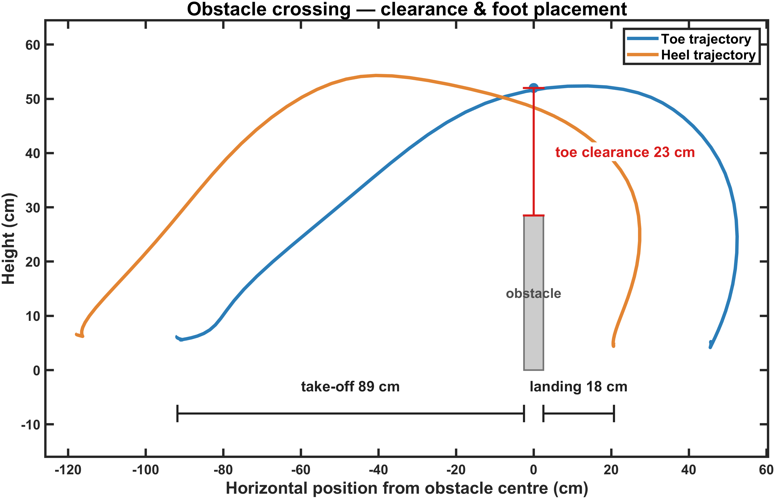

Slide 2
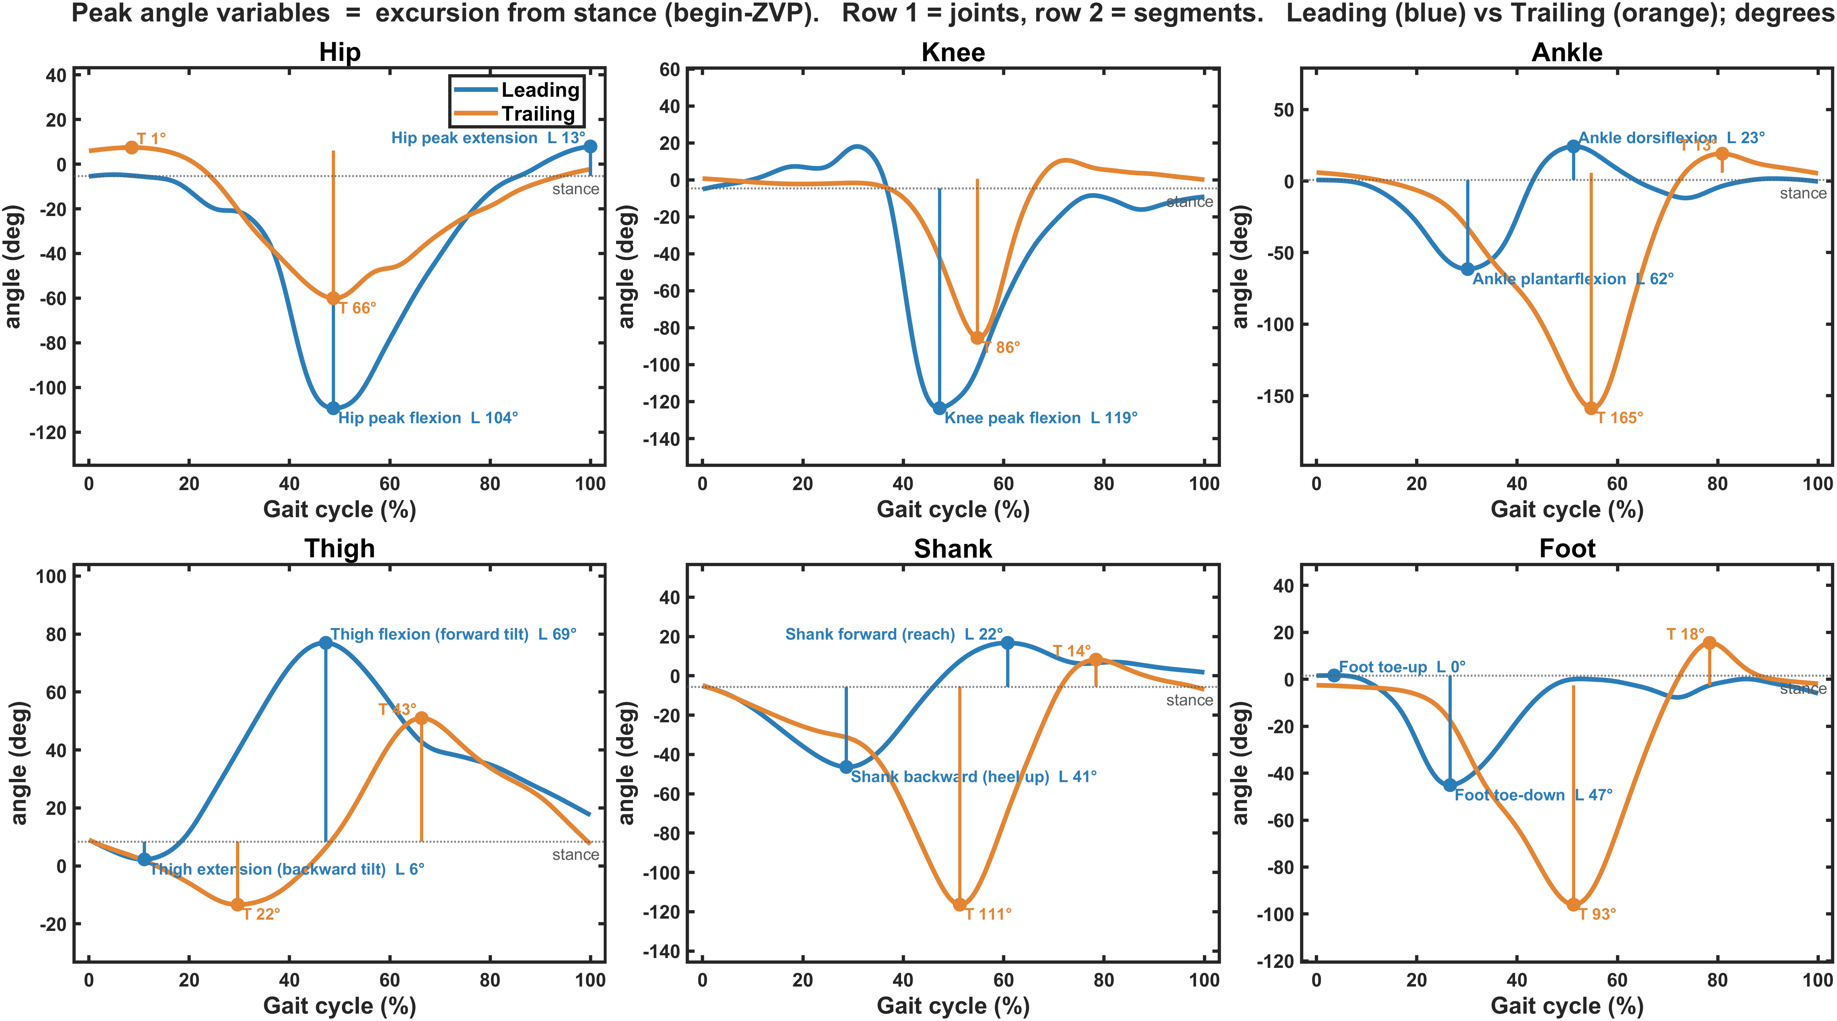

Slide 3
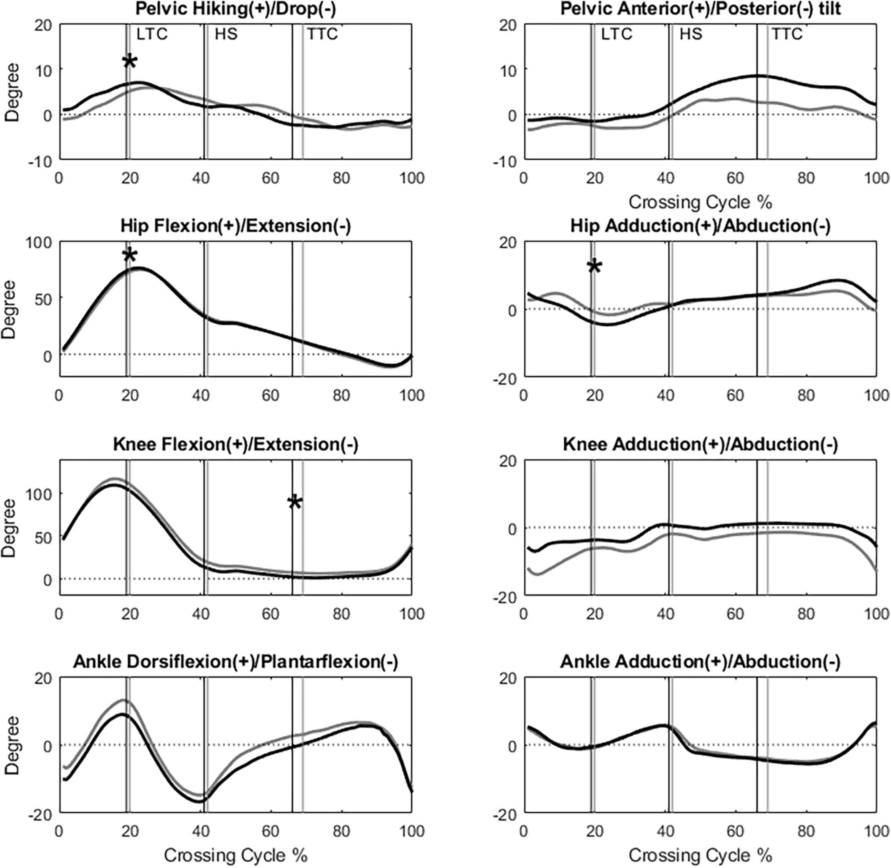

Slide 4
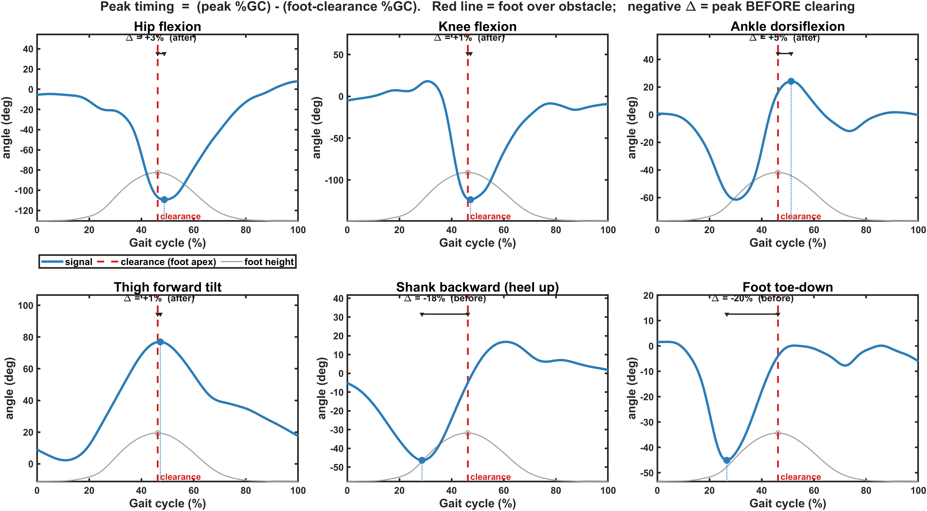

Slide 5
Changes from Level Walk
Type | Signal | Leading: % change (Δ°) | Trailing: % change (Δ°)
Joints | Hip flexion | +291% (+42°) | +172% (+25°)
 | Knee flexion | +173% (+52°) | +139% (+42°)
 | Ankle plantarflexion | −5% (−3°) | +88% (+41°)
 | Ankle dorsiflexion | +104% (+8°) | +66% (+5°)
Segments | Thigh forward tilt | +190% (+50°) | +45% (+12°)
 | Shank heel-up | +9% (+4°) | +93% (+45°)
 | Foot toe-down | ~0% (0°) | +38% (+26°)

Slide 6
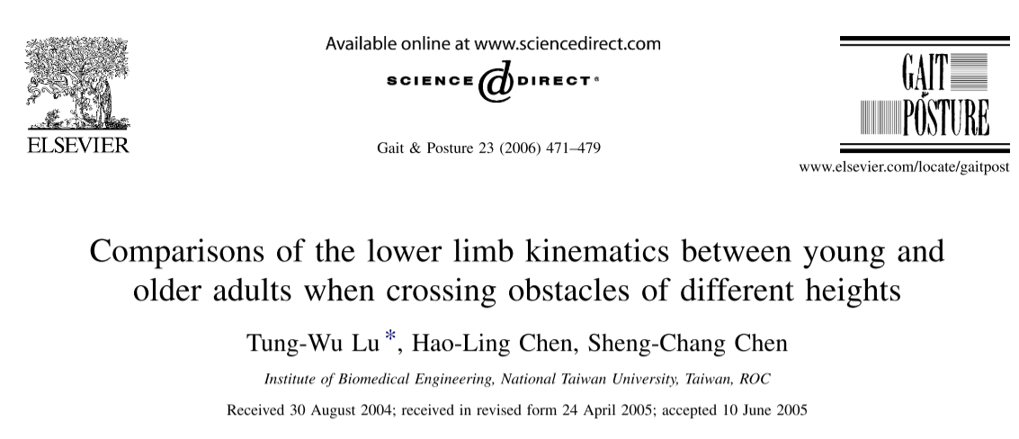
Change from Height1 to Height3
Limb | Joint | Lu et al. 2006, young adults (angle at crossing) | Ours (peak)
Trailing | Hip flexion | 19.5° → 26.9° (+7.4) | 33.1° → 46.6° (+13.5)
Trailing | Knee flexion | 91.9° → 118.9° (+27.0) | 67.5° → 76.7° (+9.2)
Trailing | Ankle dorsiflexion | 1.9° → 7.8° (+5.9) | 14.7° → 14.2° (−0.5)
Leading | Hip flexion | about 48° → 63° (+15)* | 53.0° → 59.4° (+6.4)
Leading | Knee flexion | about 84° → 107° (+24)* | 71.9° → 86.8° (+14.9)

Slide 7
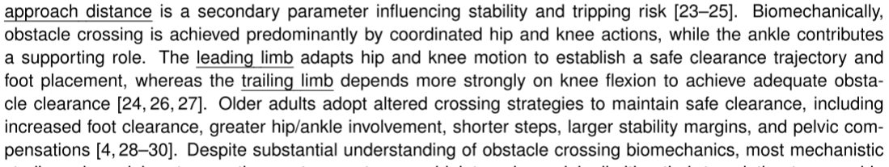

Slide 8
Signal | Report | Why | Optional
Hip (joint) | Peak flexion | It’s the lift of the thigh, the main leading-limb action | Peak extension, to show wind-up before the crossing
Knee (joint) | Peak flexion | It shortens the limb so the foot clears. It matters for both limbs, especially the trailing one. | ROM adds almost nothing here, because the extension end is near zero and ROM is roughly the flexion peak. Keep it only as a column.
Thigh (segment) | Peak forward tilt and peak backward tilt | Forward tilt is the lift. Backward tilt shows whether a bigger trailing-thigh ROM comes from a wind-up. | ROM as a column
Shank (segment) | ROM, plus the backward peak (heel up) | The trailing-limb kick-up is where the shank responded most. ROM gives an offset-free summary. | Forward peak (reach), for the leading limb’s landing

Slide 9
named peak | signal | extremum | notes
Hip peak flexion | hip_flexion | min | flexion is negative here (confirmed: thigh forward-tilt max ↔ hip min)
Hip peak extension | hip_flexion | max
Knee peak flexion | knee_angle | min
Ankle dorsiflexion | ankle_angle | max
Ankle plantarflexion | ankle_angle | min
Thigh forward tilt | Thigh | max | +68° @ mid-swing ✓
Thigh backward tilt | Thigh | min
Shank backward (heel up) | Shank | min | early swing ✓
Shank forward (reach) | Shank | max | late swing ✓
Foot toe-down / toe-up | Foot | min / max | I’ll flag foot to verify

