Slide 1



Obstacle crossing with wearable IMUs
What the sensors see, how well a model recognises the obstacle, and when to cue
Machine learning and haptic-cue design · 10 young adults · Tests 101–110
Ehsan Sharafian · 31 October 2026
Notes:
Machine-learning, biomechanics and haptic-cue results of the obstacle-crossing study (Tests 101-110). All analyses and all figures are MATLAB (Analysis/ML/crossing_ml_*.m; figures drawn by crossing_ml_figures.m in the step 9 plot template). Every accuracy is for a participant the model never saw. Full details: the ML and haptic report (Reports/26-10-31-ml-haptic-report).

Slide 2


The answer in brief
Obstacle height is readable from two foot IMUs once the device knows the person; obstacle width is not.
+10 mm
92 %
0.45 s
54–66 %
more foot lift per cm of obstacle; the clearance margin stays about constant
obstacle height (3 levels) for a new person: two foot IMUs, scaled to their own crossings, no labels
warning time: height is known at the leading-foot apex, before the trailing toe lifts
obstacle width (5 vs 15 cm, chance 50 %): people cross both depths alike
Haptic cue: take it from the leading leg (foot height, or the thigh if only angles are measured), with personal thresholds, at the leading-foot apex at the latest.
Notes:
+10 mm: mixed model, leading 10.1 and trailing 11.1 mm of foot lift per cm of obstacle; the camera clearance margin does not change significantly. 92 %: two foot IMUs, person scaling, random-forest vote of the leading and trailing models (95 % CI 87-96). 0.45 s: median time from the leading-foot apex to the trailing toe lift-off (camera). Width: 54-66 % with every input and model; even the camera foot placement gives 57.6 %.

Slide 3





What this deck covers
From the terms and the methods to the results and what they mean for a haptic cue.
01
02
03
Definitions
Data and methods
How people cross
Terms, obstacle levels and the crossing timeline
Dataset, features, how the models were tested, models
Foot lift, step 9 parameters, signature, leg dominance
04
05
06
Recognising the obstacle
Device and haptic cue
Discussion
Height and width for a new person, checks, statistics
Sensors, calibration, no camera, cheap hardware, when to cue
Meaning, recommendations, limitations, next steps
Notes:
Six parts. The results follow the four research questions: how people cross (Q1), can wearables recognise the obstacle (Q2), what would a device need (Q3), and when and how to give a haptic cue (Q4).

Slide 4
Definitions
01
The terms and the timeline used throughout
Notes:
Section 1: the vocabulary of the deck. Every number later uses these definitions.

Slide 5




Terms used in this deck
Every result is for an unseen participant and is reported as balanced accuracy.
Leading / trailing limb
Heights H1–H3, widths W1–W2
The first / second leg to step over the obstacle.
H = 10 / 20 / 30 % of the leg length; W = 5 / 15 cm deep along the walkway.
Swing and foot apex
Time 0 = trailing toe lift-off
Swing = toe-off to heel strike of one leg; apex = highest point of the foot.
The trailing toe leaves the floor (camera): the deadline for a cue to that leg.
Unseen participant (LOPO)
Balanced accuracy
Train on 9 people, test on the 10th; repeated for all 10.
Mean of the per-class hit rates; chance = 33 % for height, 50 % for width.
Generic model
Person scaling
Features referenced only to the person's normal walking and leg length.
Features scaled by the person's own crossings (median, IQR); no labels needed.
Notes:
Leading / trailing limb: the role is per crossing, from the camera (the IMU pipeline recovers it in 100 % of detected crossings). Obstacle height is set per participant from the measured leg length, so H1-H3 are about 9 / 18 / 27 cm. Balanced accuracy averages the hit rate of each class, so unequal class sizes cannot inflate it. 95 % confidence intervals resample the 10 participants (2000 times).

Slide 6
The crossing timeline
Median times relative to the trailing toe lift-off (camera), 260 crossings.
detect the
crossing
height known:
cue now
too late
for most
leading toe-off
−733 ms
leading foot apex
−450 ms
leading landing
−200 ms
−800
−600
−400
−200
+400
+600
ms
trailing toe lift-off
0 = deadline
trailing foot apex
+300 ms
trailing landing
+633 ms
trailing toe over
the obstacle +184
In 22 % of crossings the trailing toe has already lifted before the leading foot lands, so a cue at the leading landing is too late.
Notes:
Medians over 260 crossings, relative to the camera trailing toe lift-off. Leading foot apex IQR -517 to -350 ms; leading landing IQR -300 to -33 ms. The step-4 trailing toe-off event of the IMU pipeline comes +233 ms after the camera lift-off (the toe leaves the floor first). Crossing detection from the leading thigh or foot works from 10-30 % of the leading swing, 0.57-0.71 s before the deadline.

Slide 7
Data and methods
02
Who walked, what was measured, and how the models were built and tested
Notes:
Section 2: the dataset, the inputs of the models, the evaluation rule and the models.

Slide 8



Study and dataset
Ten young adults, six obstacles, six IMUs; one dataset row per obstacle crossing.
10 young adults
6 women, 4 men, 20–31 years; about 5 crossings per obstacle, plus level walks
The dataset (one row per crossing)
6 Movella Dot IMUs, 60 Hz
thigh, shank and foot of both legs; camera motion capture as the reference
349
260
rows: 303 obstacle crossings and 46 level walks
crossings used for ML (H1 88 · H2 90 · H3 82)
6 obstacles in blocks
3 heights (10 / 20 / 30 % of leg length) × 2 widths (5 / 15 cm)
110
43
width 5 cm
width 15 cm
Dot features: 57 leading, 52 trailing, 1 crossing duration
excluded: data quality 18, no gait events 11, invalid trajectory 10, drift 4
H1
H2
H3
H1
H2
H3
Notes:
Dataset built by Analysis/ML/build_crossing_master.m from the processing pipeline (steps 1-9): Crossing_Master_YoungAdults.csv, 349 rows x 193 columns, plus the swing-curve file and the time-aligned file. include_ml = gait events present, Dot data present, no data-quality flag and a valid camera trajectory. Lengths are divided by the leg length in the generic model.

Slide 9




What the models see
Only wearable (Dot) values are model inputs; camera values are kept as the reference.
Summary features
Clearance shape
Swing curves
Time-aligned signals
Per leg: tilt extremes, range and timing of thigh, shank and foot; angular velocity; foot acceleration; foot trajectory (peak height, height at 25 / 50 / 75 % of swing); swing and stance time; approach strides.
13 numbers from the foot-height curve: how long and how far the foot stays high, and where its apex lies.
6 signals per leg (thigh, shank and foot tilt, foot acceleration, foot height and progression) at every 2 % of the swing.
60 Hz samples from −1.5 s to +0.6 s around the trailing toe lift-off, for the real-time cue.
Camera reference, never an input: clearance, take-off and landing distances, toe-marker peak, obstacle height and the toe lift-off time.
Notes:
Summary features are named <limb>_<segment>_<measure>, e.g. lead_thigh_max, trail_zhc_peak_foot_h. ZHC = zero-velocity-update foot trajectory (height and forward progression of the foot sensor). The two toe-height columns are excluded because their sensor-to-toe vector was fitted with the camera.

Slide 10



How the models were tested
Every accuracy in this deck is for a person the model never saw in training.
Leave-one-participant-out
Balanced accuracy
mean of the per-class hit rates; chance 33 % (height), 50 % (width)
fold 1
fold 2
95 % confidence interval
the 10 participants resampled with replacement, 2000 times
fold 3
Permutation test
labels shuffled within each person: is the result above chance?
⋮
fold 10
Nested selection
when settings are compared, the best is chosen inside each training set
train on 9 people
test on the 10th
Every fitted step (imputation, scaling, feature selection, model) uses the training people only.
Notes:
LOPO: 10 folds, each participant tested once by a model trained on the other nine. Balanced accuracy = mean recall over the classes. Participant bootstrap: 2000 resamples of the 10 participants, accuracy recomputed on the pooled predictions. Permutation test: labels shuffled within participant (keeps each person's class counts), 300-1000 permutations; p <= 0.003 for the main results. Nested selection: the setting (feature set x scaling x model) is chosen inside the nine training participants of each fold.

Slide 11
Two ways to reference the features
Scaling to the person's own crossings is the key step, and it needs no labels.
Generic model
Person scaling
x − median of the person's level walk; lengths ÷ leg length
(x − median of own crossings) ÷ IQR of own crossings
Needs only a short normal walk. Keeps each person's personal obstacle margin, so neighbouring heights are confused.
Uses the person's crossings without their labels: exactly what a worn device collects. Removes the personal margin.
56–62 %
90 %
obstacle height for a new person, generic → person scaling (chance 33 %); the same features, no labels added
Notes:
Generic: each feature minus the person's median level-walk value; mm features divided by the leg length (mm). Person scaling: per participant, (x - median) / IQR over that person's obstacle crossings (linear-interpolation quantiles), no height or width labels used. In real time a causal version uses only the earlier crossings of the session. 56-62 % = generic models (logistic regression and random forest); 90 % = person-scaled random-forest vote of both legs (95 % CI 85-95).

Slide 12




Models used
Simple, interpretable models first; a neural network as a check.
Logistic regression
Random forest
Two-leg vote
SVM and boosting
L2-penalised (C = 0.1): the transparent baseline.
300–500 trees, min. leaf 2: the best single model.
One model per leg; their class probabilities averaged.
RBF SVM, boosted trees and an eight-model vote.
1D CNN
Height in cm
Offset model
Threshold rules
A convolutional network on the raw swing curves.
Ridge and forest regression of the nominal height.
Physics: foot lift = obstacle height + a personal margin.
One signal, one moment, two thresholds: the cue logic.
Notes:
Logistic regression: median imputation, z-score, L2 penalty with the scikit-learn objective (checked against Python: identical to rounding). Random forest: MATLAB TreeBagger, sqrt(p) predictors per split, uniform class prior. Soft vote: the leading- and trailing-limb models are trained separately, their class probabilities averaged. CNN: conv 5x16 - conv 5x32 - global average pooling - dropout - softmax, 60 epochs, 3 seeds. Offset model: ridge score plus a posterior-mean personal offset. Threshold rules: two ordered thresholds on one signal at one moment, chosen on the training people.

Slide 13
How people cross
03
Foot lift, where the height shows, and the personal walking signature
Notes:
Section 3: the biomechanics behind the models.

Slide 14
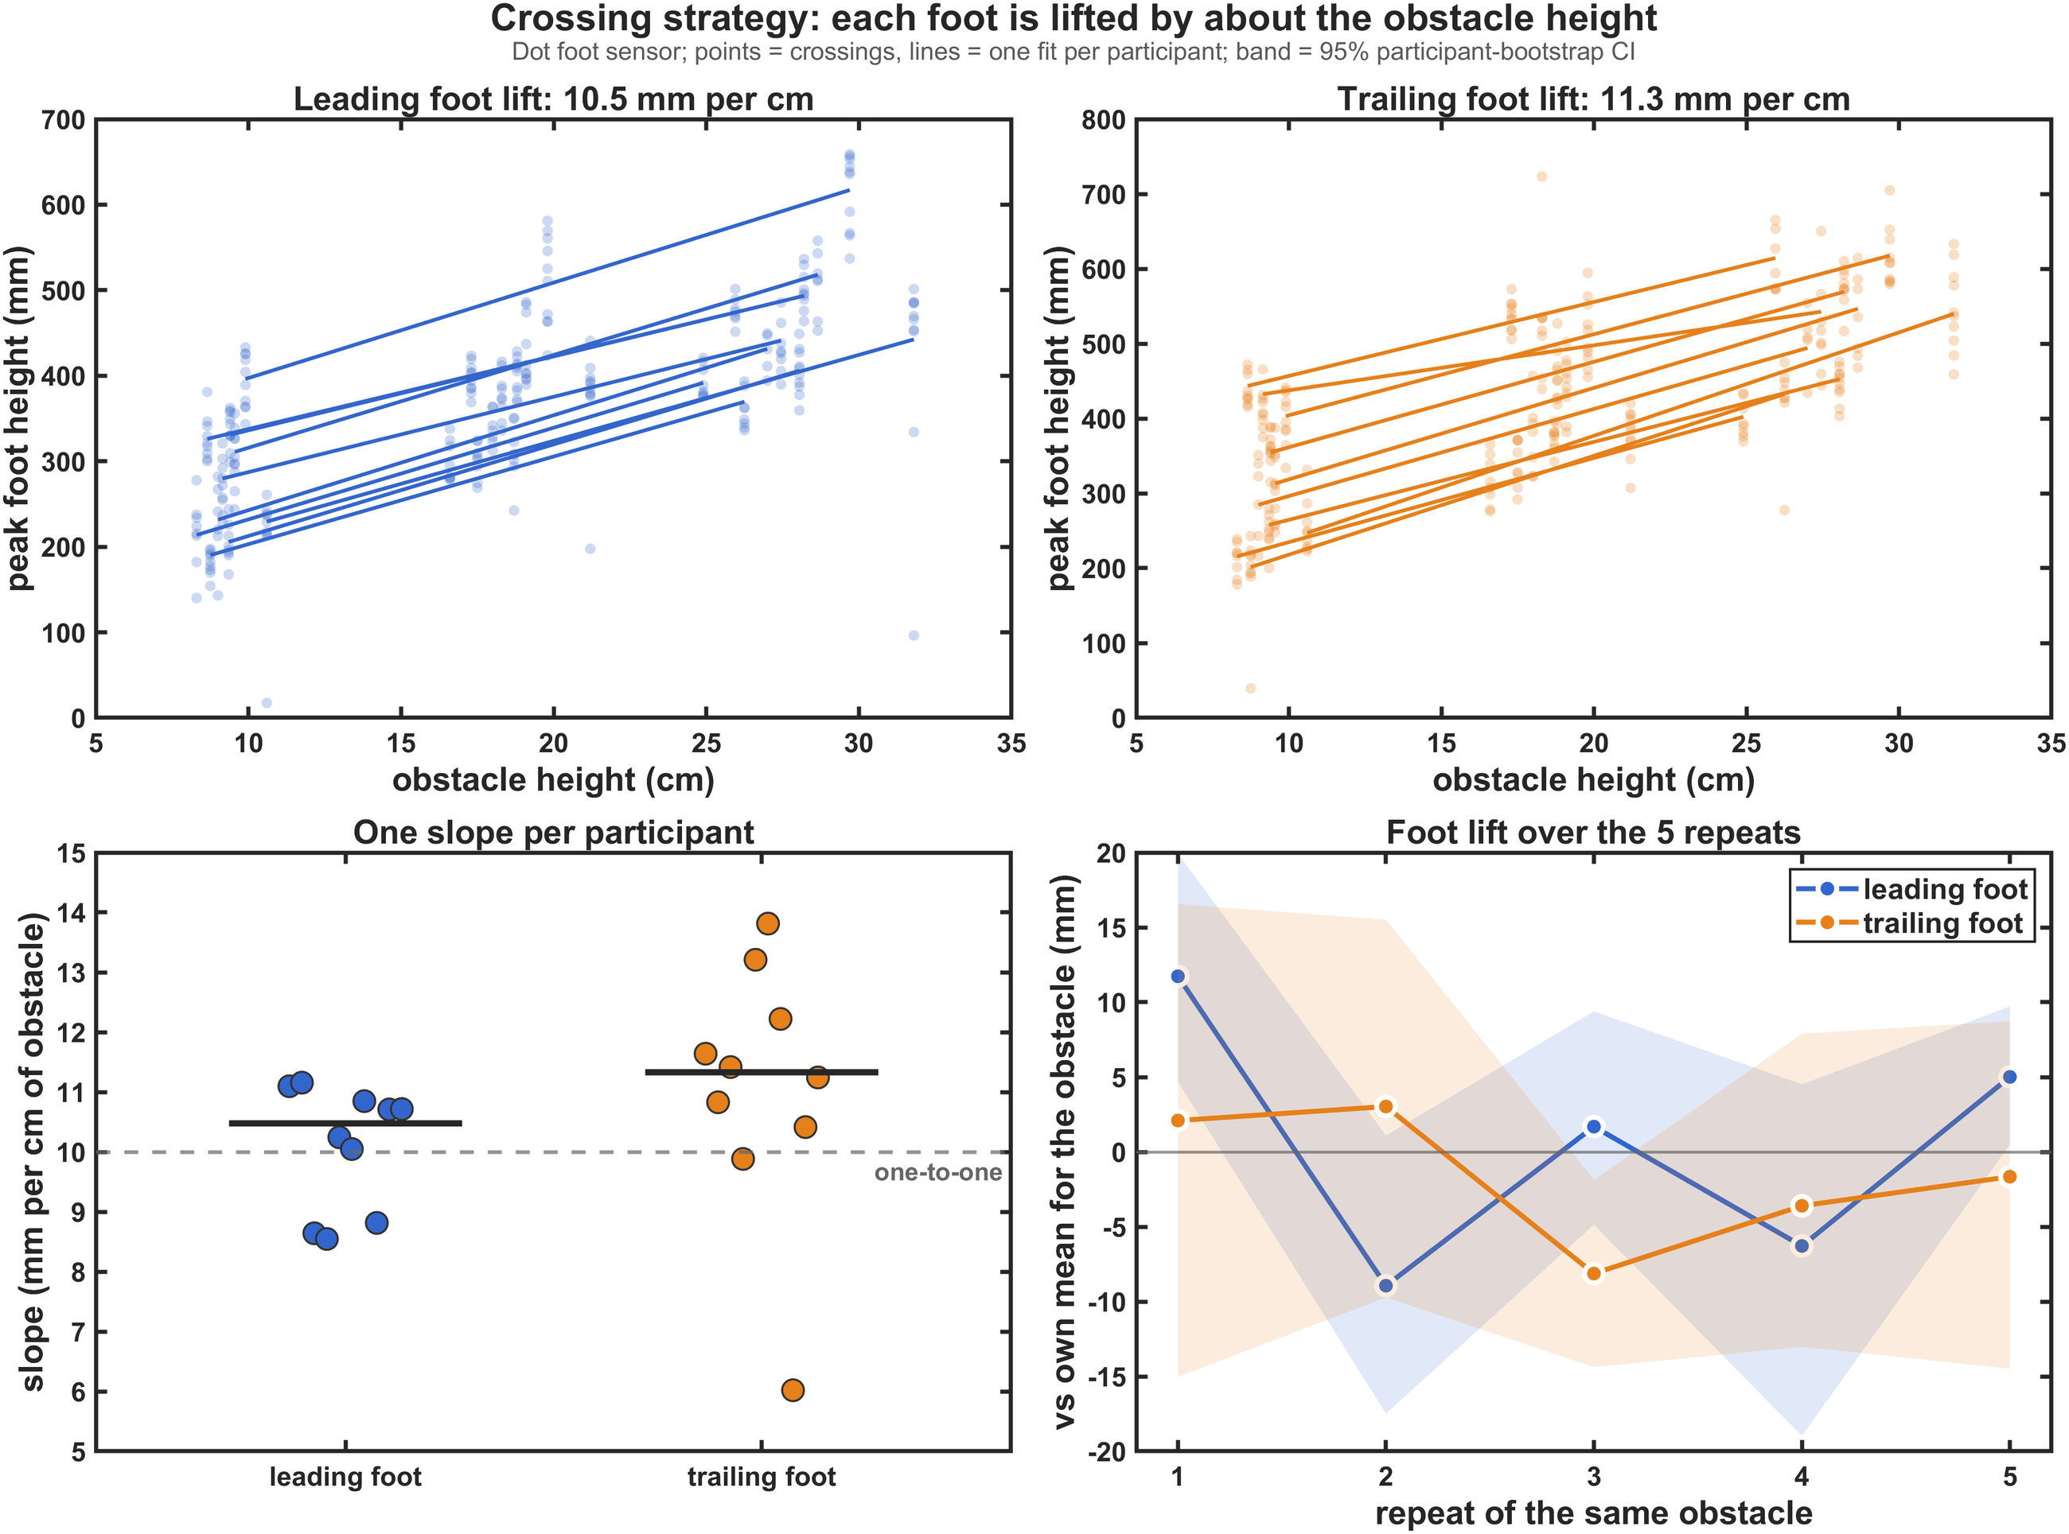
Each foot is lifted by about the obstacle height
People raise each foot by the obstacle height and keep a nearly constant safety margin.
Key numbers
+10.1 / +11.1 mm
leading / trailing foot lift per cm (mixed model), every participant
+1.2° per cm
more leading-thigh flexion and more trailing-shank heel-up
≈ constant
leading clearance kept within ±2.6 cm; trailing tends to fall
+11.7 mm
extra leading lift on the first crossing of an obstacle
Notes:
Top panels: Dot foot lift against the nominal obstacle height, one line per participant; panel titles give the median per-participant slope (10.5 / 11.3 mm per cm). The mixed model with a random slope per participant gives 10.1 (leading) and 11.1 mm (trailing) per cm. Bottom left: one slope per participant, dashed = one-to-one (10 mm per cm). Bottom right: first-crossing effect +11.7 mm (95 % CI +4.7 to +19.9), no trend afterwards; the trailing foot shows no such effect.

Slide 15
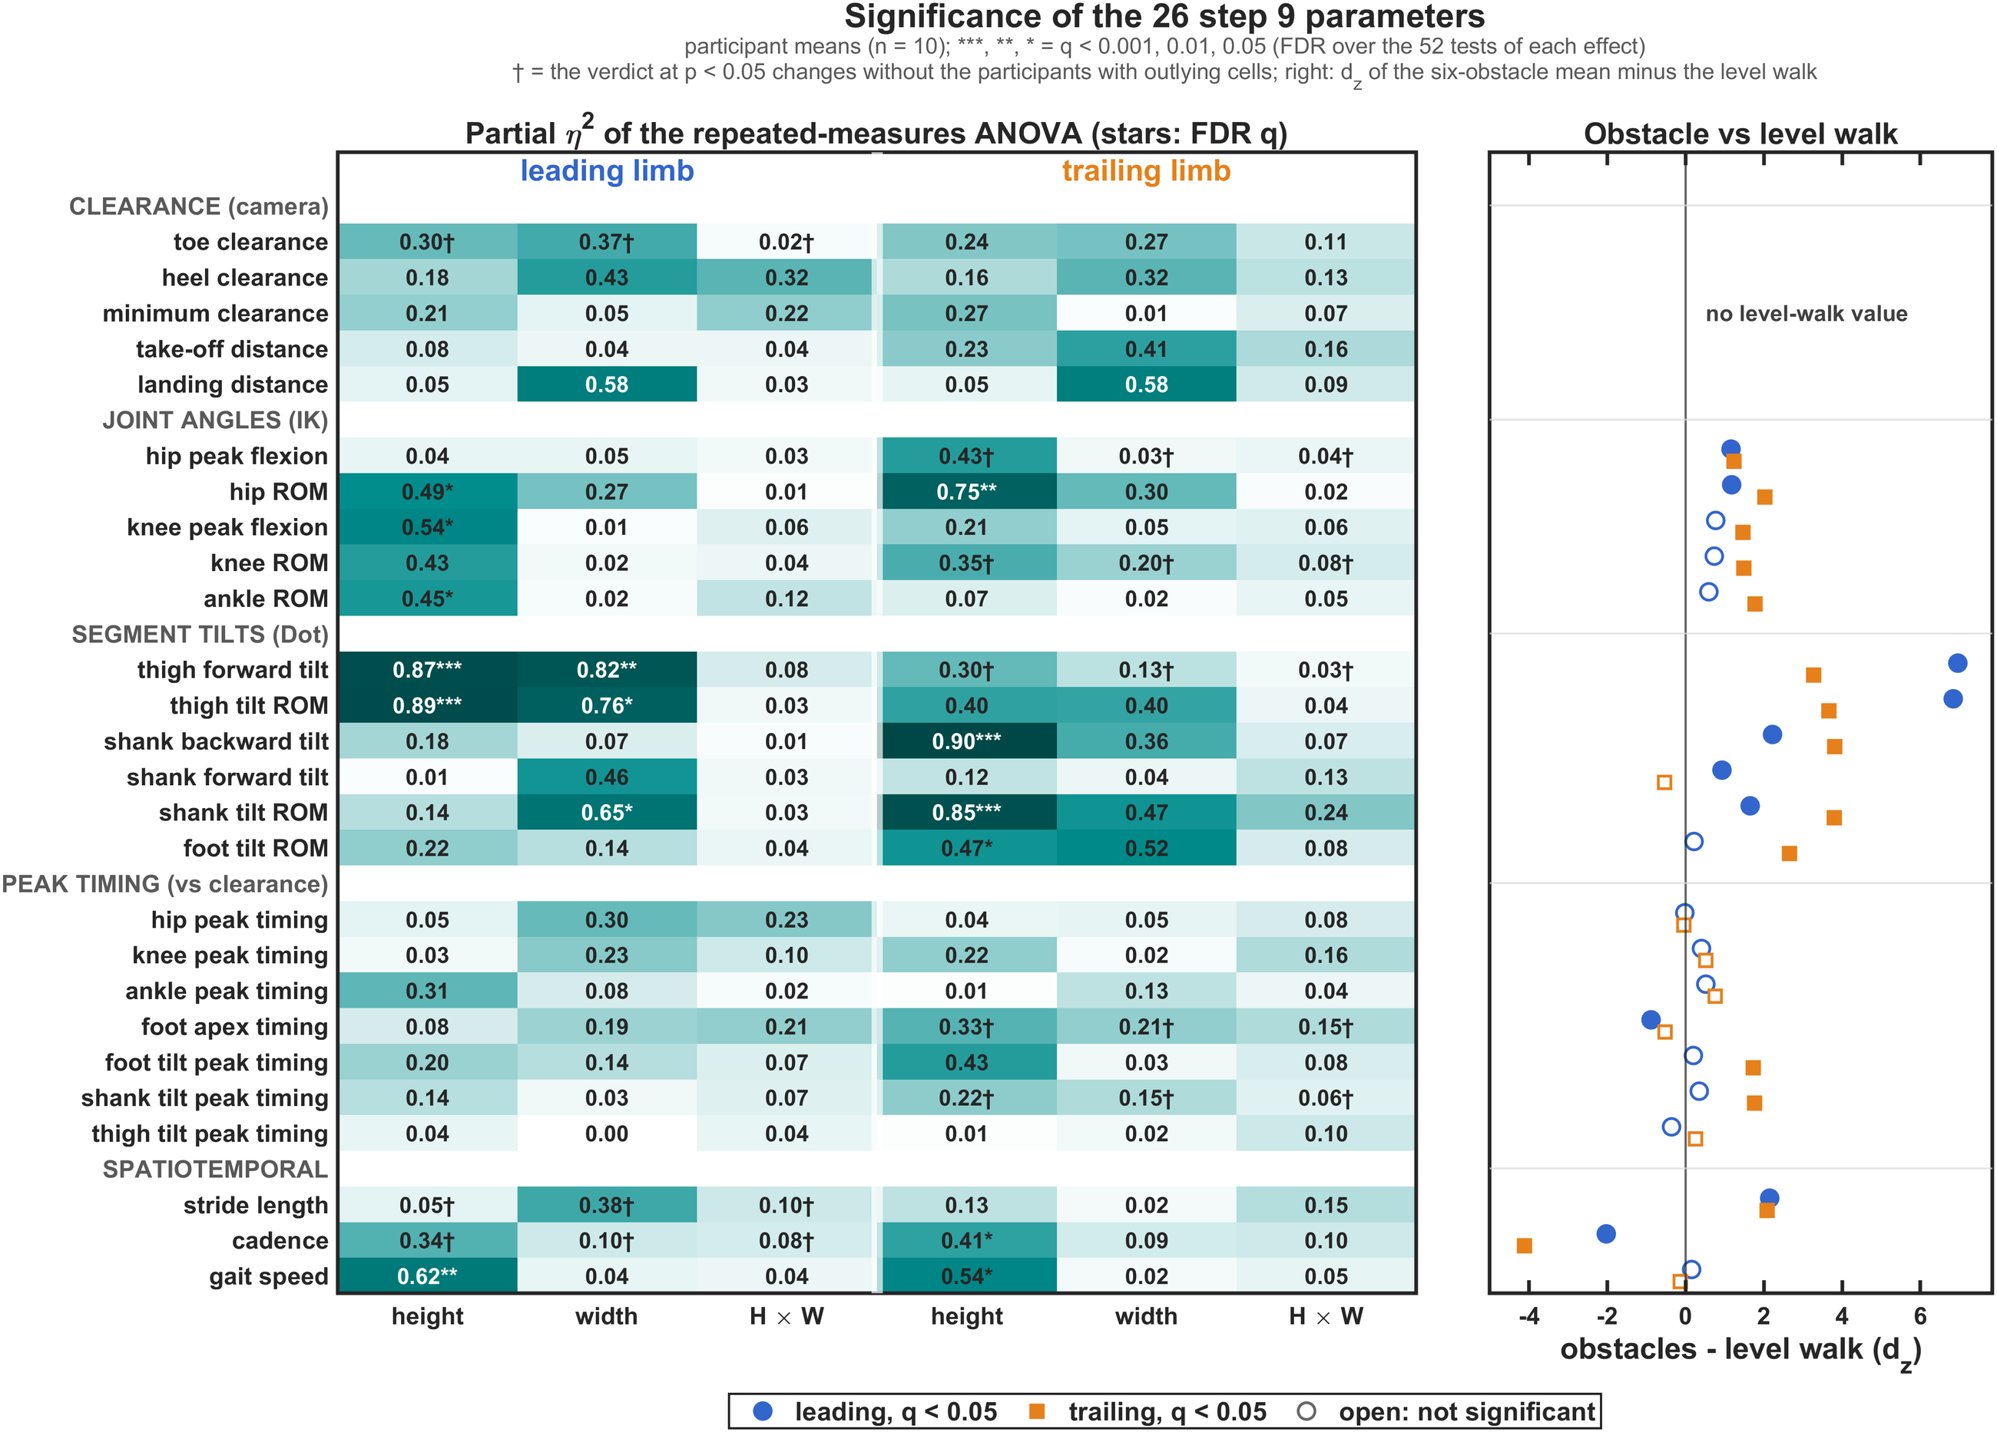
Which of the 26 step 9 parameters change
Height moves the thigh and shank tilts most; no clearance or peak-timing parameter changes.
Key numbers
6 / 6 of 26
parameters change with height, leading / trailing (FDR)
η² 0.85–0.90
leading thigh and trailing shank tilts: the clearest effects
3 / 0
width effects (leading thigh and shank tilts); no interaction
10 / 14 of 21
parameters differ from level walking (leading / trailing)
Notes:
crossing_ml_params.m on the step 9 SPSS sheet (participant means, n = 10). On the 26 October SPSS sheet the MATLAB ANOVA reproduces SPSS exactly (14 tables compared, identical F and Greenhouse-Geisser p). FDR = Benjamini-Hochberg over the 52 parameter x limb tests of each effect. Height, leading: hip ROM, knee peak flexion, ankle ROM, thigh forward tilt (+1.16 deg per cm), thigh tilt ROM, gait speed; trailing: hip ROM, shank backward tilt (+1.23 deg per cm), shank tilt ROM, foot tilt ROM, cadence, gait speed. Width: leading thigh forward tilt, thigh tilt ROM, shank tilt ROM. Right panel: d_z of the six-obstacle mean minus the level walk, filled = q < 0.05; largest for the leading thigh tilt (7.0) and the trailing shank tilt (3.8). Dagger = the verdict at p < 0.05 changes without the participants with outlying cells.

Slide 16
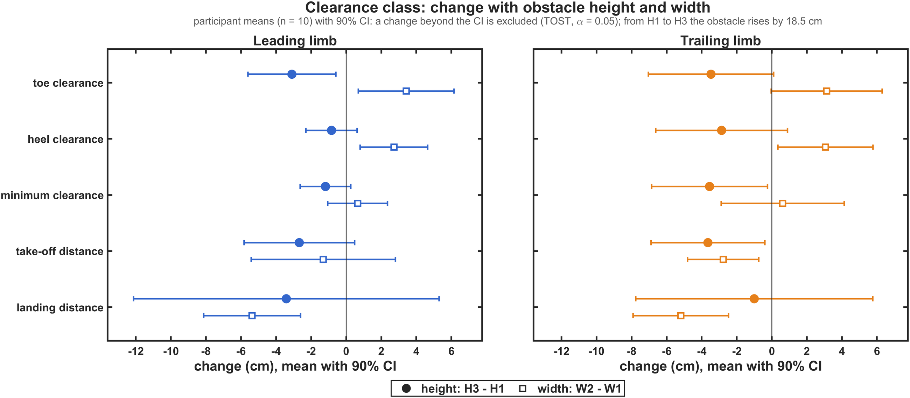
Clearance kept, and step 9 cells to check
An equivalence test shows the leading clearance is kept; outlying cells weaken the joint-angle and timing tests.
±2.6 cm
leading minimum clearance from H1 to H3, while the obstacle rises 18.5 cm
−3.5 cm
trailing minimum clearance (90 % CI −6.9 to −0.2): not shown constant
93 cells
outlying, e.g. participant 104 leading knee ROM 238–274°: check in step 9
= SPSS
the MATLAB ANOVA reproduces the SPSS GLM exactly (14 tables)
Notes:
Equivalence: 90 % CI of the change of the participant means from H1 to H3; changes beyond its larger limit are excluded by two one-sided tests (alpha 0.05). Leading minimum clearance -1.2 cm (90 % CI -2.6 to +0.3); trailing -3.5 cm (-6.9 to -0.2). Toe and heel clearance bounds 5.6 / 7.0 and 2.3 / 6.6 cm (leading / trailing). The deeper obstacle shortens the landing distance by about 5 cm (p <= 0.007, not significant after FDR). Outlying cells: modified z-score above 3.5 within each obstacle column; 93 of 3120 cells, 42 in the IK joint angles and 28 in the peak timings. Participant 104: leading knee ROM 238-274 deg and hip peak flexion 123-157 deg (column medians 60-80 and 37-50 deg). Participant 101: trailing shank-tilt peak timing +11.5 % of the gait cycle at W2_H2 (median -3.0 %). Without the participants with outlying cells 8 verdicts at p < 0.05 change, e.g. the trailing shank-tilt peak timing with height, p 0.143 -> < 0.001. Power: with 10 people a paired comparison detects only d_z >= 1.0 (80 % power).

Slide 17
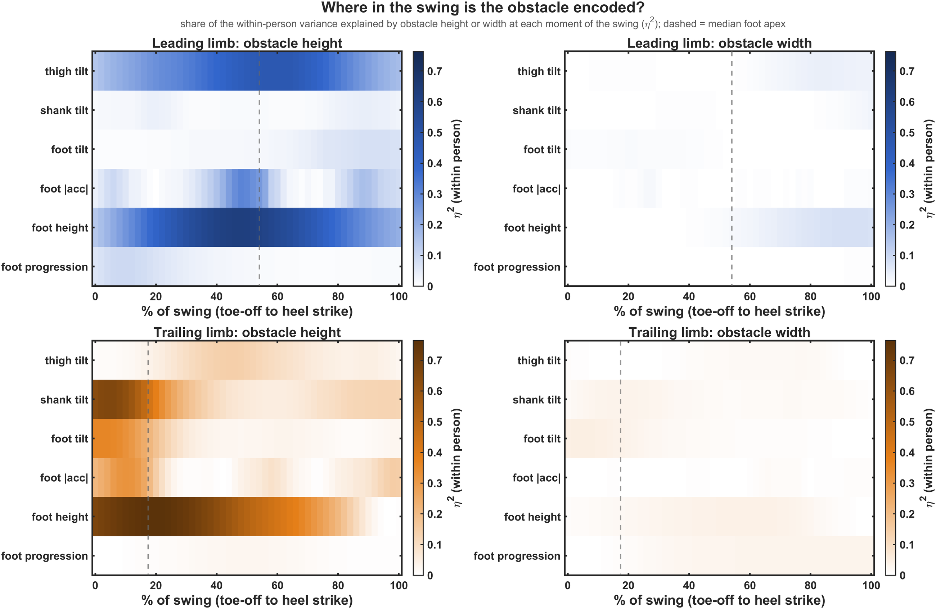
Where in the swing the obstacle shows
Height is written in the leading leg at its apex and in the trailing leg at push-off.
Key numbers
η² 0.76
trailing foot height at 20 % of its swing
η² 0.66
trailing shank tilt at push-off (4 % of swing)
η² 0.62
leading foot height near its apex (48 %)
≤ 0.08
width: almost no trace anywhere
Notes:
Within-person effect size (eta squared) of obstacle height (left) and width (right) at every 2 % of the swing, for the six Dot swing signals of the leading (top, blue) and trailing (bottom, orange) leg; each participant's mean curve removed first. Dashed line = median foot apex. Leading thigh tilt peaks at eta squared 0.47 (60 % of swing).

Slide 18
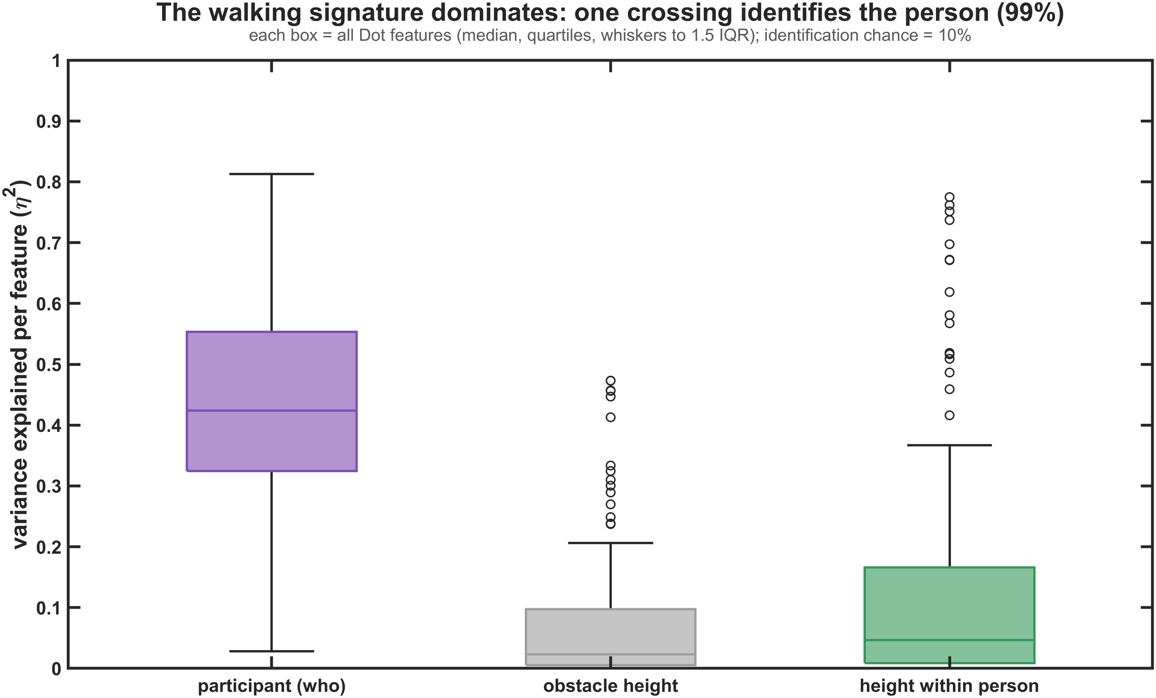
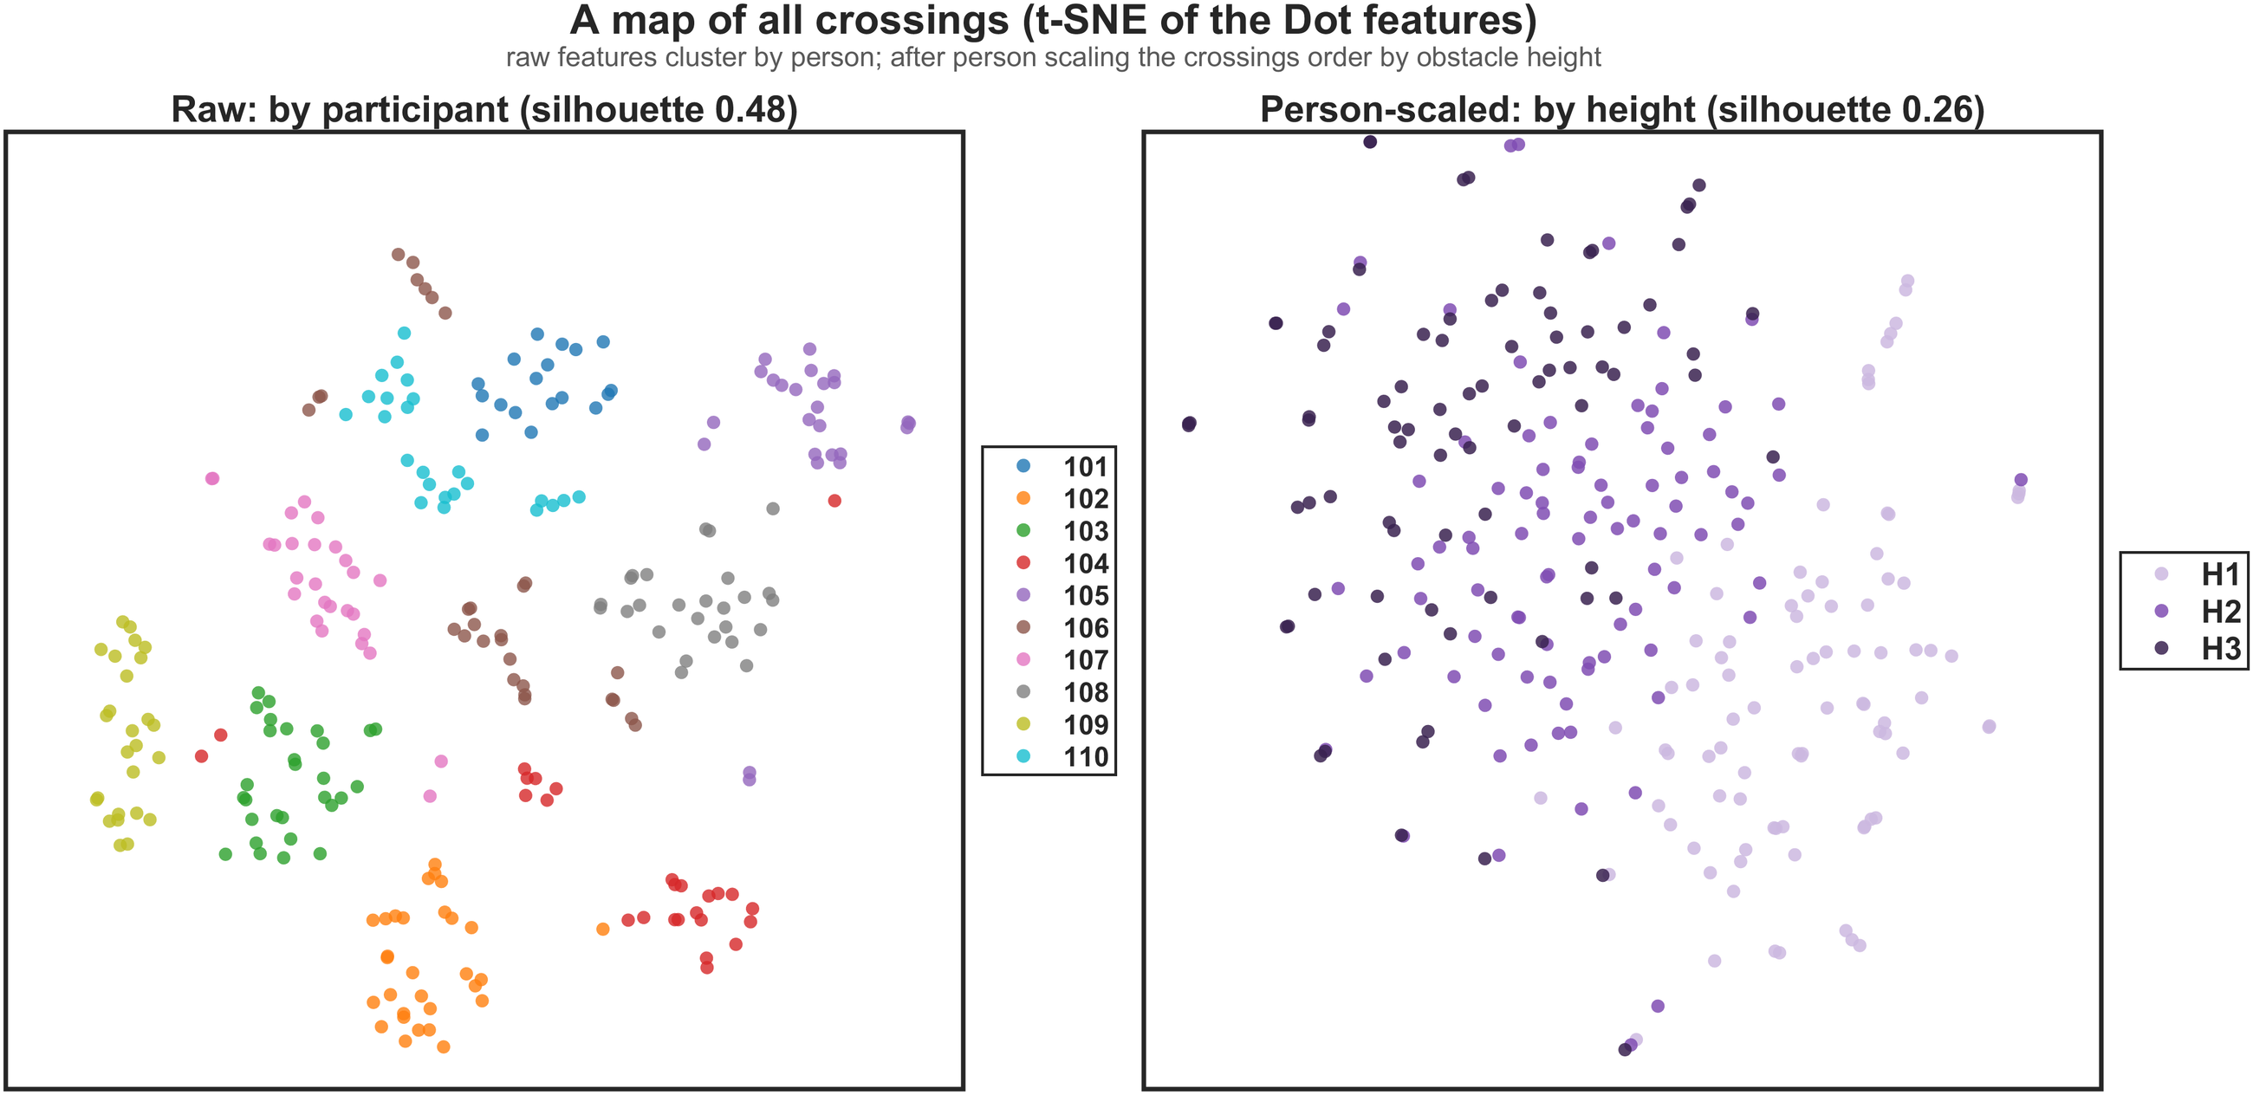
Each person has a strong walking signature
One crossing identifies the walker; scaling to the person reveals the obstacle.
99 %
one crossing identifies the person (chance 10 %)
0.42 vs 0.02
median share of feature variance: the person vs the obstacle height
−0.04 → 0.26
silhouette by height: raw → person-scaled features
Notes:
Left: for each of the 110 Dot features, the share of variance explained by the participant, by the obstacle height and by the height within each participant; the person explains more than the height in 99 of 110 features. Right: t-SNE of all crossings. Raw features cluster by participant (silhouette 0.48); after person scaling they order by height (silhouette 0.26). Participant identification: logistic model, 5-fold, 99.2 % balanced accuracy.

Slide 19

Leg dominance, and foot sensor vs toe
The non-dominant leg crosses with the larger margin; the foot sensor does not follow the toe.
Leading with the dominant leg
43.5 % of crossings; 9 of 10 people used both legs
Foot sensor vs camera toe
Bland–Altman of the foot lift; timing of the toe-off event
−34 mm
leading clearance when the dominant leg leads (foot lift −21 mm, thigh −5.4°)
+8 / +48 mm
mean difference of the foot lift, leading / trailing (Dot − camera)
+46 mm
trailing clearance when the non-dominant leg trails
±130 / ±210 mm
limits of agreement: one crossing's toe height is not the sensor height
95.6 vs 89.8 %
device accuracy, dominant vs non-dominant leading (p = 0.10)
+83 / +233 ms
IMU toe-off after the camera lift-off (median), so timing uses the camera
Associations only: people chose their leading leg. The sensor is on top of the foot, the marker on the toe.
Notes:
Leg dominance: mixed models with height, width and a random height slope per participant (crossing_ml_stats.m, S5). Dominant leg leading minus non-dominant leading: leading foot lift -21.2 mm (95 % CI -32.3 to -10.1), leading thigh flexion -5.42 deg, leading camera clearance -34.4 mm (all p < 0.001); trailing shank heel-up -2.55 deg (p = 0.013), trailing camera clearance +46.0 mm (p < 0.001). The dominant leg led 43.5 % of the crossings (participant 104 always, 107 in 7 %). Device model: 95.6 % right with the dominant leg leading (113 crossings) vs 89.8 % (147), Fisher p = 0.102. Agreement (S3): Dot foot-sensor rise vs camera toe-marker rise, bias +8 / +48 mm, limits of agreement -122 to +137 / -163 to +260 mm, no proportional bias. IMU step-4 toe-off minus camera lift-off: median +83 / +233 ms; for the trailing limb +4.9 ms per cm of obstacle (p < 0.001).

Slide 20
Recognising the obstacle
04
Obstacle height and width for a person the model has never seen
Notes:
Section 4: Q2, recognition of obstacle height and width from the Dot data alone.

Slide 21
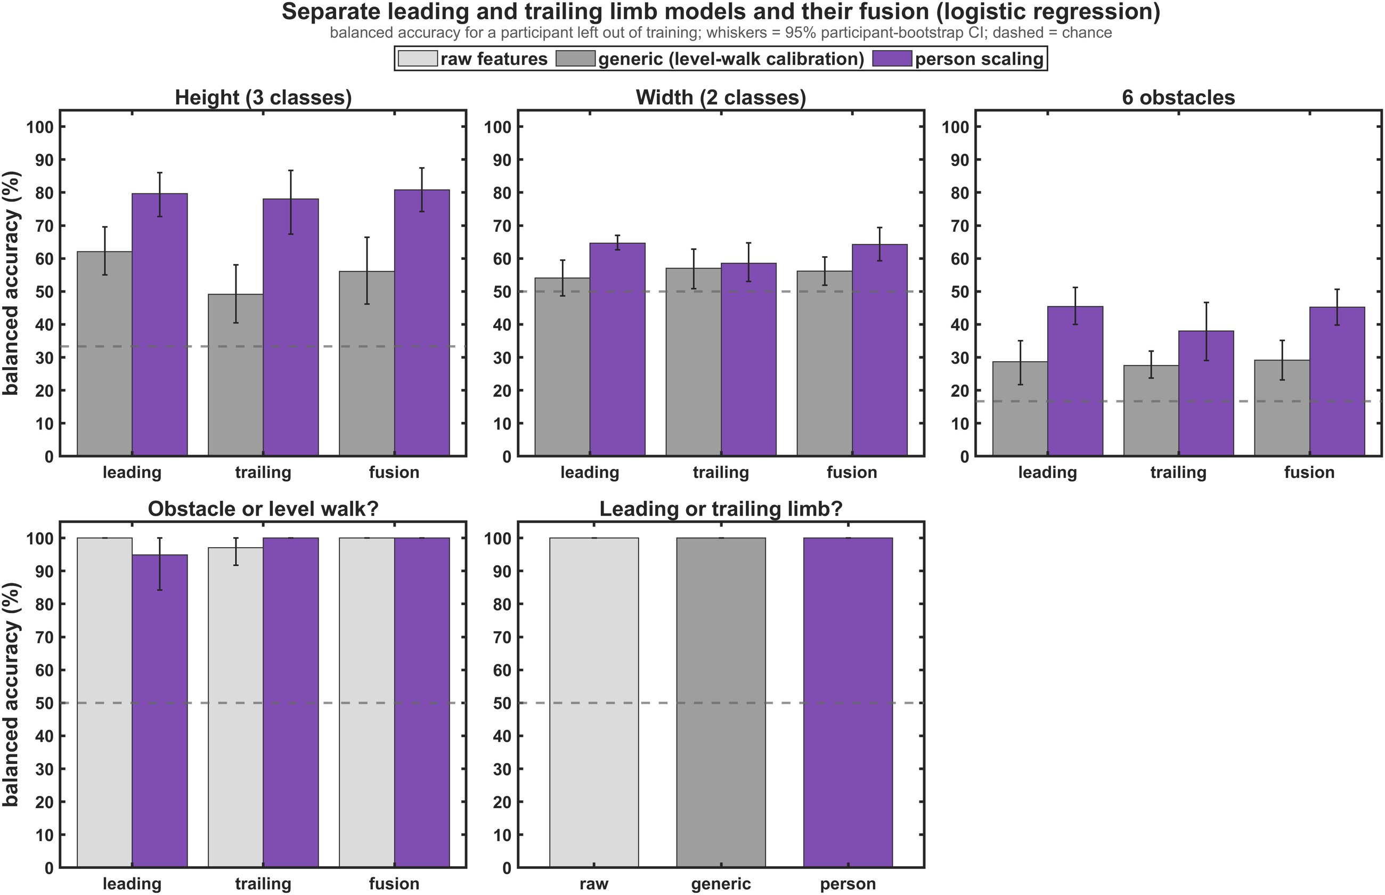
Person scaling turns 60 % into 90 %
The same features, scaled to the person's own crossings, recognise the height of a new person's obstacle.
Key numbers
56–62 %
generic models, height (chance 33 %)
90 %
person scaling, forest vote of both legs (CI 85–95)
29 → 61 %
six obstacles, generic → person scaling (chance 17 %)
100 %
leading vs trailing swing; crossing vs level stride
Notes:
Figure: logistic regression (generic 62 / 49 / 56 %, person scaling 80 / 78 / 81 % for leading / trailing / fusion). The best setting, the person-scaled random-forest vote of both legs, gives 90.0 % (85-95). Width stays near chance with every setting. Leading or trailing limb from one swing and obstacle vs level stride: 100 %.

Slide 22
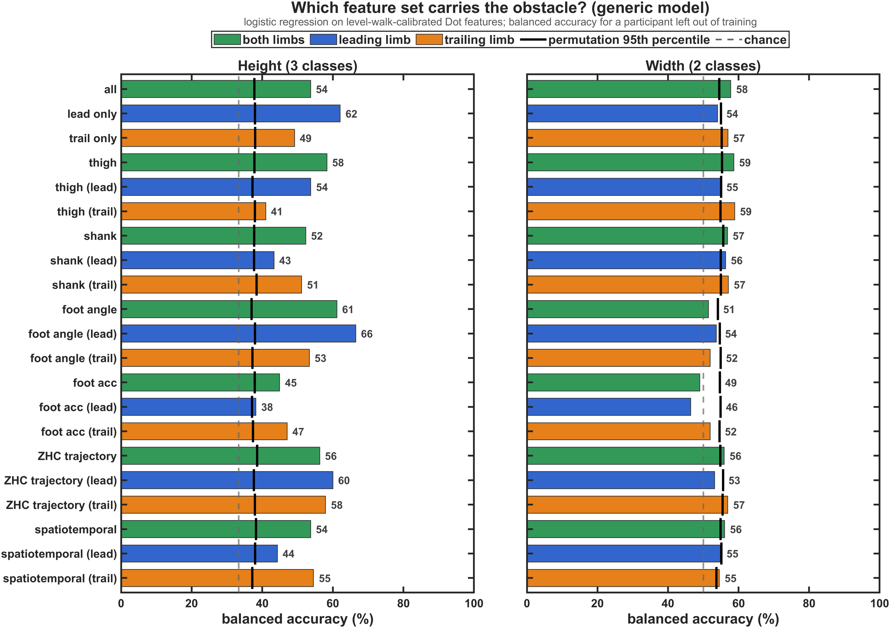
Which sensor data carry the height
Generic model: every feature set beats chance, but none is good enough on its own.
Key numbers
p ≤ 0.037
every feature set predicts height above its permutation null
66.5 %
best set: the leading foot angles
Thigh: leading
thigh and foot angles: leading leg; shank: trailing leg
46–59 %
width with any set: around its null (chance 50 %)
Notes:
Logistic regression on level-walk-calibrated features, one model per feature set; black tick = 95th percentile of the permutation null (labels shuffled within participant, 300 permutations). Height: leading only 62.1 %, all 53.7 %, trailing only 49.1 %. Width: 46-59 %.

Slide 23
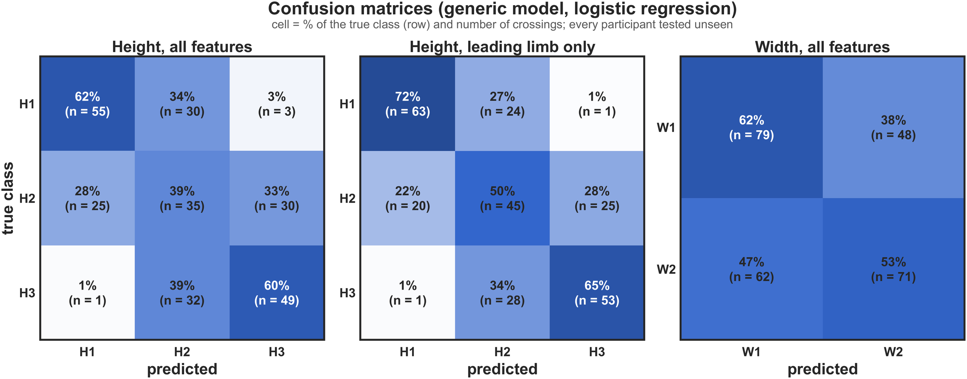
Generic errors fall between neighbouring heights
The generic model rarely mixes H1 with H3 but often misses the middle height.
4 of 170
H1 and H3 crossings confused (all features)
39 %
H2 recognised (50 % with the leading leg alone)
62 / 53 %
width: the 5 cm / 15 cm obstacle recognised
Notes:
Rows = true class, cell = share of the row and number of crossings. Height, all features: H1 62 % right, H2 39 %, H3 60 %. Leading leg only: 72 / 50 / 65 %. This is the signature of a personal offset: each person's whole H1-H2-H3 ladder is shifted, so the middle level is confused with both neighbours.

Slide 24
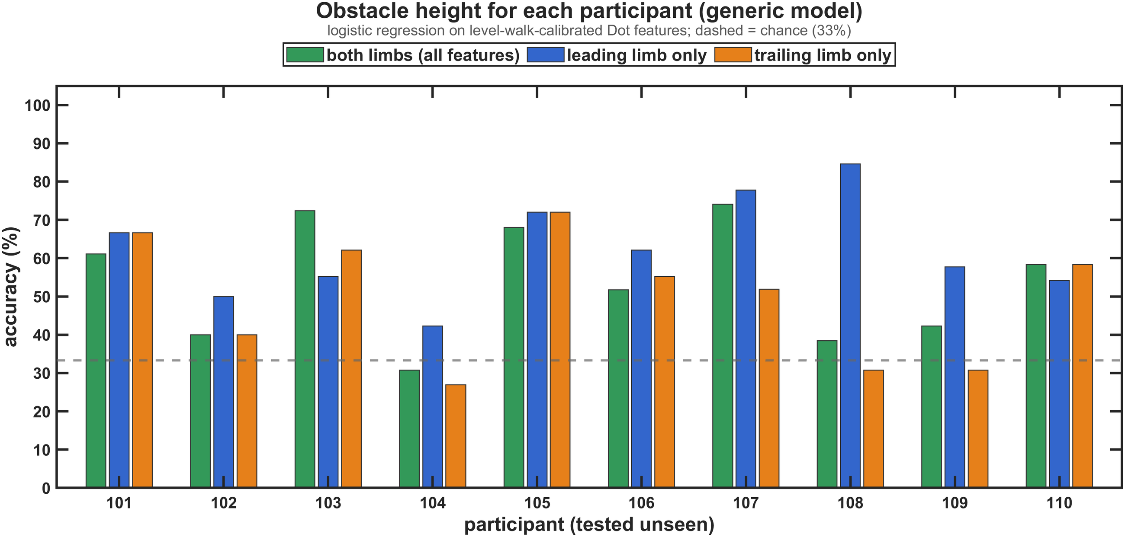
The generic model varies between people
Some people are recognised well, others near chance: a sign of personal offsets.
31–74 %
all features, per participant
42–85 %
leading leg only
108: 85 vs 31 %
leading vs trailing leg: their trailing lift is the least consistent
Notes:
Logistic regression on level-walk-calibrated features, each participant tested unseen. With person scaling the per-participant accuracy is 83-100 % for nine participants and 73 % for participant 108.

Slide 25
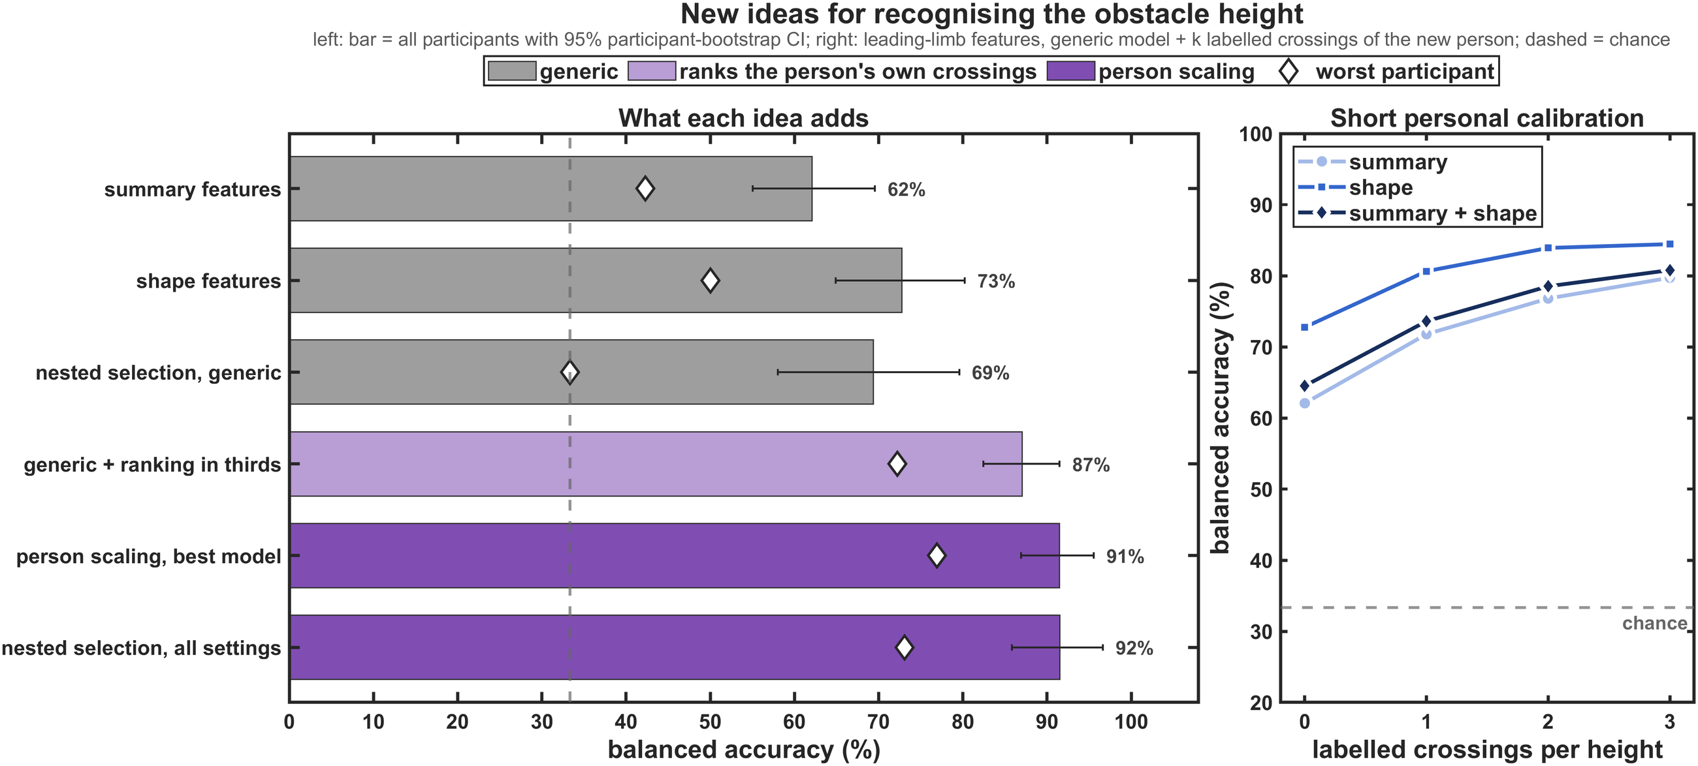
Better inputs and fair model choice
Shape features help the generic model; person scaling is what makes the large step.
72.8 %
clearance-shape features, generic (vs 62.1 % summary)
69.4 %
fair (nested) choice among generic settings
91.5 %
fair choice among all settings (95 % CI 86–97)
88.0 %
1D CNN on the raw curves, no hand-made features
Notes:
Left: bar = all participants with 95 % CI, diamond = worst participant; grey = generic, light purple = ranks the person's own crossings, purple = person scaling. Right: generic leading-limb model plus k labelled crossings per height from the new person. Nested selection over 36 settings chose the person-scaled forest vote in every fold. An eight-model soft-vote ensemble reaches 91.5 %.

Slide 26
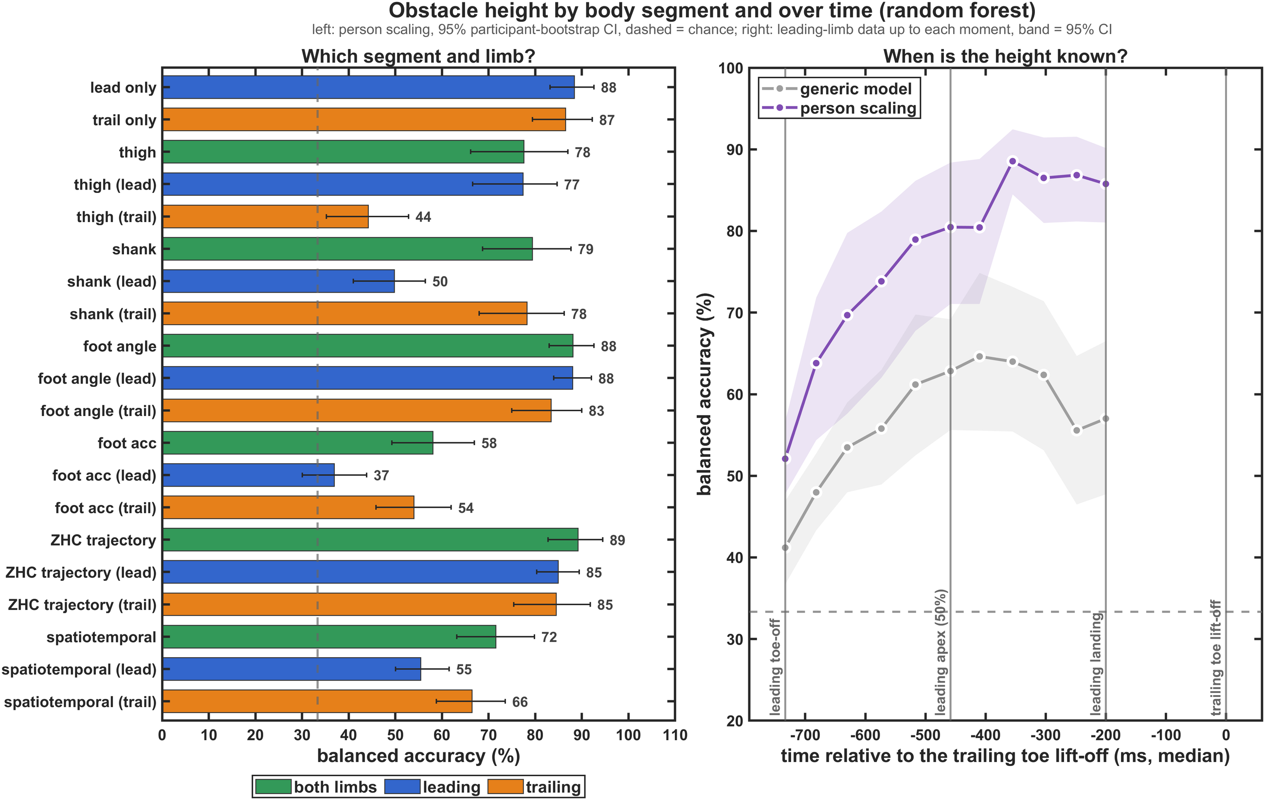
Which segment, and how early
The foot carries the most; the leading leg gives the height before the trailing leg lifts.
Key numbers
88–89 %
foot angles or foot trajectory alone (person scaling)
77 vs 44 %
thigh: leading vs trailing leg
52 → 80 %
from the leading toe-off to its apex, 0.46 s before the deadline
88.5 %
at 70 % of the leading swing, 0.36 s before
Notes:
Left: random forest with person scaling, one model per feature set (shank: trailing 78.2 vs leading 49.8 %). Right: leading-limb data available up to each moment; generic (grey) stays at 41-65 %, person scaling (purple) reaches 80.5 % at 50 % of the leading swing and 85.8 % at the leading landing (0.2 s before the deadline).

Slide 27
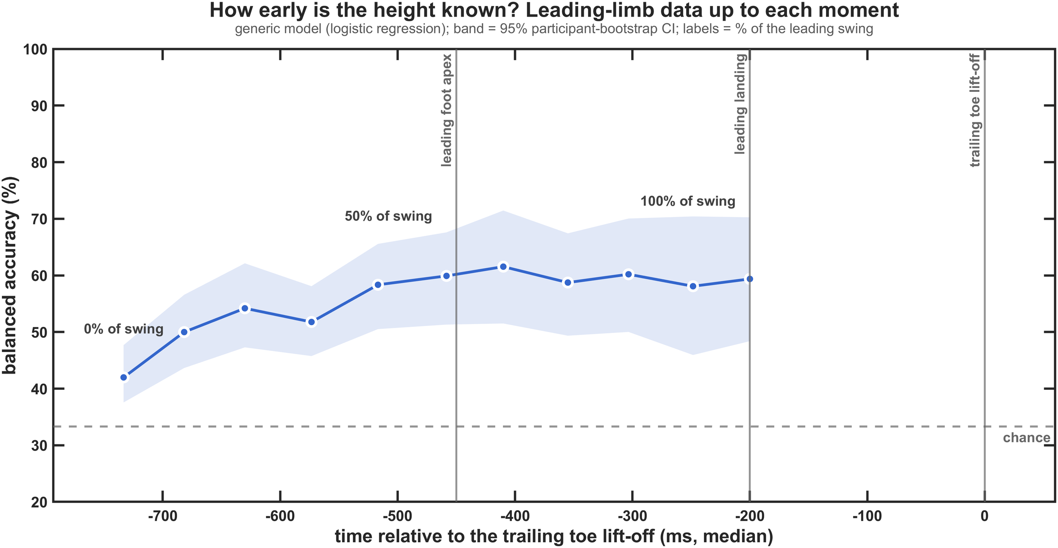
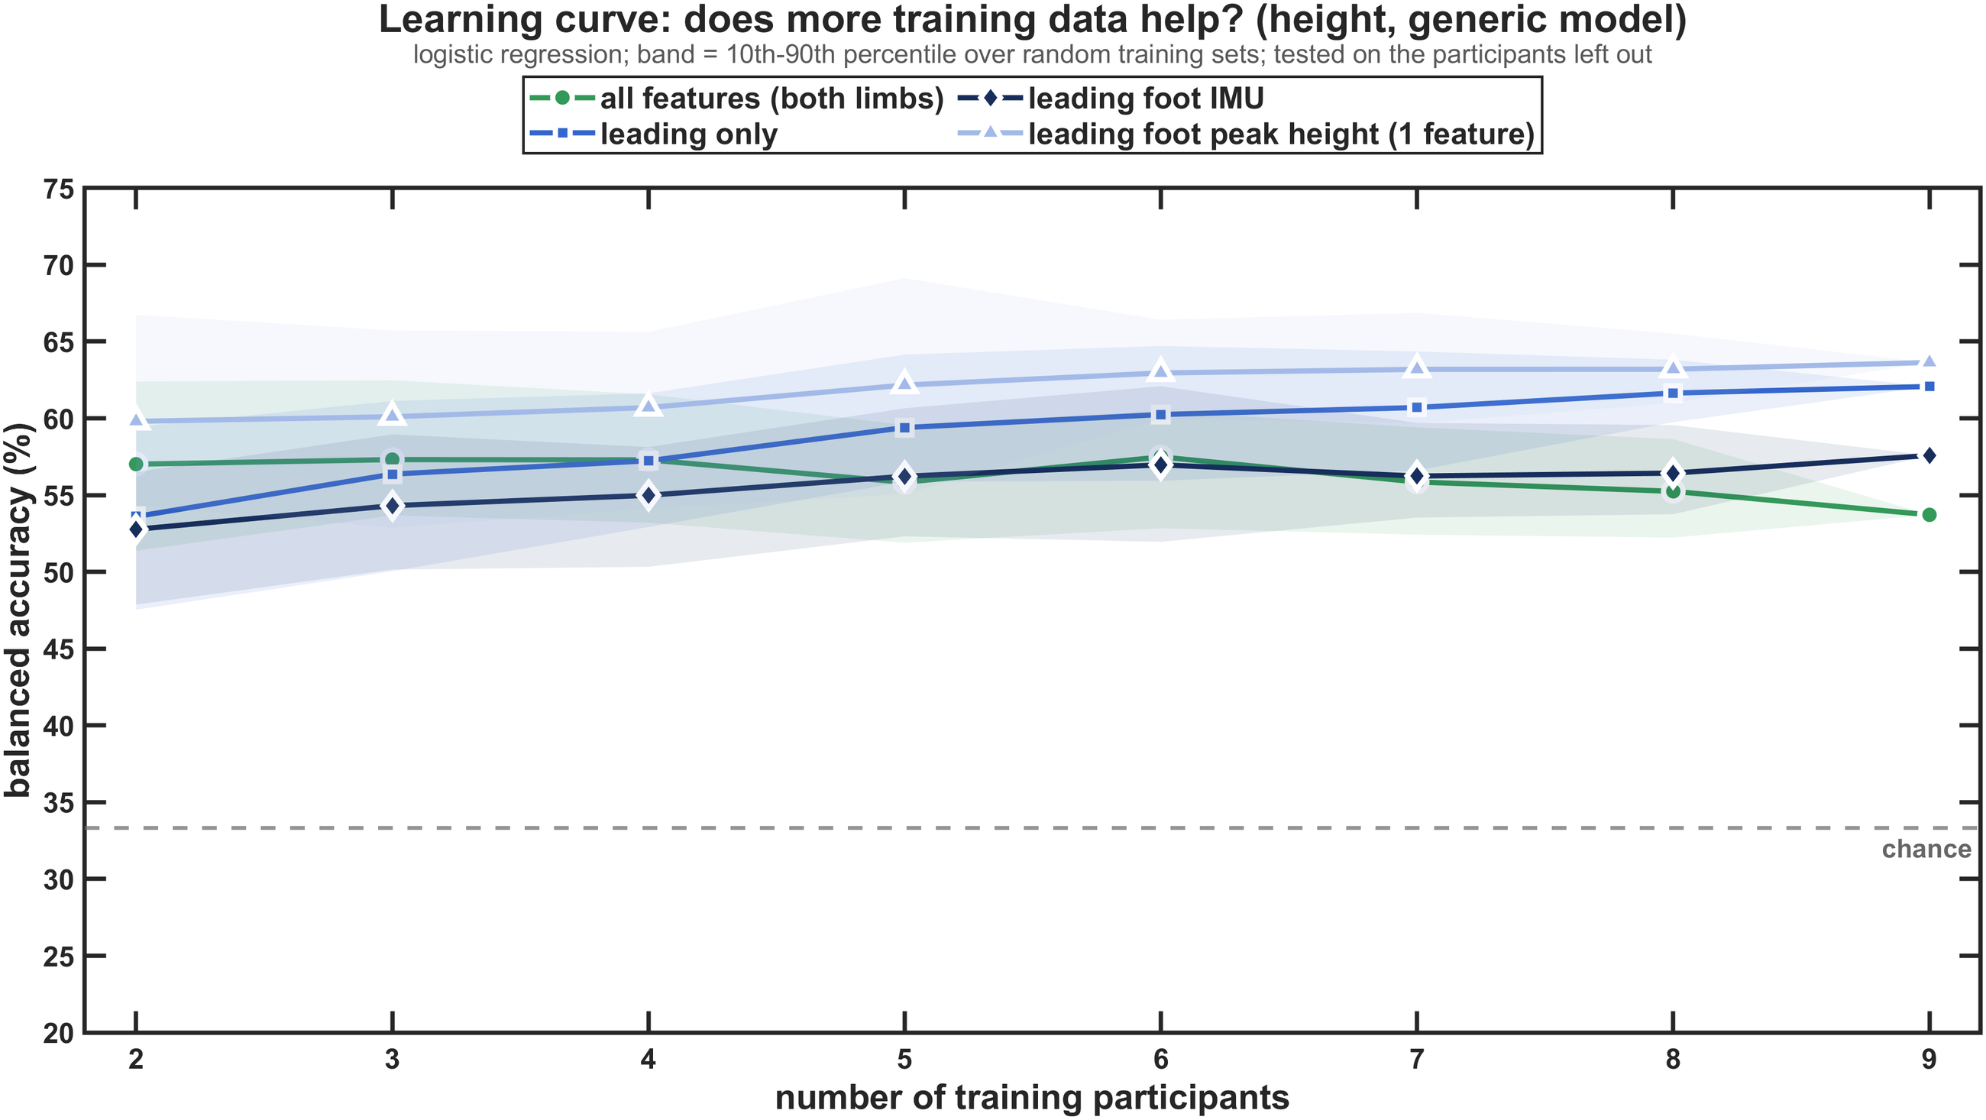
More data does not fix the generic model
The generic model plateaus early, and more training people barely help.
42 → 60 %
generic, from the leading toe-off to its apex, then flat
54–57 %
all features, with 2 to 9 training people
≤ +2 points
gain from 6 to 9 training people (leading-leg models)
Notes:
Left: logistic regression on the leading-limb data up to each % of its swing, with the median crossing events. Right: each participant predicted by a model trained on n random other participants (40 draws per n). The limit of the generic model is the difference between people, not the amount of data.

Slide 28
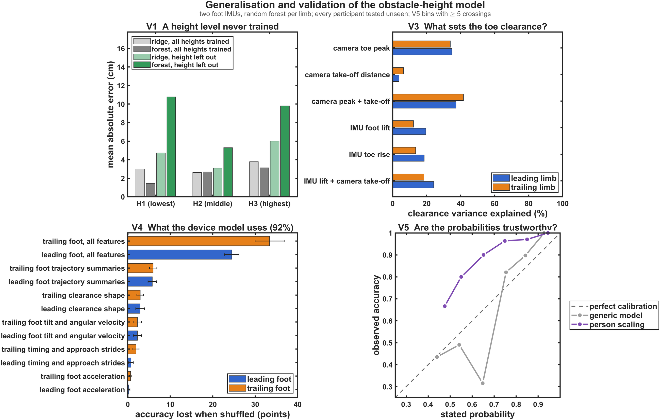
Checks: generalisation and trust
The model interpolates unseen heights, depends on both feet and is conservative.
Key numbers
3.1 cm
error for an untrained middle height (79 % right level)
−6.5 points
height trained on one width, tested on the other
33 / 25 points
accuracy lost without the trailing / leading foot features
Conservative
stated probabilities under-state the real accuracy
Notes:
V1: ridge regression left out one height level at a time; the extremes are extrapolated with a bias of about half a step (+4.0 and -5.7 cm); the forest cannot extrapolate. V3: crossing-to-crossing clearance is set mainly by how high the toe goes (camera toe peak 35 / 34 % of the variance), the IMU foot lift explains 20 / 12 %. V4: permutation importance of the feature groups. V5: Brier score 0.18 (person scaling) vs 0.51 (generic).

Slide 29
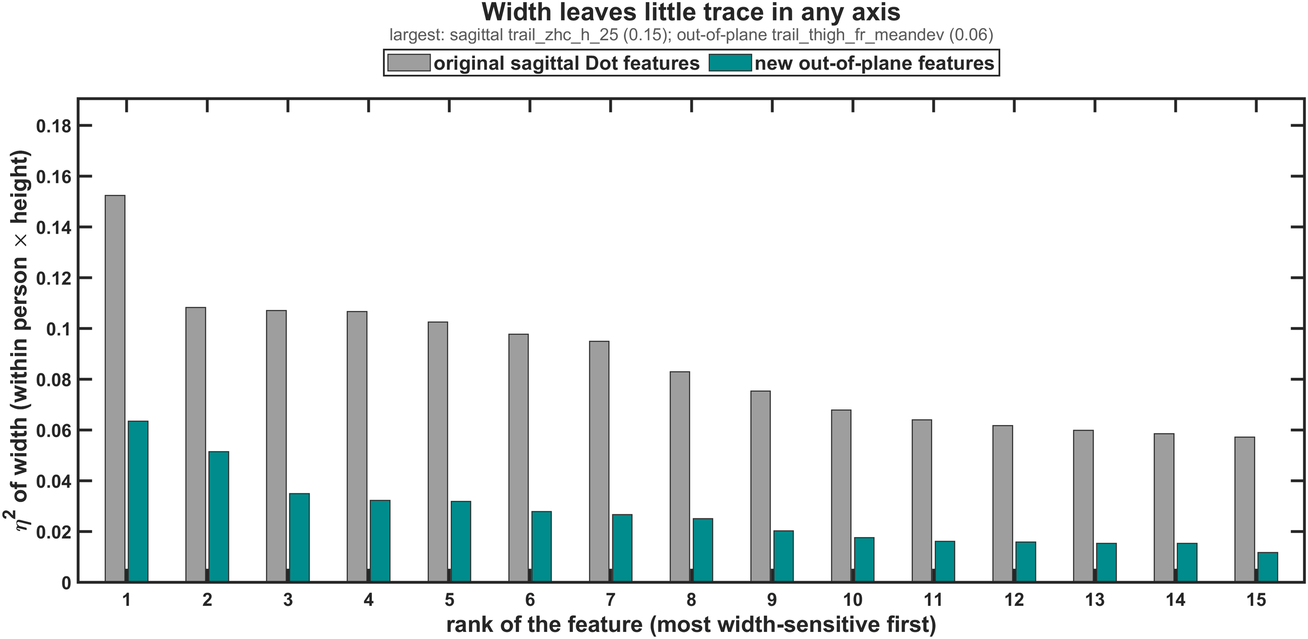
Width is behavioural, not a sensor limit
People cross a 5 cm and a 15 cm deep obstacle in almost the same way.
54–66 %
width with any input or model (chance 50 %)
57.6 %
even from the camera foot placement
+37 mm
longer crossing step for a 10 cm deeper obstacle
0.06
largest out-of-plane η² (0.15 sagittal)
Notes:
The side-to-side motion (frontal tilt and heading of thigh, shank and foot) does not carry width either: out-of-plane models reach 53-54 %. The width limit is behavioural: within 5-15 cm, people barely change how they cross. Statistics (crossing_ml_stats.m): at the same height the 15 cm obstacle raises the foot by 25 mm (p < 0.001), as much as 2.5 cm of extra height; consistent across people, hence significant for the group means, but small against the 40 mm crossing-to-crossing SD.

Slide 30
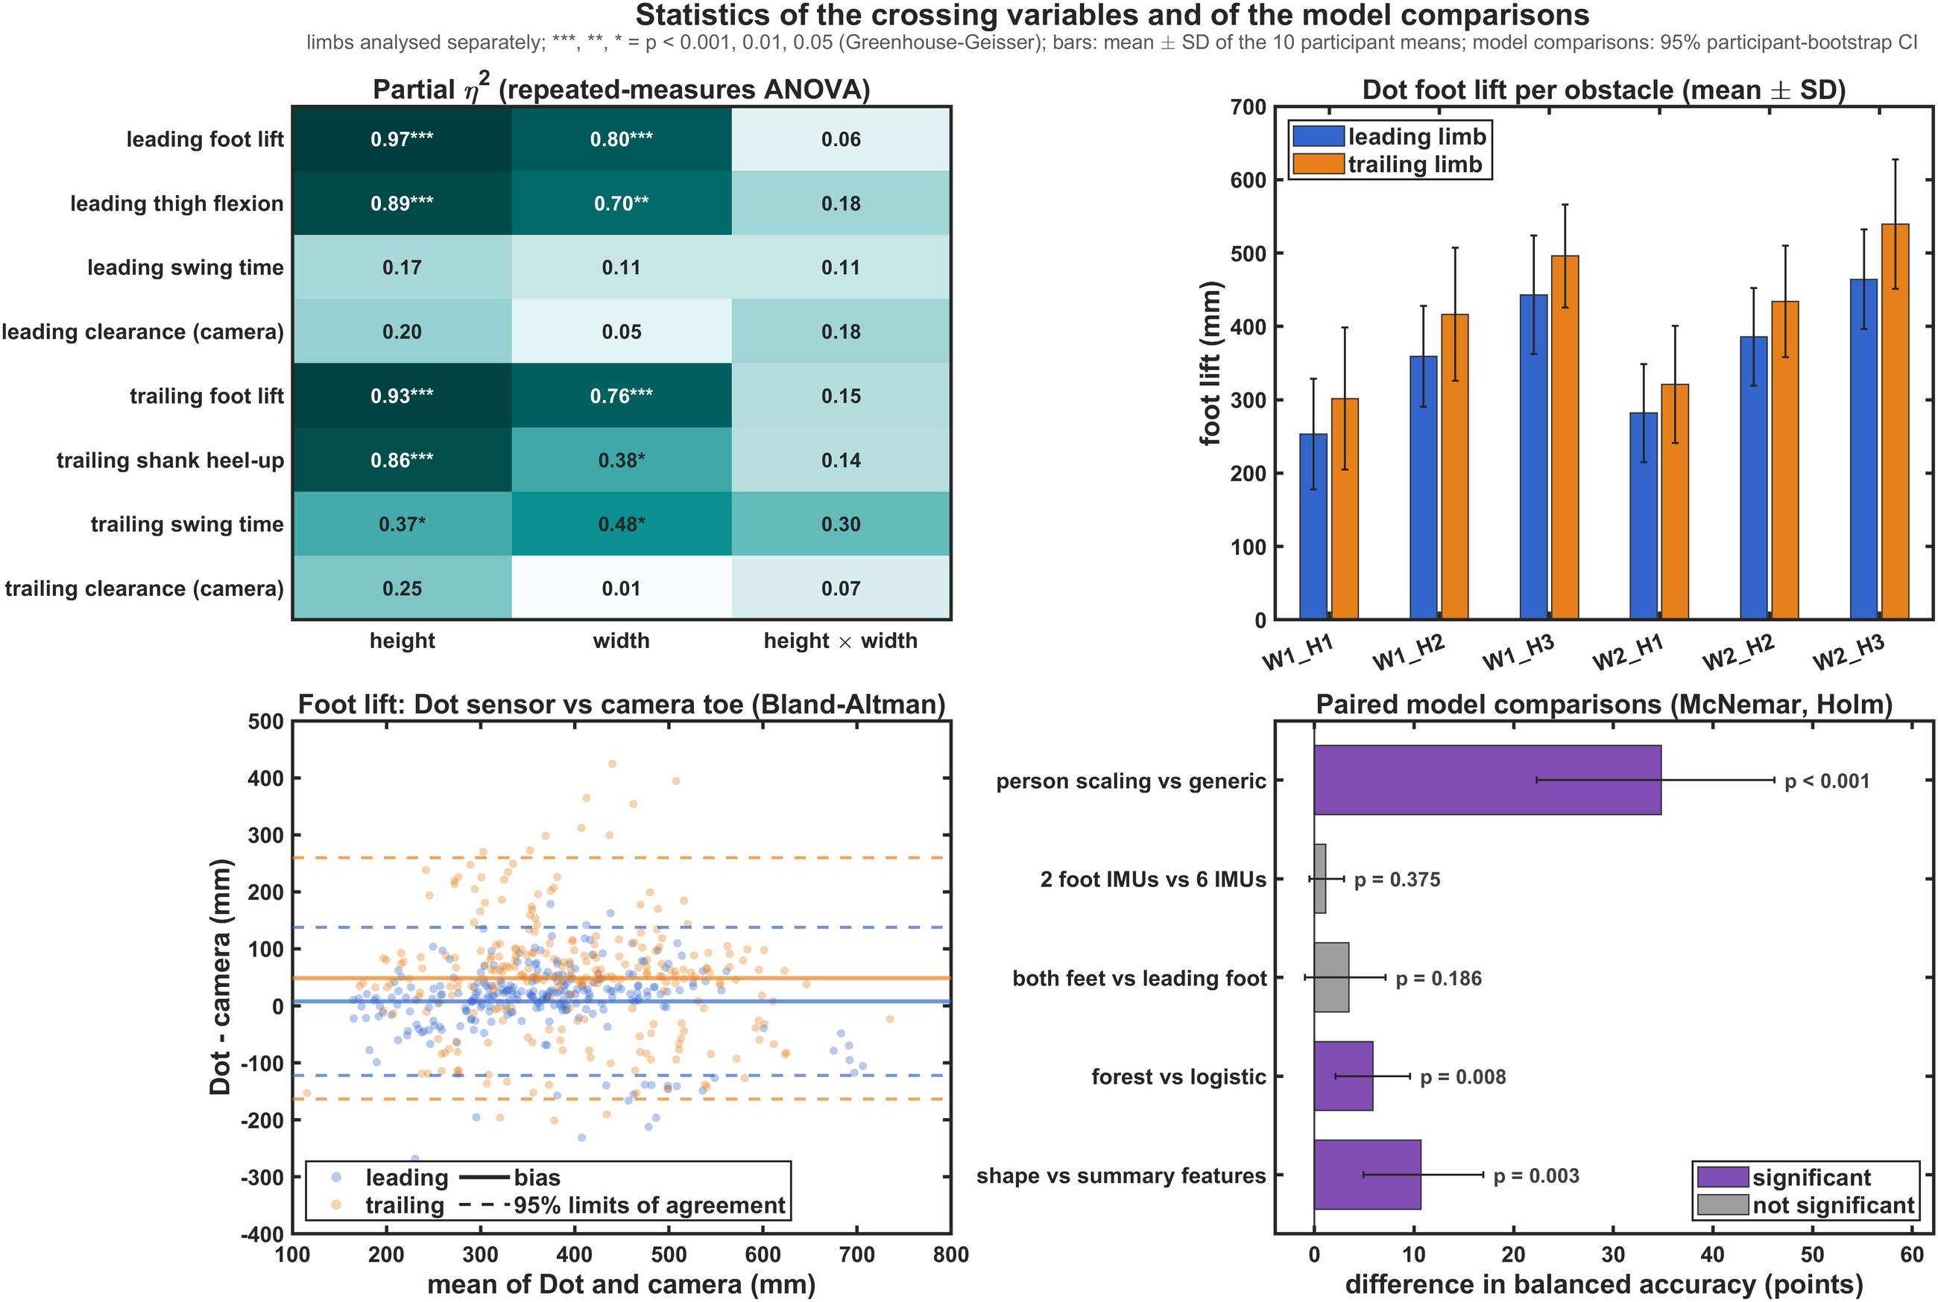
Statistics: which effects are real
Height and width both shift the crossing, but only height is large enough to read from one crossing.
Key numbers
η² 0.93–0.97
height effect on the foot lift; camera clearance not significant
+25 mm
foot lift for the 15 cm deep obstacle, against a 40 mm crossing SD
+34.8 points
person scaling vs generic (p < 0.001); forest +5.9, shape +10.7
Not significant
6 vs 2 IMUs (+1.1); both feet vs the leading foot (+3.5)
Notes:
Top left: 3 x 2 repeated-measures ANOVA per limb on the participant means (Greenhouse-Geisser p). Height: foot lift partial eta squared 0.97 (leading) and 0.93 (trailing), leading thigh 0.89, trailing shank 0.86, trailing swing time 0.37; camera clearance and leading swing time not significant. Width: foot lift 0.80 / 0.76, leading thigh 0.70, trailing shank 0.38, trailing swing 0.48; no height x width interaction. Mixed models on every crossing: +10.1 / +11.1 mm per cm, width +25 mm (as much as 2.5 / 2.3 cm of height), residual SD 41 / 40 mm. Bottom left: Bland-Altman of the Dot foot lift against the camera toe rise. Bottom right: McNemar exact test, Holm over five pairs: person scaling +34.8 points (CI 22.3-46.2), forest vs logistic +5.9 (p = 0.008), clearance-shape vs summary features +10.7 (p = 0.003); 2 vs 6 IMUs +1.1 (p = 0.38), both feet vs leading foot +3.5 (p = 0.19). Cohen kappa 0.88 (device) vs 0.36 (generic).

Slide 31
Device and haptic cue
05
Sensors, calibration, a camera-free pipeline, a real session, and when to cue
Notes:
Section 5: Q3 (what would a device need) and Q4 (when and how to cue).

Slide 32
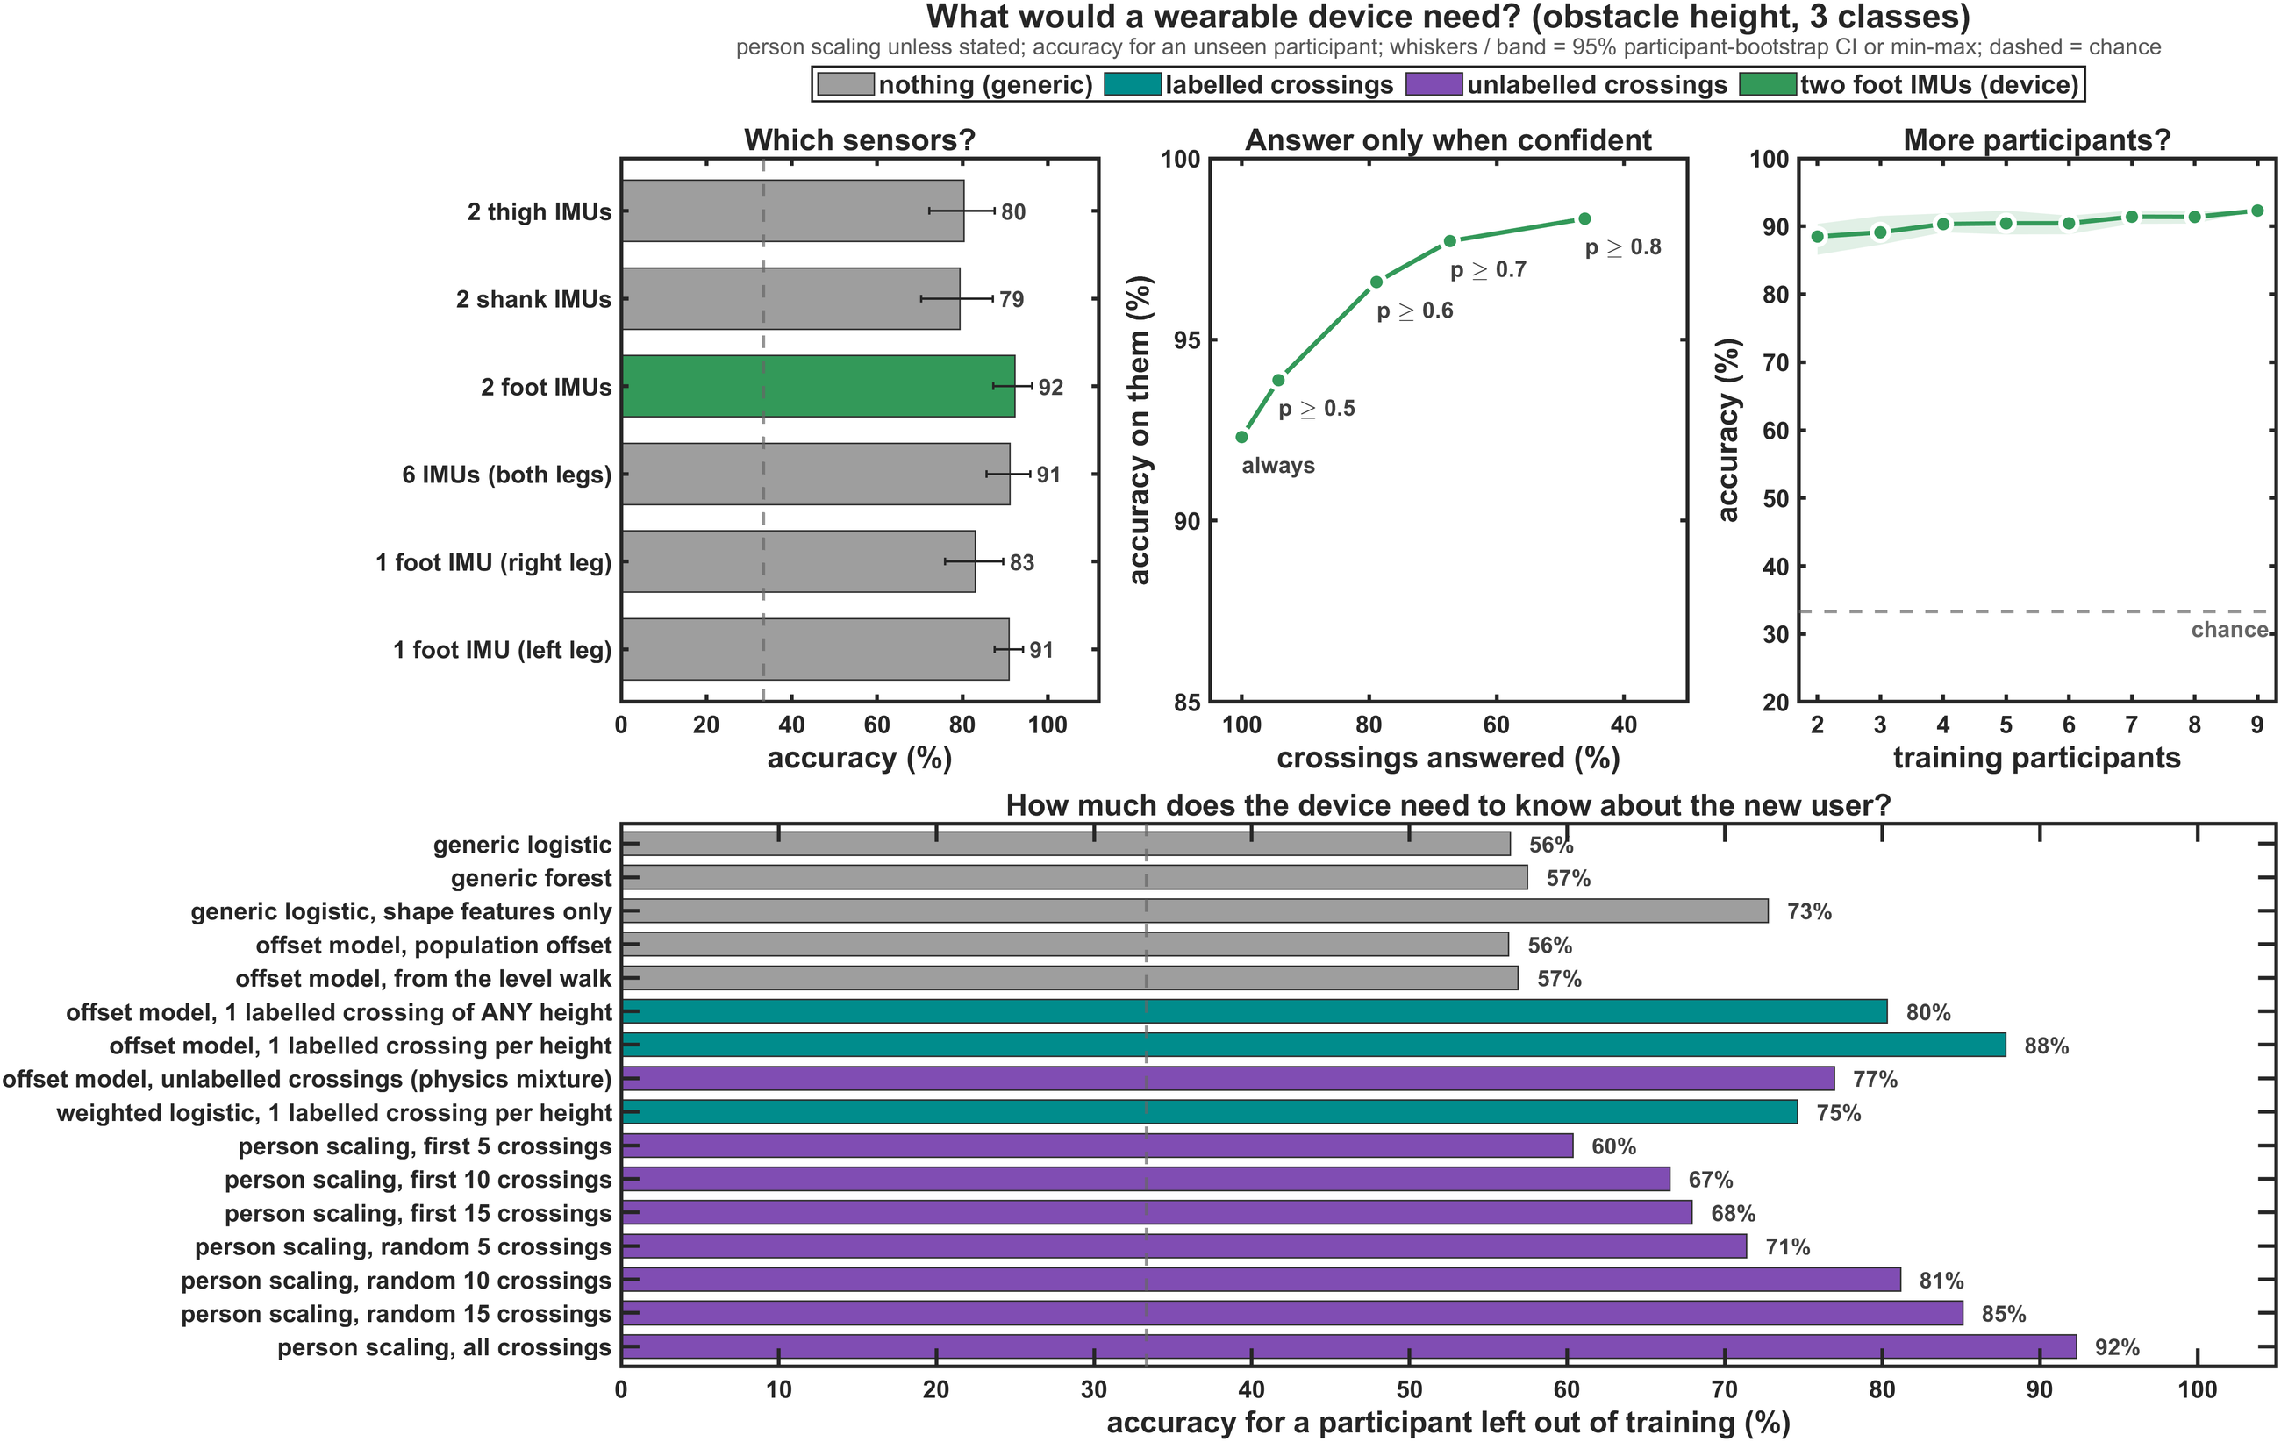
What the device needs
Two foot IMUs and a few of the user's own crossings are enough.
Key numbers
92 %
two foot IMUs (95 % CI 87–96), as good as six IMUs (91 %)
80 %
one labelled crossing; 81–85 % with 10–15 unlabelled ones
97 %
right when answering only at p ≥ 0.6 (79 % of crossings)
Flat
88–92 % from 2 to 9 training people
Notes:
Sensors: thigh pair 80.4 %, shank pair 79.4 %, one foot 82.9 % (right) / 90.9 % (left). Calibration: offset model with one labelled crossing of any height 80.3 %, one per height 87.8 %; person scaling from 10 / 15 random unlabelled crossings 81.2 / 85.1 %, from the first 5-15 crossings of a blocked session 60-68 % (they cover only one or two heights). Confidence: 98.3 % right at p >= 0.8 (46 % answered).

Slide 33
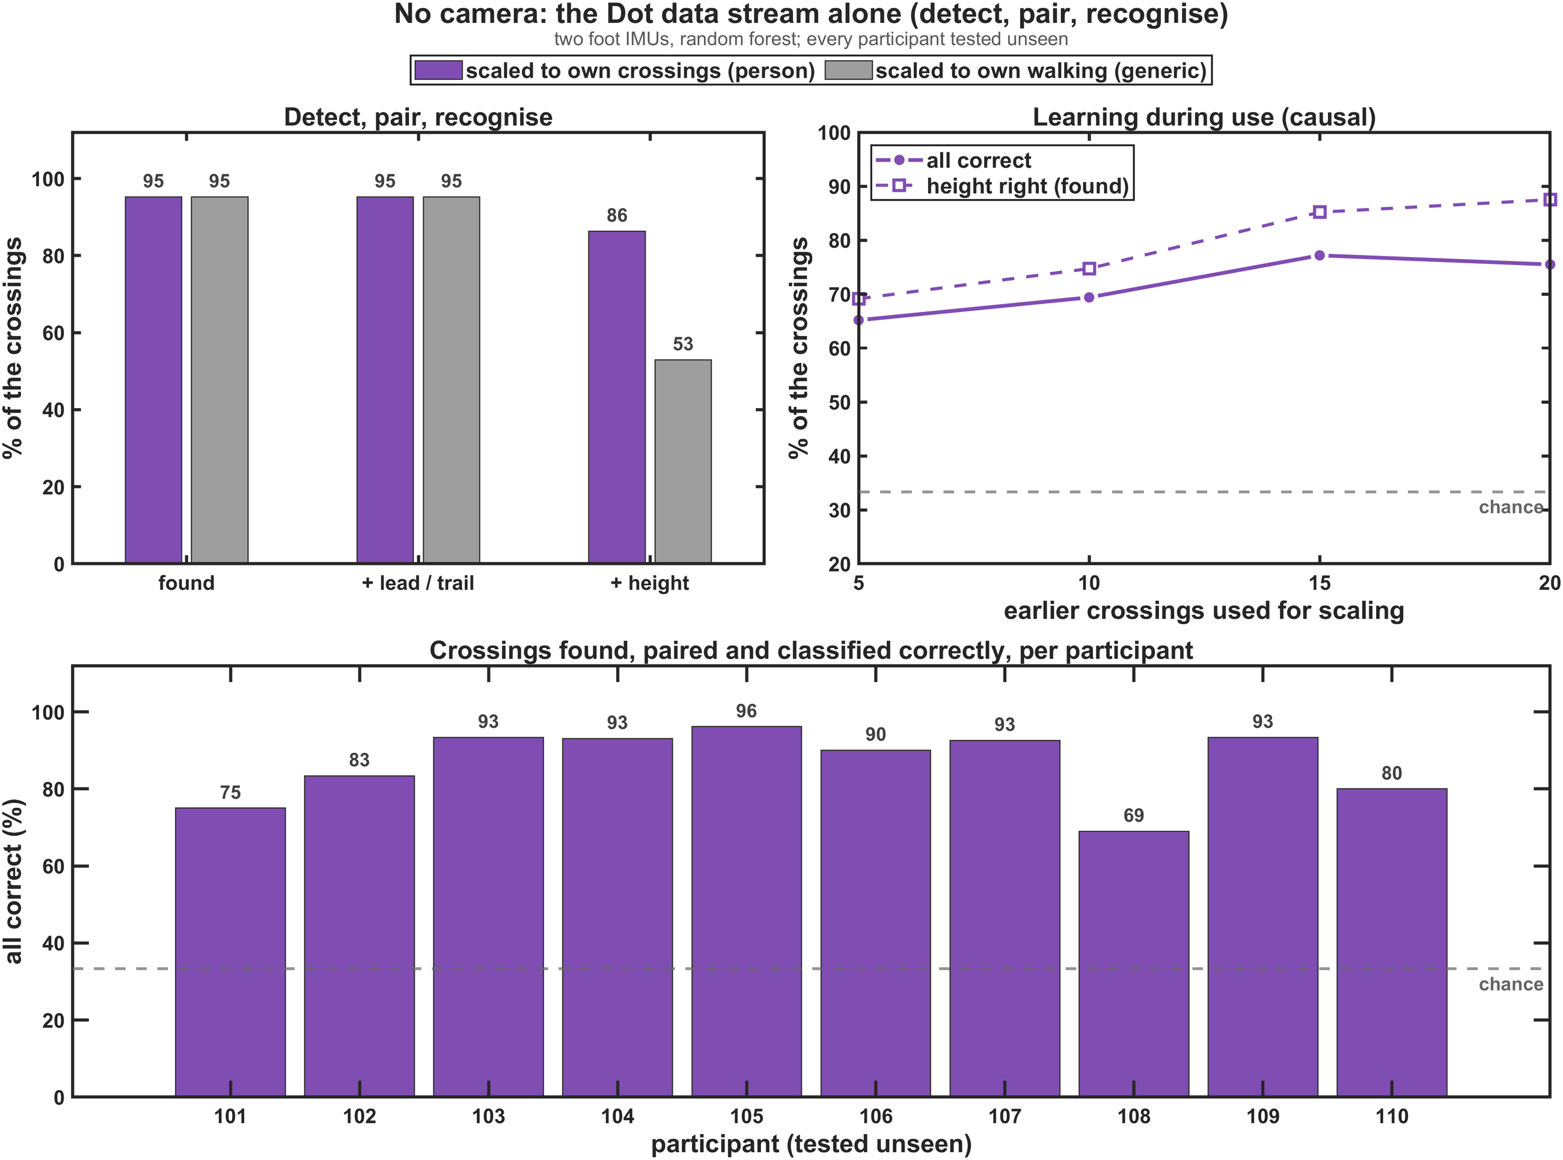
No camera: the IMU stream alone
Detect, pair and recognise every crossing from the continuous Dot data.
Key numbers
98.7 %
crossings found (precision 97.2 %)
95.2 %
leading and trailing legs paired correctly
86 %
found, paired and height correct (83.5 % of all crossings walked)
69–96 %
all correct, per participant
Notes:
Crossings are detected from the foot-sensor strides (peak height and length), the two legs paired by timing, and the height classified with the person-scaled forest. Scaled to the person's walking only, height drops to 53 %. Causal scaling (only earlier crossings) improves with use: 65 % all correct after 5 crossings, 77 % after 15.

Slide 34
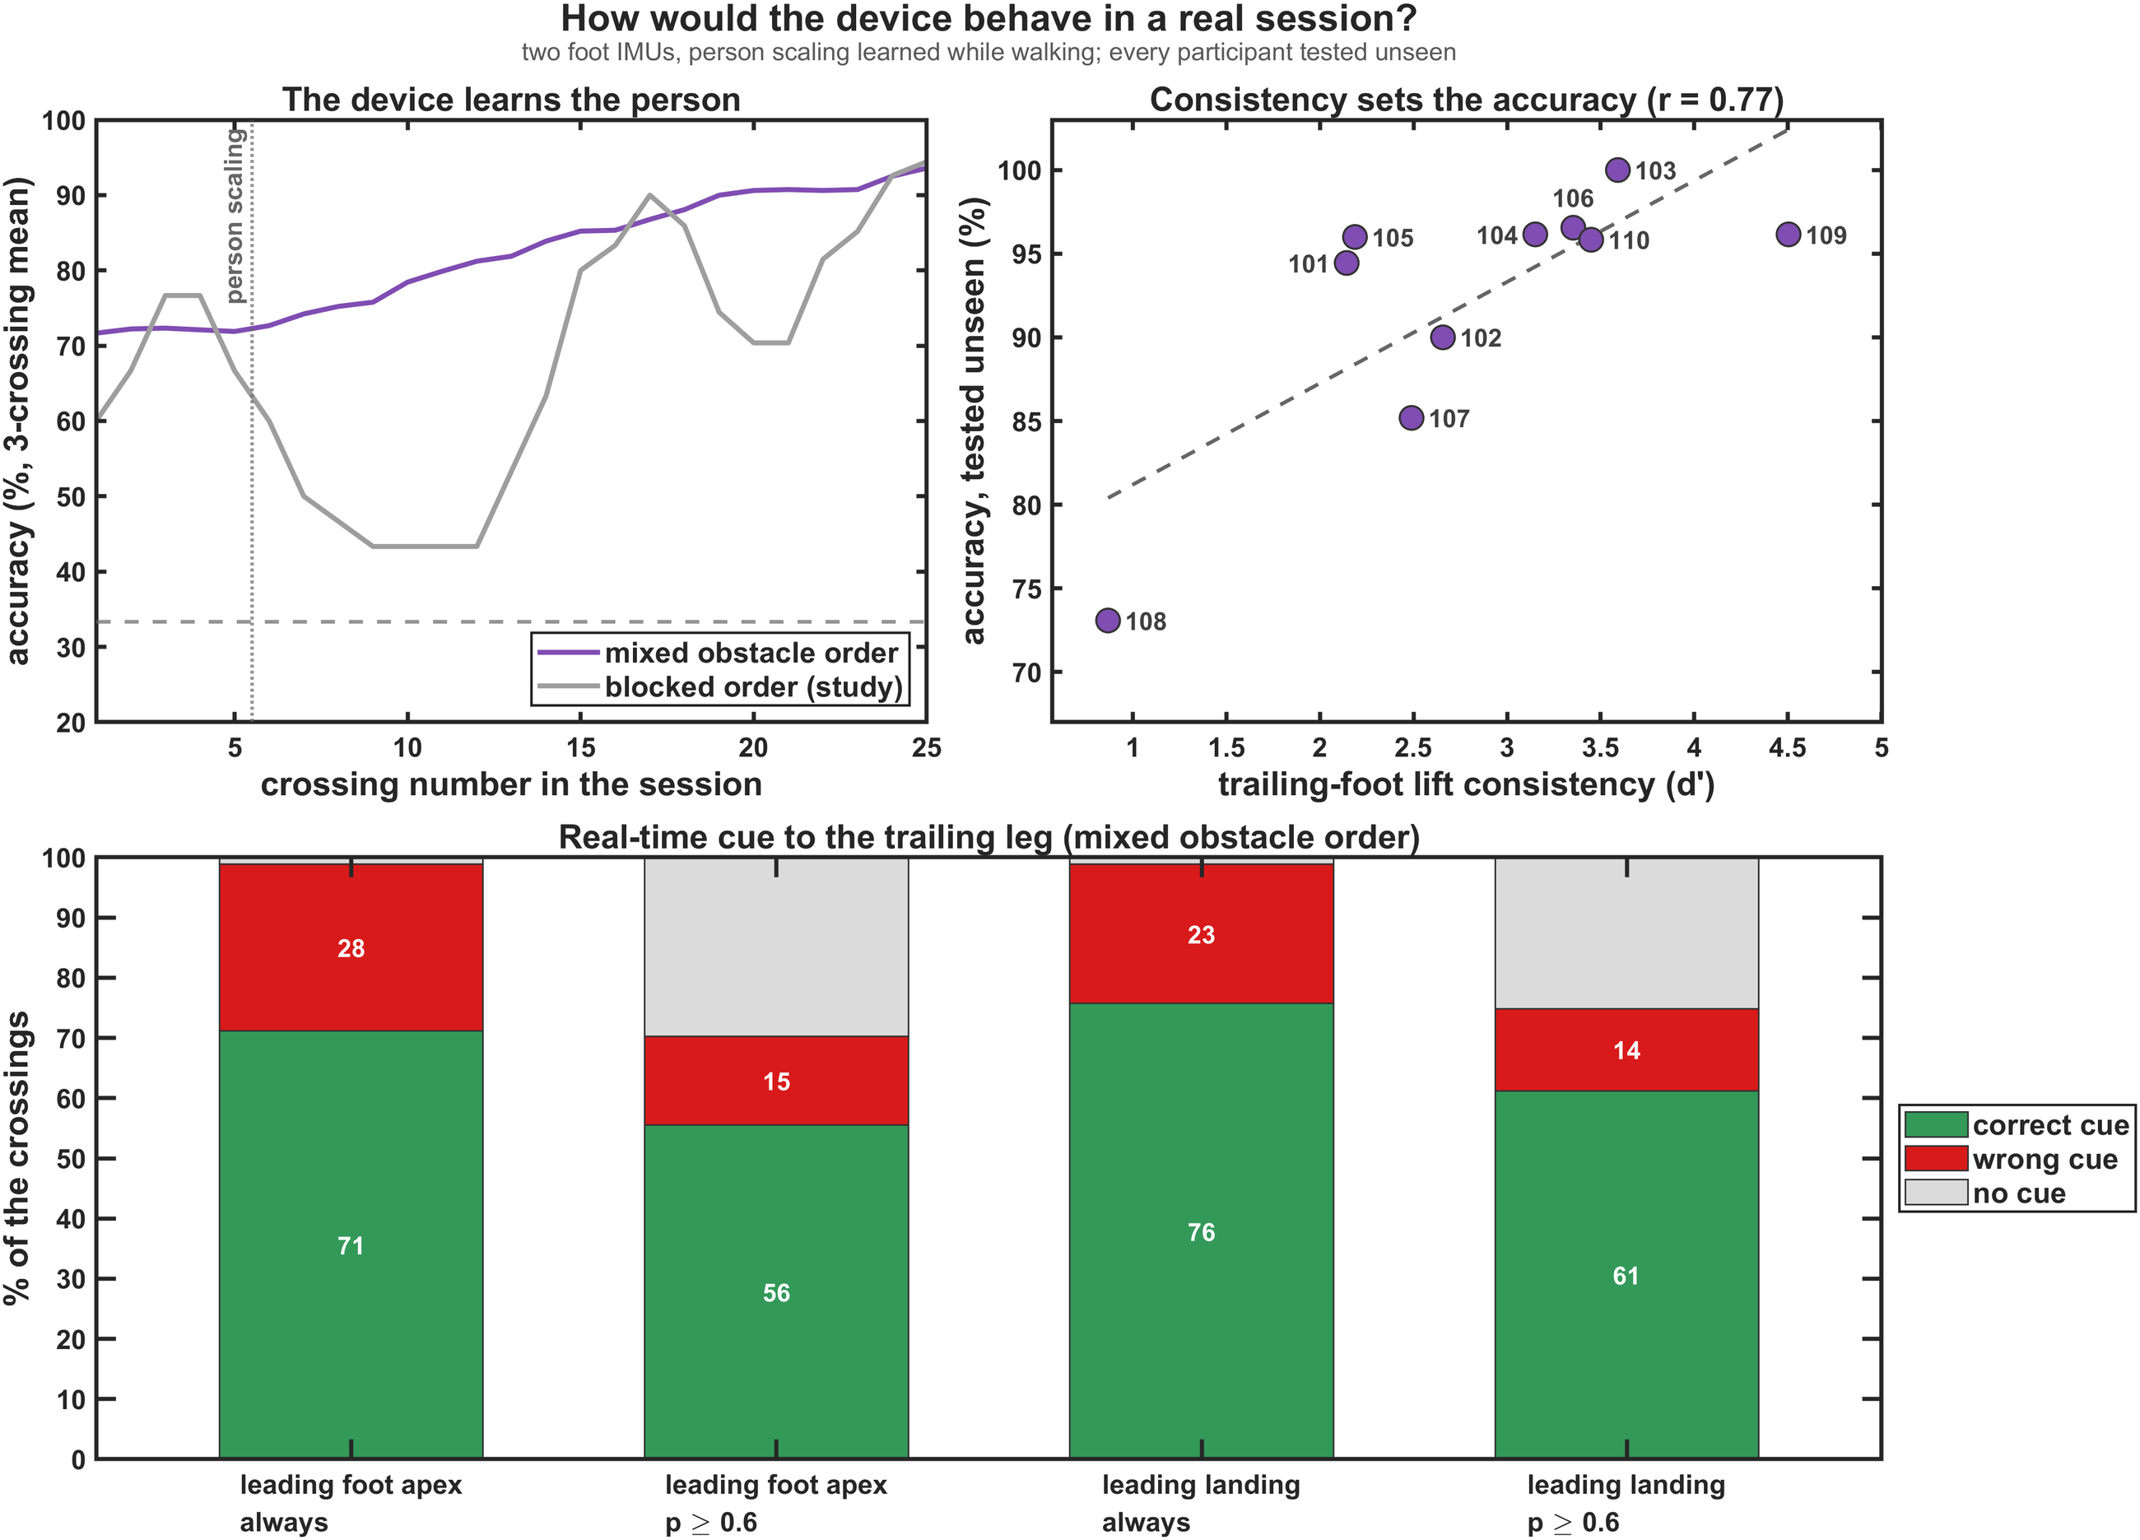
In a real session
The device learns the person while they walk; a real-time cue is right about three times in four.
Key numbers
72 → 90 %
mixed obstacle order: crossings 1–5 → from 16 on
71 / 76 %
correct real-time cues at the leading apex / landing
79–82 %
of the given cues right when the device cues only at p ≥ 0.6
r = 0.77
accuracy follows how consistently the trailing foot is lifted (d′)
Notes:
Mixed order simulated by shuffling the recorded crossings (30 orders). Real-time cue: crossing detected online at the leading-foot apex (0.45 s before the deadline) or landing (0.2 s), height decided with the causal person scaling. Detection 99.0 %, about 3 false detections per session. Participant 108 has the least consistent trailing lift (d' 0.9) and the lowest accuracy (73 %).

Slide 35
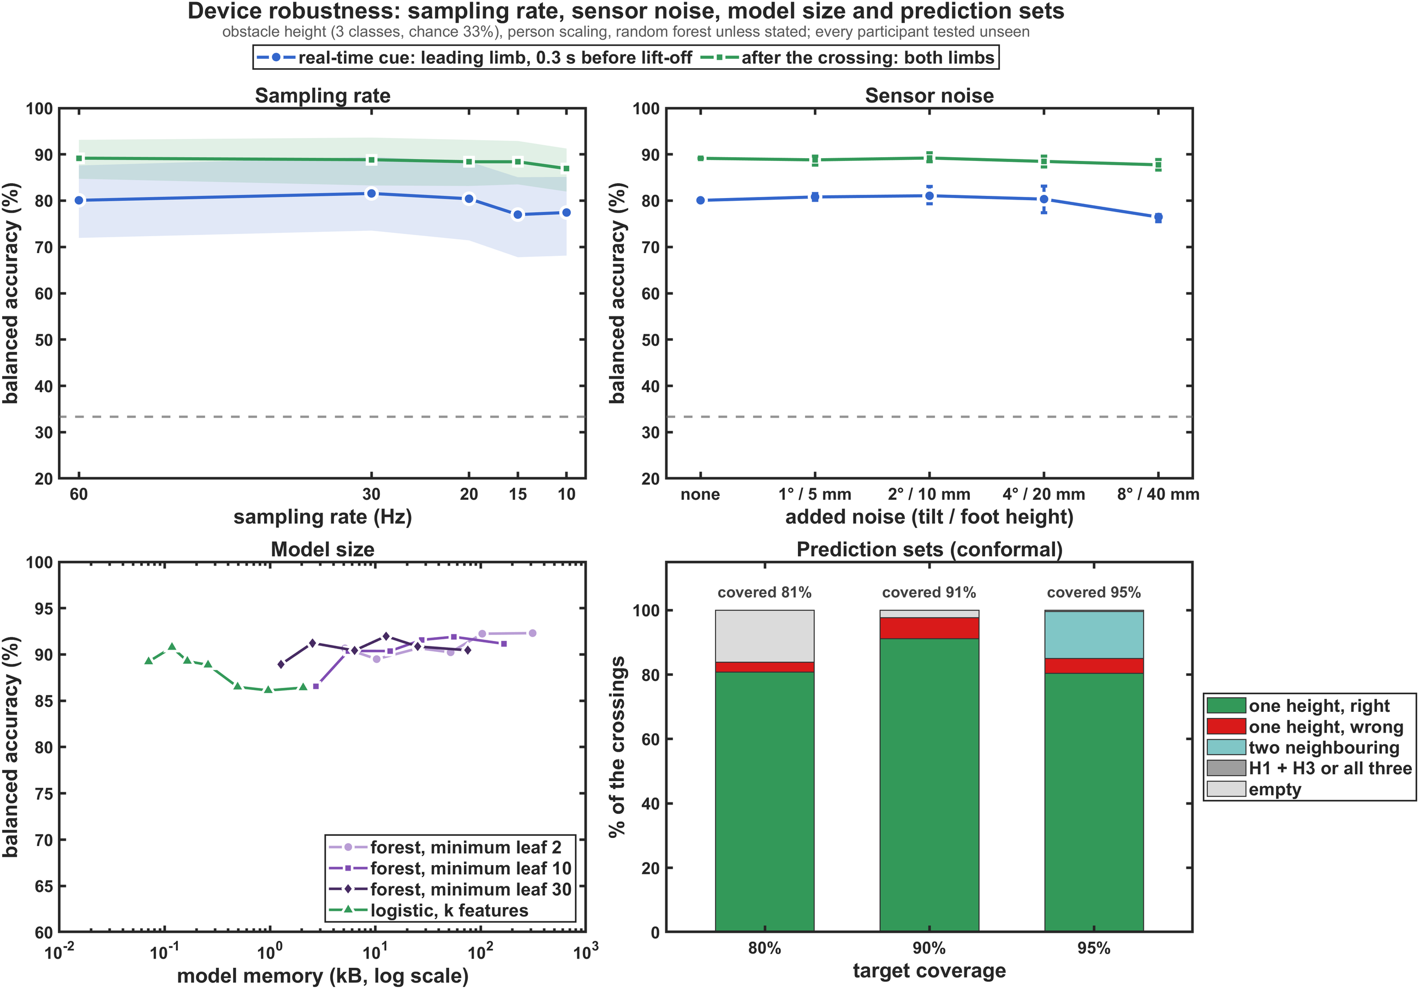
Cheap hardware is enough
A 10 Hz stream, consumer-grade sensor noise and a 3 kB model keep the accuracy.
Key numbers
−2.3 / −2.6
points from 60 to 10 Hz, after the crossing / real-time cue
No loss
with consumer-grade noise (1–2° tilt, 5–10 mm foot height)
91 % in 3 kB
10 trees (300 trees: 92.3 % in 311 kB); one feature per leg: 89 % in 72 bytes
91 % covered
by 90 % prediction sets: one height for 98 % of crossings, no cue for 2 %
Notes:
crossing_ml_robust.m. Sampling rate and noise use time-aligned features (maximum, minimum, mean, SD, last value and time of the maximum of thigh, shank and foot tilt, foot acceleration and foot height) with person scaling and a random forest. Real-time cue = leading limb up to 0.3 s before the trailing lift-off (80.1 % at 60 Hz); after the crossing = both limbs (89.2 %). Sampling rate: moving average over m samples, every m-th kept; 10 Hz gives 77.4 / 86.9 %, no rate costs more than 3.1 points. Noise: Gaussian on every sample; at 8 deg / 40 mm 76.5 / 87.7 %. Model size (device features): 12 bytes per tree node; logistic with the k best features per leg (ANOVA F), for k = 1 most often the leading peak foot height and the trailing foot height at 25 % of its swing. Prediction sets: split-conformal, nested LOPO calibration; at an 80 % target 16 % of the sets are empty, at 95 % 14.6 % are two neighbouring heights; H1 + H3 never occurs.

Slide 36
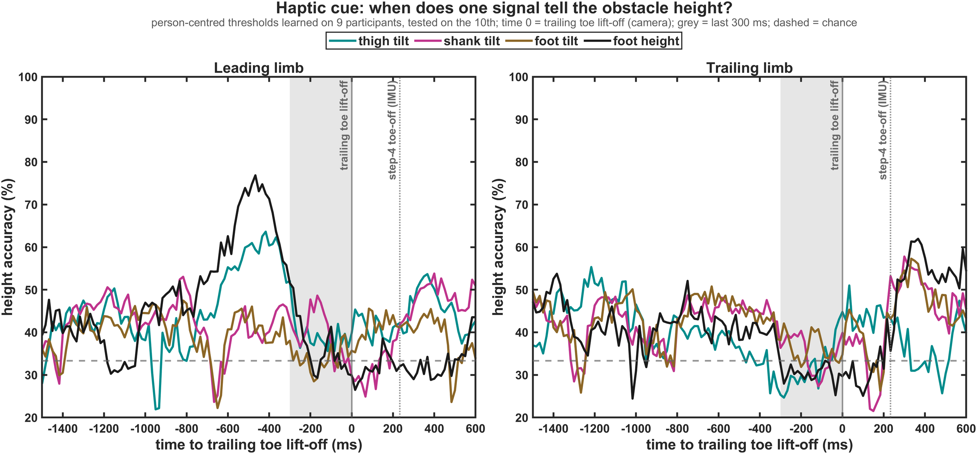
When one signal tells the height
Only the leading leg informs before the trailing toe lifts.
72 %
leading foot height, about 0.47 s before the deadline
≈ 60 %
leading thigh tilt at the same time
41–51 %
trailing-leg signals before lift-off: chance
81–82 %
trailing shank and foot, but only after lift-off
Notes:
Person-centred thresholds learned on 9 participants and tested on the 10th, at every 60 Hz sample around the trailing toe lift-off. 72 % = nested choice of the moment and thresholds (the per-sample curve peaks at 77 %). Grey band = last 300 ms before the deadline; dotted line = the step-4 trailing toe-off event of the IMU pipeline (+233 ms).

Slide 37
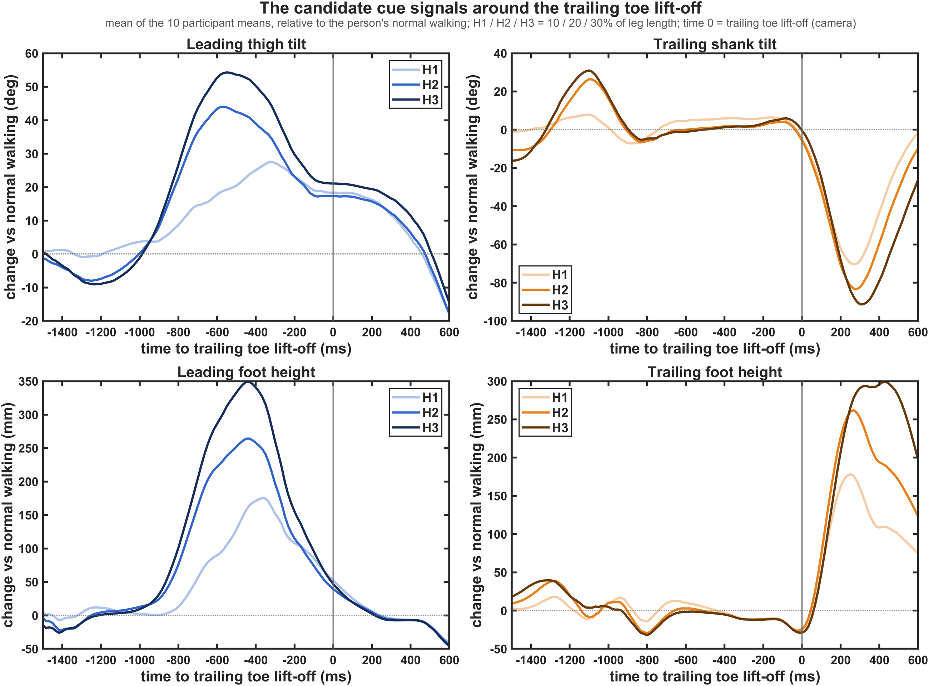
The cue signals
The leading thigh and foot separate the heights 0.6–0.8 s before the deadline; the trailing leg only after it.
Key numbers
+35 / +46 / +53°
leading thigh vs normal walking (H1 / H2 / H3)
+204 / +298 / +361 mm
leading foot height vs normal walking
−31 / −46 / −55°
trailing shank heel-up, after lift-off
+237 / +352 / +436 mm
trailing foot height, after lift-off
Notes:
Curves: mean of the 10 participant means, relative to the person's normal walking. Numbers: mean peak of each crossing per height (haptic report, H4); the curves average first, so their peaks are a little lower. Per cm of obstacle: leading thigh +0.95 deg, leading foot +8.6 mm, trailing shank -1.3 deg, trailing foot +10.9 mm; crossing-to-crossing SD 6.6 deg, 48 mm, 5.6 deg and 36 mm.

Slide 38
A three-step cue rule
Detect early, grade the height by the leading apex, cue the trailing leg before it lifts.
1 Detect
2 Grade the height
3 Cue the trailing leg
Early in the leading swing (0.57–0.71 s before the deadline): leading thigh more than +6° or leading foot more than +19 mm above normal walking.
By the leading-foot apex: two personal thresholds around the person's typical crossing (e.g. −36 / +39 mm).
At the leading-foot apex at the latest (≈ 0.45 s left), and only when the model is confident (p ≥ 0.6).
97–99 %
sensitivity, 98 % specificity
73 %
one signal; 71–76 % with the multi-feature model
79–82 %
of the given cues right
Not later: the leading landing leaves 0.2 s; the trailing leg's own signals are at chance before it lifts.
Notes:
Detection rule (nested, unseen participants): leading thigh >= +5.6 deg above normal walking at 30 % of the leading swing: 97 % sensitivity, 98 % specificity; leading foot >= +18.6 mm: 99 / 98 %; the earliest usable moments are 10 % / 4 % of the leading swing (-682 / -713 ms). Grading: person-centred thresholds on the leading-foot apex height 73.4 % (-479 ms), leading thigh 63.9 % (-345 ms); thresholds referenced only to normal walking reach 45-52 %. Cue reliability: virtual real-time cue with p >= 0.6, 79.1 % (apex) and 81.7 % (landing) of the given cues right.

Slide 39
When to cue the trailing leg
Timed from the trailing toe lift-off (0 s): measure on the leading leg, vibrate the trailing leg while it still stands.
Moment | Time before trailing toe-off | Trailing leg is … | Cue on the trailing leg
Leading toe-off | 0.73 s | starting single-leg stance | Too early: height unknown (≈ 50 %)
10–30 % of the leading swing | 0.57–0.71 s | mid-stance | Stage 1: "obstacle" warning (detection 97–99 %)
Leading-foot apex (50 %) | 0.45 s | late stance, before push-off | Stage 2: height cue, the latest good moment (≈ 80 % offline, 71 % real time)
70 % of the leading swing | 0.36 s | late stance | More accurate (≈ 88 %), but less time to react
Leading landing (100 %) | 0.20 s | starting push-off | Too late: in 22 % of crossings the trailing toe has already lifted
Trailing toe-off | 0 s | leaves the floor | Deadline
Trailing swing | after 0 s | over the obstacle; peak 0.25–0.3 s later | Too late to change the lift: feedback afterwards only
Why not during the trailing swing? its foot peaks only 0.25–0.3 s after lift-off, about one reaction time; the push-off that sets the lift starts at lift-off.
Notes:
Median times relative to the trailing toe lift-off seen by the camera (haptic report H1; ML report 2.1). Accuracy in the table = height from the leading-limb data up to that moment with person scaling and a random forest (Table "Height from the leading limb's data up to x % of its swing": 52 % at toe-off, 80.5 % at 50 %, 88.5 % at 70 %, 85.8 % at 100 %). Detection = leading thigh > +6 deg or leading foot > +19 mm above normal walking. The trailing leg shows no height information before it leaves the floor (41-51 %). Which leg is trailing is known early: the Dots tell the leading from the trailing swing 100 % of the time.

Slide 40
A real-time system: which leg and when
Cue the trailing leg, from leading-leg data: an early warning, then the height at the leading apex at the latest.
Stage | When (before trailing toe-off) | Trigger, measured on the leading leg | Reliability (real time)
1 "Obstacle!" warning | 0.57–0.71 s (10–30 % of the leading swing) | Thigh ≈ 6° or foot ≈ 19 mm above the person's normal walking | Detects 99 % of crossings; ≈ 3 false alarms per session of ≈ 725 strides
2 Height cue (low / medium / high) | 0.45 s (leading-foot apex) | Person-scaled model on the leading-leg data up to the apex | 71 % correct per crossing; 76 % after 15 crossings; 79 % of cues right if cued only at p ≥ 0.6
Not: leading landing | 0.20 s | Same model, more data | 76 % (83 % after 15), but too little time; 22 % already lifted
Calibrate
Learn during use
Measure reaction time
A short normal walk at the start.
Generic for crossings 1–5 (≈ 72 %), then person scaling: 79 % (6–15), 90 % from 16 on.
0.45 s median, ≤ 0.35 s for a quarter; a vibration reaction takes ≈ 0.2 s in young adults.
Notes:
Leading leg cannot be cued for the current crossing: nothing before the leading toe-off shows the height (approach variables at chance, 41.6 %, permutation p = 0.75). Real-time numbers from the virtual cue in a mixed session (30 shuffled orders, causal person scaling). The 90 % from crossing 16 on is the after-the-fact recognition; the real-time cue is lower (71-76 %) because only the leading limb has crossed when the cue is sent. Reaction time to the vibration was not measured and must be tested in the target users.

Slide 41
Discussion
06
What the results mean, what to build, and what is still open
Notes:
Section 6: interpretation, recommendations for the haptic cue, limitations and next steps.

Slide 42

What the results mean
A simple physical rule, a strong personal component, and a behavioural limit for width.
A simple rule plus a person
Personalise without labels
Height yes, width no
People lift each foot by about the obstacle height and keep their margin, but each person has a strong walking signature and a personal margin of about two thirds of a height step.
Generic models confuse neighbouring heights (56–73 %). Scaling to the person's own crossings removes the personal part: 90–92 % for a new person.
Height is readable early, from two foot IMUs, without a camera. Width is not: a deeper obstacle adds only 25 mm of lift, small against the 40 mm crossing SD.
Trustworthy within n = 10: unseen-person testing, nested model choice, permutation p ≤ 0.003, paired tests for the key gains, and MATLAB matches Python.
Notes:
The central result follows from the biomechanics: the obstacle changes how much the foot is lifted, by about the same amount for everybody, but the starting level differs between people by about two thirds of the step between two heights. A model that has never seen the person cannot know that offset; the person's own crossings reveal it without labels, which a worn device collects anyway.

Slide 43
Recommendations for the haptic cue
Answers to the design questions, with the evidence from this study.
Question | Answer | Evidence
When? | At the leading-foot apex at the latest (≈ 0.45 s left); detect the crossing earlier (0.57–0.71 s). | Height ≈ 80 % known at the apex; the landing leaves 0.2 s.
Which leg? | The leading leg gives the information for the trailing leg. | Trailing leg at chance before lift-off (41–51 %).
Which sensor? | A foot IMU on each foot; if only angles are measured, the leading thigh. | Foot 88–92 %; the leading shank carries nothing.
Detection | Leading thigh > +6° or leading foot > +19 mm above normal walking. | 97–99 % sensitivity, 98 % specificity.
Height thresholds | Personal, around the person's typical crossing (e.g. −36 / +39 mm). | 73 % personal vs 45–52 % population.
Calibration | A short normal walk plus own crossings (no labels), updated during use. | 10–15 crossings 81–85 %; a session 92 %.
Reliability | Cue only when confident (p ≥ 0.6), or cue a prediction set (one height, a pair or none). | 79–82 % of given cues right; 90 % sets cover 91 %.
Hardware | Two foot IMUs at 10–20 Hz; a model of a few kB fits a microcontroller. | ≤ 3 points lost at 10 Hz; 91 % in 3 kB.
Notes:
The reaction time to a vibration was not measured. About 0.45 s remain after a cue at the leading apex (0.35 s for a quarter of the crossings); a simple reaction takes about 0.2 s in young adults and longer in older adults. If it is too long, the earlier crossing detection can trigger a generic "obstacle" warning, followed by the height-specific cue at the apex. A "lift more" feedback could target the person's mean lift for the predicted height, with an alarm one to two crossing-to-crossing SDs below it (untested proposal).

Slide 44

Limitations
Feasibility results: strict tests, but a small and young sample in a laboratory.
Ten young adults
Blocked obstacle order
Camera-defined roles
Confirm on new people and on older adults, whose strategies and reaction times differ.
A mixed session was simulated by shuffling the recorded crossings.
Most analyses take leg roles and strides from the camera; the IMU pipeline pairs 95 % of crossings fully.
Features after first results
Real time simulated offline
Clearance
The clearance-shape features were designed after the first models: a small optimism may remain.
Reaction time to the vibration and the effect of the cue were not measured.
Only partly predictable from the IMU (errors 39 / 65 mm); needs the toe height, not the sensor height.
Notes:
Clearance: within a participant x obstacle cell the toe clearance varies with an SD of 37 mm (leading) and 71 mm (trailing); it depends mainly on how high the toe goes, which the foot sensor tracks only partly. Absolute clearance error from the IMU 39 / 65 mm vs 49 / 88 mm for a constant and 34 / 55 mm from the camera toe peak. The step-4 trailing toe-off event comes about 0.23 s after the toe leaves the floor; all timing uses the camera lift-off.

Slide 45

Next steps
From an offline analysis to a tested haptic device.
1
2
3
4
More participants
Build and test the cue
Toe height
New obstacles
Record new people, including older adults, with the obstacles in a mixed order.
Two foot IMUs with a leading-leg trigger; measure the reaction time and the effect on the trailing-foot clearance.
Measure the sensor position on the shoe so the toe height and clearance can be computed.
Other heights and depths (kerbs, steps) to confirm the generalisation to unseen heights.
All analysis code is MATLAB (Analysis/ML); every figure is redrawn by crossing_ml_figures.m in seconds.
Notes:
Reproducibility: build_crossing_master.m builds the dataset; the twelve crossing_ml_*.m scripts (including crossing_ml_stats.m, crossing_ml_robust.m and crossing_ml_params.m) write the reports and save the numbers behind their figures; crossing_ml_figures.m draws all 23 figures in the step 9 template. A full rerun takes about an hour and reproduces every number.

Slide 46

Take-home messages
1
People lift each foot by about the obstacle height; each person adds a personal margin.
The haptic cue in one line each
When: leading-foot apex, ≈ 0.45 s before
2
Two foot IMUs recognise the height on a new person at about 90 % once scaled to the person's own crossings; width stays near chance.
Which leg: the leading leg
Which sensor: foot IMUs (else the leading thigh)
Thresholds: personal, learned from own crossings
3
A cue for the trailing leg must come from the leading leg, by its apex: about 0.45 s ahead, with personal thresholds.
Confidence: cue only at p ≥ 0.6
Hardware: 10–20 Hz, a 3 kB model
Notes:
Three take-home messages and the cue design in one line each. Questions welcome; the report has every method, formula and table behind these slides.

