Slide 1



What wearable IMUs reveal about obstacle crossing
Machine-learning and biomechanics results
10 young adults · Tests 101–110
Ehsan Sharafian · 30 October 2026
Notes:
Results of the machine-learning and biomechanics analyses of the obstacle-crossing study (Tests 101-110). All analyses run in MATLAB; reports and figures are in Results/ML Models/MATLAB. Every accuracy is for a participant the model never saw.

Slide 2


The answer in brief
Obstacle height can be read from two foot IMUs; obstacle width cannot.
92 %
+10 mm
0.7 s
86 %
obstacle height (3 levels) recognised on a new person once scaled to their crossings
extra foot lift per cm of obstacle; the safety margin stays constant
lead time: height is ~80 % known at the lead-foot apex, before the trailing foot lifts
end to end without a camera: crossing found, legs paired, height correct
Limits: obstacle width (5 vs 15 cm) is barely recognisable (best 65 %, chance 50 %) because people cross both widths alike, and the toe-clearance margin cannot be estimated.
Notes:
Four headline findings and one limit. 92 % = two foot IMUs, person scaling, lead and trail models combined (95 % CI 87-96). 0.7 s = median time from the lead-foot apex to the trailing toe-off (683 ms). 86 % = camera-free pipeline (detect, pair, classify); 83.5 % if missed crossings are counted as errors.

Slide 3








Study design and evaluation
Every accuracy in this deck is for a participant the model never saw in training.
10 young adults
260 obstacle crossings used for ML (303 recorded), about 5 per obstacle
How the models were tested
6 Movella Dot IMUs
thigh, shank and foot of both legs; camera motion capture as the reference
Leave-one-participant-out: train on 9 people, test on the 10th, for all 10
Balanced accuracy; chance 33 % (height), 50 % (width), 17 % (6 obstacles)
6 obstacles
3 heights (10 / 20 / 30 % of leg length) × 2 widths (5 / 15 cm)
95 % CI by participant bootstrap; permutation tests shuffle labels within each person
width 5 cm
width 15 cm
Leading and trailing legs modelled separately, then combined by soft vote
Person scaling: each feature scaled by the person's own crossings (median / IQR, no labels)
10 %
20 %
30 %
10 %
20 %
30 %
Notes:
260 obstacle crossings had complete IMU and camera data (include_ml); 303 were recorded. Generic model = features scaled only to the person's level walk and leg length. Person scaling = each feature scaled by the person's own median and IQR over their crossings; it uses no height labels. Crossing order was never used as a feature.

Slide 4

How people cross an obstacle
01
How the crossing scales with obstacle height, where the information sits, and what makes each person different
Notes:
Section 1: the biomechanics. These results explain why the models behave as they do.

Slide 5
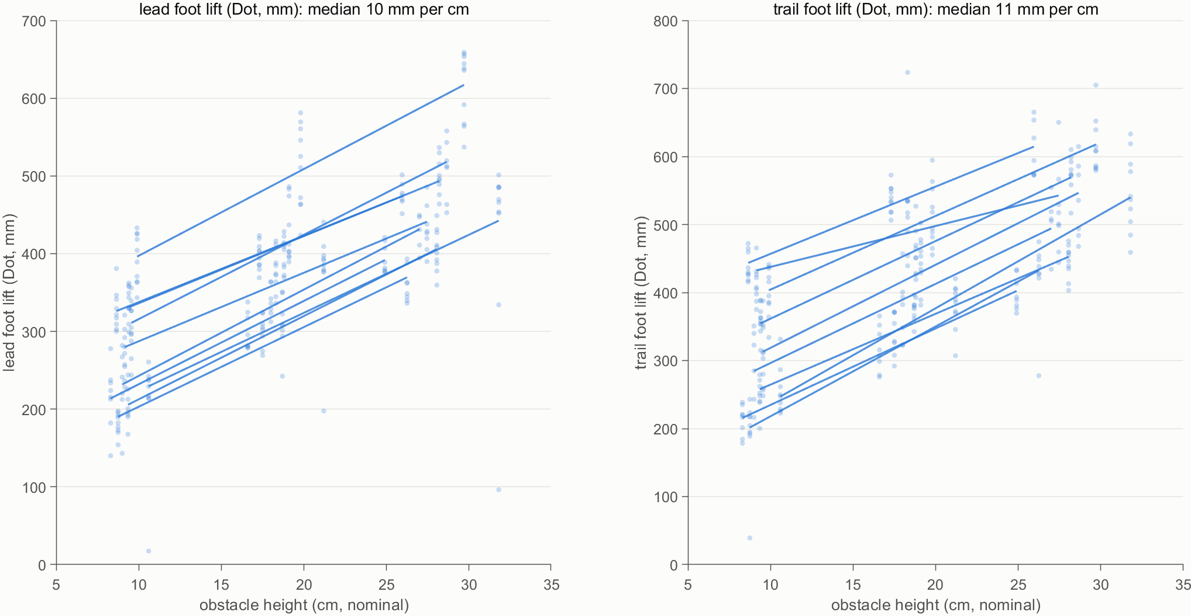
Foot lift scales 1:1 with obstacle height
People raise each foot by about the obstacle height and keep their safety margin constant.
+10.1 mm
lead foot lift per cm of obstacle (95 % CI 9.4–10.8)
+11.1 mm
trailing foot lift per cm (CI 9.7–12.6)
−0.7 mm
change in the lead safety margin per cm: not significant (CI −1.8 to +0.4); trailing −2.3 mm, n.s.
One line per participant; slopes from a mixed model (random intercept and slope per person).
Mechanism: lead thigh flexion +1.2° per cm; trailing heel-up (shank tilt −1.2° per cm).
Notes:
Mixed-effects model, random intercept and slope per participant, 260 crossings. Lead foot lift +10.08 mm per cm (9.38-10.78); trailing +11.12 mm per cm (9.66-12.59). Camera safety margin: lead -0.71 mm per cm (p = 0.185), trailing -2.32 mm per cm (p = 0.055): neither significant. Lead thigh +1.19 deg per cm; trailing shank -1.19 deg per cm (heel-up).

Slide 6
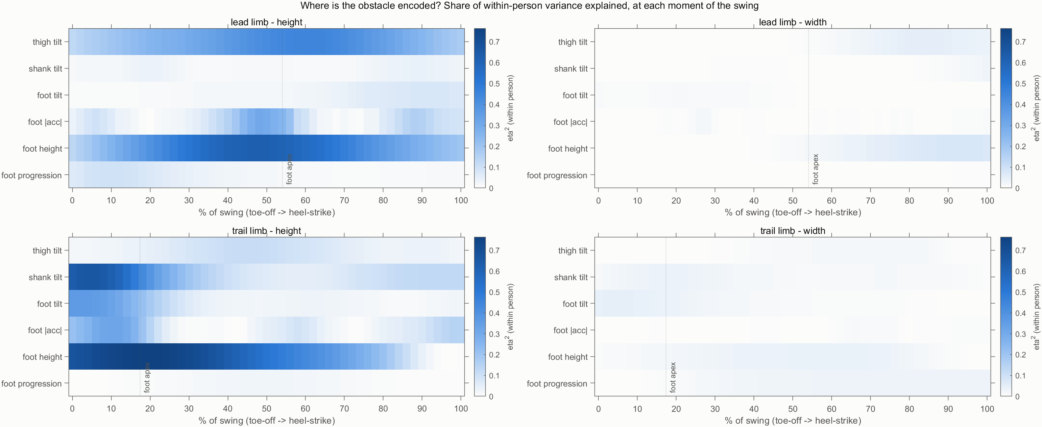

Height is encoded mid-swing; width is not
Share of within-person variance explained by the obstacle (eta²) at each moment of the swing.
0.62
lead foot height around the apex (48 %)
0.45
lead thigh tilt (62 % of swing)
0.76
trailing foot height, early swing (20 %)
0.66
Width: eta² ≤ 0.08 in every signal at every moment (right panels); the crossing barely changes with width.
trailing shank tilt at push-off (4 %)
Notes:
eta squared = share of the within-person variance explained by obstacle height (left panels) or width (right panels), at each 2 % of the swing (toe-off to heel-strike). Peaks: trailing foot height 0.76 at 20 %, trailing shank tilt 0.66 at 4 %, lead foot height 0.62 at 48 %, lead thigh tilt 0.45 at 62 %. Width stays at or below 0.08 everywhere.

Slide 7

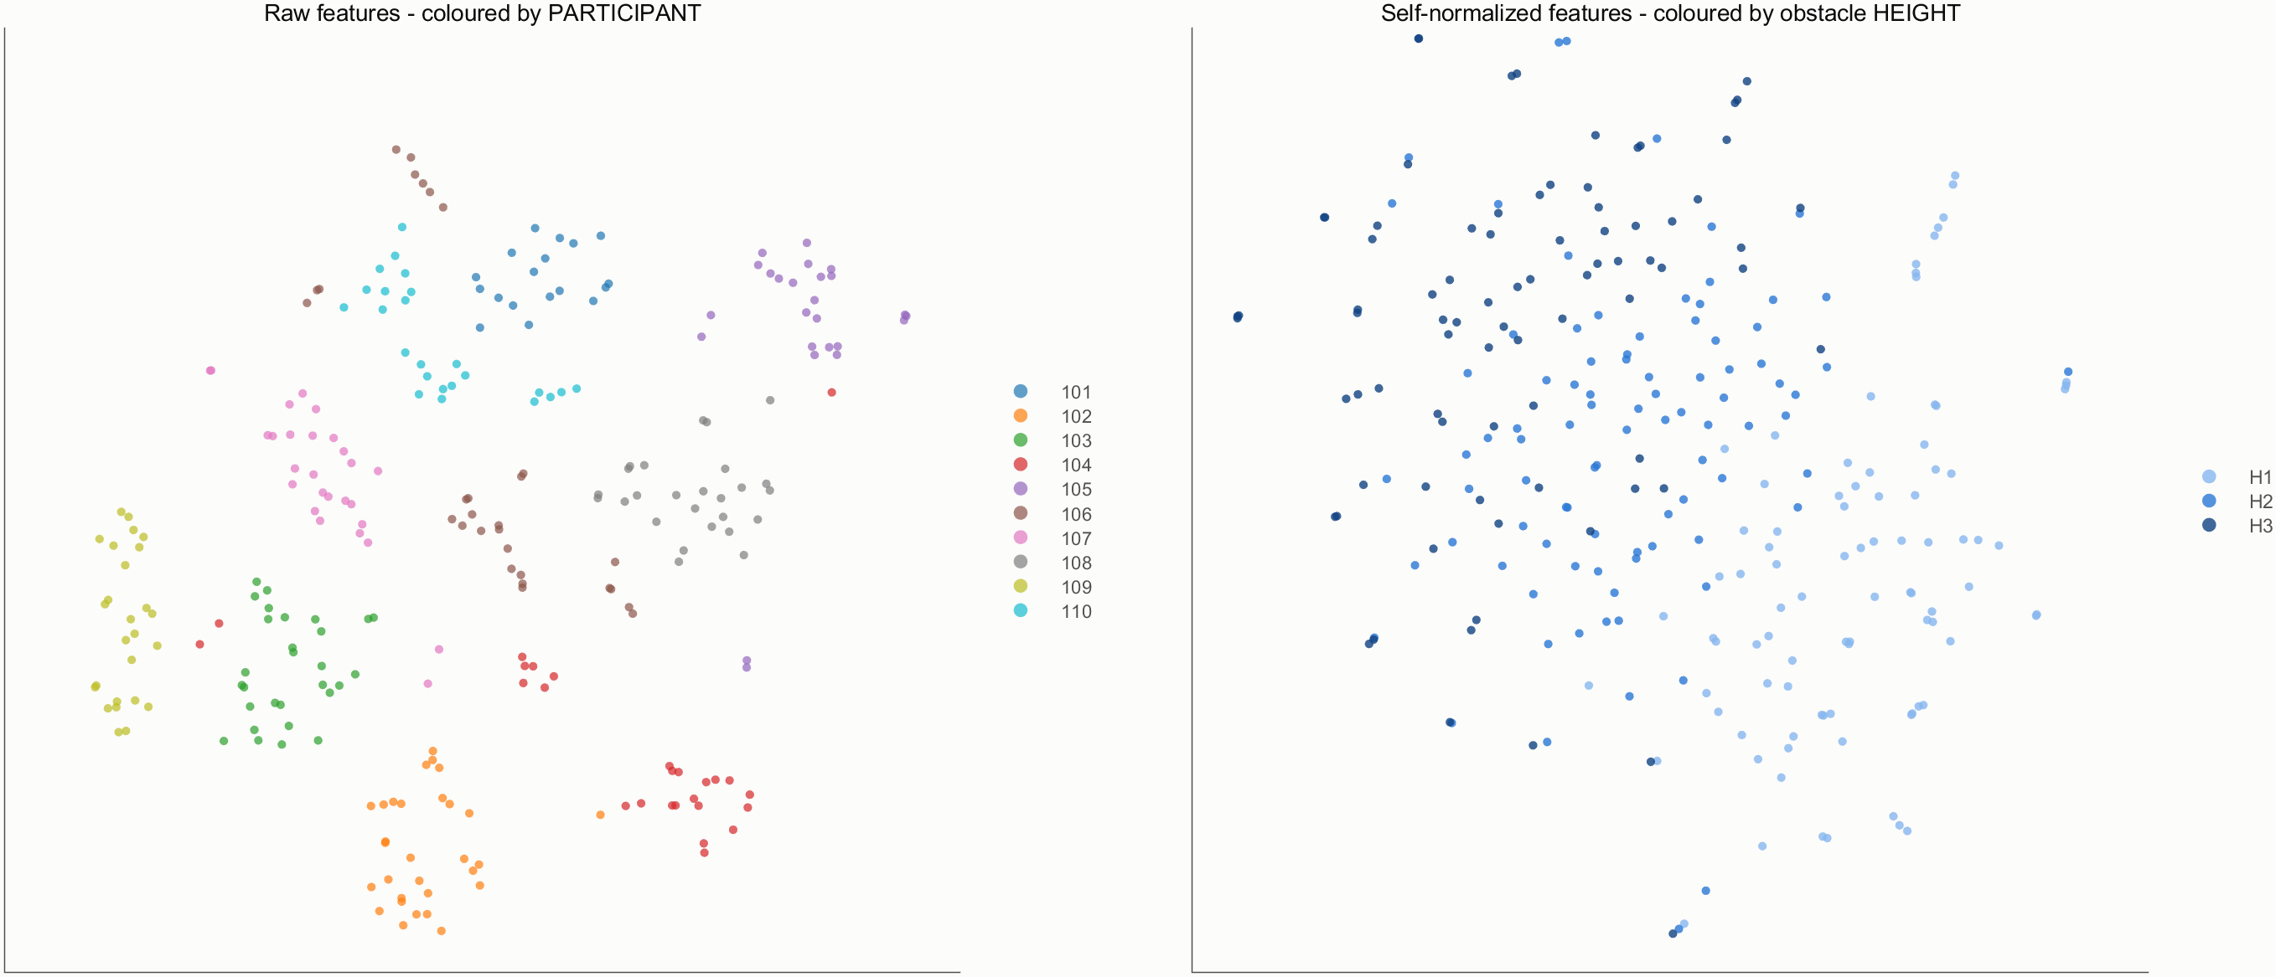
Every walker has a strong signature
Raw crossings cluster by person; only after person scaling do they order by obstacle height.
99.2 %
99 of 110
0.48
of crossings matched to the right person from one crossing (chance 10 %)
features vary more between people than between obstacle heights
cluster strength by person (silhouette); by height only 0.26, after person scaling
What it means
A generic model sees the person first and the obstacle second, so it stalls at 62–73 %. Scaling each feature to the person removes the signature and lifts accuracy to ~90 %.
Notes:
A logistic model identifies the participant from the features of one crossing with 99.2 % balanced accuracy (5-fold; chance 10 %). In 99 of the 110 features the person explains more variance than the obstacle height. t-SNE of the 110 features: silhouette by participant 0.48 and by height -0.04 for the raw features; by height 0.26 after person scaling.

Slide 8
The personal margin caps generic models
Each person's extra lift for any obstacle varies by two-thirds of the step between heights.
Hard to predict in advance
r = 0.43 with the person's normal walking and 0.20 with leg length (lead foot)
Why generic models stall
an unseen person's offset pushes crossings toward a neighbouring height: 62–73 %
What fixes it
a few of the person's own crossings, labelled or not, reveal the offset: ~90 %
Notes:
Personal margin = the lift predicted by each participant's own dose-response line at the cohort's mean obstacle height. Between-person SD 64 mm (lead) and 76 mm (trailing) against steps of 98 and 105 mm between neighbouring heights (ratios 0.66 and 0.72). Correlation with the level-walk value: 0.43 lead, -0.22 trailing; with leg length 0.20 and 0.04.

Slide 9


Lead leg, coupling and first encounters
Crossing strategy is not fixed by dominance, and each leg adapts on its own.
45 %
r ≈ 0.1
+12 mm
of crossings were led with the dominant leg; most people alternate
between the two legs' lift deviations within a crossing
extra lead-foot lift on the first crossing of a new obstacle (CI +5 to +20)
A device needs a sensor on each foot (the IMU tells lead from trail 100 %).
The trailing foot does not correct the lead foot: each leg carries its own information.
People are more cautious at a first encounter, then settle.
Notes:
45 % of the 303 crossings were led with the dominant leg (lab sheet); the IMU recovers the leading leg in 100 % of crossings. Coupling: correlations of the crossing-to-crossing deviations from each participant x obstacle mean are r = 0.11, -0.12, -0.05 and -0.07 for the pairs tested. First crossing of a new obstacle: +11.7 mm lead lift (CI 4.7-19.9) above the participant x obstacle mean.

Slide 10
Recognising obstacle height
02
Accuracy on a person the model has never seen: generic vs person-scaled models, sensors, timing and precision
Notes:
Section 2: recognising obstacle height. Three levels, chance 33 %.

Slide 11
Height accuracy rises from 62 % to 92 %
Obstacle height (3 levels, chance 33 %) on an unseen participant; balanced accuracy.
Generic (grey)
ceiling of 62–73 %: the person's offset shifts every crossing
Person-scaled (orange)
about +20 points, with no labels. Fair nested choice: 91.5 % (CI 86–97); weakest person 73 %.
Notes:
All results leave-one-participant-out. Generic: 57 summary features of the leading leg, logistic regression, 62.1 %. Clearance-shape features: 13 features of how long and how far the lead foot stays high, apex position and foot tilt at the apex (72.8 %, p = 0.003). Fair nested selection = the setting is chosen inside the training folds only: generic settings 69.4 % (CI 58-80); all 36 settings 91.5 % (CI 86-97). Two foot IMUs with person scaling 92.3 % (CI 87-96). Permutation tests p <= 0.003.

Slide 12
The foot carries both legs' information
Height accuracy from one signal at a time (person scaling, random forest).
Leading leg
the thigh lifts the foot over: thigh tilt alone 77 %
Trailing leg
push-off with heel-up: shank tilt alone 78 %
Foot IMU
tilt and path carry both legs (83–88 %); acceleration alone is weak
Notes:
Each bar is a random forest on one signal only, person scaling, leading or trailing leg. Foot tilt 88.1 / 83.4 %, foot trajectory (ZHC) 84.9 / 84.5 %, thigh tilt 77.4 / 44.2 %, shank tilt 49.8 / 78.2 %, foot acceleration 36.9 / 54.0 % (lead / trail).

Slide 13
Height is known 0.7 s before trail toe-off
Accuracy from the leading leg's data up to each moment of its swing (forest; chance 33 %).
Lead toe-off
983 ms before trail toe-off · 52 %
Lead foot apex
683 ms before · about 80 %
Lead landing
417 ms before · 86 %
Trailing toe-off
the cue must arrive by now
Notes:
Lead-leg data up to x % of its swing, random forest. With person scaling: 52.1 % at lead toe-off, about 78-80 % by the lead-foot apex (median 54 % of the swing, 683 ms before the trailing toe-off), 88.5 % at 70 %, 85.8 % at lead landing (417 ms before). The generic model stays at 40-65 %. Median times over 260 crossings.

Slide 14

Height in centimetres and from raw curves
Two further checks: predict height as a number, and learn straight from the swing curves.
Height as a number (regression)
Deep learning on raw curves
2.4 cm
0.91
85 %
88 %
56 %
54 %
mean absolute error
correlation r
nearest height right
height, person-scaled
width (chance 50 %)
height, generic
Neighbouring heights differ by 8.3–10.6 cm (10 % of leg length): the typical error is about a quarter of a step.
No hand-made features: the information is in the curves. At n = 10 the compact clearance features stay ahead (92 %).
Two foot IMUs, lead + trail vote, person scaling, random forest.
1D convolutional network on the six swing curves of each leg (51 samples each).
Notes:
Regression: lead + trail vote, person scaling, random forest: mean absolute error 2.37 cm, r = 0.91; rounding to the nearest height gives 85.2 %. CNN: two convolution layers on the six raw swing curves of each leg (51 samples each). Person scaling: 79.9 % lead, 83.1 % trail, 87.7 % combined; width 56.0 %. Generic (level) scaling: 54.4 % for height.

Slide 15
Obstacle width is barely recognisable
Width (5 vs 15 cm, chance 50 %) stays near chance with every sensor and model.
All 6 obstacles at once
chance 17 %
29 %
61 %
generic
person-scaled
Of these, the height part is right 91 % of the time and the width part 63 %: height is recognised, width adds little beyond guessing.
Notes:
Width (chance 50 %): generic forest, leading leg 61.0 %; person scaling, leading leg, logistic 64.6 % (p = 0.003); within each height 60.5 %; out-of-plane features only 53.8 %; camera foot placement 57.6 %. Six obstacles (chance 17 %): generic logistic 29.1 %; person scaling, forest, lead + trail 61.2 %.

Slide 16
People cross both widths the same way
The limit is behavioural, not the sensor: a 10 cm wider obstacle barely changes the crossing.
+4 cm
≤ 0.08
longer crossing step for a 10 cm wider obstacle (camera; 8 of 10 people)
share of within-person variance due to width in any swing curve (height: up to 0.76)
What it means
A wearable can tell how high to lift the foot, not how far to step. Width cues would need a sensor that sees the obstacle itself.
≤ 0.06
57.6 %
Largest share of within-person variance
the same for sideways tilt, twist and the outward foot path
width from the camera's own foot placement (chance 50 %)
height
0.76
width
≤ 0.08
Notes:
Camera foot placement relative to the obstacle centre: crossing step (trail toe to lead heel) +37 mm for the 15 cm obstacle, positive in 8 of 10 participants, eta squared 0.02. Width eta squared stays at or below 0.08 in all six swing curves of both legs. Out-of-plane features (sideways tilt and heading of thigh, shank and foot; outward foot path): largest width effect 6 % of the variance; width from these alone 53.4-53.8 %.

Slide 17

Toward a wearable cueing device
03
Which sensors, how much calibration, real sessions, no camera, and real-time cues
Notes:
Section 3: what a wearable obstacle-cueing device could do with these signals.

Slide 18

Two foot IMUs are enough
Height accuracy by sensor set (person scaling; lead and trail models combined).
Best site: the foot
tilt and path of both legs: 92.3 % (CI 87–96)
More sensors don't help
all six IMUs: 91.2 %
One foot only: 83–91 %
it leads in some crossings and trails in others
Notes:
Person scaling, random forest, lead and trail models combined by soft vote. Thigh pair 80.4 %, shank pair 79.4 %, foot pair 92.3 % (CI 87-96), all six 91.2 % (CI 86-96). One foot IMU: right leg 82.9 %, left leg 90.9 %. The thigh carries the leading-leg information (77 %) and the shank the trailing-leg information (78 %).

Slide 19
A little calibration goes a long way
Two foot IMUs on a new user: accuracy by what the device knows about that person.
No calibration
generic model only
Unlabelled
the device just watches the user cross (random crossings)
Labelled
the user confirms the height once (physics-informed offset model)
In the blocked study order, the first 15 crossings give only 67.9 %: they cover 1–2 obstacles.
Notes:
Unlabelled = person scaling from n random crossings of the session, tested on the remaining ones. Labelled = physics-informed offset model: a within-person height score (ridge) plus one personal offset estimated from the labelled crossing(s). Alternatives: weighted logistic with one labelled crossing per height 74.6 %; offset from unlabelled crossings by a mixture model 77.0 %. First 5 / 10 / 15 crossings in the blocked order: 60.4 / 66.5 / 67.9 %.

Slide 20
In mixed order the device learns quickly
Sessions shuffled 30×: the device starts generic, then scales to the crossings it has seen.
79 %
mixed order, crossings 6–15 (blocked order: 51 %)
90 %
mixed order, from crossing 16 on (blocked: 89 %)
A blocked early history covers 1–2 obstacles and biases the scaling, so the study's blocked-order numbers are pessimistic for real use.
Notes:
Each participant's crossings were shuffled 30 times. The device uses the generic model for the first 5 crossings, then person scaling from the crossings walked so far (no labels). Mixed: 71.9, 75.1, 82.9, 87.9, 91.3 % (82.2 % overall). Blocked: 70.0, 46.0, 56.0, 81.2, 90.3 % (69.6 % overall).

Slide 21


No camera needed: 86 % end to end
From 7,250 raw strides: find the crossings, pair lead and trail strides, classify the height.
1 · Detect
2 · Pair
3 · Classify
End to end
98.7 %
95.2 %
90.7 %
86.3 %
of crossing strides found; 97.2 % of detections are real
of crossings with the right lead and trail strides (first foot = lead)
of found crossings get the right height
fully correct; 83.5 % of every crossing walked
Scaling must come from crossings: scaling to the person's normal walking instead gives only 52.9 % end to end. About 1.4 false crossings per person per session.
Notes:
All 7,250 ZVP-to-ZVP strides of both feet; 595 are crossing strides. Detection: random forest on stride features scaled to the person's walking: 98.7 % recall, 97.2 % precision. Pairing: the first foot is the lead. Height: lead and trail forests, soft vote, features scaled to the person's detected crossings. Denominator: 293 crossings with a valid toe-off event (of 303).

Slide 22
Real-time cue: about 3 in 4 correct
Only the leading leg's data exist when the cue is sent (mixed order, learning as it goes).
99 %
of leading-leg crossings detected at the foot apex, online
3
false detections per session (~725 strides)
79–82 %
of cues are right when the device cues only if confident (p ≥ 0.6)
Time left before the trailing foot lifts: 683 ms at the lead-foot apex, 417 ms at lead landing.
Notes:
Online features up to the lead-foot apex (683 ms before the trailing toe-off) or lead landing (417 ms). Mixed order, person scaling learned causally from earlier crossings. Correct cues after 15 crossings: 75.3 % at the apex, 83.5 % at landing. With p >= 0.6, 79.1 % and 82.0 % of the given cues are right, but 30 % and 25 % of crossings get no cue. Labels below 2 % are hidden (the 1.2 % no-cue shares).

Slide 23
Confidence helps; more people barely do
Answering only when confident buys accuracy; the learning curve is flat from 2–3 people.
Notes:
Two foot IMUs, person scaling, random forest. Left: answer only when the top class probability reaches the threshold; coverage 100, 94, 79, 67, 46 % with accuracy 92.3, 93.9, 96.6, 97.7, 98.3 %. Right: each unseen participant predicted by models trained on n random other participants (10 draws per n): 88.5 % with 2 people to 92.3 % with 9. The remaining errors come from person-to-person differences, which calibration addresses.

Slide 24
Errors follow trailing-foot consistency
Per participant: person-scaled accuracy vs how consistently they lift the trailing foot (d′).
r = 0.77
accuracy vs trailing d′ over the 10 participants (lead d′: r = 0.25)
73 %
participant 108, with the least consistent trailing lift (d′ 0.9 vs 2.1–4.5)
r = −0.66
for the generic model: its errors come from the personal offset instead
Notes:
d' = separation of the three heights in units of the within-height SD, per participant. Lead d' relates weakly to person-scaled accuracy (r = 0.25). The generic model behaves differently: its accuracy falls with trailing consistency (r = -0.66), because its errors come from how far a person's personal margin is from the group. n = 10, so these correlations are indicative.

Slide 25

What the IMUs could not do
Negative results, reported as findings.
Obstacle width
Toe-clearance margin
Near-contact detection
best 65 % (chance 50 %): people cross both widths alike
not estimable from the IMUs (r ≈ 0.04; within a person 0.28)
weak: AUC 0.63–0.73 for low-clearance crossings
Self-training
Previous normal stride
Offset from unlabelled crossings
letting the model label the new user's crossings made it worse: 54–67 %
as a personal reference gives only ~60 %: the margin is not visible in ordinary walking
a mixture model reaches 77 %, below simple person scaling (92 %)
Notes:
Toe clearance: regression of the trailing clearance has a mean absolute error of 85 mm against 84 mm for predicting the mean; r = 0.04; within-person r median 0.28. Near-contact detection: AUC 0.63-0.73 depending on the clearance threshold (0.73 for clearance <= 0 mm, 15 events). Lead features do not predict trailing clearance (r = -0.14). Self-training on the new person: 54.0-67.1 %.

Slide 26



How far to trust these numbers
The checks are strict, but n = 10 young adults: these are feasibility results.
Checks passed
Caveats
Leave-one-participant-out everywhere; participant-bootstrap 95 % CIs
n = 10 young adults: confirm on new participants and on older adults
Permutation tests (labels shuffled within each person): p ≤ 0.003
Clearance-shape features were designed after the first results: small optimism possible
Fair nested selection of settings: 91.5 % (CI 86–97)
Person scaling assumes the user's crossings cover several heights
MATLAB and Python agree: mean difference 0.0 (logistic) and 0.9 points (forest)
Obstacles ran in blocks; mixed order was simulated by shuffling
Crossing order was never used as a feature
Notes:
MATLAB and Python implementations of the same models: logistic mean absolute difference 0.0 points (max 0.4), forest 0.9 (max 2.2). Permutation tests shuffle the labels within each participant. The clearance-shape features came from a few biomechanically guided iterations after the first results.

Slide 27
Conclusions and next steps
1
Foot lift scales 1:1 with obstacle height; the safety margin is constant but personal.
Next steps
Record more participants, including older adults
2
Two foot IMUs recognise obstacle height on a new person at ~92 % once scaled to their crossings; 80 % with one labelled crossing.
Run the obstacles in mixed order to test learning during use live
Estimate toe height (sensor-to-toe geometry) for clearance
3
A camera-free, real-time pipeline is feasible: 86 % end to end, and about 3 in 4 cues correct 0.4–0.7 s ahead.
Prototype the haptic cue and test it online
Notes:
Take-home messages and next steps. Width cannot be cued from body-worn IMUs; a cueing device would focus on obstacle height.

