Slide 1
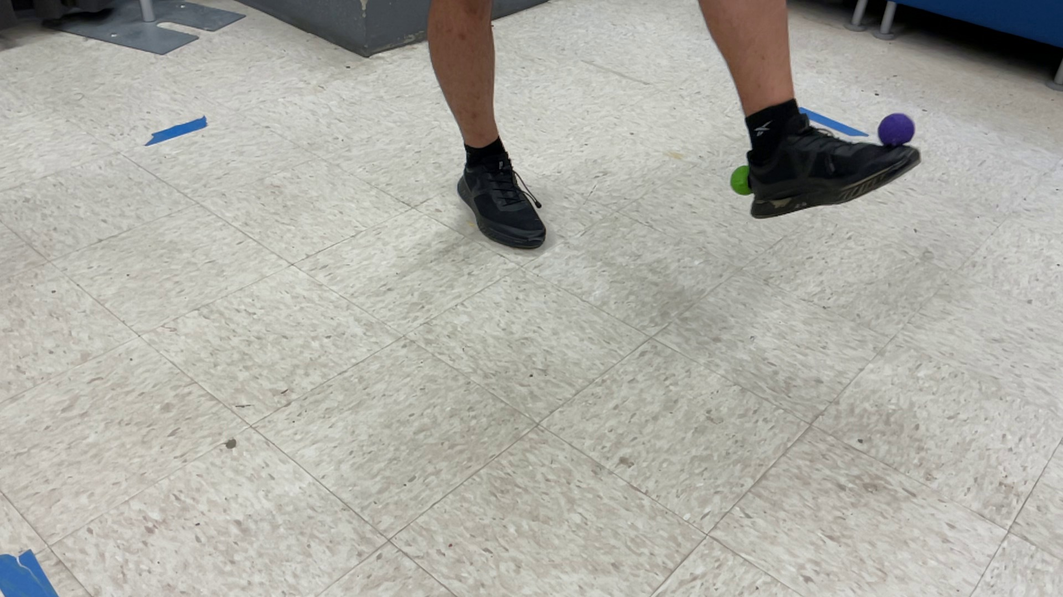
PROGRESS UPDATE · AUGUST 2026
3D Foot-Clearance Tracking
for Obstacle Crossing
A clean 3D foot trajectory from two consumer iPads — markers, calibration, sync and clearance validated end-to-end.
Ehsan Sharafian · Biomechanics Lab

Slide 2
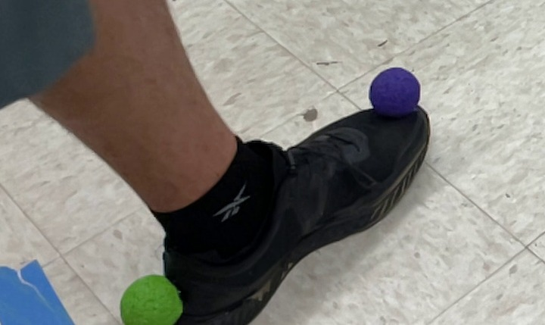

Foot Markers & Detection
Two spherical markers on the shoe
purple = toe, green = heel
Unique colours
tracked automatically in both cameras — no manual digitising
Spherical shape
looks the same from every angle as the foot rotates
Purple toe + green heel balls on the shoe
Triangulated to 3D
each marker reconstructed when seen by both cameras
Automatically detected mid-crossing (toe / heel)

Slide 3
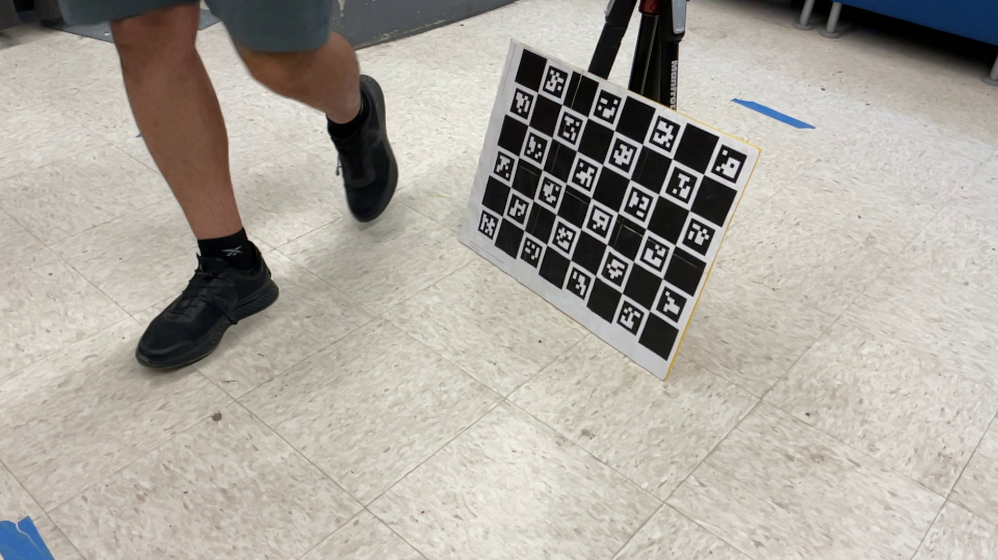
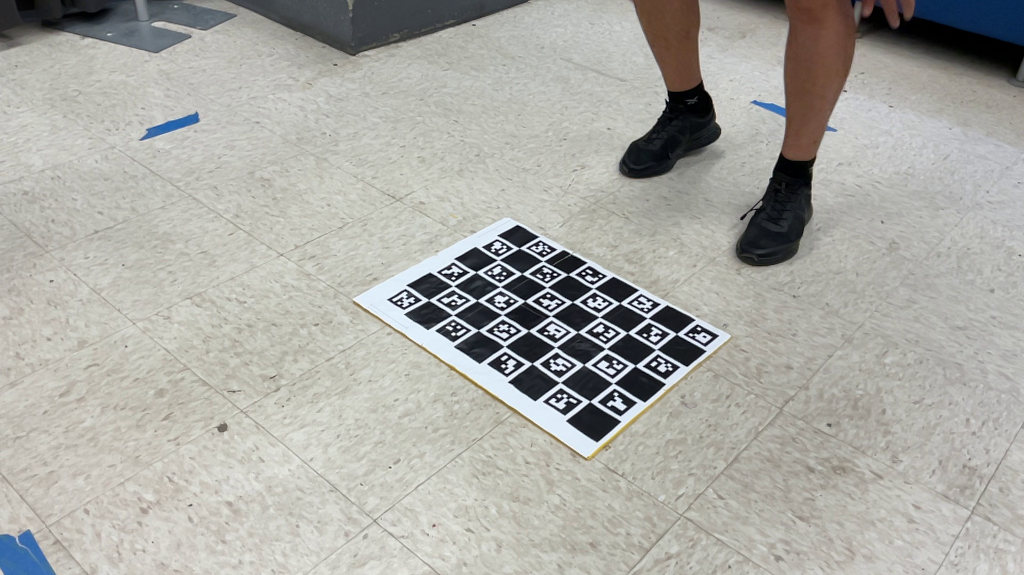
Camera Calibration — once per session
A ChArUco board gives each lens's intrinsics, the stereo geometry between the two cameras, and a floor world-frame (Z = height). One command per session; recalibrate whenever the cameras move.
Stereo reprojection error
0.92 px · baseline 1.86 m
Floor world-frame residual
Extrinsics: board held static at many poses (both cameras)
0.65 mm (flat, well below 3 mm)
Recovered camera height
986 mm — matches the physical setup
World frame: board flat on the floor (Z = up)

Slide 4
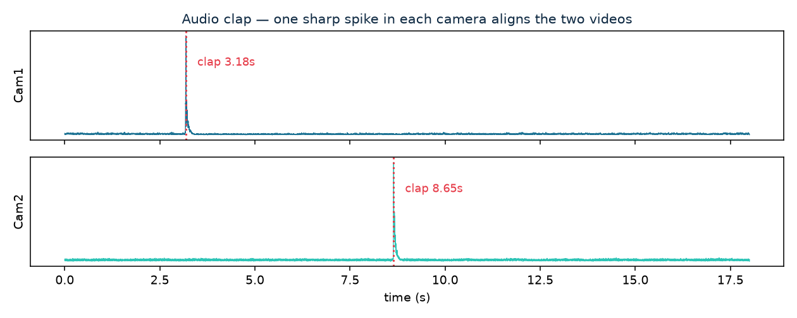
Synchronising the Cameras — one clap
1
One sharp clap at the start
a single loud spike in both cameras' audio
2
Aligned to the millisecond
cross-correlate the two audio tracks — no hardware sync
3
Works off-camera
audio only — you needn't be in the frame
4
test06 lock
After sync: outliers are gated (physically-impossible points dropped) and a rigid-shoe check removes mis-triangulated frames — leaving honest gaps where the foot is out of view.
cam2 + (−5.46 s), confidence 55

Slide 5
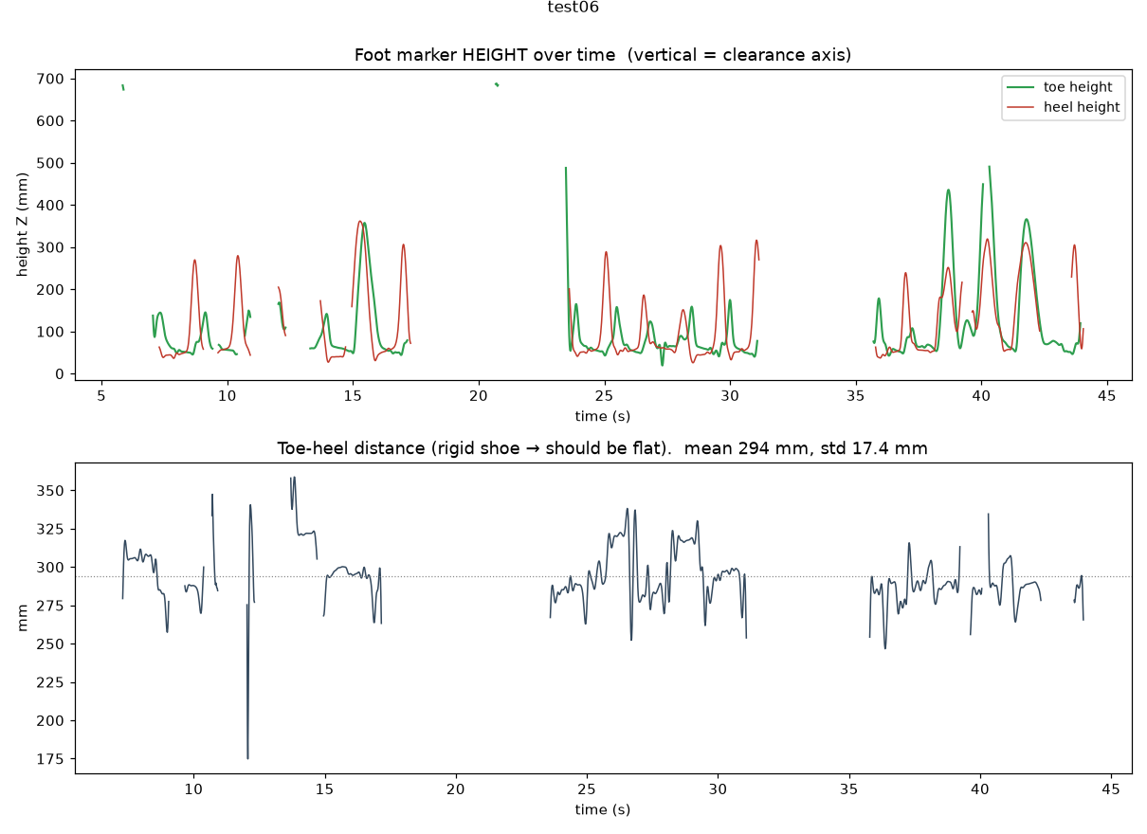
Result: 3D Foot-Clearance Trajectory
1
Clear clearance arcs
toe & heel rise ~300–500 mm over each crossing, return to a flat ~60 mm baseline
2
Rigid-body check passes
toe–heel distance holds ~294 mm (= shoe length), std 17 mm
3
Metric 3D output
per-frame X / Y / Z + time for each marker → CSV, one file per test
Top: toe/heel height over time (clearance). Bottom: toe–heel distance stays flat = clean 3D.

Slide 6
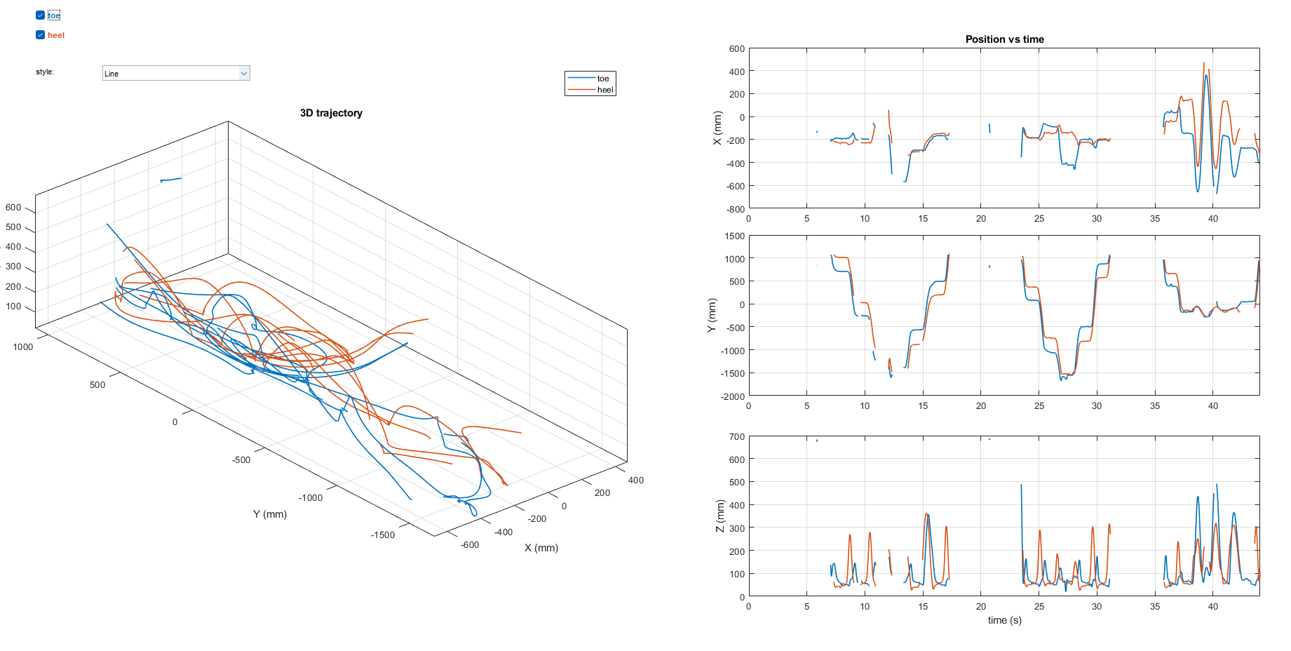
Result: 3D Foot-Clearance Trajectory
Top: toe/heel height over time (clearance). Bottom: toe–heel distance stays flat = clean 3D.

Slide 7
Status & Next Steps
WORKING
NEXT
Per-session calibration (validated: 0.9 px, 0.65 mm floor)
Spherical purple-toe / green-heel marker tracking
One-clap audio synchronisation (no hardware)
Clean 3D trajectory with real clearance arcs
Rigid-shoe check: toe–heel std ~17 mm
One-command workflow (run_calib / run_test) + CSV
Raise coverage — continuous crossings so the foot stays in both views
Add a 3rd camera (Pixel 8) to remove occlusion
Collect a participant pilot across obstacles
Fold in gait-event timing for each crossing
The full measurement chain works — from raw video to a clean 3D clearance curve.

