Slide 1

North Western University Course title: Software Engineering Sessional Course code: CSE-3206
Submitted by: | Submitted to:
Name: Ehsanul Mostafa Imon. ID:20201064010 Name: MD. Rezwan Al Masud ID: 20201066010 Name: Saiket Kumar Ray ID: 20201056010 Section: B Department of Computer Science and Engineering. North Western University, Khulna | Name: Abu Naim Khan Lecturer Department of Computer Science and Engineering. North Western University, Khulna

Slide 2

Project Name : Shop retail inventory and billing system
Software name : Kite
Logo or Monogram :
[Initially the project will have five page]
Page 1 : stock input : bringing products from the store and determining the quantity of the product , setting the price, and updating the price of necessary.

Slide 3
Page 2 : offer fair :
i) If there is a discount for any product , it given from here.
ii) Similarly mega offers.
iii) Offer package / combo offer
iv) If any discount on certain price ranges.
Page 3 : Product category : Its main function is to look/search at the product of stroke.
i) Searching in different ways.
ii) By Category, by price range.
iii)Top Selling product , quick selling product.
iv) All product view.

Slide 4
Page 4 : Billing : Billing only by adding the name and quantity of the product .
i) Make a complete receipt
ii) Save the receipt .
iii)Creating a printable file.
iv)adding VAT,Discount .
v)Besides , Warranty Will be given from here.
Page 5 : Account :
i) keep track of the balance , keep track of customer installments.
ii) Calculate monthly- annual profit-loss.

Slide 5
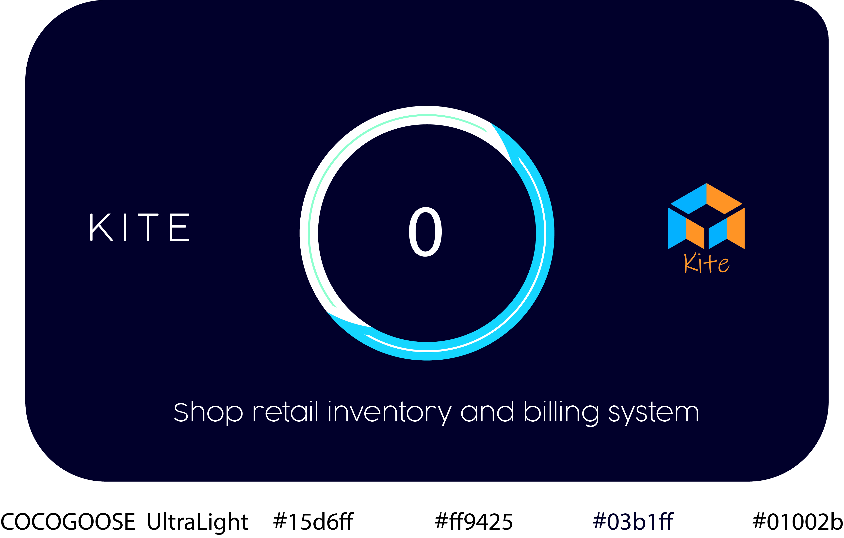
loading window

Slide 6
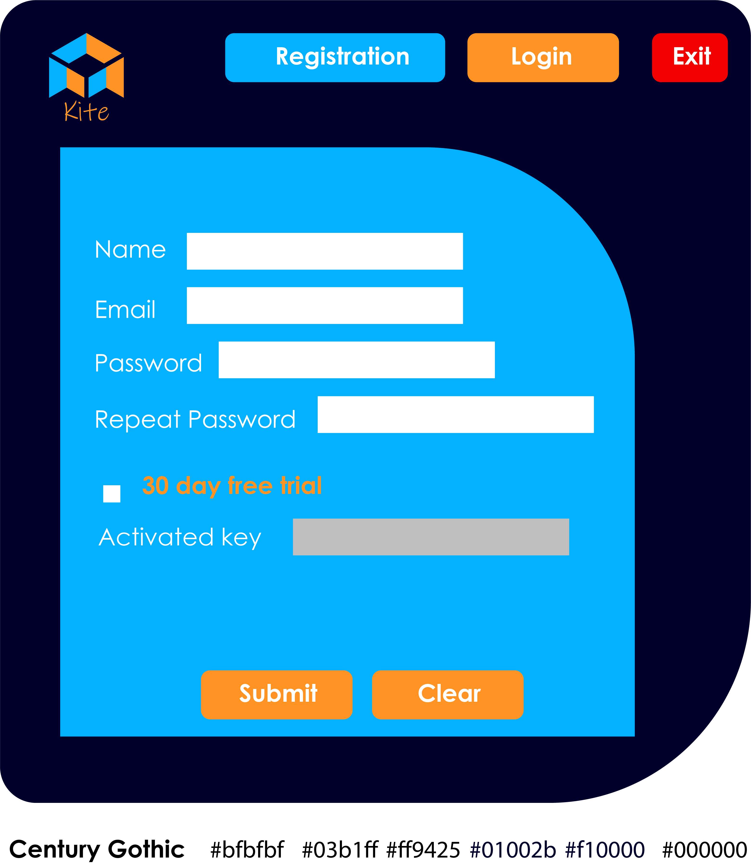
login window

Slide 7
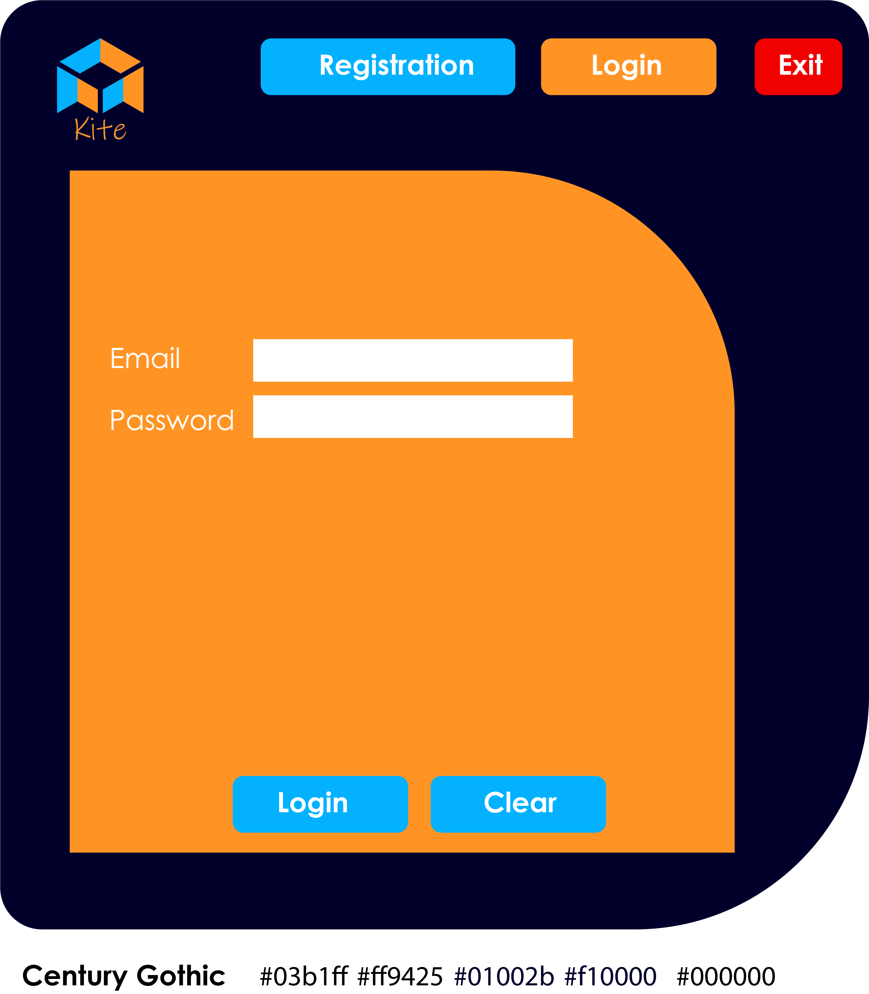
login window

Slide 8
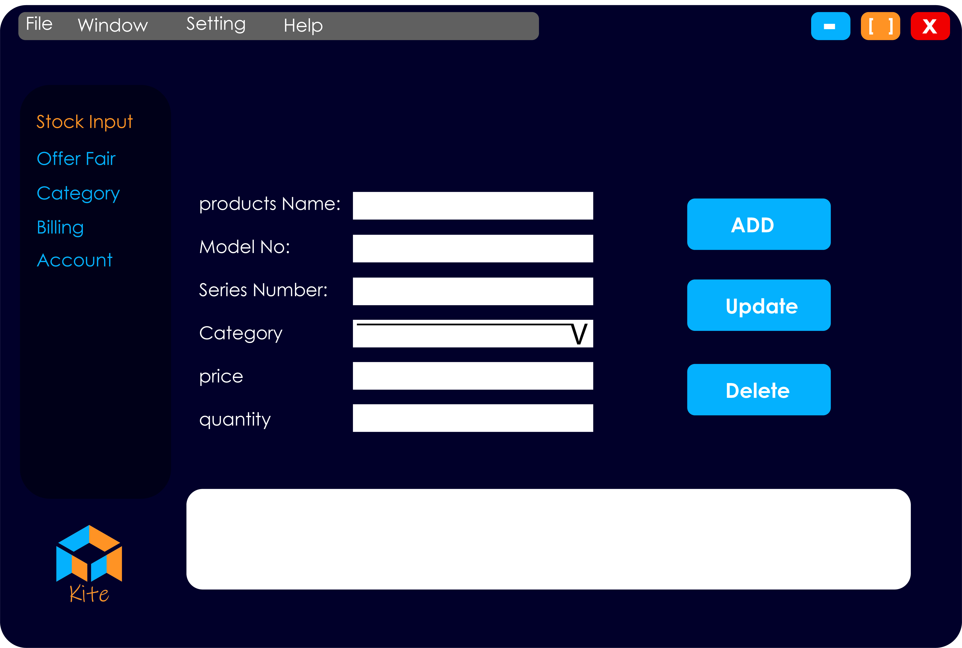
Stock Input window

Slide 9
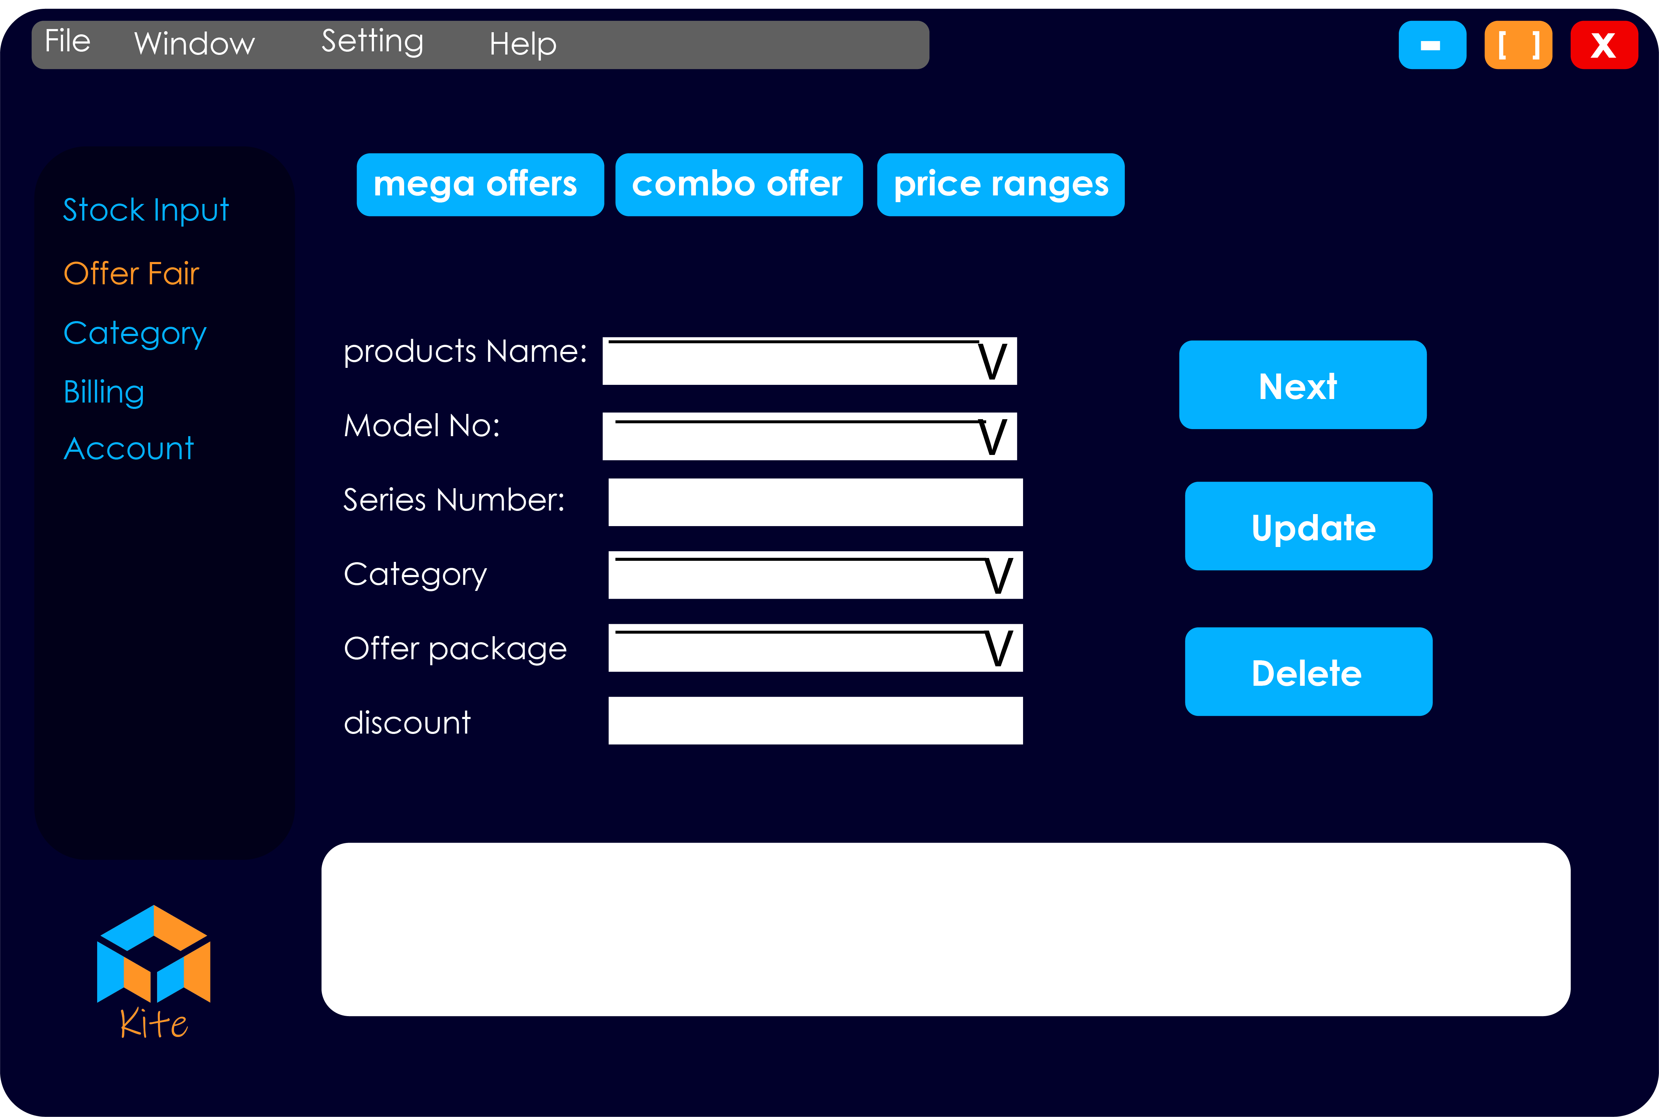
Offer Fair window

Slide 10
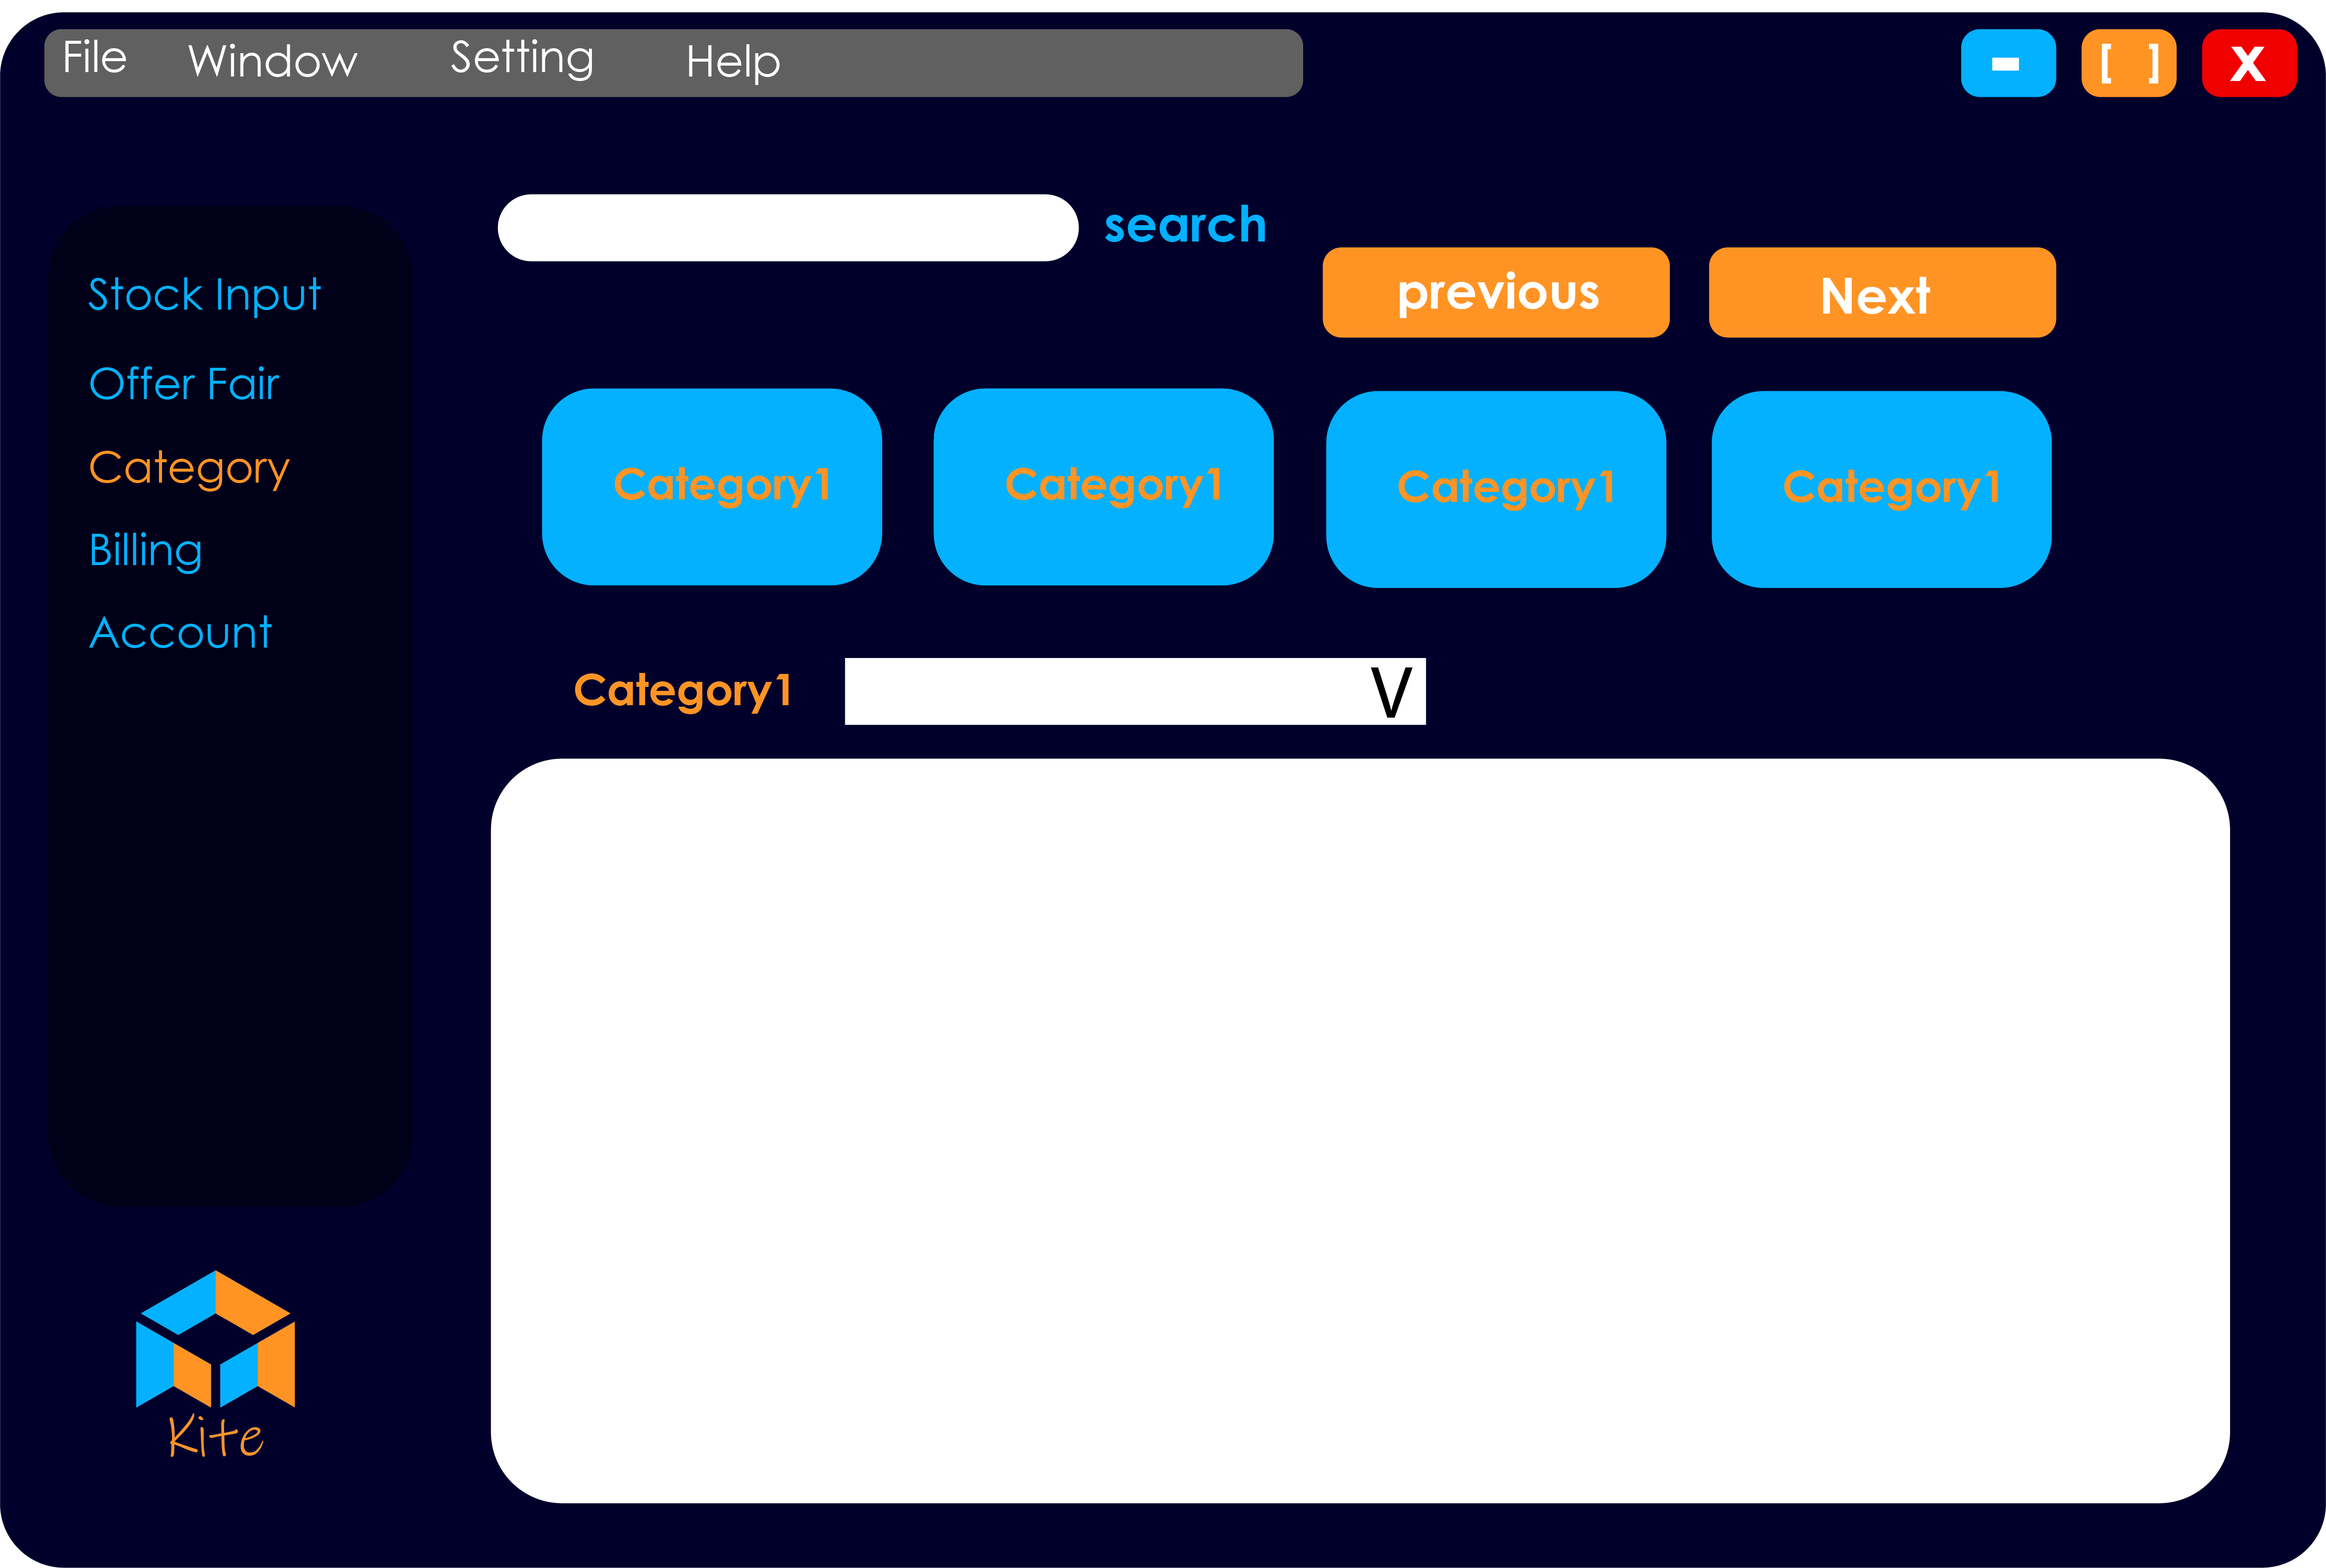
Category window

Slide 11
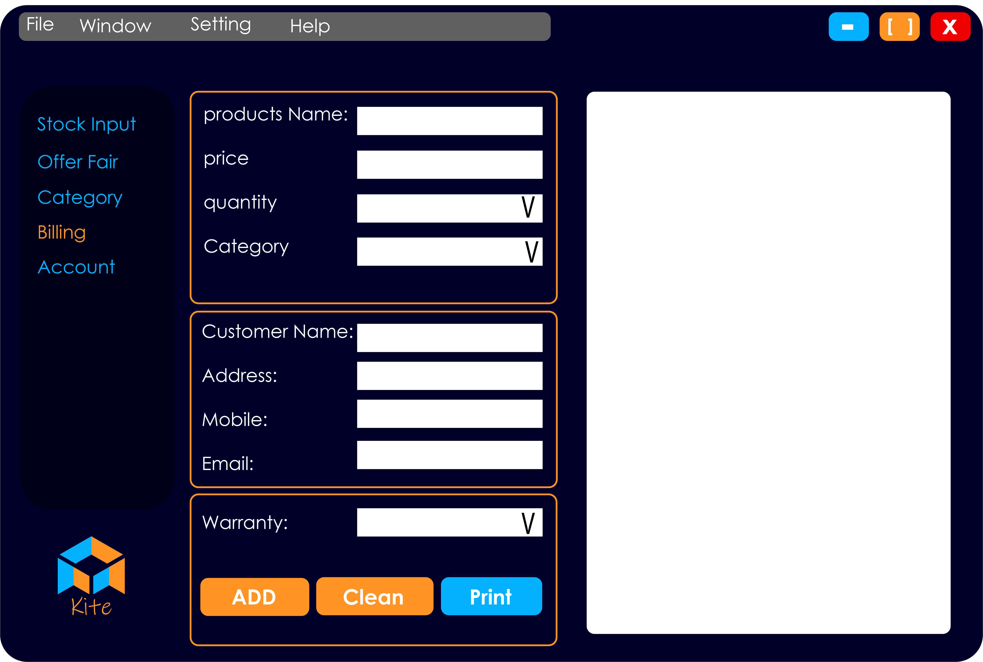
Billing window

Slide 12
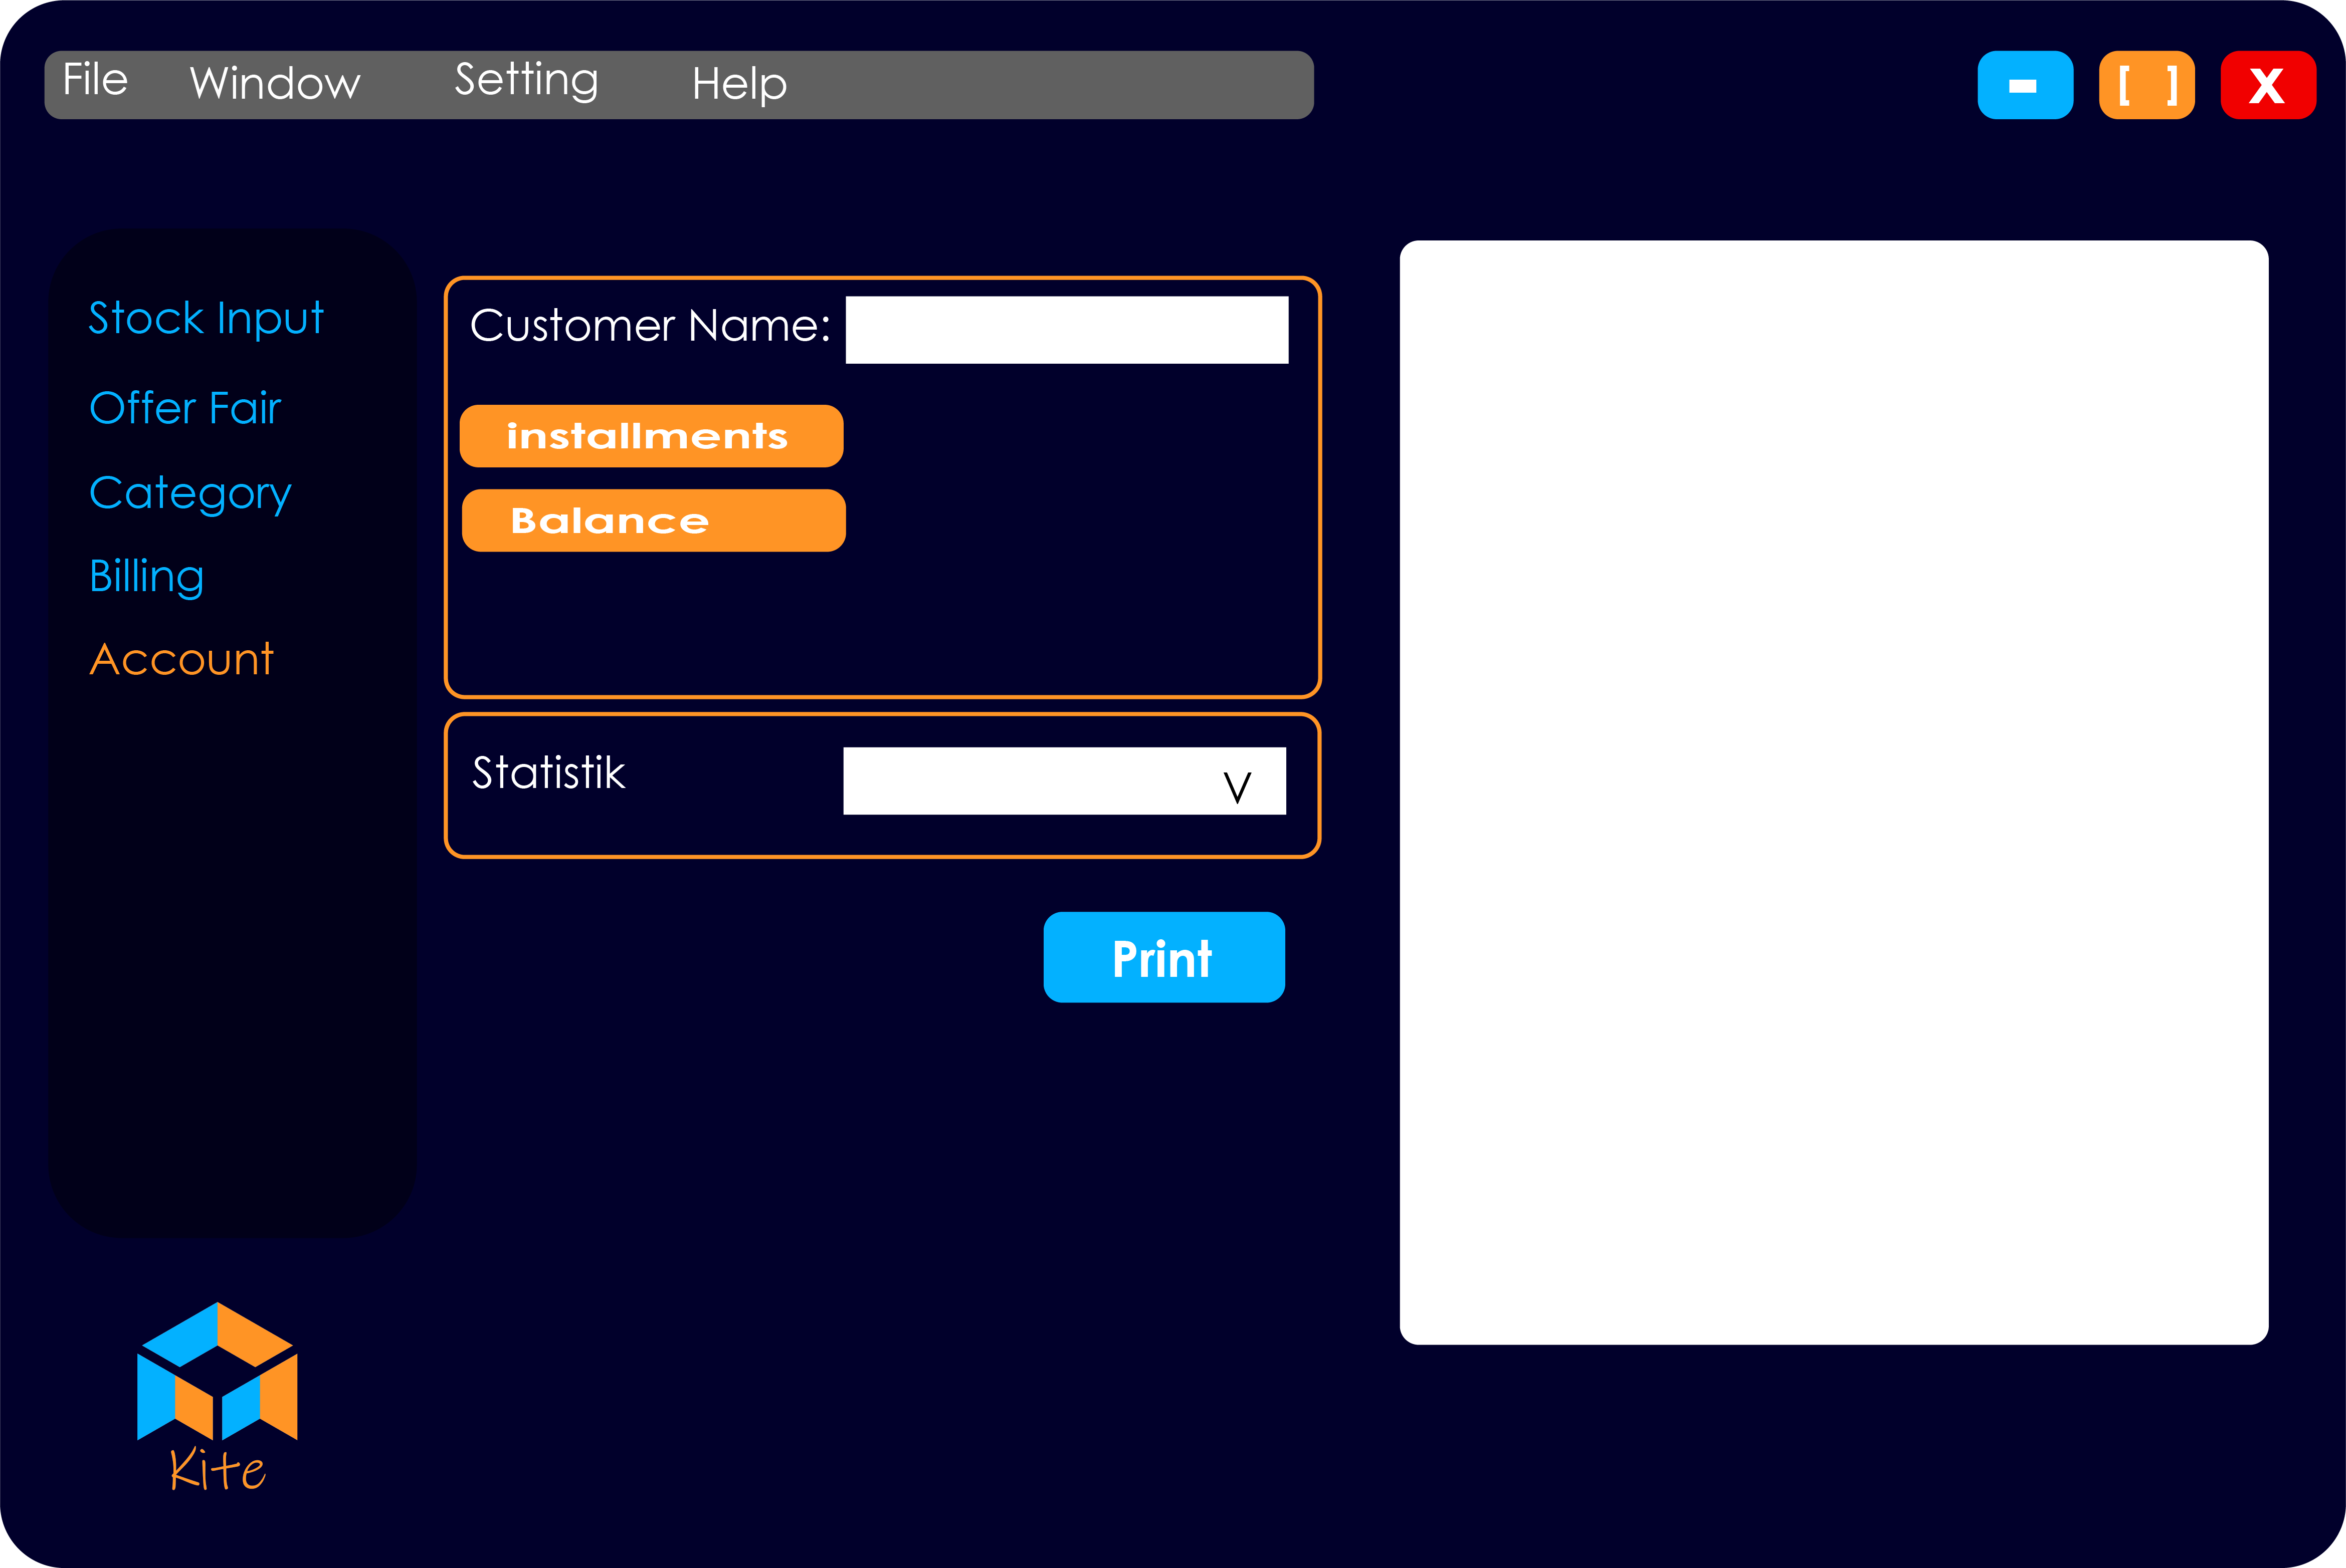
Account window

