Slide 1
ShellbyBites Explore the Culinary Delights
Presented By
Ehsan Yaqoob
Daniyal Mehmood Mudassir Saleem

Slide 2
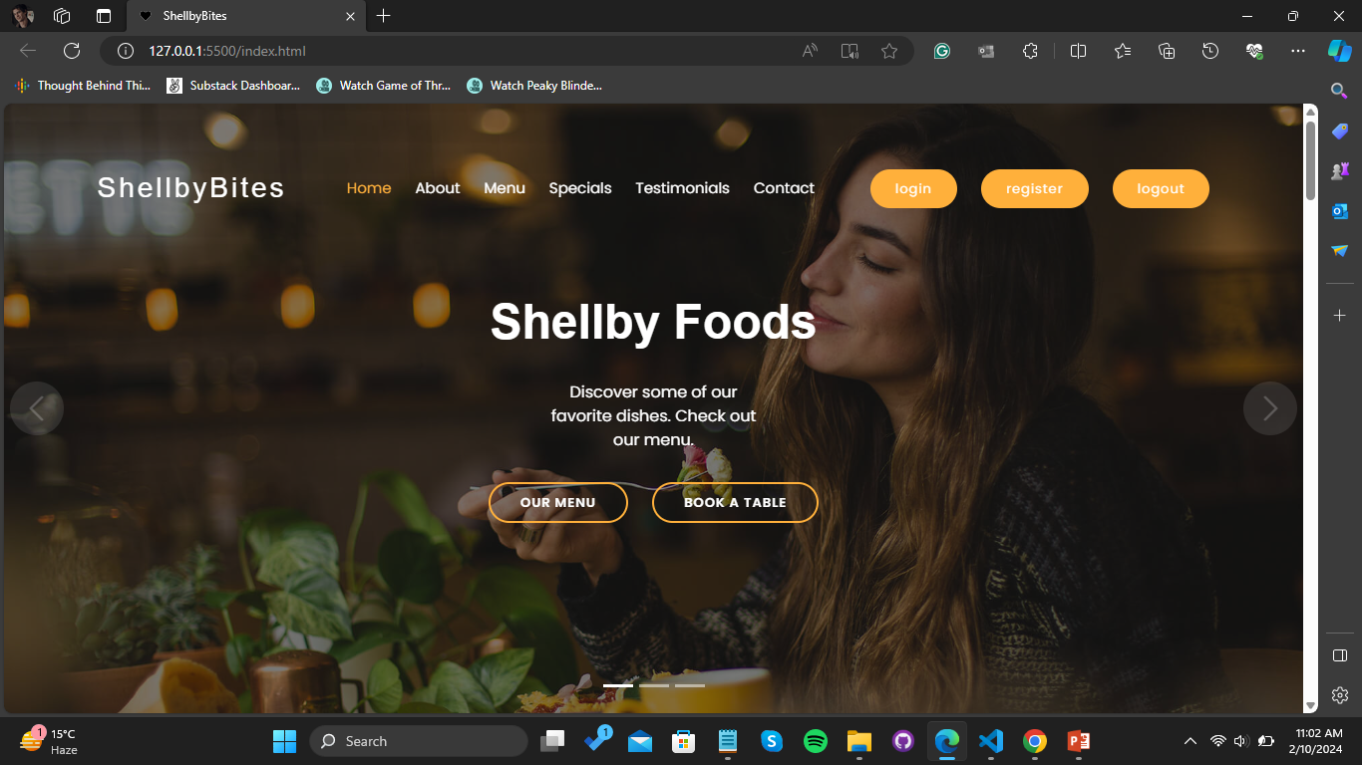
Introduction
Welcome to [ShellbyBites], your go-to spot for mouthwatering delights.
Purpose: Amp up your culinary skills with a variety of delectable recipes and connect with our lively food community.
Audience: Ideal for all food enthusiasts, regardless of their cooking expertise.
Join us in relishing the joy of cooking at [ShellbyBites], where every bite is a flavorful experience.

Slide 3
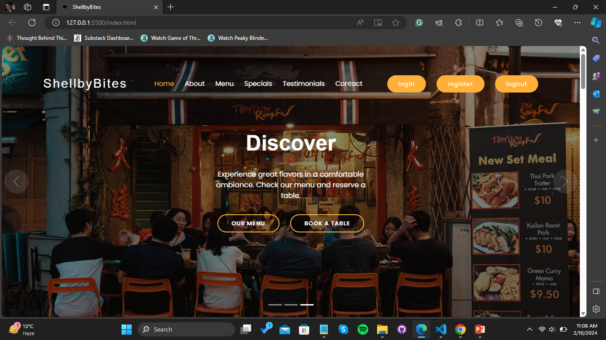
Mission and Vision
Mission: Empower every food lover to create delicious moments through accessible, diverse recipes and a supportive community.
Vision: Become the ultimate online destination where culinary enthusiasts of all backgrounds come together to share, learn, and enjoy the art of cooking.
Values: Quality, inclusivity, and a passion for gastronomy drive our commitment to enhancing your culinary journey.

Slide 4
Key Features
Testimonials: Real-life stories from satisfied users.
Order Customization: Tailor your orders to your taste preferences.
Diverse Recipes: Explore a vast collection of mouthwatering recipes.
User-Friendly Interface: Navigate effortlessly through our platform.
Vibrant Community: Connect with fellow food lovers.
Exclusive Offers: Indulge in KFC-inspired delights.

Slide 5
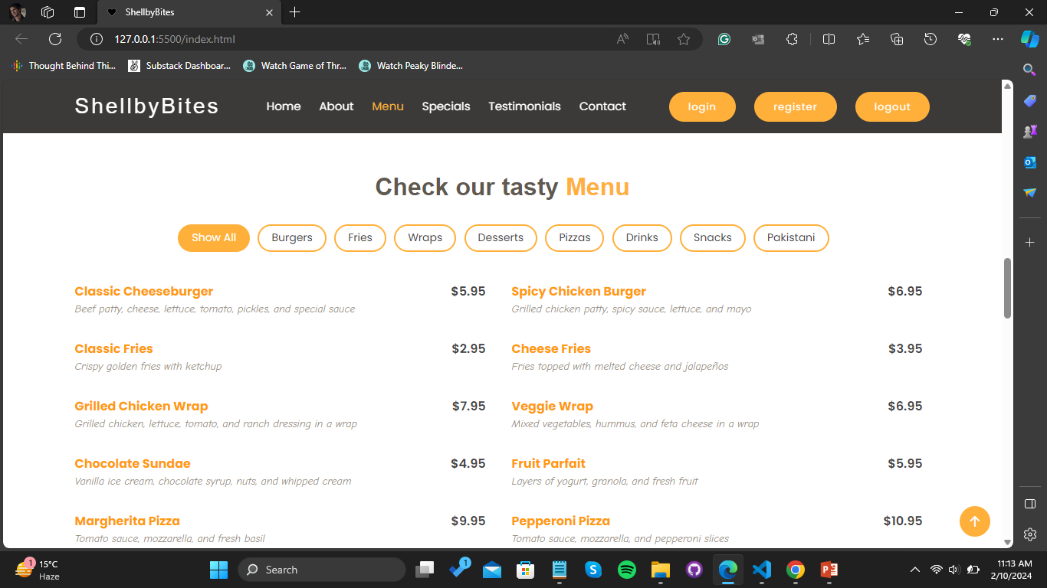

Slide 6
User Registration
Unlock Exclusive Content:
Register and gain access to premium recipes, tips, and culinary secrets.
Personalized Experience:
Enjoy a tailored journey based on your preferences and cooking style.
Join a Thriving Community:
Connect with like-minded food enthusiasts and share your culinary adventures.
Receive Updates and Special Offers:
Stay in the loop with the latest recipes, events, and exclusive promotions.
Quick and Easy Sign-Up:
Become a member in just a few clicks and start your personalized culinary experience.

Slide 7
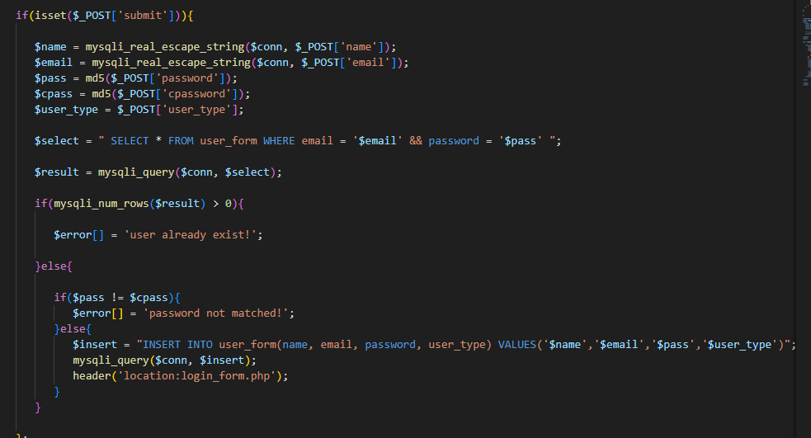

Slide 8
Booking Reservation
Book Your Culinary Experience:
Elevate your dining adventure by reserving your spot at [ShellbyBites].
Seamless Booking Process:
Enjoy a hassle-free reservation system designed for your convenience.
Special Occasions and Gatherings:
Reserve tables for special occasions, gatherings, or events, and let us make it memorable.
Stay Connected:
Follow us on social media for real-time updates on reservations, exclusive events, and culinary delights.
Secure Your Seat and Let the Culinary Journey Begin at [ShellbyBites]!

Slide 9


Slide 10
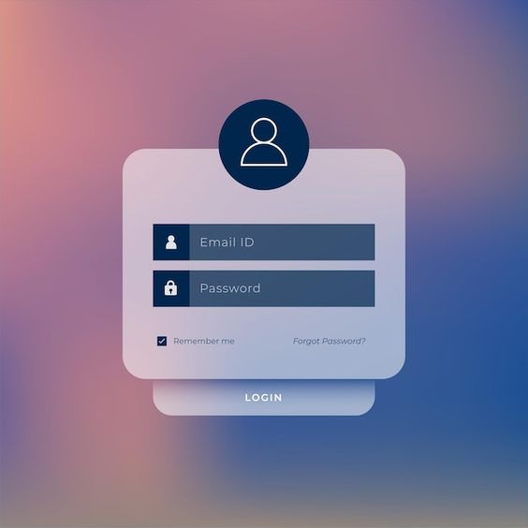
Just A Demo Slide for Sign Up

Slide 11
Recipe Section
Diverse Culinary Palette:
Explore an extensive array of recipes spanning various cuisines and cooking styles.
Step-by-Step Guides:
Access easy-to-follow instructions for each recipe to ensure culinary success.
Search and Discover:
Effortlessly find the perfect recipe using our intuitive search and filter options.
Chef's Recommendations:
Benefit from curated lists of must-try recipes from our culinary experts.
User Contributions:
Share your own recipes and culinary creations with the community.

Slide 12
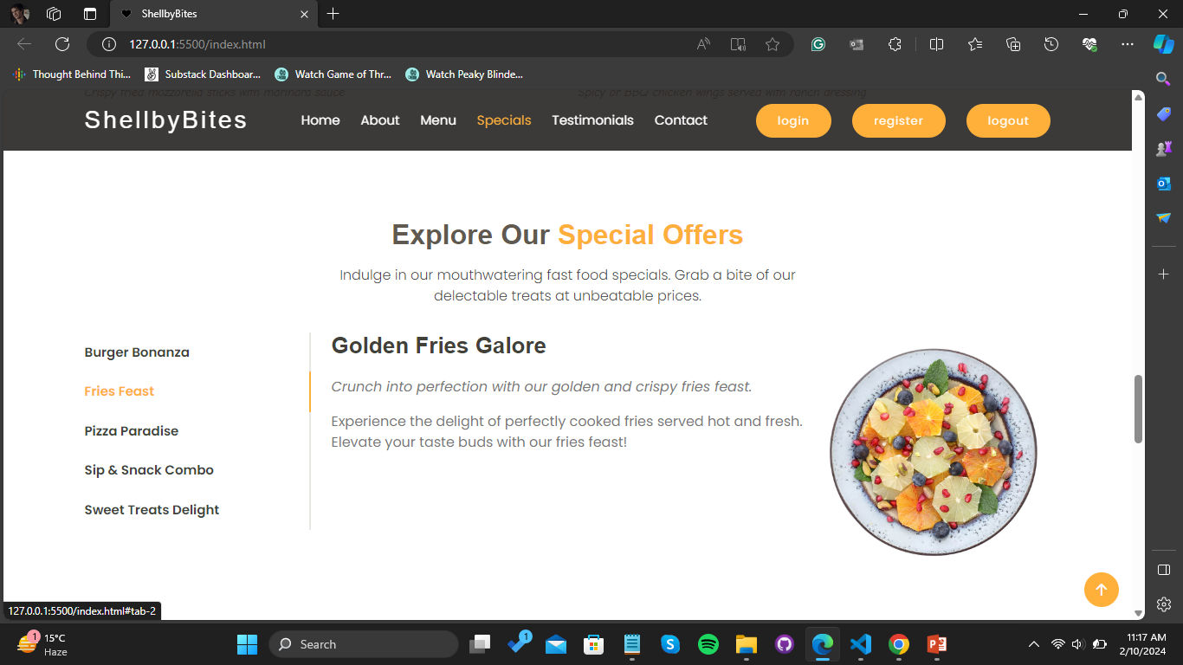

Slide 13
Website Sections
Homepage:
Welcome to [ShellbyBites], where culinary adventures begin with a click.
About Section:
Uncover the story behind [ShellbyBites], our passion for food, and the journey that brought us here.
Menu / Specials Section:
Indulge in a flavorful experience with our menu, featuring specials inspired by KFC and delightful surprises.

Slide 14
Website Sections
Testimonials:
Hear the voices of our satisfied community members as they share their love for [ShellbyBites].
Contact Page:
Reach out to us easily through our contact page – we're here to assist and connect with our food-loving community.
Food Photography Showcase:
Immerse yourself in a visual feast with our captivating food photography showcase, where every image tells a delicious story.
Community Hub:
Join the vibrant [ShellbyBites] community hub, where food enthusiasts connect, share, and inspire one another.

Slide 15
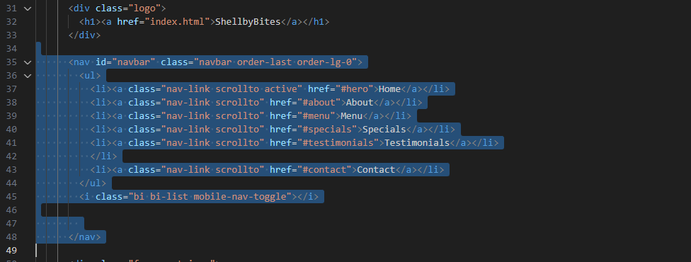

Slide 16
Conclusion
Culinary Connection:
[ShellbyBites] is more than a website; it's a culinary journey that connects food enthusiasts from all walks of life.
Diverse Delights Await:
From our diverse recipes and menu specials to the vibrant community hub, every corner of [ShellbyBites] is a celebration of flavors.
Your Story Matters:
Whether you're a seasoned chef or a home cook exploring new horizons, [ShellbyBites] invites you to be part of a community where every culinary story matters.
Join Us in Savoring Joy:
As we conclude, we invite you to join us in savoring the joy of cooking, sharing, and connecting at [ShellbyBites].
Thank You for Being a Part of Our Culinary Adventure!

