Slide 1
Alphanumeric LCD – AVR ATmega8
Ehsan Yousefzadeh-Asl
2021

Slide 2
Alphanumeric LCD – How does it work?
LCD stands for Liquid Crystal Display
A peripheral device for displaying data from the microcontroller
It is preferred to 7Seg and LEDs due to more characters showing capability
What we see on an LCD is based on the reaction of liquid crystal in an electrical field.
Each LCD have a background source of light. Light goes through liquid crystal.
When the electrical field is enabled on the liquid crystal. The new arrangement of its molecules does not let the light to pass.
So, with different voltages we can control how light passes or does not pass through the pixels of the LCD.

Slide 3
Alphanumeric LCD Characters
A 2*16 LCD can show 32 characters in total, 16 characters in each row
Every character is a 5x10 or 5x8 or 5x7 matrix of pixels
For showing a character some of those pixels are on and some of them are off
So, for showing a character, we should send 8 bytes to the LCD
Fortunately, we do not do such things
A controller like HD44780 performs all these tasks and makes microcontroller programmers’ life easy
Row 1: 1-1-1-1-0 / 0x1E
Row 1: 0-1-1-1-0 / 0x0E
Row 2: 1-0-0-0-1 / 0x11
Row 2: 1-0-0-0-1 / 0x11
Row 3: 1-0-0-0-1 / 0x11
Row 3: 1-0-0-0-1 / 0x11
Row 4: 1-1-1-1-0 / 0x1E
Row 4: 1-1-1-1-1 / 0x1F
Row 5: 1-0-0-0-1 / 0x11
Row 5: 1-0-0-0-1 / 0x11
Row 6: 1-0-0-0-1 / 0x11
Row 6: 1-0-0-0-1 / 0x11
Row 7: 1-0-0-0-1 / 0x11
Row 7: 1-1-1-1-0 / 0x1E
Row 8: 0-0-0-0-0 / 0x00
Row 8: 0-0-0-0-0 / 0x00

Slide 4
Alphanumeric LCD Registers
Every LCD has two registers: Instruction and Data Registers
Instruction Register: Receiving and keeping LCD instructions like: Initialization, Screen Clear Command, Cursor location Change Command etc.
Data Register: Keeps the data that will be shown on the LCD

Slide 5
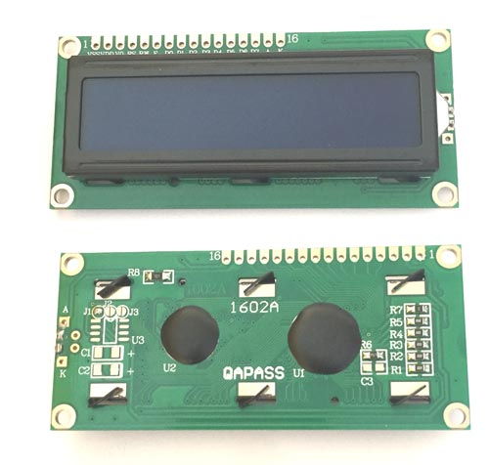
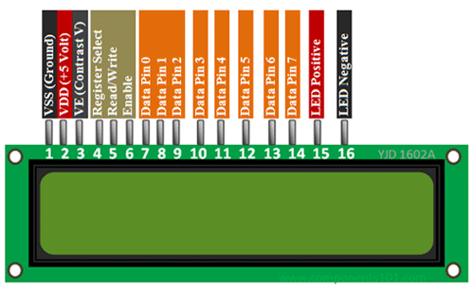
Alphanumeric LCD Pins

Slide 6
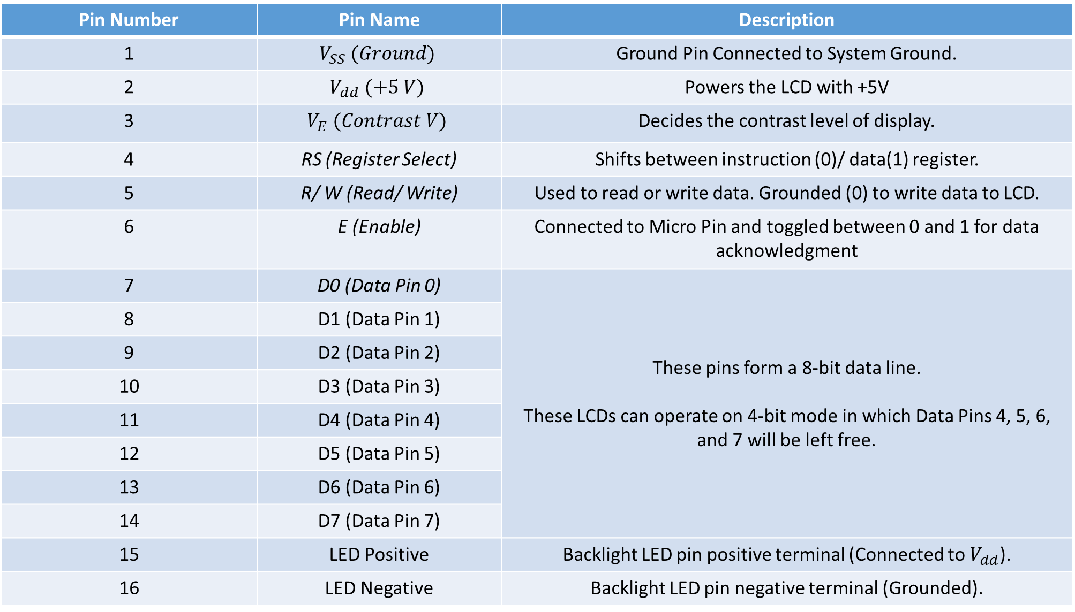
Pin Number | Pin Name | Description
1 | $$V_{SS} (Ground)$$ | Ground Pin Connected to System Ground.
2 | $$V_{dd} (+5 V)$$ | Powers the LCD with +5V
3 | $$V_{E} (Contrast V)$$ | Decides the contrast level of display.
4 | RS (Register Select) | Shifts between instruction (0)/ data(1) register.
5 | R/ W (Read/ Write) | Used to read or write data. Grounded (0) to write data to LCD.
6 | E (Enable) | Connected to Micro Pin and toggled between 0 and 1 for data acknowledgment
7 | D0 (Data Pin 0) | These pins form a 8-bit data line. These LCDs can operate on 4-bit mode in which Data Pins 4, 5, 6, and 7 will be left free.
8 | D1 (Data Pin 1)
9 | D2 (Data Pin 2)
10 | D3 (Data Pin 3)
11 | D4 (Data Pin 4)
12 | D5 (Data Pin 5)
13 | D6 (Data Pin 6)
14 | D7 (Data Pin 7)
15 | LED Positive | Backlight LED pin positive terminal (Connected to $V_{dd}$).
16 | LED Negative | Backlight LED pin negative terminal (Grounded).

Slide 7
Alphanumeric LCD
E pin on a negative edge, reads from the bus
If the input is data, it will be displayed on LCD
Otherwise, it will be executed
LCD displays have two kinds of RAM memories:
DDRAM (Display Data RAM): is used for showing ASCII characters – It keeps the hexadecimal data needed for showing each ASCII character on 5x8 matrices
CGRAM (Character Generator RAM): Enables programmers to build their own characters.

Slide 8
Alphanumeric LCD instructions
 | Instruction Description | Hexadecimal Code of the Instruction
1 | Displaying in 2 rows | 0x38
2 | Displaying in 1 row | 0x30
3 | Displaying in 2 row in 4-bit mode | 0x28
4 | Displaying in 1 row in 4-bit mode | 0x20
5 | Display and RAM clear | 0x08
6 | Display clear without RAM | 0x01
7 | Turning On Cursor and Display | 0x0E
8 | Left Shifting all Content | 0x18
9 | Right Shifting all Content | 0x1C
10 | Left Move of Cursor | 0x10
11 | Right Move of Cursor | 0x14
In fact, we program the controller of LCD to display what we want
We send instructions to the controller of LCD
We should learn the instructions of the controller of the LCD by reading the controller’s datasheet

Slide 9
LCD Modes
8-bit Mode
Easier Programming
Faster Updating of Displayed data
4-bit Mode
Less pins of the microcontroller are assigned for LCD

Slide 10
8-bit Mode
Sending command 0x38
Delay_ms(1);
Sending command 0x01
Delay_ms(1);
Sending command 0x0E
Delay_ms(1);
Sending Command 0x80
LCD Initialization
0x38
0x01
0x0E
0x80
Cursor goes to the first column
of the first row
Display clear without RAM
Displaying in 2 rows
Turning On Cursor and Display

Slide 11
8-bit Mode
PORTB = Command_code;
PORTD = 0x04;
Delay_ms(1);
PORTD = 0x00;
Delay_ms(50);
Sending Commands to LCD
Command Code
RS = 0
R/W = 0
E = 1
Delay
E = 0

Slide 12
8-bit Mode
PORTB = character_to_show;
PORTD = 0x05;
Delay_ms(1);
PORTD = 0x00;
Delay_ms(50);
Data for Display
ASCII code on Pin
R/W = 0
RS = 1
E = 1
Delay
E = 0

Slide 13
4-bit Mode
We can do it with the help of libraries fast and easily.
Functions of alcd library
Lcd_init(number_of_columns_of_the_LCD)
Lcd_clear(): removes everything and the cursor goes to location (0,0)
Lcd_gotoxy(column_number, row_number)
Lcd_putchar(character_to_display)
Lcd_puts(string_to_display)

