Slide 1
Spark-based Application for Log Analysis and Abnormal log Detection

Slide 2
Agenda
Problem Statement
Architecture
Technology Stack

Slide 3
Problem Statement
Design a scalable log analysis application
Application can process live data from different applications
It can produce some statistics about application from the logs which can further be utilized to form pattern
Any deviation from pattern can be considered as alert or abnormal condition…

Slide 4
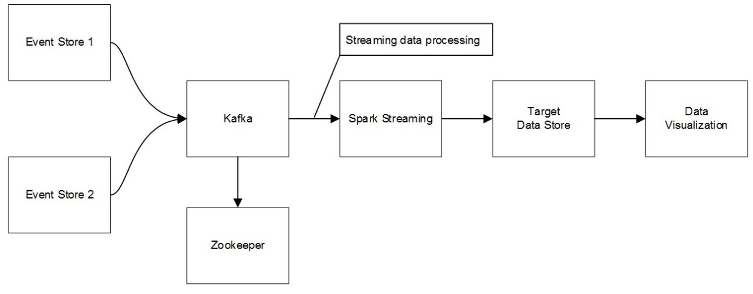
Architecture Diagram

Slide 5
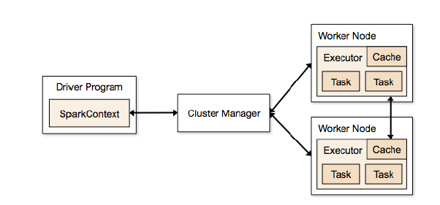
Technology stack
Apache Spark is a cluster computing system for big data processing, with built-in modules for streaming, SQL, machine learning and graph processing.

Slide 6
Technology stack
Spark Streaming is an extension of core Spark API. Spark Streaming makes it easy to build fault-tolerant processing of real-time data.
Zookeeper is a centralized service providing reliable distributed coordination for distributed applications.
Apache Kafka is a real time, fault tolerant, scalable messaging system for moving data in real time.

Slide 7
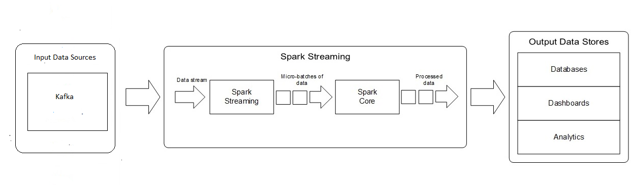
Spark Streaming Architecture

Slide 8
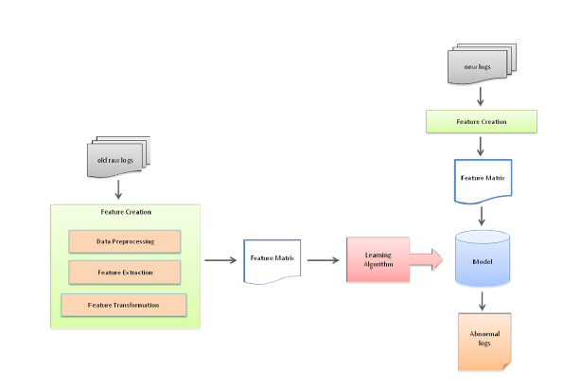
Ericsson Thesis

