Slide 1

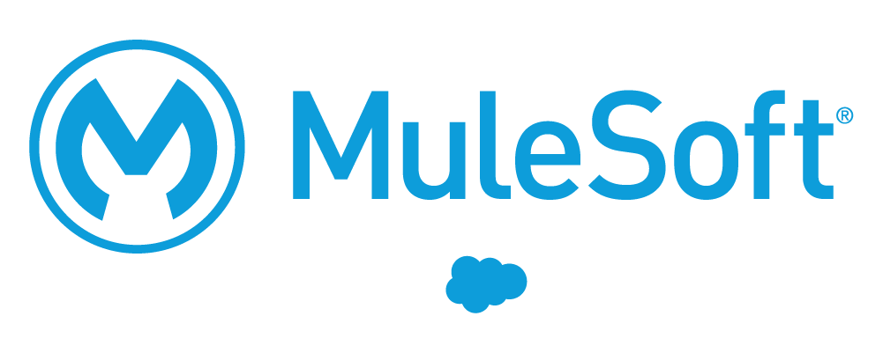



AI-POWERED ENABLEMENT
Salesforce Certification
Practice Playground
A self-service practice and exam-simulation environment that builds certification readiness across the Salesforce ecosystem.
Professional Services teams need certifications quickly, yet real exams are high-stakes and quality study material is scattered. This playground gives every team member unlimited, realistic practice, grows a shared question bank through community contribution, and applies agentic AI with built-in legal and quality safeguards to keep all content clean and defensible.
Professional Services Enablement | Executive briefing for EVP & VP sponsors | June 2026

Slide 2







WHY IT MATTERS
Practice the exam before the exam
Certification is gated by confidence and repetition. The playground gives every team member a safe, repeatable place to build both, with two modes that mirror the real journey.
Practice mode
Exam-simulation mode
Open-book style with instant per-question feedback and explanations. Learn the reasoning behind every answer.
Timed, no mid-test feedback, real passing-score thresholds. A faithful dress rehearsal for the live exam.
Unlimited attempts
Many certs, one platform
Readiness, not cramming
No seat limits and no cost per attempt. Practice until it sticks.
Admin, Agentforce, Data Cloud, MuleSoft, and certs beyond Salesforce.
Randomized questions and broad topic coverage reduce memorization.

Slide 3





AI-POWERED & EFFORTLESS
Snap a screenshot, agentic AI does the rest
Adding study material is as easy as taking a screenshot. Agentic AI reads the image, PDF, or text and turns it into clean, structured practice questions, with no manual data entry.
›
›
›
STEP 1
STEP 2
STEP 3
STEP 4
Upload
AI extracts
Auto-screened
Admin approves
Drop a screenshot, PDF, or text. That is the whole workflow.
A large language model pulls out questions, options, and topics automatically.
A lightweight model flags possible leaked or paid dump content for review.
A person makes the final call before questions go live.
Cost-controlled by design. A lightweight model handles screening, a higher-accuracy model runs only where extraction quality matters, and a daily AI budget guardrail pauses processing before costs run away.

Slide 4




LEGAL & QUALITY SAFEGUARDS
No dumps. No paid content. Defensible by design.
Leadership's top concern is protecting Salesforce from legal exposure. The platform treats that as a first-class requirement, with multiple layers that keep leaked or paid exam content out of the question bank.
AI dump-check screening
Human in the loop
Every upload is screened by an LLM and labeled clean, suspicious, or dump. Anything reading like real exam questions is caught.
Flagged uploads carry a visible warning and route to an admin queue. A person, not the AI, makes the final approve or reject call.
Source allow-list and block-list
Continuous quality feedback
The companion crawler ingests only public, free study material, respects robots.txt, and hard-blocks known dump sites.
Verifier roles vote with reasons on every question, and feedback aggregates into quality reports that retire weak content.

Slide 5

COMMUNITY OF PRACTICE
Everyone contributes, the bank gets stronger
Each member who uploads a study set makes the platform better for the next person. A shared, crowdsourced question bank with built-in roles turns individual prep into collective acceleration.
Roles that keep quality high
Why it accelerates certification
Members : Practice tests and contribute study material.
Compounding bank. More contributors lead to more coverage and faster prep for all.
Verifiers : Vote with a required reason, feeding quality control.
Shared, not siloed. Knowledge that used to live in one person's notes is now reusable.
Domain admins : Curate and approve questions for their assigned cert.
Peer-validated. Voting surfaces the best questions and retires the weak ones.
Super admins : Govern users, roles, and platform-wide settings.
Org-wide momentum. Teams hit certification milestones together, not one by one.

Slide 6



ANALYTICS & SCALE
Prove progress, then scale beyond PS
Tests taken
Improvement trend
Weak areas
Per-user attempt counts across practice and exam modes.
Score-over-time charts show who is getting exam-ready.
Topic breakdowns pinpoint exactly where mistakes cluster.
Illustrative readiness trend
Beyond Professional Services
Cert-agnostic by design, the platform already runs AWS and TOGAF alongside Salesforce. Any team with a certification goal can adopt it: Sales, Customer Success, partners, and new-hire onboarding.
The ask: endorse a pilot within your org and nominate a domain admin to seed your certs.

