Slide 1
Predicting Genetic Disorders in Children
Supervised Learning Capstone Project
By: Edward Sung
Date: 12/20/21

Slide 2
What is the problem at hand?
The world’s population is growing exponentially, so is the population with genetic disorder ailments.
How can the healthcare system keep up in being able to diagnosis and treat patients effectively and efficiently?
Provided a large database of medical information on children:
How can machine learning be used to predict genetic conditions in children?
Which key features from the medical database have significant impact in predicting genetic disorder?

Slide 3
Medical Database
Data provided by Kaggle via HackerEarth competition:
“HackerEarth Machine Learning Challenge: Of Genomics and Genetics”.
Medical information collected from various hospitals around the United States
train.csv
45 Feature columns – includes the two target columns: Genetic Disorder and Disorder Subclass
22083 rows of patient data
test.csv
43 Feature columns – excluding the two target columns
9465 rows of patient data
sample_submission.csv
Example format for submitting output file for grading.
Patient Id, Genetic Disorder, Disorder Subclass

Slide 4





Data Wrangling
Exploratory Data Analysis
Feature Engineering
Modeling and Recommendations
Follow-Up and Future Projects

Slide 5

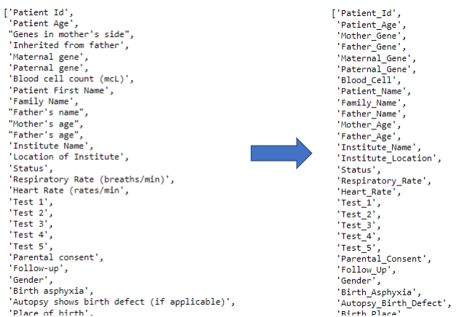
Data Wrangling
Inconsistent feature names
Feature names were cross referenced with a column name description table to derive new informational, but simple naming scheme.
Examples:
Genes in mother’s side -> Mother_Gene
Inherited from father -> Father_Gene

Slide 6
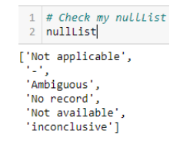
Data Wrangling
Inconsistent feature names
Feature names were cross referenced with a column name description table to derive new informational, but simple naming scheme.
Examples:
Genes in mother’s side -> Mother_Gene
Inherited from father -> Father_Gene
Valid and null values
Data included null values, but also values that would be null values in context.
Valid_check function is applied to each feature to identify all unique_val, which are then manually identified and added to a NullList.
NullList is applied to the entire data set to convert these values to labeled null values.

Slide 7
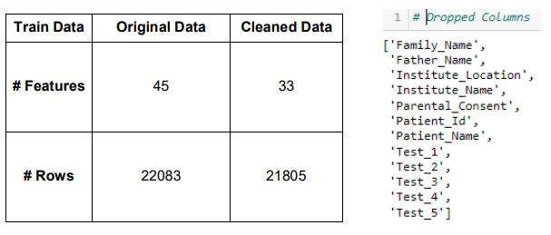
Data Wrangling
Inconsistent feature names
Feature names were cross referenced with a column name description table to derive new informational, but simple naming scheme.
Examples:
Genes in mother’s side -> Mother_Gene
Inherited from father -> Father_Gene
Valid and null values
Data included null values, but also values that would be null values in context.
Valid_check function is applied to each feature to identify all unique_val, which are then manually identified and added to a NullList.
NullList is applied to the entire data set to convert these values to labeled null values.
Feature relevance
Features were evaluated based on meaningful and relevant information for predicting genetic disorders
Irrelevant features were dropped to reduce dimensionality and noise
Rows of data were dropped if they were missing values for both target features

Slide 8

Exploratory Data Analysis
Target features to predict are in a hierarchical relationship.
Genetic Disorder -> Disorder Subclass
New Focus: Predict only the Disorder Subclass
Genetic Disorder can be inferred
Genetic Disorder | Disorder Subclass
Single-gene inheritance diseases | Cystic fibrosis
 | Tay-Sachs
 | Hemochromatosis
Multifactorical genetic inheritance disorders | Diabetes
Multifactorical genetic inheritance disorders | Alzheimer’s
 | Cancer
Mitochondrial genetic inheritance disorders | Leigh syndrome
 | Mitochondrial myopathy
Mitochondrial genetic inheritance disorders | Leber’s hereditary optic neuropathy

Slide 9
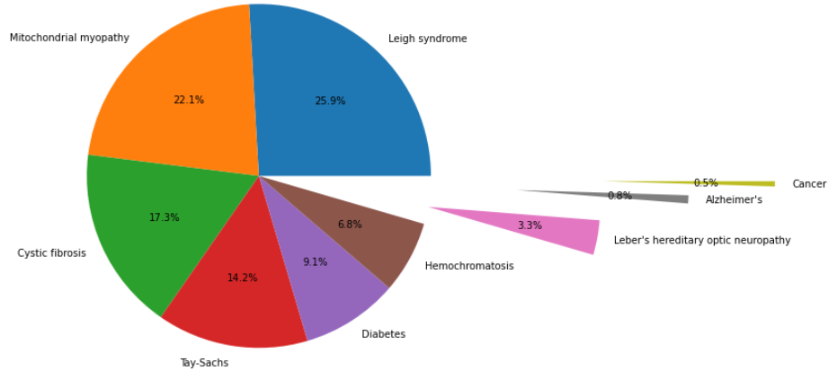
Exploratory Data Analysis
Significant Class imbalance within the Disorder Subclass
Disorder Subclass | Percent of Data (%)
Leigh syndrome | 25.9
Mitochondrial myopathy | 22.1
Cystic fibrosis | 17.3
Tay-Sachs | 14.2
Diabetes | 9.1
Hemochromatosis | 6.8
Leber’s hereditary optic neuropathy | 3.3
Alzheimer’s | 0.8
Cancer | 0.5

Slide 10
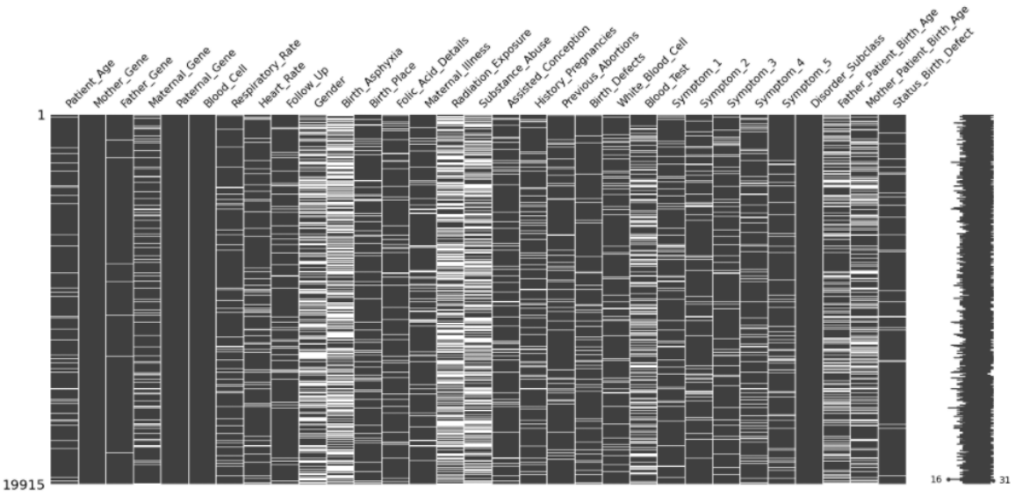
Exploratory Data Analysis
Large amounts of missing data throughout the data set
Significant amounts with 54-55% missing in:
Gender
Birth_Asphyxia
Radiation_Exposure
Substance_Abuse

Slide 11

Feature Engineering
Studies have shown a strong correlation between parent’s age and patient’s birth, due to biological degradation as one ages.
Degradation in proteins that facilitate joining and growing of fertilized eggs.
Degradation in the ability to correct / remove sperm cells that contain detrimental genetic disorders.
More accurate representation of parent’s age:
Mother_Age – Patient_Age = Mother_Patient_Birth_Age
Father_Age – Patient_Age = Father_Patient_Birth_Age

Slide 12
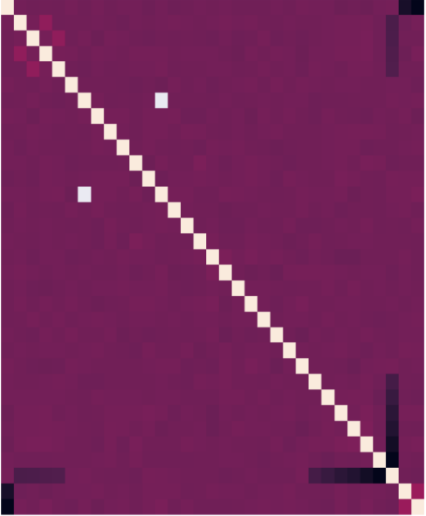
Feature Engineering
Pearson’s correlation map revealed a significant connection between Status and Autopsy_Birth_Defect, as shown as the isolated white square.
Autopsy_Birth_Defect – autopsy performed on deceased patients and indicates any birth defect found
Status – patient is either Alive or Deceased
Patient’s with Alive Status have Not-Applicable value in Autopsy_Birth_Defect
A combine feature can be derived from these two features to remove double counting and dimensionality.
Status_Birth_Defect (Status / Autopsy_Birth_Defect)
Alive / Not Applicable – Alive
Deceased / Yes – Yes
Deceased / No – No
Deceased / Nan = Nan

Slide 13

Modeling Decision
Tree Model | Train_Score (%) | Test_Score (%) | Train_CV_Score (%)
Random Forest Classifier | 100.0 | 38.9 | 37.6
Gradient Boosting Classifier | 49.0 | 39.8 | 40.8
Xtreme Gradient Boosting Classifier | 95.6 | 36.4 | 37.7
Chosen Model: Xtreme Gradient Boosting Classifier (XGB)
Handles large amount of missing data through treating missing data as its own category
Handles class imbalance through making greedy optimal decisions at nodes and not the entire data set at once
Train_Score shows overfitting, allowing for hyperparameter tuning to reduce overfitting and increase Test_Score
Class weights were added to help minimize the class imbalance in the dataset

Slide 14
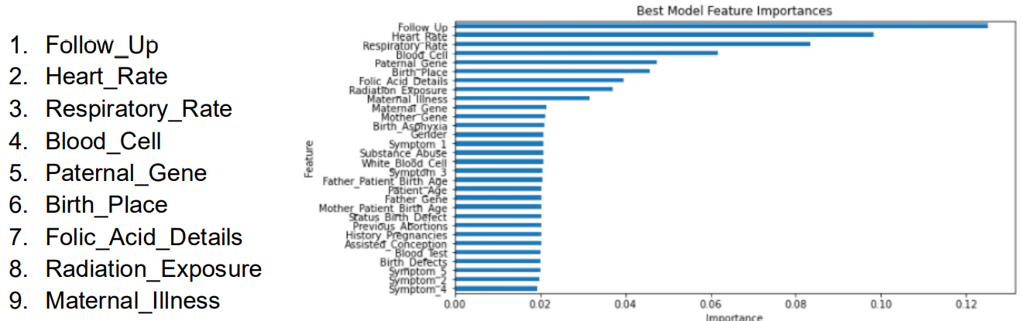
Modeling and Recommendations
Model Recommendation Use:
Low predicting power at 33.56% on test data set. Best to use model as guideline for doctors to narrow down potential genetic disorder.
9 features were identified to have the highest impact in predicting genetic disorder.
Gender, Birth_Asphyxia, Radiation_Exposure, Substance_Abuse were identified with largest missing values. Evidence to use for improving data management and recording.
Tuned XGB model reduced the initial overfitting and increased the overall predicting power.
Feature Importance
Entire Data Score | Initial Model (%) | Tuned Model (%) | Difference (%)
Accuracy_Score | 92.5 | 73.9 | -18.6
CV_Score | 37.3 | 39.7 | 2.4

Slide 15

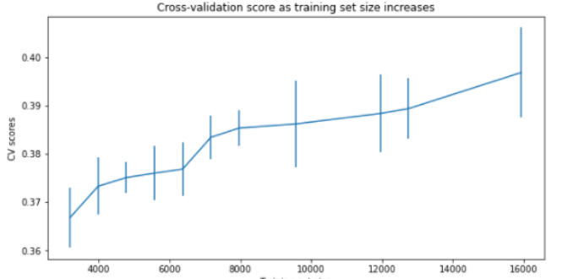
Follow-Up and Future Projects
Change the model from giving predictions to giving probabilities on genetic disorders
Collect more data
Collecting more data will help compensate the missing data
Alternatively, collect different features to replace features with large amounts of missing data or low feature importance
More data on the minor classes to help with class imbalance
Alternatively, investigate other imputation strategies such as SMOTE or oversampling

Slide 16
Thank You
Springboard Data Science Track
Supervised Learning Capstone Project
Mentor: Lucas Allen

