Slide 1
White Blood Cell Image Classification
Image Classification Neural Network – Transfer Learning Based
By Edward Sung
Date: 2/14/22

Slide 2
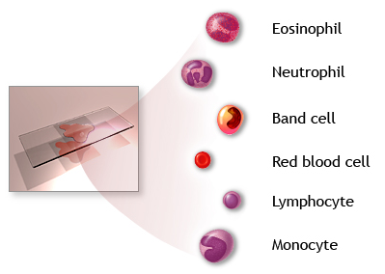
Complete Blood Count (CBC)
Health related illness and diseases can be diagnosed through blood cell counting called complete blood count (CBC).
Part of CBC is counting and identifying the types of white blood cells present and their respective levels in the sample.

Slide 3
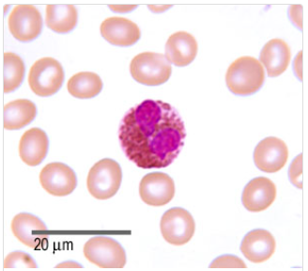
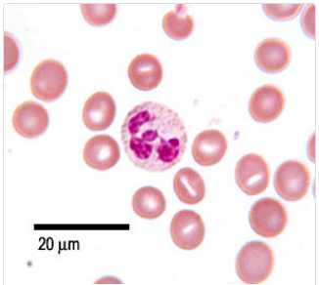
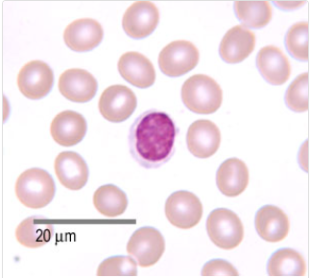
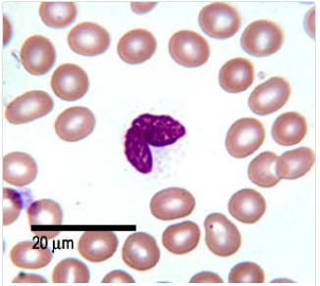
What are white blood cells?
Eosinophils: bi-lobed, sausage-shaped nucleus; fights against parasites.
Neutrophils: multi-lobed nucleus; fights against bacterial infections.
Lymphocytes: single large and round nucleus: fights against viral infections.
Monocytes: single large and kidney shaped nucleus; cleans up dead/damaged cells.

Slide 4
Image database
Data comes from Kaggle and is provided by Paul Mooney.
Augmented from 410 images from Shenggan github.
Images are jpegs with image size of 240 x 320
Training Set Folder:
Eosinophil Folder: 2497 images
Lymphocyte Folder: 2483 images
Monocyte Folder: 2478 images
Neutrophil Folder: 2499 images
Testing Set Folder:
Eosinophil Folder: 623 images
Lymphocyte Folder: 620 images
Monocyte Folder: 620 images
Neutrophil Folder: 624 images

Slide 5
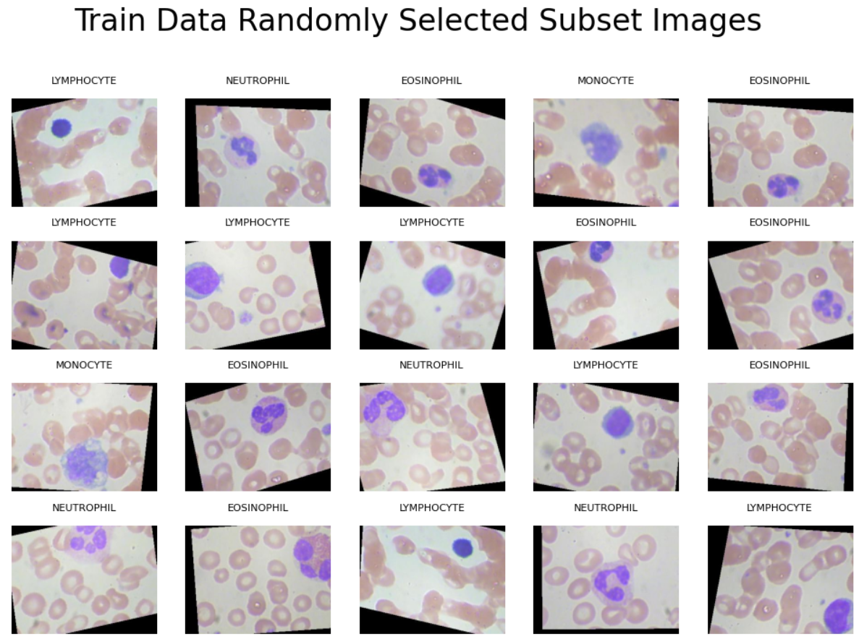

Slide 6
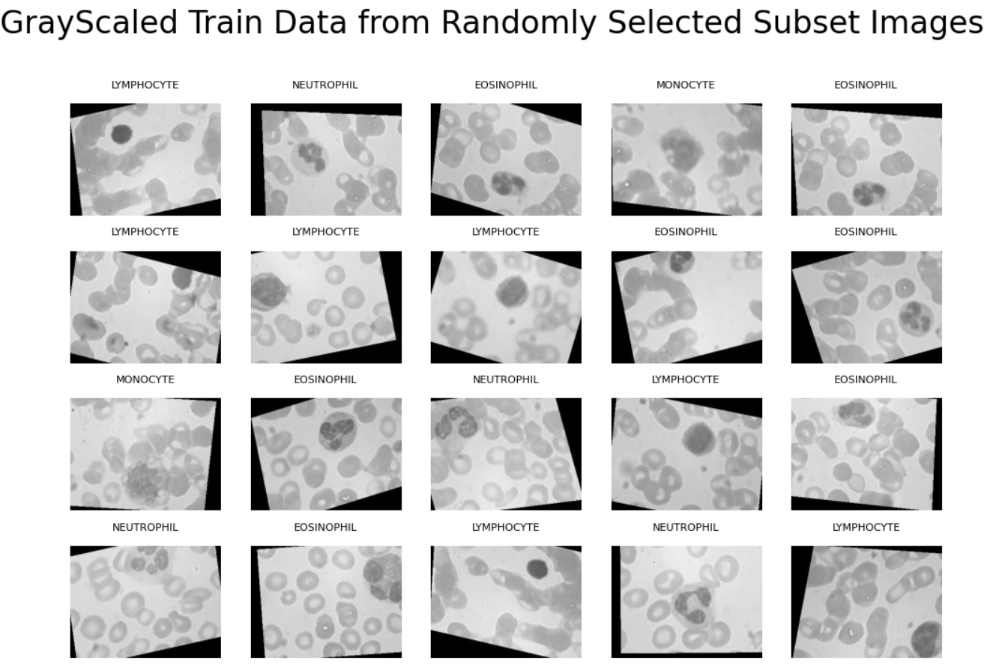

Slide 7
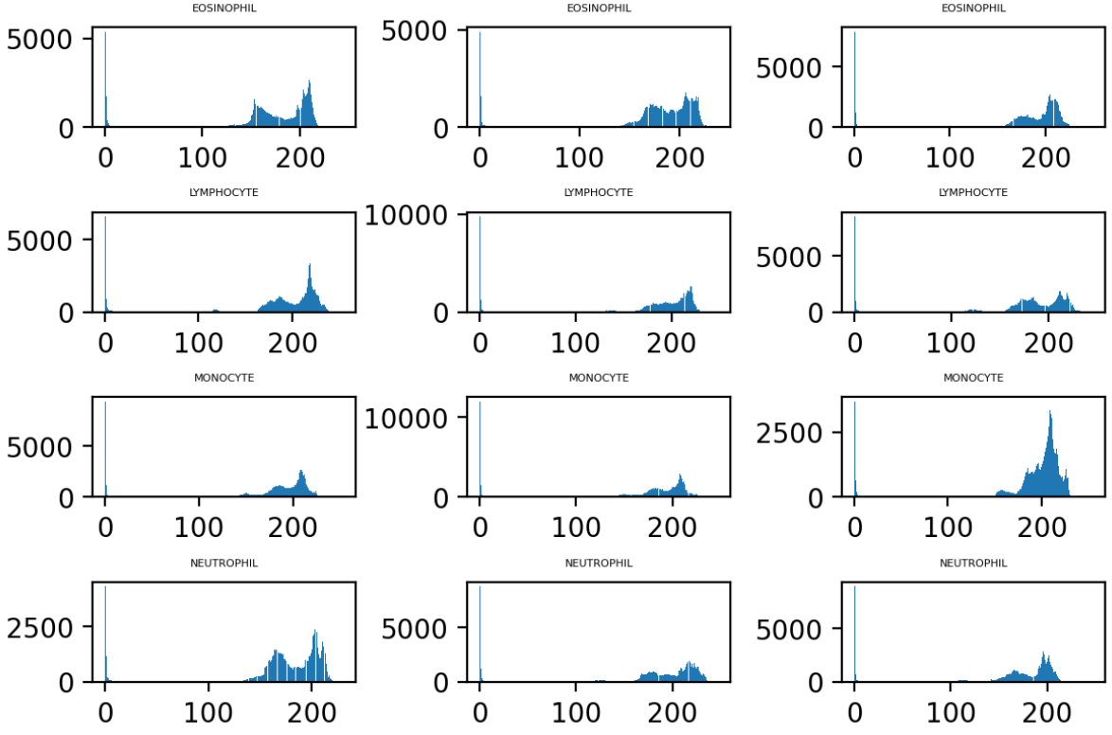
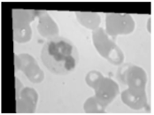
Gray scale exploration
Histogram distribution of the pixel intensities show a grouping at 0 and towards 200.
0 intensity pixel group are the black border caused by rotational augmentation of the image.

Slide 8
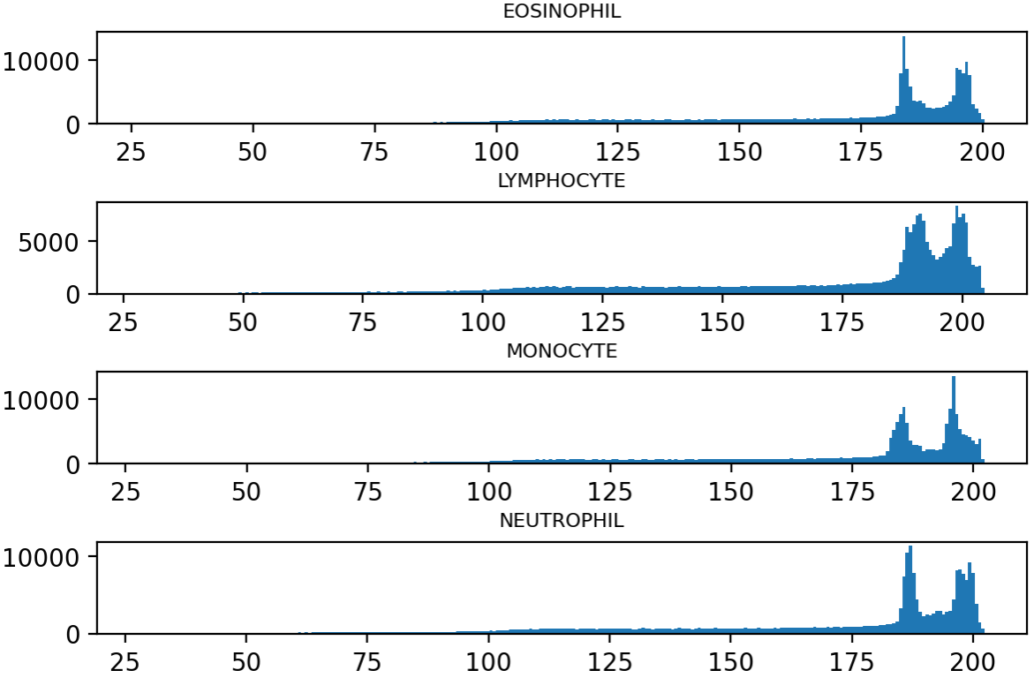
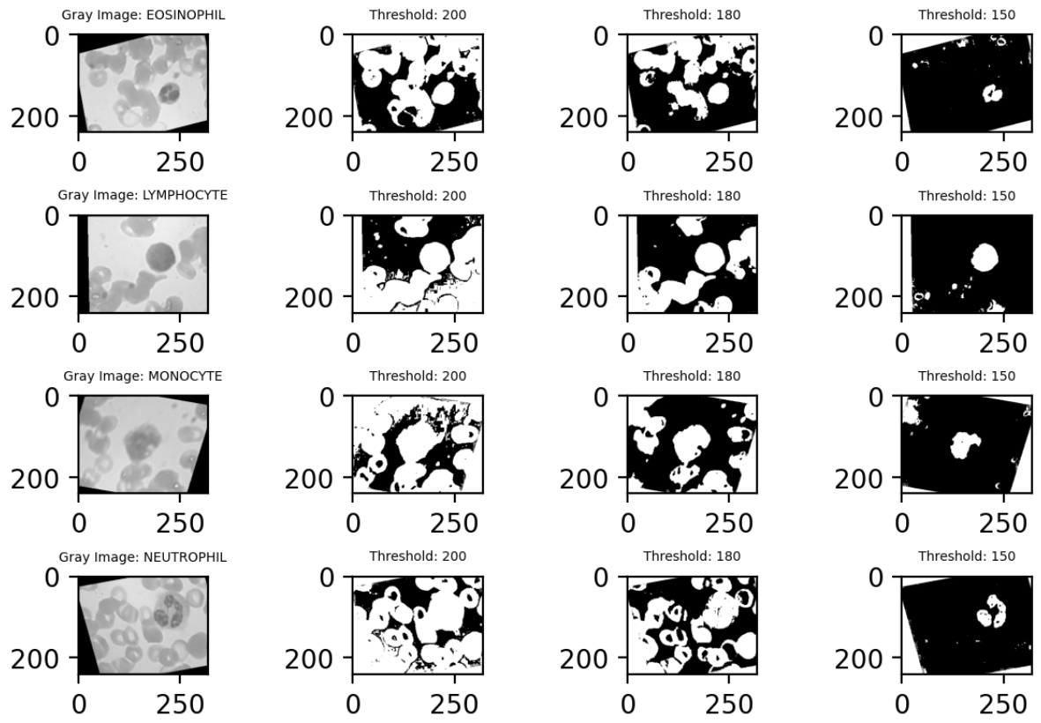
Combined Average Histogram Distribution
0 pixel grouping is insignificant compared to rest of image.
Similar bi-modal peaks for all four types of cells.
Threshold: 200 – empty spaces between the cells.
Threshold:180 – cells/including target cell.
Threshold: 150 – target cell, identifiable shape.

Slide 9
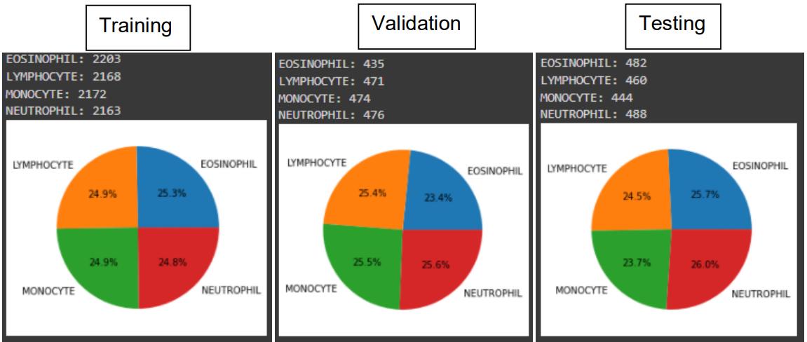
Preprocessing
Augmentation process not provided by author.
Potential bias or separate augmentation process done to training and test set separately.
Combined and created own training, validation, and testing sets.
Ensures testing sets will be representative of the training data.

Slide 10
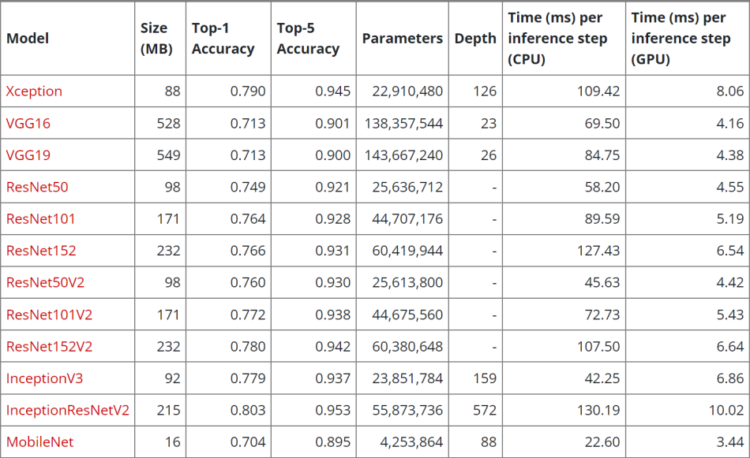
Modeling I
Model choice: Xception
Best accuracy and speed for its size
Preprocessing Layer
Xception requires image array values to be -1 and 1
Preprocessing method included in Keras

Slide 11
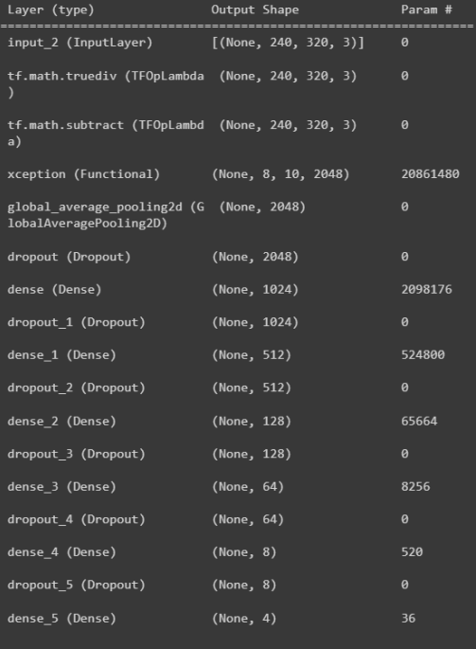
Modeling II
Preprocessing layer
Xception base model layer
Top layer classifier, dense layers
Exponentially reduction in nodes to match number of class to identify
Dropout layer in-between dense layers
Reduce overfitting

Slide 12
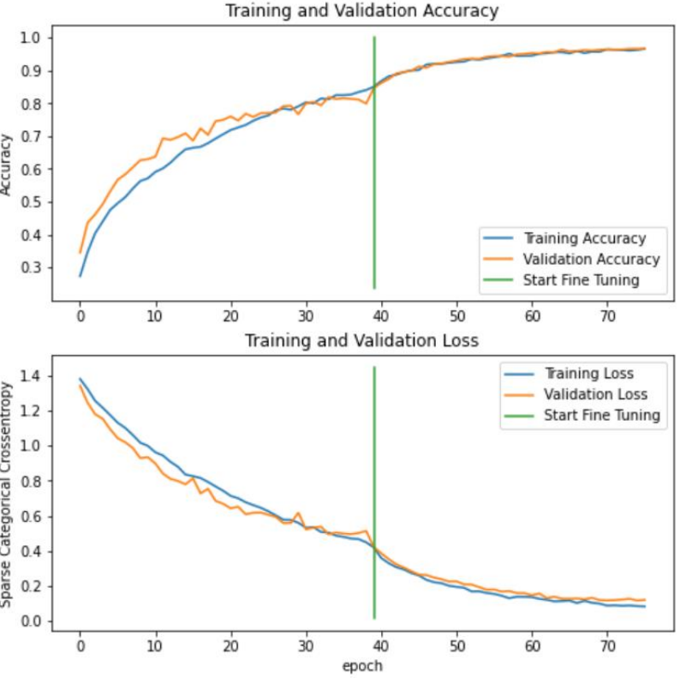
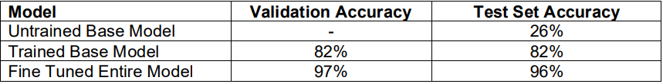
Training and Results
2 Rounds of training was done with the model
1st round: base model Xception is frozen, training just the top layer classifier
2nd round: base model Xception is unfrozen and the learning rate is set to very low.

Slide 13
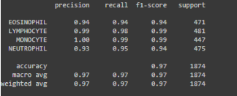
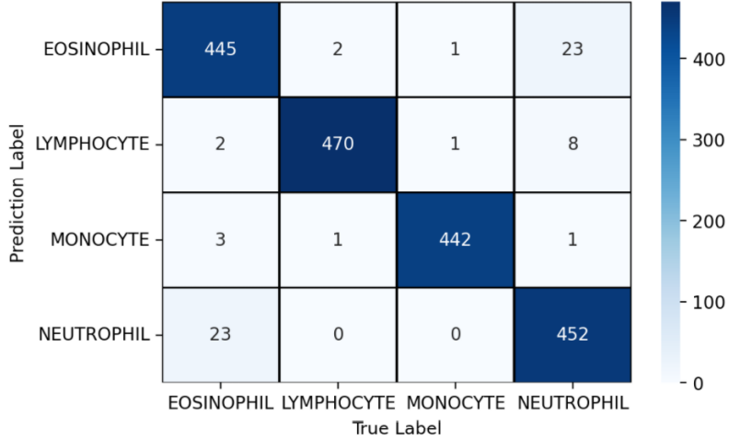
Model Evaluation I
Strong model with high classifying accuracy.
May have underlying issue of small original training data
Model may be memorizing the images well rather then learning since the images are multiple augmentations of a small set of images.

Slide 14
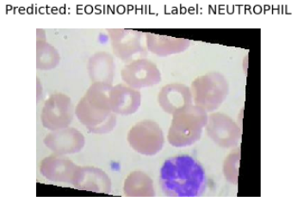
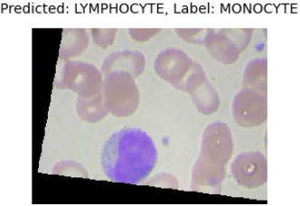
Model Evaluation II
Where the model failed to predict:
Eosinophils / Neutrophils: may be due to staining residues being included in the evaluation.
Lymphocyte / Monocyte: may be due to poor image quality / not distinct enough staining or shape.

Slide 15
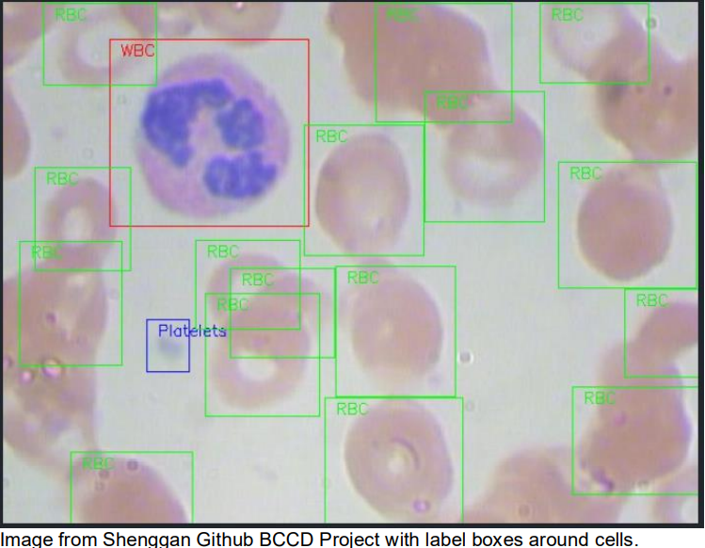
Follow-Up and Further Projects
Collecting new images for the model to train on.
Use own data augmentation generator rather than the provided image set.
Increase model’s capabilities by allowing it to classify and count multiple target cells in an image.
Increase model’s capabilities by expanding the classification nodes to different types of cells.
Uses for cancer cell identification or drug discovery.

Slide 16
Thank you
Springboard Data Science Track
Image Classification Capstone Project
Mentor: Lucas Allen

