Slide 1
SCOOP TAB

Slide 2
Member Details
Name
JAMIUL FARIYAH JASIM JIM
MD. JAHIDUL ISLAM RIYAD
EMAM HOSSAIN
MD. TASNIM ANJUM
ID
18-38540-2
19-41121-2
19-41131-2
19-41136-2

Slide 3
Project Motivation & Objective
Scoop Tab is built for making tedious tasks easier, getting things done faster and done efficiently. The system is easier, attractive and more correct from other system. Also non technical users can operate it easily.
By using Scoop Tab admin can store information about the stock of products, customer orders, daily business, billing and staff of a ice cream parlor. The admin can easily access to the system and check for availability of the items. The proposed system enables the customer to make the order by registering their details.

Slide 4
USER
OWNER
PARLOR MANAGER
EMPLOYEE
CUSTOMER

Slide 5
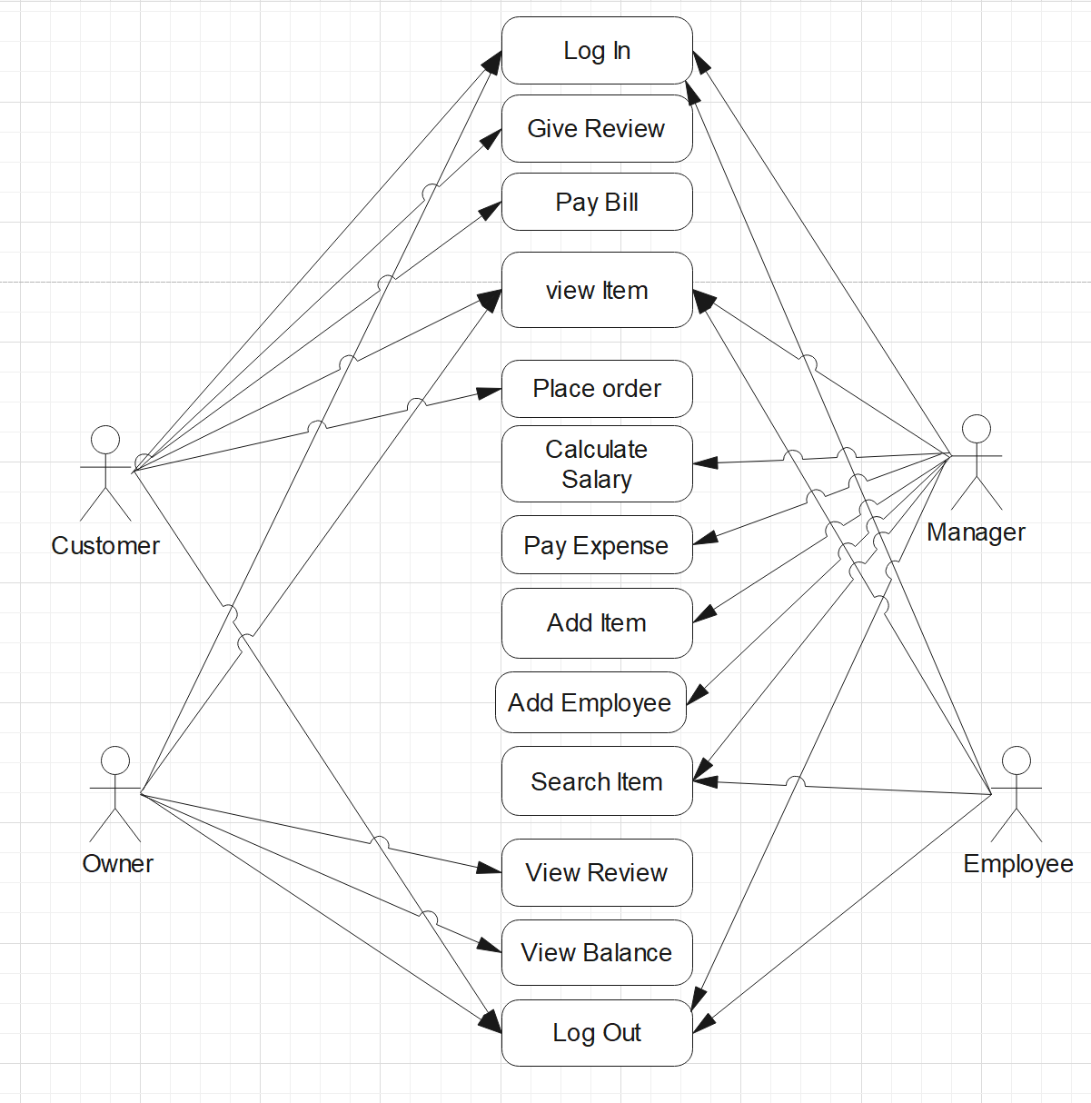
USE CASE DIAGRAM

Slide 6
FUNCTIONALITIES
OWNER
Can view the items
Can view the review given by customer
Can view the total balance and expense
Can add manager
Can view employee and manager list

Slide 7
FUNCTIONALITIES
MANAGER
Can view item
Can add item
Can add employee
Can calculate salary
Can pay expense

Slide 8
FUNCTIONALITIES
EMPLOYEE
Can view the items
Can search items
Can deliver item

Slide 9
FUNCTIONALITIES
CUSTOMER
Can view the items
Can give review
Can pay bill
Can place an order

Slide 10
CONTRIBUTION
JAMIUL FARIYAH JASIM JIM
MD. JAHIDUL ISLAM RIYAD
EMAM HOSSAIN
MD. TASNIM ANJUM
OWNER
EMPLOYEE
MANAGER
CUSTOMER

Slide 11
LIMITATIONS
1. Owner and Manager can’t view who logged in to the system
2. Customer can’t recover the password if he/she forgot it
3. Manager / Owner can’t delete customer
4. Manager/ Owner can’t view the working hour of an employee
5. Maybe changes in user interface will make this system more attractive

Slide 12
POSSIBLE UPDATES
System will be connected through internet
Change in interface to make it user friendly
Limitations will be solved
Customer will be able track his/her order

Slide 13
THANK YOU

