Slide 1

Title: Fosterage Team ID: CTO-f96c
Team Member Details
EMAM HOSSAIN
MD. TASNIM ANJUM
MD. MEHBUB UL ISLAM

Slide 2

Content
PROBLEM STATEMENT
BENEFICIARY
SOLUTION STATEMENT
FINANCIAL VIABILITY
CHALLENGES
FUTURE EXPANSION

Slide 3
Problem statement of the project
Children who are homeless are especially prone to abuse and exploitation. Additionally, the hazards to these kids' safety and wellbeing have escalated. Many of them work to support themselves and their families, frequently in dangerous and low-paying occupations. Many families rely on the wages of their children to make ends meet because of poor family income and parental unemployment. Children who are homeless are also more susceptible to other types of exploitation and commonly become the targets of trafficking, physical and sexual abuse, and slavery. Numerous criminal organizations use youngsters for commercial sex work, smuggling, theft, and the trafficking of drugs and firearms in order to generate substantial profits.

Slide 4
There are guardians who wants to adopt children. But for having lack of information they cannot adopt.
Communication between two individuals are not correctly happening.
A proper source is needed for adopting foster children and make an impact reducing child crime.
Although the street children and foster children both are becoming victim of vulnerable conditions.

Slide 5
Beneficiary
Street children
Orphans
Parents who wants to adopt children

Slide 6
Solution Statement
An online base platform can be introduced to solve this problem.
The platform will introduce information to the guardian or an orphanage of foster children.
The platform will be verify by the government.
The solution will reduce the problem and increase the chance of the street children and foster children to lead a better life.

Slide 7
Case story: 1
Suppose a new born child lost her mother and she was his/her only guardian to look after. The child deserves a better life, proper education. The hospital management can visit the platform and check if there any guardian or orphanage is available to take responsibility. They can create an account and get the service according to terms and policy.
Case Story: 2
Suppose there are some street children who are affected by drugs and criminal activities. We can give them proper education and ethical moralities by giving a new life. We can send them under a proper care by giving them a guardian or an organization who can take care of them. It can be change their life.

Slide 8
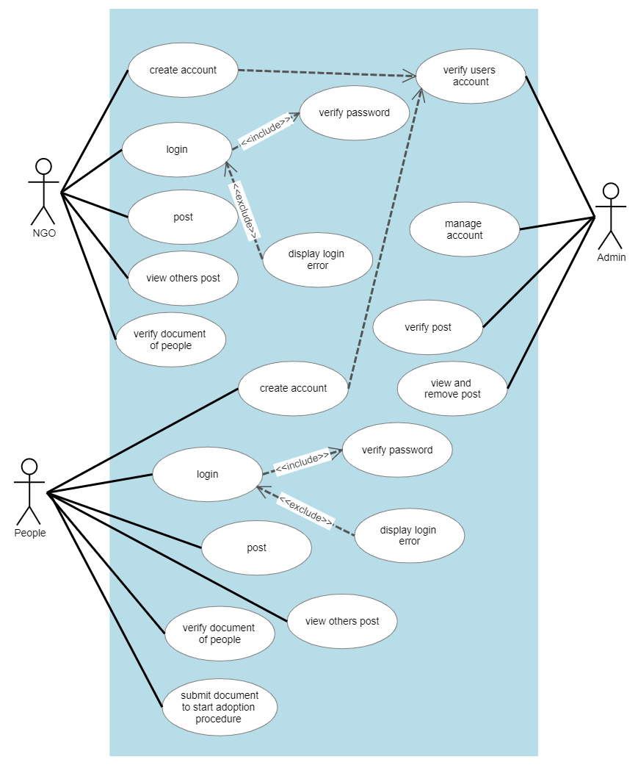
Use Case Diagram

Slide 9
Financial Viability
If the street children becomes educated then the literacy rate of our country will be increased. We can use more man power for the development of our country
The government have to think less about the orphan or street child. Also it will less the amount of govt. fund that was directly on indirectly funded for them.
Donation process can be apply to fulfill financial viability.
Premium membership will be organized for collection of resources which will apply for children.
Specific NGO or organization contribution should be added to take care of the children.
Each donation have specific documentation which will be verify by NGO.
Online donation system will be implemented.

Slide 10
Challenges
If a couple/family wants to adopt a child then to verify the family or to know how the will treat the child will be difficult.
There is no resource contributor on building this project.
Hospitals contribution are needed to gather information.
NGO's acceptability and government acceptance are needed.
There is no testing team. Quality assurance for script testing will be challenging.
Manual testing can be apply, but automated testing is challenging for the lack of resources.
Proper SDLC apply process will be challenging.

Slide 11
Future Expansion
The platform can be applied in different cities and rural areas.
We can develop extra features where healthcare will be provided with the help of government.
If there occurs any false information or cyber attack activities, we will in need of cyber security development.
There will be always a backup server to store the data.
If someone wants to be a part of the social work they can apply.
False information detector will be apply in future.
We will keep in touch with the children if they are getting proper care or not.

Slide 12
THANK YOU

