Slide 1
CSE 635
Topic: Social Media Mining for Health Monitoring
Team: Data Miners
Team Members: Mohd Ehtesham Shareef
Priya Rao

Slide 2
Contents
Problem Statement
Dataset
Preprocessing
Baseline Architecture
Task 1
Task 2
Task 3
Final Architecture
End to End Demonstration

Slide 3
Problem Statement
Task 1
Binary classification of tweets into those that contained an adverse drug reaction from those that do not. This corresponded to the Task 2 in the SMM4H’20 Shared Task.
Task 2
Extract the span of text containing an ADR (from a corpus containing tweets with ADR and Non-ADR mentions) of a medication from tweets that report an ADR presence.
Task 3
Mapping the extracted ADR to a standard concept ID in the MedDRA vocabulary (preferred terms). Task 2 and 3 correspond to Task 3 in the SMM4H’20 Shared Task
Task 4
End-to-end demonstration of ADR mentions in tweets

Slide 4
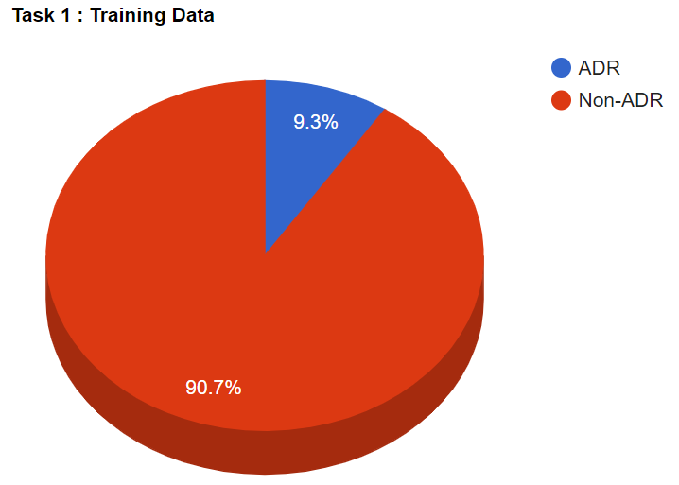

Dataset
The distribution of the dataset for task 1 had almost 90% of the tweets being Non-ADR tweets for the training and validation dataset.

Slide 5
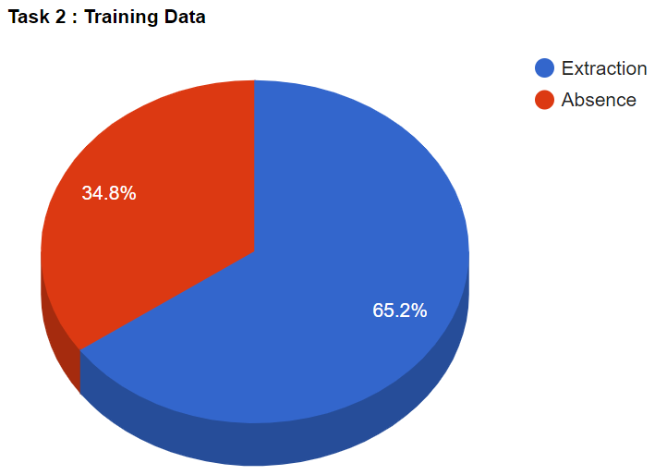

Dataset
The dataset for task 2 was roughly split as 65% containing an ADR from which it could be extracted with the start and end span. For task 3 the same dataset mapped these extractions to MedDRA preferred terms (PT) and IDs of which there were a total of 477 unique MedDRA IDs. Multiple extractions corresponded to multiple MedDRA IDs which meant the tweet being present multiple times in the corpus.

Slide 6
Pre-Processing
Since tweets often contain abbreviations, slang, hyperlinks, emoticons, emojis, etc, they need to be ‘cleaned’. The common steps we employed for both datasets were:
Strip punctuations, hyperlinks, emoticons, emojis and “rt”
Expanded contractions and abbreviations using a pre-built dictionary
for example: wouldn’t wanna -> would not want to
LOL -> laughing out loud
3. Tokenized the text

Slide 7
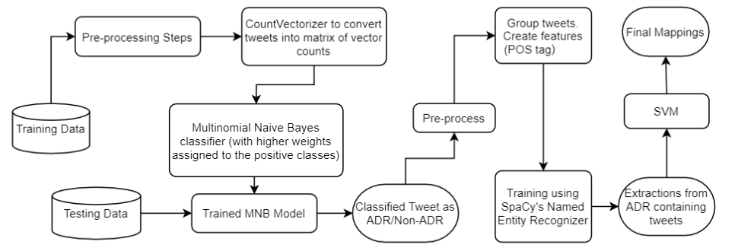
Baseline Architecture

Slide 8
Task 1
In addition to the common pre-processing steps mentioned, for task 1, we also tried stemming and lemmatization but this did not contribute to the results we were already achieving.
Aside from training MNB with and without sample weights, we also tried the BERT model using the Transformers library by Hugging face. This BERT model was then fine-tuned through weight decay and a bias factor.
We implemented “bert-base-uncased”,“bert-large-uncased” and “biobert_large_v1.1_pubmed” and adjusted the hyperparameters for better results.
Finally we implemented the RoBERTa model as it uses a bigger training data and uses dynamic masking unlike BERT which is based off static masking.

Slide 9
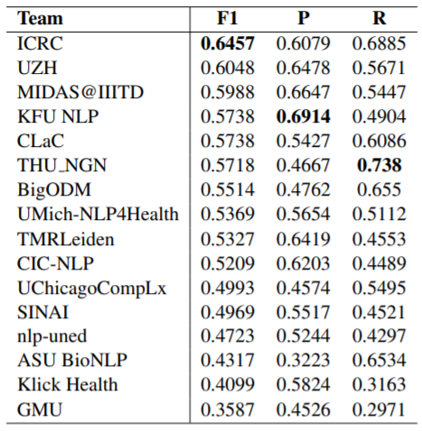
Task 1 - Results
Model | F-1 Score
MNB with CountVectorizer | 0.48
BERT | 0.59
BERT (bert-base-uncased) | 0.60
BERT (bert-large-uncased) | 0.63
BERT (biobert-large) | 0.63
RoBERTa (roberta-large) | 0.65

Slide 10
Task 2
For this task, we tried to implement state of the art techniques for named entity recognition.
We implemented two techniques :
BERT
Residual LSTM with ELMo embeddings.
For both the models, we used a pretrained model trained on a biomedical corpus :
biobert_v1.1_pubmed for BERT
bioELMo word embeddings pretrained on pubmed abstracts.1_pu

Slide 11
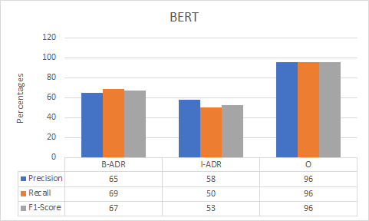
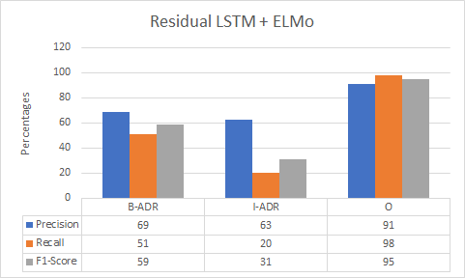
Task 2 - Model Comparison
Macro Average (F1-Score): 0.72 Macro Average(F1-Score): 0.61

Slide 12
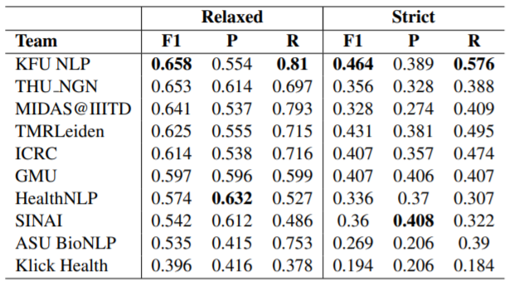
Task 2 - Results
Model | Relaxed F-1 Score | Strict F-1 Score
spaCy (residual CNNs) | 0.417 | 0.36
Residual LSTM with ELMo embeddings | 0.52 | 0.45
BERT (biobert-large) | 0.70 | 0.60

Slide 13
Task 3
Created vectors for the representation of an extracted ADR and used cosine similarity to find out the closest possible match from the MedDRA terms.
Instead of using traditional methods like word2vec, fasttext to embed the extractions, we used sentence embeddings because simply averaging word vectors to get a vector representation of a sentence does not take into consideration the interaction between the words in a sentence, nor the word order.
To achieve this, we tried using Google’s Universal Sentence Encoder and sentence embeddings from BERT as a service to get the embeddings for the extracted terms and the MedDRA terms, and using cosine similarity to get the closest possible match for them.

Slide 14
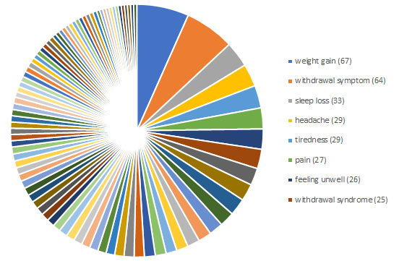
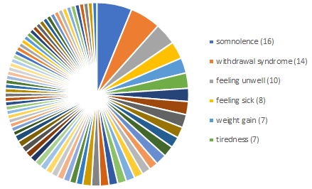
Task 3 - MedDRA distribution
Training Corpus
Testing Corpus

Slide 15
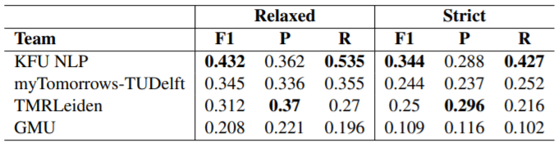
Task 3 - Results
Model | F-1 Score | Accuracy
SVM | 0.38 | 0.375
BERT + CS | 0.45 | 0.48
USE + CS | 0.48 | 0.49

Slide 16
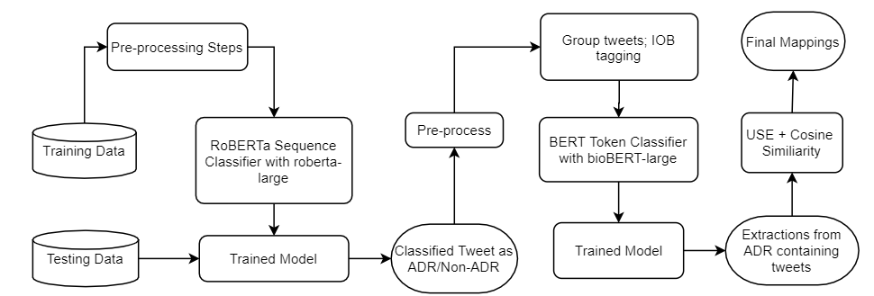
Final Architecture

Slide 17
End to end Demonstration

Slide 18
Thank You

