Slide 1
Data modeling and partitioning in Azure Cosmos DB

Slide 2
Session's objectives
Understand how Cosmos DB differs from relational databases
Get familiar with NoSQL concepts
Learn NoSQL data modeling techniques and technologies used
Apply them to a real-world scenario

Slide 3
What is Azure Cosmos DB?
Microsoft's NoSQL database on Azure
Non-relational and
horizontally scalable

Slide 4



What is Azure Cosmos DB?
horizontally scalable
Unlimited throughput
Unlimited storage capacity

Slide 5

What is Azure Cosmos DB?
non-relational

Slide 6
What is Azure Cosmos DB?
non-relational
and
horizontally scalable

Slide 7
So is Cosmos DB suitable for relational workloads?
It sure is!
  Most workloads in Cosmos are actually relational
Different techniques used to implement relationships
Not intuitive. Relational best practices don't translate well and may even be anti-patterns!

Slide 8
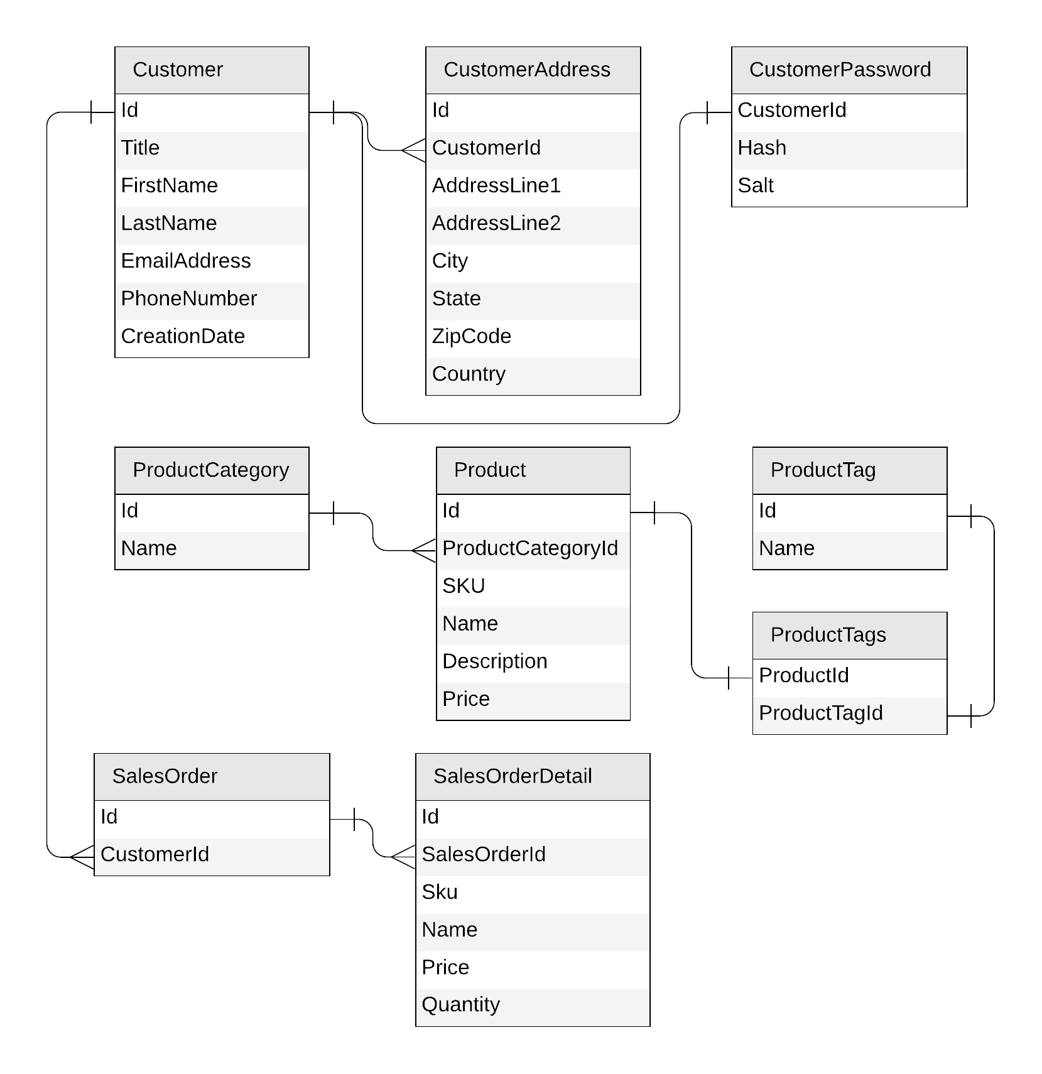
Let's look at a concrete example
E-commerce workload
Customers
Products
  Categories
  Tags
Sales Orders

Slide 9
Identifying the operations for our app
Create a customer
Edit a customer
Retrieve a customer
Create a product category
Edit a product category
List all product categories
Create a product tag
Edit a product tag
List all product tags
Create a product
Edit a product
List all products from a category
(with name of category)
Create a sales order
List all sales order for a customer
Query top 10 customers by number of sales orders

Slide 10
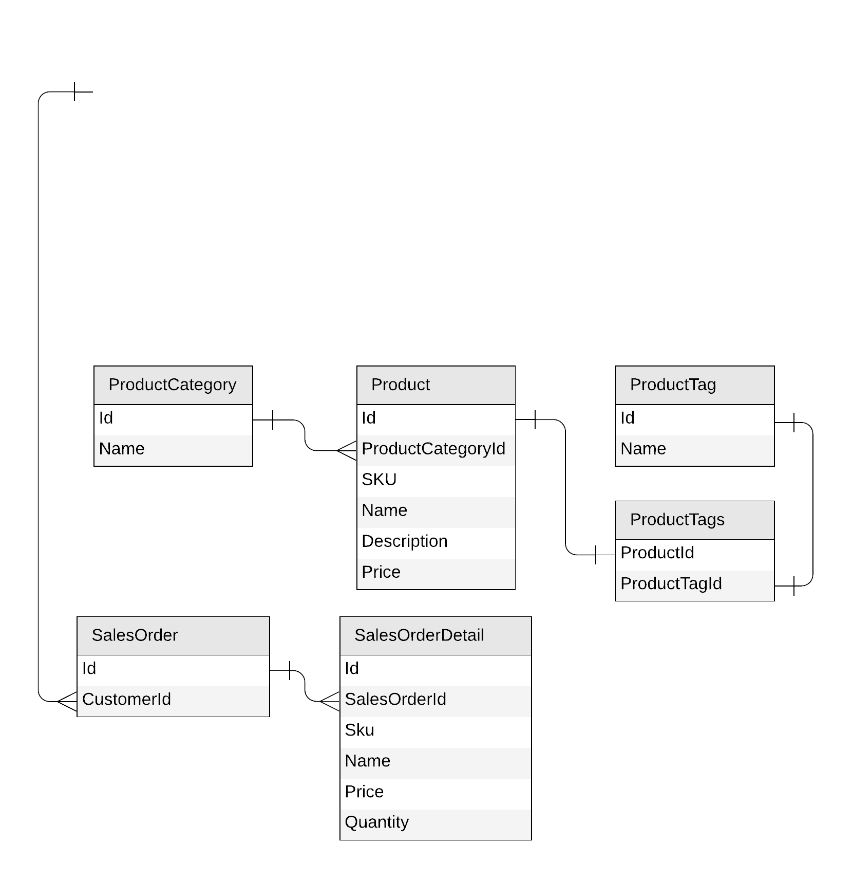
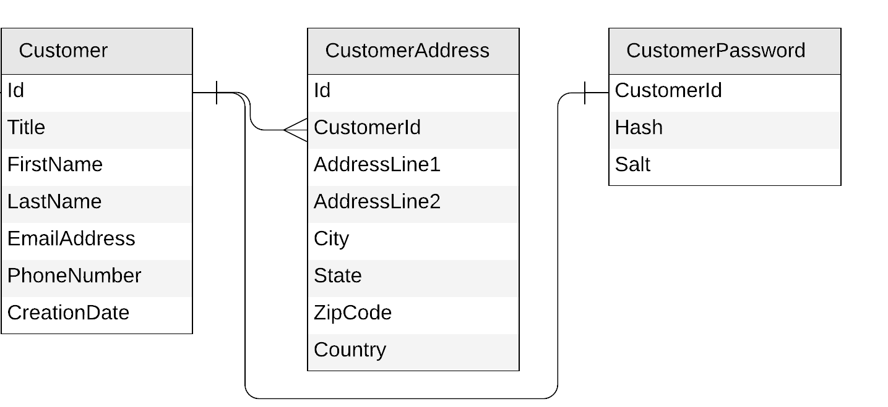
Let’s get started!

Slide 11
Starting with the Customer entity
Create a customer
Edit a customer
Retrieve a customer
{
"id": "…",
"title": "…",
"firstName": "…",
"lastName": "…",
"emailAddress": "…",
"phoneNumber": "…",
"creationDate": "…"
}
{
"id": "…",
"customerId": "…",
"addressLine1": "…",
"addressLine2": "…",
"city": "…",
"state": "…",
"zipCode": "…",
"country": "…"
}
{
"id": "…",
"customerId ": "…",
"hash": "…",
"salt": "…"
}

Slide 12
Starting with the Customer entity
{
"id": "…",
"title": "…",
"firstName": "…",
"lastName": "…",
"emailAddress": "…",
"phoneNumber": "…",
"creationDate": "…",
"addresses": [{
"addressLine1": "…",
"addressLine2": "…",
"city": "…",
"state": "…",
"zipCode": "…",
"country": "…"
}],
"password": {
"hash": "…",
"salt": "…"
}
}

Slide 13
To embed or to reference?
{
"id": "…",
"title": "…",
"firstName": "…",
"lastName": "…",
"emailAddress": "…",
"phoneNumber": "…",
"creationDate": "…",
"addresses": [{
"addressLine1": "…",
"addressLine2": "…",
"city": "…",
"state": "…",
"zipCode": "…",
"country": "…"
}],
"password": {
"hash": "…",
"salt": "…"
}
}
{
"id": "…",
"title": "…",
"firstName": "…",
"lastName": "…",
"emailAddress": "…",
"phoneNumber": "…",
"creationDate": "…"
}
{
"id": "…",
"customerId": "…",
"addressLine1": "…",
"addressLine2": "…",
"city": "…",
"state": "…",
"zipCode": "…",
"country": "…"
}
{
"id": "…",
"customerId ": "…",
"hash": "…",
"salt": "…"
}

Slide 14
To embed or to reference?
Embed when:
1:1 relationship
1:few relationship
Related items are queried or updated together
Reference when:
1:many relationship (especially if unbounded)
Many:many relationship
Related items are queried or updated independently

Slide 15
Our first entity: Customer
{
"id": "…",
"title": "…",
"firstName": "…",
"lastName": "…",
"emailAddress": "…",
"phoneNumber": "…",
"creationDate": "…",
"addresses": [{
"addressLine1": "…",
"addressLine2": "…",
…
}],
"password": {
"hash": "…",
"salt": "…"
}
}

Slide 16
Customer
{
"id": "…",
"title": "…",
"firstName": "…",
"lastName": "…",
"emailAddress": "…",
"phoneNumber": "…",
"creationDate": "…",
"addresses": [{
"addressLine1": "…",
"addressLine2": "…",
…
}],
"password": {
"hash": "…",
"salt": "…"
}
}
customer
PK: ?

Slide 17
What is partitioning?

Slide 18

What is partitioning?
logical partitions

Slide 19
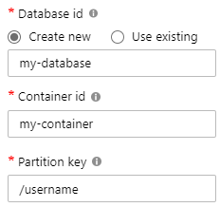
What is partitioning?
Andrew
Thomas
Deborah
Tim
Mark
Theo

Slide 20
What is partitioning?
Max size: 2 MB
Max size: 20 GB

Slide 21

What is partitioning?

Slide 22


Hierarchical partition keys
https://aka.ms/cosmos-hierarchical-partitioning

Slide 23
What is partitioning?

Slide 24

Redistribute throughput (preview) https://aka.ms/CosmosRedistributeThroughput

Slide 25

Dynamic Scaling https://aka.ms/CosmosDynamicAutoscale

Slide 26
What is partitioning?

Slide 27

What is partitioning?
Andrew
Deborah
Tim
Mark
Thomas
Theo
SELECT * FROM c WHERE c.username = 'Mark'
our partition key

Slide 28
What is partitioning?
Andrew
Deborah
Tim
Mark
Luis
Theo
SELECT * FROM c WHERE c.favoriteColor = 'orange'
?

Slide 29
Physical vs logical partitions
Max RU: 10K
Max size: 20 GB
logical partitions
Max size: 50 GB

Slide 30
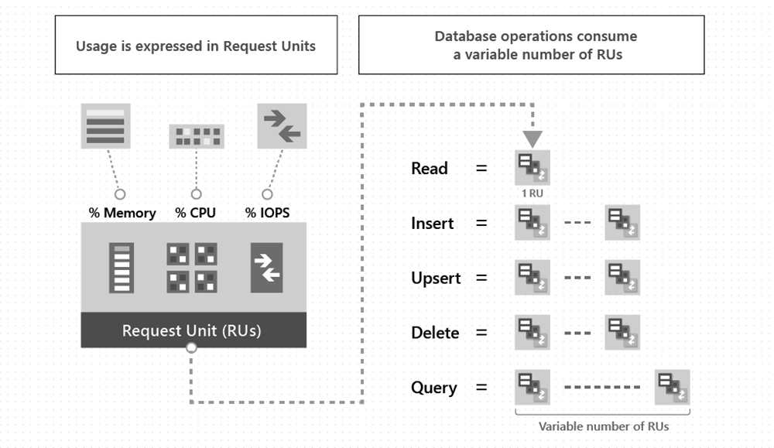
What is an RU?
Per SECOND!
Amortize over time
Monthly batch job
100,000 documents (~1kb)
10 RU/s insert
1M RU total
Cost to insert
1 second?
10 seconds?
1 minute?
1 month?
learn.microsoft.com/azure/cosmos-db/request-units
Notes:
1 second = 1 million RU = $80/hour
10 seconds = 100,000 RU = $8/hour
1 minute = 17,000 RU = $1.36/hour
1 month = 4 RU (1000 RU/s = .08c)

Slide 31
Key tips on Throughput
Throughput and partitions are bound to each other
Heuristic for partition splits is more aggressive at container creation than afterwards.
Massive scale-up then down again can result in throughput fragmentation and 429’s later
  100,000 RU = 10 partitions
  If I go from 100,000 RU -> 1,000 RU then…
  1000 RU/10 = 100 RU/partition (too little compute to do much)
Read this before doing any major scale up
learn.microsoft.com/azure/cosmos-db/scaling-provisioned-throughput-best-practices

Slide 32

Merge Partitions (preview) https://aka.ms/AzureCosmosDB/MergePartPreview

Slide 33
Choosing a partition key for customers
{
"id": "…",
"title": "…",
"firstName": "…",
"lastName": "…",
"emailAddress": "…",
"phoneNumber": "…",
"creationDate": "…",
"addresses": [{
"addressLine1": "…",
"addressLine2": "…",
…
}],
"password": {
"hash": "…",
"salt": "…"
}
}
customer
PK: ?

Slide 34
Choosing a partition key for customers
customer
PK: ?
Create a customer
Edit a customer
Retrieve a customer
(by id)

Slide 35
Choosing a partition key for customers
customer
PK: id
Create a customer
Edit a customer
Retrieve a customer
(by id)

Slide 36
Choosing a partition key for customers
customer
PK: id

Slide 37
Demo
Query customers

Slide 38
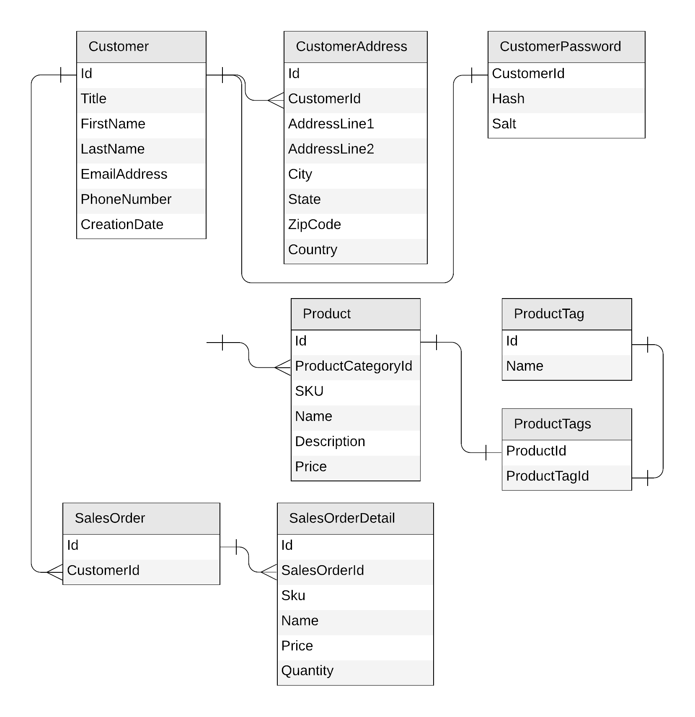
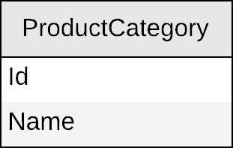
Next: products

Slide 39
Product category
{
"id": "…",
"name": "…"
}

Slide 40
Product category
productCategory
PK: ?
{
"id": "…",
"name": "…"
}

Slide 41
Product category
productCategory
PK: ?
Create a product category
Edit a product category
List all product categories
SELECT * FROM c

Slide 42
Product category
productCategory
PK: type
{
"id": "…",
"name": "…",
"type": "category"
}
SELECT * FROM c WHERE
c.type = “category”

Slide 43
Demo
Query product categories

Slide 44
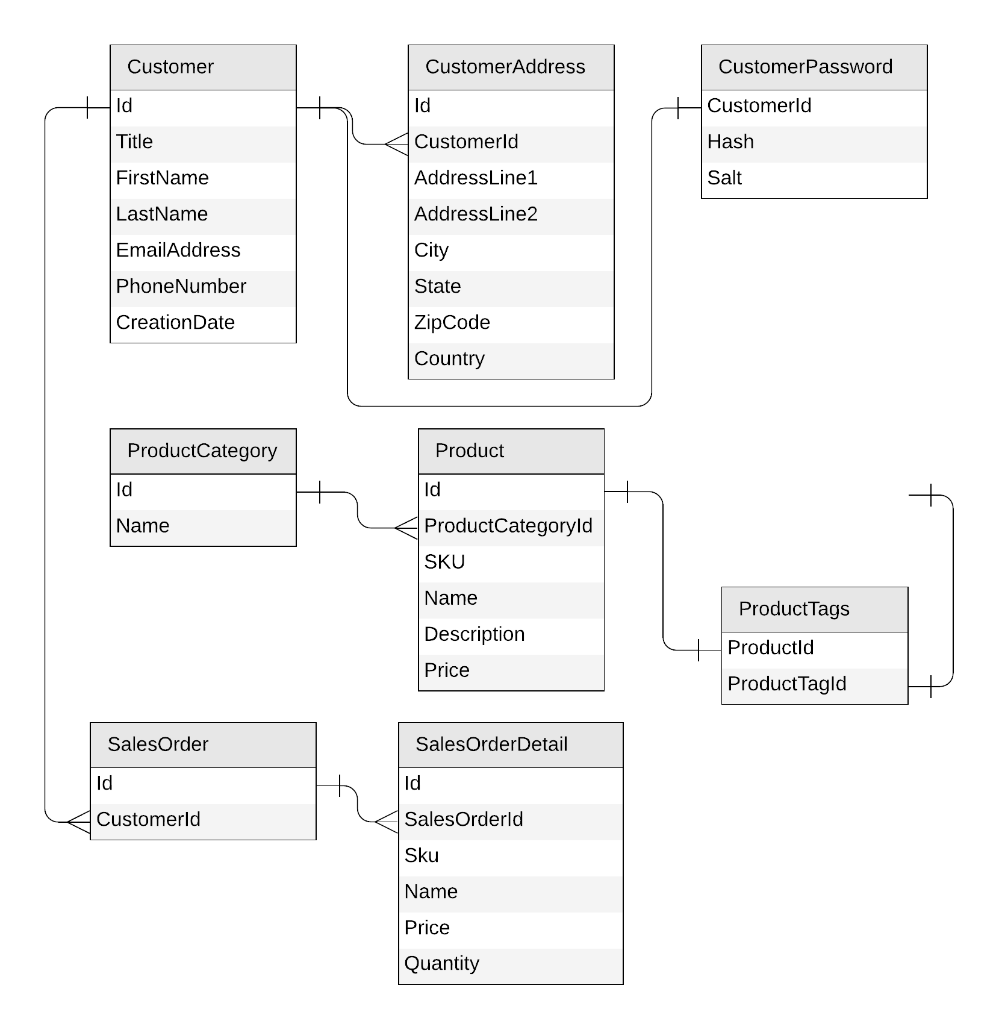
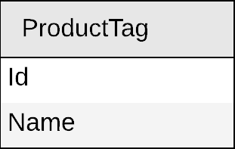
Next: product tag

Slide 45
Product tag
{
"id": "…",
"name": "…"
}

Slide 46
Product tag
productTag
PK: ?
{
"id": "…",
"name": "…"
}

Slide 47
Product tag
productTag
PK: ?
Create a product tag
Edit a product tag
List all product tags

Slide 48
Product tag
productTag
PK: type
{
"id": "…",
"name": "…",
"type": "tag"
}

Slide 49
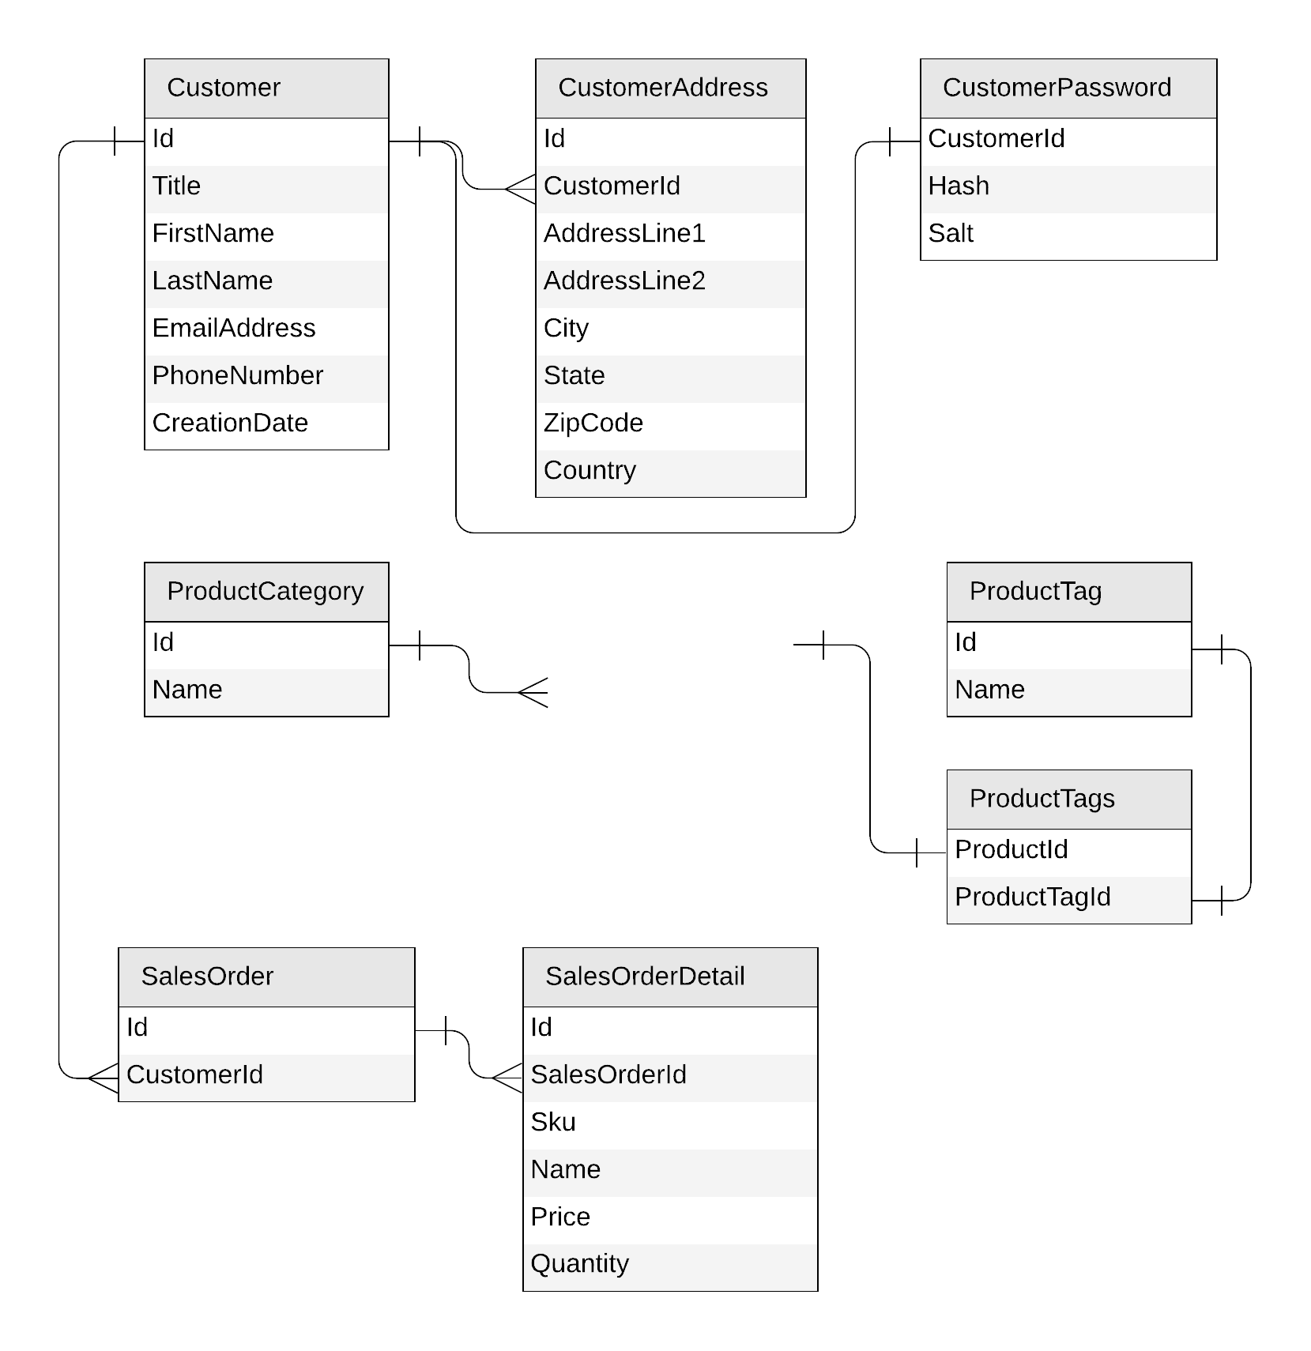
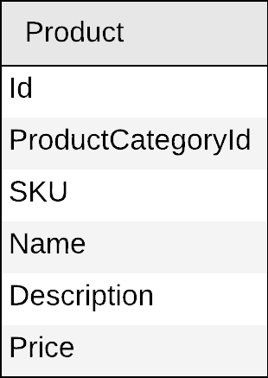
Next: product

Slide 50
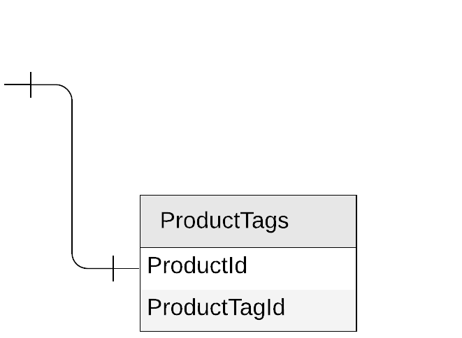
Product
{
"id": "…",
"categoryId": "…",
"sku": "…",
"name": "…",
"description": "…",
"price": …
}

Slide 51
Products
{
"id": "…",
"categoryId": "…",
"sku": "…",
"name": "…",
"description": "…",
"price": …,
"tagIds": [
"…",
"…"
]
}

Slide 52
Products
{
"id": "…",
"categoryId": "…",
"sku": "…",
"name": "…",
"description": "…",
"price": …,
"tagIds": [
"…",
"…"
]
}
product
PK: ?

Slide 53
Products
Create a product
Edit a product
List all products from a category
(with name of category and tags)
product
PK: ?
SELECT * FROM c WHERE c.categoryId = 'CategoryA'
CategoryA
CategoryB
CategoryC

Slide 54
Products
{
"id": "…",
"categoryId": "…",
"sku": "…",
"name": "…",
"description": "…",
"price": …,
"tagIds": [
"…",
"…"
]
}
category name?
product
PK: categoryId
tag names?

Slide 55

Products: how to return category and tag names?
product
SELECT * FROM c WHERE c.categoryId = 'CategoryA'
WHERE ARE MY JOINS?
productCategory
SELECT c.name FROM c WHERE c.id = 'CategoryA'
productTag
SELECT * FROM c
WHERE c.id IN ('<tagId1>', '<tagId2>', '<tagId3>')

Slide 56
Introducing denormalization
When working with non-relational databases, we optimize our data models to make sure that all the required data is ready to be served by the queries

Slide 57
Products: denormalizing category and tag names
{
"id": "…",
"categoryId": "…",
"categoryName": "…",
"sku": "…",
"name": "…",
"description": "…",
"price": …,
"tags": [
{
"id": "…"
"name": "…"
},
{
"id": "…"
"name": "…"
},
]
}
product
PK: categoryId

Slide 58
Demo
Query a product with category name and tag names

Slide 59
Products: keeping everything in sync
productCategory
ProductCategory
product
Product
productTag
ProductTag

Slide 60

Cosmos DB's change feed
The change feed is an API exposed by Cosmos DB containers
It streams any change happening in a container (document creation or update)

Slide 61

Products: keeping everything in sync
productCategory
product
productTag

Slide 62
Demo
Update product category name
Use Change Feed to propagate the change into product container

Slide 63
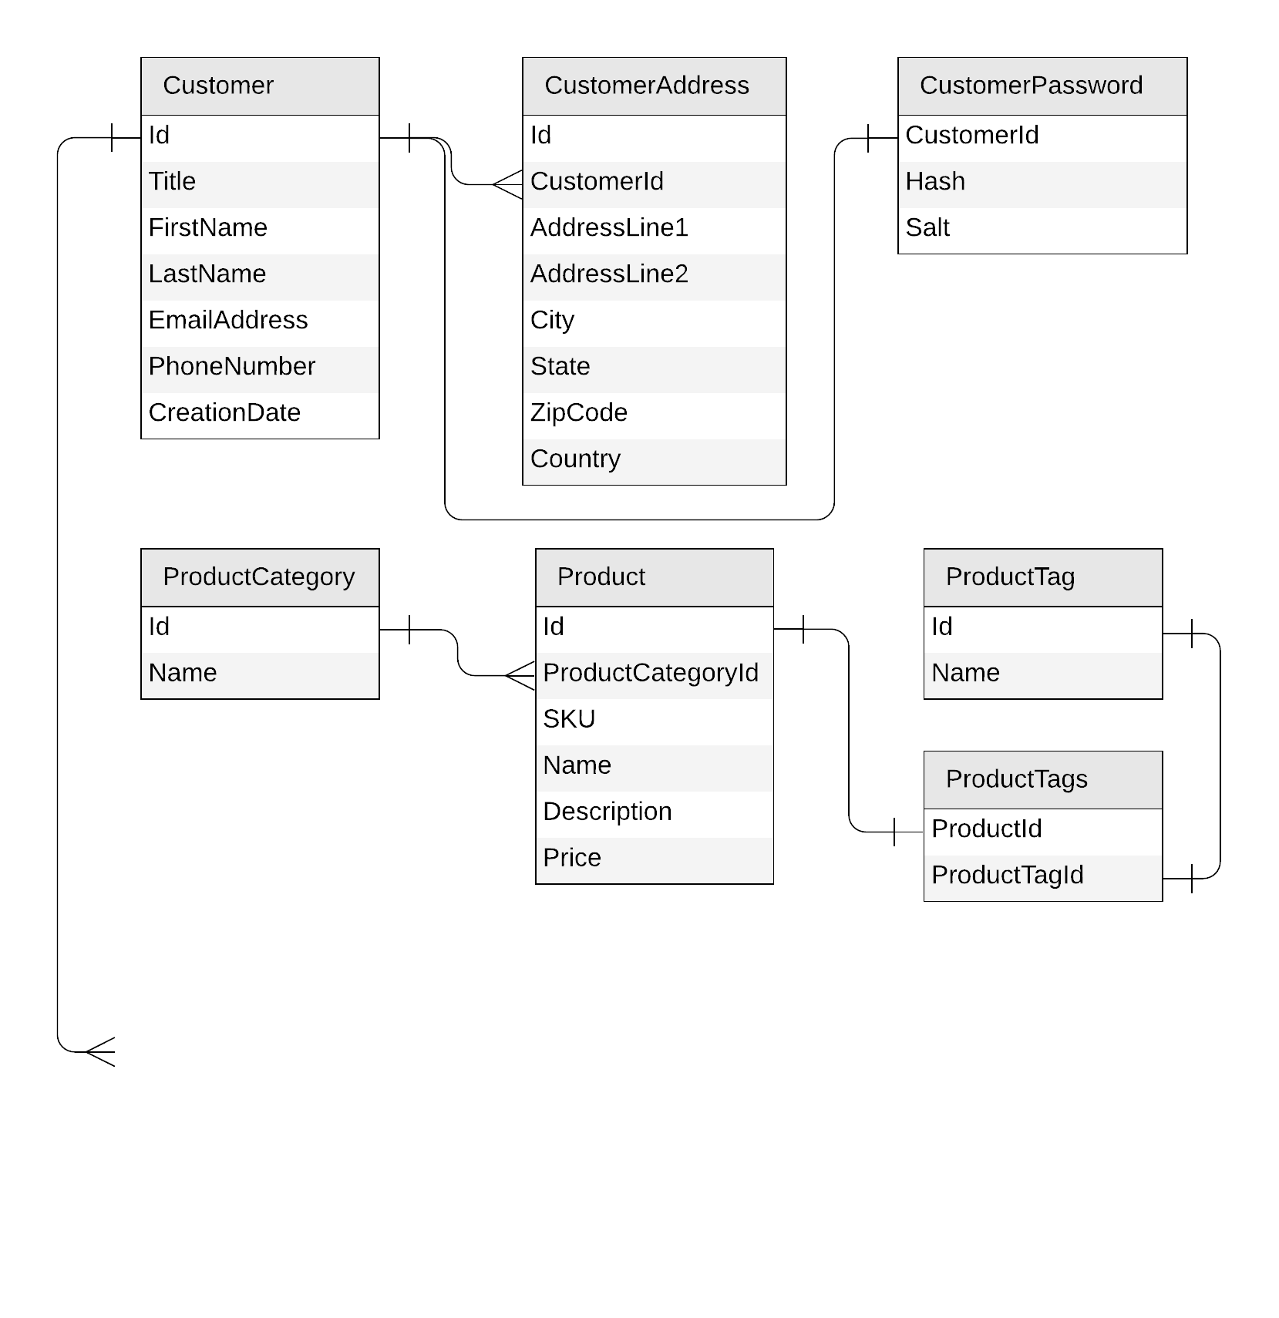
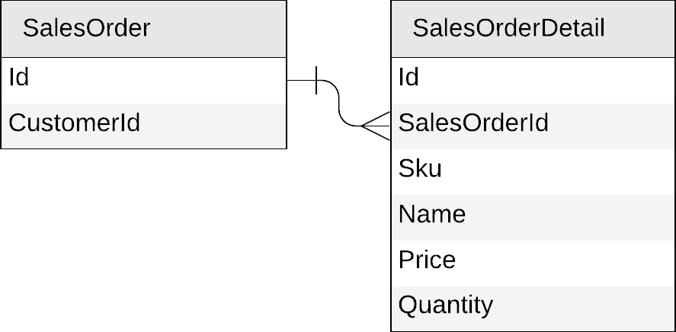
Next: sales orders

Slide 64
Sales orders
{
"id": "…",
"customerId": "…"
}
{
"id": "…",
"salesOrderId": "…",
"sku": "…",
"name": "…",
"description": "…",
"price": …,
"quantity": …
}

Slide 65
Sales orders
{
"id": "…",
"customerId": "…",
"details": [{
"sku": "…",
"name": "…",
"description": "…",
"price": …,
"quantity": …
}]
}

Slide 66
Sales orders
{
"id": "…",
"customerId": "…",
"details": [{
"sku": "…",
"name": "…",
"description": "…",
"price": …,
"quantity": …
}]
}
salesOrder
PK: ?

Slide 67
Sales orders
salesOrder
PK: ?
Create a sales order
List all sales orders for a customer
Query top 10 customers by number of sales orders

Slide 68
Sales orders
salesOrder
PK: ?
Create a sales order
List all sales orders for a customer
SELECT * FROM c WHERE c.customerId = 'CustomerA'
CustomerA
CustomerB
CustomerC

Slide 69
Sales orders
{
"id": "…",
"customerId": "…",
"details": [{
"sku": "…",
"name": "…",
"description": "…",
"price": …,
"quantity": …
}]
}
salesOrder
PK: customerId

Slide 70
Sales orders
{
"id": "…",
"customerId": "…",
"details": [{
"sku": "…",
"name": "…",
"description": "…",
"price": …,
"quantity": …
}]
}
salesOrder
PK: customerId
{
"id": "…",
"title": "…",
"firstName": "…",
"lastName": "…",
"emailAddress": "…",
"phoneNumber": "…",
…
}
customer
PK: id

Slide 71
Mixing entities in the same container?
YES!
Leverage the schema-agnostic nature of Cosmos DB
Suitable when different entity types
  share similar access patterns
  share the same partition key

Slide 72
Sales orders
{
"id": "…",
"customerId": "…",
"details": [{
"sku": "…",
"name": "…",
"description": "…",
"price": …,
"quantity": …
}]
}
salesOrder
PK: customerId
{
"id": "…",
"title": "…",
"firstName": "…",
"lastName": "…",
"emailAddress": "…",
"phoneNumber": "…",
…
}
customer
PK: id

Slide 73
Sales orders: mixing with customers
{
"id": "…",
"customerId": "…",
"details": [{
"sku": "…",
"name": "…",
"description": "…",
"price": …,
"quantity": …
}]
}
customer
PK: id
{
"id": "…",
"title": "…",
"firstName": "…",
"lastName": "…",
"emailAddress": "…",
"phoneNumber": "…",
…
}

Slide 74
Sales orders: mixing with customers
{
"id": "…",
"customerId": "…",
"details": [{
"sku": "…",
"name": "…",
"description": "…",
"price": …,
"quantity": …
}]
}
customer
PK: customerId
{
"id": "…",
"customerId": "…",
"title": "…",
"firstName": "…",
"lastName": "…",
"emailAddress": "…",
"phoneNumber": "…",
…
}

Slide 75
Sales orders: mixing with customers
{
"id": "…",
"type": "salesOrder",
"customerId": "…",
"details": [{
"sku": "…",
"name": "…",
"description": "…",
"price": …,
"quantity": …
}]
}
customer
PK: customerId
{
"id": "…",
"type": "customer",
"customerId": "…",
"title": "…",
"firstName": "…",
"lastName": "…",
"emailAddress": "…",
"phoneNumber": "…",
…
}

Slide 76
Sales orders: mixing with customers
customer
sales orders
customer
PK: customerId
CustomerA
CustomerB
CustomerC

Slide 77
Sales orders
customer
PK: customerId
Create a sales order
List all sales order for a customer
SELECT * FROM c WHERE c.customerId = 'CustomerA' AND c.type = 'salesOrder'

Slide 78
Demo
Query sales orders by customer id

Slide 79
Sales orders
customer
PK: customerId
Create a sales order
List all sales orders for a customer
Query top 10 customers by number of sales orders

Slide 80
Denormalizing the count of sales orders per customer
{
"id": "…",
"type": "customer",
"customerId": "…",
"title": "…",
"firstName": "…",
"lastName": "…",
"emailAddress": "…",
"phoneNumber": "…",
"creationDate": "…",
"addresses": [{
"addressLine1": "…",
"addressLine2": "…",
…
}],
"password": {
"hash": "…",
"salt": "…"
}
}

Slide 81
Denormalizing the count of sales orders per customer
{
"id": "…",
"type": "customer",
"customerId": "…",
"title": "…",
"firstName": "…",
"lastName": "…",
"emailAddress": "…",
"phoneNumber": "…",
"creationDate": "…",
"addresses": [{
"addressLine1": "…",
"addressLine2": "…",
…
}],
"password": {
"hash": "…",
"salt": "…"
},
"salesOrderCount": …
}

Slide 82
Denormalizing the count of sales orders per customer
customer
sales orders
customer
PK: customerId
CustomerA
CustomerB
CustomerC

Slide 83
Denormalizing the count of sales orders per customer
update the customer
add a sales order
customer
PK: customerId
CustomerA
CustomerB
CustomerC

Slide 84
Sales orders
customer
PK: customerId
Create a sales order
List all sales order for a customer
Query top 10 customers by number of sales orders
SELECT TOP 10 * FROM c WHERE c.type = 'customer'
ORDER BY c.salesOrderCount DESC

Slide 85
Demo
Create a new sales order & update total sales orders
Query for top 10 customers

Slide 86
Our final design
customer
PK: customerId
Customer
productTag
PK: type
ProductTag
SalesOrder
product
PK: categoryId
productCategory
PK: type
Product
ProductCategory

Slide 87
Our final design
productCategory
PK: type
ProductCategory
productMeta
PK: type
ProductTag
ProductCategory
productTag
PK: type
ProductTag
SELECT * FROM c WHERE c.type = ‘category'
SELECT * FROM c WHERE c.type = ‘tag'

Slide 88
Our final design, optimized!
customer
PK: customerId
Customer
SalesOrder
productMeta
PK: type
ProductTag
ProductCategory
product
PK: categoryId
Product

Slide 89
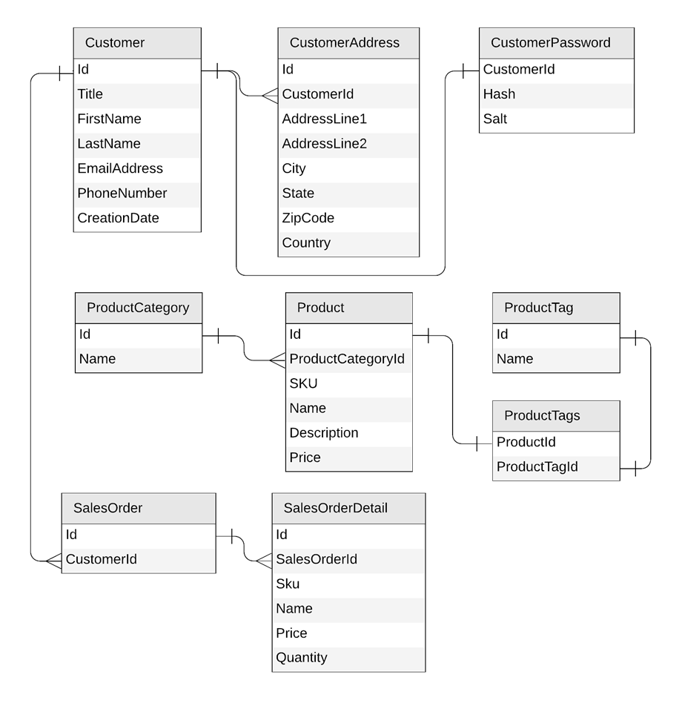
Original Relational Model

Slide 90
Key takeaways
Identify key access patterns and design for them
Partitioning is critical for best performance and scalability
Materialize relations between entities by:
  Embedding
  Denormalizing and pre-aggregating
  Storing related entities in the same container
Different methods to implement denormalization
  Using the change feed
  Using stored procedures or transactional batch

Slide 91
Going further
Demos and links to sample data.
  github.com/AzureCosmosDB/CosmicWorks
  github.com/AzureCosmosDB/CosmicWorksJava
New Microsoft Learn Labs
  https://aka.ms/msl-modeling-partitioning-1
  https://aka.ms/msl-modeling-partitioning-2
Awesome videos
  youtube.com/azurecosmosdb
Monthly User Group
  meetup.com/azure-cosmos-db-global-user-group
Weekly Live Podcast
  aka.ms/CosmosDBLiveTV
Notes:
So if you’re interested in getting the demos you saw today as well as the data and resources to try this yourself, feel free to checkout the link here at the top on GitHub.
The second link here is for an article that goes through some of what I showed here today but uses a blog platform as the use case.
Also definitely check out all our awesome videos out on our you tube channel.
And finally, gotcosmos.com which has links to lots of great content as well as our blog.

Slide 92
End

