Slide 1

Embodied Carbon Calculations Using
Carbo Life Calculator©

Slide 2

Carbo Life
Content
Installation
Workflow
Model Preparation
Extraction
The Calculation
Export
Heatmaps / Overview Page
Add to Our Database!
Advanced

Slide 3
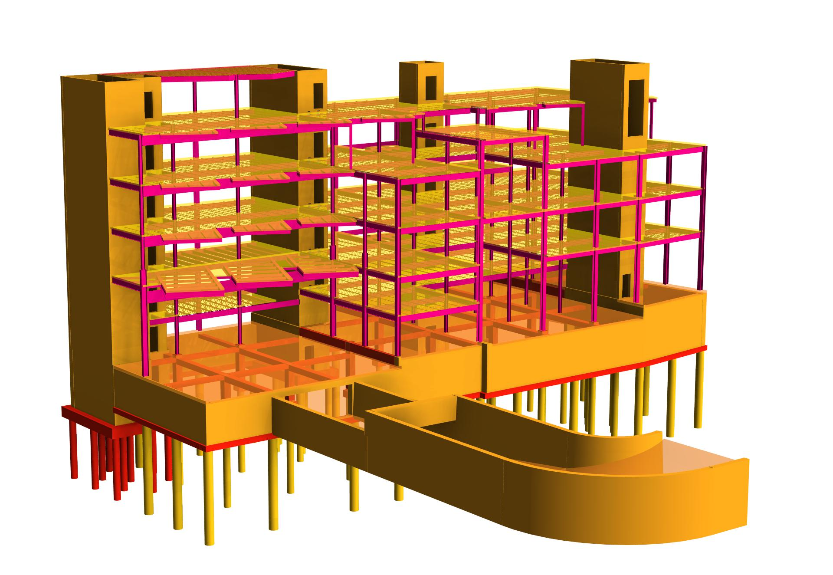
Carbo Life
Content
Timber
0.225 kgCO₂e/kg
Concrete
0.126 kgCO₂e/kg
Steel
2.77 kgCO₂e/kg

Slide 4
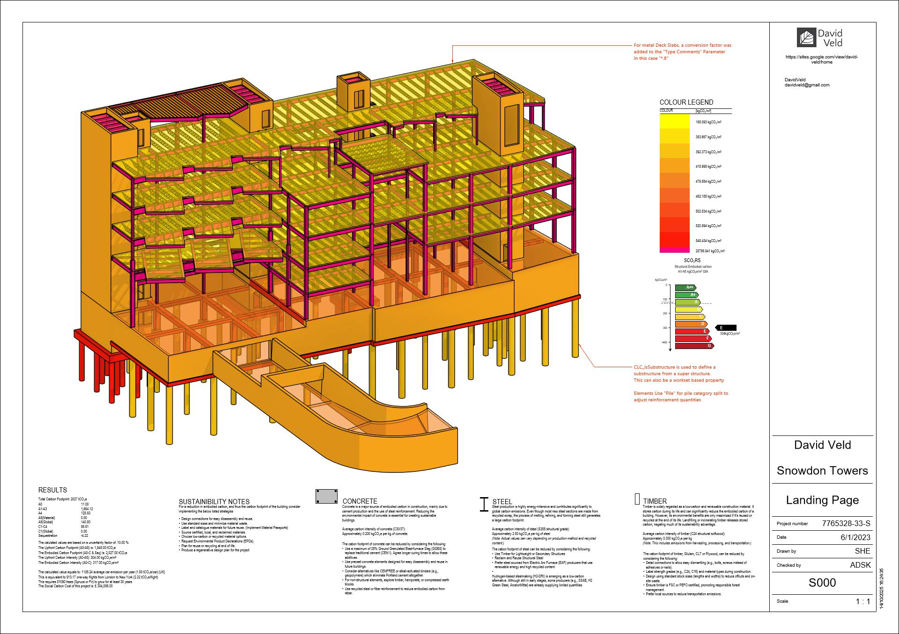
Carbo Life
Content

Slide 5




Carbo Life
Intro
Carbo Life
Free
Open Source
CarboLifeAPI
(Core)
CarboCroc
(Grasshopper Plugin)
CarboLifeRevit
(Revit Plugin)
Carbo Life Calculator
Carbo Circle (WIP)

Slide 6
Carbo Life
Installation
Useful links: Source (most recent) https://github.com/DavidVeld/CarboLifeCalc
Help: https://github.com/DavidVeld/CarboLifeCalc/wiki
(This Powerpoint)

Slide 7
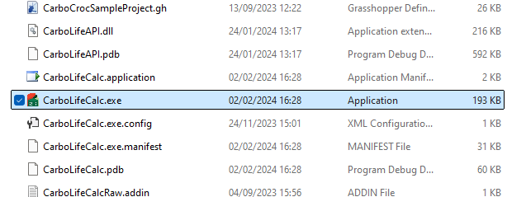
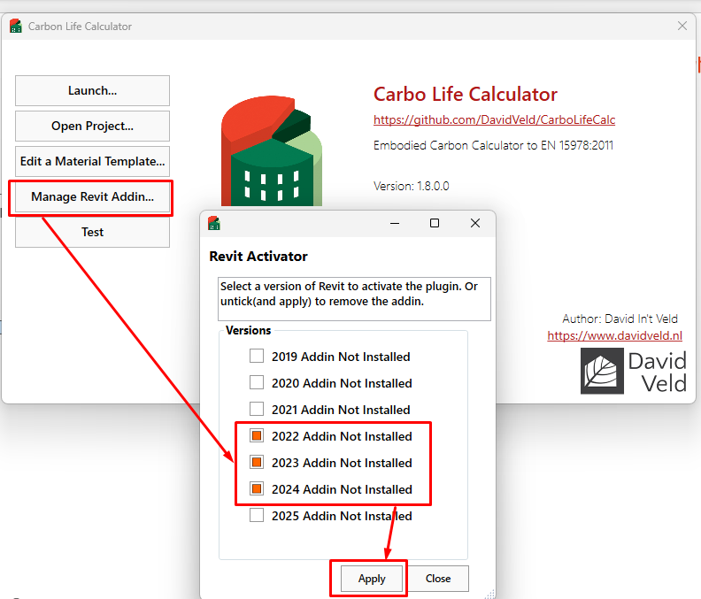
Carbo Life
Installation
If downloaded from Github Copy The files to a directory of your choice
Launch the stand alone .exe
Select “Manage Revit Plugins”
Select Versions and press “Apply”

Slide 8
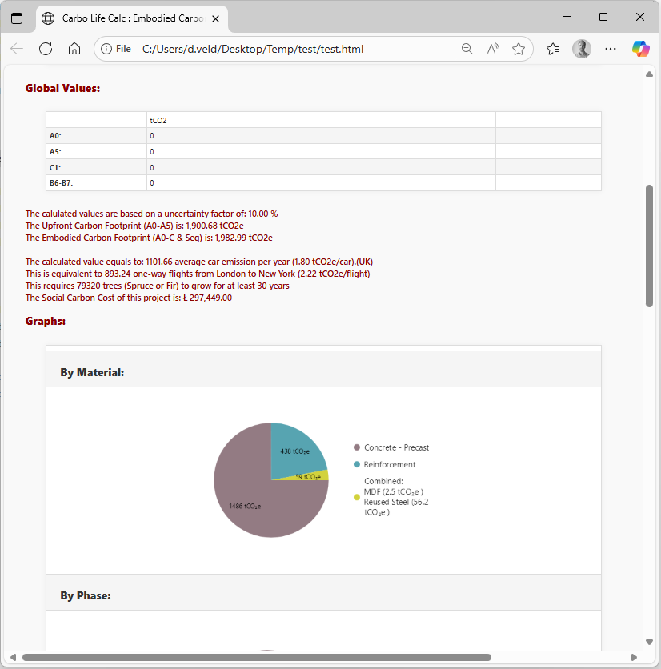
Carbo Life
Overall Process
Automated
Report
Extract
Carbo Life
Output
MODEL
Model Preparation
Calculation
Process
Revit
Category
Parameters
Volume
Material Name
Carbo Life Material Containing Carbon Data
Found in material Template

Slide 9
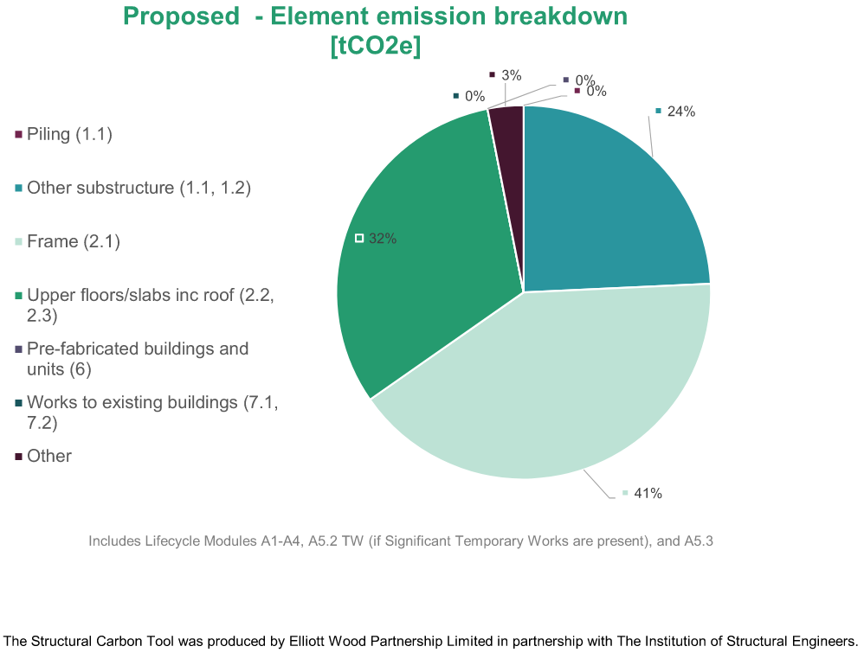
Carbo Life
Model Preparation – Substructure Workset
To align with the IStructE tool & gain insight to our designs we isolate the Substructure from Slabs, Frame and Walls
All substructure, including ground floor slab, should be in a workset that includes “Substructure” in its name

Slide 10
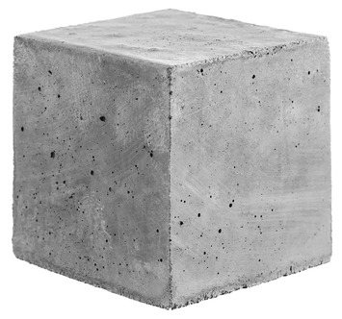
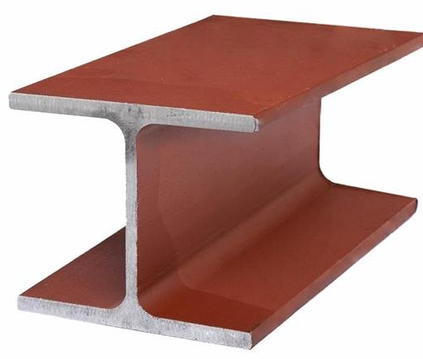
Carbo Life
Model Preparation – Concrete Strengths & Steel Sections
Your concrete strength (and mixes*) and steel section types have a big impact on ECO2**
Substructure / Slabs / Columns / Walls / Beams (framing) will be isolated for you to allocate concrete mixes against.
If you need to sub-divide these groups, agree with your technician a parameter to use for identifier.
Revit does not differentiate plate / open section / closed section / cold rolled steel, all of which have different ECO2 factors.
Agree with your technician a parameter to use to identify section type.
Certain geometries in Revit do not represent the “real” geometries such as Hollocore slabs / metal decks / timber stud walls / secant piled walls etc.
Agree with your technician a parameter to use for a “correction value”.
*We only consider 25% GGBS mixes, unless specifically asked by the Client
**If substantial in your design. Consider accuracy required vs time efficiency.

Slide 11
Carbo Life
Model Preparation
Model Preparation Demonstration

Slide 12
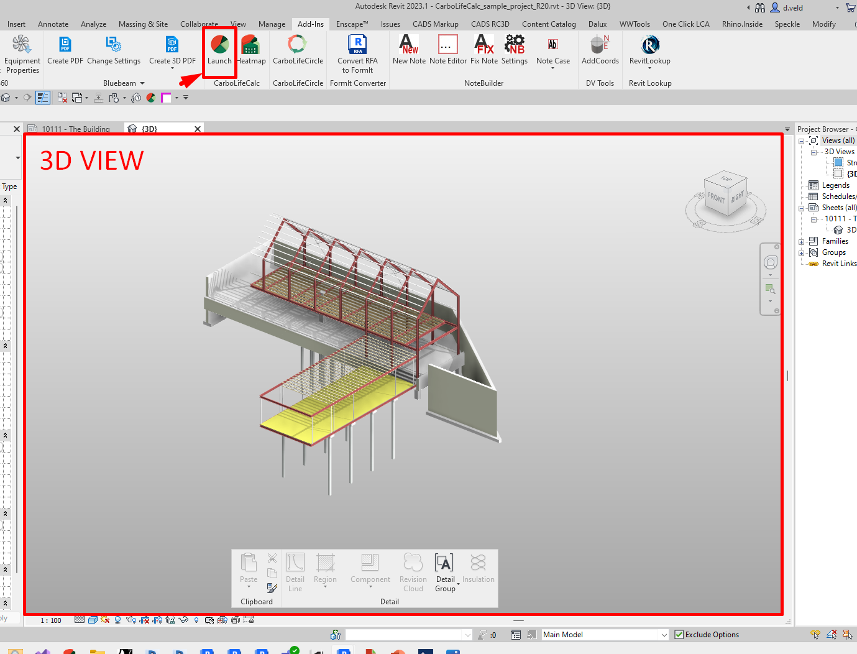
Carbo Life
Model Preparation – Scope & Extents
Hide/filter out anything you don’t want included
Make sure your pile lengths are accurate!
Carbo Life imports what it sees!
Open a 3D View
Set the ‘Phase Filter’ to “Show new”

Slide 13
Carbo Life
Extraction:
Revit
(Source)
CarboLife

Slide 14
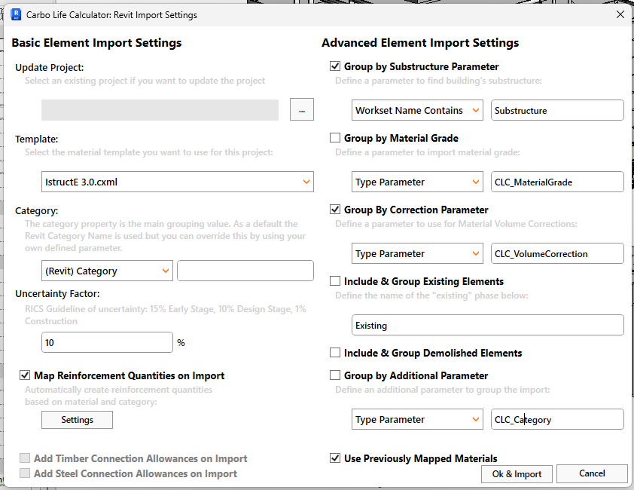
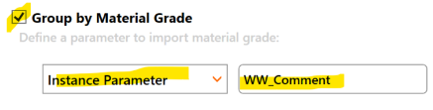
Carbo Life
Extraction:
Revit
(Source)
CarboLife
The Import Dialog Window defines how the software translates Revit elements to CarboLife Elements.
Example: if you have Concrete Strength / Steel Type variations within component types, change to:
Generic values are default. Update at stage 4/5 once rebar rates are known.

Slide 15
Carbo Life
Extraction:
CarboLifeRevit
(Source)
CarboLifeAPI
(Core)
Key
6
Select an existing project file to update a project.
Select a database where CarboLife will pick it’s embodied carbon material values from. This can be a *. Cxml (template) file or *.csv
The element’s categories are taken from the Revit Category, you can override this value for a parameter
Specify an uncertainty factor, as per RICS and IstructE’s Guidelines.
Check if you want to automatically generate reinforcement values
Define which property defines substructures
Assign this value to better group different grades
Certain elements’ volumes do not match their actual, a correction can fix this: The format would be “*.8” without quotes
If existing or demolished elements need to be extracted make sure these are checked
If you would like to extract & group any other parameter make sure to fill this in.
1
7
2
8
3
9
4
5
10
Start Import

Slide 16
Carbo Life
Extraction:
CarboLifeRevit
(Source)
CarboLifeAPI
(Core)
Extraction Demonstration

Slide 17
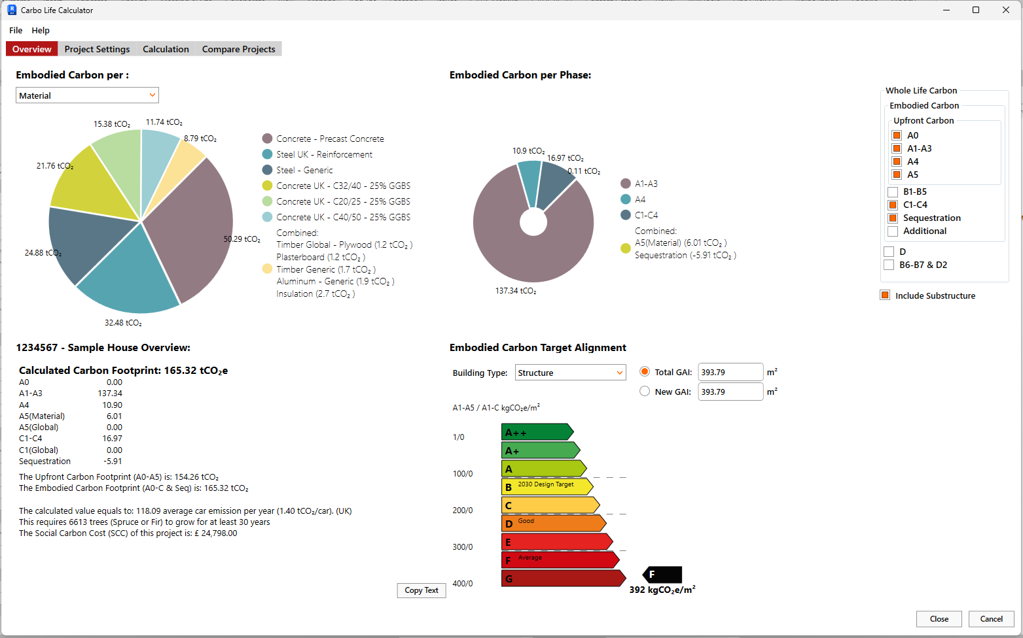
Carbo Life Calculator
(UI)
Carbo Life
Extraction:
CarboLifeAPI
(Core)
After pressing “Ok & Import” the Carbo Life Calculator UI will pop up and present its initial best-guess embodied carbon calculation.
THE BETTER THE IMPORT DATA THE BETTER & ACCURATE THE CALCULATION
THE UI IS DISCONNECTED FROM THE MODEL, YOU CANNOT BREAK THE REVIT MODEL THROUGH CARBOLIFE

Slide 18
Carbo Life Calculator
(UI)
Carbo Life
Extraction:
CarboLifeAPI
(Core)
Key
1
Global Program Options
Import / Export / Save / Open Files
Project Areas
Graphs
Summary Text
Calculation Scope
Target alignment graph.
2
3
5
4
6

Slide 19
Carbo Life
Extraction:
CarboLifeRevit
(Source)
CarboLifeAPI
(Core)
User Interface Demonstration

Slide 20
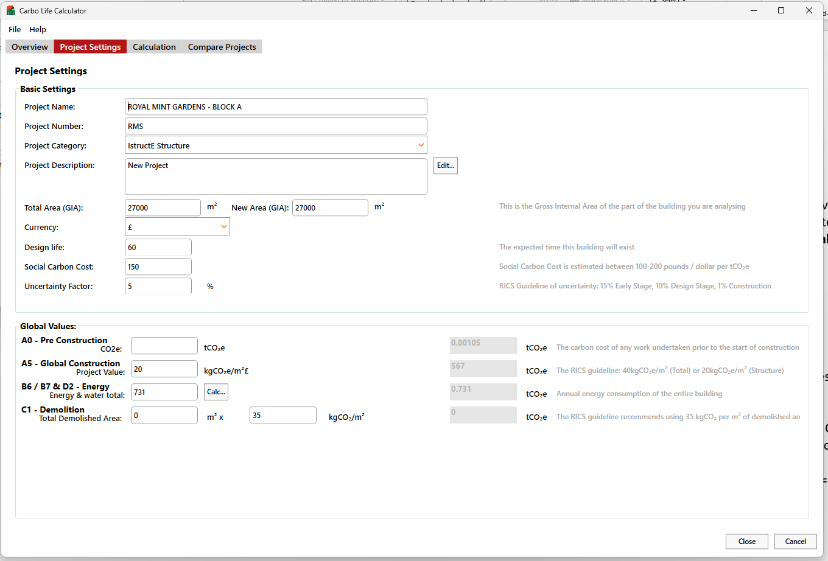
Carbo Life Calculator
(UI)
Carbo Life
Extraction:
CarboLifeAPI
(Core)
Key
Project settings, taken from the Revit model on import, and can be manually adjusted
Define the GIA new and total in this area
Define design life
Define Social Carbon Cost
Uncertainty Factor
Global Values
A0 – Pre Construction*
A5 – Construction**
B - In Use*
C1 - Global Demolition Values***
*A0 & B = 0 for buildings
**The ISE Tool considers 17.5kg/m² Pre Construction Demolition (A5.1) and 20kg/m² Construction Activities (A5.2). Do the same to be comparable.
***C1 is a % of A5.2. Business as usual = 25%, Good practice = 30%, Best practice = 50%.
1
2

Slide 21
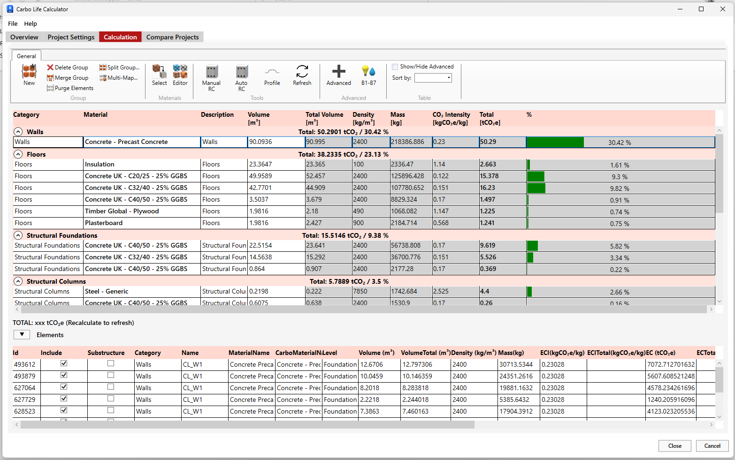
Carbo Life Calculator
(UI)
Carbo Life
Extraction:
CarboLifeAPI
(Core)
The Calculation Tab offers access to the core of the calculation.
Manage used materials
Add / remove values
Correct volumes / data
! Apply your concrete strength / steel section types here !
Default Concrete is equivalent to C32/40 25% GGBS
Use the ‘Editor’ to add missing materials, referencing valid sources such as EPDs or the Inventory of Carbon and Energy. Sync so these automatically load next time.
! Use the metal deck adjustment tool if required !
Speak to DV if you have hollowcore or composite CLT

Slide 22
Carbo Life Calculator
(UI)
Carbo Life
Extraction:
CarboLifeAPI
(Core)
All elements in Revit with similar properties, defined in the import dialog are grouped together and their volumes summed up together.
The mapping of the Revit material to carbo life’s material is based on, material name, material grade & material class.
THE BETTER THE CARBOLIFE MATERIAL LIBRARY MATCHES THE REVIT MATERIAL LIBRARY

Slide 23
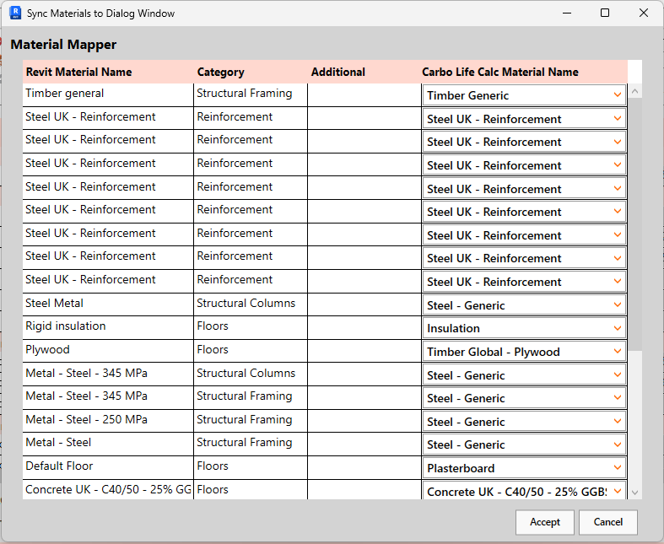
Carbo Life Calculator
(UI)
Carbo Life
Extraction:
CarboLifeAPI
(Core)
2
3
The Multi-map tool allows quick change of all materials, the first step to confirm the right materials.
Change the material or edit the material properties.
Show the advanced columns which are needed for volume corrections and waste.
1

Slide 24
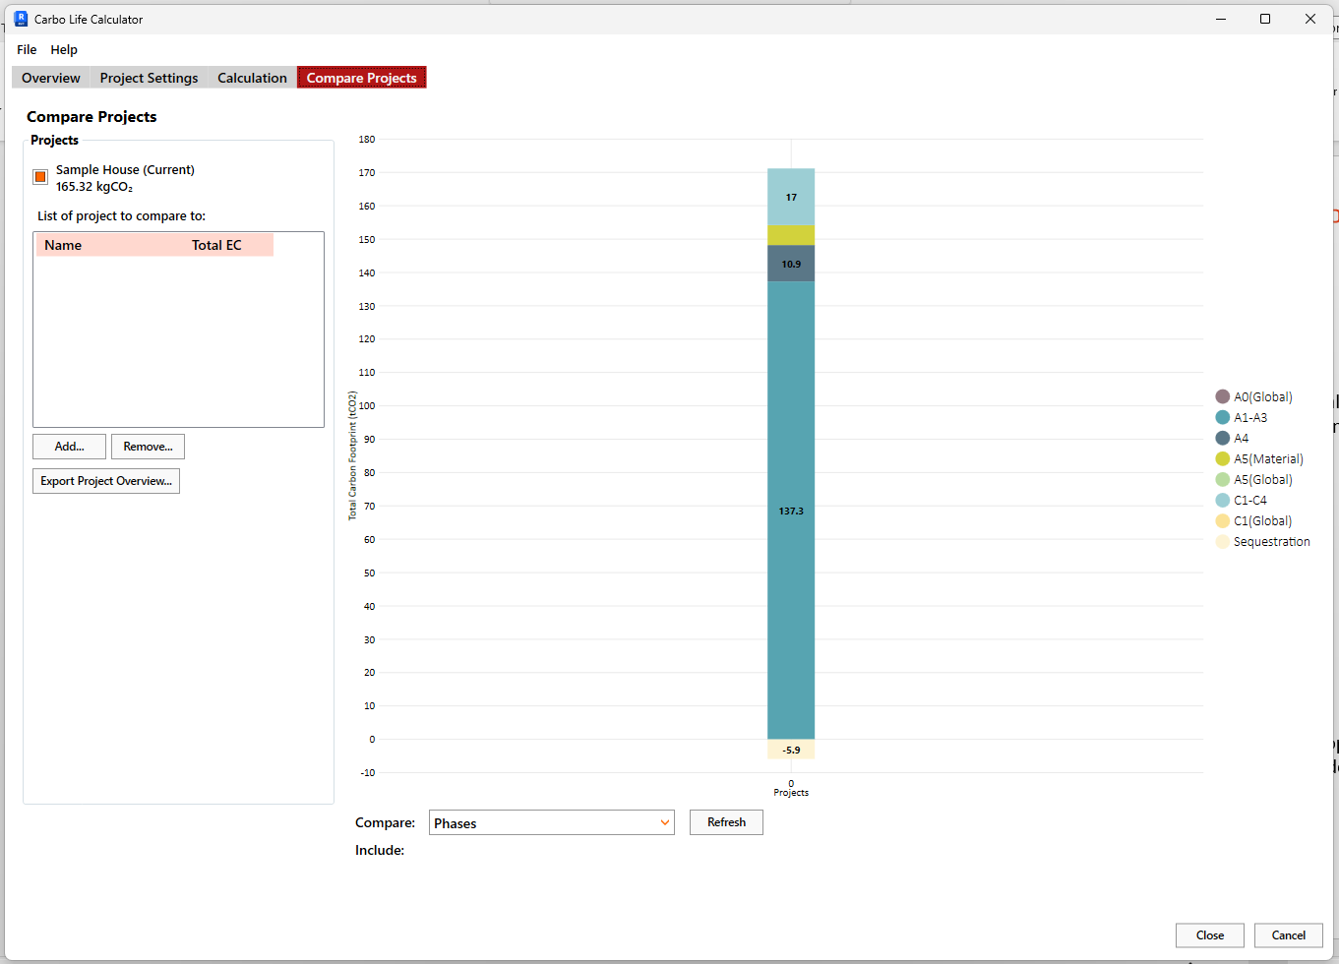
Carbo Life Calculator
(UI)
Carbo Life
Extraction:
CarboLifeAPI
(Core)
Compare projects allow for comparison of different projects and export multiple projects.

Slide 25
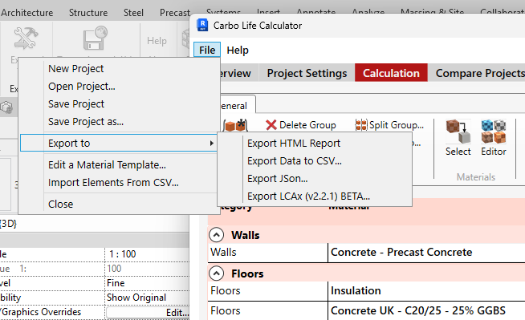
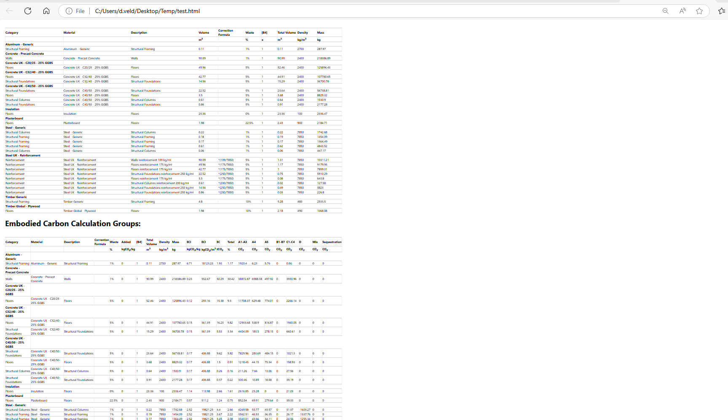
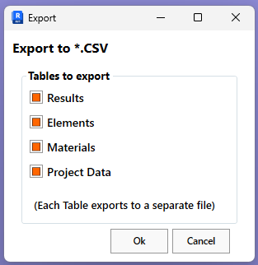

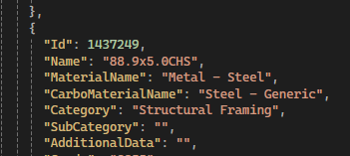
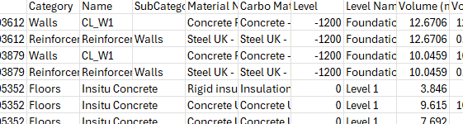
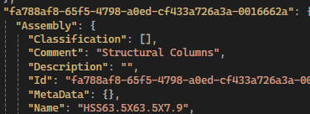
Carbo Life
Export:
HTML report:
The basic group totals and material values
CSV:
All elements, groups, totals, summary
Json:
All elements to CarboLife JSON format
LCAx:
All element to LCAx 2.2.1

Slide 26
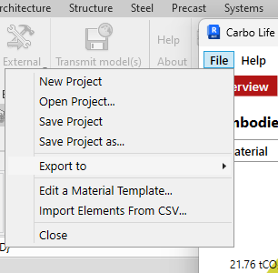
Carbo Life
Heatmaps / Overview page:
1. Save The project to be able to open the data for heatmap images:

Slide 27
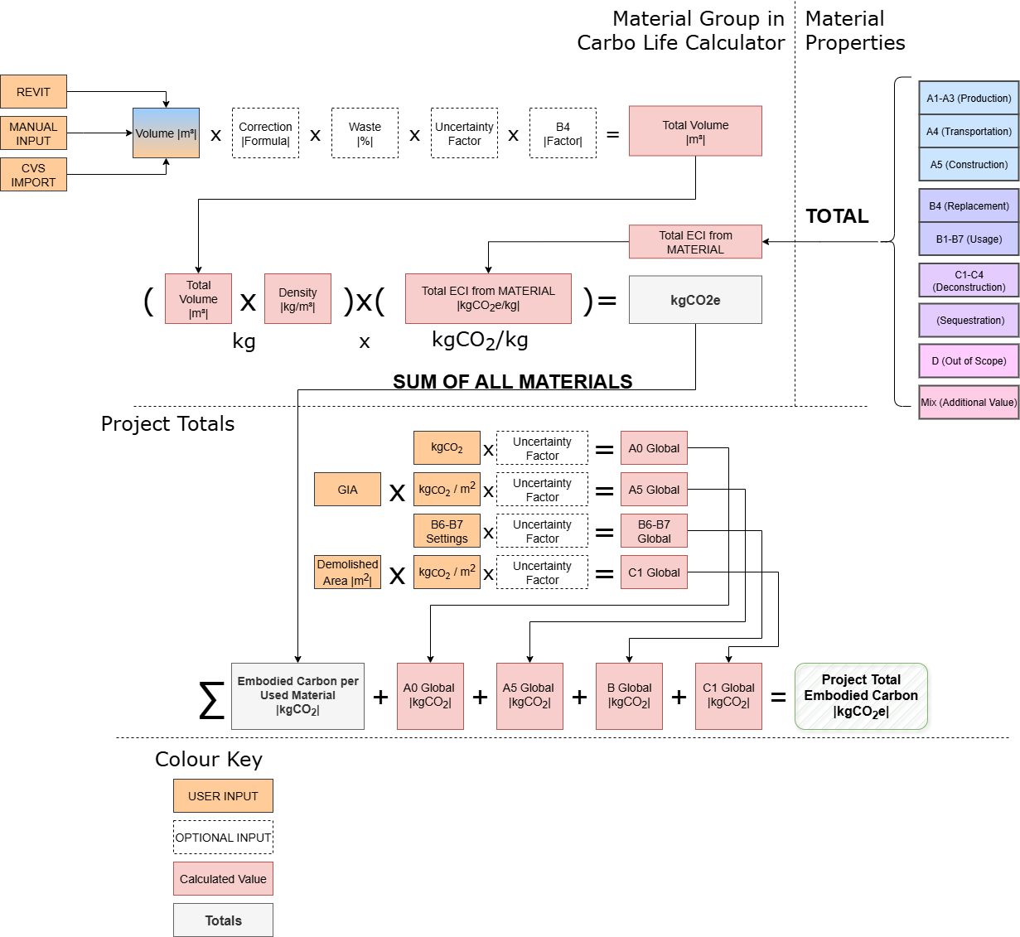
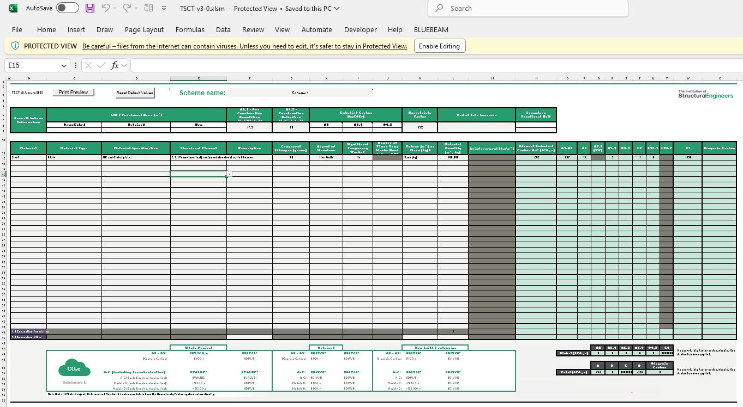
Carbo Life
The calculation:
Input
CarboLifeAPI
(Core)
Material Based Values
Global Based Values
Output
05. The Calculation · DavidVeld/CarboLifeCalc Wiki · GitHub

Slide 28
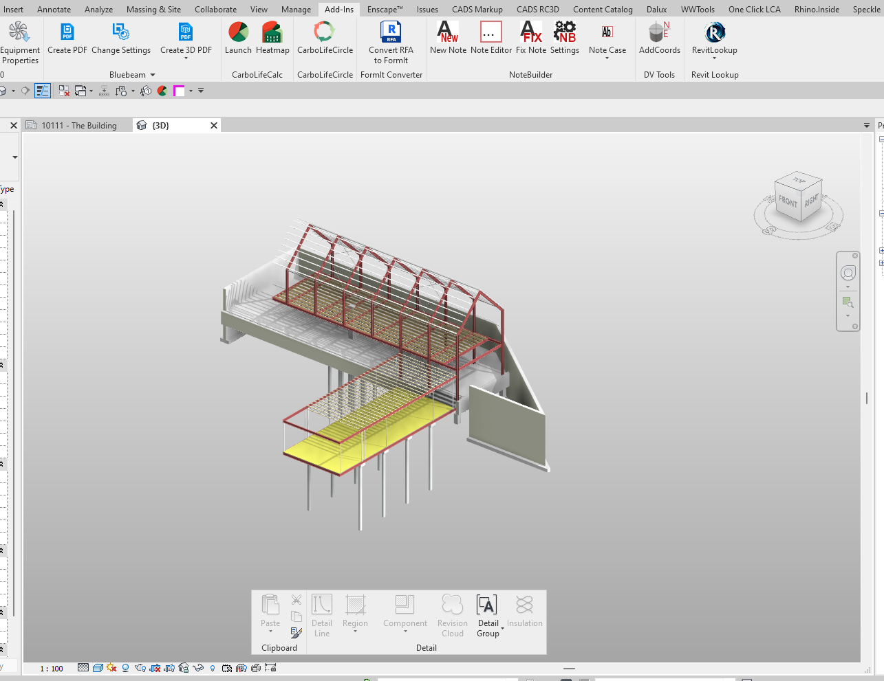
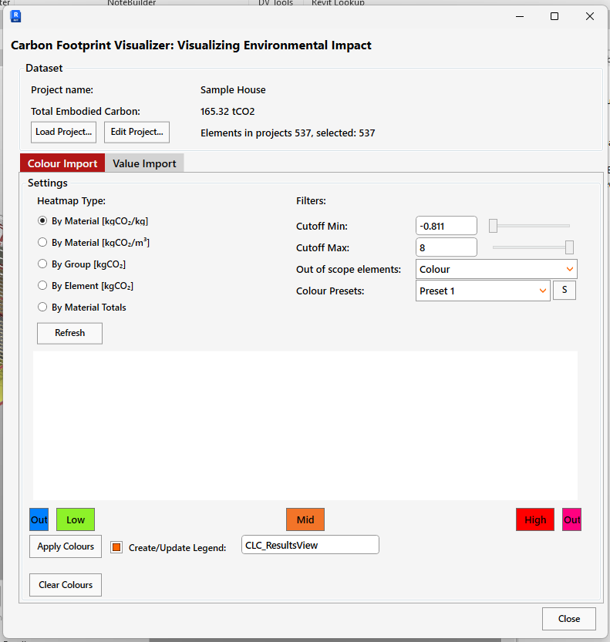
Carbo Life
Heatmaps / Overview page:
2. Launch -> Open Project
1. 3D VIEW

Slide 29
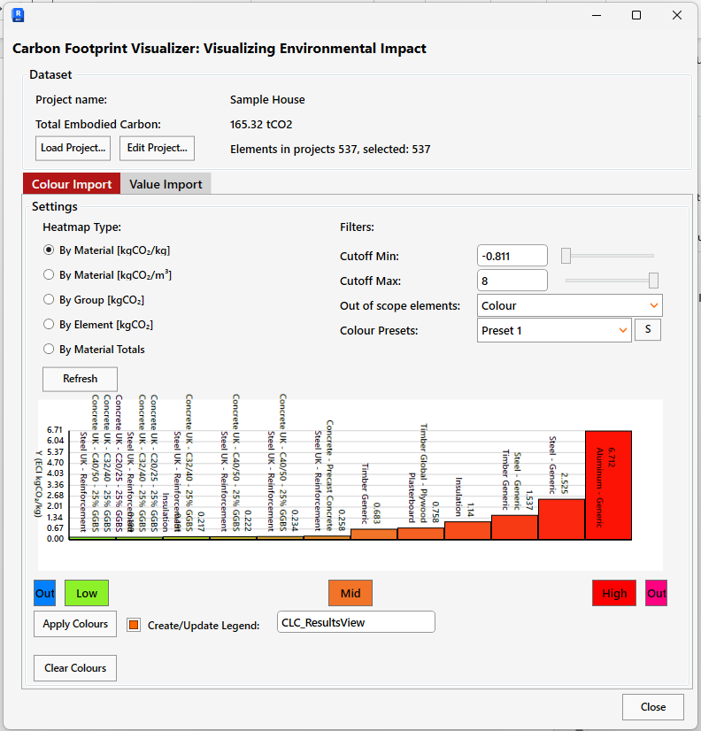
Carbo Life
Heatmaps / Overview page:
1
Key
Project information
Open a new project dataset /
edit the project
Select Heatmap Type
Settings:
Apply Colours to view
Generate a legend when colours are applied
Clear all colours
2
3
4
5
6

Slide 30
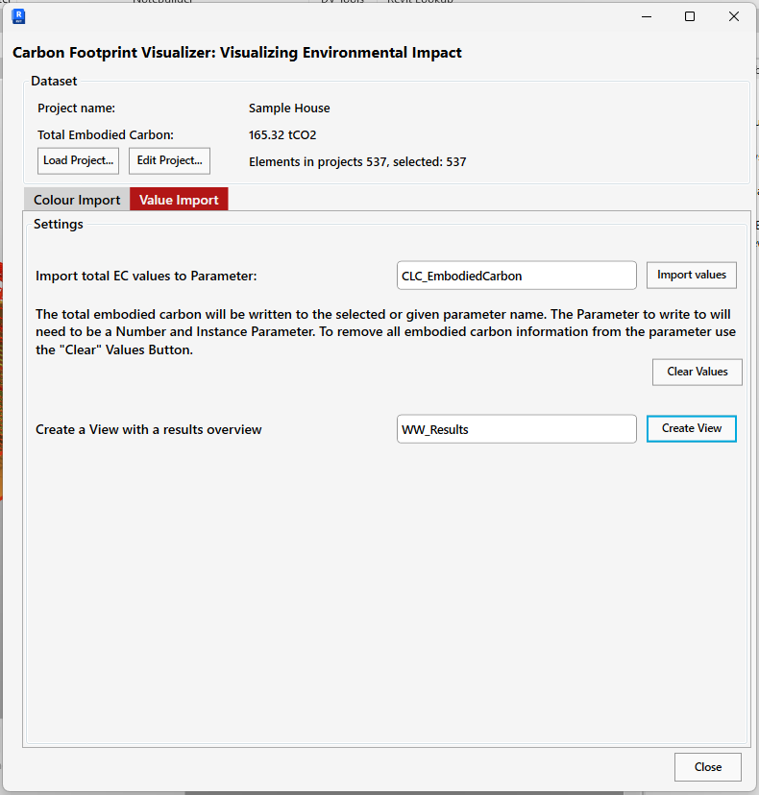
Carbo Life
Heatmaps / Overview page:
1
Key
Project information
Open a new project dataset /
edit the project
Write the embodied carbon values into a specified Revit instance parameter.
Create a View with all the calculation results.
2
3

Slide 31
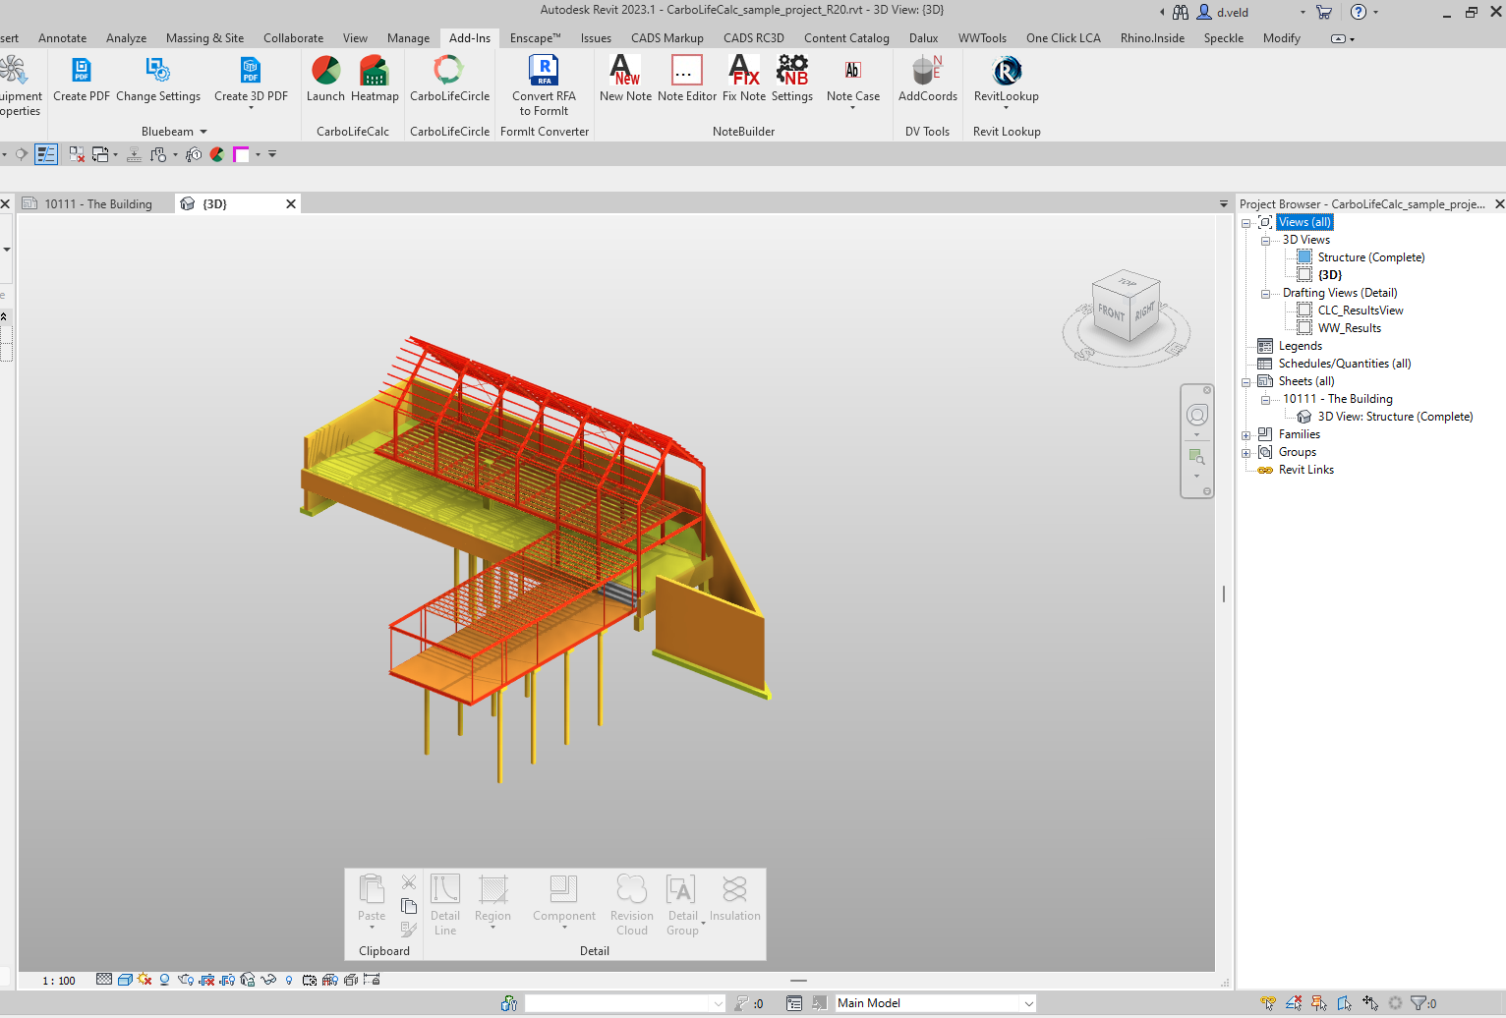
Carbo Life
Heatmaps / Overview page:

Slide 32
Carbo Life
Extraction:
Heatmap / Embodied Carbon Sheet Setup Demonstration

Slide 33
Carbo Life
Advanced Steps
Super / Substructure
Correction Factor Import for Metal deck
Import & Split By Concrete Grade
Existing / Demo analysis ← More Whole Life Carbon (ESG) remit
Material Editor (If time)

