Slide 1
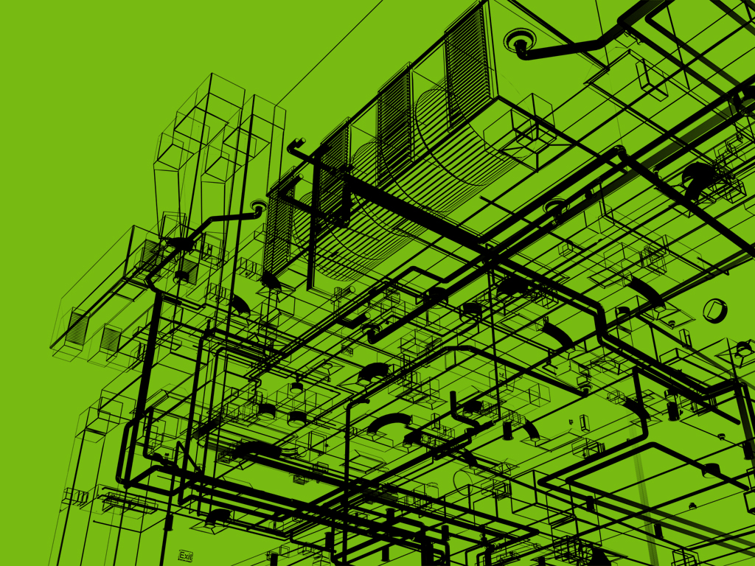
The Ins and Outs of Revit® MEP Programming
Jeremy Tammik
Consulting Analyst

Slide 2

About the Presenter
Jeremy Tammik
Developer Technical Services
EMEA
Autodesk SARL
Jeremy is a member of the AEC workgroup of the DevTech team, providing developer support, training, and conferences to the Autodesk Developer Network ADN. He originally joined Autodesk in 1988 as the technology evangelist responsible for European developer support. In this capacity, he wrote articles, consulted, lectured on AutoCAD application programming techniques, and supported AutoCAD application developers in Europe, the U.S., Australia, and Africa. He was a cofounder of ADGE, the AutoCAD Developer Group Europe, and a prolific author on AutoCAD application development. He left Autodesk in 1994 to work as an HVAC application developer, and then rejoined the company in 2005.
Jeremy graduated with a MA in mathematics and physics in Marburg, Germany, in 1984, and worked first as a teacher and translator of both computer and human languages, then as a C++ programmer on early GUI and multitasking projects. He is fluent in five European languages, vegetarian, has four kids, plays the flute, likes reading, travelling, theatre improvisation and carpentry, loves mountains, oceans, sports and especially climbing.
Jeremy writes a blog on the Revit API at http://thebuildingcoder.typepad.com and can be contacted at jeremy.tammik@eur.autodesk.com.

Slide 3
Agenda
Introduction
The Revit MEP API
Revit MEP SDK samples
RME API Samples
RME HVAC sample
RME Electrical sample
Notes:
We discuss the use of the Revit API for programming Revit MEP, or RME. First we provide an overview of the generic and the MEP specific Revit API and the SDK samples provided to demonstrate its use. We then discuss two additional samples, one HVAC oriented one making use of the generic Revit API to analyse and manipulate duct air terminals, and an electrical sample for analysis and display of an electrical system in a tree view showing the connection hierarchy.

Slide 4
Revit API
Basic Revit API is generic
All flavours use the same RevitAPI.dll .NET assembly
Specific additional features exist
Architecture: Rooms
Structure: Analytical model
MEP: Additional features added for the first time 2009
Generic API can also be for MEP
Can access and modify MEP model
The HVAC sample uses this generic parameter access
Notes:
Most of the Revit API is generic and applies to all three flavours of the Revit product, i.e. Architecture, MEP and Structure. All three flavours of Revit also include the same RevitAPI.dll .NET assembly making the API available to third-party applications. However, some specific additional features exist for each of the flavours as well, for instance some room-related functionality in Revit Architecture and support for the analytical model in Revit Structure.
Up until Revit 2008, no MEP-specific functionality was provided by the API. It was however still possible and useful to make use of the generic Revit platform API to access and manipulate a Revit MEP model. This is demonstrated by the HVAC sample using generic parameter access which we discuss below.
Revit 2009 added MEP-specific functionality to the API for the first time. We will discuss the functionality and new SDK samples provided and present an electrical example application that makes use of this to explore the data and hierarchical relationships in a system and present these in an intuitive manner.

Slide 5
Revit MEP API
RME specific API
Included in RevitAPI.dll
Specific additional features for RME
First introduced in 2009
New classes and properties added
ElectricalEquipment, LightingDevice, LightingFixture
MechanicalEquipment
FamilyInstance.MEPModel
Create and modify elements of categories
Connector, ElectricalSystem
Space, Zone, Space Tag
Notes:
We assume that you already know the Revit programming basics, so we will only discuss the RME specific API at this point. It is included in the standard RevitAPI.dll .NET assembly, which is identical for all three flavours of Revit and documented in the SDK ‘Getting Started Revit API 2009.doc’. If API functionality not supported by the currently running flavour is accessed, the call will simply do nothing. The specific additional features for RME were first introduced in Revit 2009. The new functionality includes
New classes
New properties
New categories
MEP project information
Green Building XML support
Some of the new classes and properties are
ElectricalEquipment, LightingDevice, LightingFixture
MechanicalEquipment
FamilyInstance.MEPModel
Among other things, the RME specific API functionality enables an application to create and modify elements of the categories
Connector
ElectricalSystem
Space
Zone
Space Tag
Some of the new classes added to the Autodesk.Revit.Elements, MEP, Space and Symbols namespaces are:
Autodesk.Revit.Elements.ElectricalSystem
Autodesk.Revit.Elements.ElectricalSystemSet
Autodesk.Revit.Elements.Space
Autodesk.Revit.Elements.SpaceSet
Autodesk.Revit.Elements.Zone
Autodesk.Revit.MEP.Connector
Autodesk.Revit.MEP.ConnectorManager
Autodesk.Revit.MEP.ConnectorSet
Autodesk.Revit.Space.BoundarySegment
Autodesk.Revit.Symbols.MEPBuildingConstruction
Autodesk.Revit.Symbols.SpaceTag
Autodesk.Revit.Symbols.SpaceTagType

Slide 6
MEP Project Info and gbXML
MEP Project Info
Access through ProjectInfo.gbXMLSettings
Data includes PostalCode, ProjectLocation, BuildingService, BuildingConstruction, GroundPlane, ShadingSurfaces, ProjectPhase
Green Building XML export
Document.Export(
string folder,
string name,
GBXMLExportOptions );
Notes:
Revit MEP project info is provided through the element Autodesk.Revit.Elements.gbXMLParamElem and its properties, which is accessed through the ProjectInfo.gbXMLSettings property. The available data includes PostalCode, ProjectLocation, BuildingService, BuildingConstruction, GroundPlane, ShadingSurfaces, and ProjectPhase.

Slide 7
RME Spaces and Zones
2009 improved workflow between Architecture and MEP
2008: MEP user has to Copy/Monitor rooms from architect
Rooms were unsuitable: wrong height, often too large for analysed region
2009: use Space instead of Room, and Zone to manage spaces
Subdivide room into exterior and interior subspaces
Upgrading a 2008 project to 2009 converts Copy/Monitored rooms to spaces
Our HVAC sample application uses spaces instead of rooms
More info is available at
http://inside-the-system.typepad.com/my_weblog/2008/
02/a-volume-for-en.html (20 Feb)
02/space-creation.html (21 Feb)
03/space-creation.html (03 March)
03/let-there-be-zo.html (17 March)
03/zoning-it-up.html (19 March)
03/building-perfor.html (31 March)
Notes:
In Revit 2009, the workflow between Architecture and MEP was improved. In 2008, the MEP user had to Copy/Monitor rooms from the architect. Rooms are unsuitable for MEP analysis, because they often have the wrong height or are too large for the analysed region. In 2009, one uses spaces instead of rooms, and zones to group spaces. This enables a subdivision of a room into exterior and interior subspaces. If a 2008 project is upgraded to 2009, the Copy/Monitored rooms are automatically converted to spaces. The HVAC sample application we present here uses spaces instead of rooms. More information on this topic is available in Kyle Bernhardt’s blog at http://inside-the-system.typepad.com in postings in February and March 2008.

Slide 8
RME API Update in WU2
Samples included here use RME API from web update 2
Updated RevitAPI.dll adresses two issues
Implemented FamilyInstance space property and get_Space( phase ) method
FamilyInstance fi; // get an instance
Space space = fi.Space; // query the space in which the
// instance is located during the last phase
Space space2 = fi.get_Space( phase ); // query the space
// in which the instance is located in the given phase
ConnectorManager.Connectors property providing access to the electrical system returns logical as well as physical type connectors
ElectricalSystem sys;
ConnectorSet connectors = sys.ConnectorManager.Connectors;

Slide 9
Revit MEP SDK Samples
Notes:
The introduction of an MEP specific API was accompanied by two new SDK samples to demonstrate the new functionality: AddSpaceAndZone demonstrates handling the new space and zone elements, and PowerCircuit demonstrates manipulation of electrical power circuits.

Slide 10
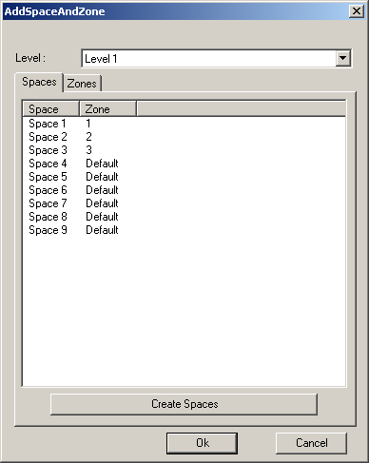
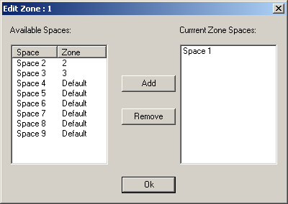
AddSpaceAndZone
Retrieve and list all spaces and zones using element filter
Create new spaces via NewSpaces() method
Automatically detects and creates a new space for each closed wall loop or closed space separator
Add and remove spaces in a zone
Zone members AddSpaces(), Remove()
Notes:
This sample creates spaces and zones. These are required for HVAC analysis. Main features:
- Use element filtering to get all Space and Zone elements in a specified level.
- Create Space elements for each closed wall loop or closed space separation.
- Create a new Zone element in a specified level and phase.
- Add and remove spaces in a Zone element.
Spaces are created using the method ElementSet NewSpaces( Level level, Phase phase, View view ).
Spaces in a zone are added and removed using the Zone class member methods AddSpaces( SpaceSet ) and Remove( SpaceSet ).
Instructions:
- Open a Revit MEP 2009 file containing some enclosed loops made up of walls. A sample project file WallLoopForAddingSpaceAndZone.rvt is available in the sample folder.
- Run the command.
- The AddSpaceAndZone dialog IS shown to display all the Space and Zone elements filtered by level. The Spaces are displayed as a list in the Spaces Tag page, the Zones as a tree list to show the spaces each Zone element contains.
- Click 'Create Spaces' button in Space Tag page to create spaces for each closed wall loop or closed space separation in the selected level.
- Click 'Create Zone' button in Zones Tag page to create a zone in a current level and phase of the active view
- Select a Zone, click the 'Edit Zone' button, a ZoneEditorForm will be shown to display the available spaces list and the spaces the selected zone contains in current level. Select some spaces in the available spaces list, click Add to add them to the current Zone. Select some spaces in the current spaces list, click Remove to remove them from the current Zone. Click OK to return the AddSpaceAndZone dialog.
- Click OK to accept or Cancel to abort.

Slide 11


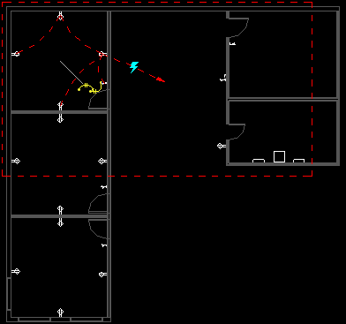
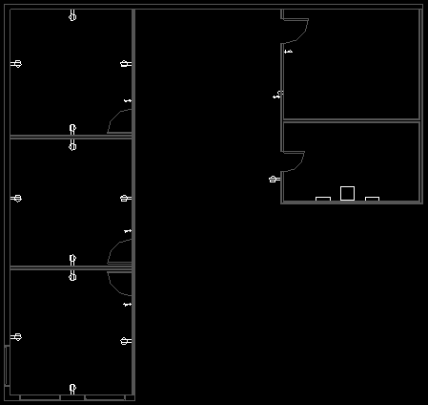
PowerCircuit
Operate power circuits, similar to RME Circuit Editor toolbar
Also demonstrates handling interactive element selection
Implementing external command toolbar user interface
Using ResourceManager
Create a new power circuit with selected elements
Edit circuit and add and remove circuit elements
Select or disconnect a circuit panel
Explore Autodesk.Revit.MEP namespace, MEPModel and ElectricalSystem classes
Notes:
This RME electrical sample shows how to operate power circuits, as well as how to handle interactive element selection in Revit, use a ResourceManager to manage images and localisable string resources, and implement a toolbar user interface for an external command. It mainly exercises classes from the Autodesk.Revit.MEP namespace. It provides the following functionality:
- Create a power circuit with selected elements, edit a power circuit, or add or remove an element to or from a circuit. The elements should have unused electrical connectors with same voltage definition and pole numbers.
- Select a panel for a circuit, or disconnect panel from a circuit if the circuit has a panel.
Creating a new circuit is achieved by the creation document method NewElectricalSystem(), passing in a list of circuit elements and an electrical systm type from the ElectricalSystemType enum, which can currently be one of Data, PowerCircuit, Telephone, Security, FireAlarm, NurseCall, Controls, and Communication.
For editing the circuit, the elements make use of the FamilyInstance MEPModel property, which provides access to the elements connector manager and electrical systems.
Instructions:
Open or new a Revit project and make sure needed electrical elements are placed. A sample project file PowerCircuit.rvt is available in the sample folder. Then execute the command.
- Create a power circuit: Select elements which all have unused electrical connectors within same voltage definition and pole numbers in current project, execute the command and click the button. Expected result: A power circuit is created with the selected elements and highlighted. Note: 1. Currently the API provides no good way to check whether the connectors have the same voltage definition or pole numbers, therefore the sample skips validating this information and just displays a message if the creation fails. User must know whether the selected elements' connectors' voltage and pole numbers match. 2. In this sample it is not allowed to create a power circuit with elements which are all lighting devices.
- Edit a power circuit: Select a power circuit or an element belongs to one or more circuits, execute the command and click the button. If the selected element belongs to more than one power circuits, select a circuit from its circuits to edit in the 'Select a Circuit' dialog. If not, go to next step. Choose an option to edit the circuit in the 'Edit Circuit' dialog:
- Click button to add an element to the circuit. Then select an element which has unused electrical connectors within same voltage definition and pole numbers as the other circuit elements. The sample skips validating the voltage and pole numbers and provides message if creation fails. Expected result: The selected element is added to the circuit and the circuit is highlighted.
- Click button to remove an element from the circuit. Then select the element to remove. Expected result: The selected element is removed from the circuit and the circuit is highlighted.
- Click button to select a panel for the circuit, select a power circuit or an element belongs to one or more circuits, execute the command and click button to select a panel for the circuit. If the selected element belongs to more than one power circuits, select a circuit from its circuits to edit in the 'Select a Circuit' dialog. If not, go to next step: Select a panel to assign it to the circuit. The panel must be assigned to distribution system with the same voltage definition as the other circuit elements. Also the panel must have same pole numbers as the other circuit elements. For the same reason as Note in step 1, the sample just skips validating the voltage and pole numbers and provides message if creation fails. Expected result: The selected panel is assigned to the circuit and the circuit is highlighted.
- Disconnect the panel from a circuit: Select a power circuit or an element belongs to one or more circuits, execute the command, and click button to disconnect the panel from the circuit. If the selected element belongs to more than one power circuits, select a circuit from its circuits to edit in the 'Select a Circuit' dialog. If not, go to next step. Expected result: The panel of the circuit is removed from the circuit and the circuit is highlighted.

Slide 12
RME HVAC Sample
Notes:
We now discuss our two custom samples. The first is for HVAC air terminal analysis and sizing. Before looking at the HVAC sample itself, let us consider the workflow it supports.

Slide 13
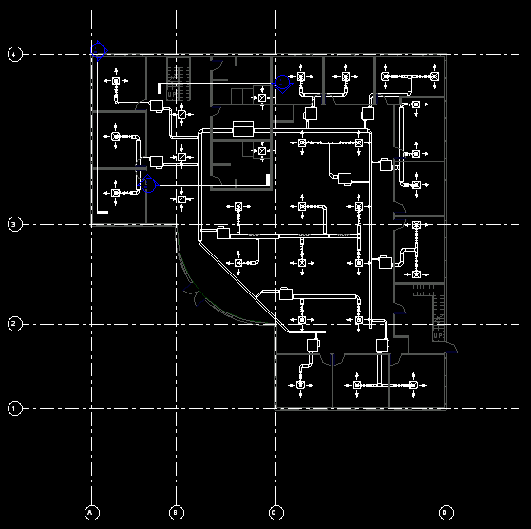
HVAC Task
Place and size air distribution ducts and terminals
Analysis and verification of results
Notes:
Some of the main tasks of an HVAC engineer are:
Placement and sizing of air distribution ducts and terminals
Analysis and verification of results

Slide 14
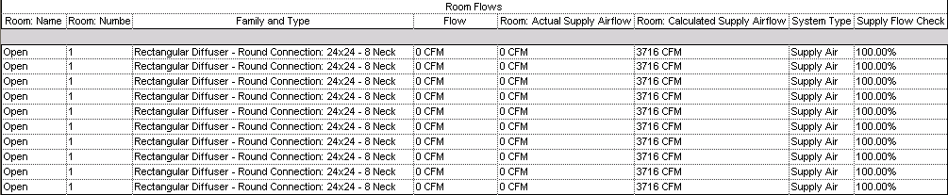
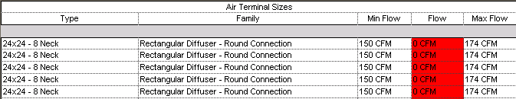
HVAC Engineering Workflow
Manually lay out air terminals
Run heating and cooling load analysis
Based on load analysis, assign flow to terminals
Based on terminal flow, size air terminals
Validate design; common check figure uses air flow per surface area
Total amount of supply air divided by the size of the room
In US, typically measured in CFM / Sq Ft, cubic feet per minute per square foot
This computation is available in schedule, but not for colour fill ... API sample
Notes:
The more detailed HVAC engineering workflow might look like this. In HVAC design, a common check figure to validate design is the flow density, or air flow per floor area, i.e. the total amount of supply air divided by the size of the room. In the US, this is typically measured in cubic feet per minute per square foot, or CFM / SF. There are common rules of thumb based on the room type on the result expected from such a calculation. Anomalies can be quickly identified, both in a schedule, as well as in a colour fill. A schedule can calculate the CFM/SF, but this computation is not available to a colour fill, thus the reason for this example application.

Slide 15
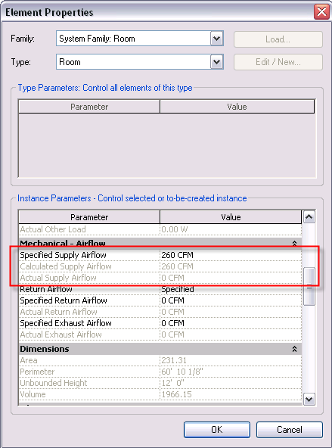
Room Supply Airflow
Calculated
Calculated by external application
Specified
Assigned by design engineer
Actual
Tabulated based on supply air terminals in the room
After calculating, specified is set equal to calculated. The engineer can then adjust manually if necessary.
Notes:
Revit MEP maintains several different values related to the air flow through a room. The calculated value can be set by using IES heating and cooling loads calculation, or importing from gbXML. After the calculation, the ‘specified’ value is set equal to the ‘calculated’ one. The engineer can then adjust manually if necessary.

Slide 16
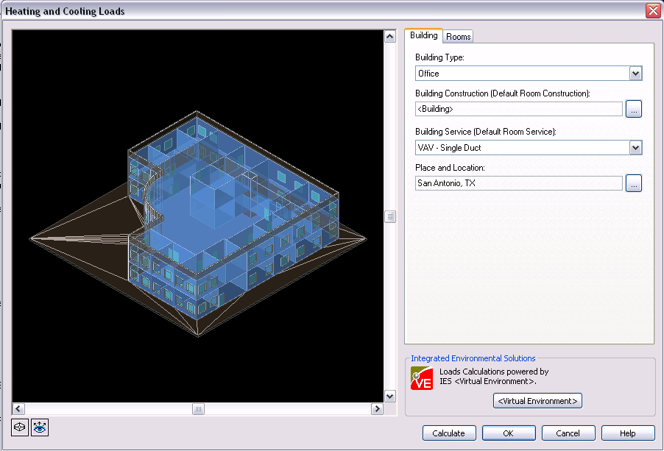
Heating/Cooling Load Calculation
IES Virtual Environment built-in module
Export to IES VE
Connect to other analysis packages via gbXML
Notes:
Revit MEP includes the IES Virtual Environment as a built-in module. It also supports export to IES VE, and import and export to other calculation applications via gbXML, the Green Building XML format.

Slide 17
HVAC Sample Commands
Assign flow to terminals
Change air terminal size
Verify design by air flow per surface area
Find unhosted elements
Reset demo
About
Notes:
The RME HVAC sample application implements six commands. The first three commands support the actual HVAC engineering workflow, the fourth is independent, the fifth cleans up and resets the data manipulated by the first three, and the last simply presents the application description and version number.

Slide 18
RME HVAC Sample History
Originally implemented for RME 2008
Runs faster in RAC than in RME
Originally based on Room elements
Rewritten for 2009 using Space instead
WU2 Updated version of RevitAPI.dll
Notes:
This HVAC sample was originally implemented for RME 2008. In that version, it was based on Room elements. It was rewritten for 2009 using Space instead. To run it in Revit MEP 2009, be sure to use the updated version of RevitAPI.dll provided in the Revit MEP 2009 web update 2, since previous versions do not provide full API access to the spaces, especially the FamilyInstance.Space property.
One interesting thing to note about this application is the following: although it indirectly manipulates the MEP duct system, it only makes use of generic Revit API functionality to manipulate parameters and type of the duct system elements. Therefore, it can be run in Revit Architecture as well as in Revit MEP. Interestingly, it runs significantly faster in the Architecture flavour of Revit than in the MEP flavour, because there is no MEP machinery running in the background trying to clean up and recalculate the duct system every time the application updates some parameter value.

Slide 19
RME HVAC Sample
Implementation
Assembly mep.dll
Namespace mep
Implements six external commands
Assign flow to terminals CmdAssignFlowToTerminals
Change air terminal size CmdChangeSize
Verify design by air flow per surface area CmdPopulateCfmPerSf
Find unhosted elements CmdUnhostedElements
Reset demo CmdResetDemo
About CmdAbout
Implements an external application interface
External application implementation class App
The choice of interface is up to you
Notes:
These commands can be added directly to the Revit Tools > External Tools menu by listing them individually in Revit.ini. The application also implements an external application interface. If you add an entry for that to Revit.ini instead, it adds a new top level menu to the Revit menu, which packages all six commands together. It also includes the commands for the electrical sample:
Information on how to add new external commands and applications to Revit.ini is provided in the Revit SDK “Getting Started Revit API 2009.doc”, and in the other introductory material discussed in http://thebuildingcoder.typepad.com/blog/2008/08/getting-started.html.
The assembly name is mep.dll, and it defines the external commands and application in the namespace mep. The external application implementation class name is App.
Some implementation details are interesting to mention from a programming point of view: we perform some manipulation of paths and command names in the external application method App.AddMenu(), called from the OnStartup() method, to determine the names and path of the external command class implementations when adding them to the menu. We also implement a useful generic about box for the application, discussed below.

Slide 20
Modify Revit.ini
[ExternalCommands]
ECCount=<n>
...
[ExternalApplications]
EACount = 1
EAClassName1 = mep.App
EAAssembly1 = C:\My Documents\ADSK\Samples\src\mep\mep\bin\Debug\mep.dll

Slide 21
External Application
Implement Autodesk.Revit.IExternalApplication interface
Implement OnStartup() and OnShutdown() methods
public class App : IExternalApplication
{
public IExternalApplication.Result
OnStartup( ControlledApplication application )
{
AddMenu( application );
return IExternalApplication.Result.Succeeded;
}
public IExternalApplication.Result
OnShutdown( ControlledApplication application )
{
return IExternalApplication.Result.Succeeded;
}
}
In C#
Notes:
An external application does not automatically appear anywhere in the Revit UI. It can define its own menu entries and custom toolbars as it likes. The user interface objects are hooked up with external command implementations which are invoked and receive the same input and output parameters as normal external commands added to the external tools menu.

Slide 22
External Application Menu
AddMenu method adds menu to access the MEP Sample Application Commands
private static void AddMenu( ControlledApplication app )
{
const string m = "mep.Cmd"; // namespace and command prefix
string path = System.Reflection.Assembly.GetExecutingAssembly().Location;
Autodesk.Revit.MenuItem rootMenu = app.CreateTopMenu( "ME&P API Samples" );
MenuItem.MenuType mt = MenuItem.MenuType.BasicMenu;
rootMenu.Append( mt, "&Assign flow to terminals", path, m + "AssignFlowToTerminals" );
rootMenu.Append( mt, "Change &size", path, m + "ChangeSize" );
rootMenu.Append( mt, "&Populate CFM per SF on rooms", path, m + "PopulateCfmPerSf" );
rootMenu.Append( mt, "&Unhosted elements", path, m + "UnhostedElements" );
rootMenu.Append( mt, "&Reset demo", path, m + “ResetDemo" );
rootMenu.Append( mt, "A&bout...", path, m + "About" );
}
In C#

Slide 23
Air Terminal Layout
Starting point: air terminals have been arranged for uniform air distribution
Notes:
The first command in the sequence assigns flow to terminals. Before it is executed, we assume that the air terminal layout has been completed, so as a starting point all air terminals have been arranged in the building model for a uniform air distribution. The application then automatically assigns the appropriate flow to the terminals by performing the following steps:
Calculate required air flow in each space
Determine air terminals for each space
Assign the flow to the terminals
The required air flow in each space can be calculated using an analysis tool, which populates the calculated supply airflow on each space.
To determine the air terminals for each space, the command can proceed as follows: the spaces do not maintain a list of the terminals they contain, but the terminals do know which space they live in. Therefore, we can determine this child-parent relationship and invert it to obtain the parent-child one. This is similar to the algorithm for inverting the relationship between the wall host elements and the doors and windows hosted by them described in the post on “Relationship Inverter” in http://thebuildingcoder.typepad.com. The implementation is simple:
Define a dictionary mapping each space number to list of air terminals contained by that space
Select all air terminals in the model
For each terminal, determine its space number and add it to the dictionary
To assign flow to its terminals, we can iterate over the spaces in the model, or just the spaces with an entry in the dictionary, determine the required air flow of that space, divide it by the number of terminals in the space, and distribute the space's required air flow evenly across all contained terminals.
Both steps can make use of Revit 2009 filtering, to select all air terminals and all spaces in the model respectively. In the code, we have left the 2008 implementation of the element selection in place in a separate method GetSupplyAirTerminals2008(), so you can compare that with the new method GetSupplyAirTerminals2009() making use of the filtering feature.
Another issue that requires some attention here is the unit conversion. In Revit, the required air flow in each space is stored as cubic feet per second, whereas in the US, the convention is to display the value in CFM, cubic feet per minute. Also, per convention, it is rounded up to nearest multiple of 5 CFM.
So, to summarise some generic aspects, this sample demonstrates how to find instances of a particular family category in a room or space and how to assign a value to a family instance parameter.

Slide 24
Assign Flow to Terminals

Slide 25
Assign Flow to Terminals
Calculate required air flow in each space using analysis tool
This populates the calculated supply airflow on each space
Determine air terminals for each space
Build a dictionary mapping space number to list of air terminals
For each terminal in the model, determine its space number and add it
For each space in the model, assign flow to its terminals
Distribute space's required air flow evenly across all contained terminals
Both steps can make use of Revit 2009 filtering
Compare GetSupplyAirTerminals2008(), GetSupplyAirTerminals2009()
Handle unit conversions
Flow is stored as cubic feet per second, parameter requires per minute
Round up to nearest multiple of 5 cfm
Notes:
This sample demonstrates how to find instances of a particular family category in a room.
Further, it demonstrates how to assign a value to a parameter of the families.
Note that internally, the flow is stored as cubic feet per second, and we need to convert to cubic feet per minute
Finally, it is common for the flow on a terminal to be rounded to the nearest 5 or 10 CFM.
First, we calculate the required airflow in each room using the heating/cooling loads tool. This computation populates the Calculated Supply Airflow on each room object.

Slide 26
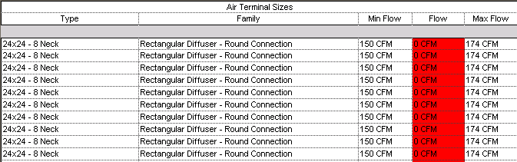
Size Air Terminals
Notes:
Once the required air flow has been determined for each individual air terminal in the first step, the air terminals can be sized appropriately. Air terminals are commonly sized based on a table of air flows. The greater the flow required, the larger the neck size of the air terminal. Selecting a different neck size for an air terminal family instance means determining which symbol to use from the air terminal family. Within the family, each air terminal symbol has been assigned parameter values specifying the maximum and minimum air flow it is suited for.
A completely different approach would be to implement a much more complex family definition making use of a set of nested if-then statements which switch its neck sizes depending on the flow assigned, without a need to select a different symbol. One additional problem with such an approach is that to manually override the selection for any reason would require additional complexity in the family definition.
This sample demonstrates the first approach, interrogating the min and max flow characteristics of each type, and then assigning the proper size based on the required flow. In this case, overriding the selection is a simple matter of selecting an alternate type.
First of all the application sets up a table mapping the various ranges of air flow to specific air terminal type to use for that range. It does so by iterating over selected air terminal families. These are identified within the Revit database by their category, which is BuiltInCategory.OST_DuctTerminal. All such families are identified and presented to the user to select which of them to process. For each family, a list of all its types specifying its min and max flow is constructed.
Once the families have been selected and their lists of flow ranges with associated types are set up, we can iterate over all air terminal family instances. For each terminal, we retrieve its flow and find and assign a symbol from the list whose range matches the required flow.
This sample thus demonstrates how to swap a family type based on user input, the flow, and characteristics of the type, the min and max flow. To summarise, the following steps are executed:
Retrieve all air terminal families.
User selection of families to process.
Set up list of symbols with min to max flow ranges.
Retrieve all supply air terminal instances.
For each terminal, set the appropriate type so that its required flow falls within the symbol’s min/ and max flow range.
From the Revit product side, a schedule can be set up as a powerful tool to simplify checking whether all terminals indeed have been assigned the correct type. By comparing the required air flow with the min and max range assigned to the type, invalid values falling outside the type range can be automatically highlighted.
Once the first two steps have been executed, the design is basically complete: the air terminals have been assigned a suitable required flow based on the space requirements, and then assigned a suitable symbol based on that required flow. The next step serves to validate the design.

Slide 27
Size Air Terminals
All air terminal symbols define parameters for min and max flow
Retrieve all families of category BuiltInCategory.OST_DuctTerminal
Ask user which of these families to process
For each family, build a list of all elements specifying each symbol with its min and max flow
Iterate over all instances, retrieve its flow, find and assign corresponding symbol in list
Notes:
This sample demonstrates how to swap a family type based on user input (Flow), and characteristics of the type (Min Flow/Max Flow)
Air terminals are commonly sized based on a table of air-flows… the greater the flow, the larger the neck size of the air terminal. Instead of utilizing complicated nested if-then statements in the family definition, this sample demonstrates interrogating the Min Flow/Max Flow characteristics of each type, and assigning the proper size based on the assigned flow.
Pseudocode:
Get list of all families and create a dictionary of Air Terminals with min/max members
Get all Supply Air Terminals
Iterate over all terminals, and set the appropriate type based on the min/max

Slide 28
Calculate Flow Density
Retrieve all space elements
Retrieve area and actual supply air flow parameter data
Calculate flow per area and set custom parameter
Project parameter "CFM per SF"
In 2009, "Calculated Supply Airflow per area" exists: ROOM_CALCULATED_SUPPLY_AIRFLOW_PER_AREA_PARAM built-in parameter
Define area fill based on this parameter

Slide 29
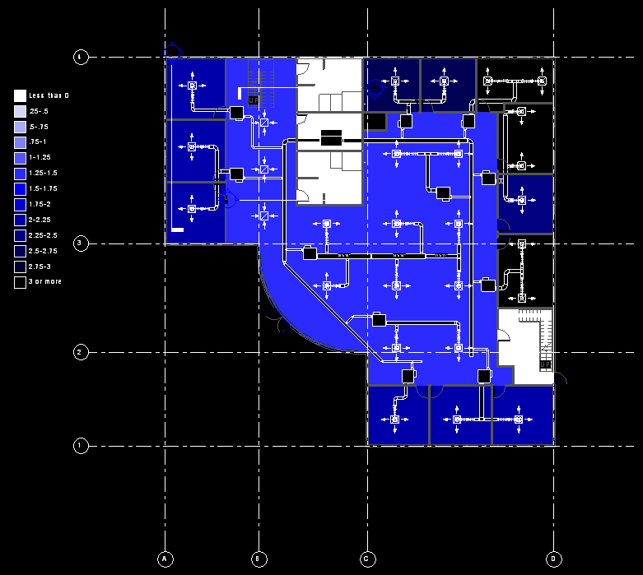
Flow Density Colour Fill
Notes:
This sample demonstrates how to assign a calculated value parameter to a built-in family, in this case, a room.
In HVAC design, a common check figure to validate design is the CFM/SF, the total amount of supply air divided by the size of the room. There are common ‘rules of thumb’ based on the room type that can be expected from such a calculation. Anomalies can be quickly identified, both in a schedule, as well as in a color fill.
A schedule can calculate the CFM/SF, but this computation is not available to a color fill, thus the reason for this example.

Slide 30
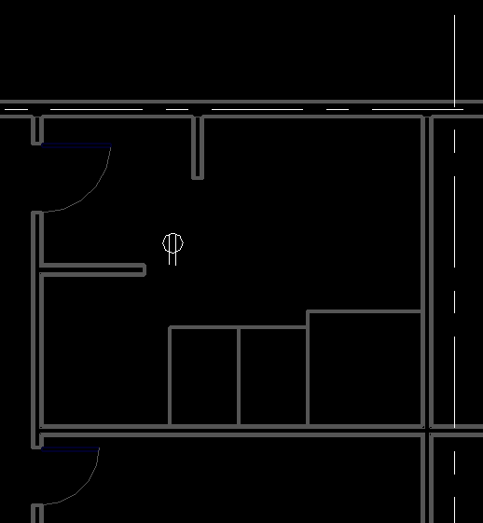
Find Unhosted Elements
Find all family instances
Check BuiltInParameter.INSTANCE_FREE_HOST_PARAM
"<not associated>" or "None" signify unhosted
Display unhosted element ids
Use Revit 2009 filtering
Notes:
The fourth command provided in this sample demonstrates how to interrogate the model to find unhosted elements. Such functionality is beneficial to MEP designers to find elements that no longer are associated with architectural elements. For example, if a hosted element such as a receptacle, air terminal, plumbing fixture or sprinkler is placed on a wall, and the wall is later shortened or deleted, the receptacle may be orphaned, i.e. unhosted. This command helps the designer detect such situations so they may be addressed.
To find all unhosted elements, we search for all family instances with a built-in parameter INSTANCE_FREE_HOST_PARAM whose value is "<not associated>" or "None", to signify unhosted. The search for these elements is again implemented in two different versions, iterating over all database elements and checking the desired parameter one by one in DetermineUnhostedElements2008(), and using the more efficient 2009-style element filtering in DetermineUnhostedElements2009().
The resulting element ids of unhosted elements are displayed in a dialogue and can be copied to the clipboard for further analysis, for instance to highlight and zoom in to them using the Revit menu entry Tools > Element Ids > Select by ID.

Slide 31
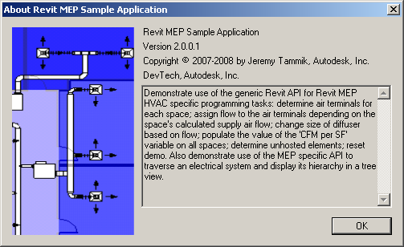
About Form
Separate external command
Return Cancelled, so the document remains unmodified
Query the executing .NET assembly for version number and description

Slide 32

Progress Bar
Only visible when running in Revit MEP

Slide 33
RME Electrical Sample
Notes:
The purpose of this MEP electrical sample is to determine and display the hierarchical structure of the electrical systems in the model. The reason why this is slightly challenging is that the Revit MEP API does not provide a top down access for traversing the electrical system elements. Instead, we have to collect all the candidate leaf node elements ourselves, and for each child element, determine its parent element from its properties and parameter values. The method to select the relevant elements and to determine the parent node varies for different element types. Once we have determined the relationship from child to parent, we can add it to a dictionary with a key entry for each parent associated with a value listing all of its children. This is again similar to the algorithm used in the HVAC application described above for inverting the relationship between the spaces of a building and the air terminals located within each of them, or the wall host elements and the doors and windows hosted by them described in the post on “Relationship Inverter” in http://thebuildingcoder.typepad.com.

Slide 34
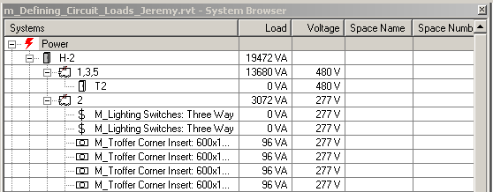
Exploration and Development Steps
Traverse system
Reproduce system browser data structure
Determine and display connection hierarchy tree view
Notes:
The standard RME system browser displays electrical components in a three-level flat list, and the complete hierarchical structure of the connection tree is not immediately apparent.
In this sample, we inspect the electrical system, and explore how to reproduce the structure and information displayed by the system browser as well as the full connection hierarchy.

Slide 35
RME Electrical Sample Commands
CmdElectricalSystemBrowser
CmdElectricalHierarchy
CmdElectricalHierarchy2
Common approach
Collect the relevant Revit elements
Determine their relationships from child to parent Sort this data into a dictionary
Determine the inverted relationship from parent to children
Display the hierarchical structure in a modeless form tree view
Display additional nodes listing the electrical loads
Modeless form remains visible, but does not update
Navigate in parallel in Revit model and in form
Notes:
The tree view is displayed in a modeless dialogue, so it remains visible and can be navigated after the command has terminated. You can leave the form open and switch back and forth between it and Revit to explore the electrical system simultaneously from both points of view. Note, however, that updates to the model won’t be reflected in the dialogue until the command is re-executed.

Slide 36
Reproducing the System Browser Structure
Inspect the electrical system
Reproduce structure and information displayed by system browser
Three levels of nodes, panel > system > element
Two data sources in Revit elements
Electrical equipment, which always has a system name and is either unassigned or has a panel name
Filter for ElectricalEquipment type
Circuit elements, which have a non-empty circuit number parameter value
Filter for RBS_ELEC_CIRCUIT_NUMBER
Sort into dictionaries mapping panel and circuit = system to list of connected elements
Merge dictionaries into appropriate data structure
Notes:
To retrieve the Revit elements associated with these nodes, we obviously make use of the Revit 2009 API filters. We have two different sources of data:
- Electrical equipment
- Circuit elements
Electrical equipment always has a system name and is either unassigned or has a panel name. To retrieve these elements, we can filter for the ElectricalEquipment type.
Circuit elements have a non-empty circuit number parameter value, so we can retrieve those by filtering for RBS_ELEC_CIRCUIT_NUMBER.
It is possible to determine the hierarchical connection structure between the elements from properties and parameters. These values are present on the child elements and can be used to deduce the respective parent element. There are no such properties immediately available to determine the inverse relationship.
We sort the selected elements into dictionaries mapping each parent element, a panel or circuit = system, to a list of connected elements, which can be circuit elements or nested lower level systems. After that, the dictionaries can be merged into an appropriate data structure.

Slide 37
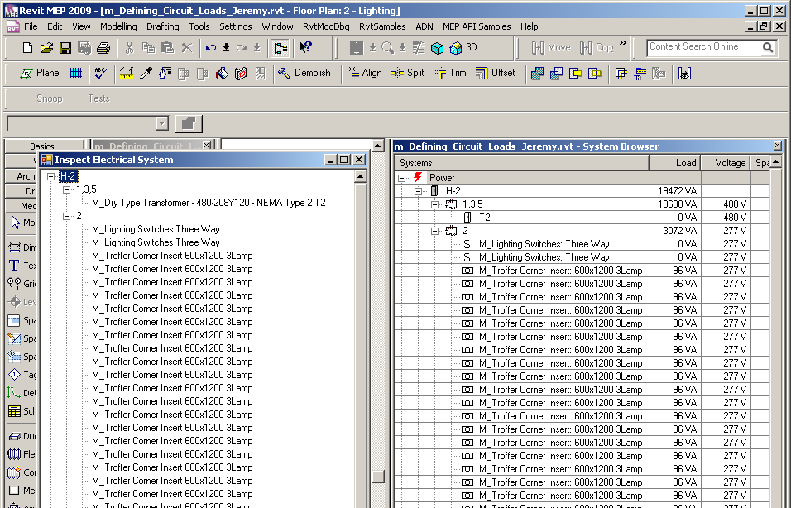
System Browser Structure
Dictionaries keys
Panel:circuit number
Panel:system name
Unassigned:system name
Notes:
CmdElectricalSystemBrowser was used for the initial exploration. In the first stage of implementation, we explored how to retrieve the information displayed in the Power section of the RME System Browser and replicate its three-level node structure. Later, the same information is used in CmdElectricalHierarchy to display the full tree view representing the entire connection hierarchy. The only difference between the two implementations, is the choice whether to call the PopulateLikeSystemBrowser() or PopulateFullHierarchy() helper methods in the CmdInspectElectricalForm constructor.
The initial challenge here was to reproduce all the system browser nodes, and the exact sorting order. The system browser has three levels of nodes, panel > system > element, as well as one 'Unassigned' top level node on the same level as the panel nodes. The system entry may also contain a circuit number.
The elements used to establish the entire connection hierarchy are the electrical equipment and the circuit elements described above. Each of these two sets is sorted into dictionaries using one of the following the keys:
Panel:circuit number
Panel:system name
Unassigned:system name
Each such key in the dictionary is mapped to a list of child nodes that the corresponding parent element is connected to. These two dictionaries, merged together and appropriately sorted, represent the same structure as the System Browser.

Slide 38
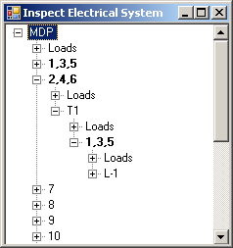
Initial Connection Hierarchy Tree
Based on exact same dictionary info
Simply sort differently into tree structure
Notes:
To display the entire connection hierarchy instead of the three-level structure shown in the System Browser, we can use the exact same information, and simply sort the items into the tree differently, making use of a recursive algorithm. Due to the design of the initial dictionary structure, the algorithm used in PopulateLikeSystemBrowser() is significantly simpler than the recursive multi-tiered PopulateFullHierarchy() one.
The CmdElectricalSystemBrowser command was implemented in parallel with the exploration of how the system is actually hooked up, and CmdElectricalHierarchy makes use of the same data collection code. Once that is fully understood, a more straightforward and efficient algorithm for traversing and displaying the system can be implemented. This code also includes some experimental sections that have been commented out but are useful for further exploration. Please don't simply reuse this code, understand it first and then rewrite it. This led to the second implementation described next.

Slide 39
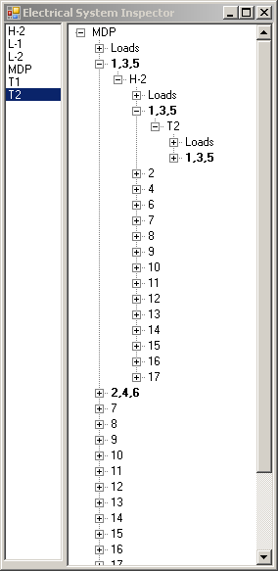
Connection hierarchy tree
Dictionary MapParentToChildren maps parent element id to list of child elements
Retrieve panels with GetElectricalEquipment()
Retrieve ElectricalSystem elements, determine parent panels and add to map
Iterate panels, determine parent systems or root node and add
Retrieve circuit elements, determine parent circuit and add
Populate form using recursion, pick out equipment nodes for highlighting and adding to list box for quick navigation
Notes:
CmdElectricalHierarchy2 displays the same tree view as CmdElectricalHierarchy, but it uses slightly different methods to identify the relationships. In addition, it also displays a list of systems on the left hand side. Selecting one of the systems on the left side automatically collapses and reopens the tree on the right hand side to display the nodes belonging to that system, with no need to manually navigate to them through the tree.
This implementation directly assembles the tree hierarchy from the element relationships, mapping parent element to child nodes using a dictionary-derived class MapParentToChildren. It also uses element ids wherever possible, instead of key strings of the form "panel name : circuit or system name". The dictionary directly maps each parent element id to a list of child element instances. For the different levels of the tree, it maps
Null > root panels
Panel > systems
System > circuit elements, lower-level panels, etc.
We also define a helper dictionary mapPanel which contains all the electrical equipment and panels and maps their name to their family instance. The electrical equipment is identified by the built-in category OST_ElectricalEquipment.
The following steps performed by the command determine all system elements, add them to the appropriate place in the map:
Retrieve panels with GetElectricalEquipment(), add to mapPanel and main map
Retrieve ElectricalSystem elements, determine parent panels and add to map
Iterate panels, determine parent systems or root node and add
Retrieve circuit elements, determine parent circuit and add
To display the complete connection hierarchy in the tree view, we populate it using recursion. During the addition, the equipment nodes are identified for highlighting, and also for adding them to list box for the quick navigation support.

Slide 40
Learning More
Online Help and SDK Samples
DevTV Introduction to Revit 2008 Programming
http://adn.autodesk.com/adn/servlet/item?siteID=4814862&id=10194238&linkID=4901650
Recording of Revit 2009 Programming Introduction Webcast
http://adn.autodesk.com/adn/servlet/index?siteID=4814862&id=5475217&linkID=4901650
http://www.adskconsulting.com/adn/cs/api_course_sched.php
Discussion Groups
http://discussion.autodesk.com > Revit API
API Training Classes – Leave Business Card for Free Training
http://www.autodesk.com/apitraining
ADN, The Autodesk Developer Network
http://www.autodesk.com/joinadn
DevHelp Online for ADN members
http://adn.autodesk.com
The Building Coder, a Revit API Blog
http://thebuildingcoder.typepad.com
Notes:
Just a quick reminder that we’ll again be offering free attendance at an API training class to anyone who attends one of our classes at AU. Please announce this in your classes.
The offer will be one free training class per attendee to be taken at any time during calendar year 2009. To get this, they must leave their contact details with the presenter in the class (e.g. a business card). The free training is non-transferable, and is limited to one free training class per person (i.e. they can’t get more free training by handing in their cards at different classes). To use the free training, they just register for a training class on www.autodesk.com/apitraining and tell us they attended a class at AU and would like their free training when we confirm their registration, whereupon we’ll check their name against the collected business cards.
Please collect the business cards and hand them over to me.
Cheers,
Stephen

Slide 41
Meet The Experts
DE315-1 AEC API Talk
Thu. 12/4 3:15 pm - 4:45 pm

Slide 42
Thank you!
Thank you very much for your interest and attention!
Much success with the Revit API and your application development!
Please complete the session survey
Course id is DE301-2

Slide 43



& YOU

