Slide 1
Reinforce Your Design: Revit Structure API for Rebar and Detailing
Jeremy Tammik, Autodesk Inc.
Consulting Analyst

Slide 2

About the Presenter
Overview
Jeremy Tammik
Developer Technical Services
EMEA
Autodesk SARL
Jeremy worked with Autodesk from 1988 until 1994 as a technology evangelist responsible for European Developer Support before the inception of the Autodesk Developer Network ADN. He was a co-founder of the AutoCAD Developer Group Europe and a prolific author around AutoCAD application development. He left Autodesk to work as an HVAC application developer, and then rejoined in 2005 to work in the AEC group of the ADN DevTech team.
Jeremy studied mathematics and physics in Germany (Dipl. Math.), has four children, is a vegetarian, likes theatre improvisation and sports, especially climbing, plays the flute, and is fluent in five European languages.
Notes:
It is my pleasure to work in for the Autodesk Developer Network, ADN, in the AEC workgroup.

Slide 3
Agenda
Overview
Overview
Revit Structure Rebar Workflow
Rebar
Generate and extract rebar and its information
Detailing
Generate views and sheets
Import and export dwg
Add text, dimensioning and annotations
Sample and API feature walkthrough in the rebar workflow context

Slide 4
Revit Structure Rebar Workflow
Overview
Revit Structure 3D
Object Model
User
Input
3rd Party
Analysis
Design
Physical Model
Analytical Model
User
Input
3D Rebar Model
Concrete Drawings
User
Input
Typical Rebar Details
Specific Rebar Details
Specific Rebar Details
3D Design
QTO
Shop
Drawing
Manual
Automated
Notes:
Working with reinforcements in Revit Structure involves two phases. The initial phase is the building analysis, which may result in design changes. In the second phase, reinforcements are added, analysed, and detailed. Both phases may include multiple iterations. Many of the tasks required can be automated. This is where our applications can save a lot of time, effort, and eliminate sources for errors.
The central hub is the Revit Structure three-dimensional object model which integrates the physical and analytical models used respectively for the building design and analysis. The 3D rebar model is integrated in this database. The physical model is used to generate concrete drawings including rebar specific details. The rebar model can be used to generate rebar specific details and quantity takeoffs. The analytical model is used to connect to third party analysis and design packages, which in turn can help define the rebar model.

Slide 5
The 3D Rebar Model
Overview
Revit Structure has a 3D rebar model composed of
Single bars
Sets (array of bars with rules)
Area reinforcement for slabs and walls
Path reinforcement for slabs
3D rebar model can be generated
Manually by user
Loaded from a group that defines a cage
Generated with the API from analysis and design software or from macros
Advantages of 3D rebar model
Quantities
Complex layout
Automatic reinforcement drawings
Basic scheduling
Scheduling is specific to each country
Opportunity for third party developers to use the 3D rebar model to generate DWG schedules and import them back as a drafting view in Revit Structure
Notes:
5

Slide 6
Relationship Between Topics
Overview
Rebar
Generate rebar
Extract rebar information
Detailing
Generate a section view
Generate a drafting view
Create a sheet
Import and export dwg
Add text, dimensioning and annotations
Notes:
Here are some relationships between these rebar topics and the rebar workflow: after the structural framing analysis part is done, an engineer will take the values of the load and stress information for each element and design the rebar for each element. You design the size of the column, number of rebars, and number of rib-bars. Based on this information, a rebar can be generated externally. It may need modification, which requires extraction and analysis of existing information. The extracted information may also be used for estimation purposes. To show the rebar placement in a column or beam, you need a section view. The Revit SDK samples CreateSimpleAreaRein and CreateComplexAreaRein generate reinforcement elements, and can be used to demonstrate the kinds of section view required. For structure detailing, we need a drafting view where we may want to import a dwg file. Adding text, annotations and dimensioning is further typical detailing functionality. Some of the items listed here are general, but especially useful as part of the rebar workflow for structural detailing.

Slide 7
Rebar

Slide 8
Rebar
Rebar
Generate rebar
Extract rebar information

Slide 9
Generate Beam or Column Rebar
Rebar
Sample: Reinforcement
Create reinforcement rebars in selected non-reinforced concrete beam or column
Beam rebar: top, bottom or transverse
Column rebar: transverse or vertical
Class
Autodesk.Revit.Elements.Rebar
Method
// for creation
Rebar createdRebar = rvtDoc.Create.NewRebar( rebarType, startHook, endHook, m_hostObject,
ref origin, ref normal, curves, (int)startOrient, (int)endOrient );
Notes:
We can use the Revit SDK sample Reinforcement to demonstrate the creation of new reinforcement elements. It creates a bar set in a selected concrete beam or column element that does not have any reinforcement. Three kinds of beam rebar are created: top, bottom and transverse rebar. Two kinds of column rebar are created: transverse and vertical. It uses the Autodesk.Revit.Creation.Document.NewRebar() method to create rebar for the selected host. The NewRebar() method expects two parameters RebarBarType and RebarHookType. Suitable values for these two parameters can be retrieved by iterating the active document elements.

Slide 10
Reinforcement Implementation
Rebar
FrameReinMakerFactory class manages all the work
Precondition checks
Is the selected object a beam or column?
Is it made of concrete?
Does it already contain any rebar elements?
Create a corresponding FrameReinMaker and the reinforcement rebars
Host-dependant working classes
BeamFramReinMaker and ColumnFramReinMaker
GeomUtil
Basic geometric utility methods
GeometrySupport
Base class for BeamGeometrySupport and ColumnGeometrySupport, manages the solid of beam or column, the extend or sweep path of the beam or column, the beam or column direction vector, lists to store the edges and points, the transformation etc.
ParameterUtil
Utility methods find or set certain parameter

Slide 11
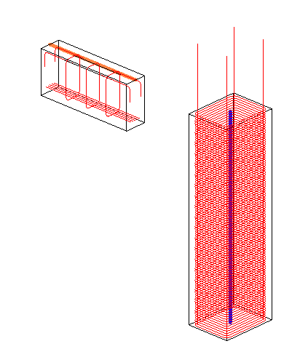
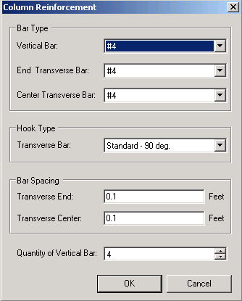
Generate Rebar Demo
Rebar
Ensure only one beam or column is selected
Retrieve all rebar types and all hook types
Retrieve and analyse member geometry
Run worker method
Notes:
This is demonstrated by the sample Reinforcement. The sample can create rebar for both beam and column.
Register the command:
[ExternalCommands]
ECCount = 16
ECName16=Rebar - Reinforcement
ECClassName16 = Revit.SDK.Samples.Reinforcement.CS.Command
ECAssembly16 = C:\a\lib\revit\2008\sdk\Samples\Reinforcement\CS\bin\Debug\Reinforcement.dll
ECDescription16 = Create bar set in a selected concrete element (beam or column) that does not have any reinforcement.
Draw a Concrete Beam or Column elements without any reinforcement and select it.
Please make sure the beam or column section size is big enough, e.g. for column it can be 24x32.
Run the command.
Set the parameters for the rebar in the pop up dialog.
Click Ok, Rebar for the selected element (Beam or Column) will be created.
If you want to debug, this can be done from SDKSamples10.0.sln.

Slide 12
Generate Floor or Wall Rebar
Rebar
Sample: NewPathReinforcement
Create path reinforcement
Class
Autodesk.Revit.Elements.Rebar
Method
XYZ p1, p2; Line curve;
CurveArray curves = m_appCreator.NewCurveArray();
for (int i = 0; i < points.Count - 1; i++)
{
p1 = new XYZ(points[i].X, points[i].Y, points[i].Z);
p2 = new XYZ(points[i + 1].X, points[i + 1].Y, points[i + 1].Z);
curve = rvtDoc.CreateNewLine(ref p1, ref p2, true);
curves.Append(curve);
}
PathReinforcementType pathReinforcementType = rvtDoc.Create.NewPathReinforcementType();
return rvtDoc.Create.NewPathReinforcement(pathReinforcementType, m_host, curves, flip);
Notes:
We can use the Revit SDK sample NewPathReinforcement to demonstrate how to create a new PathReinforcement element through the API. The PathReinforcement host is a floor or a wall. The method used is
NewPathReinforcement( PathReinforcementType, Element, CurveArray, bool );
We can use Document.Create.NewPathReinforcementType() method to create a PathReinforcementType if there is none in current document. The Element argument is the host of the PathReinforcement. The CurveArray stores its path. The Boolean value indicates which side of the path the PathReinforcement is located on.
To run the sample, draw a Structure wall or slab, select it, and run this command. Draw the path of PathReinforcement you want to create. You can click right mouse button to finish drawing. Click the “Preview” button to preview the path reinforcement to be created. Select or unselect the “Flip” check box to create the PathReinforcement on the left or right side of the path. Click the “Create” button to create the PathReinforcement. You can clean and redraw the sketch of the path using the “Clean” button. Here is the central code snippet given an array of points defining the path.

Slide 13
Extract Rebar Information
Rebar
AreaReinParameters Sample
Provides starting point
Extended to list rebar information
Uses built-in parameters
BarDescriptions Sample
AreaReinforcement has a BarDescription property
Same functionality as above
Generic Tools
BuiltInParameterChecker
RvtMgdDbg
Notes:
All the generic data extraction and debugging utilities such as RvtMgdDbg and BuiltInParameterChecker can be used to read parameters and other information from a rebar element.
In addition, the Revit SDK sample AreaReinParameters shows how to use the API to display and modify AreaReinforcement parameters. We have expanded the sample to list rebar elements and their parameters as well in a separate command RebarParas. The enhanced sample is included in the presentation material.
Another sample for extracting rebar information is the BarDescriptions sample. It shows how to find all BarDescriptions in the project, display their properties in a DataGridView, and export their parameter information to an external comma delimited *.csv file. BarDescription is a property of an AreaReinforcement element, so some AreaReinforcement elements should be drawn first.
Some rebar information is accessible through built-in parameters and can be determined using BuiltInParameterChecker, some is accessible only through hard-coded localised parameter names. The AreaReinParameters sample only works with floor or wall area reinforcements, not with rebar. Not all rebar parameters are accessible as built-in parameters. We can however retrieve almost all necessary information with its instance parameters, hence the RebarParas enhancement.

Slide 14
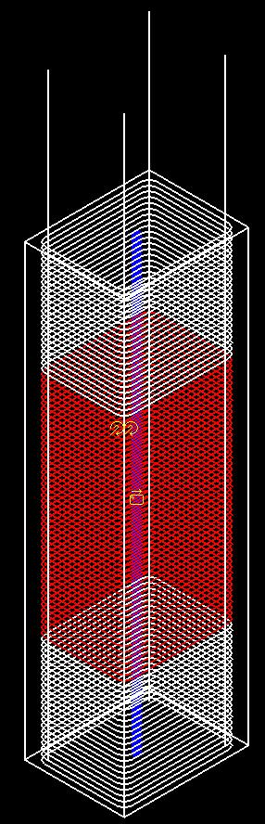
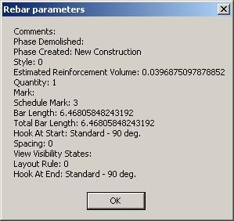
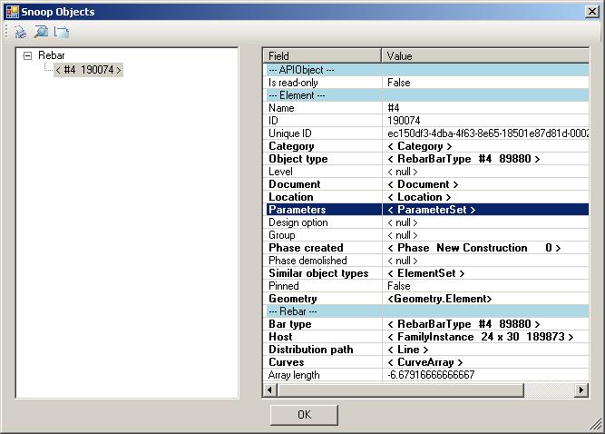
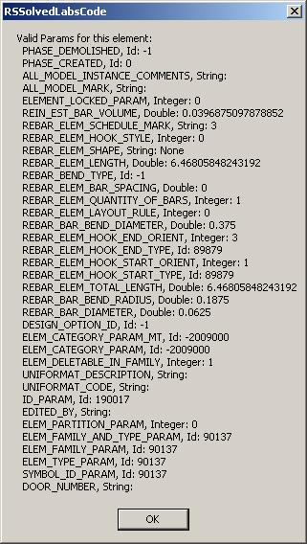
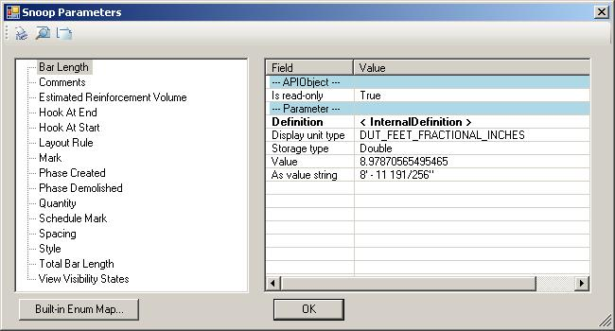
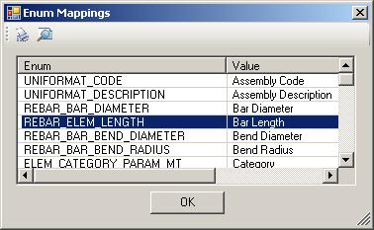
Rebar Information Demo
Rebar
Notes:
Register the command:
[ExternalCommands]
ECName32 = RebarParas
ECClassName32 = Revit.SDK.Samples.AreaReinParameters.CS.RebarParas
ECAssembly32 = C:\Revit\SDK\Samples\AreaReinParameters\CS\bin\Debug\AreaReinParameters.dll
ECDescription32 = Show parameters of a rebar
Select a rebar.
Run this command.

Slide 15
Detailing

Slide 16
Detailing
Detailing
Detailing
Generate a section view
Generate a drafting view
Create a sheet
Import and export dwg
Add text, dimensioning and annotations

Slide 17
Generate Section View
Detailing
Demonstrate creation of a Detail View
Using NewViewSection()
Creates detail view across the midpoint of selected element
Works on linear elements such as slab, wall and beam
Create and initialise a bounding box
// create a BoundingBoxXYZ and set the Max and Min properties:
BoundingBoxXYZ m_box = new BoundingBoxXYZ();
m_box.Enabled = true;
m_box.Max = new XYZ(LENGTH, LENGTH, 0);
m_box.Min = new XYZ(-LENGTH, -LENGTH, -HEIGHT);
// setting the Transform property is the most important thing.
// it defines the origin and the directions RightDirection,
// UpDirection and ViewDirection) of the created view:
Transform transform = GenerateTransform();
if (null == transform)
{
return false;
}
m_box.Transform = transform;
// Create a section view, pass the bounding box.
ViewSection section = m_project.Create.NewViewSection(m_box);
Notes:
The Revit SDK sample CreateViewSection demonstrates the creation of a detail view. Given a linear element such as a wall, floor or beam, it generates a section view across the midpoint of the element using the NewViewSection() method. It performs the following steps:
Retrieve the selected linear element
Generate a BoundingBoxXYZ instance to be used in NewViewSection()
Set its Max and Min properties
Generate a Transform instance for the BoundingBoxXYZ Transform property, which defines the origin and directions of the created view, including RightDirection, UpDirection and ViewDirection
Create the section view using the BoundingBoxXYZ.
The NewViewSection method takes a parameter of type BoundingBoxXYZ. The key part of the code is actually to create the box. And the key part for the box is to create its transform matrix. The actual matrix generated depends on the selected element type. Separate implementations are provided for beam, floor and wall. These are called from within GenerateTransform().

Slide 18
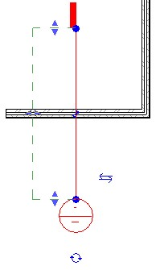
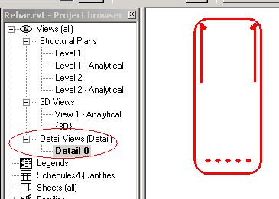
Generate Section View Demo
Detailing
Notes:
Use the Revit SDK sample CreateViewSection to demonstrate this.
Register the command:
ECName19=Rebar - CreateViewSection
ECClassName19=Revit.SDK.Samples.CreateViewSection.CS.Command
ECAssembly19=C:\a\lib\revit\2008\sdk\Samples\CreateViewSection\CS\bin\Debug\CreateViewSection.dll
ECDescription19=Create a section view across the mid point of the selected wall, floor or beam
Launch Revit Structure 2008.
Open the project Rebar.rvt.
Select a beam or column with rebar.
Execute the external command.
Note that a new section view is added to the detail views in the project explorer.

Slide 19
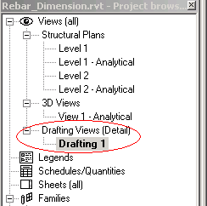
Generate Drafting View
Detailing
Code
Document doc = commandData.Application.ActiveDocument;
// Create a drafting view
ViewDrafting drafting = doc.Create.NewViewDrafting();
Notes:
The NewViewDrafting() method does not take any parameters. It creates an empty drawing view. We have added a second external command CreateDraftingView to the Revit SDK sample CreateViewSection to demonstrate this.

Slide 20
Import DWG
Detailing
Import
DWGImportOptions opts = new DWGImportOptions();
opts.Placement = ImportPlacement.Centered; // Origin, Center, Shared
// other possible options.
opts.ColorMode = ImportColorMode.Preserved; // BlackAndWhite, Inverted, Preserved
//opts.CustomScale = 1;
opts.OrientToView = true; // true or false
opts.ThisViewOnly = false; // Imports dwg, dgn, and dxf drawings into active view only?
opts.Unit = ImportUnit.Default;
opts.View = m_revitApp.ActiveDocument.ActiveView;
opts.VisibleLayersOnly = false; // true or false
Revit.Element newElement = new Revit.Element();
rvtDoc.Import( dbox.FileName, opts, ref newElement );
Notes:
Importing and exporting DWG files is demonstrated by the Revit SDK sample ImportExportDWG. It shows how to export the current project to dwg files and import a dwg file into Revit. It also demonstrates how to and provides a user interface to set up the import and export options appropriately. To run it, start up Revit, open a suitable project, and execute the command.
To export, check the radio button “Export”. In the next dialog, specify the file name to export as, set the common options and click the “Option…” button to set the lower priority options; click the “Select…” button to select multi-views to export. Then click the “Save” button to perform the export.
To import, check the radio button “Import”. In the next dialog, specify the file to import from and set the other options. Then click the “Open” button to perform the import.
The last parameter of the Import() method is an element. It is not neccessary to create a new element prior calling the Import() method. You can simply pass a variable of type Element and it can be null. This provides a possibility to return the element that was just imported, so that it can be accessed and modified after the import. For example, if you import an image, the import method gives you no scaling nor rotating options. If you would need this functionality, you can achieve it by manipulating the image after the import.

Slide 21
Export DWG
Detailing
Export
opts dwgExportOptions = new DWGExportOptions();
opts.ExportingAreas = false; // export room and areas
opts.FileVersion = ACADVersion.R2007; // acad file version
opts.LayerMapping = “AIA”; // layer standard: AIA/CP83/BS1192/ISO13567
opts.LineScaling = LineScaling.ModelSpace; // PaperSpace/ModelSpace/ViewScale
opts.MergedViews = true;
opts.PropOverrides = PropOverrideMode.NewLayer; // NewLayer/ByLayer/ByEntity
opts.SharedCoords = true;
opts.TargetUnit = ExportUnit.Millimeter;
opts.ExportOfSolids = SolidGeometry.ACIS;
exported = rvtDoc.Export( folder, name, views, opts );

Slide 22
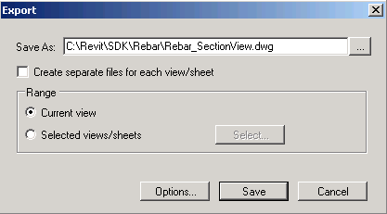
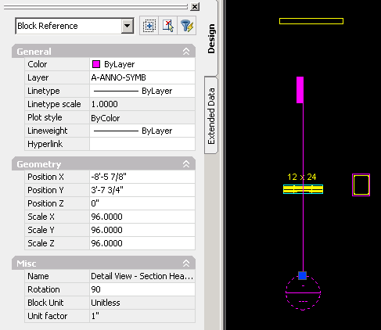
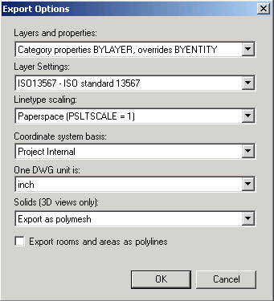
Import and export DWG Demo
Detailing
Notes:
We use the Revit SDK sample ImportExportDWG to demonstrate this.
Register the command:
ECName21=ImportAndExportForDWG
ECClassName21=Revit.SDK.Samples.ImportAndExportForDWG.CS.Command
ECAssembly21=C:\a\lib\revit\2008\sdk\Samples\ImportExportDWG\CS\bin\Debug\ImportAndExportForDWG.dll
ECDescription21=Export current project to dwg files and import a dwg file into revit
Open Revit application and execute the command.
To export, check the radio button "export". In the next dialog, specify the file name to export as, set the common options and click "Option…" button to set the lower priority options, click "Select…" button to select multi-views to export. Then click "Save" button to perform export.
To import, check the radio button "import". In the next dialog, specify the file to import from and set the other options. Then click "Open" button to perform import
I exported the level 1 in the attached test revit project.

Slide 23
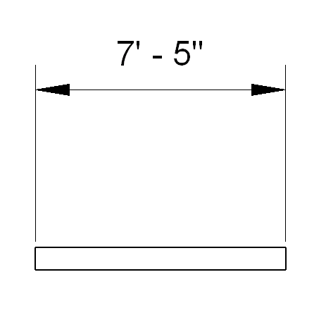
Create New dimensioning
Detailing
Create a dimension between two references
CreateDimensions sample
XYZ p1 = newLine.get_EndPoint(0);
p1.X += 5;
p1.Y += 5;
XYZ p2 = newLine.get_EndPoint(1);
p2.X += 5;
p2.Y += 5;
Line newLine2 = app.Create.NewLine( ref p1, ref p2, true );
// set the references
. . .
// create a dimention
Dimension newDimension = rvtDoc.Create.NewDimension(
rvtDoc.ActiveView, newLine2, referenceArray );
Notes:
New dimenioning can be generated through the API using the NewDimension() method. Searching globally through all the samples discovers one single instance of this method, in the CreateDimensions sample. This sample adds a command taking a selection of basic structural walls and adds dimensioning from the start to the end of each. Dimensioning is created between graphical references stored in a ReferenceArray instance. The key part is the creation of the reference array. Once the reference array has been set up, the creation of the dimensioning is simple.

Slide 24
Dimensioning Reference Array
Detailing
Create a reference array for a structural wall
ReferenceArray referenceArray = new ReferenceArray();
Options options = rvtApp.Create.NewGeometryOptions();
options.ComputeReferences = true;
options.View = rvtDoc.ActiveView;
Revit.Geometry.Element geomElem = wallTemp.get_Geometry(options);
GeometryObjectArray geoObjectArray = geomElem.Objects;
for (int j = 0; j < geoObjectArray.Size; j++)
{
GeometryObject geoObject = geoObjectArray.get_Item(j);
Curve curve = geoObject as Curve;
if (null != curve)
{
//find the two upright lines beside the line
if (Validata(newLine, curve as Line))
{
referenceArray.Append(curve.Reference);
}
if (2 == referenceArray.Size)
{
break;
}
}
}
Notes:
For the basic wall, the location line of the wall is used to discover the two vertical edges at each end of one side of the wall. Some calculation and comparison work needs to be done in order to find the two right reference lines. For each of these two curves, a reference is added to the reference array. Note that the geometry options for obtaining the wall geometry have options.ComputeReferences set to true.

Slide 25
Dimension Creation Tips
Detailing
Extend the sample to work with other elements than structural wall
Architectural wall cannot get reference from edge
Use face instead - not all geometry has reference
Solid solid = geoObject as Solid;
if(null != solid)
{
FaceArrayIterator faceItor = solid.Faces.ForwardIterator();
while (faceItor.MoveNext())
{
PlanarFace face = faceItor.Current as PlanarFace;
if (null != face)
{
// find the two upright lines beside the line.
// NOTE: overloading this function. We pick up the face in term of its Normal.
if (Validata(newLine, face.Normal))
{
referenceArray.Append(face.Reference);
}
if (2 == referenceArray.Size)
{
break;
// . . .

Slide 26
Rebar dimensioning
Detailing
Extending the sample to work with rebar
Need to dig into geometry elements ...
SPR #130423 Reference returned by a curve (line, ellipse etc.) seems to remain null
SPR #125909 API wish: create dimension between a column edge and a rebar center
// get rebar reference
if (m_rebar != null)
{
Revit.Geometry.Element gelement = m_rebar.get_Geometry(options);
GeometryObjectArray geoObjectArray = gelement.Objects;
// enum the geometry element
for (int j = 0; j < geoObjectArray.Size; j++)
{
GeometryObject geoObject = geoObjectArray.get_Item(j);
Line line = geoObject as Line;
if (line != null && line.Reference != null)
{
referenceArray.Append(line.Reference);
}
}
}

Slide 27
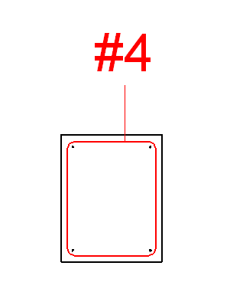
Add Tags
Detailing
Simple Tag sample in RvtMgdDbg’s Test Framework
if( elem is Rebar )
{
// Cast to Rebar and get its first curve
Revit.Elements.Rebar rebar = elem as Rebar;
Revit.Geometry.Curve curve = rebar.Curves.get_Item(0);
// Create a rebar tag at the first end point of the first curve
IndependentTag tag = revitDoc.Create.NewTag(
view, // view to place the tag
rebar, // host object to tag
true, // have a leader?
TagMode.TM_ADDBY_CATEGORY, // mode by category, multi-category or material
TagOrientation.TAG_HORIZONTAL, // orientation: vertical/horizontal
curve.get_EndPoint(0) ); // location point
}
Notes:
The NewTag method signature and its parameters:
public IndependentTag NewTag( View dbview, Element objelem, bool leader, TagMode tagmode, TagOrientation tagorientation, XYZ pnt );
Parameters
dbview
The view in which the dimension is to be visible.
objelem
The host object of tag
leader
whether have leader
tagmode
the mode of tag. Add by Category, add by Multi-Category and add by material
tagorn
The Orientation of the Tag
pnt
The position of the Tag
I used category tag mode and horizontal tag orientation here.

Slide 28
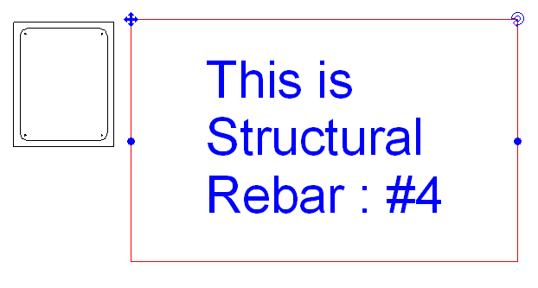
Add Text
Detailing
if( elem is Rebar )
{
// cast to Rebar and get its first curve
Revit.Elements.Rebar rebar = elem as Rebar;
Revit.Geometry.Curve curve = rebar.Curves.get_Item(0);
// calculate arguments
Revit.Geometry.XYZ origin = curve.get_EndPoint(0);
origin.X += curve.Length * 10; // draw the text at the right size
Revit.Geometry.XYZ baseVec = new Revit.Geometry.XYZ(1,0,0);
Revit.Geometry.XYZ upVec = new Revit.Geometry.XYZ(0,0,1);
double textSize = curve.Length / 10;
double lineWidth = curve.Length / 50;
string strText = "This is " + rebar.Category.Name + " : " + rebar.Name;
// create the text
Revit.Elements.TextNote text = revitDoc.Create.NewTextNote(
view, origin, baseVec, upVec, textSize, lineWidth,
Revit.Enums.TextAlignFlags.TEF_ALIGN_CENTER
| Revit.Enums.TextAlignFlags.TEF_ALIGN_MIDDLE, strText );
text.Width = curve.Length * 10; // set the width of the text
}
Notes:
public TextNote NewTextNote( View pView, XYZ origin, XYZ baseVec, XYZ upVec, double textSize, double lineWidth, TextAlignFlags textAlign, string strText );
Parameters
pView
Current DBView
origin
origin of the TextNote
baseVec
baseVec parameter of the TextNote.
upVec
upVec parameter of the TextNote.
textSize
text size.
lineWidth
line width of the out rectangle.
textAlign
align style.
strText
text.
TextNote is just text. The textSize parameter of the NewTextNote method is actually not used and can be ignored Tao says 'Our developer has confirmed that this param is no use at all for the internal behavior has been changed. The actual size value comes from Font (family type). So this param should be removed. Our developer will fix it.'

Slide 29
Learning More
Online Help and SDK Samples
DevTV Introduction to Revit Programming
http://adn.autodesk.com/adn/servlet/item?siteID=4814862&id=10194238&linkID=4901650
Discussion Groups
http://discussion.autodesk.com
Revit API
API Training Classes
www.autodesk.com/apitraining
Leave your business card for free attendance, worth up to USD 1500
Autodesk Developer Network
www.autodesk.com/joinadn
DevHelp Online for ADN members
adn.autodesk.com/
Notes:
We are offering free API training to attendees of our DevTech AU seminars. If they leave their business cards during the seminar, then they can attend one of our scheduled 2008 API training classes free of charge. Normal costs for these classes are up to 1500 USD per person. The schedule is posted on www.autodesk.com/apitraining. Feel free to add a slide to your presentations to advertise this. You can give the business cards you collect to Stephen Preston or any of our San Rafael based DevTech team (who can hand them to him).

Slide 30
Thank you very much!
Thank you very much for your interest and attention!
Much success with the Revit API and your application development!

Slide 31

End of Presentation
A.You

